Slide 1
Planning and Acting
Lesson 20

Slide 2
Outline
The real world
Conditional planning
Monitoring and replanning

Slide 3
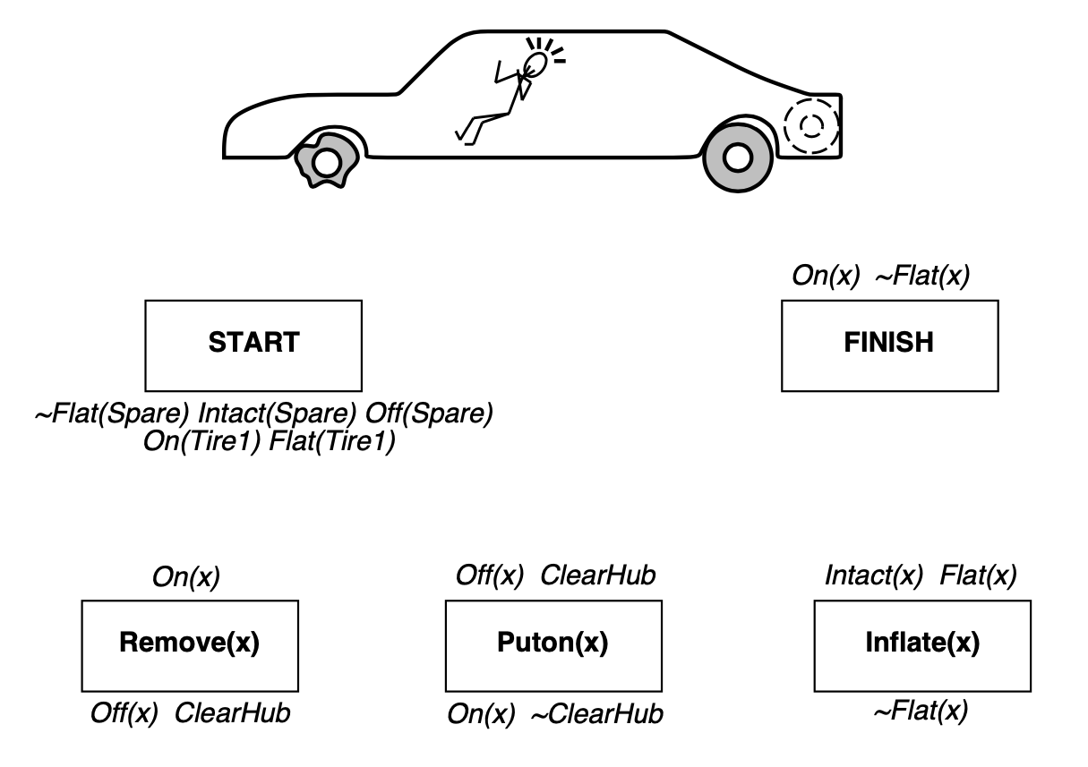
The real world

Slide 4
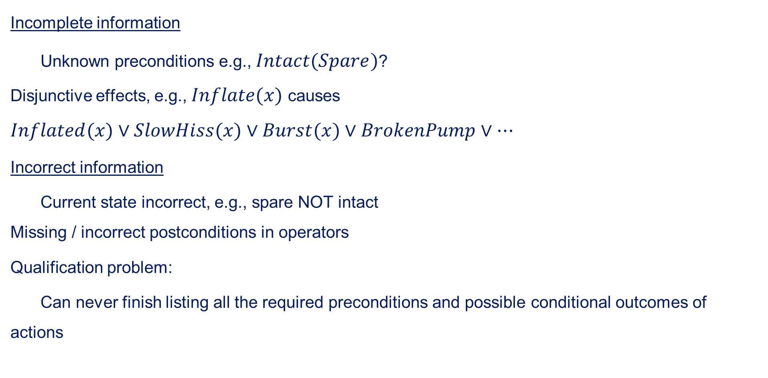
Things go wrong
Incomplete information
Unknown preconditions e.g., $Intact(Spare)$? Disjunctive effects, e.g., $Inflate(x)$ causes
$$Inflated(x)∨SlowHiss(x)∨Burst(x)∨BrokenPump∨…$$
Incorrect information
Current state incorrect, e.g., spare NOT intact Missing / incorrect postconditions in operators
Qualification problem:
Can never finish listing all the required preconditions and possible conditional outcomes of actions

Slide 5
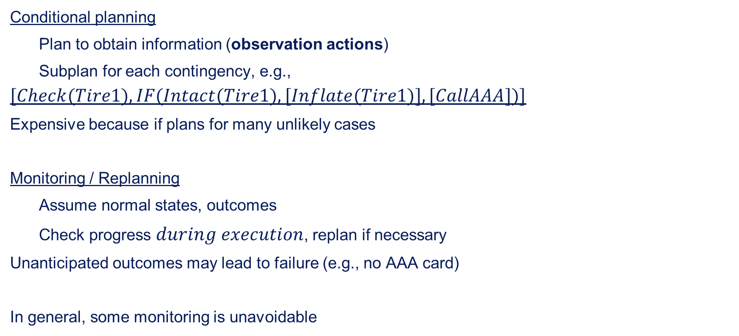
Solution
Conditional planning
Plan to obtain information (observation actions)
Subplan for each contingency, e.g.,
$$[Check(Tire1),IF(Intact(Tire1),[Inflate(Tire1)],[CallAAA])]$$
Expensive because if plans for many unlikely cases
Monitoring / Replanning
Assume normal states, outcomes
Check progress $during$ $execution$, replan if necessary
Unanticipated outcomes may lead to failure (e.g., no AAA card)
In general, some monitoring is unavoidable

Slide 6
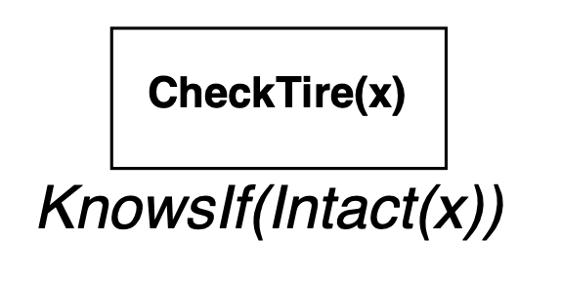
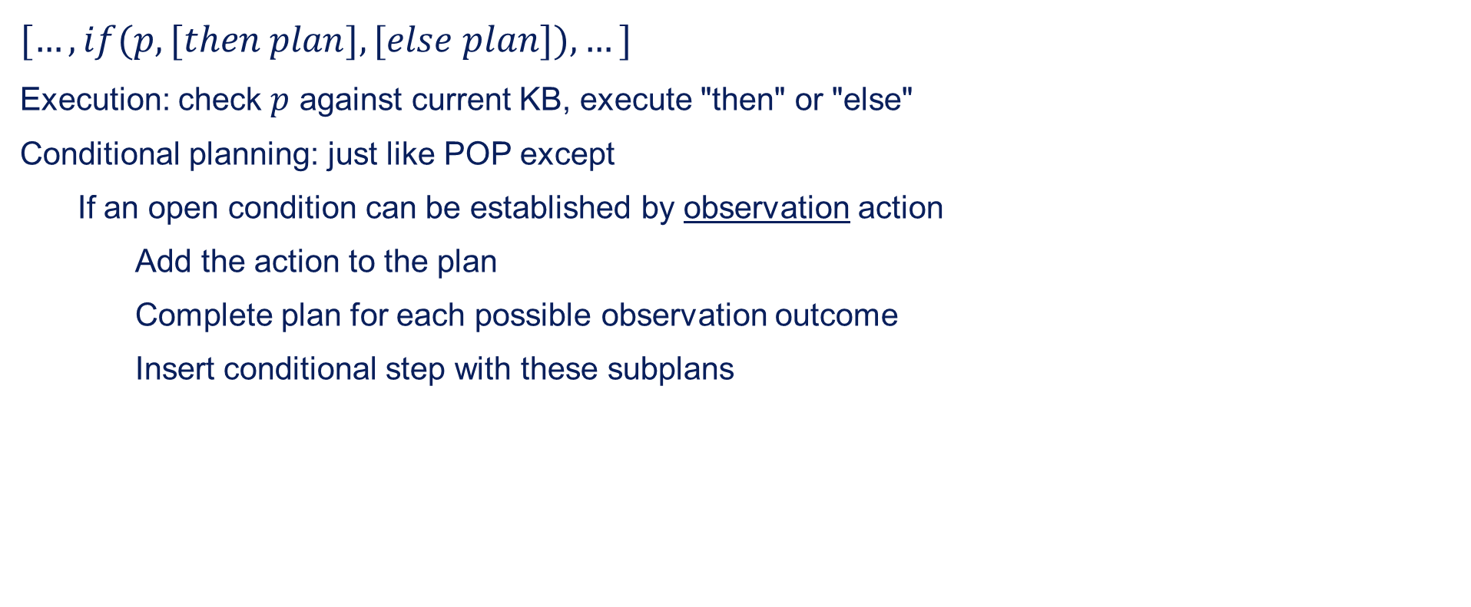
Conditional planning
$[…,if(p,[then$ $plan],[else$ $plan]),…]$
Execution: check $p$ against current KB, execute "then" or "else"
Conditional planning: just like POP except
If an open condition can be established by observation action
Add the action to the plan
Complete plan for each possible observation outcome
Insert conditional step with these subplans

Slide 7
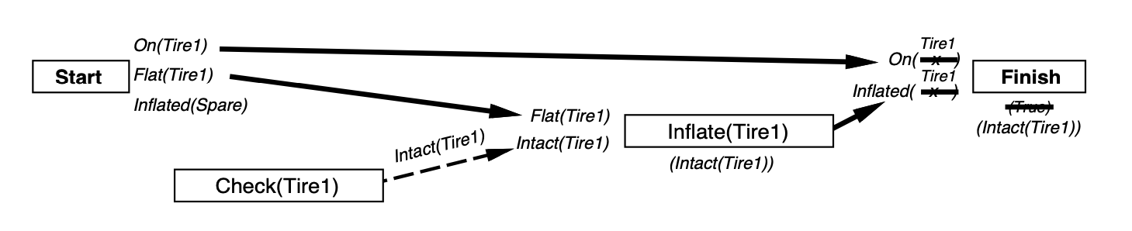
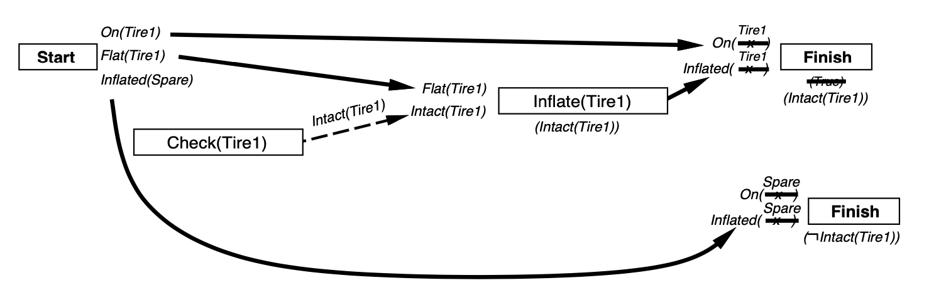
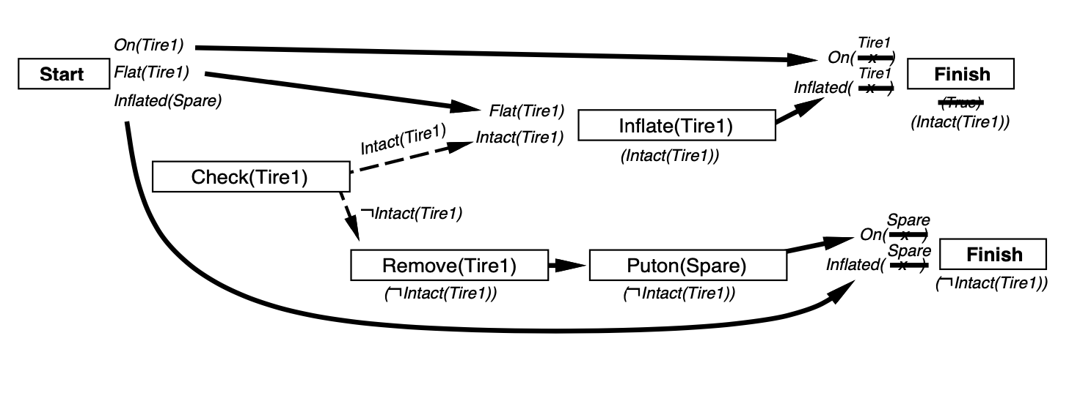
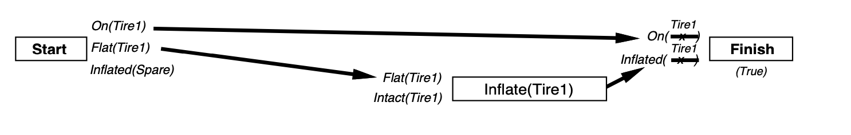
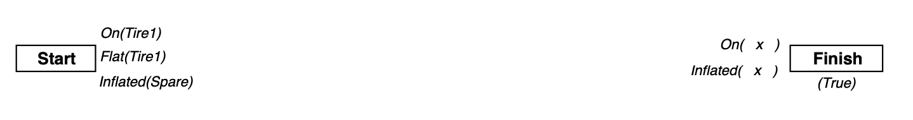
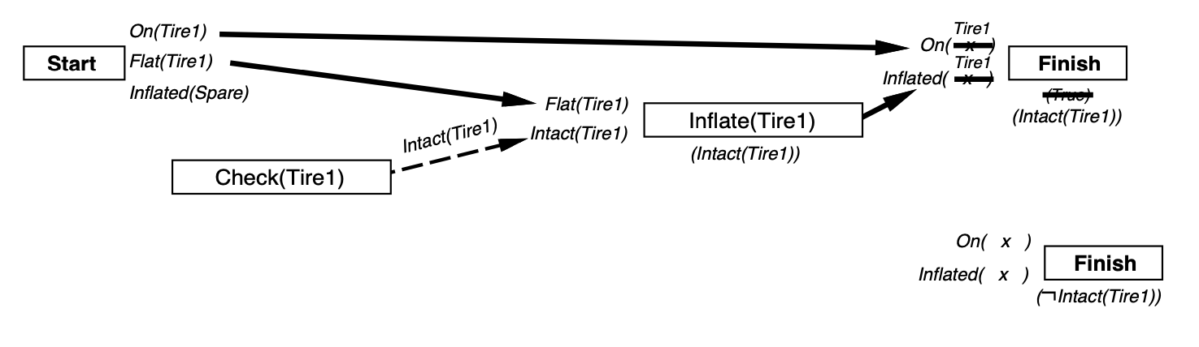
Conditional planning example

Slide 8
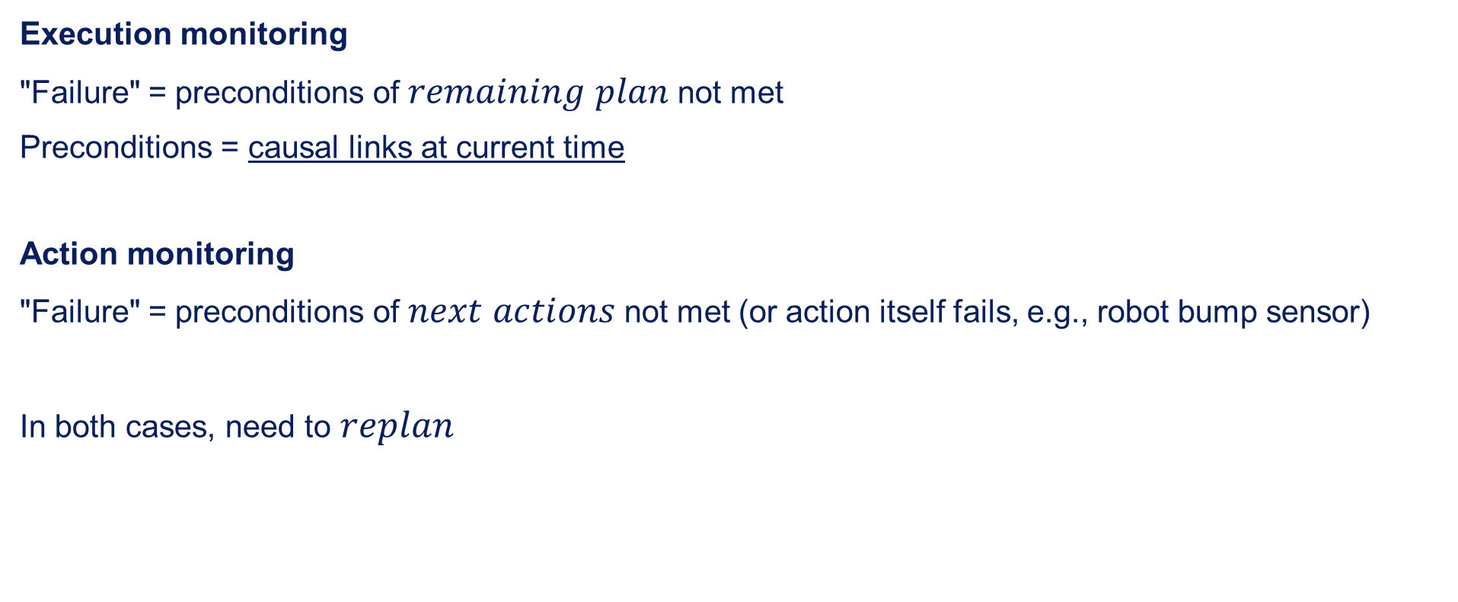
Monitoring
Execution monitoring
"Failure" = preconditions of $remaining$ $plan$ not met
Preconditions = causal links at current time
Action monitoring
"Failure" = preconditions of $next$ $actions$ not met (or action itself fails, e.g., robot bump sensor)
In both cases, need to $replan$

Slide 9
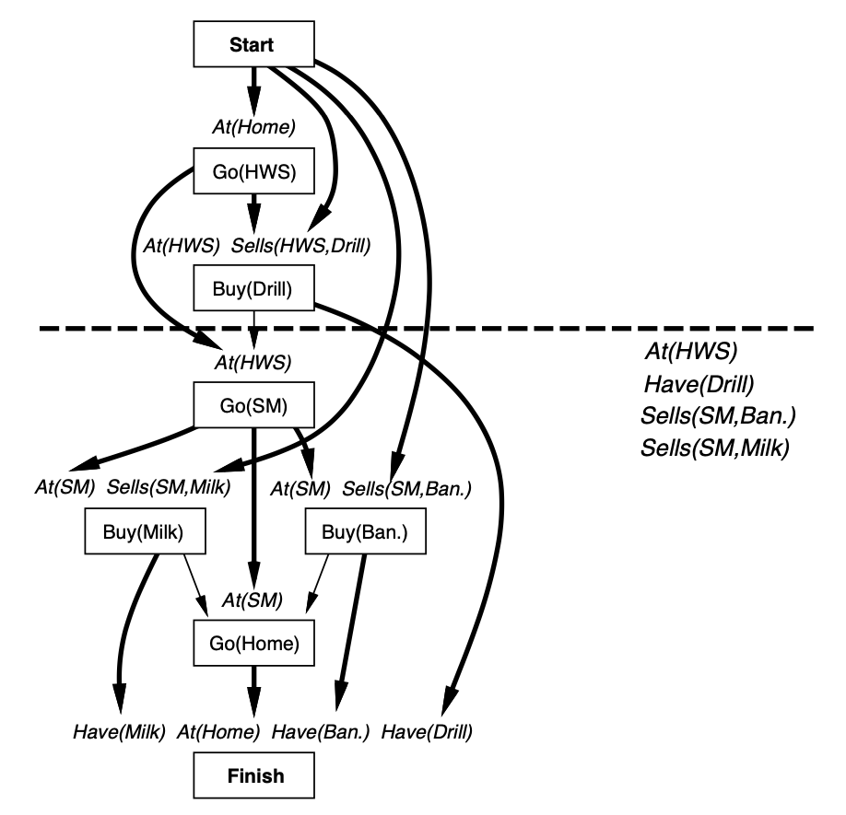
Preconditions for remaining plan

Slide 10
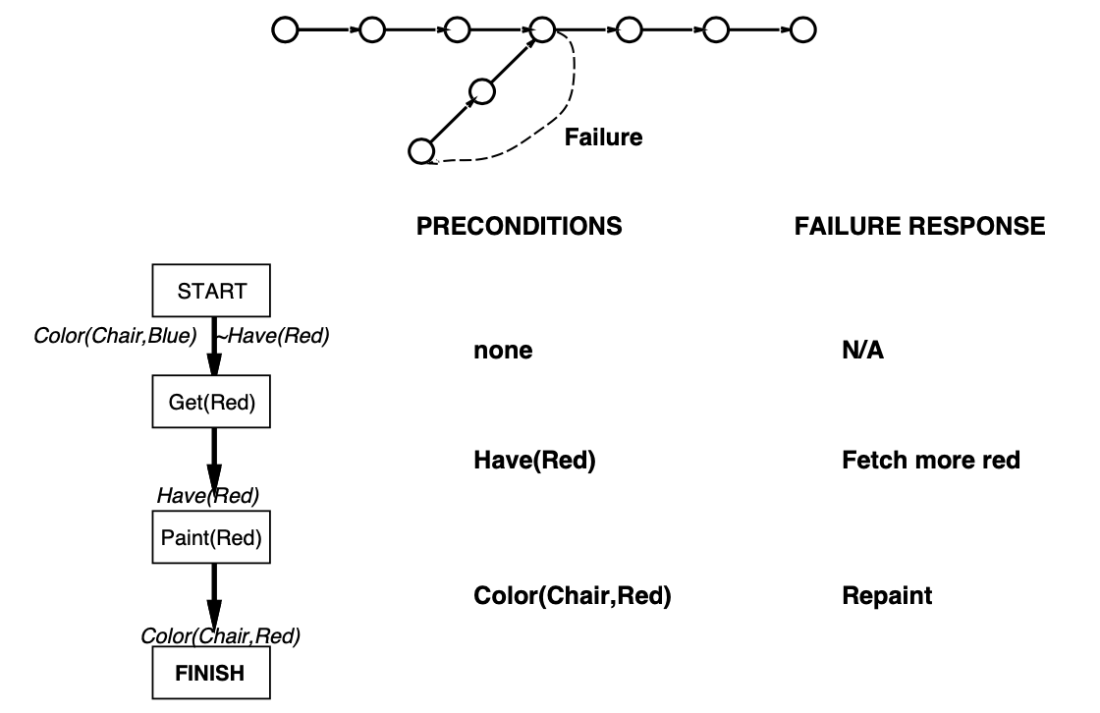
Replanning
Simplest: on failure, replan from scratch
Better: plan to get back on track by reconnecting to best continuation
Generates "loop until done" behaviour with no explicit loop

