Slide 1
Intelligent
Agents
Lesson 3

Slide 2
Outline
Agents and environments
Rationality
PEAS (Performance measure, Environment, Actuators, Sensors)
Environment types
Agent types

Slide 3
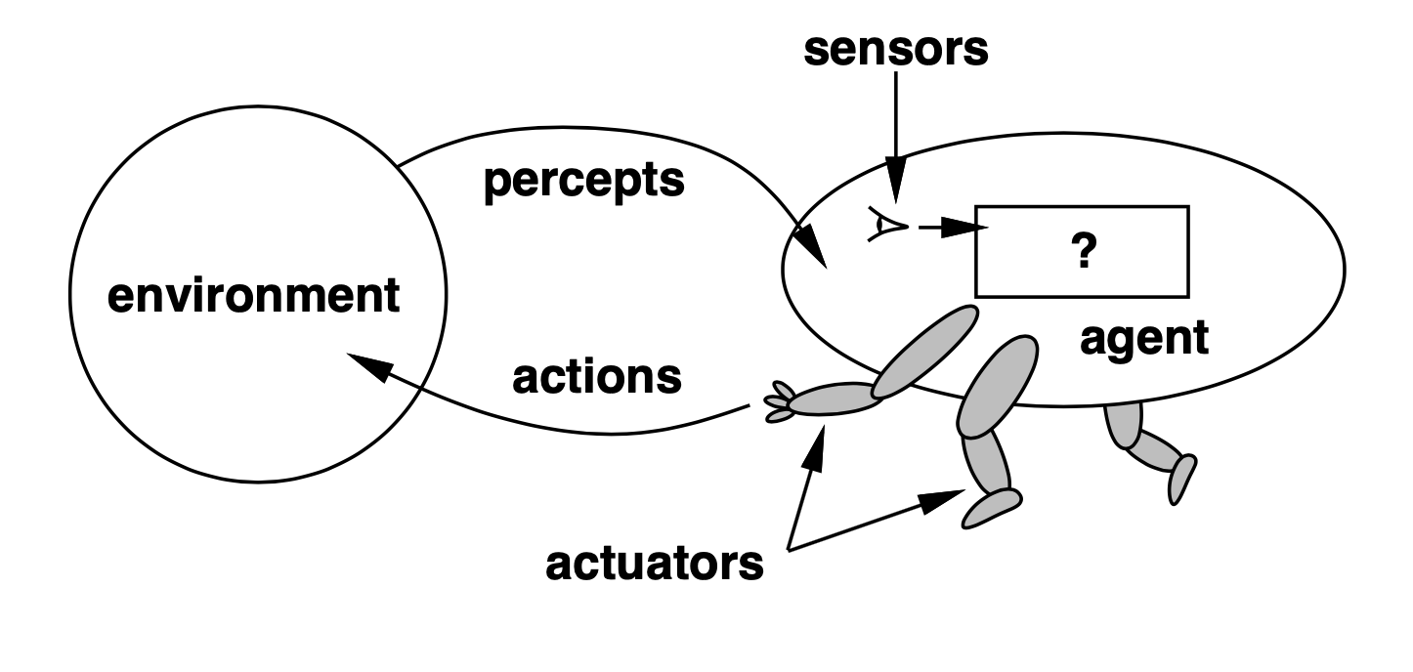
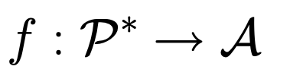
Agents and environments
Agents include humans, robots, softbots, thermostats, etc.
The agent function maps from percept histories to actions:
The agent program runs on the physical architecture to produce

Slide 4
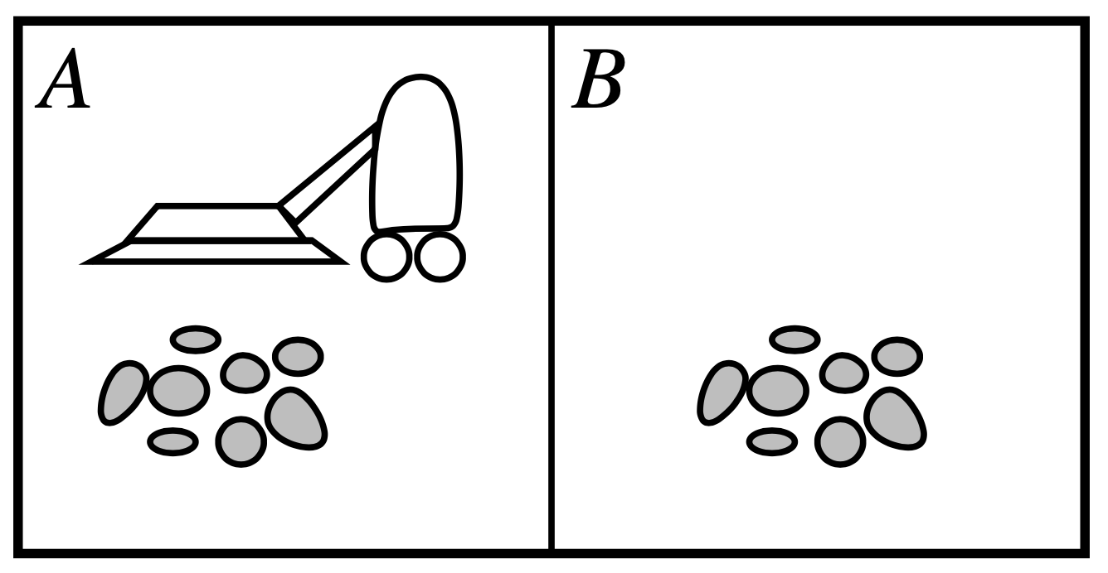
Vacuum-cleaner world
Percepts: location and contents, e.g., [A, Dirty]
Actions: Left, Right, Suck, NoOp

Slide 5
A vacuum-cleaner agent
Right
Suck
Left
Suck
Right
Suck
…
[A, Clean]
[A, Dirty]
[B, Clean]
[B, Dirty]
[A, Clean], [A, Clean]
[A, Clean], [A, Dirty]
What is the right function?
Can it be implemented in a small agent program?
Function Reflex-Vacuum-Agent([location,status]) returns an action
if status = Dirty then return Suck
else if location = A then return Right
else if location = B then return Left

Slide 6
Rationality
Fixed performance measure evaluates the environment sequence
One point per square cleaned up in time T?
One point per clean square per time step, minus one per move?
Penalize for > k dirty squares?
A rational agent chooses whichever action maximises the expected value of the performance measure given the percept sequence to date
Rational ≠ omniscient
Percepts may not supply all relevant information
Rational ≠ clairvoyant
Action outcomes may not be as expected
Hence, rational ≠ successful
Rational ➡ exploration, learning, autonomy

Slide 7
PEAS
To design a rational agent, we use specify the task environment
Consider, e.g., the task of designed an automated taxi:
Performance measure?
Environment?
Actuators?
Sensors?
Safety, destination, profits, legality, comfort, …
US streets / freeways, traffic, pedestrians, weather, …
Steering, accelerator, brake, horn, speaker / display, …
Video, accelerometers, gauges, engine sensors, keyboard, keyboard, GPS, …

Slide 8
Internet shopping agent
Performance measure?
Environment?
Actuators?
Sensors?
Price, quality, appropriateness, efficiency
Current and future WWW sites, vendors, shippers
Display to user, follow URL, fill in form
HTML pages (text, graphics, scripts)

Slide 9
Environment types
Solitaire
Backgammon
Internet shopping
Taxi
Observable?
Yes
Yes
No
No
Deterministic?
Yes
No
Partly
No
Episodic?
No
No
No
No
Static?
Yes
Semi
Semi
No
Discrete?
Yes
Yes
Yes
No
Single agent?
Yes
No
Yes (except auctions)
No
The environment type largely determines the agent design
The real world is (of course) partially observable, stochastic, sequential, dynamic, continuous, multi-agent

Slide 10
Agent types
Four basic types in order of increasingly generality:
Simple reflex agents
Reflex agents with state
Goal-based agents
Utility-based agents
All these can be turned into learning agents

Slide 11
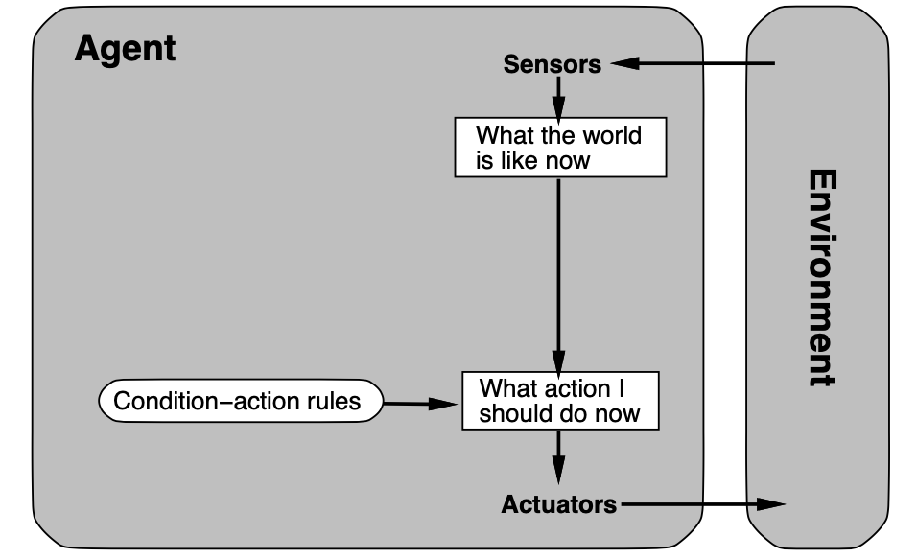
Simple reflex agents

Slide 12
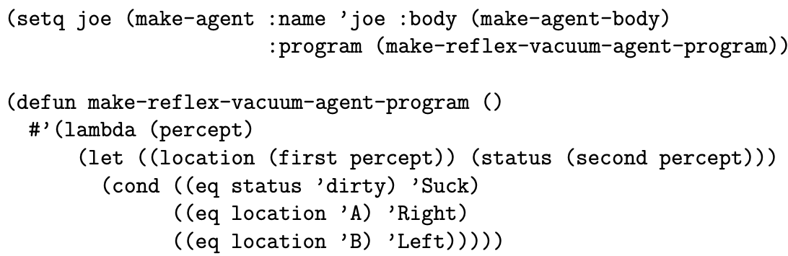
Example
Function Reflex-Vacuum-Agent([location, status]) returns an action
If status = Dirty then return Suck
Else if location = A then return Right
Else if location = B then return Left

Slide 13
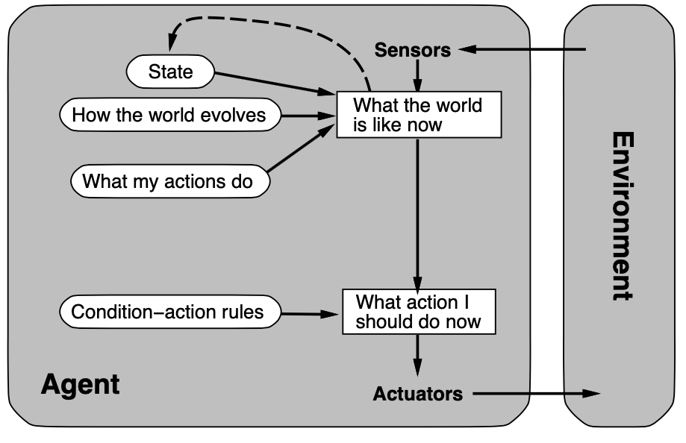
Reflex agents with state

Slide 14
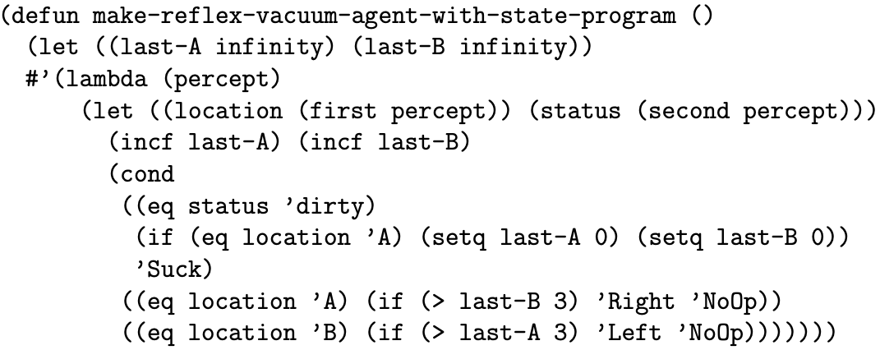
Example
Function Reflex-Vacuum-Agent([location, status]) returns an action
Static: last_A, last–B, numbers, initially ∞
If status = Dirty then …

Slide 15
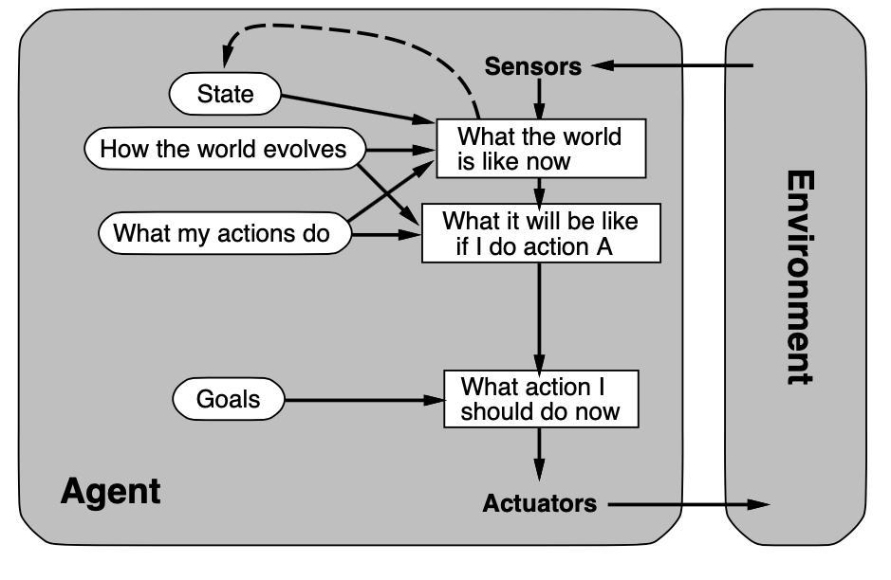
Goal-based agents

Slide 16
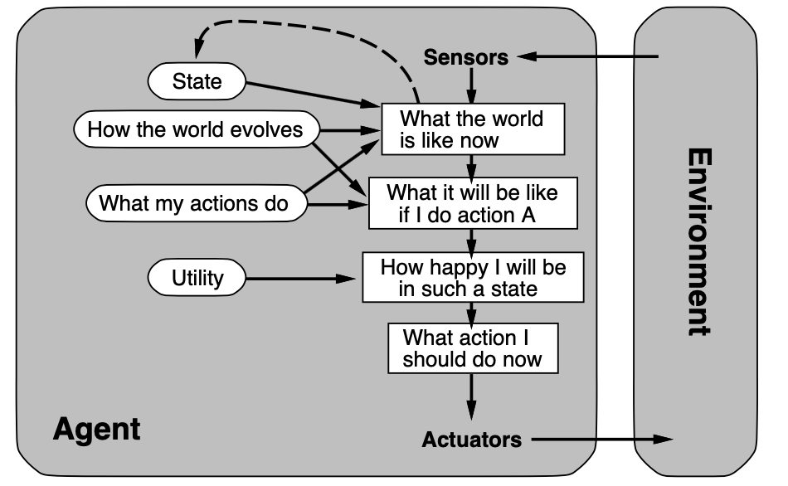
Utility-based agents

Slide 17
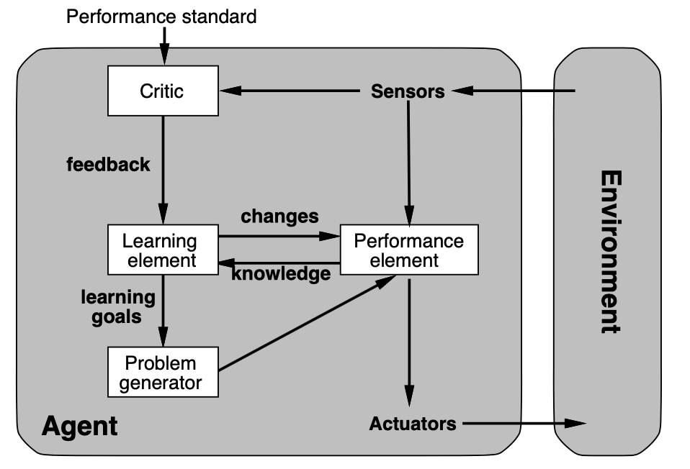
Learning agents

Slide 18
Summary
Agents interact with environments through actuators and sensors
The agent function describes what the agent does in all circumstances
The performance measure evaluates the environment sequence
A perfectly rational agent maximises expected performance
Agent programs implement (some) agent functions
PEAS descriptions define task environments
Environments are categorised along several dimensions: Observable? Deterministic? Episodic? Static? Discrete? Single-agent?
Several basic agent architectures exist: Reflex, reflex with state, goal-based, utility-based

