Slide 1
Learning From Observations
Lesson 6

Slide 2
Outline
Learning agents
Inductive learning
Decision tree learning
Measuring learning performance

Slide 3
Learning
Learning is essential for unknown environments,
i.e., when designer lacks omniscience
Learning is useful as a system construction method,
i.e., expose the agent to reality rather than trying to write it down
Learning modifies the agent's decisions to improve performance

Slide 4
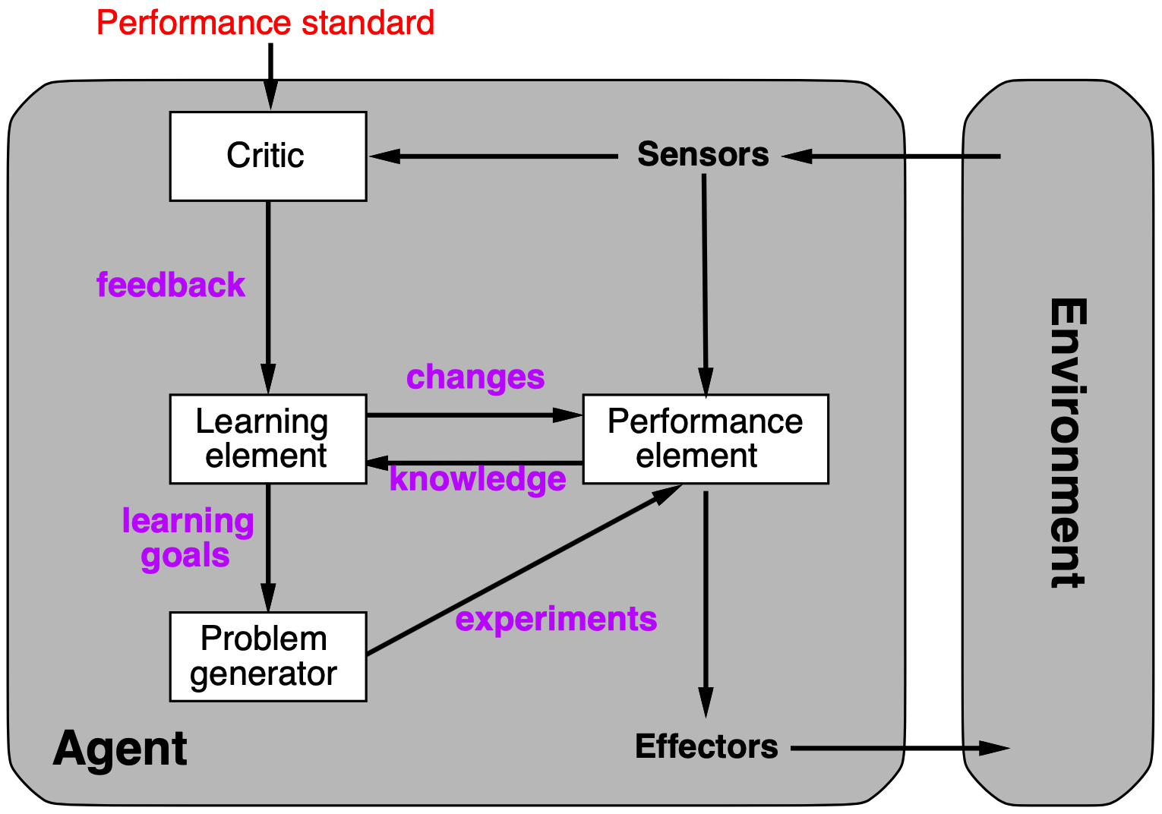
Learning agents

Slide 5
Learning element
Design of learning element is dictated by
What type of performance is used
Which functional component is to be learned
How that functional component is represented
What kind of feedback is available

Slide 6
Learning element
Example scenario:
Performance element | Component | Representation | Feedback
Alpha-beta search Logical agent Utility-based agent Simple reflex agent | Eval. fn. Transition model Transition model Percept-action fn | Weighted linear function Successor-sate axioms Dynamic Bayes net Neural net | Win/loss Outcome Outcome Correct action
Supervised learning: correct answers for each instance
Reinforcement learning: occasional rewards

Slide 7
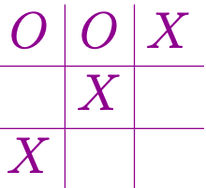

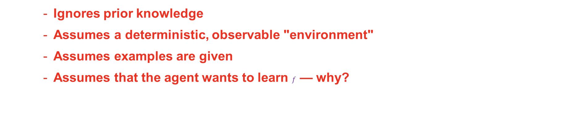
Inductive learning (a.k.a Science)
Simplest form: learn a function from examples (tabula rasa)
f is the target function
An example is a pair $x,f(x),$e.g., , +1
Problem: find a(n) hypothesis h
Such that $h≈f$ given a training set of examples
(This is a highly simplified model of real learning:
)
Ignores prior knowledge
Assumes a deterministic, observable "environment"
Assumes examples are given
Assumes that the agent wants to learn $f$ — why?

Slide 8
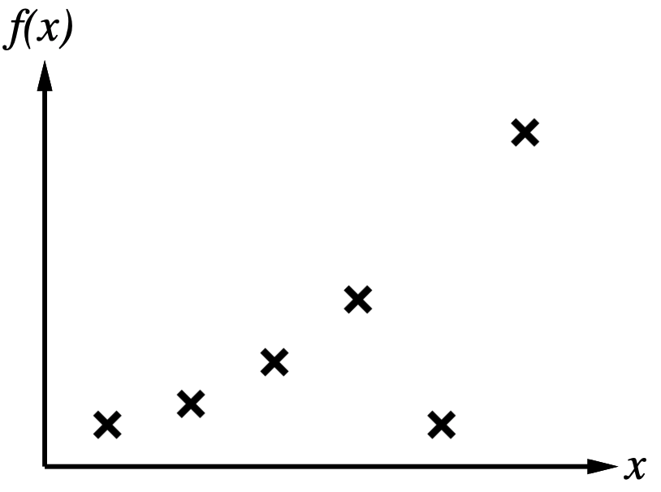
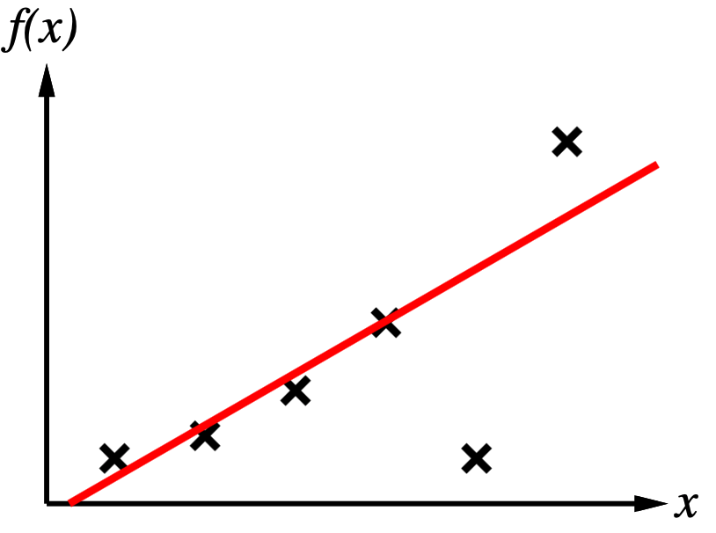
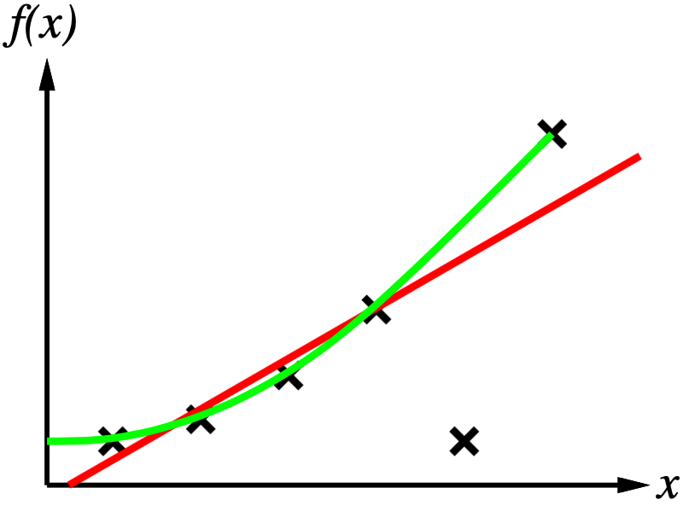
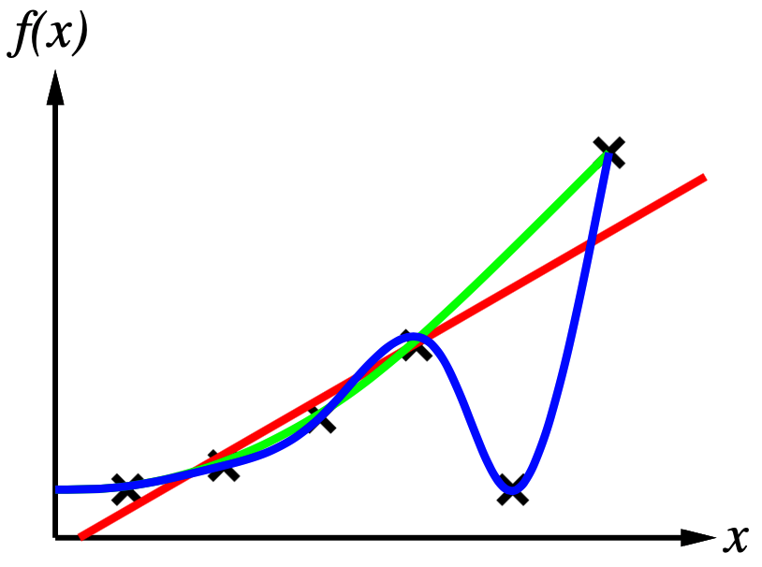
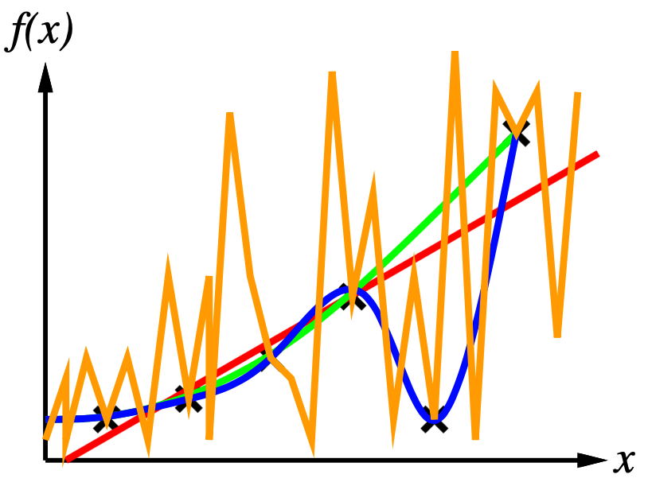
Inductive learning method
Construct / adjust h to agree with f on training set (h is consistent if it agrees with f on all examples)
E.g., curve fitting:
Ockham's razor: maximise a combination of consistency and simplicity

Slide 9








Attribute-based representations
Examples described by attribute values (Boolean, discrete, continuous, etc.)
E.g. situations where I will / won't wait for a table:
Example |  |  |  |  |  | Attributes |  |  |  |  | Target
 | Alt | Bar | Fri | Hun | Pat | Price | Rain | Res | Type | Est | WillWait
 | T | F | F | T | Some | $$$ | F | T | French | 0-10 | T
 | T | F | F | T | Full | $ | F | F | Thai | 30-60 | F
 | F | T | F | F | Some | $ | F | F | Burger | 0-10 | T
 | T | F | T | T | Full | $ | F | F | Thai | 10-30 | T
 | T | F | T | F | Full | $$$ | F | T | French | >60 | F
 | F | T | F | T | Some | $$ | T | T | Italian | 0-10 | T
 | F | T | F | F | None | $ | T | F | Burger | 0-10 | F
 | F | F | F | T | Some | $$ | T | T | Thai | 0-10 | T
$$X_{1}$$
$$X_{2}$$
$$X_{3}$$
$$X_{4}$$
$$X_{5}$$
$$X_{6}$$
$$X_{7}$$
$$X_{8}$$

Slide 10




Attribute-based representation
Example |  |  |  |  |  | Attributes |  |  |  |  | Target
 | Alt | Bar | Fri | Hun | Pat | Price | Rain | Res | Type | Est | WillWait
 | F | T | T | F | Full | $ | T | F | Burger | >60 | F
 | T | T | T | T | Full | $$$ | F | T | Italian | 10-30 | F
 | F | F | F | F | None | $ | F | F | Thai | 0-10 | F
 | T | T | T | T | Full | $ | F | F | Burger | 30-60 | T
$$X_{9}$$
$$X_{10}$$
$$X_{11}$$
$$X_{12}$$
Classification of examples is positive (T) or negative (F)

Slide 11
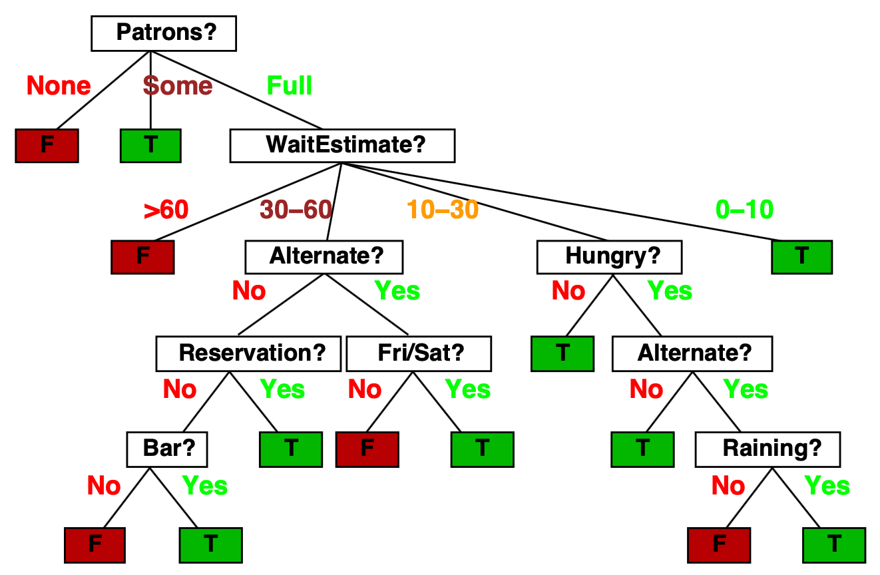
Decision trees
One possible representation for hypotheses
E.g., here is the "true" tree for deciding whether to wait:

Slide 12
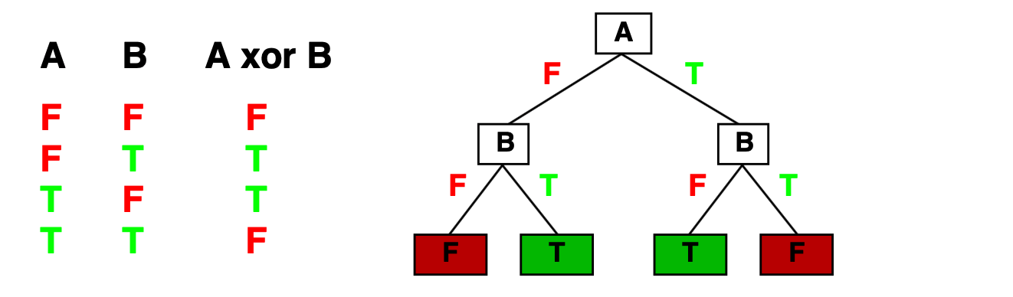
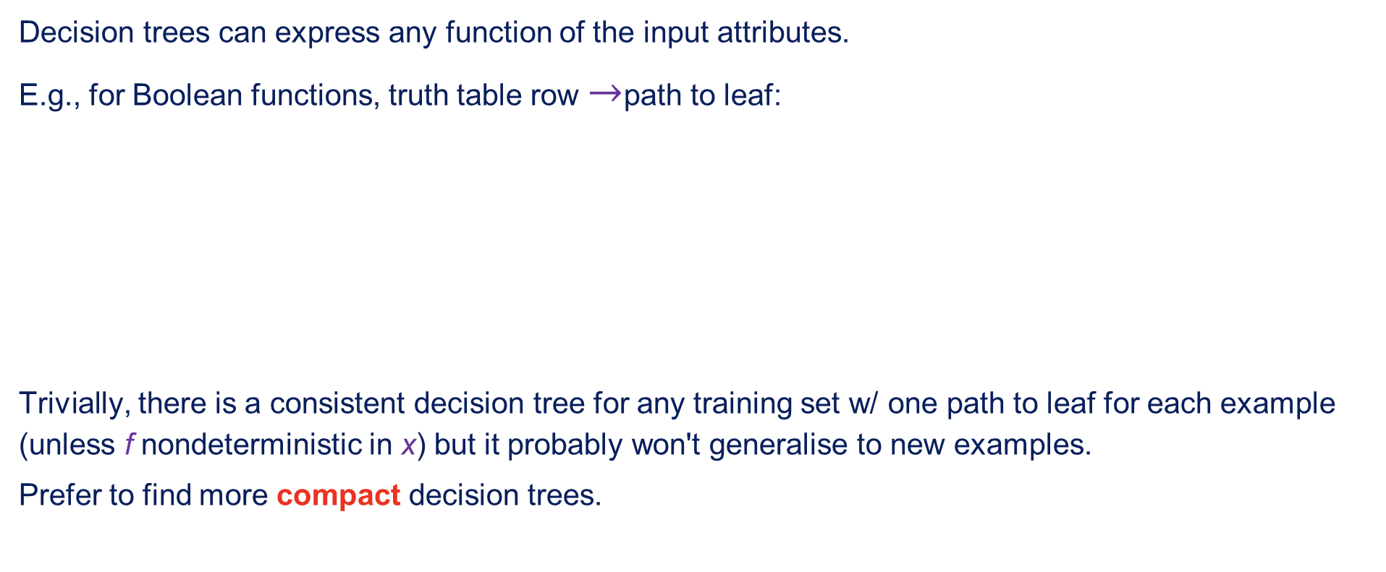
Expressiveness
Decision trees can express any function of the input attributes.
E.g., for Boolean functions, truth table row $→$path to leaf:
Trivially, there is a consistent decision tree for any training set w/ one path to leaf for each example (unless f nondeterministic in x) but it probably won't generalise to new examples.
Prefer to find more compact decision trees.

Slide 13
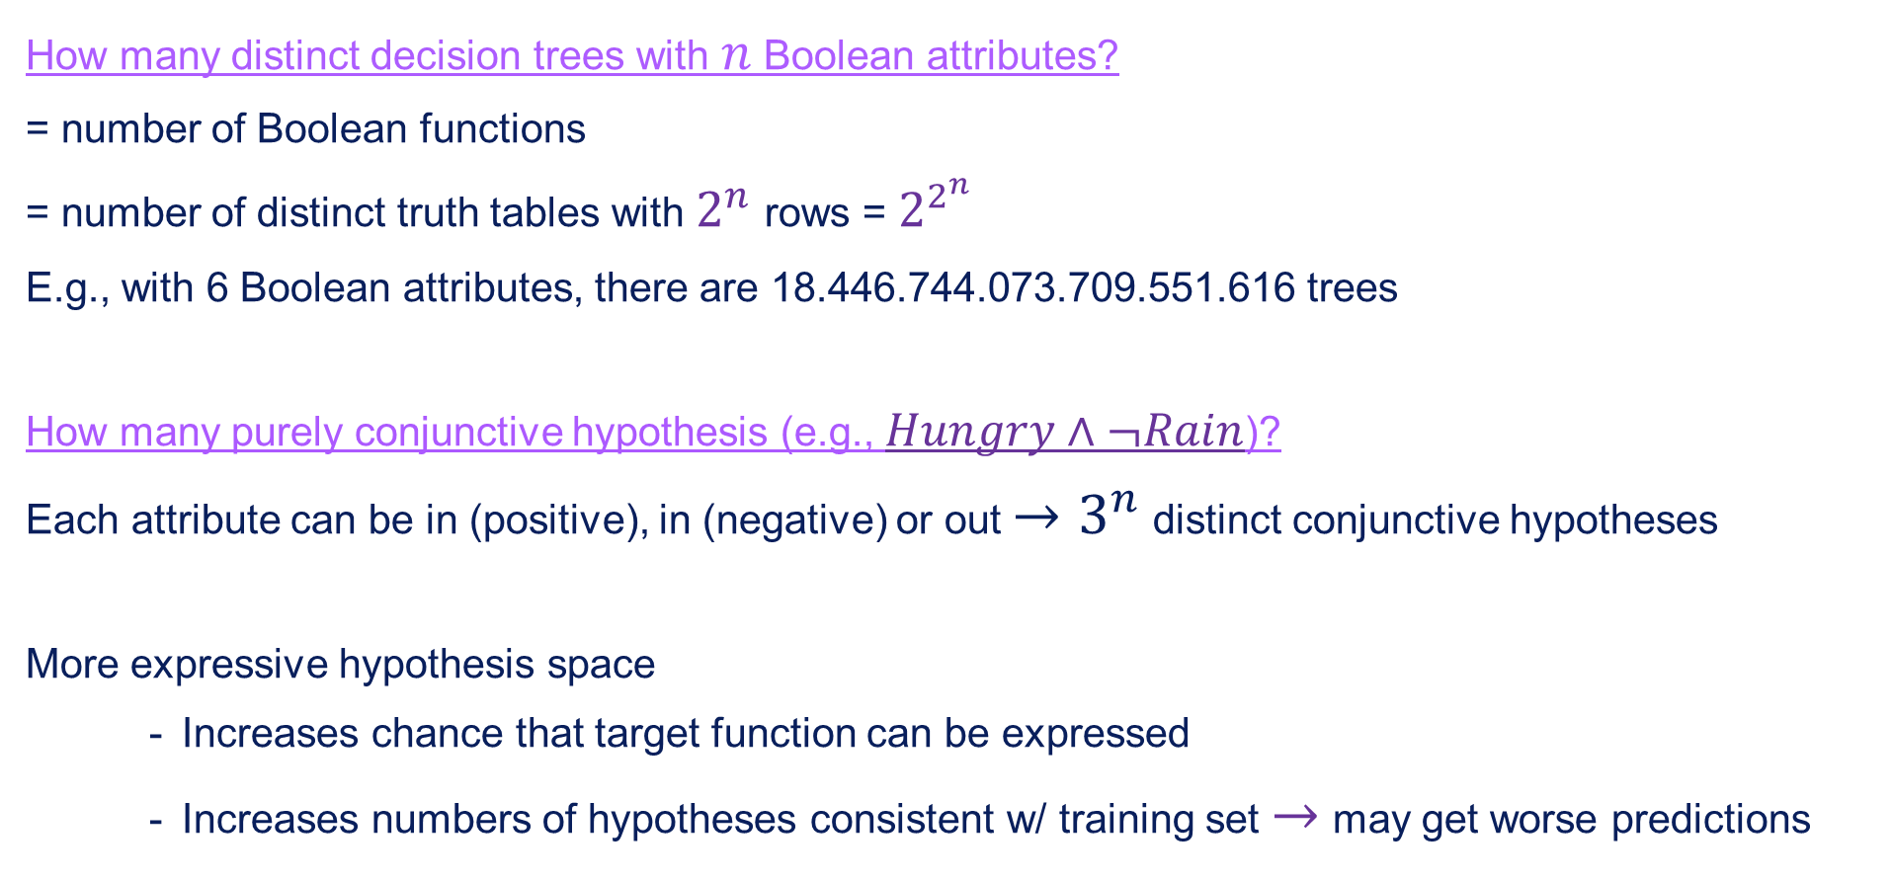
Hypothesis spaces
How many distinct decision trees with $n$ Boolean attributes?
= number of Boolean functions
= number of distinct truth tables with $2^{n}$ rows = $2^{2^{n}}$
E.g., with 6 Boolean attributes, there are 18.446.744.073.709.551.616 trees
How many purely conjunctive hypothesis (e.g., $Hungry∧¬Rain$)?
Each attribute can be in (positive), in (negative) or out $→3^{n}$ distinct conjunctive hypotheses
More expressive hypothesis space
Increases chance that target function can be expressed
Increases numbers of hypotheses consistent w/ training set $→$ may get worse predictions

Slide 14
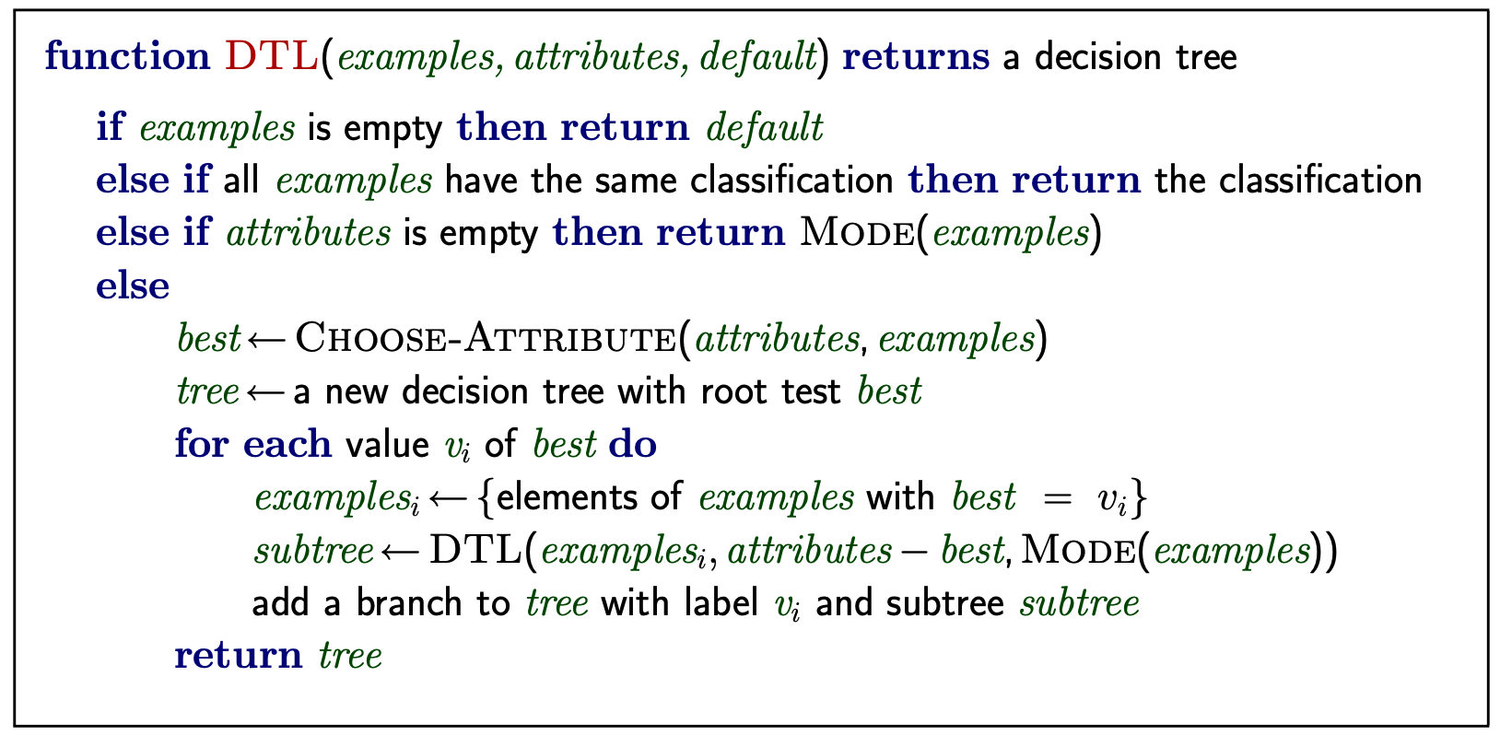
Decision tree learning
Aim: find a small tree consistent with the training examples
Idea: (recursively) choose "most significant" attribute as root of (sub)tree

Slide 15
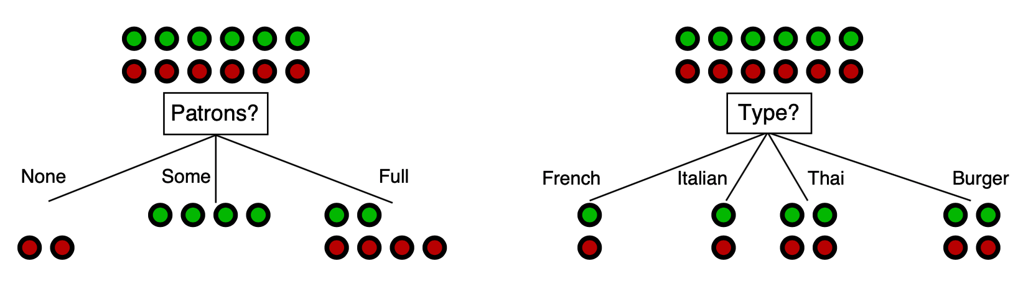
Choosing an attribute
Idea: a good attribute splits the examples into subsets that are (ideally) "all positive" or "all negative"
Patrons? Is a better choice – gives information about the classification

Slide 16
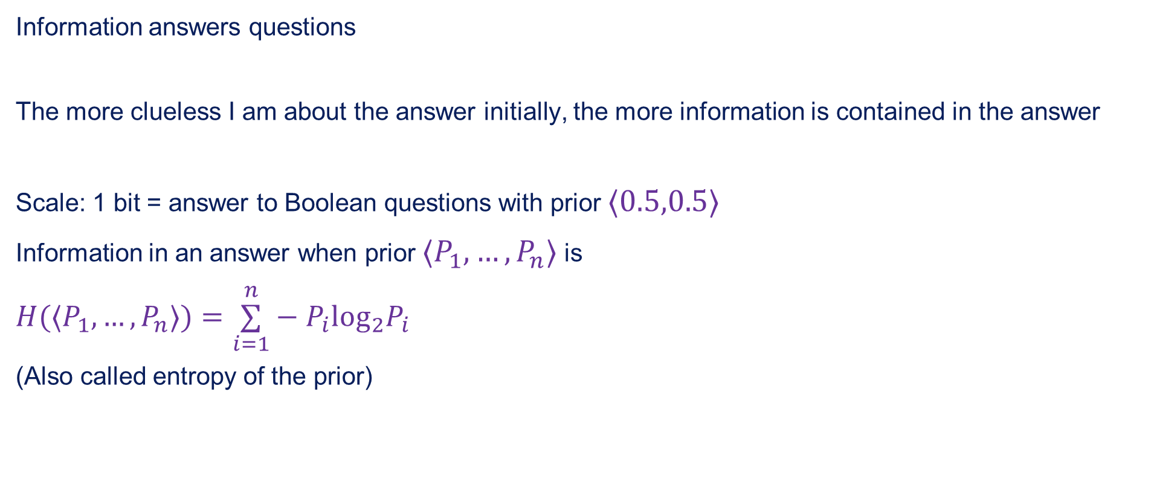
Information
Information answers questions
The more clueless I am about the answer initially, the more information is contained in the answer
Scale: 1 bit = answer to Boolean questions with prior $⟨0.5,0.5⟩$
Information in an answer when prior $⟨P_{1},…,P_{n}⟩$ is
$$H(⟨P_{1},…,P_{n}⟩)=\overset{n}{\underset{i=1}{∑}}−P_{i}\log_{2}P_{i}$$
(Also called entropy of the prior)

Slide 17
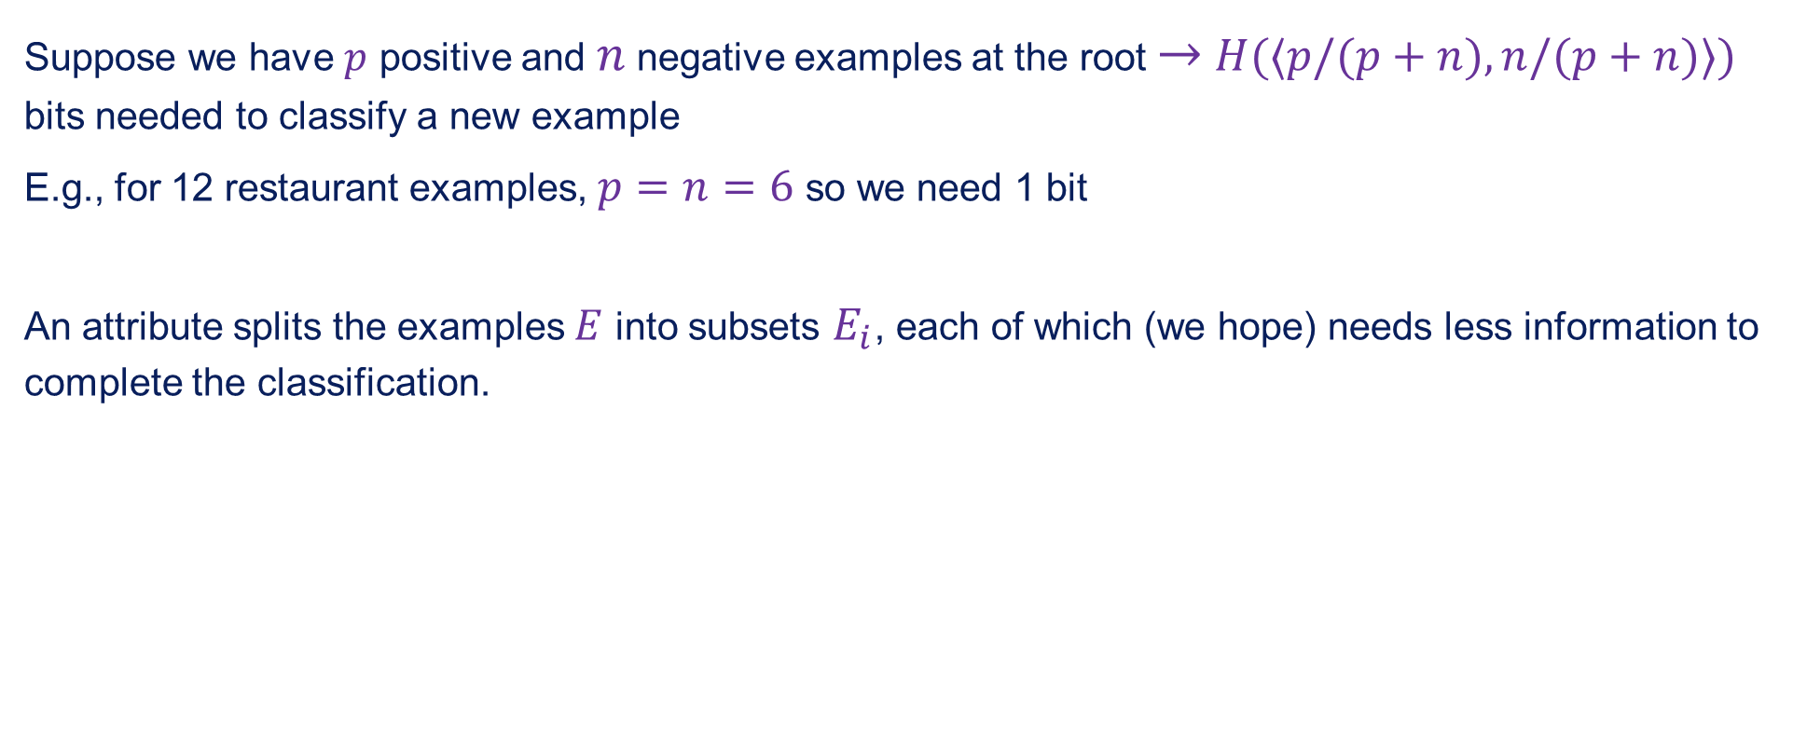
Information contd.
Suppose we have $p$ positive and $n$ negative examples at the root $→$ $H(⟨p/(p+n),n/(p+n)⟩)$ bits needed to classify a new example
E.g., for 12 restaurant examples, $p=n=6$ so we need 1 bit
An attribute splits the examples $E$ into subsets $E_{i}$, each of which (we hope) needs less information to complete the classification.

Slide 18
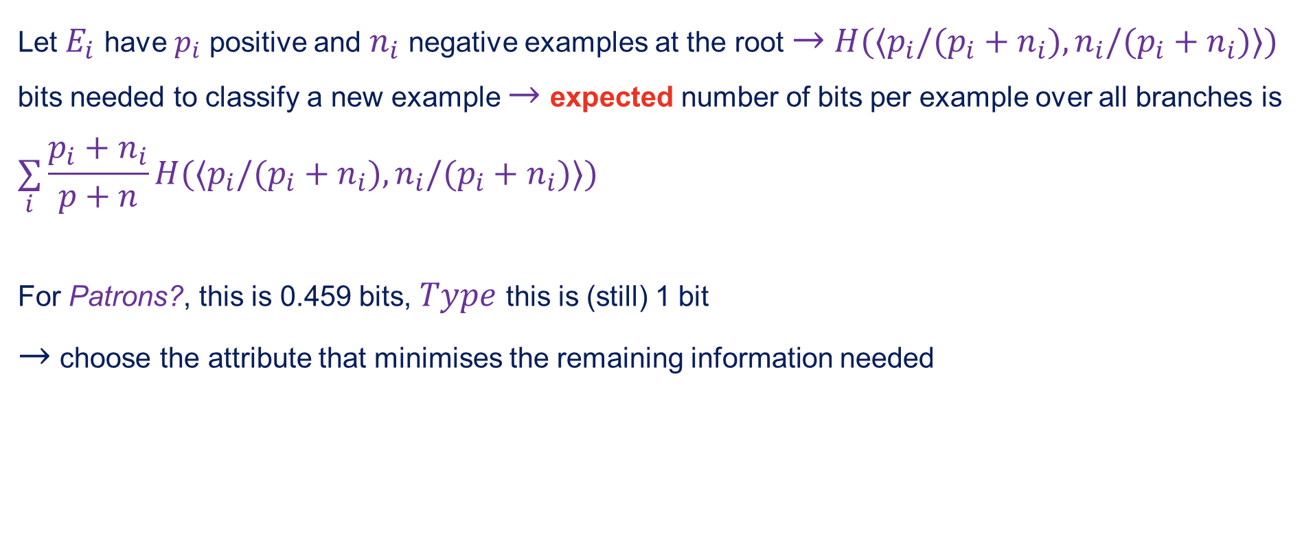
Information contd.
Let $E_{i}$ have $p_{i}$ positive and $n_{i}$ negative examples at the root $→$ $H(⟨p_{i}/(p_{i}+n_{i}),n_{i}/(p_{i}+n_{i})⟩)$ bits needed to classify a new example $→$ expected number of bits per example over all branches is
$$\underset{i}{∑}\frac{p_{i}+n_{i}}{p+n}H(⟨p_{i}/(p_{i}+n_{i}),n_{i}/(p_{i}+n_{i})⟩)$$
For Patrons?, this is 0.459 bits, $Type$ this is (still) 1 bit
$→$ choose the attribute that minimises the remaining information needed

Slide 19
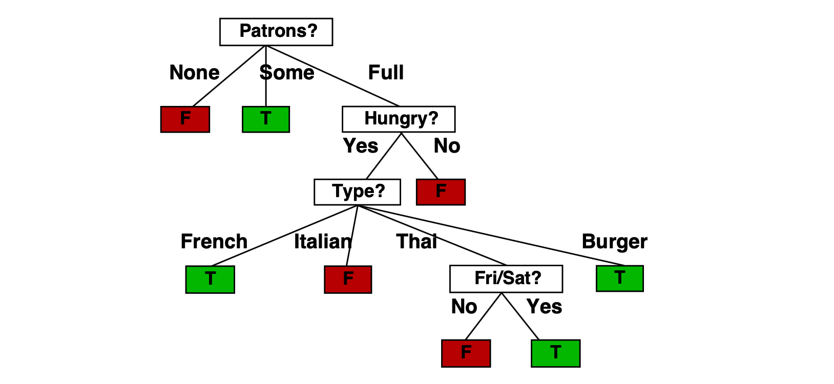
Example contd.
Decision tree learned from the 12 examples:
Substantially simpler than a "true" tree — a more complex hypothesis isn't justified by small amount of data.

Slide 20
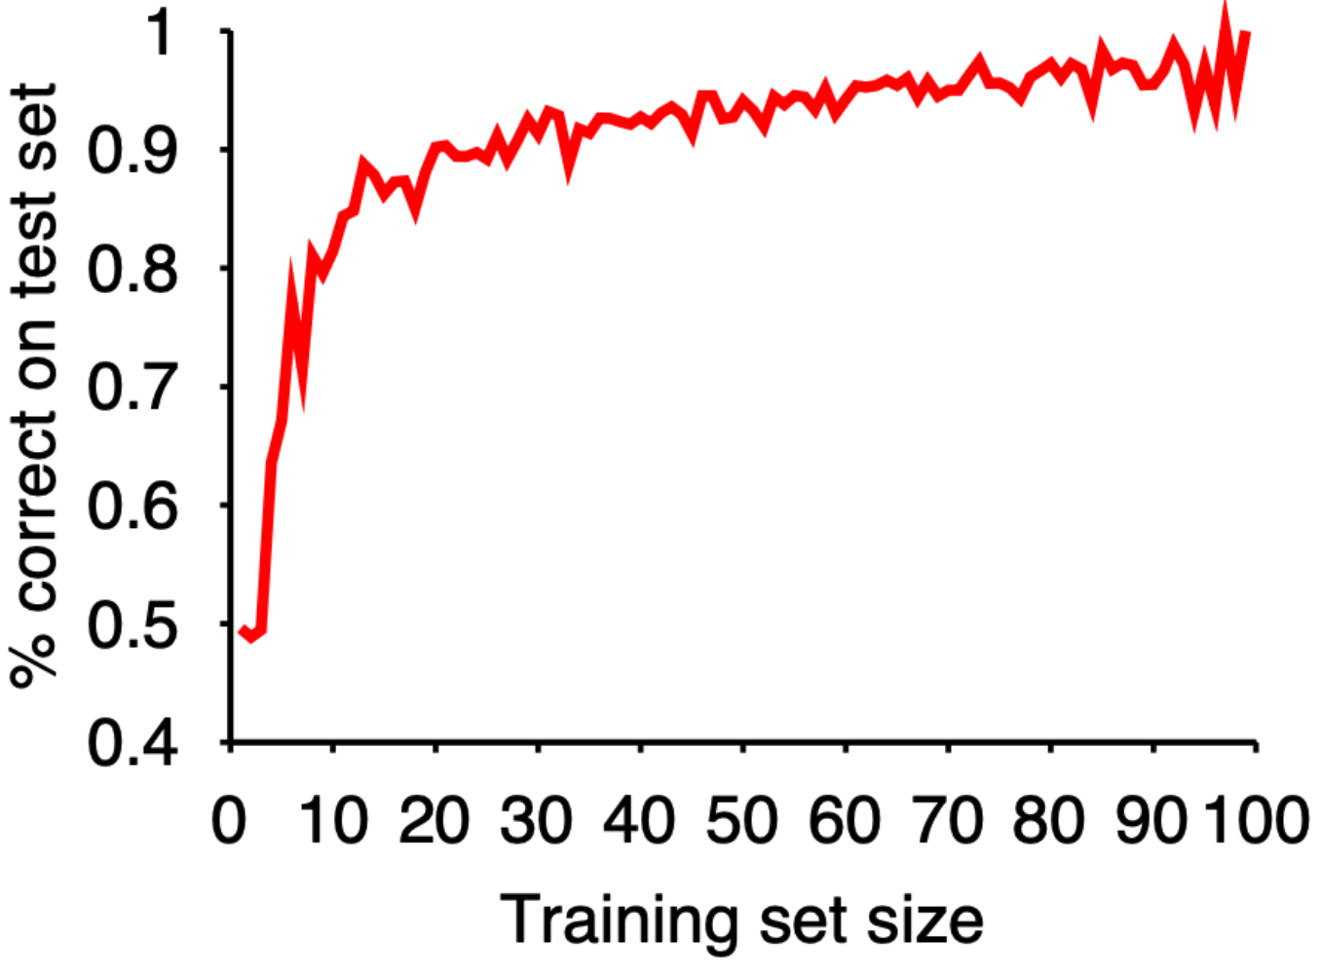
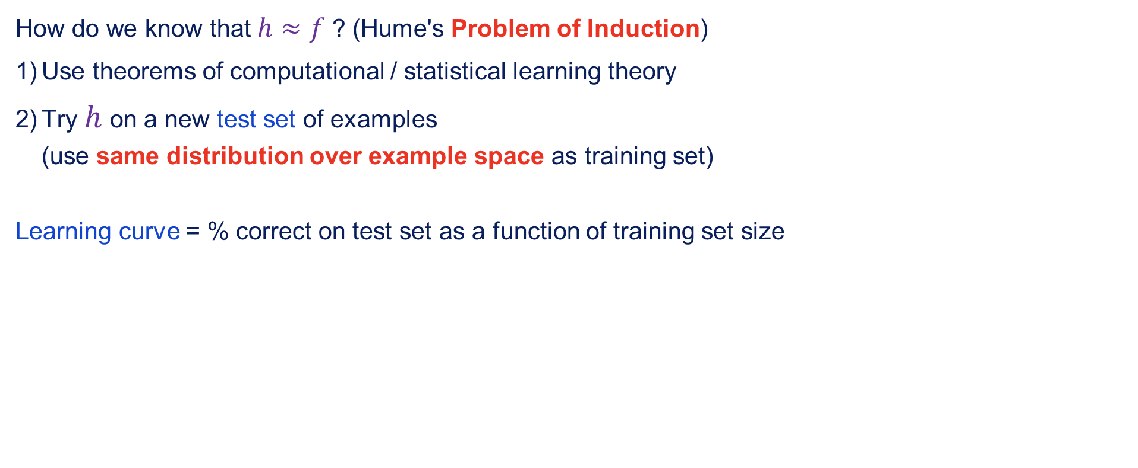
Performance measurement
How do we know that $h≈f$ ? (Hume's Problem of Induction)
Use theorems of computational / statistical learning theory
Try $h$ on a new test set of examples (use same distribution over example space as training set)
Learning curve = % correct on test set as a function of training set size

Slide 21
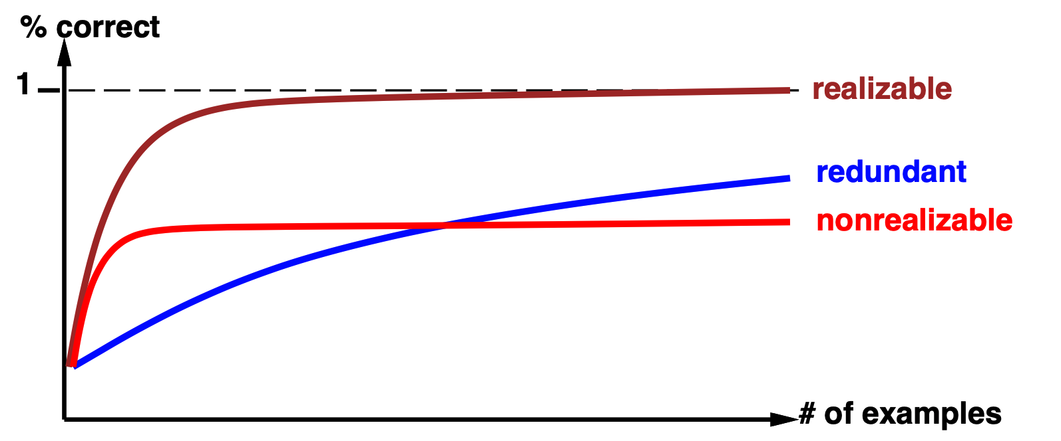
Performance measurement contd.
Learning curve depends on
Realisable (can express target function) vs. non-realisable non-realisability can be due to missing attributes or restricted hypothesis class (e.g., thresholded linear function)
Redundant expressiveness (e.g., loads of irrelevant attributes)

Slide 22
Summary
Learning needed for unknown environments, lazy designers
Learning agent = performance element + learning element
Learning method depends on type of performance element, available feedback, type of component to be improved and it's representation
For supervised learning, the aim is to find a simple hypothesis that is approximately consistent with training examples.
Decision tree learning using information gain.
Learning performance = prediction accuracy measured on test set.

