Slide 1
Constraint Satisfaction Problems
Lesson 7

Slide 2
Outline
CSP examples
Backtracking search for CSPs
Problem structure and problem decomposition
Local search for CSPs

Slide 3
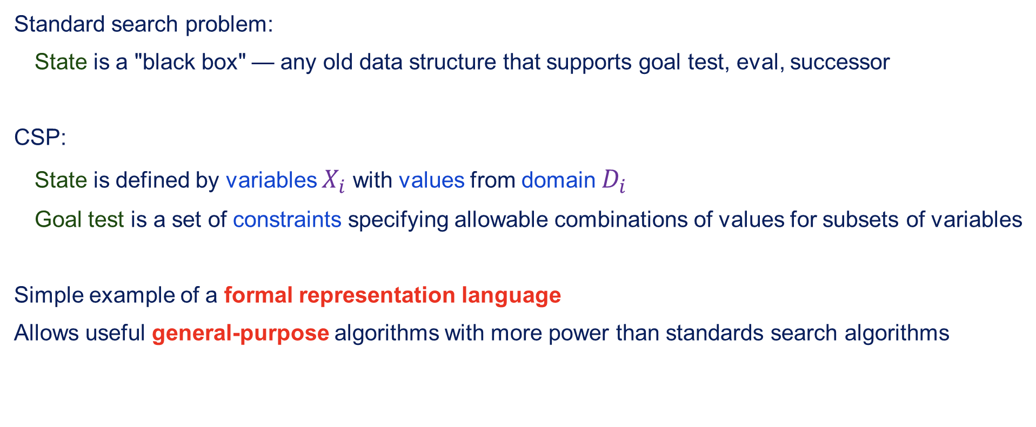
Constraint satisfaction problems (CSPs)
Standard search problem:
State is a "black box" — any old data structure that supports goal test, eval, successor
CSP:
State is defined by variables $X_{i}$ with values from domain $D_{i}$
Goal test is a set of constraints specifying allowable combinations of values for subsets of variables
Simple example of a formal representation language
Allows useful general-purpose algorithms with more power than standards search algorithms

Slide 4
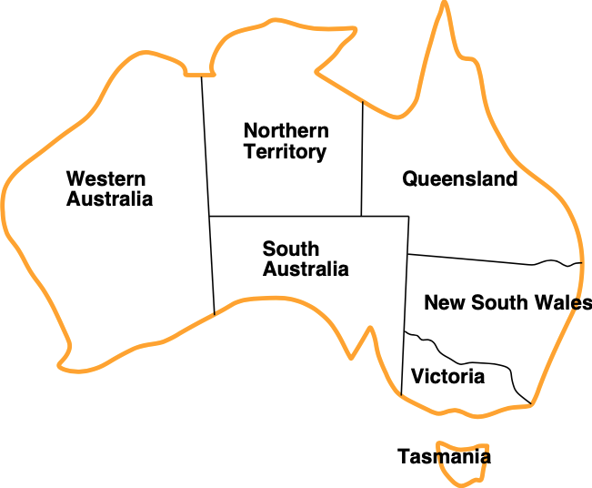
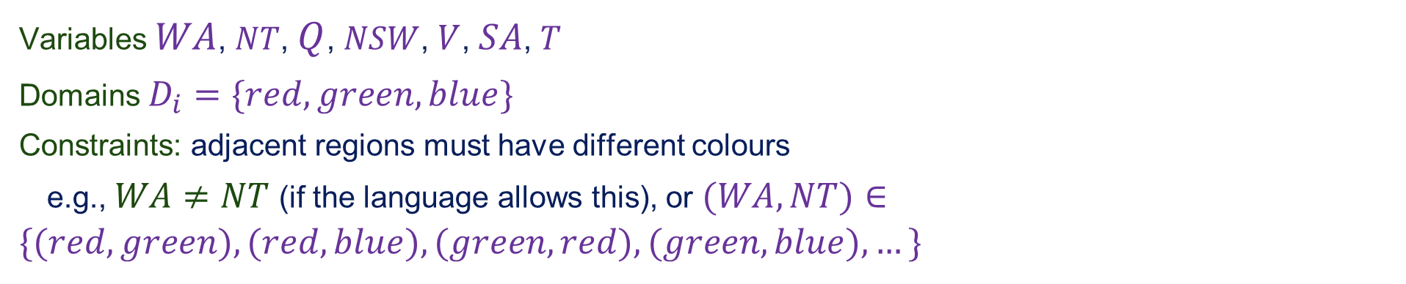
Example: Map-Colouring
Variables $WA$, $NT$, $Q$, $NSW$, $V$, $SA$, $T$
Domains $D_{i}=\{red,green,blue\}$
Constraints: adjacent regions must have different colours
e.g., $WA≠NT$ (if the language allows this), or $(WA,NT)∈\{(red,green),(red,blue),(green,red),(green,blue),…\}$

Slide 5
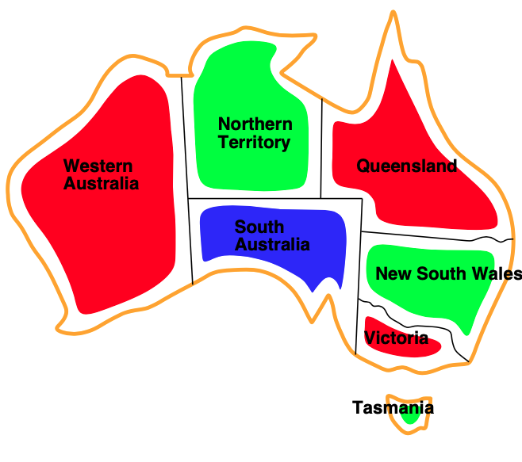
Example: Map-Colouring contd.
Solutions are assignments satisfying all constraints, e.g.,
$$\{WA=red,NT=green,Q=red,NSW=green,V=red,SA=blue,T=green\}$$

Slide 6
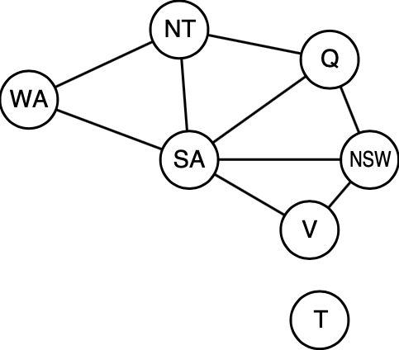
Constraint graph
Binary CSP: each constraint relates at most two variables
Constraint graph: nodes are variables, arc show constraints
General-purpose CSP algorithms use the graph structure to speed up search.
E.g, Tasmania is an independent subproblem!

Slide 7
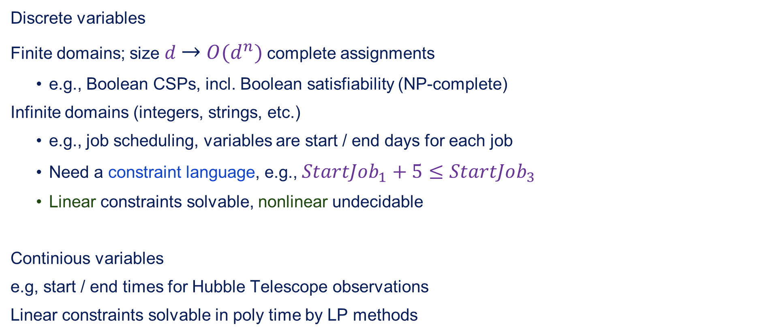
Varieties of CSPs
Discrete variables
Finite domains; size $d$ $→$ $O(d^{n})$ complete assignments
e.g., Boolean CSPs, incl. Boolean satisfiability (NP-complete)
Infinite domains (integers, strings, etc.)
e.g., job scheduling, variables are start / end days for each job
Need a constraint language, e.g., $StartJob_{1}+5≤StartJob_{3}$
Linear constraints solvable, nonlinear undecidable
Continious variables
e.g, start / end times for Hubble Telescope observations
Linear constraints solvable in poly time by LP methods

Slide 8
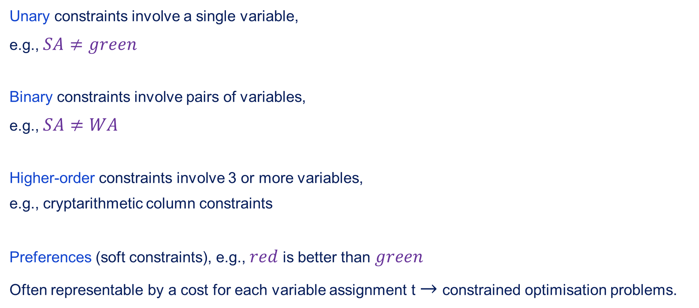
Varieties of constraints
Unary constraints involve a single variable,
e.g., $SA≠green$
Binary constraints involve pairs of variables,
e.g., $SA≠WA$
Higher-order constraints involve 3 or more variables,
e.g., cryptarithmetic column constraints
Preferences (soft constraints), e.g., $red$ is better than $green$
Often representable by a cost for each variable assignment t $→$ constrained optimisation problems.

Slide 9
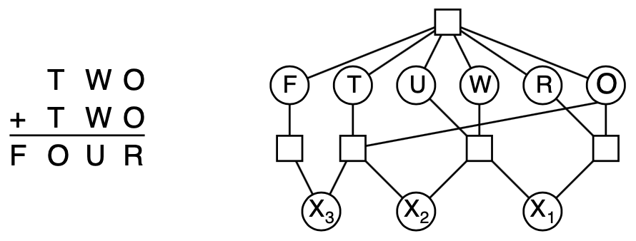
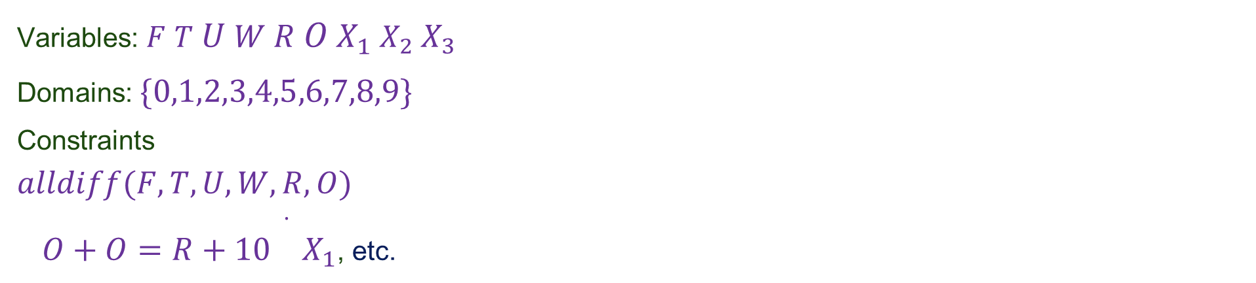
Example: Cryptarithmetic
Variables: $F$ $T$ $U$ $W$ $R$ $O$ $X_{1}$ $X_{2}$ $X_{3}$
Domains: $\{0,1,2,3,4,5,6,7,8,9\}$
Constraints
$$alldiff(F,T,U,W,R,O)$$
$O+O=R+10\overset{·}{}X_{1}$, etc.

Slide 10
Real-world CSPs
Assignment problems: e.g., who teaches what class
Timetabling problems: e.g., which class is offered when and where?
Hardware configuration
Spreadsheets
Transportation scheduling
Factory scheduling
Floorplanning
Notice that many real-world problems involve real valued variables

Slide 11
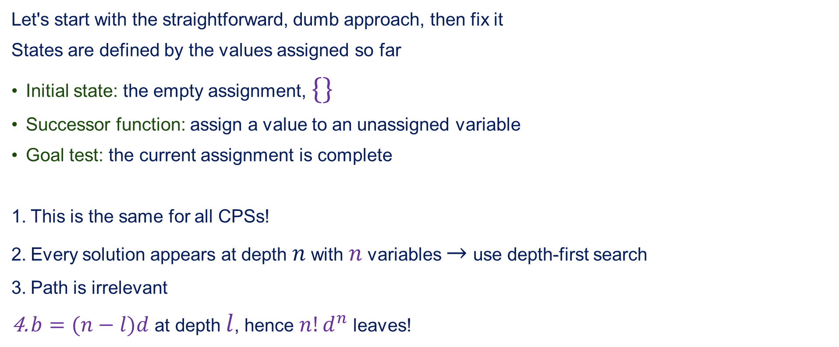
Standard search formulation
Let's start with the straightforward, dumb approach, then fix it
States are defined by the values assigned so far
Initial state: the empty assignment, $\{\}$
Successor function: assign a value to an unassigned variable
Goal test: the current assignment is complete
This is the same for all CPSs!
Every solution appears at depth $n$ with $n$ variables $→$ use depth-first search
Path is irrelevant
$b=(n−l)d$ at depth $l$, hence $n!d^{n}$ leaves!

Slide 12
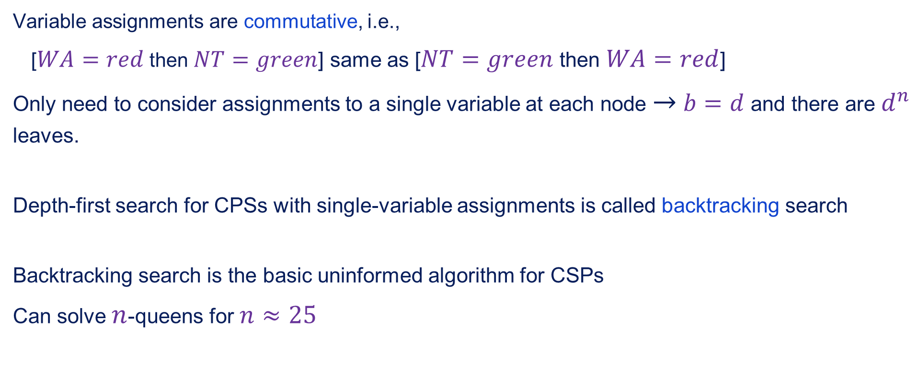
Backtracking serach
Variable assignments are commutative, i.e.,
[$WA=red$ then $NT=green$] same as [$NT=green$ then $WA=red$]
Only need to consider assignments to a single variable at each node $→$ $b=d$ and there are $d^{n}$ leaves.
Depth-first search for CPSs with single-variable assignments is called backtracking search
Backtracking search is the basic uninformed algorithm for CSPs
Can solve $n$-queens for $n≈25$

Slide 13
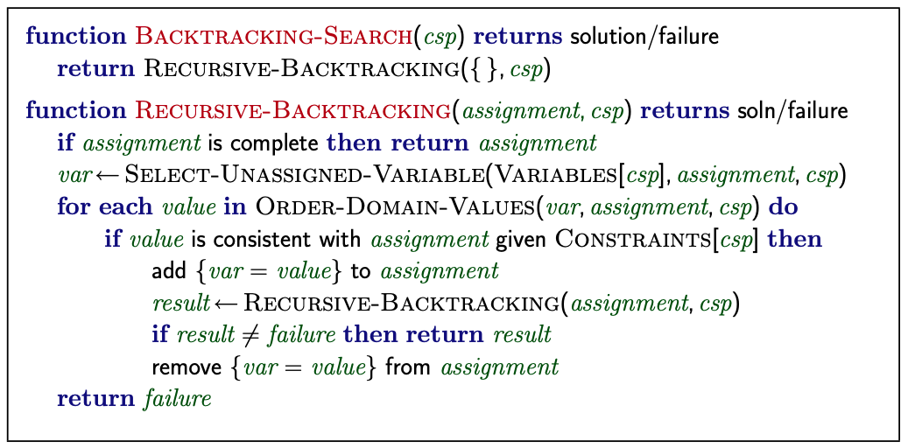
Backtracking search

Slide 14

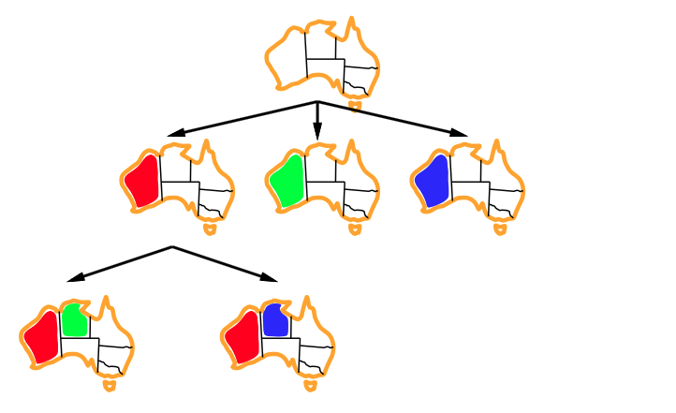
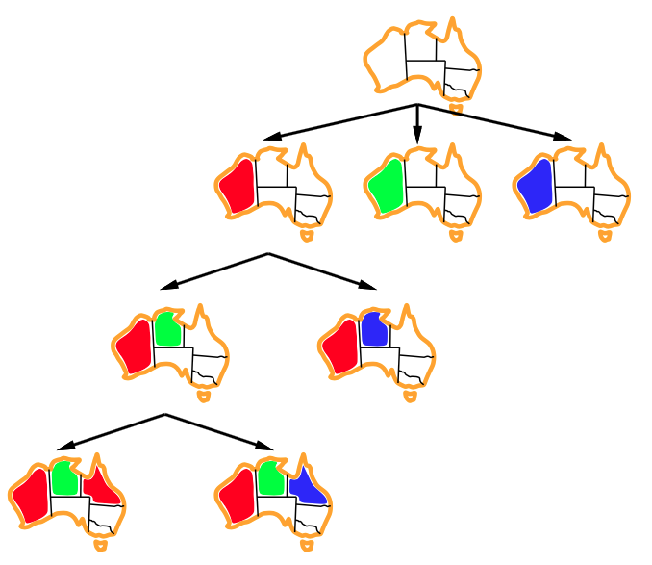
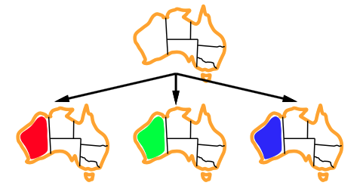
Backtracking example

Slide 15
Improving backtracking efficiency
General-purpose methods can give huge gains in speed:
Which variables should be assigned next?
In what order should variables be tried?
Can we detect inevitable failure earlier?
Can we take advantage of problem structure?

Slide 16
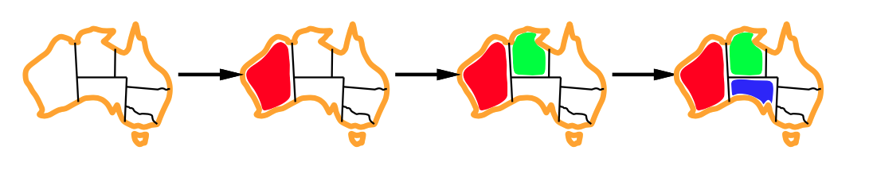
Minimum remaining values
Minimum remaining values (MRV): choose the variable with the fewest legal values

Slide 17
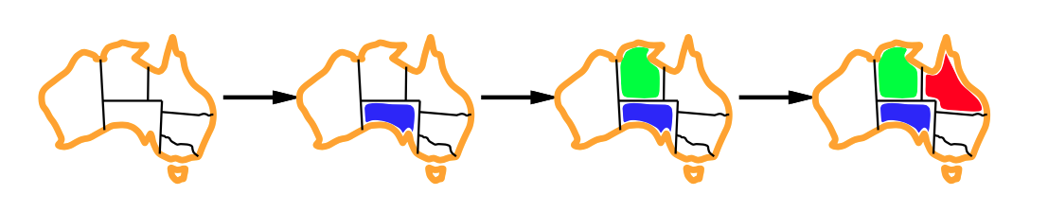
Degree heuristic
Tie-breaker among MRV variables
Degree heuristic: choose the variable with the most constraints on remaining variables

Slide 18
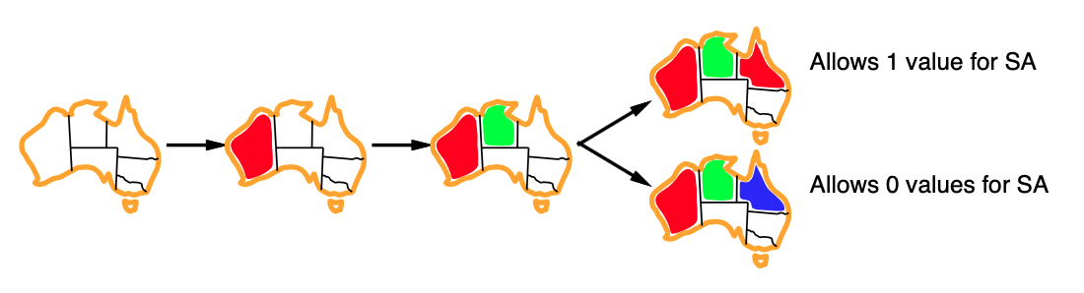
Least constraining value
Given a variable, choose the least constraining value:
The one that rules out the fewest values in the remaining variables
Combining these heuristics makes 1000 queens feasable

Slide 19
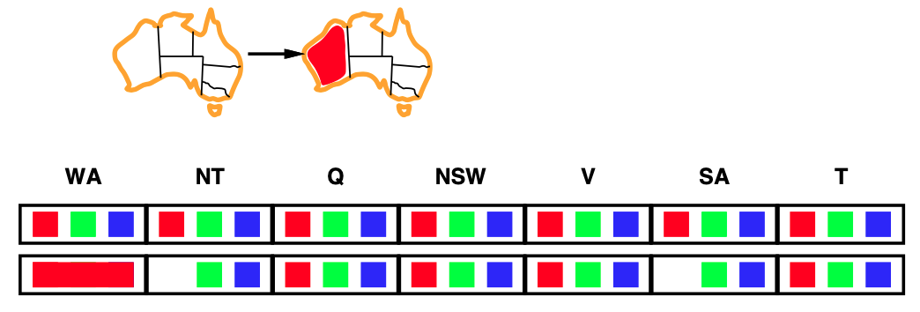
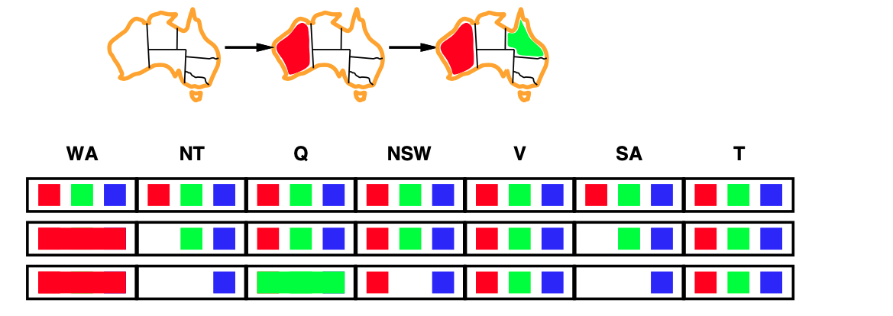
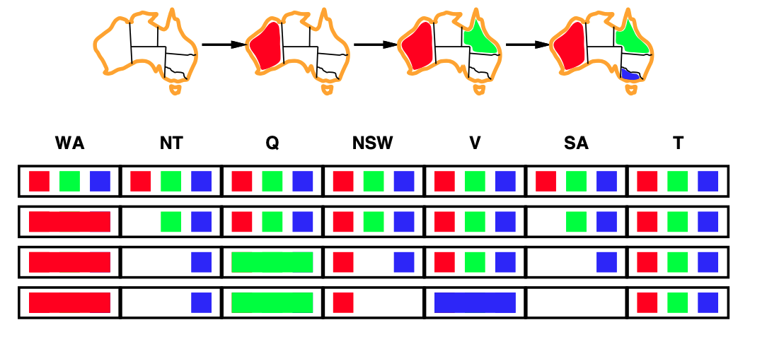
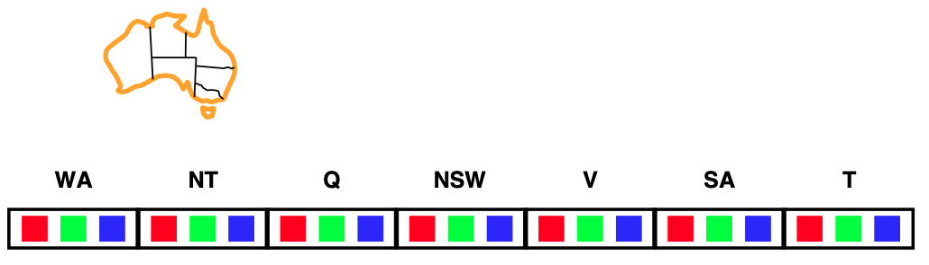
Forward checking
Idea: Keep track of remaining legal values for unassigned variables. Terminate search when any variable has no legal values.

Slide 20
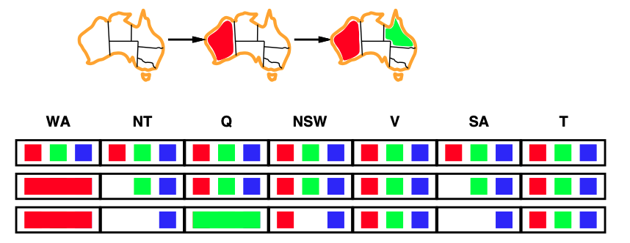

Constraint propagation
Forward checking propagates information from assigned to unassigned variables, but doesn't provide early detection for all failures:
$NT$ and $SA$ cannot both be blue!
Constraint propagation repeatedly enforces constraints locally

Slide 21
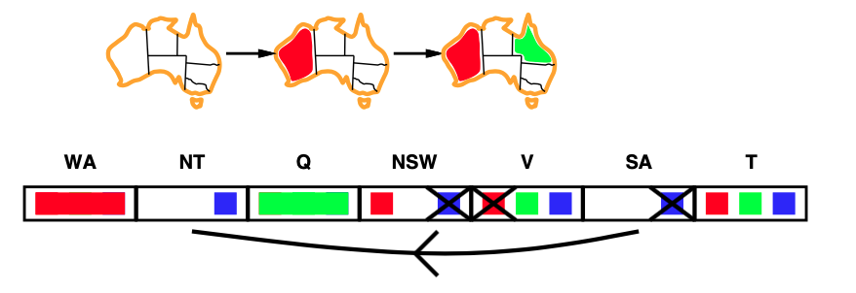
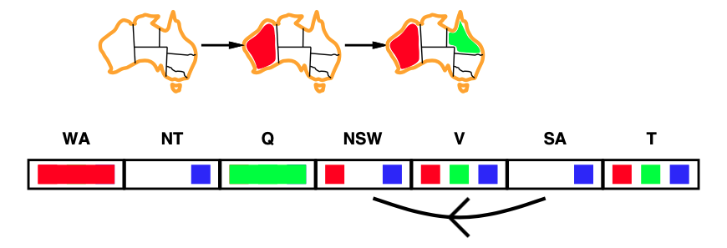
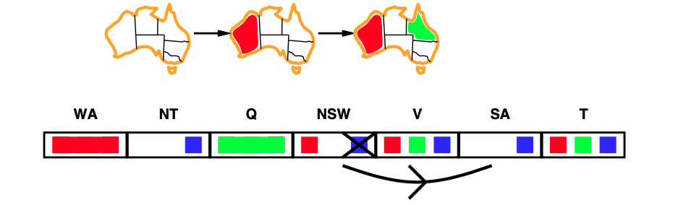

Arc consistency
Simplest form of propagation makes each arc consistent
$X→Y$ is consistent iff for every value $x$ of $X$ there is some allowed $y$
If $X$ loses a value, neighbours of $X$ need to be rechecked.
Arc consistency detects failure earlier than forward checking. Can be run as preprocessor or after each assignment

Slide 22
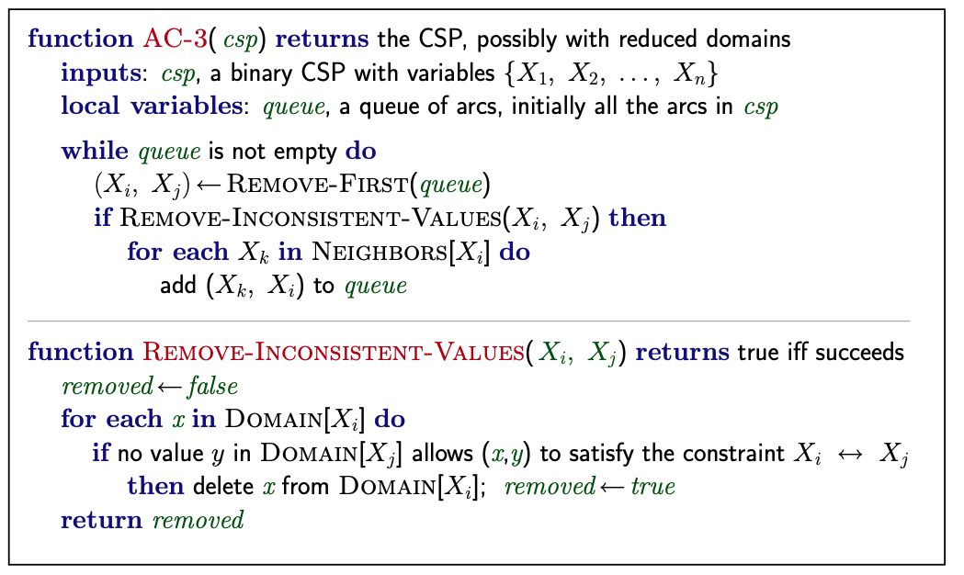
Arc consistency algorithm
$O(n^{2}d^{3})$, can be reduced to $O(n^{2}d^{2})$ (but detecting all is NP-hard)

Slide 23
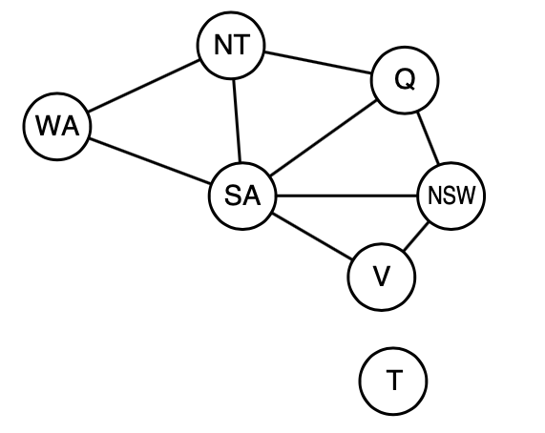
Problem structure
Tasmania and mainland are independent subproblems
Identifiable as connected components of constraint graph

Slide 24

Problem structure contd.
Suppose each subproblem has $c$ variables out of $n$ total
Worst-case solution cost is $n/c\overset{·}{}d^{c}$, linear in $n$
E.g., $n=80$, $d=2$, $c=20$
$2^{80}$ = 4 billion years at 10 million nodes/sec
$4\overset{·}{}2^{20}$ = 0,4 seconds at 10 million nodes/sec

Slide 25
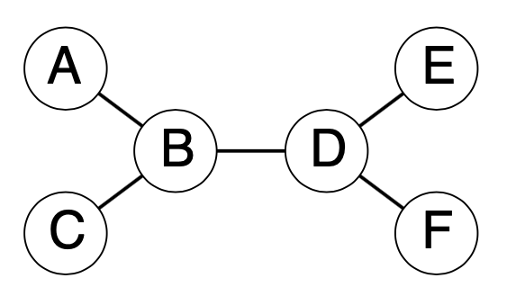
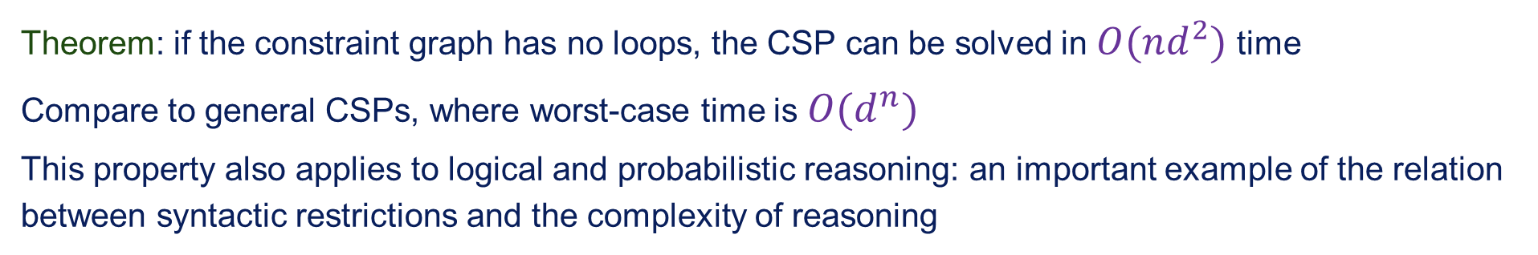
Tree structured CSPs
Theorem: if the constraint graph has no loops, the CSP can be solved in $O(nd^{2})$ time
Compare to general CSPs, where worst-case time is $O(d^{n})$
This property also applies to logical and probabilistic reasoning: an important example of the relation between syntactic restrictions and the complexity of reasoning

Slide 26
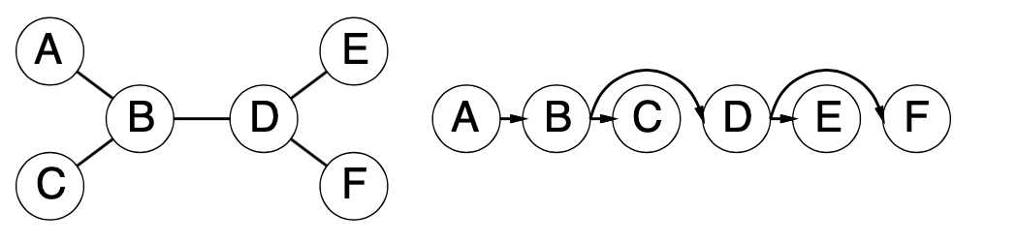

Algorithm for tree-structured CSPs
Choose a variable as root, order variables from root to leaves such that every node's parent precedes it in the ordening
For $j$ from $n$ down to $2$, apply $RemoveInconsistent(Parent(X_{j}),(X_{j}))$
For $j$ from $1$ to $n$, assign $X_{j}$ consistently with $Parent(X_{j})$

Slide 27
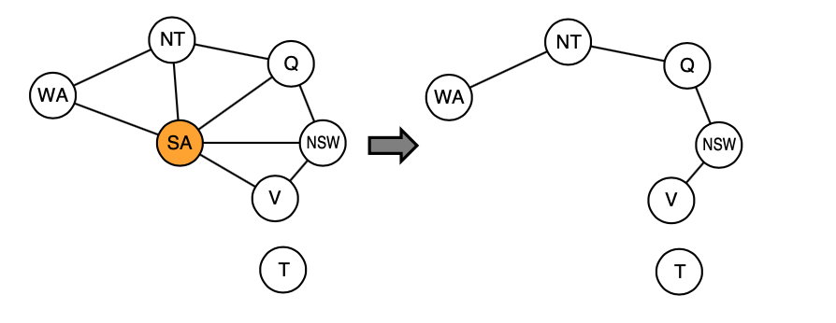

Nearly tree-structured CSPs
Conditioning: initiate a variable, prune its neighbours' domains
Cutset conditioning: instantiate (in all ways) a set of variables such that the remaining constraint graph is a tree
Cutset size $c$ $→$ runtime $O(d^{c}\overset{·}{}(n−c)d^{2})$, very fast for small $c$

Slide 28
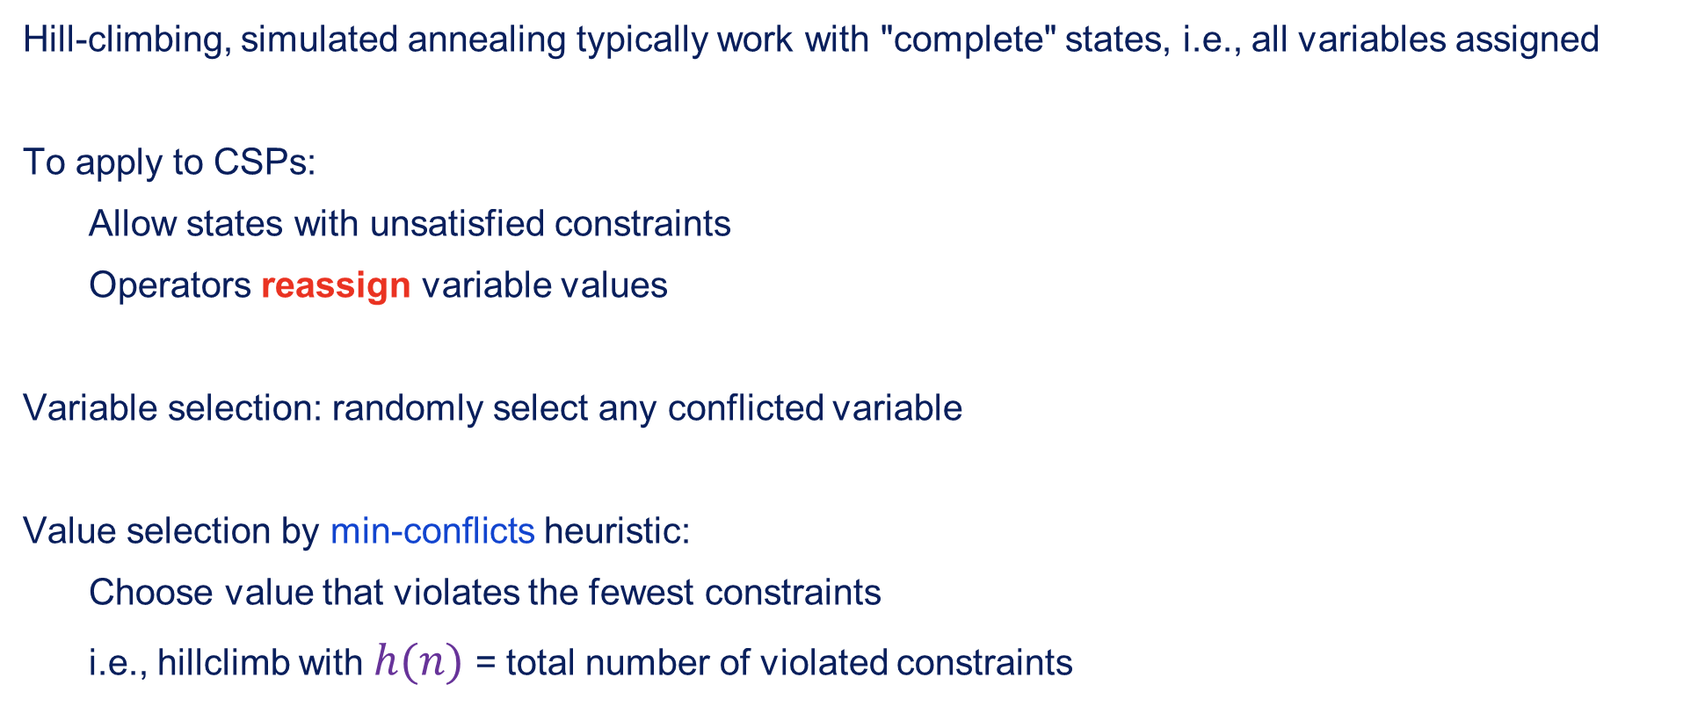
Iterative algorithms for CSPs
Hill-climbing, simulated annealing typically work with "complete" states, i.e., all variables assigned
To apply to CSPs:
Allow states with unsatisfied constraints
Operators reassign variable values
Variable selection: randomly select any conflicted variable
Value selection by min-conflicts heuristic:
Choose value that violates the fewest constraints
i.e., hillclimb with $h(n)$ = total number of violated constraints

Slide 29
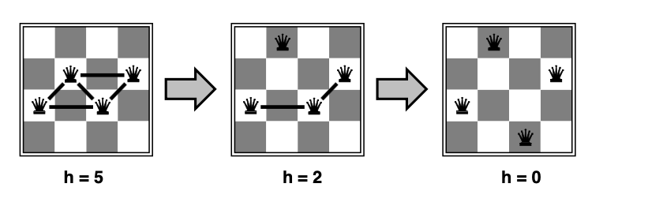

Example: 4-queens
States: 4 queens in r column ($4^{4}=256$ states)
Operators: move queen in column
Goal test: no attacks
Evaluation: $h(n)$ = number of attacks

Slide 30
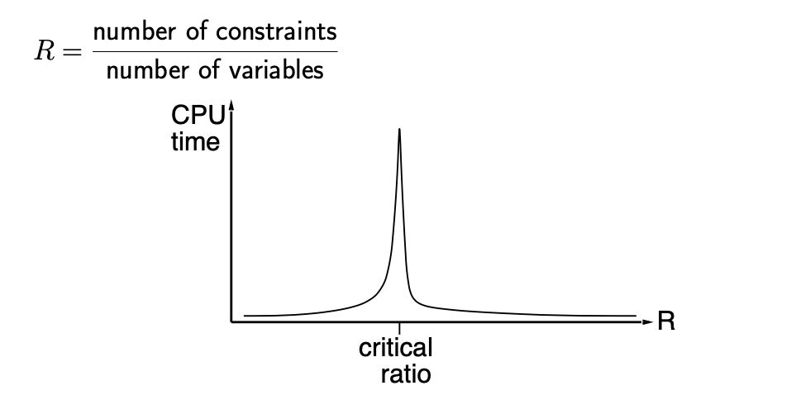

Performance of min-conflicts
Given random initial state, can resolve $n$-queens in almost constant time for arbitrary $n$ with high probability (e.g., $n$ = 10.000.000)
The same appears to be true for any randomly-generated CSP except in a narrow range of the ratio

Slide 31
Summary
CSPs are a special kind of problem
States defined by values of a fixed set of variables
Goal test defined by constraints on variable values
Backtracking = depth-first search with one variable assigned per node
Variable ordering and value selection heuristics help significantly
Forward checking prevents assignments that guarantee later failure
Constraint propagation (e.g., arc consistency) does additional work to constrain valleys and detect inconsistencies
The CSP representation allows analysis of problem scripture
Tree-structured CSPs can be solved in linear time
Iterative min-conflicts is usually effective in practice

