Slide 1
First-Order Logic
Lesson 8

Slide 2
Outline
Why FOL
Syntax and semantics of FOL
Fun with sentences
Wumpus world im FOL

Slide 3
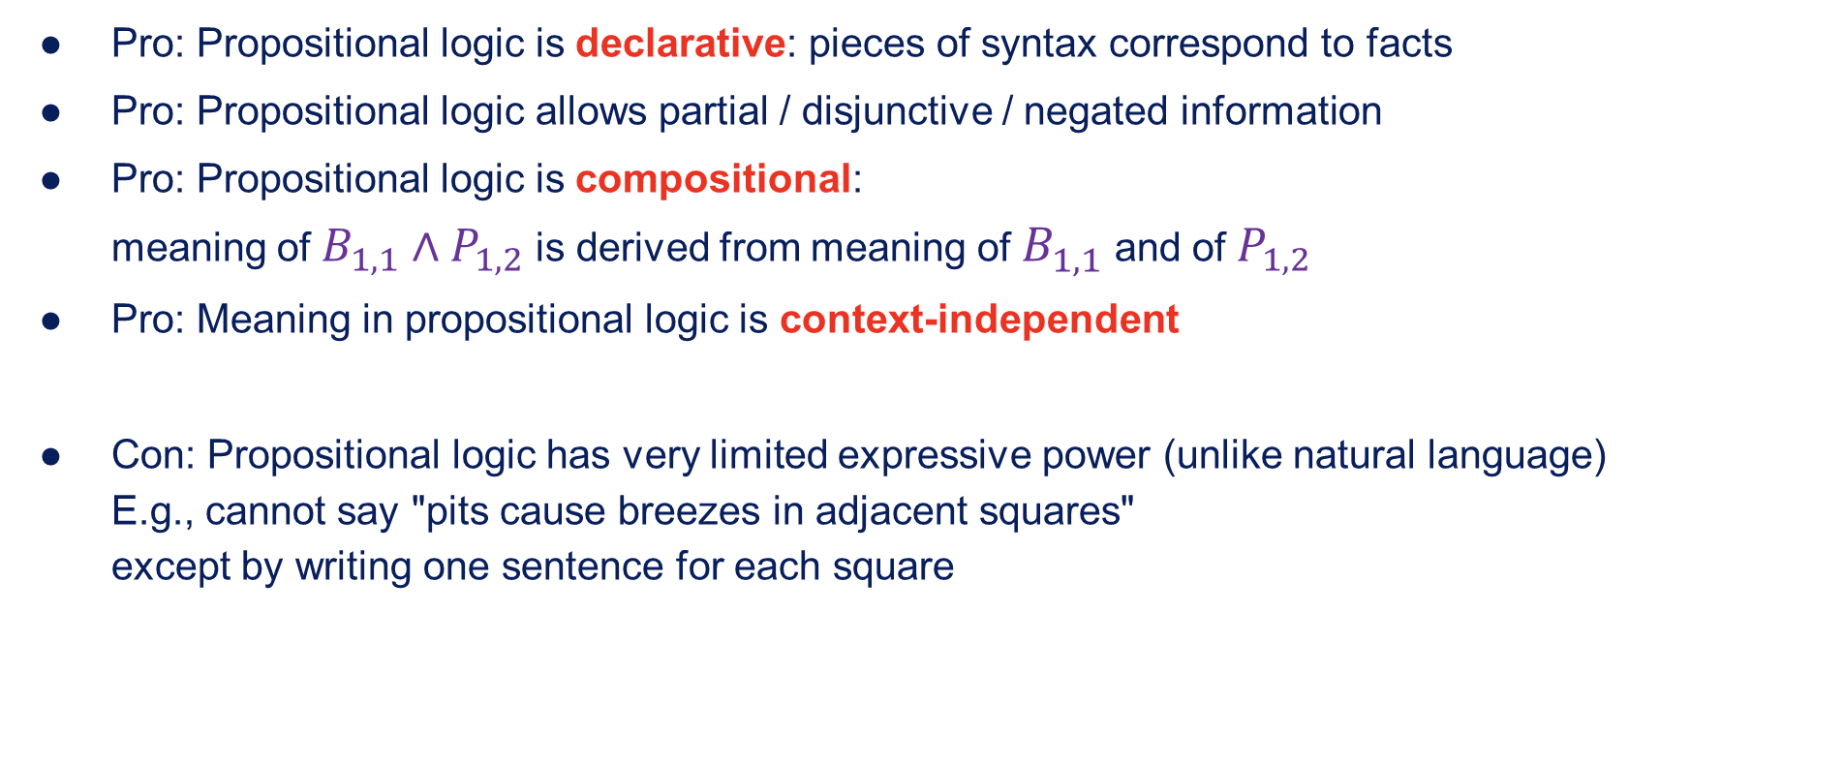
Pros and cons of propositional logic
Pro: Propositional logic is declarative: pieces of syntax correspond to facts
Pro: Propositional logic allows partial / disjunctive / negated information
Pro: Propositional logic is compositional: meaning of $B_{1,1}∧P_{1,2}$ is derived from meaning of $B_{1,1}$ and of $P_{1,2}$
Pro: Meaning in propositional logic is context-independent
Con: Propositional logic has very limited expressive power (unlike natural language) E.g., cannot say "pits cause breezes in adjacent squares" except by writing one sentence for each square

Slide 4
First-order logic
Whereas propositional logic assumes world contains facts,
First-order logic (like natural languages) assumes the world contains
Objects: People, houses, numbers, theories, Ronald McDonald, colours, wars, centuries,…
Relations: Red, round, bogus, prime, brother of, bigger then, inside, part of, has color,…
Functions: Father of, best friend, third inning of, one more than, end of,…

Slide 5
Logics in general
Language | Ontological Commitment | Epistemological Commitment
Propositional Logic | Facts | True / false / unknown
First-order logic | Facts, objects, relations | True / false / unknown
Temporal logic | Facts, objects, relations, times | True / false / unknown
Probability theory | Facts | Degree of belief
Fuzzy logic | Facts + degree of truth | Known interval value

Slide 6

Syntax of FOL: Basic elements
Constants
Predicates
Functions
Variables
Connectives
Equality
Quantifiers
$KingJohn$, $2$, $UCB$, $…$
$Brother$, $>$, $…$
$Sqrt$, $LeftLegOf$, $…$
$x$, $y$, $a$, $b$, $…$
$∧$, $∨$, $¬$, $⇒$, $⇔$
$$=$$
$∀$ $∃$

Slide 7

Atomic sentences
Atomic sentence = $predicate(term_{1},…,term_{n})$ or $term_{1}=term_{2}$
Term = $function(term_{1},…,term_{n})$ or $constant$ or $variable$
E.g., $Brother(KingJohn,RichardTheLionheart)>(Length(LeftLegOf(Richard)),Length(LeftLegOf(KingJohn)))$

Slide 8

Complex sentences
Complex sentences are made from atomic sentences using connectives:$¬S$, $S_{1}∧S_{2}$, $S_{1}∨S_{2}$, $S_{1}⇒S_{2}$, $S_{1}⇔S_{2}$
E.g, $Sibling(KingJohn,Richard)⇒Sibling(Richard,KingJohn)$
$$>(1,2)∨≤(1,2)$$
$$>(1,2)∧¬>(1,2)$$

Slide 9
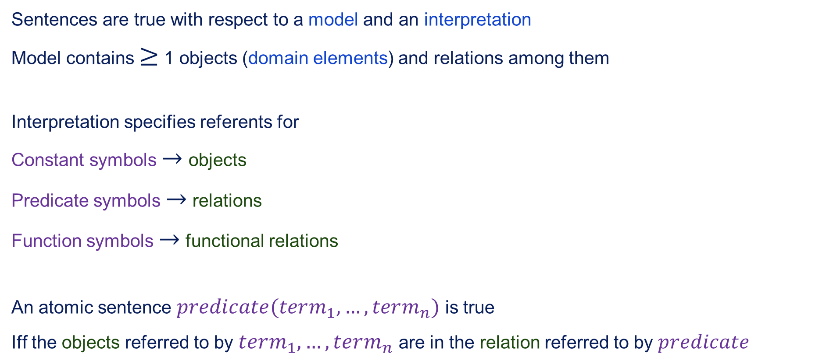
Truth in first-order logic
Sentences are true with respect to a model and an interpretation
Model contains $≥$ 1 objects (domain elements) and relations among them
Interpretation specifies referents for
Constant symbols $→$ objects
Predicate symbols $→$ relations
Function symbols $→$ functional relations
An atomic sentence $predicate(term_{1},…,term_{n})$ is true
Iff the objects referred to by $term_{1},…,term_{n}$ are in the relation referred to by $predicate$

Slide 10
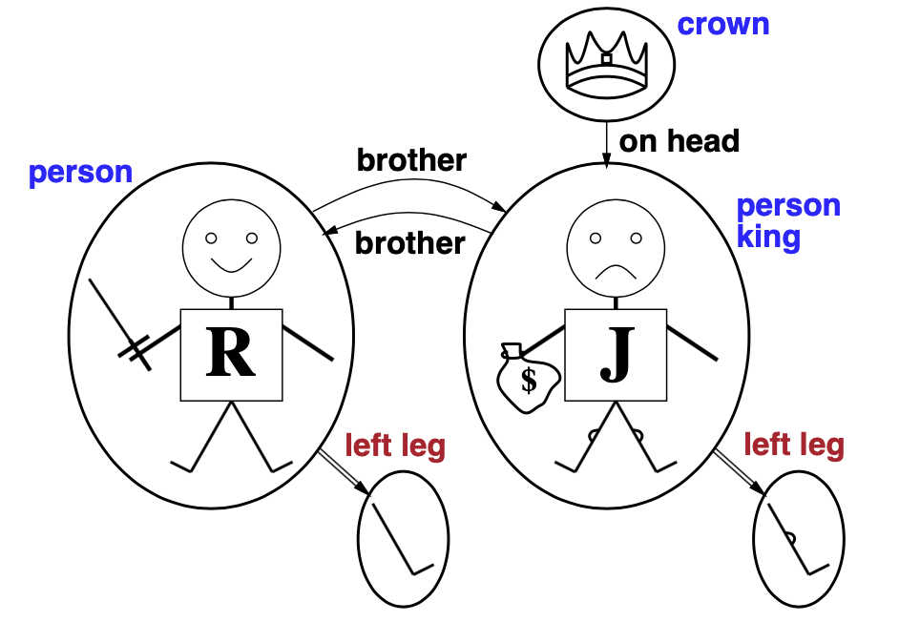
Models for FOL: Example

Slide 11
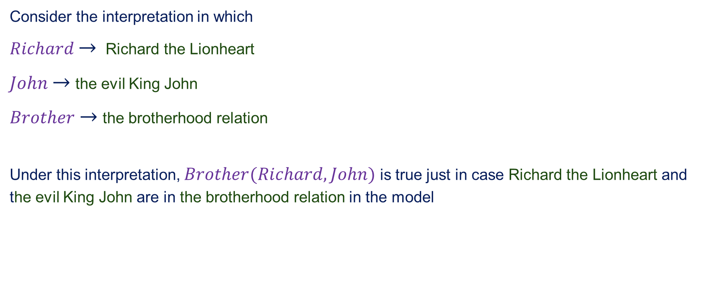
Truth example
Consider the interpretation in which
$Richard$ $→$ Richard the Lionheart
$John$ $→$ the evil King John
$Brother$ $→$ the brotherhood relation
Under this interpretation, $Brother(Richard,John)$ is true just in case Richard the Lionheart and the evil King John are in the brotherhood relation in the model

Slide 12
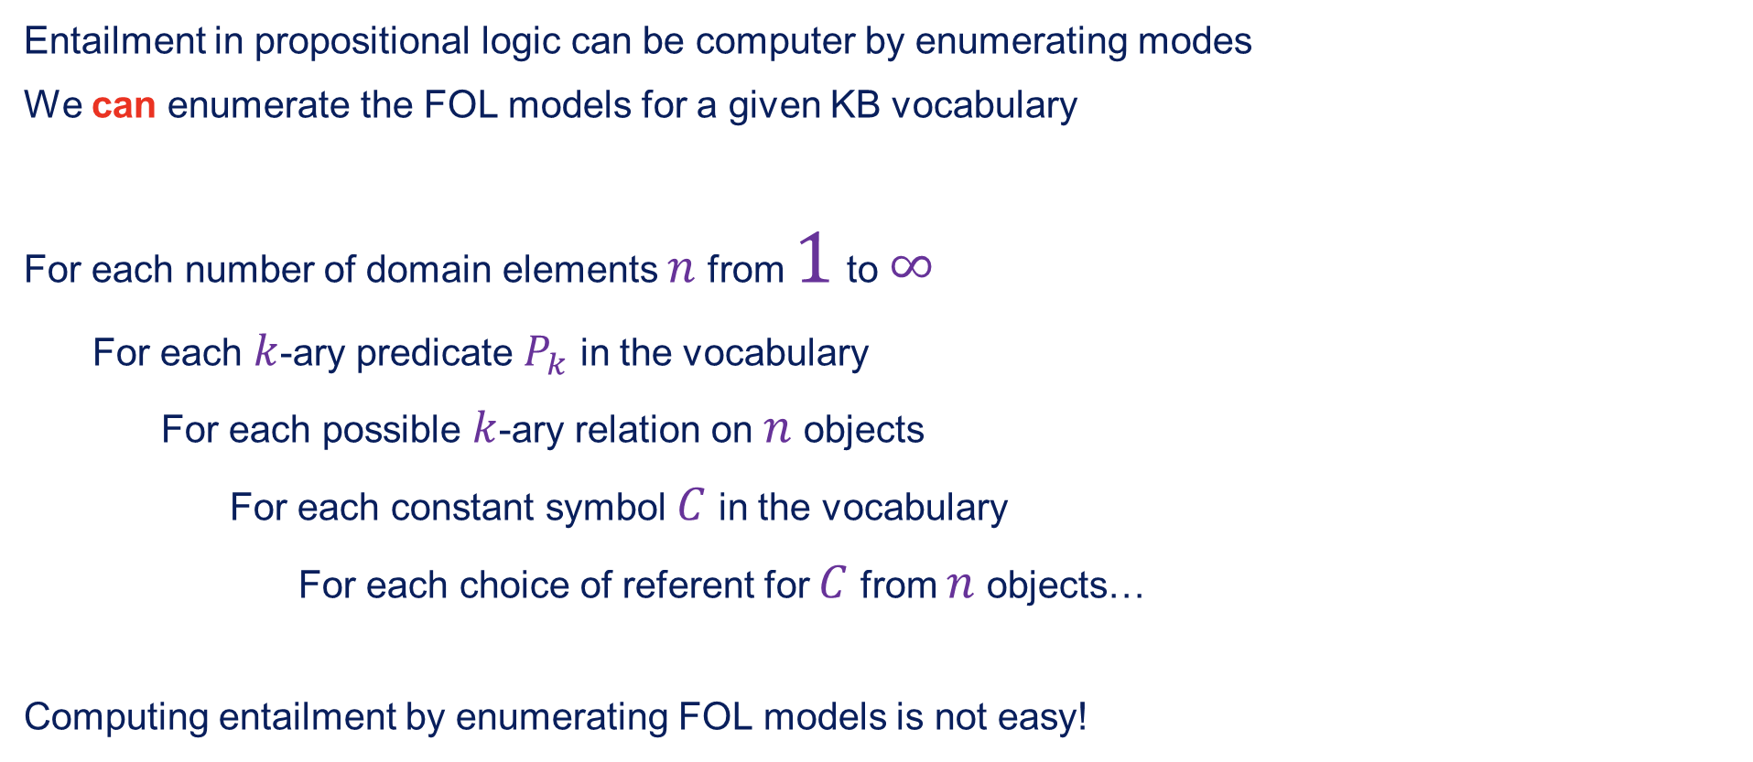
Models for FOL: Lots!
Entailment in propositional logic can be computer by enumerating modes
We can enumerate the FOL models for a given KB vocabulary
For each number of domain elements $n$ from $1$ to $∞$
For each $k$-ary predicate $P_{k}$ in the vocabulary
For each possible $k$-ary relation on $n$ objects
For each constant symbol $C$ in the vocabulary
For each choice of referent for $C$ from $n$ objects…
Computing entailment by enumerating FOL models is not easy!

Slide 13
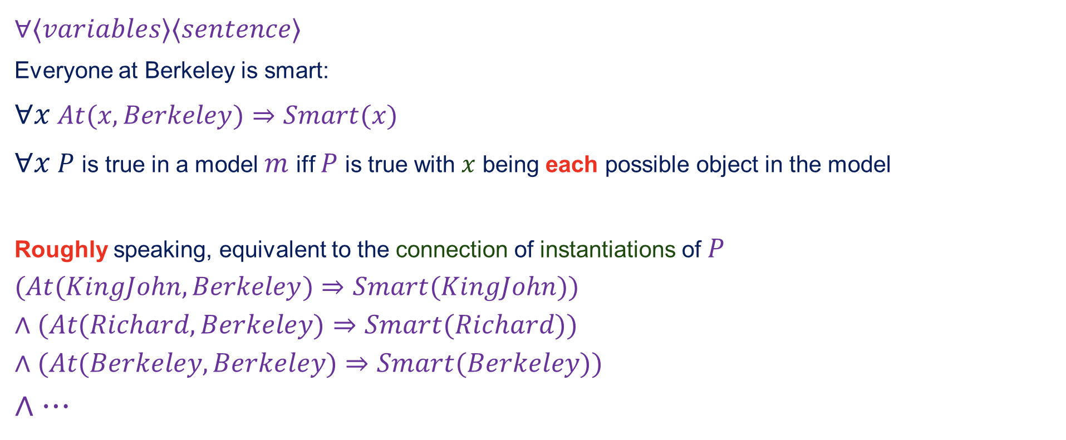
Universal quantification
$$∀⟨variables⟩⟨sentence⟩$$
Everyone at Berkeley is smart:
$∀x$ $At(x,Berkeley)⇒Smart(x)$
$∀x$ $P$ is true in a model $m$ iff $P$ is true with $x$ being each possible object in the model
Roughly speaking, equivalent to the connection of instantiations of $P$
$$(At(KingJohn,Berkeley)⇒Smart(KingJohn))$$
$$∧(At(Richard,Berkeley)⇒Smart(Richard))$$
$$∧(At(Berkeley,Berkeley)⇒Smart(Berkeley))$$
$$∧…$$

Slide 14

A common mistake to avoid
Typically, $⇒$ is the main connective with $∀$
Common mistake: using $∧$ as main connective with $∀$:
$∀x$ $At(x,Berkeley)∧Smart(x)$
means "Everyone is at Berkeley and everyone is smart"

Slide 15
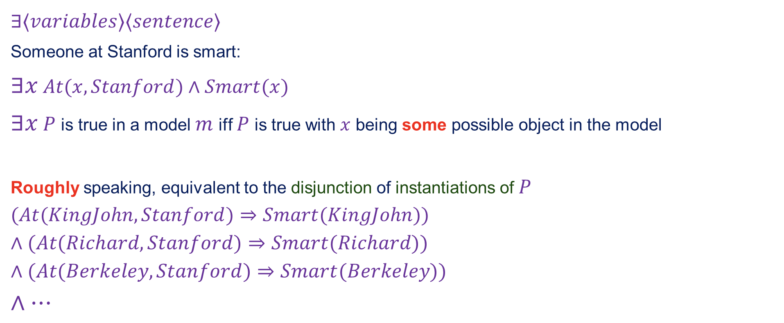
Existential quantification
$$∃⟨variables⟩⟨sentence⟩$$
Someone at Stanford is smart:
$∃x$ $At(x,Stanford)∧Smart(x)$
$∃x$ $P$ is true in a model $m$ iff $P$ is true with $x$ being some possible object in the model
Roughly speaking, equivalent to the disjunction of instantiations of $P$
$$(At(KingJohn,Stanford)⇒Smart(KingJohn))$$
$$∧(At(Richard,Stanford)⇒Smart(Richard))$$
$$∧(At(Berkeley,Stanford)⇒Smart(Berkeley))$$
$$∧…$$

Slide 16

Another common mistake to avoid
Typically, $∧$ is the main connective with $∃$
Common mistake: using $⇒$ as the main connective with $∃$:
$$∃xAt(x,Stanford)⇒Smart(x)$$
is true if there is anyone who is not at Stanford!

Slide 17
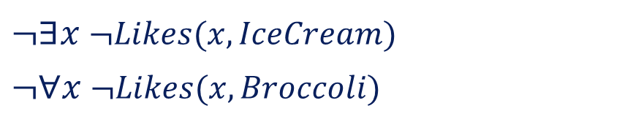
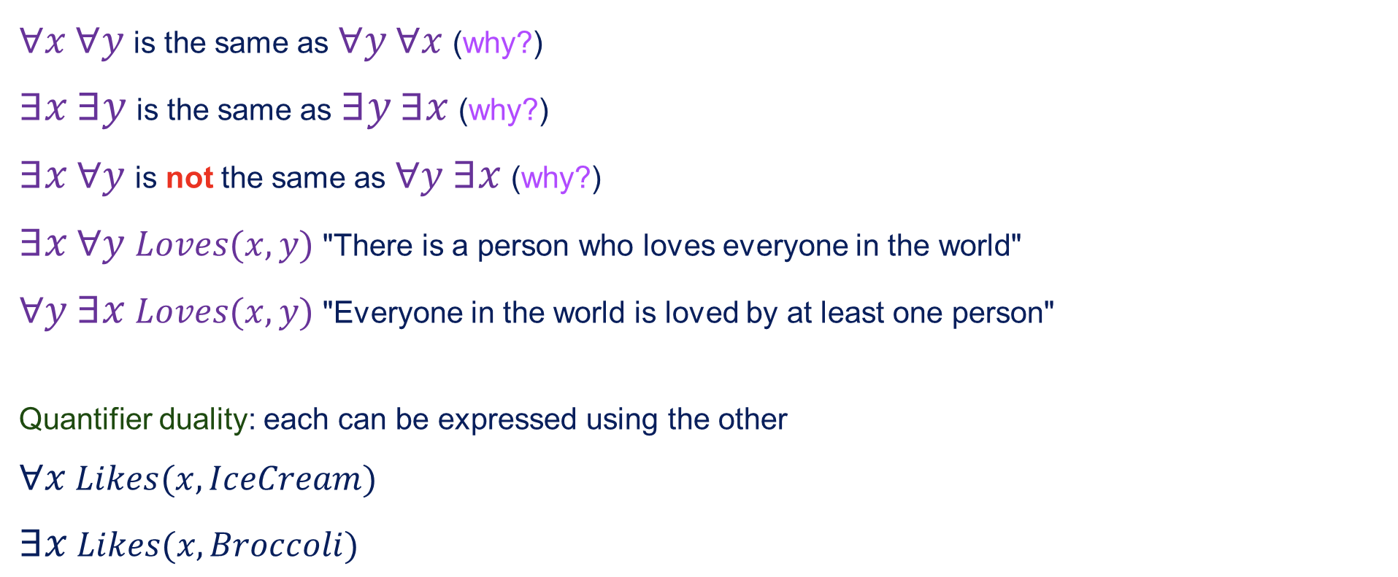
Properties of quantifiers
$∀x$ $∀y$ is the same as $∀y$ $∀x$ (why?)
$∃x$ $∃y$ is the same as $∃y$ $∃x$ (why?)
$∃x$ $∀y$ is not the same as $∀y$ $∃x$ (why?)
$∃x$ $∀y$ $Loves(x,y)$ "There is a person who loves everyone in the world"
$∀y$ $∃x$ $Loves(x,y)$ "Everyone in the world is loved by at least one person"
Quantifier duality: each can be expressed using the other
$∀x$ $Likes(x,IceCream)$
$∃x$ $Likes(x,Broccoli)$
$¬∃x$ $¬Likes(x,IceCream)$
$¬∀x$ $¬Likes(x,Broccoli)$

Slide 18
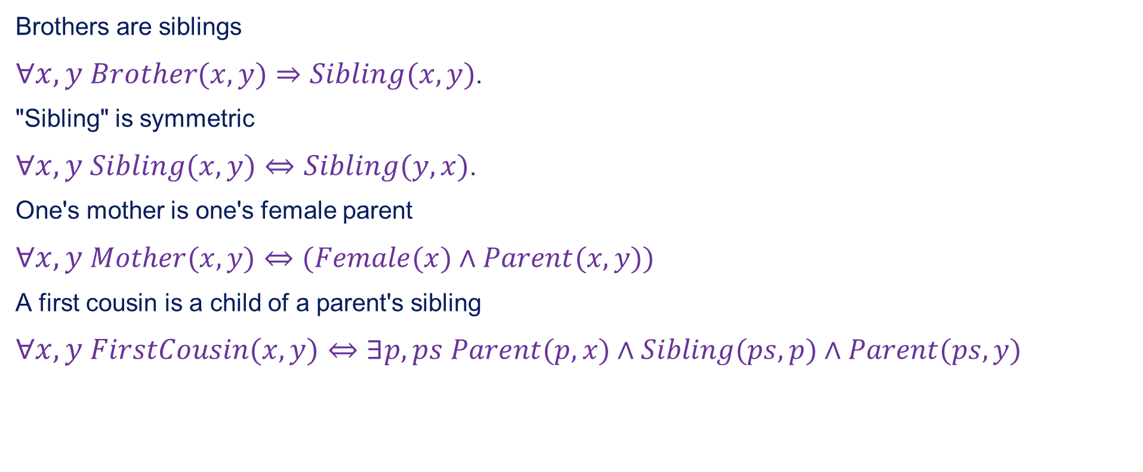
Fun with sentences
Brothers are siblings
$∀x,y$ $Brother(x,y)⇒Sibling(x,y)$.
"Sibling" is symmetric
$∀x,y$ $Sibling(x,y)⇔Sibling(y,x)$.
One's mother is one's female parent
$∀x,y$ $Mother(x,y)⇔(Female(x)∧Parent(x,y))$
A first cousin is a child of a parent's sibling
$∀x,y$ $FirstCousin(x,y)⇔∃p,ps$ $Parent(p,x)∧Sibling(ps,p)∧Parent(ps,y)$

Slide 19
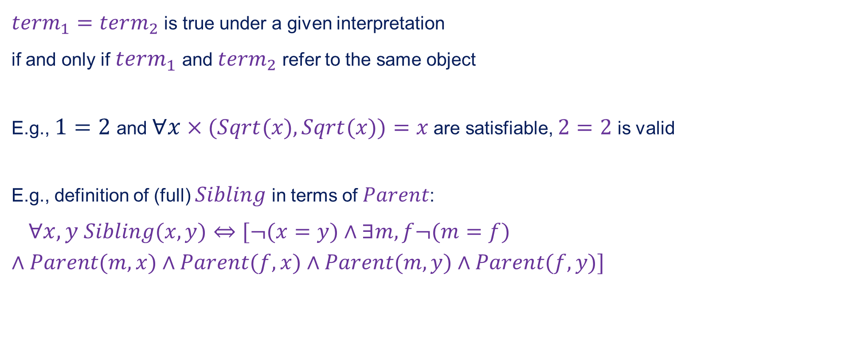
Equality
$term_{1}=term_{2}$ is true under a given interpretation
if and only if $term_{1}$ and $term_{2}$ refer to the same object
E.g., $1=2$ and $∀x$ $×(Sqrt(x),Sqrt(x))=x$ are satisfiable, $2=2$ is valid
E.g., definition of (full) $Sibling$ in terms of $Parent$:
$∀x,y$ $Sibling(x,y)⇔[¬(x=y)∧∃m,f¬(m=f)$
$$∧Parent(m,x)∧Parent(f,x)∧Parent(m,y)∧Parent(f,y)]$$

Slide 20
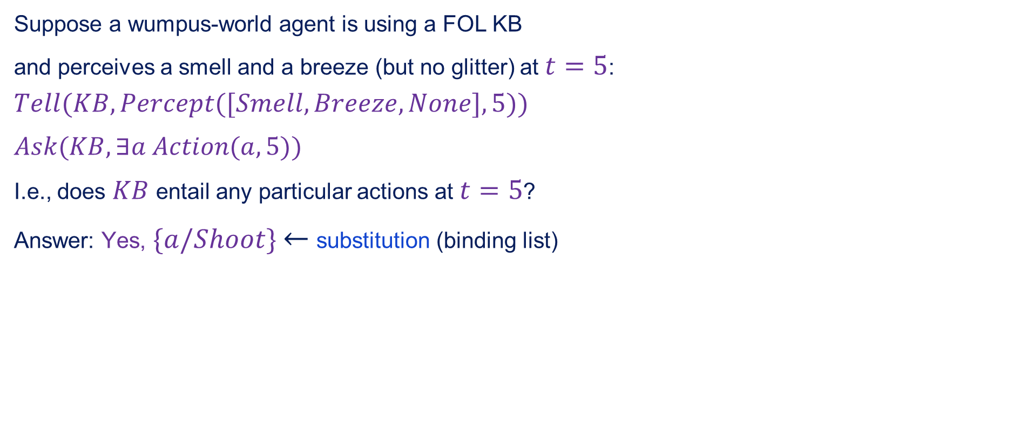
Interacting with FOL KBs
Suppose a wumpus-world agent is using a FOL KB
and perceives a smell and a breeze (but no glitter) at $t=5$:
$$Tell(KB,Percept([Smell,Breeze,None],5))$$
$Ask(KB,∃a$ $Action(a,5))$
I.e., does $KB$ entail any particular actions at $t=5$?
Answer: Yes, $\{a/Shoot\}$ $←$ substitution (binding list)

Slide 21

Interacting with FOL KBs contd.
Given a sentence $S$ and a substitution $σ$,
$Sσ$ denotes the result of plugging $σ$ into $S$; e.g,
$$S=Smarter(x,y)$$
$$σ=\{x/Hillary,y/Bill\}$$
$$Sσ=Smarter(Hillary,Bill)$$
$Ask(KB,S)$ returns some / all $σ$ such that $KB⊨Sσ$

Slide 22
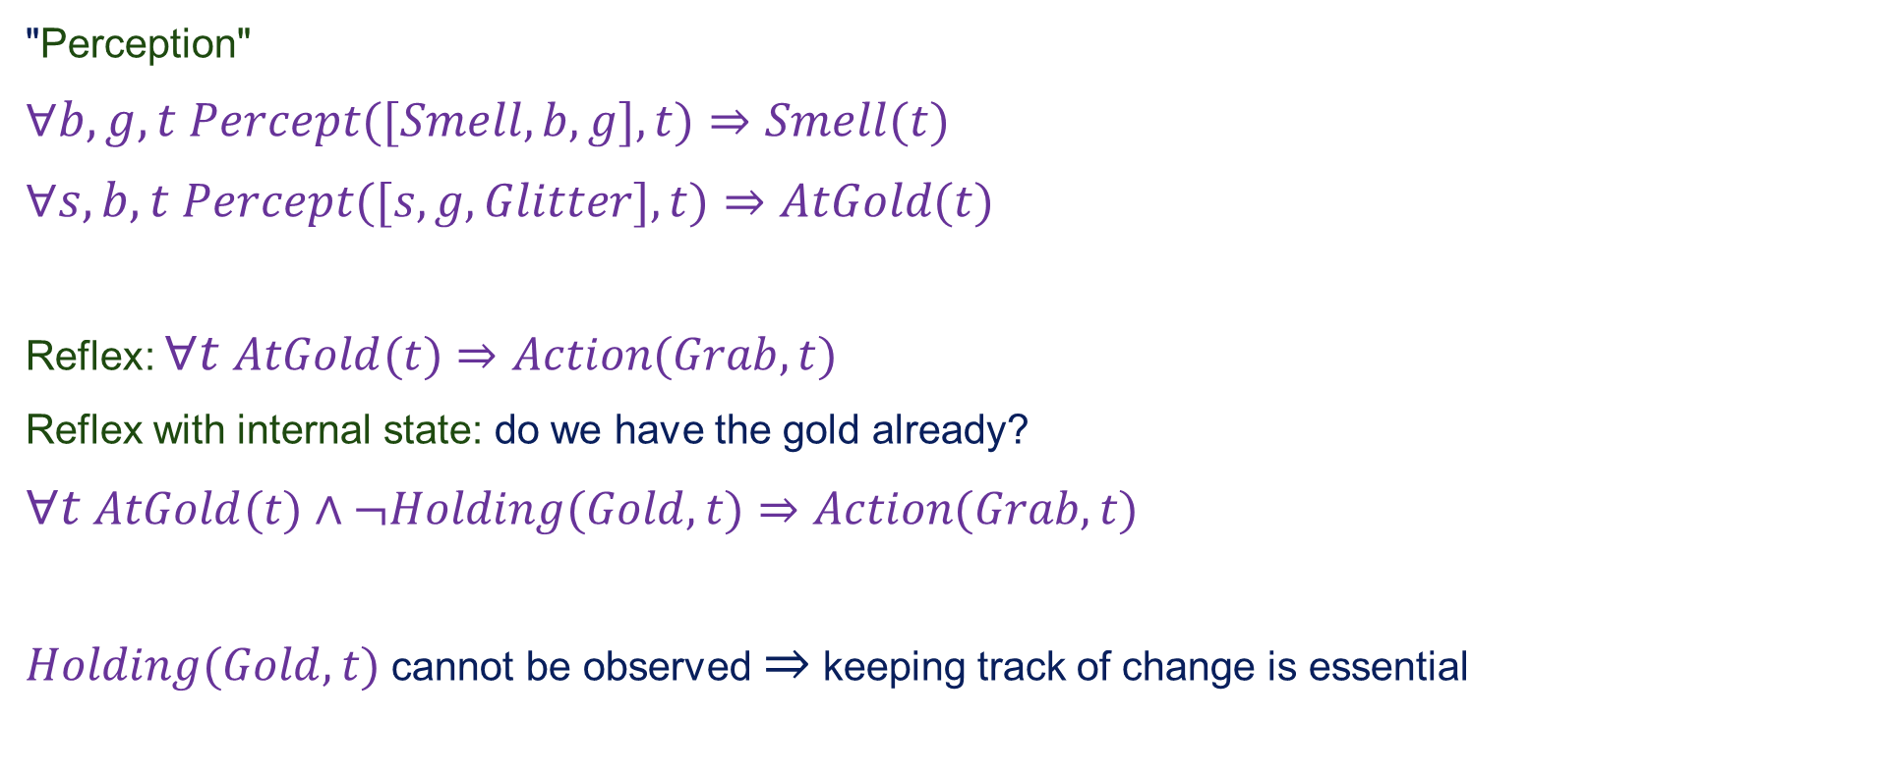
Knowledge base for the wumpus world
"Perception"
$∀b,g,t$ $Percept([Smell,b,g],t)⇒Smell(t)$
$∀s,b,t$ $Percept([s,g,Glitter],t)⇒AtGold(t)$
Reflex: $∀t$ $AtGold(t)⇒Action(Grab,t)$
Reflex with internal state: do we have the gold already?
$∀t$ $AtGold(t)∧¬Holding(Gold,t)⇒Action(Grab,t)$
$Holding(Gold,t)$ cannot be observed $⇒$ keeping track of change is essential

Slide 23
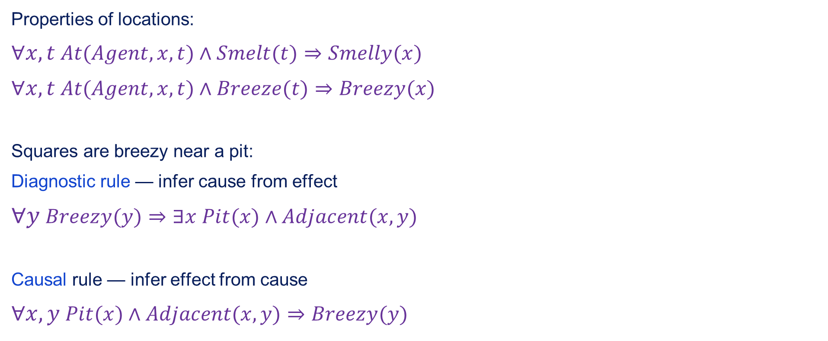
Deducting hidden properties
Properties of locations:
$∀x,t$ $At(Agent,x,t)∧Smelt(t)⇒Smelly(x)$
$∀x,t$ $At(Agent,x,t)∧Breeze(t)⇒Breezy(x)$
Squares are breezy near a pit:
Diagnostic rule — infer cause from effect
$∀y$ $Breezy(y)⇒∃x$ $Pit(x)∧Adjacent(x,y)$
Causal rule — infer effect from cause
$∀x,y$ $Pit(x)∧Adjacent(x,y)⇒Breezy(y)$

Slide 24

Deducting hidden properties contd.
Neither of these is complete — e.g., the causal rule doesn't say whether squares far away from pits can be breezy
Definition for the $Breezy$ predicate:
$∀y$ $Breezy(y)⇔[∃x$ $Pit(x)∧Adjacent(x,y)]$

Slide 25
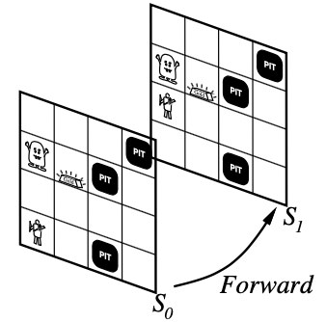
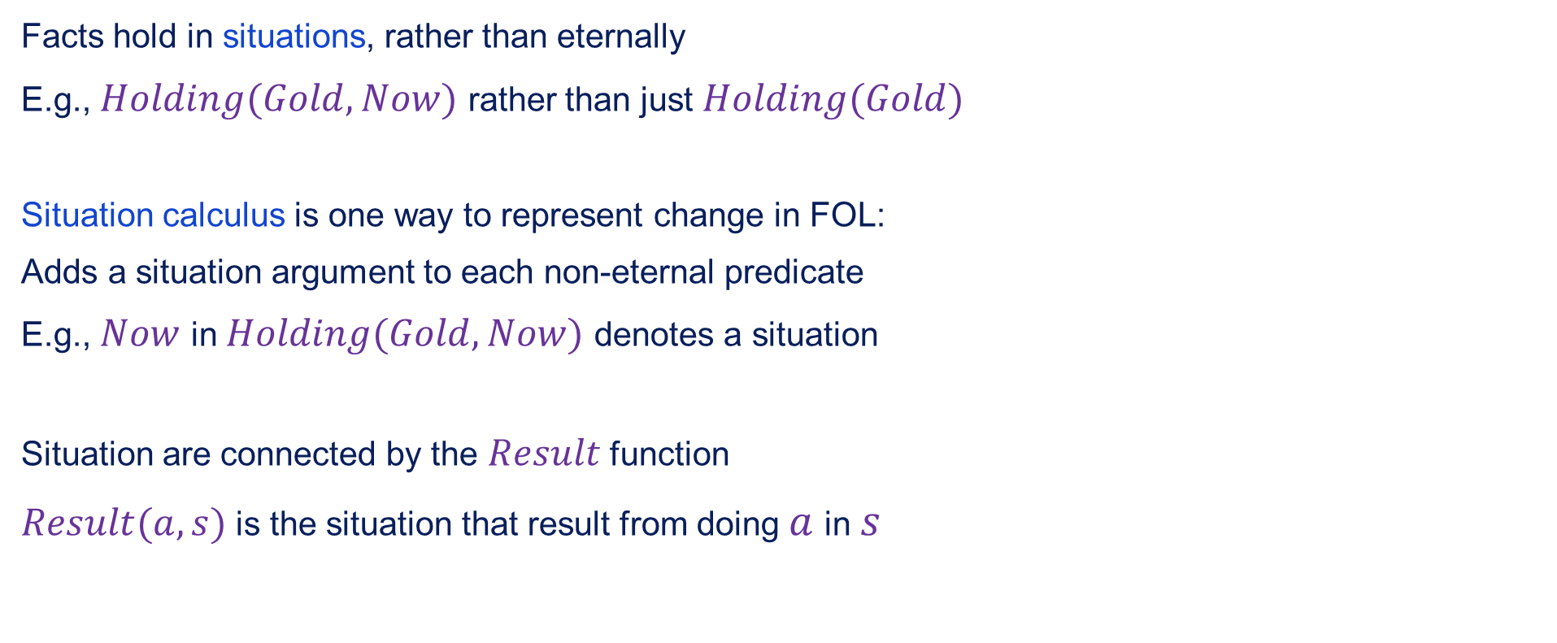
Keeping track of change
Facts hold in situations, rather than eternally
E.g., $Holding(Gold,Now)$ rather than just $Holding(Gold)$
Situation calculus is one way to represent change in FOL:
Adds a situation argument to each non-eternal predicate
E.g., $Now$ in $Holding(Gold,Now)$ denotes a situation
Situation are connected by the $Result$ function
$Result(a,s)$ is the situation that result from doing $a$ in $s$

Slide 26
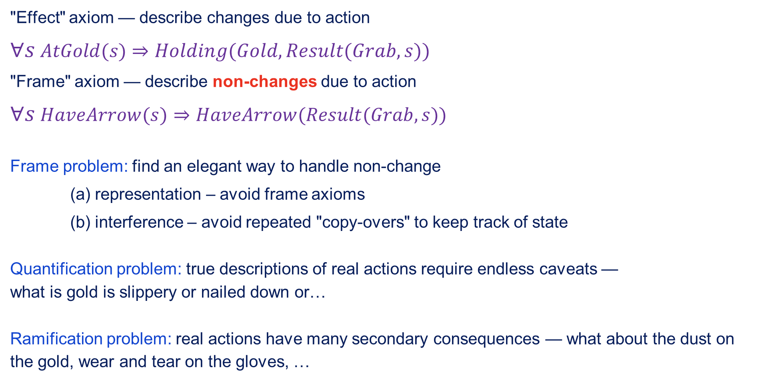
Describing actions I
"Effect" axiom — describe changes due to action
$∀s$ $AtGold(s)$ $⇒Holding(Gold,Result(Grab,s))$
"Frame" axiom — describe non-changes due to action
$∀s$ $HaveArrow(s)⇒HaveArrow(Result(Grab,s))$
Frame problem: find an elegant way to handle non-change
(a) representation – avoid frame axioms
(b) interference – avoid repeated "copy-overs" to keep track of state
Quantification problem: true descriptions of real actions require endless caveats — what is gold is slippery or nailed down or…
Ramification problem: real actions have many secondary consequences — what about the dust on the gold, wear and tear on the gloves, …

Slide 27
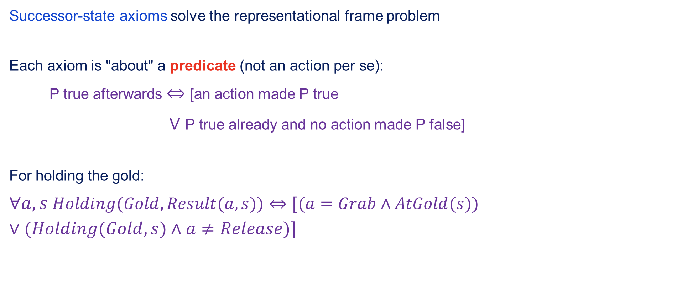
Describing actions II
Successor-state axioms solve the representational frame problem
Each axiom is "about" a predicate (not an action per se):
P true afterwards $⇔$ [an action made P true
$∨$ P true already and no action made P false]
For holding the gold:
$∀a,s$ $Holding(Gold,Result(a,s))⇔[(a=Grab∧AtGold(s))$
$$∨(Holding(Gold,s)∧a≠Release)]$$

Slide 28
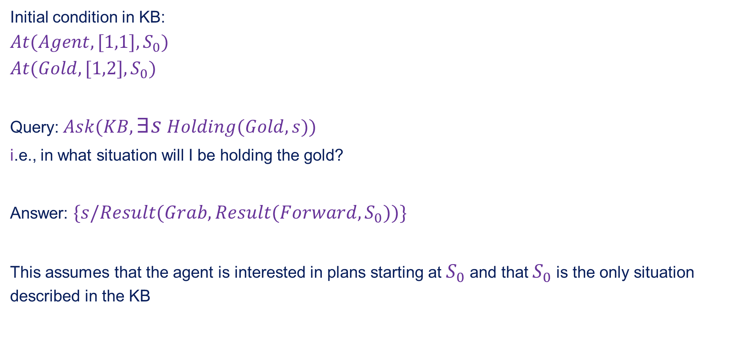
Making plans
Initial condition in KB:
$$At(Agent,[1,1],S_{0})$$
$$At(Gold,[1,2],S_{0})$$
Query: $Ask(KB,∃s$ $Holding(Gold,s))$
i.e., in what situation will I be holding the gold?
Answer: $\{s/Result(Grab,Result(Forward,S_{0}))\}$
This assumes that the agent is interested in plans starting at $S_{0}$ and that $S_{0}$ is the only situation described in the KB

Slide 29
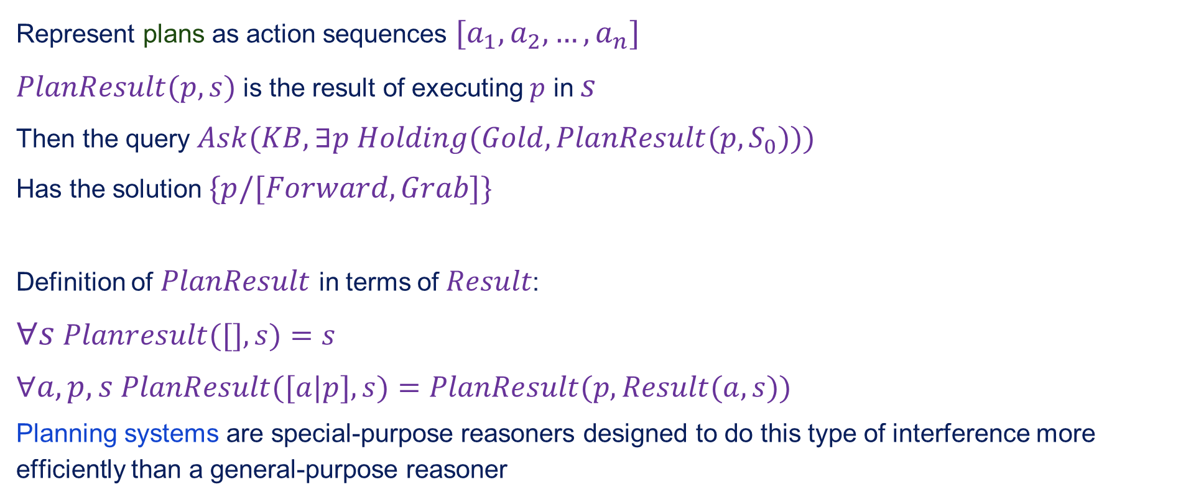
Making plans: A better way
Represent plans as action sequences $[a_{1},a_{2},…,a_{n}]$
$PlanResult(p,s)$ is the result of executing $p$ in $s$
Then the query $Ask(KB,∃p$ $Holding(Gold,PlanResult(p,S_{0})))$
Has the solution $\{p/[Forward,Grab]\}$
Definition of $PlanResult$ in terms of $Result$:
$∀s$ $Planresult([],s)=s$
$∀a,p,s$ $PlanResult([a|p],s)=PlanResult(p,Result(a,s))$
Planning systems are special-purpose reasoners designed to do this type of interference more efficiently than a general-purpose reasoner

Slide 30
Summary
First-order logic:
Objects and relations are semantic primitives
Syntax: constants, functions, predicates, equality, quantifier
Increased expressive power: sufficient to define wumpus world
Situation calculus
Conventions for describing actions and change in FOL
Can formulate planning as inference on a situation calculus KB

