Slide 1
Inference in first-order logic
Lesson 9

Slide 2
Outline
Proofs
Unification
Generalised Modus Ponens
Forward and backward chaining

Slide 3
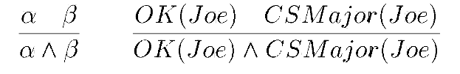
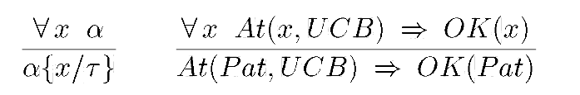

Proofs
Sound inference: find $α$ such that $KB⊨α$.
Proof process is a search, operators are inference rules
E.g., Modus Ponens (MP)
E.g., And-Introduction (AI)
E.g., Universal Elimination(UE)

Slide 4

Example proof
$Buffalo(Bob)$
$Pig(Pat)$
$∀x,y$ $Buffalo(x)∧Pig(y)⇒Faster(x,y)$
$Buffalo(Bob)∧Pig(Pat)$
$Buffalo(Bob)∧Pig(Pat)$ $⇒Faster(Bob,Pat)$
$Faster(Bob,Pat)$
Bob is a buffalo Pat is a pig Buffaloes outrun pigs
Bob outruns Pat AI 1 & 2 UE 3, {x /Bob, y / Pat } MP 6 & 7

Slide 5
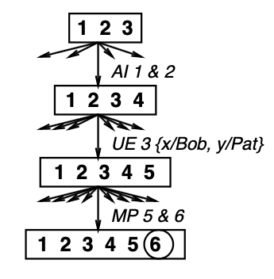
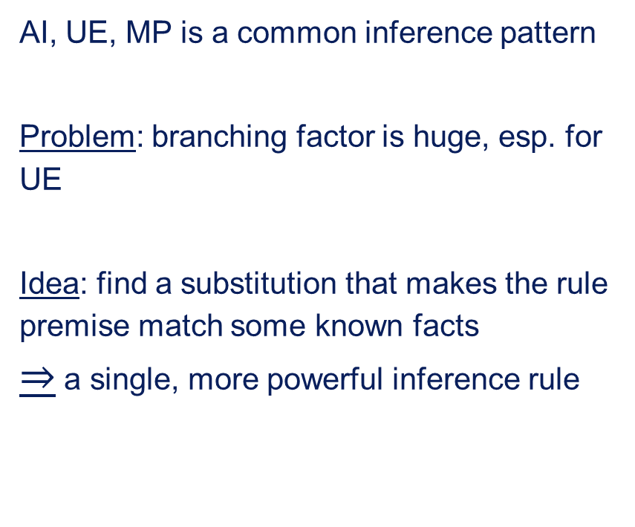
Search with primitive inference rules
Operators are inference rules
States are sets of sentences
Goal test checks state to see if it contains query sentence
AI, UE, MP is a common inference pattern
Problem: branching factor is huge, esp. for UE
Idea: find a substitution that makes the rule premise match some known facts $⇒$ a single, more powerful inference rule

Slide 6




Unification
A substitution $σ$ unifies atomic sentences $p$ and $q$ if $pσ=qσ$
Idea: Unify rule premises with known facts, apply unifier to conclusion
E.g., if we know $q$ and $Knows(John,x)⇒Likes(John,x)$
Then we can conclude $Likes(John,Jane)$, $Likes(John,OJ)$, $Likes(John,Mother(John))$
$$p$$
$$Knows(John,x)$$
$$Knows(John,x)$$
$$Knows(John,x)$$
$$q$$
$$Knows(John,Jane)$$
$$Knows(y,OJ)$$
$$Knows(y,Mother(y))$$
$$σ$$
$$\{x/Jane\}$$
$$\{x/John,y/OJ\}$$
$$\{y/John,x/Mother(John)\}$$

Slide 7
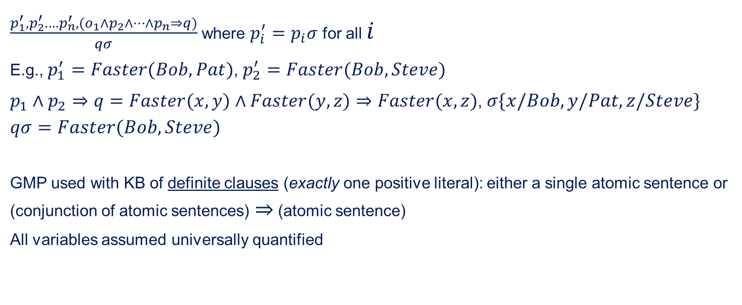
Generalised Modus Ponens
$\frac{p_{1}^{′},p_{2}^{′}.…p_{n}^{′},(o_{1}∧p_{2}∧…∧p_{n}⇒q)}{qσ}$ where $p_{i}^{′}=p_{i}σ$ for all $i$
E.g., $p_{1}^{′}=Faster(Bob,Pat)$, $p_{2}^{′}=Faster(Bob,Steve)$
$p_{1}∧p_{2}⇒q=Faster(x,y)∧Faster(y,z)⇒Faster(x,z)$, $σ\{x/Bob,y/Pat,z/Steve\}$
$$qσ=Faster(Bob,Steve)$$
GMP used with KB of definite clauses (exactly one positive literal): either a single atomic sentence or (conjunction of atomic sentences) $⇒$ (atomic sentence)
All variables assumed universally quantified

Slide 8
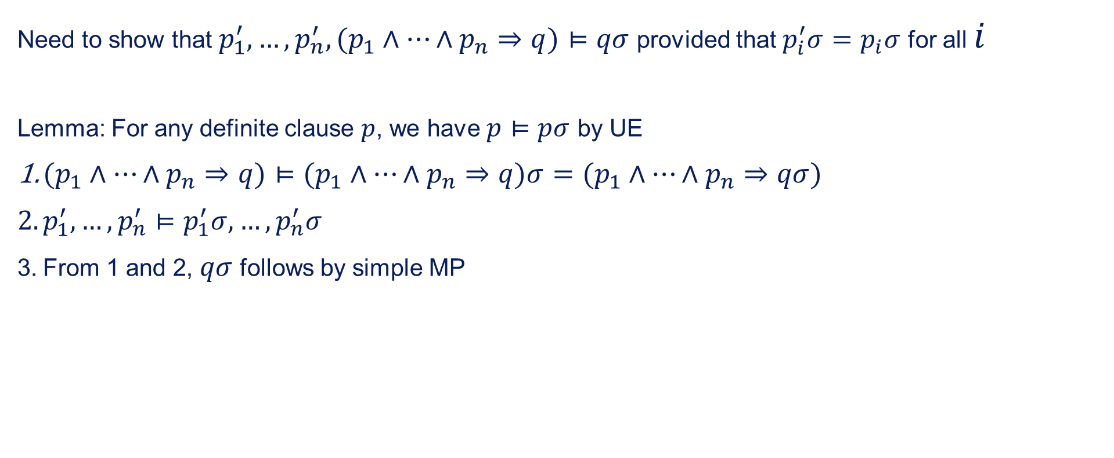
Soundness of GIMP
Need to show that $p_{1}^{′},…,p_{n}^{′},(p_{1}∧…∧p_{n}⇒q)⊨qσ$ provided that $p_{i}^{′}σ=p_{i}σ$ for all $i$
Lemma: For any definite clause $p$, we have $p⊨pσ$ by UE
$(p_{1}∧…∧p_{n}⇒q)⊨(p_{1}∧…∧p_{n}⇒q)σ=(p_{1}∧…∧p_{n}⇒qσ)$
$p_{1}^{′},…,p_{n}^{′}⊨p_{1}^{′}σ,…,p_{n}^{′}σ$
From 1 and 2, $qσ$ follows by simple MP

Slide 9
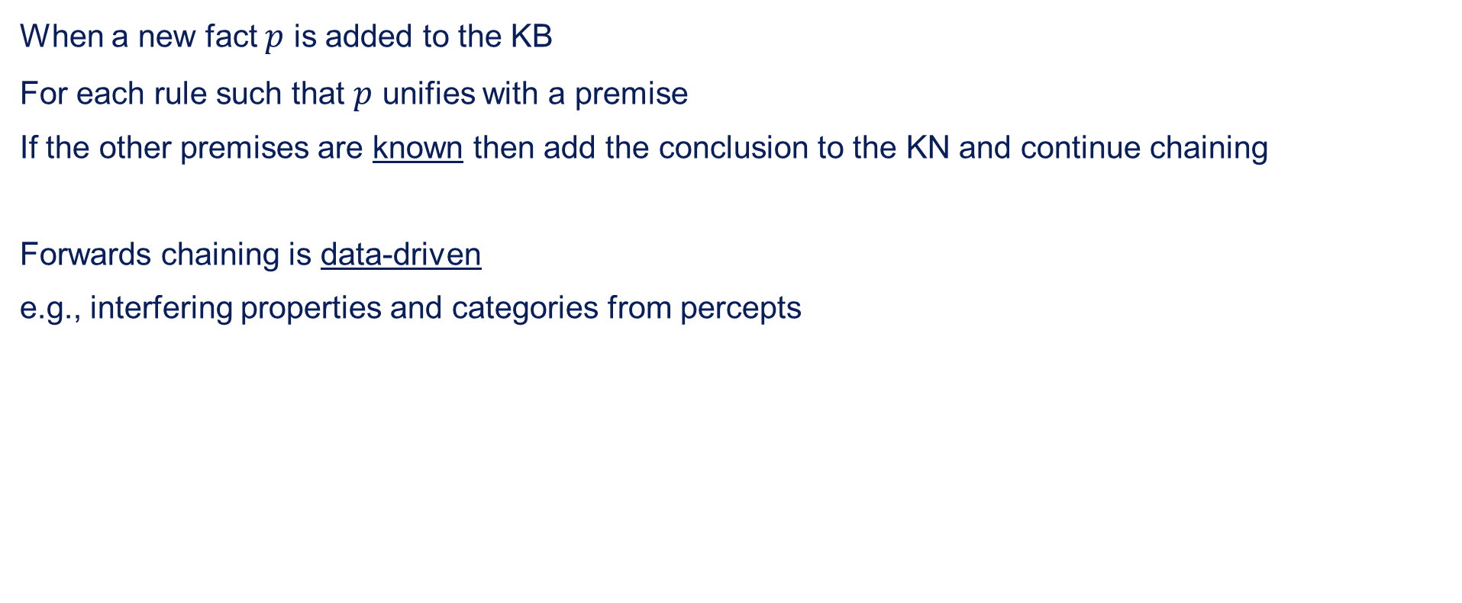
Forward chaining
When a new fact $p$ is added to the KB
For each rule such that $p$ unifies with a premise
If the other premises are known then add the conclusion to the KN and continue chaining
Forwards chaining is data-driven
e.g., interfering properties and categories from percepts

Slide 10
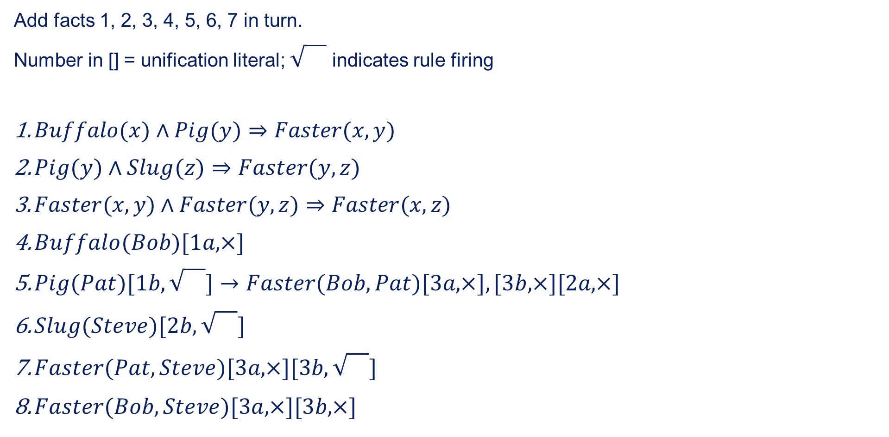
Forward chaining example
Add facts 1, 2, 3, 4, 5, 6, 7 in turn.
Number in [] = unification literal; indicates rule firing
$Buffalo(x)∧Pig(y)⇒Faster(x,y)$
$Pig(y)∧Slug(z)⇒Faster(y,z)$
$Faster(x,y)∧Faster(y,z)⇒Faster(x,z)$
$Buffalo(Bob)[1a,×]$
$Pig(Pat)[1b,\sqrt{}]→Faster(Bob,Pat)[3a,×],[3b,×][2a,×]$
$Slug(Steve)[2b,\sqrt{}]$
$Faster(Pat,Steve)[3a,×][3b,\sqrt{}]$
$Faster(Bob,Steve)[3a,×][3b,×]$

Slide 11
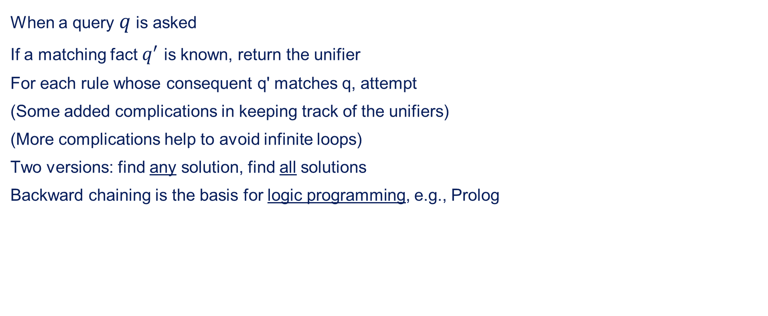
Backward chaining
When a query $q$ is asked
If a matching fact $q^{′}$ is known, return the unifier
For each rule whose consequent q' matches q, attempt
(Some added complications in keeping track of the unifiers)
(More complications help to avoid infinite loops)
Two versions: find any solution, find all solutions
Backward chaining is the basis for logic programming, e.g., Prolog

Slide 12
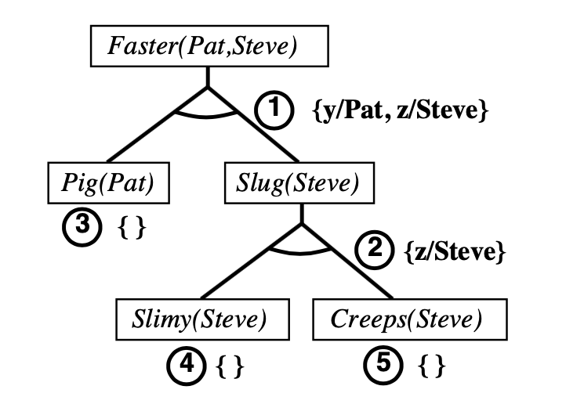
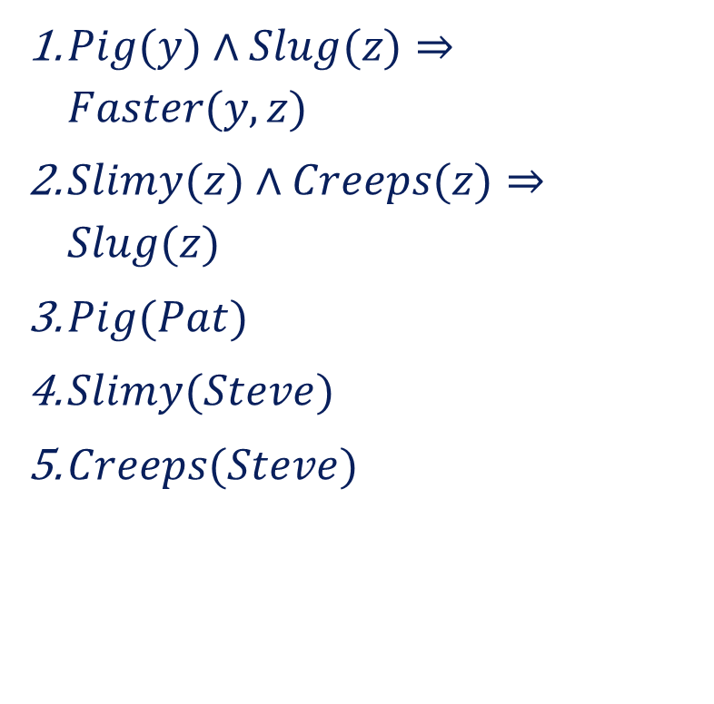
Backward chaining example
$Pig(y)∧Slug(z)⇒Faster(y,z)$
$Slimy(z)∧Creeps(z)⇒Slug(z)$
$Pig(Pat)$
$Slimy(Steve)$
$Creeps(Steve)$

