Slide 1
Neural networks
Difference between neural network methods and traditional models:
Traditional classifiers use hand-derived features (although the bag of words model is already very low-level)
Neural networks take raw data as input and learn to induce features as part of the process of learning to classify
Also see lecture 3: word embeddings (representation learning)

Slide 2
Neural networks from the inside
Neural networks share much of the same mathematics as logistic regression
But neural networks are a more powerful classifier than logistic regression:
multiple nodes = multiple functions = non-linearity
multiple layers = multiple abstractions over the input data
a minimal neural network can be shown to learn any function

Slide 3
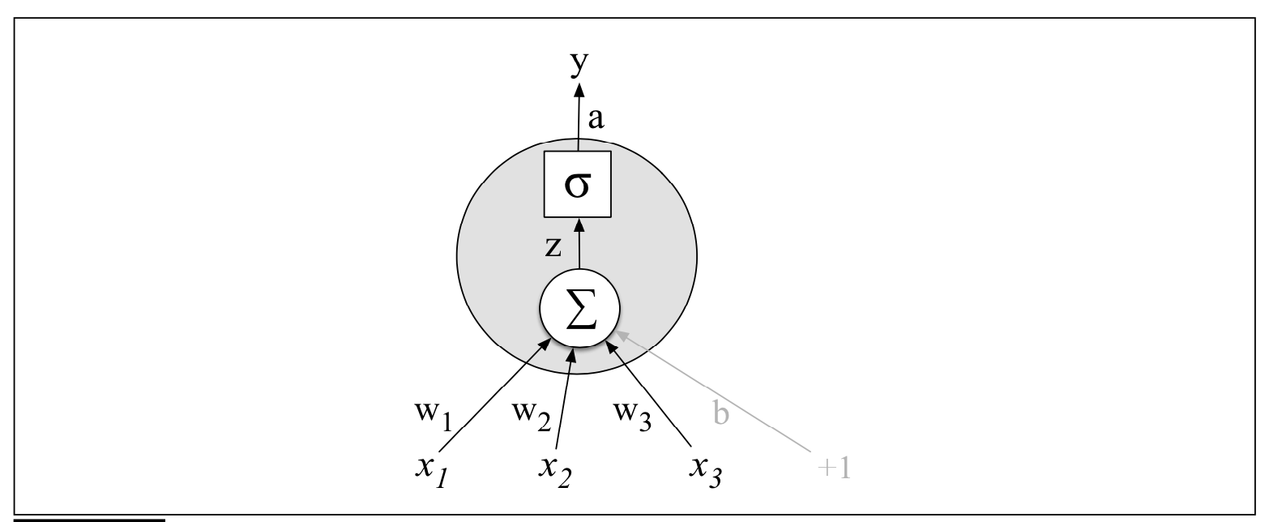
Neural network units (J&M 7.1)
Figure of one single unit with one function for three input variables
σ: non-linear activation function (sigmoid)
Most used activation function : ReLU (Rectifier Linear Unit): y = max(x,0)
Notes:
Finally, instead of using z, a linear function of x, as the output, neural units apply a non-linear function f to z.

Slide 4
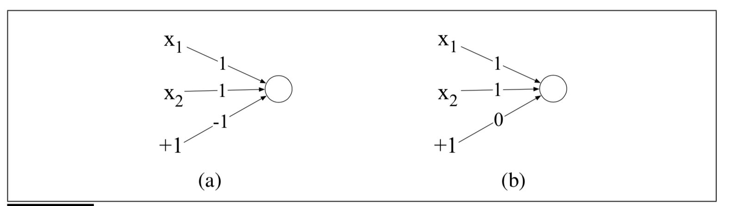
functions with one neuron
the numbers on the arrows are weights
the input is (x1,x2)
+1 is the bias (with weight -1 in (a) and weight 0 in (b)
AND
OR

Slide 5
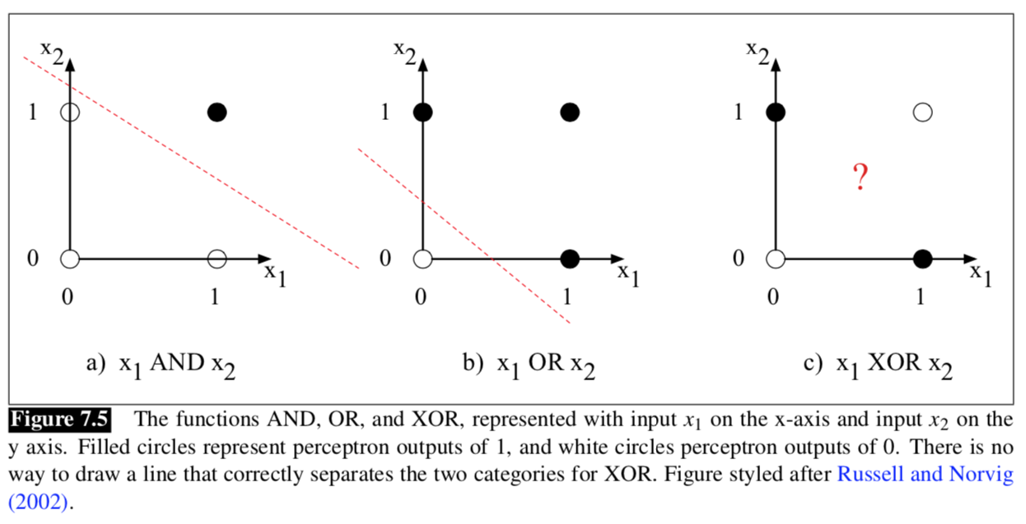
The XOR problem (J&M 7.2)
Why one unit is not sufficient for non-linear functions (‘exclusive OR’)

Slide 6
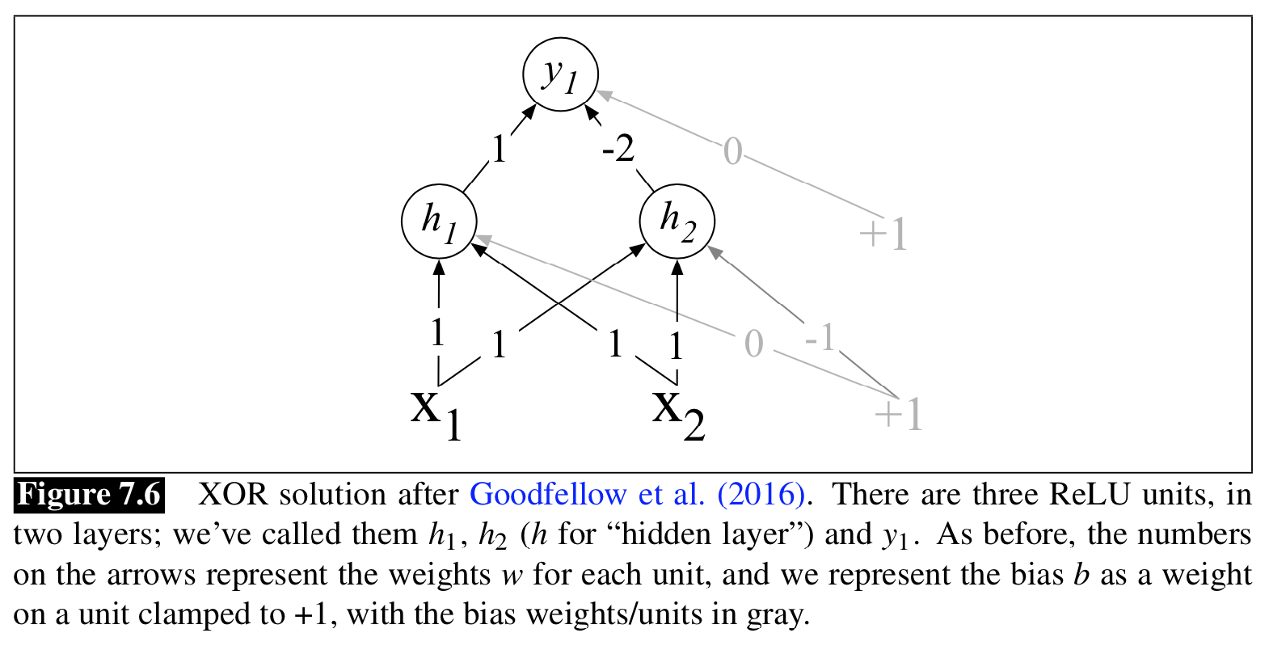
Adding a Hidden layer
Small neural network for solving the XOR problem
Inputvector (x1,x2)
x1 ∈ {0,1}
x2 ∈ {0,1}
What is the output for each of these vectors:[0,0]
[0,1]
[1,0]
[1,1]
[0, 0] -> [1*0 +1*0 + 0*1, 1*0 + 1*0 -1*1] = [0, -1] ~>ReLU: [0, 0] -> 1*0 – 2*0 +0*1 = 0-0+0 = 0
[0, 1] -> [1*0 +1*1 + 0*1, 1*0 + 1*1 -1*1] = [1, 0] ~>ReLU: [1, 0] -> 1*1 – 2*0 +0*1 = 1-0+0 = 1
[1, 0] -> [1*1 +1*0 + 0*1, 1*1 + 1*0 -1*1] = [1, 0] ~>ReLU: [1, 0] -> 1*1 – 2*0 +0*1 = 1-0+0 = 1
[1, 1] -> [1*1 + 1*1 + 0*1, 1*1 + 1*1 -1*1] = [2, 1] ~>ReLU: [2, 1] -> 1*2 -2*1 + 0*1 = 2-2+0 = 0
The hidden layer is a representation of the unit, mapping [0,1] and [1,0] to the same point
Notes:
The middle layer (called h) has two units, and the output layer (called y) has one unit. A set of weights and biases are shown for each ReLU that correctly computes the XOR function.
Let’s walk through what happens with the input x = [0 0]. If we multiply each input value by the appropriate weight, sum, and then add the bias b, we get the vector [0 -1], and we then apply the rectified linear transformation to give the output of the h layer as [0 0]. Now we once again multiply by the weights, sum, and add the bias (0 in this case) resulting in the value 0. The reader should work through the computation of the remaining 3 possible input pairs to see that the resulting y values are 1 for the inputs [0 1] and [1 0] and 0 for [0 0] and [1 1].
Notice that the input point [0 1] has been collapsed with the input point [1 0], making it possible to linearly separate the positive and negative cases of XOR.
The merger makes it easy to linearly separate the positive and negative cases of XOR. In other words, we can view the hidden layer of the network as forming a representation for the input.

Slide 7
Learning the weights
In this example we manually added the weights
For real examples the weights for neural networks are learned automatically (supervised learning using the true labels)
By learning the weights to optimize the output classification the hidden layers will learn to form useful representations
Think about XOR: input = [x1,x2] output = 1 if x1 = 1 XOR x2=1; else output is 0 learn weights so that the output is correct for all [0,0] [0,1] [1,0] [1,1]

Slide 8
Feedforward networks (J&M 7.3)
A feedforward network is a multilayer network in which the units are connected with no cycles:
the outputs from units in each layer are passed to units in the next layer, and no outputs are passed back to lower layers
Simple feedforward networks have three kinds of nodes: input units, hidden units, and output units
In the standard architecture, each layer is fully-connected
each unit in each layer takes as input the outputs from all the units in the previous layer. Thus each hidden unit sums over all the input units

Slide 9
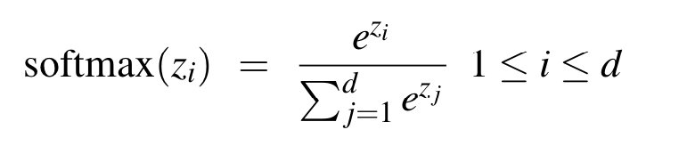
Feedforward network as classifier
Binary classification (e.g. yes/no): single output node
y is the probability of postive output (yes)
Multi-class classification: one output node for each category,
y is the probability of that category
The output layer thus gives a probability distribution
The output of the classifier z (real-valued numbers) is transformed to a probability distribution using the softmax function
d=dimensionality
z = [0.5,3.6,-1.2]
softmax(z) = [0.043,0.949,0.0078]

Slide 10
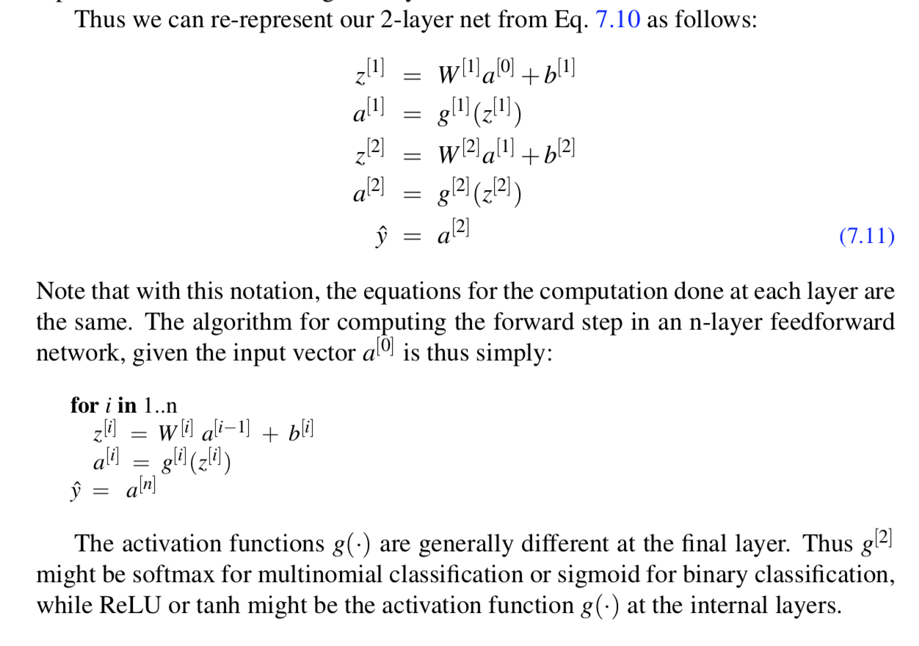
Equations for a 2-layer net

Slide 11
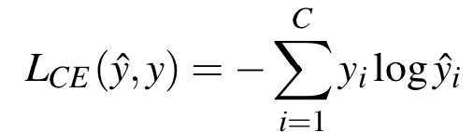
Training Neural Nets (J&M 7.4)
Feedforward neural net: supervised learning with input x and correct output y
The system produces ŷ, an estimation of the true y
The goal of the training procedure is to learn parameters W[i] and b[i] for each layer i that make ŷ for each training observation as close as possible to the true y. Needed:
Loss function that models the distance between ŷ and y: cross-entropy loss
Find the parameters that minimize this loss function: gradient descent optimization algorithm

Slide 12
Training Neural Nets
Challenge: optimizing the weight parameters in all layers of the network, even though the loss is computed only at the very end of the network
The solution is the error backpropagation algorithm
iterative, recursive and efficient method for computing the weights updates to improve the network
Dropout to prevent overfitting: randomly dropping some units and their connections from the network during training

Slide 13
HyperParameters
The parameters of a neural network are the weights W and biases b; those are learned by gradient descent
Hyperparameters of the architecture and learning set-up:
E.g. learning rate η, the mini-batch size, the number of layers, the number of hidden nodes per layer, the choice of activation functions, dropout rate
The hyperparameters are chosen by the algorithm designer; optimal values are tuned on a development set rather than by gradient descent learning on the training set

Slide 14
Neural Language models
J&M Section 7.5

Slide 15
Recap of lecture 7: word2vec
Word2vec learns word embeddings from raw text
Intuition:
Train a classifier on a binary prediction task (on a text without labels!): “Is word w likely to show up near the word bicycle?”
We don’t actually care about this prediction task; instead we’ll take the learned classifier weights as the word embeddings
The classifier is a neural network with one hidden layer
Logistic sigmoid functions are used as activation functions in the hidden layer. The regression weights are the embeddings

Slide 16
Language modelling
The word prediction task is called language modelling
Traditional n-gram model: given the previous n words, predict the next word
Neural language model: feedforward neural network that takes as input a representation of the previous n words and outputs a probability distribution over possible next words
Neural language models can handle much longer histories, and they can generalize over contexts of similar words
The resulting embeddings matrix is referred to as language model
The language model can be used as representation in other tasks

