Slide 1
Today’s lecture
Named Entity Recognition
Feature-based models
Neural models
Rule-based models
Relation extraction
Evaluation of Information Extraction

Slide 2
After this lecture...
You can describe the process of Named Entity Recognition (NER) as supervised sequence learning task using ‘IOB’ labels
You can list a few commonly used features in NER
You can explain MEMM and CRF for sequence labelling on a conceptual level
You can explain recurrent neural networks for sequence labelling on a conceptual level
You can describe three methods for extracting relations between two entities
You can define precision and recall for the evaluation of information extraction tasks

Slide 3
Information Extraction

Slide 4
Information Extraction
“Information extraction from text is an important task in text mining. The general goal of information extraction is to discover structured information from unstructured or semi-structured text.”
Example applications:
automatically identify mentions of biomedical entities from patents and to link them to their corresponding entries in existing knowledge bases
find person names in bank transactions/electronic health records for the purpose of anonymization
find company names, dates and stock market information in economic newspaper texts
More advanced search problems such as entity search, structured search and question answering can provide users with better search experience

Slide 5
Example task
GIST is a rare form of cancer; the available medical knowledge about GIST is limited
We have data from the GIST support Facebook group
Goal: extract medical knowledge from this archive
to be used by patients and medical researchers
information about medications, side effects, relations to other forms of cancer and patients’ coping strategies

Slide 6
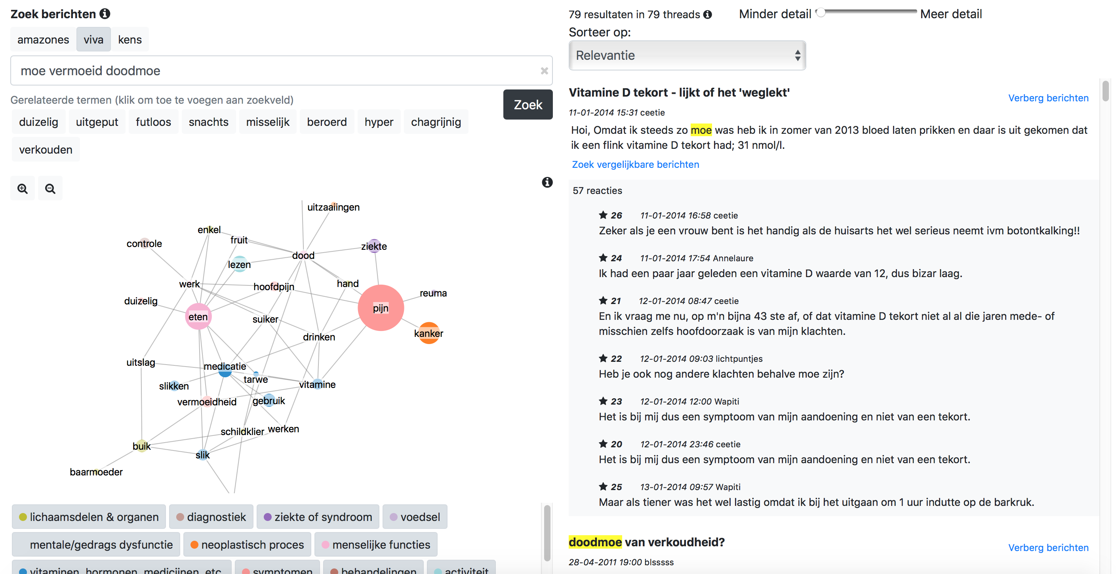
example

Slide 7
Information Extraction tasks
Named Entity Recognition (NER) (section 18.1 in J&M)
Relation extraction (section 18.2 in J&M)

Slide 8
Named Entity Recognition

Slide 9
Recognizing entities
A named entity is a sequence of words that designates some real-world entity (typically a name), e.g. ‘California’, ‘Steve Jobs’ and ‘Apple Inc.’
General types, occurring in most domains: person, organization, location
Extended types (strictly speaking not named entities): dates, times, monetary values and percentages
Domain-specific types, e.g. biomedical entities
Task: Named entity recognition (NER)

Slide 10
Challenges of NER
Ambiguity of segmentation:
what is an entity and what is not an entity?
where are the boundaries of an entity? (e.g. ‘King Willem-Alexander of the Netherlands’)
Type ambiguity
E.g. The mention ‘JFK’ can refer to a person, the airport in New York, or any number of schools, bridges, etc.
Shift of meaning
E.g. ‘president of the US’ refers to Donald Trump, but in a newspaper article from 2011 it refers to Obama

Slide 11
Recognizing entities
We could use a list of names and label them in the text. Limitations:
Entities are typically multi-word phrases (boundaries?)
List is limited (new names, new domains)
We would need to add all variants (Trump, Donald Trump, Donald John Trump, President Trump, Mr. Trump, ...)
NER is a sequence-labelling problem
a word-by-word sequence labelling task, in which the assigned tags capture both the boundary and the type

Slide 12
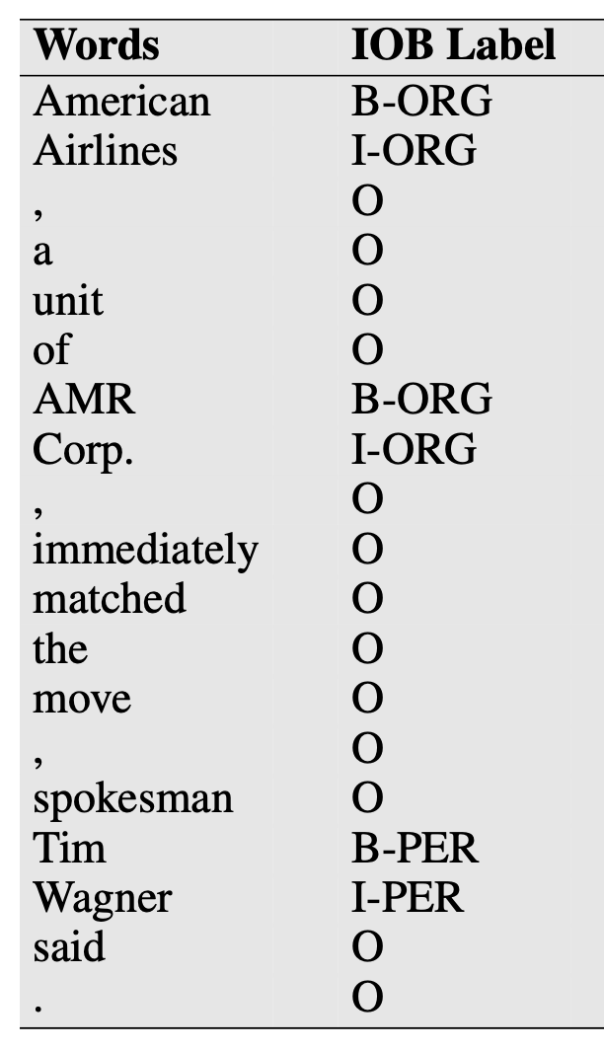
Sequence labelling
NER is a sequence labelling task
sequence = sentence; element = word; label = entity type
one label per word
IOB tagging:
Each word gets a label (tag)
beginning (B), inside (I) of each entity type
and one for tokens outside (O) any entity

Slide 13
Methods for NER
Methods:
Feature-based (section 18.1.2)
Neural-network-based (section 18.1.3)
Rule-based (section 18.1.4)

Slide 14
Feature-based NER
J&M 18.1.2

Slide 15
Feature-based NER
Supervised learning:
Each word represented by a feature vector with information about the word and its context
x_{i} is the word in position i
→ Create a feature vector for x_{i}, describing x_{i} and its context
Training data needed: IOB-labeled texts

Slide 16
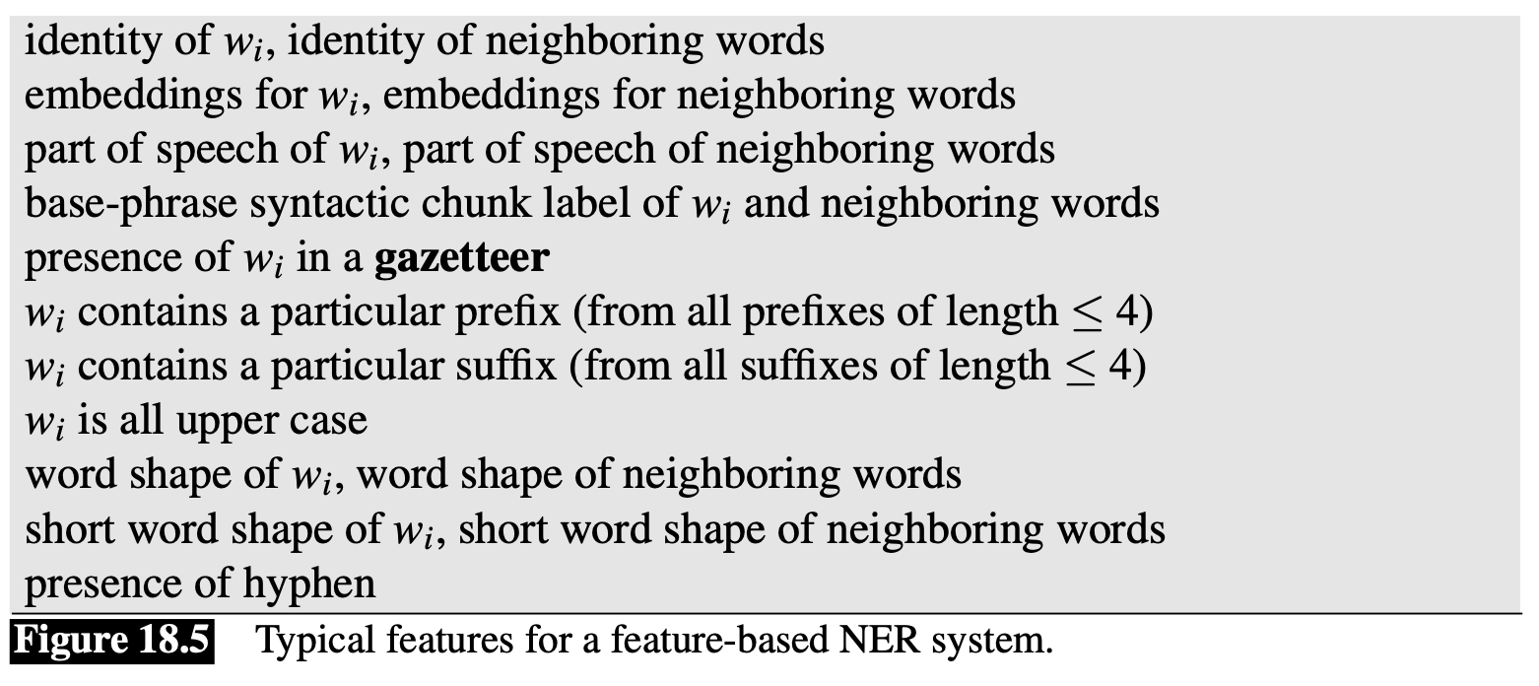
Feature-based NER
Commonly used features for sequence labelling NER:

Slide 17
Side step: Part-of-speech tagging
Part-of-speech (POS) = ‘category of words that have similar grammatical properties’
noun, verb, adjective, adverb
pronoun, preposition, conjunction, determiner
Example: The/DT grand/JJ jury/NN commented/VBD on/IN a/DT number/NN of/IN other/JJ topics/NNS ./.
Why would the POS of a word be informative for NER?

Slide 18
Feature-based NER
Commonly used features for sequence labelling NER:

Slide 19
Feature-based NER
Use of lists:
A gazetteer is a list of (place) names
Name lists (common first and last person names)
Word shape features are used to represent the abstract letter pattern of the word by mapping lower-case letters to ‘x’, upper-case to ‘X’, numbers to ’d’, and retaining punctuation. Thus for example I.M.F would map to X.X.X. and DC10-30 would map to XXdd-dd

Slide 20
Feature-based NER
Commonly used features for sequence labelling NER:
Task: label all words in the sentence using a sequential model

Slide 21
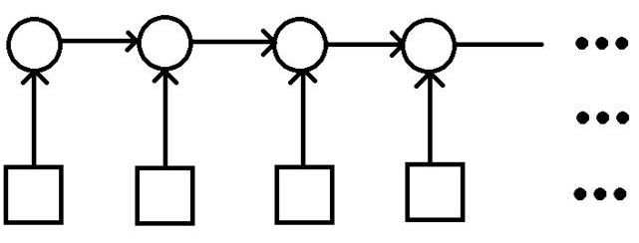
Maximum Entropy Markov Models
A powerful discriminative model for sequence labelling
the probability of the current state y_{i} given the previous states y, the current observation x_{i}, the previous observations x_{i-m} to x_{i-1} and the next observations x_{i+1} to x_{i+m}
B-ORG O
States (y): labels
EU rejects German call
Observations (x): words with features

Slide 22
Conditional random fields (CRF)
Undirected graphical model
Powerful because of bidirectionality
Does not compute a probability for each tag at each time step
Instead, at each time step the CRF includes features and predicted labels of words in future time steps
Optimizes the sequence as a whole. The probability of the best sequence is computed by the Viterbi algorithm
https://en.wikipedia.org/wiki/Viterbi_algorithm

Slide 23
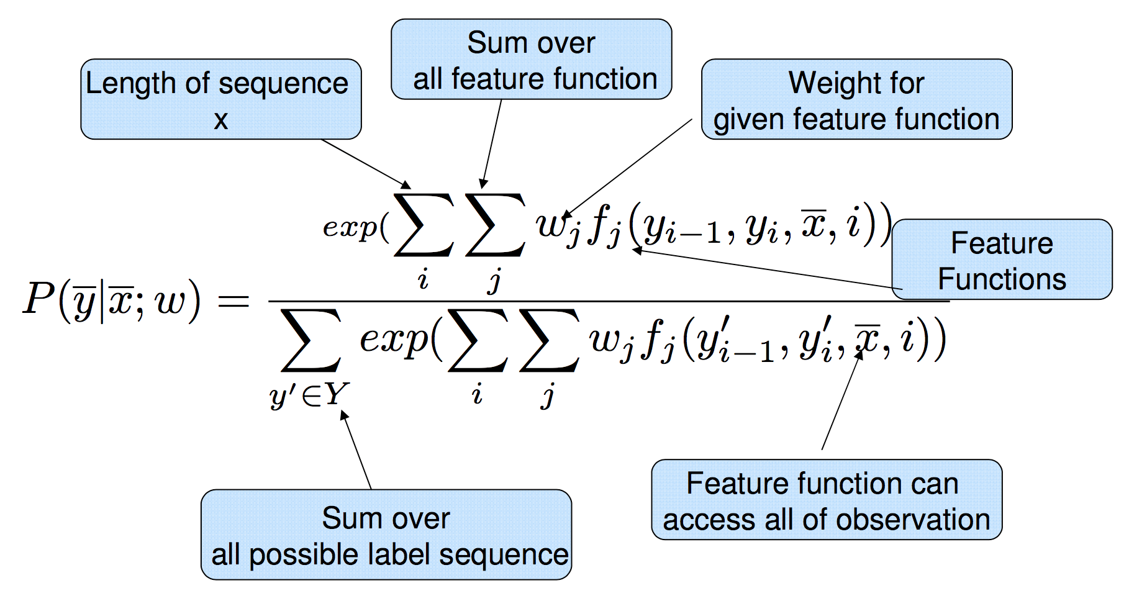
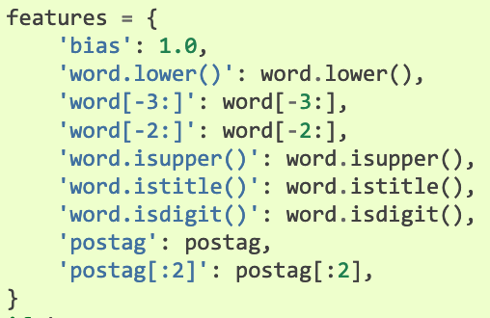
Conditional random fields (CRF)
Image: http://www.davidsbatista.net/blog/2017/11/13/Conditional_Random_Fields/
Implementation of CRF in sklearn: https://sklearn-crfsuite.readthedocs.io/en/latest/

Slide 24
Neural models for NER
J&M 18.1.3

Slide 25
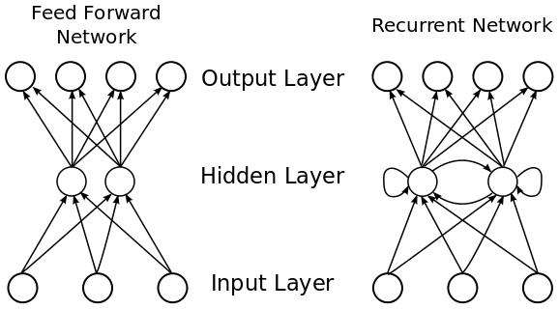
Neural sequence models
Most commonly used neural sequence model for NER: bi-LSTM
LSTM = Long-short term memory
Bi-LSTMs are Recurrent Neural Networks (RNNs)
https://en.wikipedia.org/wiki/Long_short-term_memory

Slide 26
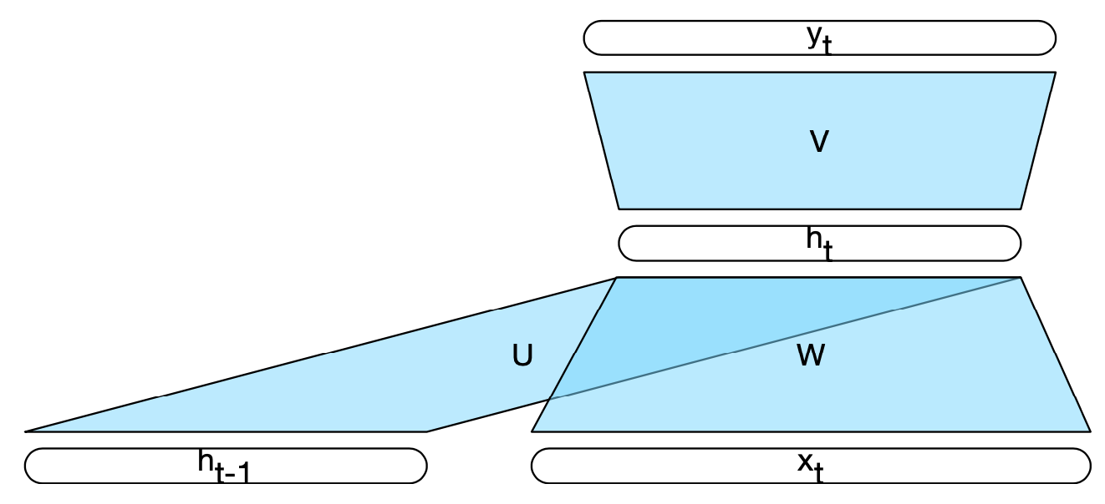
Recurrent neural networks
An RNN is any network that contains a cycle within its network connections.
Similar to ‘normal’ feedforward network, but with 1 addition: a set of weights, U, that connect the hidden layer from the previous time step to the current hidden layer
These weights determine how the network should make use of past context in calculating the output for the current input
As with the other weights in the network, these connections are trained via backpropagation

Slide 27
Bi-LSTMs
Bidirectional neural model for NER: bi-LSTM
Word and character embeddings are computed for input word w_{i} and the context words
These are passed through a bidirectional LSTM, whose outputs are concatenated to produce a single output layer at position i
Simplest approach: direct pass to softmax layer to choose tag t_{i}
For NER the softmax approach is insufficient:
strong constraints for neighboring tokens needed (e.g., the tag I-PER must follow I-PER or B-PER)
Use CRF layer on top of the bi-LSTM output: biLSTM-CRF

Slide 28
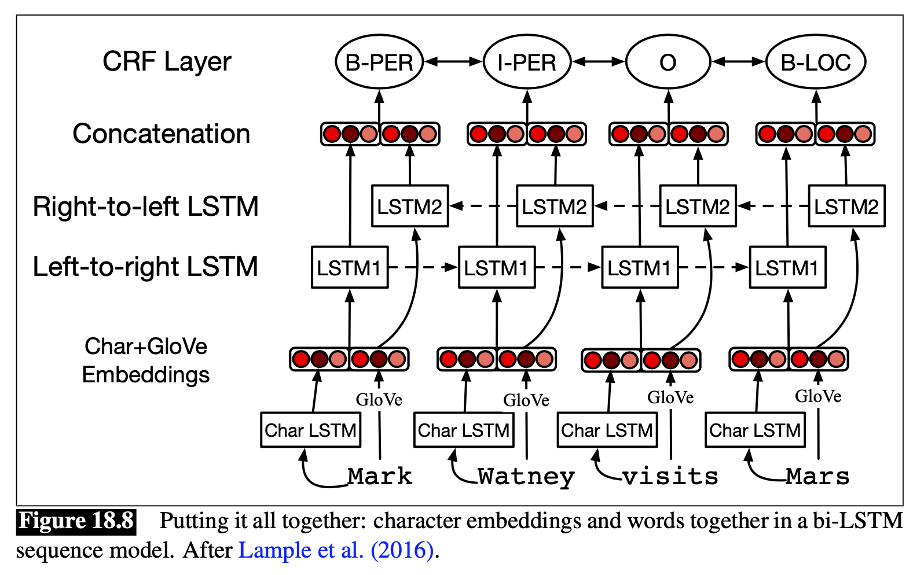
Neural-network-based NER

Slide 29
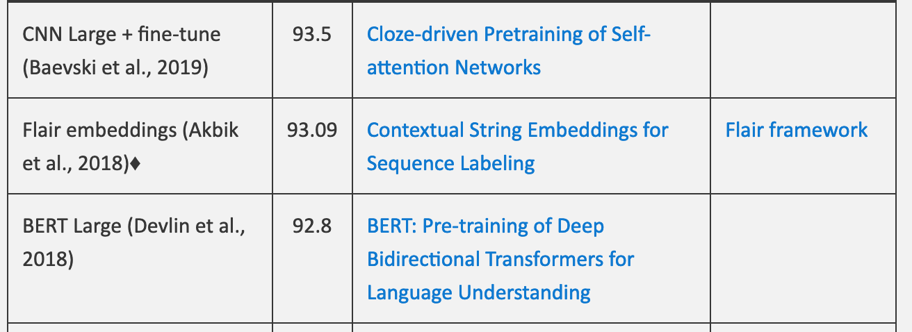
State of the art for NER
http://nlpprogress.com/english/named_entity_recognition.html
Results on CONLL-2003 benchmark:
Flair Code and tutorial: https://github.com/zalandoresearch/flair

Slide 30
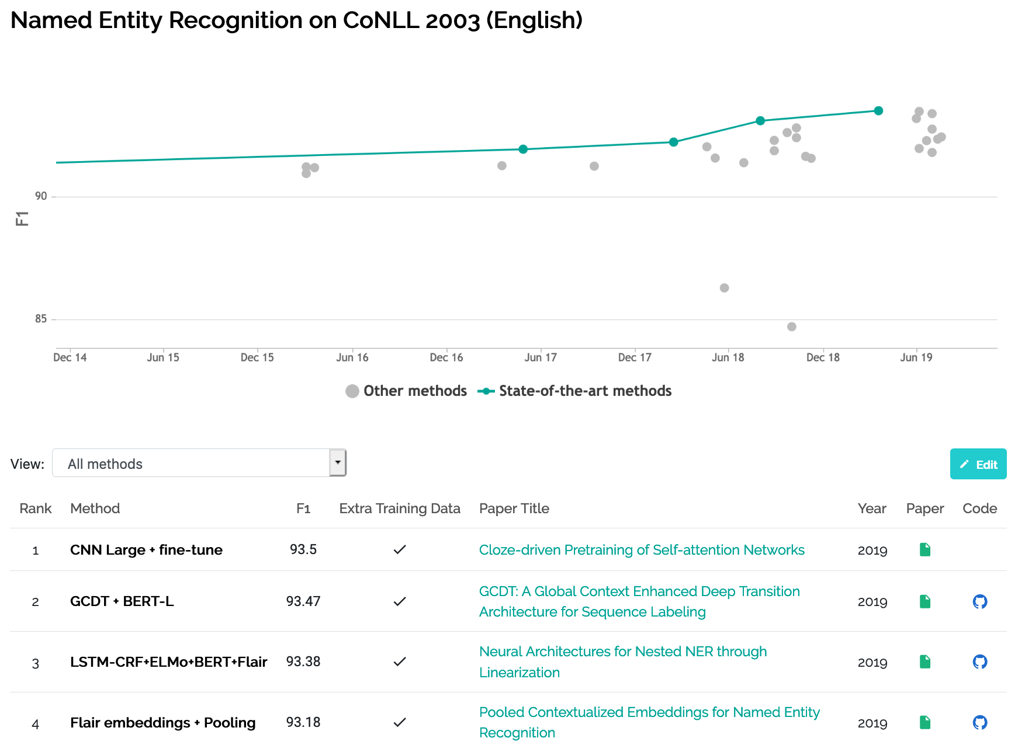
State of the art for NER
https://paperswithcode.com/sota/named-entity-recognition-ner-on-conll-2003

Slide 31
Rule-based NER

Slide 32
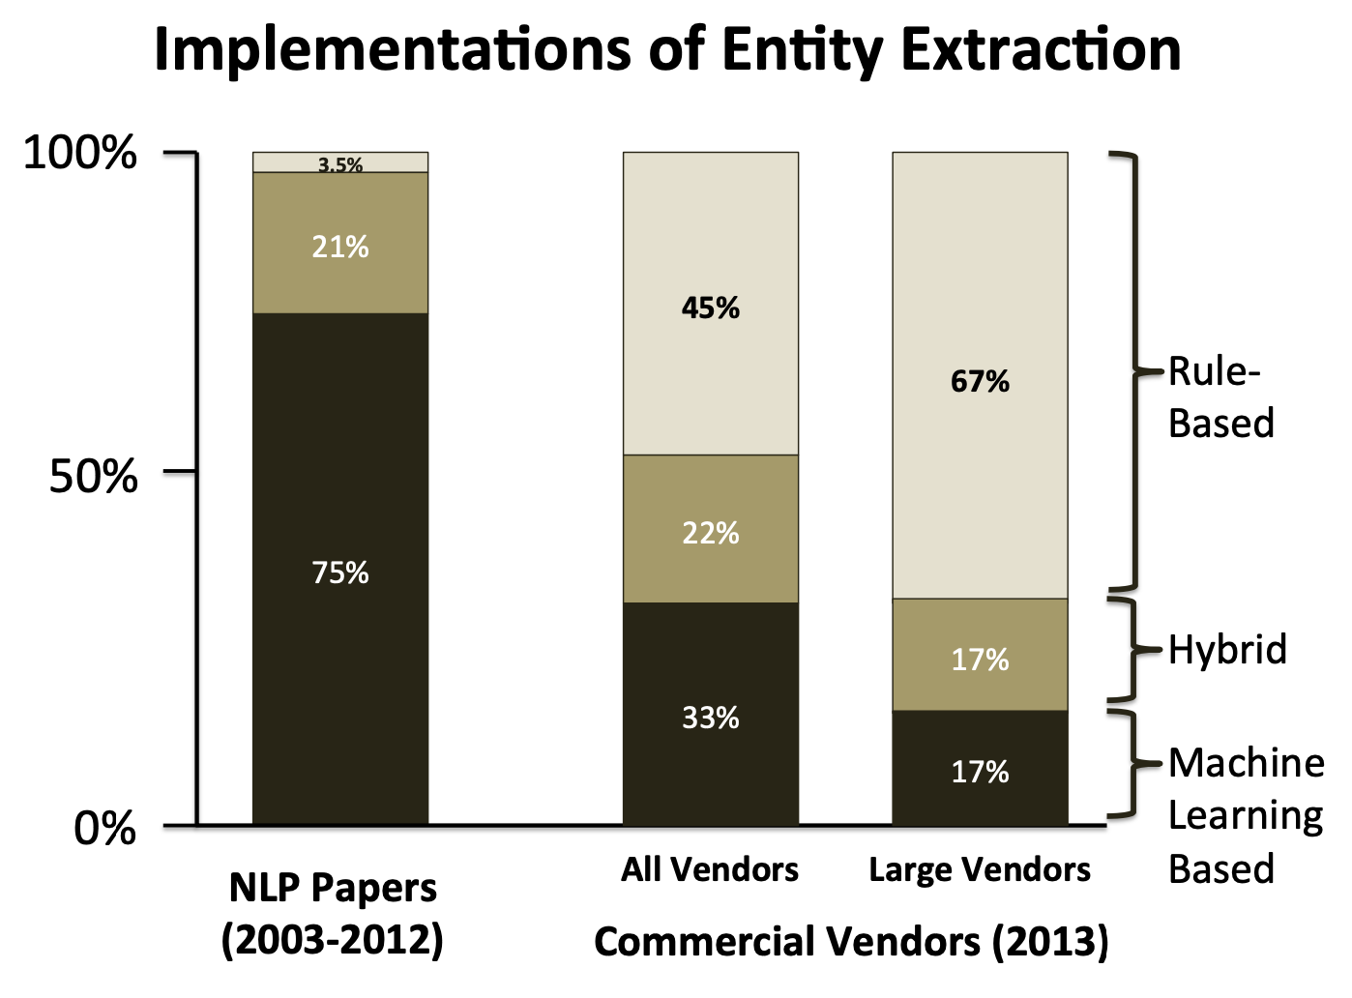
Rule-based NER
Machine learned sequence models are the norm in academic research
Commercial implementations of NER are often based on lists and rules, with some smaller amount of supervised machine learning
Chiticariu, L., Li, Y., and Reiss, F. R. (2013). Rule-Based Information Extraction is Dead! Long Live Rule-Based Information Extraction Systems!. In EMNLP 2013, 827– 832.

Slide 33
Rule-based NER
First, use high-precision rules to tag unambiguous entity mentions
Then, search for substring matches of the previously detected names
Consult application-specific name lists to identify likely named entity mentions from the given domain
Finally, apply probabilistic sequence labelling techniques that make use of the tags from previous stages as additional features

Slide 34
Relation extraction
J&M 18.2

Slide 35
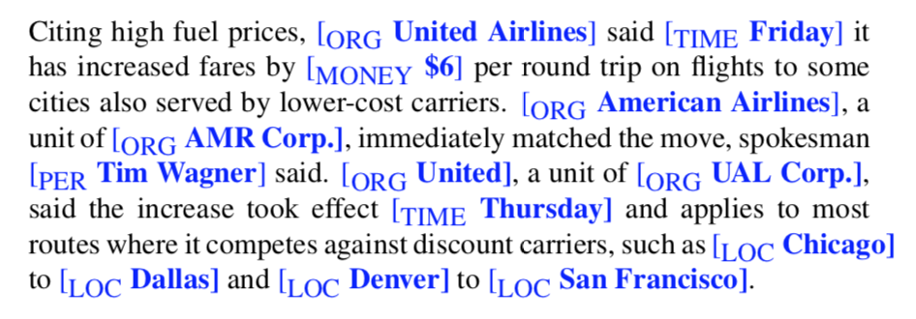
Relation Extraction
Example text with named entities:
Relations:
Tim Wagner is a spokesman for American Airlines
United is a unit of UAL Corp.
etc

Slide 36
RDF and Ontologies
These facts can be turned into into relations in a metalanguage called RDF (Resource Description Framework)
An RDF triple is a tuple of entity-relation- entity, called a subject-predicate-object expression. E.g.:
subject predicate object
GoldenGatePark location SanFrancisco
Example: DBpedia. An ontology derived from Wikipedia containing over 2 billion RDF triples
https://wiki.dbpedia.org/

Slide 37
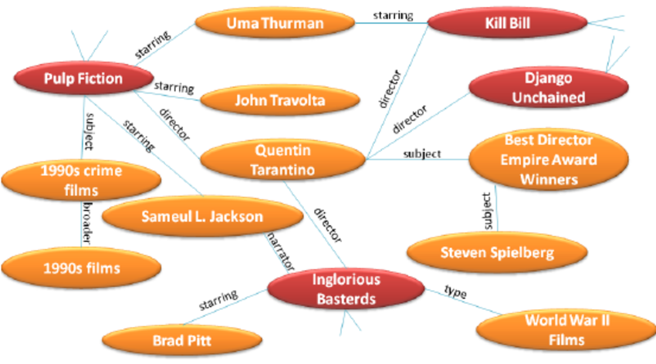
RDF and ontologies
Fragment of an RDF graph extracted from DBpedia
https://www.researchgate.net/publication/285780203_A_Linked_Data_Recommender_System_Using_a_Neighborhood-Based_Graph_Kernel

Slide 38
Methods for relation extraction
Pattern-based (18.2.1)
Feature-based (supervised learning) (18.2.2)
Bootstrapping (18.2.3)
Distant supervision (18.2.4)
Option 2 is the most reliable. However, supervised learning requires labelled data. If labelled data is limited, we need the other options

Slide 39
Pattern-based relation extraction
Example: “Agar is a substance prepared from a mixture of red algae, such as Gelidium, for laboratory or industrial use.”
Pattern: NP0 such as NP1
Generic relation: hyponym(NP1,NP0)
Example relation: hyponym(Gelidium,red algae)
Advantages:
high-precision
can be tailored to specific domains
Disadvantages:
not generalizable
low recall
NP = Noun Phrase = a phrase with a noun as syntactic head. Examples:
Bicycle
The bicycle
The green bicycle
The bicycle that I got for my birthday

Slide 40
Feature-based relation extraction
Supervised learning
Assumptions:
Two entities, one relation
Relation is verbalized in one sentence
Relation extraction as classification problem:
For each pair of entities in a sentence,
determine whether or not they have a relationship
and if they do, what the relation is

Slide 41
Feature-based relation extraction
Features:
co-occurrence frequencies
entity features (words in the phrase, entity type e.g. person)
lexical contextual features (e.g. the word ‘founded’)
syntactic contextual features (e.g. SUBJ – ‘founded’ – OBJ)
Example of this method: http://dl.acm.org/citation.cfm?id=2002651
background knowledge (e.g. clusters of entities from a large embeddings model)

Slide 42
Bootstrapping for relation extraction
Start with a set of known pairs, e.g. medicine – side effect
Flomax – fever
Flomax – cough
Flomax – low back pain
Lipitor – cough
Lipitor – itching
Lipitor – fast heartbeat
Lipitor – skin rash
Search for co-occurrences of these items in a large text collection:
Flomax may cause fever
Side effects of Flomax, including fever
Fever is a possible side effect of the use of Flomax

Slide 43
Bootstrapping for relation extraction
Extract generalized patterns (‘Hearst patterns’)
X may cause Y
Side effects of X, including Y
Y is a possible side effect of the use of X
Filter for unreliable patterns (e.g. ‘PER (LOC)’)
Use the reliable patterns to find more pairs of entities
Example application of this method in open information extraction: http://rtw.ml.cmu.edu/rtw/ (2010)
Hearst, M. A. (1992, August). Automatic acquisition of hyponyms from large text corpora. In Proceedings of the 14th conference on Computational linguistics-Volume 2 (pp. 539-545). Association for Computational Linguistics.

Slide 44
Distant supervision for relation extraction
Start with a large, manually created knowledge base (e.g. Freebase, DBpedia)
Find occurrences of pairs of related entities from the database in sentences
Assumption: If two entities participate in a relation, any sentence that contains these entities express that relation
Define features over the sentences expressing the relation (supervised learning)
Apply these features to sentences with yet unconnected other entities in order to find new relations

Slide 45
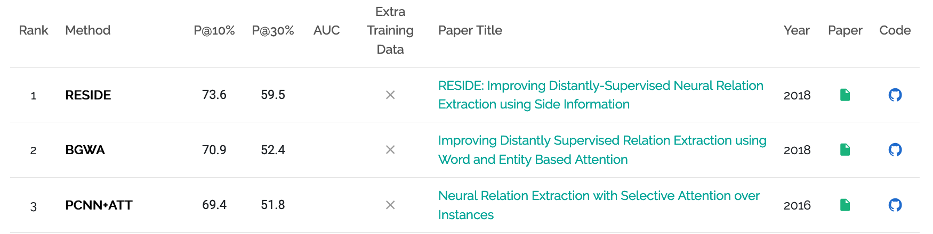
Distant supervision for relation extraction
The distant supervision paradigm is 10 years old:
Mintz, M., Bills, S., Snow, R., and Jurafsky, D. (2009). Distant supervision for relation extraction without labeled data. In ACL IJCNLP 2009.
But still applied in domains with limited labelled data
https://paperswithcode.com/task/relationship-extraction-distant-supervised

Slide 46
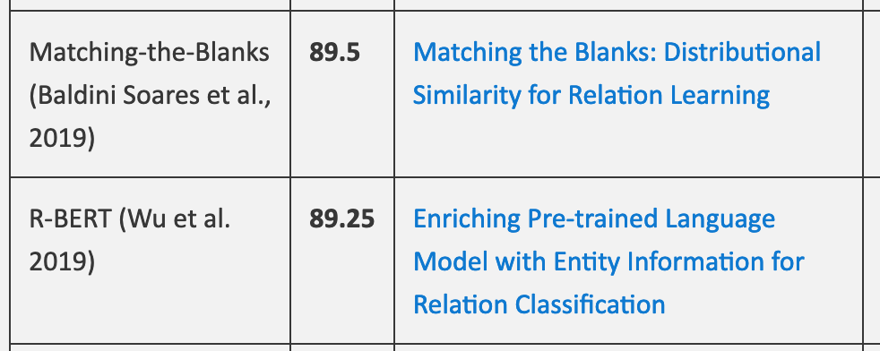
State of the art for relation extraction
http://nlpprogress.com/english/relationship_extraction.html
https://paperswithcode.com/task/relation-extraction

Slide 47
Evaluation

Slide 48
Evaluation of IE systems
Needed: manually annotated documents (‘ground truth’)
Best: use benchmark datasets
ready-to-use
well edited (multiple annotators)
for comparison to other methods
Benchmark datasets have been created in the context of conferences and workshops
E.g. CoNLL-2003 (multiple languages)
Tjong Kim Sang, E. F., & De Meulder, F. (2003, May). Introduction to the CoNLL-2003 shared task: language-independent named entity recognition. In Proceedings of the seventh conference on Natural language learning at HLT-NAACL 2003-Volume 4 (pp. 142-147). Association for Computational Linguistics.

Slide 49
Evaluation of NER
2 criteria for correctly identified named entities:
correct entity identification (boundaries)
correct entity classification (types)
Using human labels as the ground truth, we can calculate Precision and Recall
What is the definition of precision and recall for entity identification?
F = set of entities found by algorithm
T = set of true entities according to human

Slide 50
Evaluation of IE systems
In order to fit the quality of a system in 1 measure:
F-score:

