Slide 1
Sentiment analysis

Slide 2
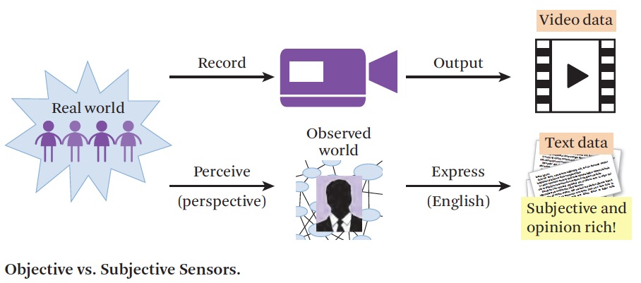
Subjective sensors
Zhai & Massung, 2016

Slide 3
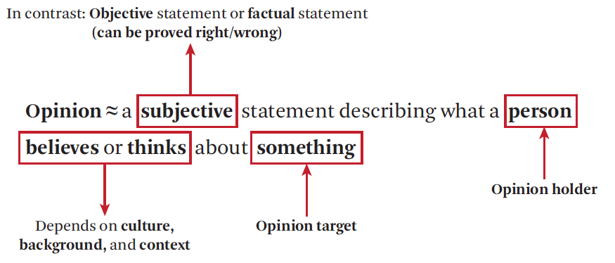
Sentiment analysis and opinion mining
Booming research area since 2000s
Connected to the rise of social media: the place for expressing personal and subjective opinions
Zhai & Massung, 2016
Notes:
definition of the book in chapter 18: opinion mining
covers the broad task of detecting the opinions and sentiments of people towards entities, events or topics in text

Slide 4
Sentiment Analysis or Opinion Mining?
Opinion mining, opinion extraction, sentiment mining, subjectivity analysis, affect analysis, emotion detection, review mining, …
Sentiment expressions are a subset of subjective language use
E.g. “I think he went home” = subjective but no sentiment
Notes:
all these terms are used for the area
subjective = personal
sentiment is always subjective but not al all subjective language expresses sentiment

Slide 5
Typical opinion/Sentiment questions
Find the opinion of a person or organization (opinion holder) on a particular topic.
E.g., what is Trump’s opinion on immigrants?
Aggregate positive and/or negative opinions on a particular entity (or some aspects of the entity), e.g.,
customer opinions on a phone
public opinions on a political topic
Detect how opinions change over time
How does entity A compare with entity B?
Comparative opinions
‘Coke tastes better than Pepsi’
Notes:
Slide From bing

Slide 6
Levels of Sentiment Analysis
Document level: e.g. a sentiment score for the complete product review or Tweet
Sentence level: e.g. subjectivity classification (distinguish between objective and subjective sentences)
Entity and Aspect level: relate the sentiment to features of a product, event or entity

Slide 7
Annotation for sentiment analysis

Slide 8
Levels of Sentiment Analysis
Annotation on:
Document level
Sentence level
Entity and Aspect level

Slide 9
Annotation on the document level
Most basic and common labeling: negative, positive, neutral
Alternatives:
Objective versus Subjective
Emotion classes: joy, fear, anger, sadness, disgust, shame, and guilt
Ordinal Scales:
very bad bad neutral good very good
-2 -1 0 +1 +2
1 2 3 4 5

Slide 10
Annotation on the document level
Sentence | Sentiment (-2, ..+2)
today on the advice of Paulien with me for relaxation therapy because of anxiety and fatigue | -2
It goes pretty well. | +1
There is a decrease of the complaints with respect to the previous treatment. | +1
it goes reasonably well, still notices muscle pain in the thigh and now considerable bruising by the knee | +1
Pain in the right ankle since Friday (outside), painful today with cycling and walking. No trauma moment. | -1
goes well, no details. Wednesday to doctor | +1
Going has a small tip laterally thigh which is a bit painful / nagging | -2
Sentence | Sentiment (-2, ..+2)
today on the advice of Paulien with me for relaxation therapy because of anxiety and fatigue
It goes pretty well.
There is a decrease of the complaints with respect to the previous treatment.
it goes reasonably well, still notices muscle pain in the thigh and now considerable bruising by the knee
Pain in the right ankle since Friday (outside), painful today with cycling and walking. No trauma moment.
goes well, no details. Wednesday to doctor
Going has a small tip laterally thigh which is a bit painful / nagging

Slide 11
Annotation on the document level
Misclassifying an entity with true label ‘-2’ as ‘-1’ is a smaller mistake than labeling an entity with true label ‘-2’ as ‘+2’
Ordinal regression: learn a model to predict class labels on an ordinal scale
Some background:
Introduction to regression: https://towardsdatascience.com/introduction-to-machine-learning-algorithms-linear-regression-14c4e325882a
Opinion Mining and Sentiment Analysis Ordinal Logistic Regression: https://www.youtube.com/watch?v=xOHtd6fTRak
Notes:
ordinal logistic regression : model that aims to predict the sentiment score (categorial dependent variable) from a set of feature values (independent variables) by estimating probabilities using a logistic function
logistic function (s-shaped curve): mathematical function input are real valued numbers, output is between zero and one
SVM: learn a threshold for each ordinal class that divids the hyperplane in intervals
e

Slide 12
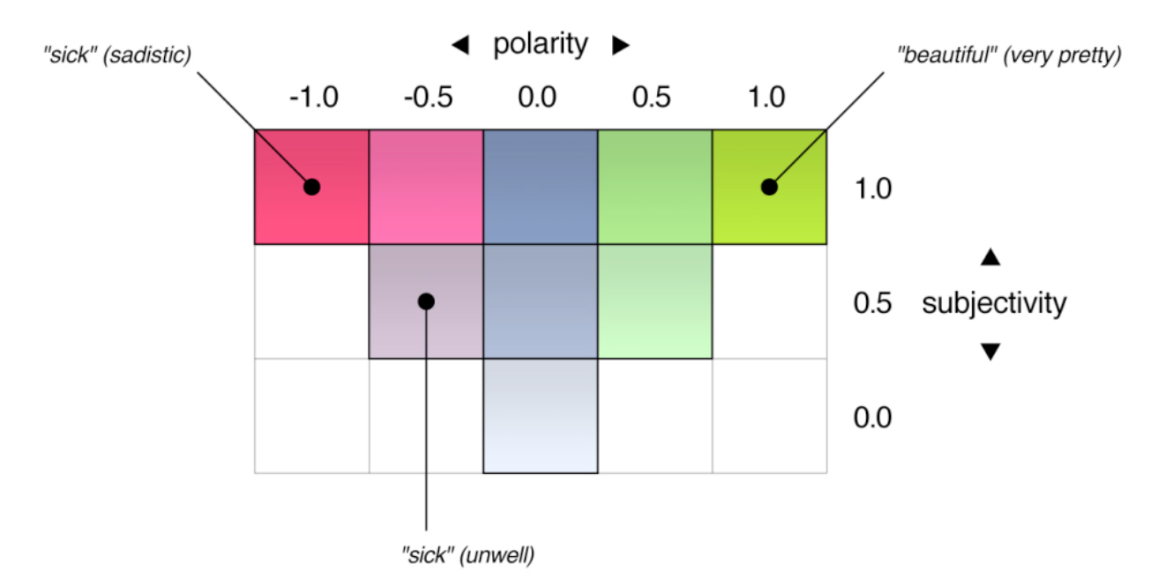
Polarity/Subjectivity/Intensity Scale
valence
Intensifiers: incredibly good, very nice
De Smedt, T., & Daelemans, W. (2012). Pattern for python. The Journal of Machine Learning Research, 13(1), 2063-2067.
Notes:
two dimensioal scale
who can give an example for polarity 0 and subjectivity 0?

Slide 13
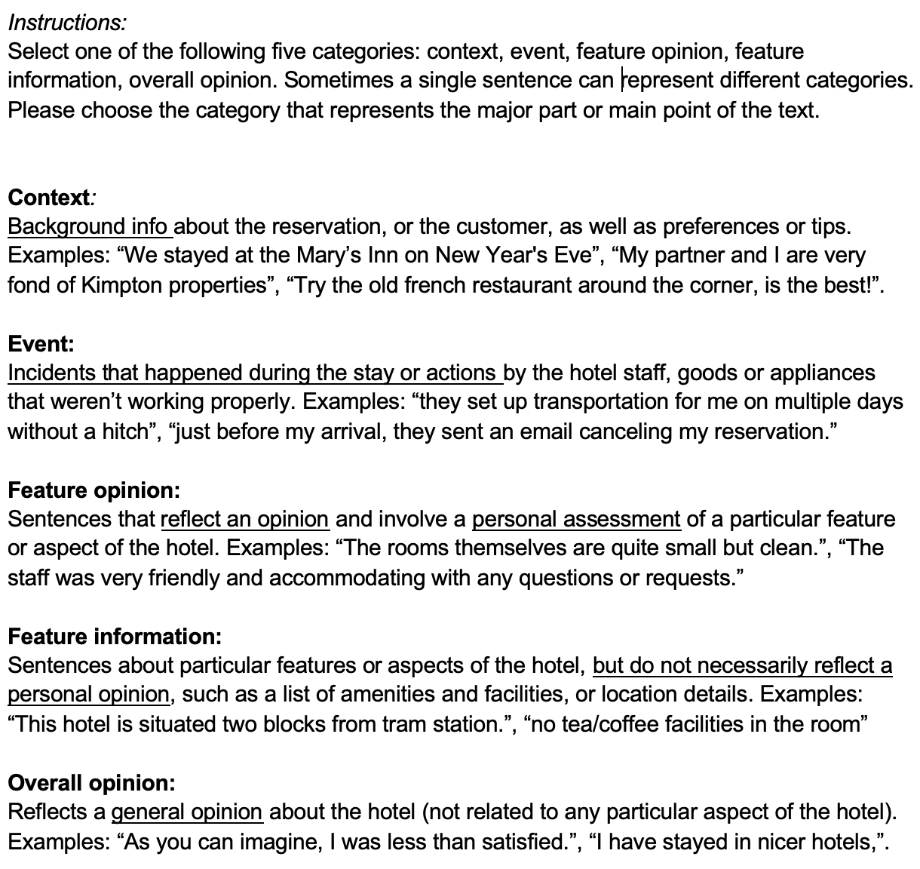
Annotation on the sentence level
Annotation for hotel reviews:
What is the function of each sentence

Slide 14
Annotation on the entity/aspect level
John Doe, 8 November 2018: “I bought an iPhone a few days ago. It was such a nice phone. The touch screen was really cool. The voice quality was clear too. Although the battery life was not long, that is ok for me.”
This text contains:
Opinions
Targets of opinions
Opinion holder(s)
Notes:
Slide From bing, adapted
However, my mother was mad with me as I did not tell her before I bought the phone. She also thought the phone was too expensive, and wanted me to return it to the shop. …”

Slide 15
Annotation on the entity/aspect level
Simple Document sentiment analysis: find opinion pair (D,S)
D: document
S: sentiment score
Aspect-based sentiment analysis: find Quintuple (E, A, S, H, C)
E: opinion target (entity, event or topic)
A: aspect or feature of E
S: sentiment/opinion content (phrase or a sentiment score of A)
H: opinion holder
C: context; time and location of the expression
Notes:
Finding all 5 elements is not easy, not all present in the same sentence for example
(E, A, S, H, T)
(iphone,touch screen,+2,I,unknown)

Slide 16
Example of a Product Review
John Doe, 8 November 2018: “I bought an iPhone a few days ago. It was such a nice phone. The touch screen was really cool. The voice quality was clear too. Although the battery life was not long, that is ok for me.”
(E, A, S, H, C)
(iphone, touch screen, really cool, John Doe, 8 November 2018)

Slide 17
detect (E,A,S,H,C) in document D
E: entity, event or topic → Named Entity Recognition /Event Detection
A: aspect or feature of E → Information Extraction / aspect categorization
This camera is expensive → implicit aspect ‘price’
Both E and A elements are domain dependent and can be challenging to extract

Slide 18
detect (E,A,S,H,C) in document D
S: sentiment score of A → sentiment classification
H: opinion holder
In tweets and reviews: usually the author
But can also be present in the text: → Named Entity Recognition
“The mayor is loved by the people in the city, but he has been criticized by the state government.”
C: context: time and location of the expression
Date /location stamp of tweet, blog or review
But can also be present in the text: → Time expression Recognition
or Geolocation classication / NER

Slide 19
Annotation issues
What are the challenges in annotation?
“This past Saturday, I bought a Samsung phone and my girlfriend bought a HTC phone with 3D touch. We called each other when we got home. The voice on my phone was not so clear, worse than my previous phone. The battery life was long. My girlfriend was quite happy with her phone. I wanted a phone with good sound quality. So my purchase was a real disappointment. I returned the phone yesterday.”

Slide 20
Annotation issues
comparison: 2 opinion holders, 2 targets
different aspects with different sentiments
co-reference resolution
factual statement expressing sentiment
sentiment words not expressing sentiment
This past Saturday, I bought a Samsung phone and my girlfriend bought a HTC phone with 3D touch. We called each other when we got home. The voice on my phone was not so clear, worse than my previous phone. The battery life was long. My girlfriend was quite happy with her phone. I wanted a phone with good sound quality. So my purchase was a real disappointment. I returned the phone yesterday.”

Slide 21
Challenges of sentiment analysis
Sentiment words do not always express a sentiment
Detecting an entity+sentiment is not enough:
“Can you tell me which Sony camera is good?”
“If I can find a good camera in the shop, I will buy it.”
However, excluding questions and conditionals would be too easy:
“Does anyone know how to repair this terrible printer?”
“If you are looking for a good car, get an Audi Passat”

Slide 22
Challenges of sentiment analysis
Sentiment words are ambiguous, context- and domain dependent
“This video game is totally unpredictable” vs
“This car is totally unpredictable”
Sarcasm
“What a great car! It stopped working in two days.”
Objective sentences that express sentiments
“After sleeping on the mattress for two days, a valley has formed in the middle.”
“The washing machine uses a lot of water.”
Notes:
Unpredictable: positive for a roller-coaster of video game, negative for a car, radio

Slide 23
Evaluation

Slide 24
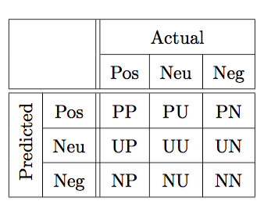
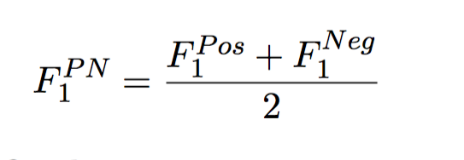
Evaluation of sentiment analysis
In case of three labels: Positive(P) Neutral(U) Negative(N)
P_{pos} = PP / PP+PU+PN
R_{pos} = PP / PP+UP+NP
F₁^{pos} = 2 * (P_{pos} * R_{pos})/(P_{pos}+ R_{pos})
Average F-score is computed on positive and negative labels only:

Slide 25
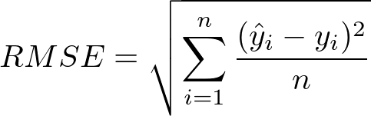
Evaluation of sentiment analysis
In case of regression:
Root Mean Squared Error (RMSE)
Correlation metric: Pearson/Spearman correlation coefficient (r)

Slide 26
State of the art
Sentiment analysis on tweets

Slide 27
Semeval
Sentiment analysis benchmark competition on Twitter data
2018: 75 teams participated
Task 1: Affect in Tweets
1. emotion intensity regression
2. emotion intensity ordinal classification
3. valence (sentiment) regression
4. valence ordinal classification
5. emotion classification
Mohammad, S., Bravo-Marquez, F., Salameh, M., & Kiritchenko, S. (2018). Semeval-2018 task 1: Affect in tweets. In Proceedings of The 12th International Workshop on Semantic Evaluation (pp. 1-17).
Notes:
I

Slide 28
Dataset creation
For each emotion X, they selected 50 to 100 terms that were associated with that emotion at different intensity levels.
E.g. for anger: angry, mad, frustrated, annoyed, peeved, irritated
Term sources: Roget’s Thesaurus, nearest neighbors in a word embeddings space, and emoticons
Retrieve tweets from Twitter API that include these terms
Sample for emotion tweets:
1400 tweets for intensity of joy
1400 tweets for each of the negative emotions

Slide 29
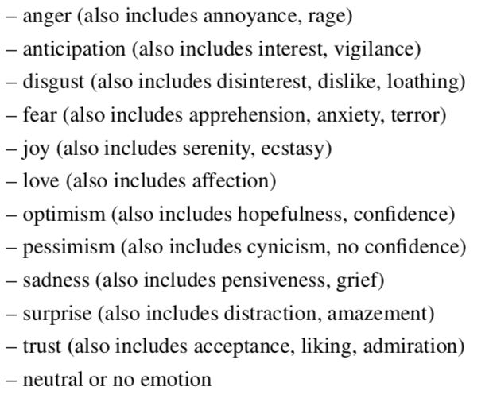
Annotation
Crowdsourcing
About 5% of the tweets in each task were annotated internally beforehand (‘gold tweets’) to control the quality
One tweet at a time: “which of the following options best describes the emotional state of the tweeter”
7 annotations per tweet; 174,356 responses in total

Slide 30
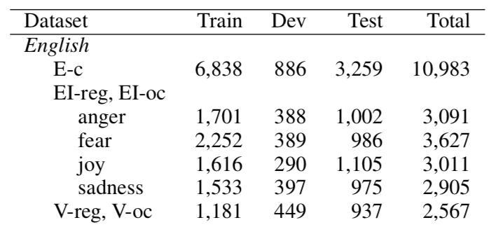
Resulting data
1. emotion intensity regression (EI-reg)
2. emotion intensity ordinal classification (EI-oc)
3. valence (sentiment) regression (V-reg)
4. valence ordinal classification (V-oc)
5. emotion classification (E-c)
Notes:
Interestingly the Twitter task also had an additional test set with SMS text messages !
25 words on average per tweet/sms with 120 chars

Slide 31
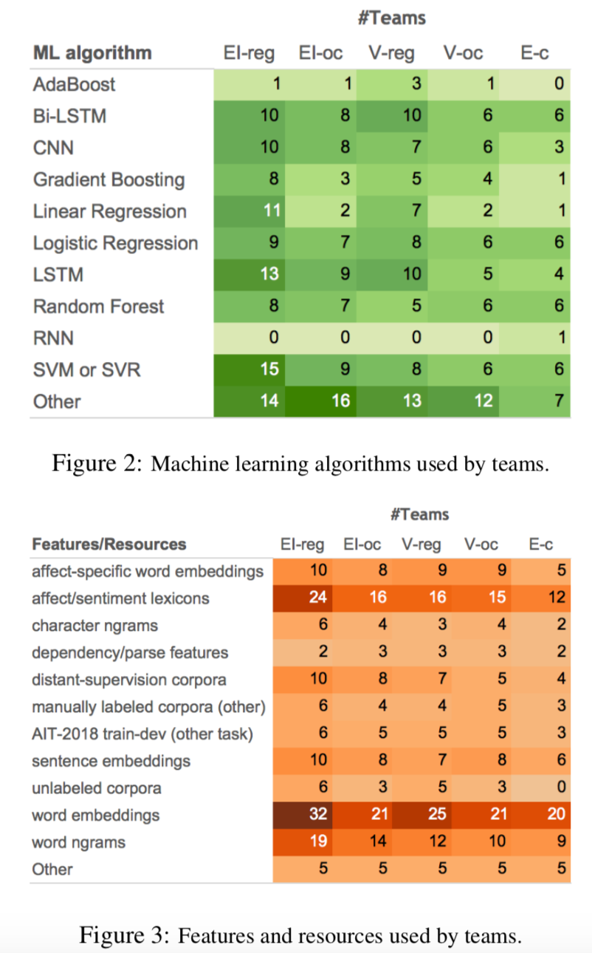
Methods and features used
“Most of the top-performing teams relied on sentence embeddings as well as features derived from existing sentiment and emotion lexicons.”

Slide 32
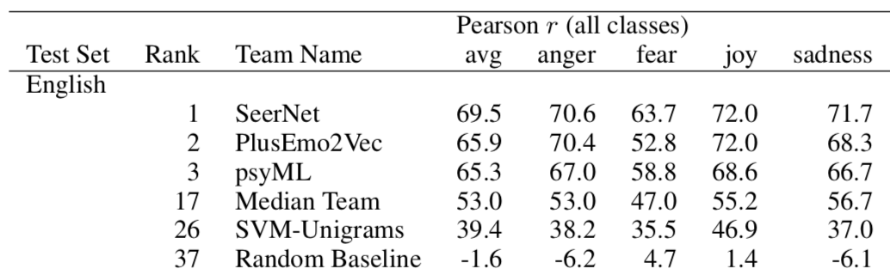
Results
Summary of results for emotion intensity ordinal classification (EI-oc)
Notes:
Classifier: SVM with linear kernel

Slide 33
Best system
SeerNet
“a unified architecture for regression and ordinal classification based on the fusion of heterogeneous features and the ensemble of multiple predictive models”
Models/features used:
DeepMoji (Felbo et al., 2017): a neural network for predicting emoji for tweets trained from a very large distant supervision corpus. The last two layers of the network were used as features (transfer learning)
Skip thoughts: an unsupervised neural network for encoding sentences (Kiros et al., 2015)
Sentiment neurons (Radford et al., 2017): a byte-level recurrent language model for learning sentence representations
Features derived from affective lexicons

Slide 34
Results & Analysis
“In the standard deep learning or representation learning approach, data representations (tweets in our case) are jointly trained for the task at hand via neural networks with convolution or recurrent layers (LeCun et al., 2015). The claim is that this can lead to more robust representations than relying on manually-engineered features.
In contrast, here, most of the top-performing systems employed manually-engineered representations for tweets. These representations combine trained representations, models trained on distant supervision corpora, and unsupervised word and sentence embeddings, with manually-engineered features, such as features derived from affect lexicons.
This shows that despite being rather powerful, representation learning can benefit from working in tandem with task-specific features.”

Slide 35
Conclusions

Slide 36
Software that includes sentiment analysis
Pattern: Python package for web mining, natural language processing, machine learning and network analysis
http://www.clips.ua.ac.be/pattern
NLTK natural language toolkit
http://www.nltk.org/howto/sentiment.html

