Slide 1




AT82.02
Data Modeling and Management
Lab4: advanced SQL Commands

Slide 2
Advanced SQL Query
Using SET Operators : UNION (ALL), INTERSECT, MINUS
Subquery
Joining Multiple Tables : INNER JOIN, LEFT JOIN, RIGHT JOIN, OUTER JOIN, SELF JOIN
Notes:
https://www.sqltutorial.org/seeit/

Slide 3
Using SET Operators
UNION and UNION ALL – combine result set of two or more queries into a single result set using the UNION and UNION ALL operators.
INTERSECT – return the intersection of two or more queries using the INTERSECT operator.
MINUS – subtract a result set from another result set using the MINUS operator.

Slide 4
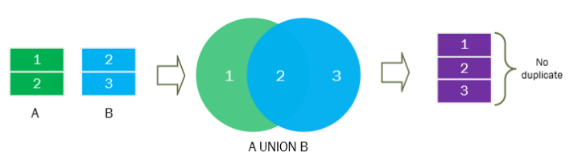
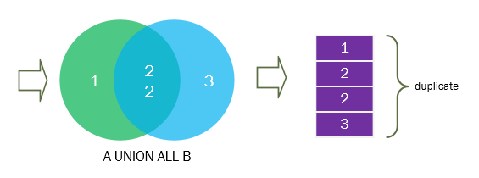
SQL UNION operator
The UNION operator combines result sets of two or more SELECT statements into a single result set.

Slide 5
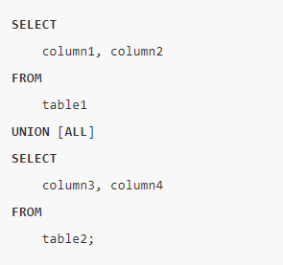
SQL UNION Syntax
Using the UNION operator to combine result sets of two queries:

Slide 6
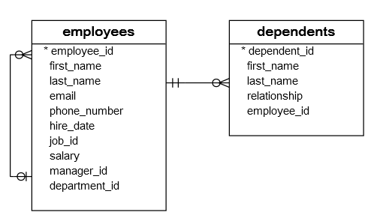
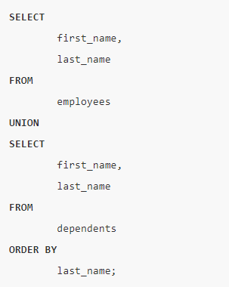
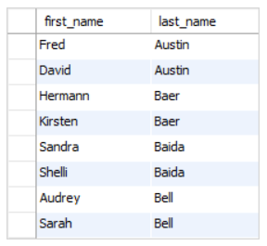
SQL UNION Example
Notes:
SELECT last_name FROM employees where last_name like 'K%g' UNION all SELECT last_name FROM dependents where last_name like 'K%g'

Slide 7
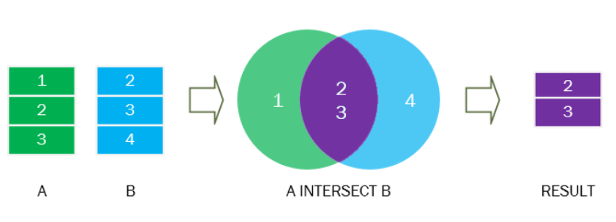
SQL INTERSECT operator
The INTERSECT operator is a set operator that returns distinct rows of two or more result sets from SELECT statements.

Slide 8
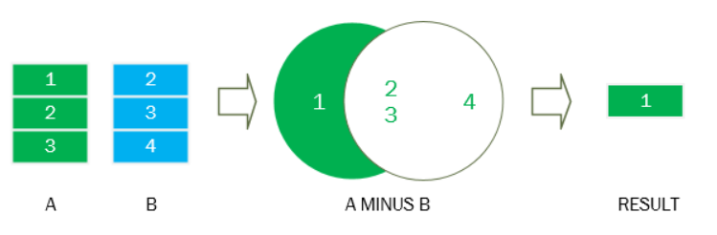
SQL MINUS operator
The MINUS operator is a set operator that allows you to subtract one result set from another result set.

Slide 9
Subquery

Slide 10
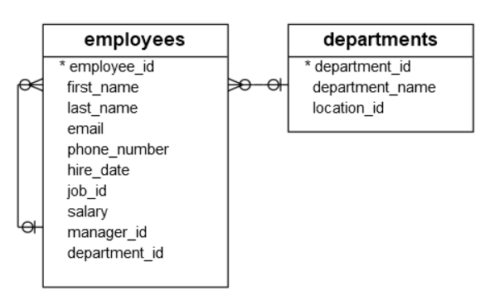
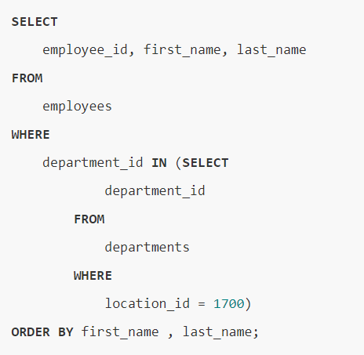
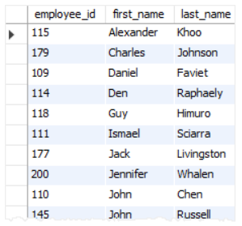
SQL subquery with IN
Example: Find all employees who locate in the location 1700:
Notes:
SELECT * FROM departments WHERE location_id = 1700;
SELECT employee_id, first_name, last_name FROM employees WHERE department_id IN (1 , 3, 8, 10, 11) ORDER BY first_name , last_name;
SELECT employee_id, first_name, last_name FROM employees WHERE department_id IN (SELECT department_id FROM departments WHERE location_id = 1700) ORDER BY first_name , last_name;

Slide 11
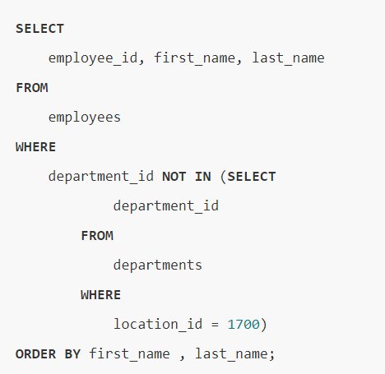
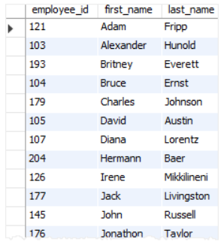
SQL subquery with NOT IN operator
Example: Find all employees who do not locate in the location 1700:
Notes:
SELECT employee_id, first_name, last_name FROM employees WHERE department_id NOT IN (SELECT department_id FROM departments WHERE location_id = 1700) ORDER BY first_name , last_name;

Slide 12
Joining Multiple Tables
INNER JOIN – introduce you to the join concept and show you how to use the INNER JOIN clause to combine data from multiple tables.
LEFT [RIGHT] OUTER JOIN – provide you with another kind of joins that allows you to combine data from multiple tables.
FULL OUTER JOIN – join multiple tables by including rows from both tables whether or not the rows have matching rows from another table.
SELF JOIN – join a table to itself using either the inner join or left join clause.

Slide 13
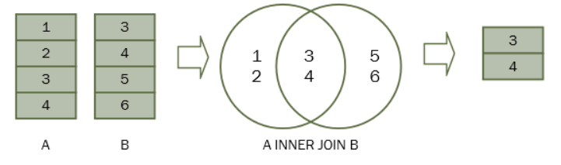
SQL INNER JOIN
The inner join clause links two (or more) tables by a relationship between two columns.
Notes:
Whenever you use the inner join clause, you normally think about the intersection.

Slide 14
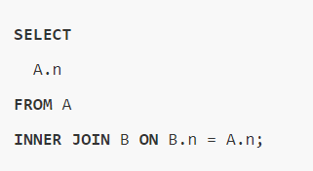
SQL INNER JOIN Syntax
Suppose the column name of the A & B tables is n, the following statement illustrates the inner join clause:
Notes:
Whenever you use the inner join clause, you normally think about the intersection.

Slide 15
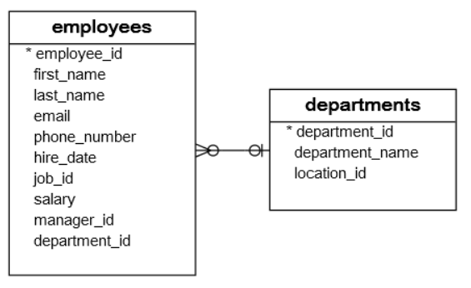
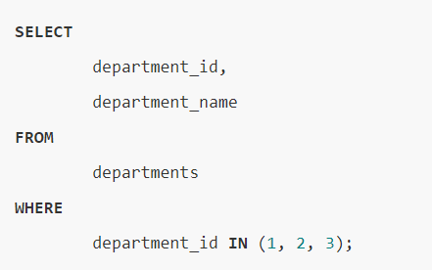
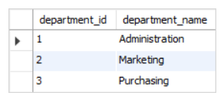
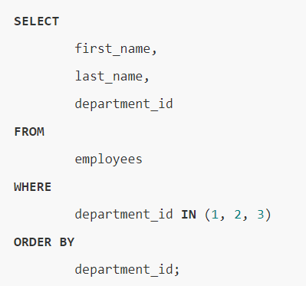
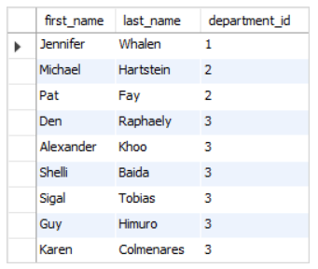
SQL INNER JOIN 2 tables example
Table: departments
Table: employees
Notes:
SELECT department_id, department_name FROM departments WHERE department_id IN (1, 2, 3);
SELECT first_name, last_name, department_id FROM employees WHERE department_id IN (1, 2, 3) ORDER BY department_id;

Slide 16
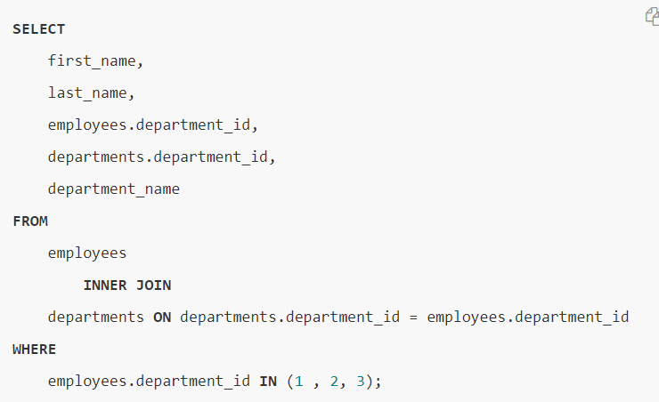
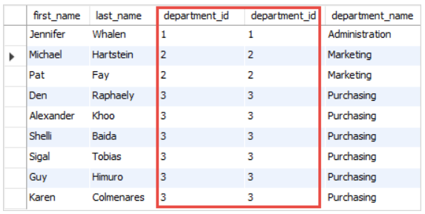
SQL INNER JOIN 2 tables example (2)
Notes:
SELECT first_name, last_name, employees.department_id, departments.department_id, department_name FROM employees INNER JOIN departments ON departments.department_id = employees.department_id WHERE employees.department_id IN (1 , 2, 3);

Slide 17
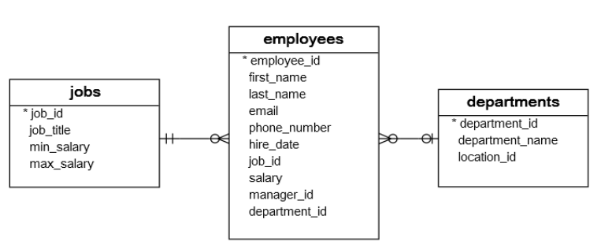
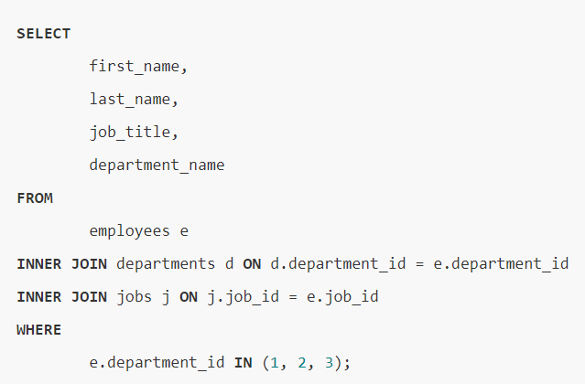
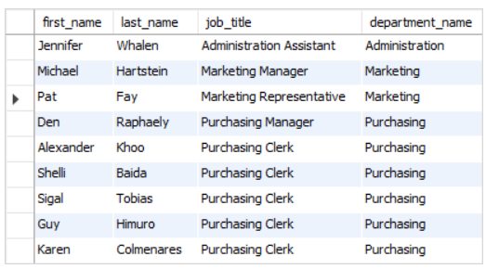
SQL INNER JOIN 3 tables example
Notes:
SELECT first_name, last_name, job_title, department_name FROM employees e INNER JOIN departments d ON d.department_id = e.department_id INNER JOIN jobs j ON j.job_id = e.job_id WHERE e.department_id IN (1, 2, 3);

Slide 18
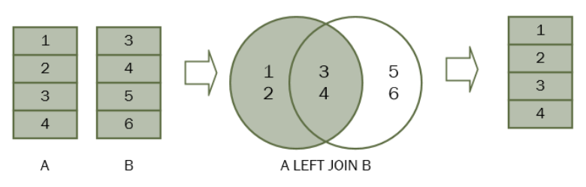
SQL LEFT JOIN
The left join returns all rows from the left table whether or not there is a matching row in the right table.

Slide 19
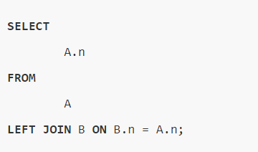
SQL LEFT JOIN Syntax
Suppose the column name of the A & B tables is n, the following statement illustrates the left join clause:

Slide 20
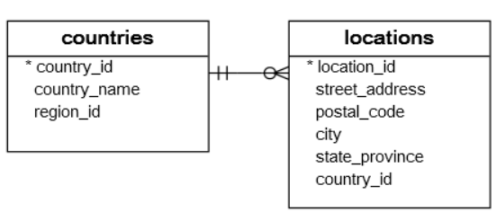
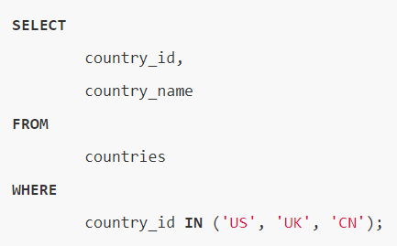
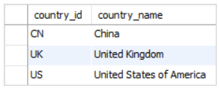
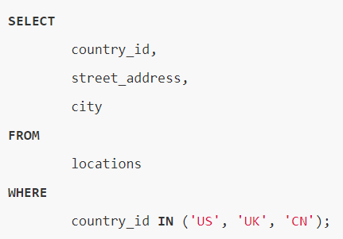
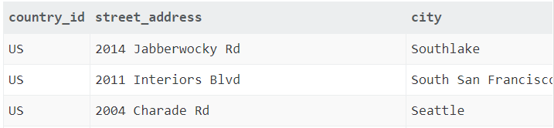
SQL LEFT JOIN 2 tables example
Table: countries
Table: employees
Notes:
SELECT country_id, country_name FROM countries WHERE country_id IN ('US', 'UK', 'CN’);
SELECT country_id, street_address, city FROM locations WHERE country_id IN ('US', 'UK', 'CN’);

Slide 21
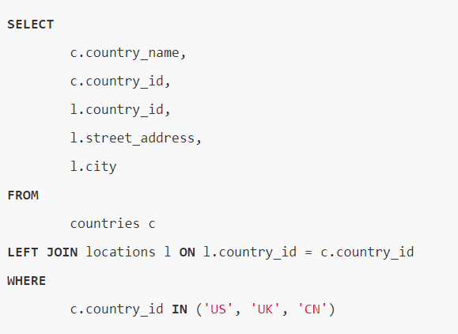
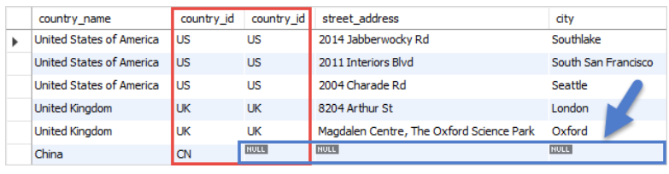
SQL LEFT JOIN 2 tables example (2)
Notes:
SELECT c.country_name, c.country_id, l.country_id, l.street_address, l.city FROM countries c LEFT JOIN locations l ON l.country_id = c.country_id WHERE c.country_id IN ('US', 'UK', 'CN’)
non-matching rows in the right table are filled with the NULL values, you can apply the LEFT JOIN clause to miss-match rows between tables.
The condition in the WHERE clause is applied so that the statement only retrieves the data from the US, UK, and China rows.
Because we use the LEFT JOIN clause, all rows that satisfy the condition in the WHERE clause of the countries table are included in the result set.
For each row in the countries table, the LEFT JOIN clause finds the matching rows in the locations table.
If at least one matching row found, the database engine combines the data from columns of the matching rows in both tables.
In case there is no matching row found e.g., with the country_id CN, the row in the countries table is included in the result set and the row in the locations table is filled with NULL values. Because non-matching rows in the right table are filled with the NULL values, you can apply the LEFT JOIN clause to miss-match rows between tables

Slide 22
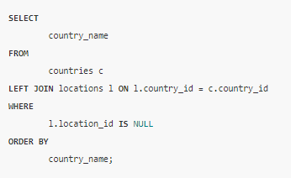
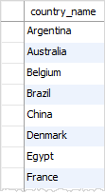
EX. find the country that does not have any locations in the locations table

Slide 23
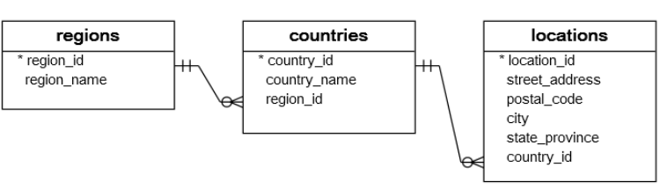
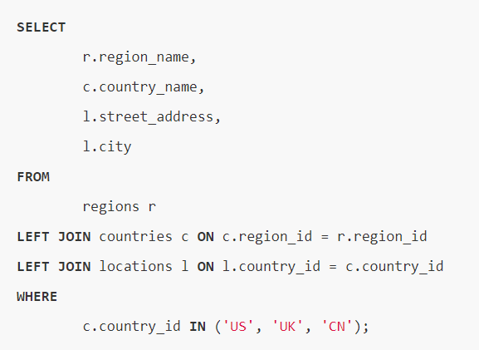
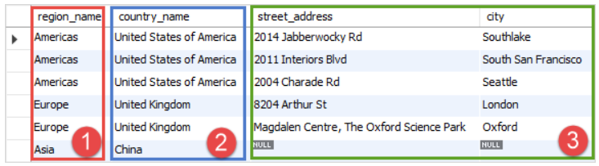
SQL LEFT JOIN 3 tables example
Notes:
SELECT r.region_name, c.country_name, l.street_address, l.city FROM regions r LEFT JOIN countries c ON c.region_id = r.region_id LEFT JOIN locations l ON l.country_id = c.country_id WHERE c.country_id IN ('US', 'UK', 'CN');

Slide 24
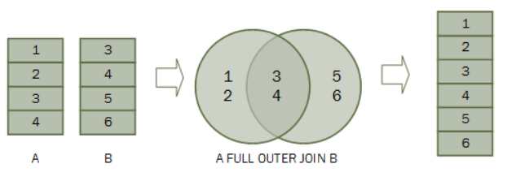
SQL FULL OUTER JOIN
A full outer join is the combination of a left join and a right join. The full outer join includes all rows from the joined tables whether or not the other table has the matching row.

Slide 25
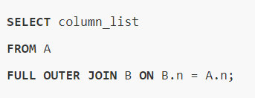
SQL FULL OUTER JOIN Syntax
Suppose the column name of the A & B tables is n, the following statement illustrates the full outer join clause:
Notes:
Whenever you use the inner join clause, you normally think about the intersection.

Slide 26
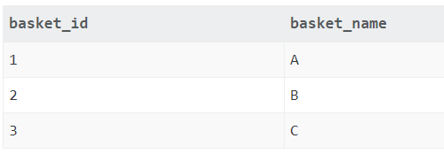
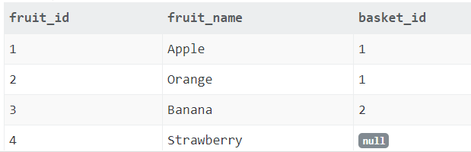
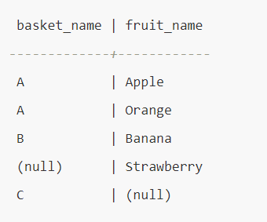
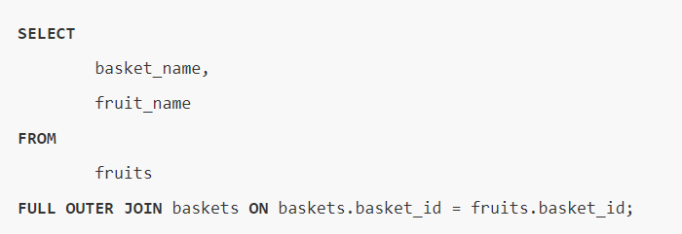
SQL FULL OUTER JOIN example
Table: baskets
Table: fruits
Notes:
Whenever you use the inner join clause, you normally think about the intersection.

Slide 27
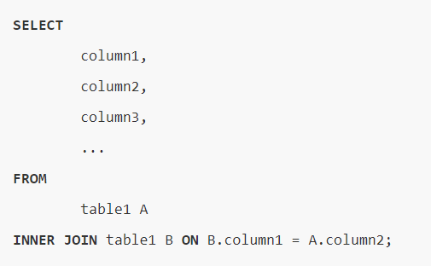
SQL SELF JOIN
We join a table to itself to evaluate the rows with other rows in the same table. To perform the self-join, we use either an inner join or left join clause.
Notes:
Whenever you use the inner join clause, you normally think about the intersection.

Slide 28
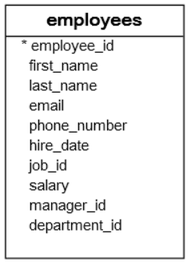
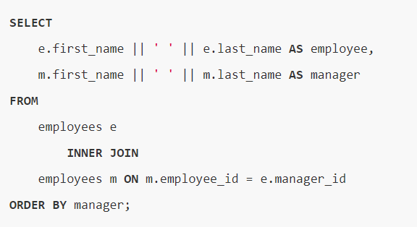
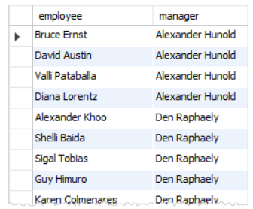
SQL SELF JOIN example
Notes:
SELECT e.first_name || ' ' || e.last_name AS employee, m.first_name || ' ' || m.last_name AS manager FROM employees e INNER JOIN employees m ON m.employee_id = e.manager_id ORDER BY manager;

Slide 29
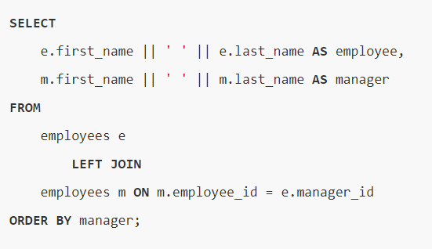

SQL SELF JOIN example (2)
Notes:
SELECT e.first_name || ' ' || e.last_name AS employee, m.first_name || ' ' || m.last_name AS manager FROM employees e LEFT JOIN employees m ON m.employee_id = e.manager_id ORDER BY manager;

Slide 30
References
SQL Tutorial: https://www.sqltutorial.org/
Sample Datasets: https://www.sqltutorial.org/sql-sample-database/

Slide 31

Thank you.

