Slide 1




AT82.02
Data Modeling and Management
Lab3: Basic SQL Commands

Slide 2
Basic SQL Query
Selecting Data
Filtering Data
Sorting Data
Aggregation Functions (e.g., COUNT, SUM, AVG, MIN, MAX)
GROUP BY
HAVING
Notes:
https://www.sqltutorial.org/seeit/

Slide 3
SELECT Syntax
SELECT expressions
FROM tables
[WHERE conditions]
[GROUP BY expressions]
[HAVING conditions]
[ORDER BY expression [ ASC | DESC ]]
[LIMIT number_rows ]

Slide 4
Simple form
SELECT expressions
FROM tables
[WHERE conditions]
[GROUP BY expressions]
[HAVING conditions]
[ORDER BY expression [ ASC | DESC ]]
[LIMIT number_rows ]

Slide 5
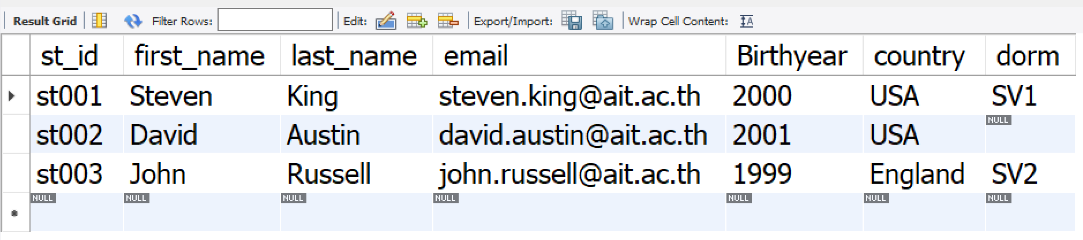
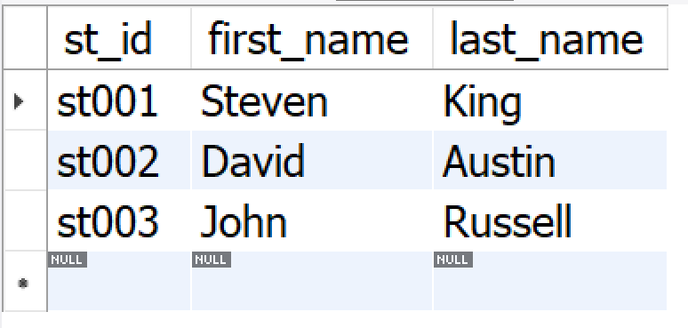
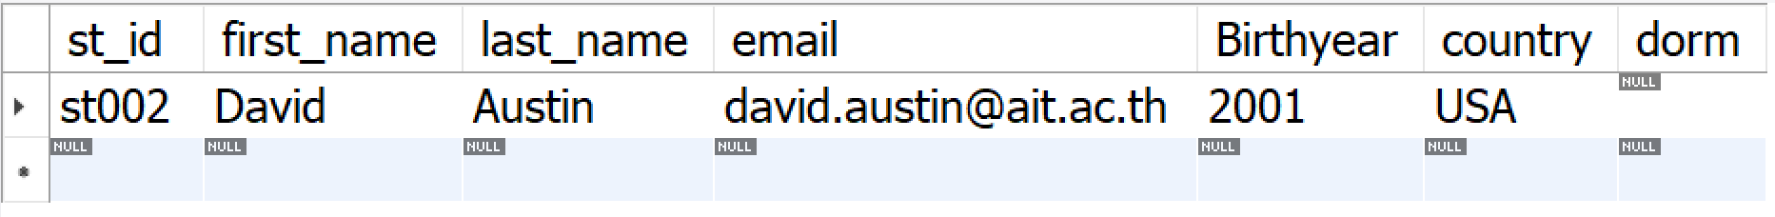
SQL Query
Table students
For listing all columns, ‘*’
SELECT *
FROM students
SELECT st_id, first_name, last_name
FROM students
SELECT *
FROM students
WHERE st_id = ‘st002’
Notes:
SELECT employee_id, first_name, last_name
FROM employees
WHERE employee_id = 100
SELECT *
FROM employees
WHERE employee_id = 100

Slide 6
Sorting Data
SELECT expressions
FROM tables
[WHERE conditions]
[GROUP BY expressions]
[HAVING conditions]
[ORDER BY expression [ ASC | DESC ]]
[LIMIT number_rows ]

Slide 7
Sorting Data
ORDER BY sort the output rows
Sorting the output rows make it easier to read the results
ORDER BY
DESC: high to low
ASC: low to high <- default
ORDER BY can be used with more than 1 column name
Only when the value in the first column is equal, the second column will be used.

Slide 8
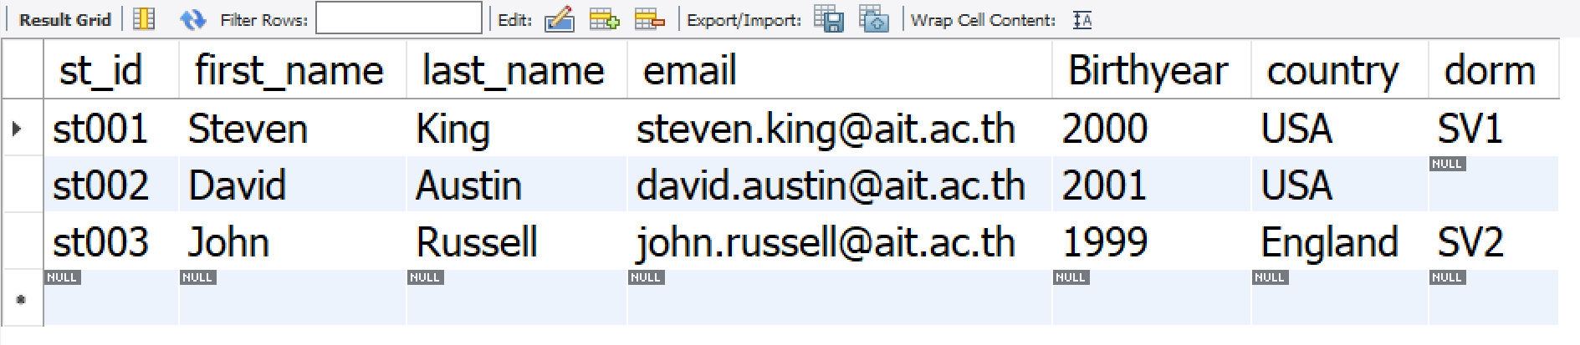
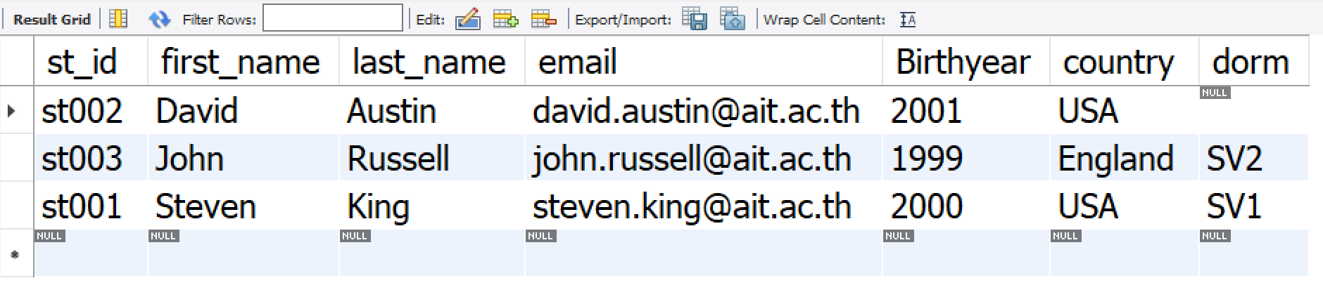
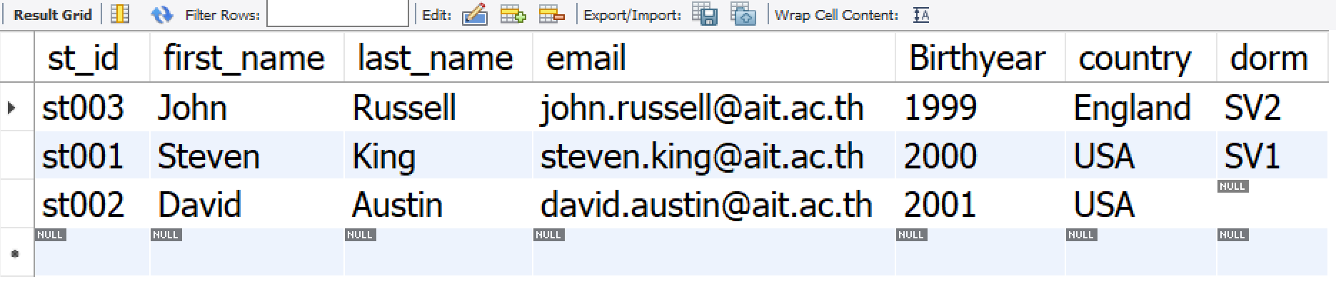
Table students
Sorting
SELECT *
FROM students
SELECT *
FROM students
ORDER BY first_name
SELECT *
FROM students
ORDER BY last_name DESC
Notes:
SELECT employee_id, first_name, last_name
FROM employees
WHERE employee_id = 100
SELECT *
FROM employees
WHERE employee_id = 100

Slide 9
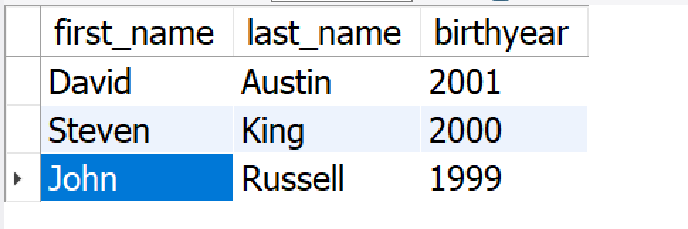
Sorting Data
Example
/* sort the results by year of birth (later year first), if the same year, then sort by lastname (a->z) */
SELECT first_name, last_name, birthyear
FROM students
ORDER BY birthyear DESC, lastname

Slide 10
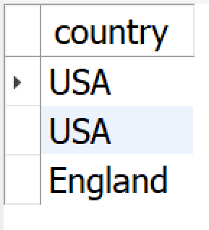
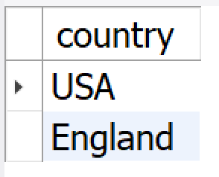
Output Adjustments
Duplicate Elimination :
In SQL, duplicated output rows must be explicitly eliminated using ‘DISTINCT’, e.g.
SELECT country FROM students /* one country can have more than one students so there may be rows with the same country*/
SELECT DISTINCT country FROM courses /* this will eliminate duplicated rows*/

Slide 11
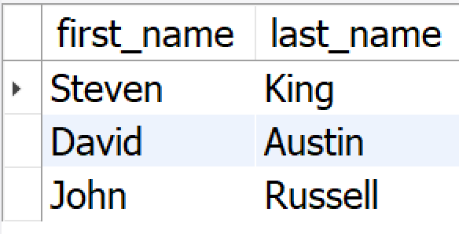
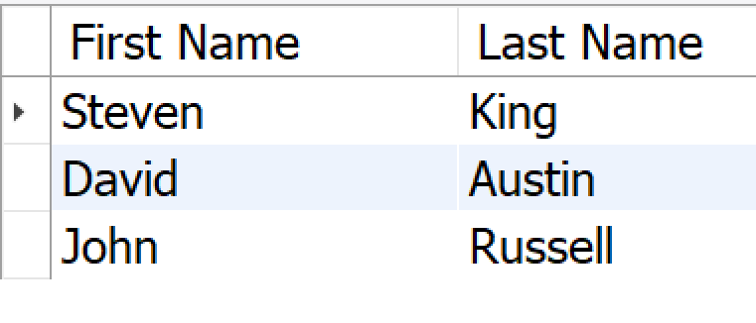
Output Adjustments
Renaming output columns
Output column can be renamed,
for example,
SELECT first_name "First Name" , last_name "Last Name“ FROM students

Slide 12
Filtering Data : WHERE
SELECT expressions
FROM tables
[WHERE conditions]
[GROUP BY expressions]
[HAVING conditions]
[ORDER BY expression [ ASC | DESC ]]
[LIMIT number_rows ]

Slide 13
Filtering Data : WHERE
Comparison Operators
BETWEEN Operators
IN Operators
LIKE Operators
IS NULL Operators
NOT Operators
AND, OR, NOT Operators

Slide 14
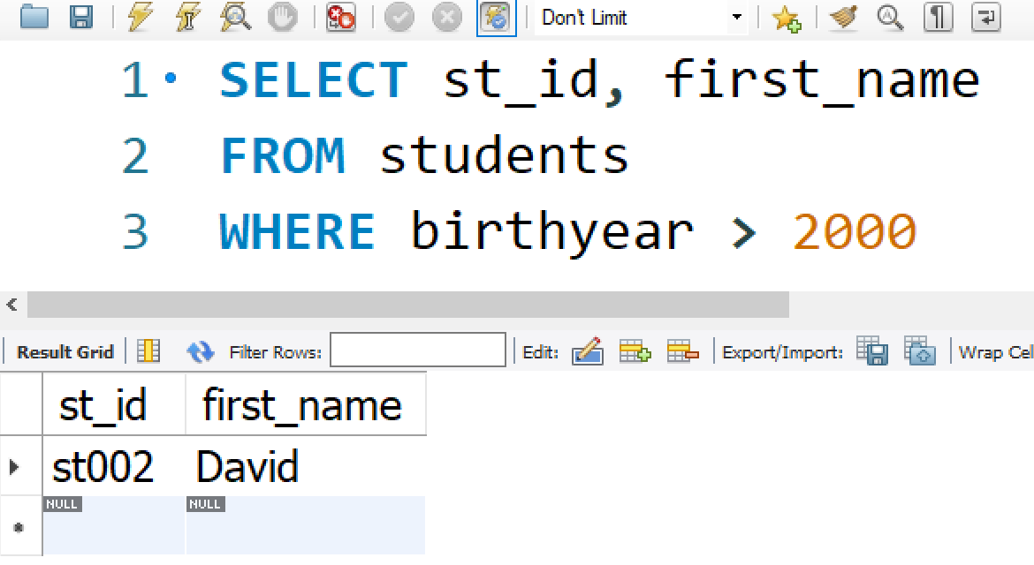
Filtering Data (cont.)
Comparisons
Operators: =, >, <, >=, <=, <> (not equal, != can also be used)
Comparison operators can be used for both numbers and strings:
Example:
WHERE birthyear > 2000

Slide 15
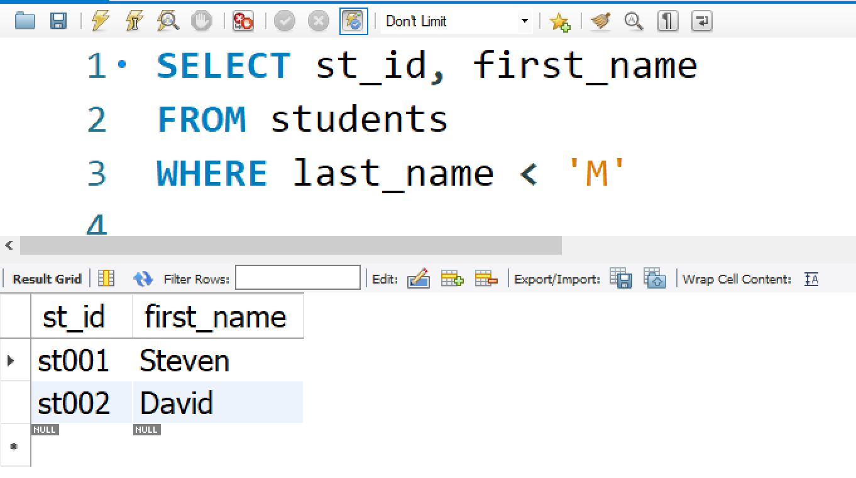
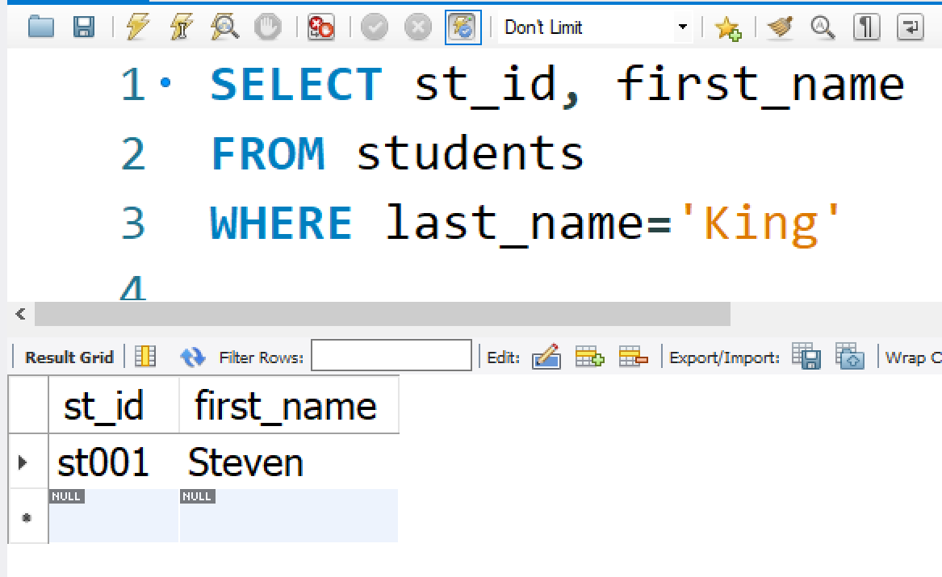
Filtering Data (cont.)
WHERE last_name < ‘M’
WHERE last_name=‘King’

Slide 16
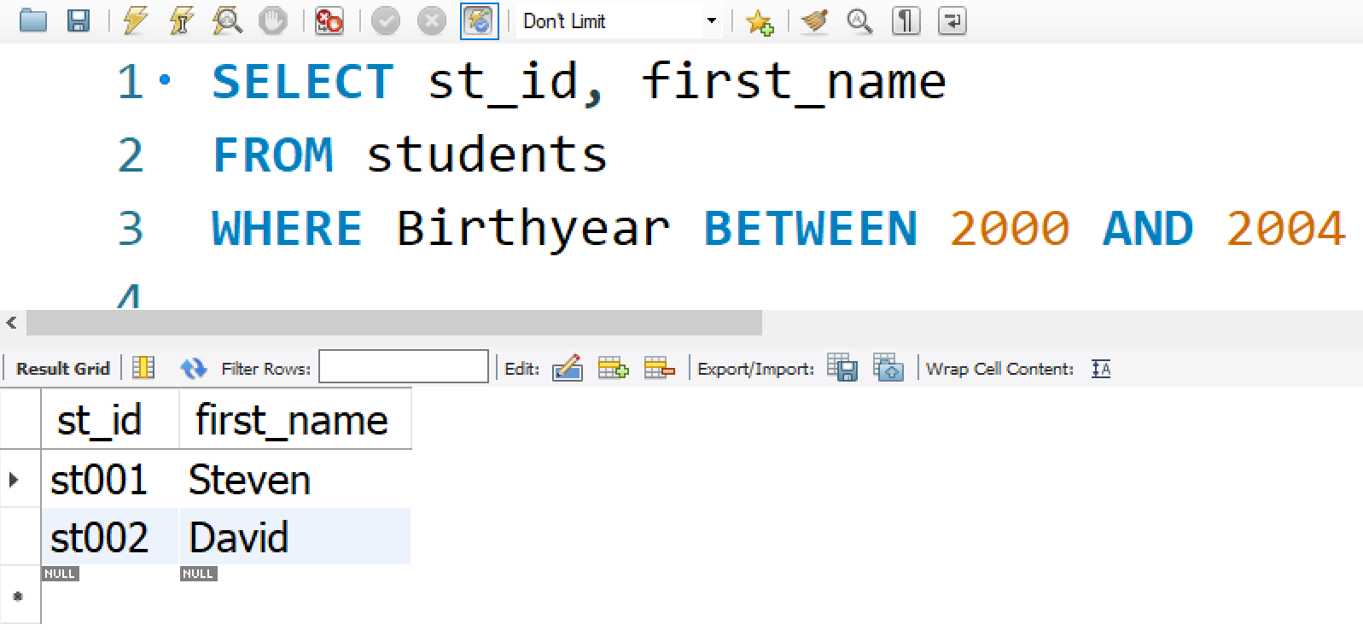
Filtering Data (cont.)
BETWEEN… AND
The following conditions are equivalent
WHERE Birthyear BETWEEN 2000 AND 2004

Slide 17
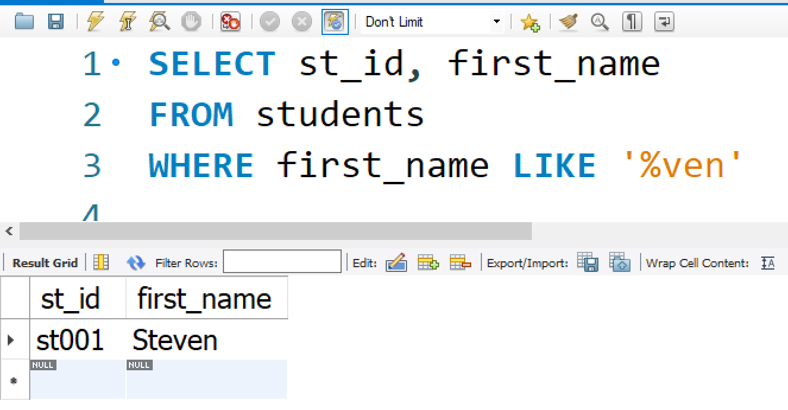
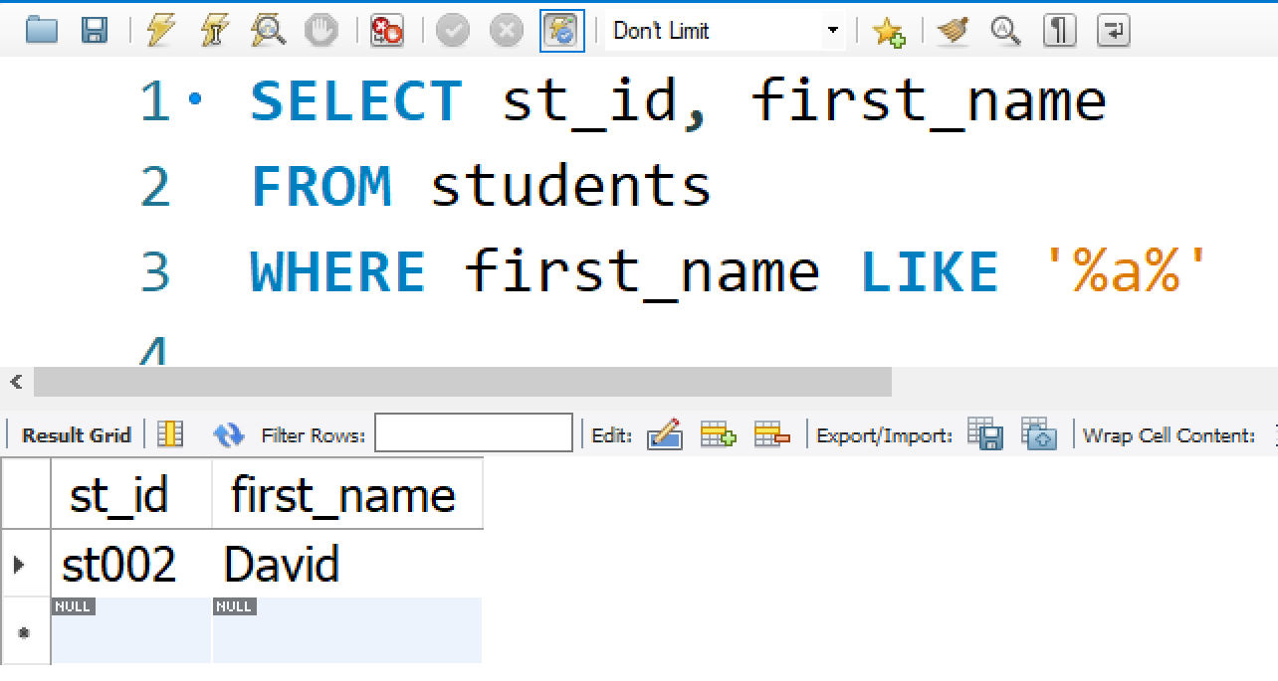

Filtering Data (cont.)
LIKE
‘%’ match any sequence of characters in the string
E.g. WHERE first_name LIKE ‘%ven’
WHERE first_name LIKE ‘%a%’
‘_’ match any single character in the string
E.g. WHERE first_name LIKE ‘Joh_’

Slide 18
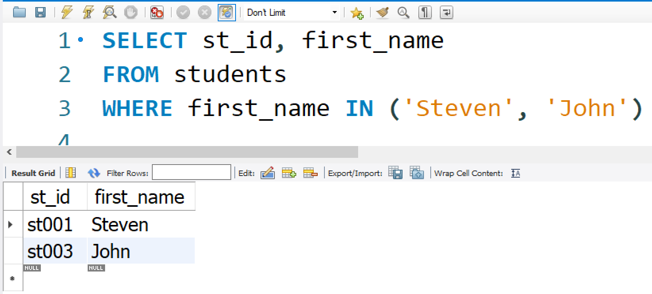
Filtering Data (cont.)
IN
The following conditions are equivalent
WHERE first_name IN (‘Steven’, ‘John’)

Slide 19
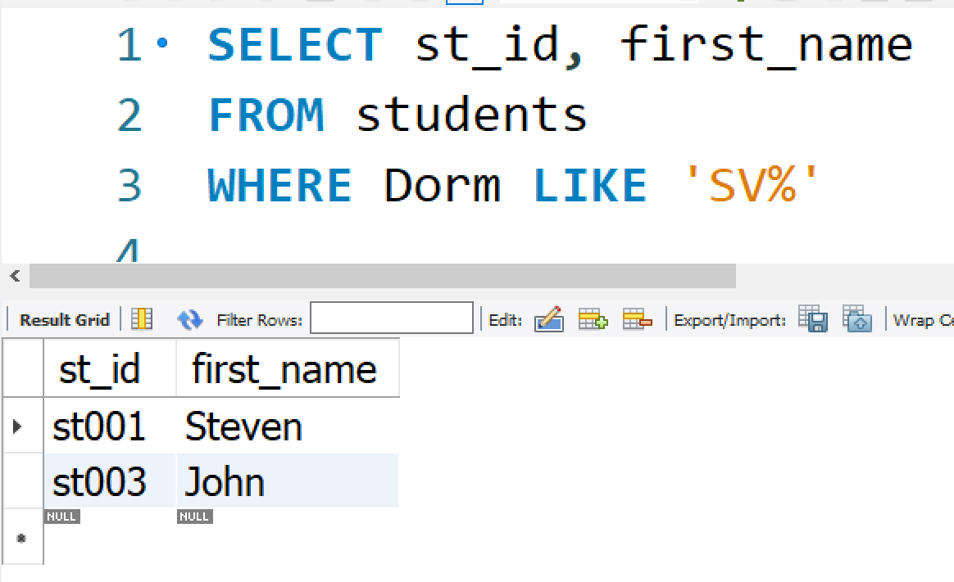
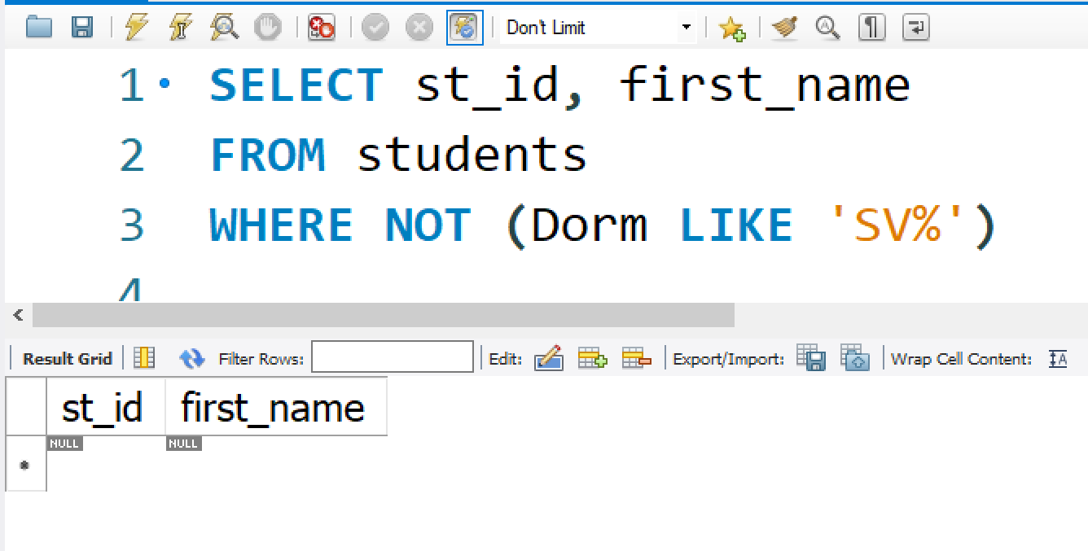
Filtering Data (cont.)
Usually, null value will not match any
condition
For example,
WHERE (Dorm LIKE ‘SV%’)
WHERE NOT (Dorm LIKE ‘SV%’)
Both conditions will not return those with null values

Slide 20
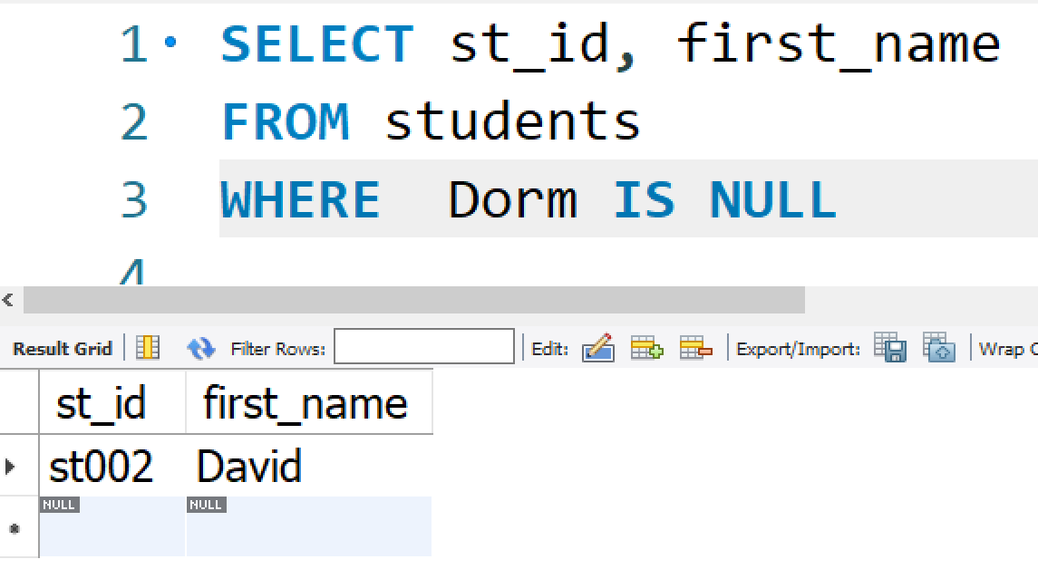
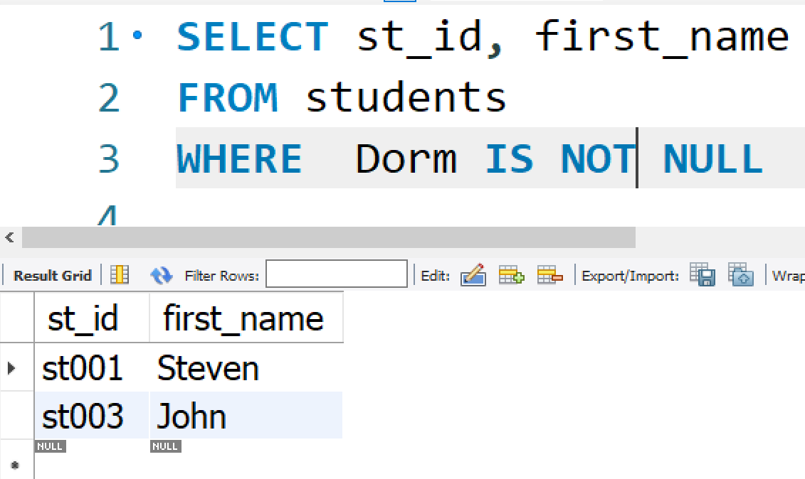
Filtering Data (cont.)
IS NULL, IS NOT NULL
Test for null value, e.g.
WHERE Dorm IS NULL WHERE Dorm IS NOT NULL
WHERE Dorm = NULL will not give the correct results !!

Slide 21
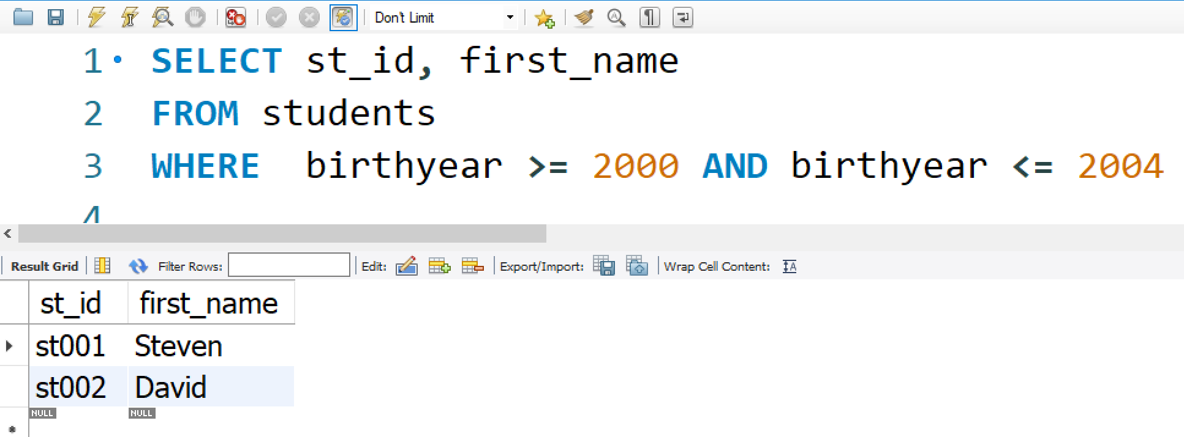
Filtering Data (cont.)
AND, OR, NOT
If there is no parentheses ‘(..)’ the order of processing will be: NOT, AND, OR
WHERE birthyear >= 2000 AND score <= 2004

Slide 22
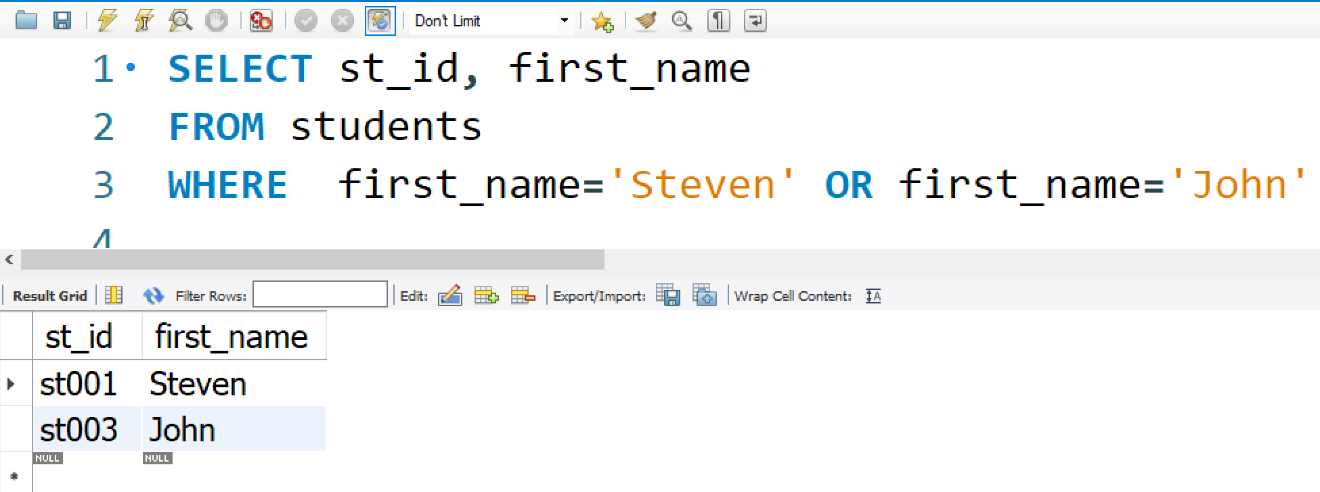
Filtering Data (cont.)
AND, OR, NOT
WHERE first_name=‘Steven’ OR first_name=‘John’

Slide 23
SELECT Syntax
SELECT expressions
FROM tables
[WHERE conditions]
[GROUP BY expressions]
[HAVING conditions]
[ORDER BY expression [ ASC | DESC ]]
[LIMIT number_rows ]

Slide 24
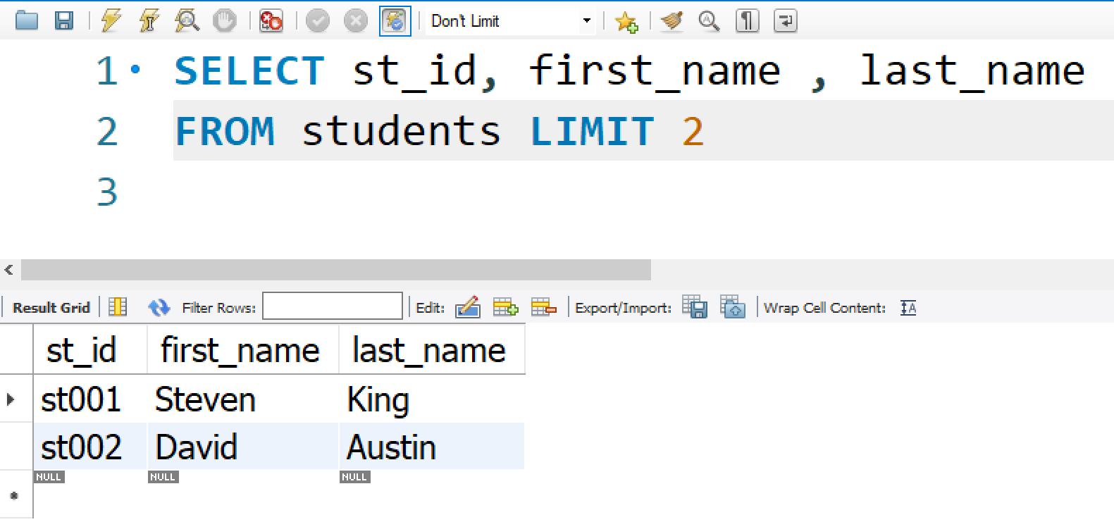
LIMIT
LIMIT is used to retrieve records from one or more tables in a database and limit the number of records returned based on a limit value.
Example - Using LIMIT keyword SELECT st_id, first_name , last_name FROM students LIMIT 2
Notes:
https://www.sqltutorial.org/seeit/query/sql-limit/#3

Slide 25
Aggregation Functions
Convert set into a single value, e.g. min{20,55,16,73} = 16
SQL Aggregation functions
COUNT: Counting total number
SUM: Sum total value
AVG: Average value
MIN: Minimum value
MAX: Maximum value

Slide 26
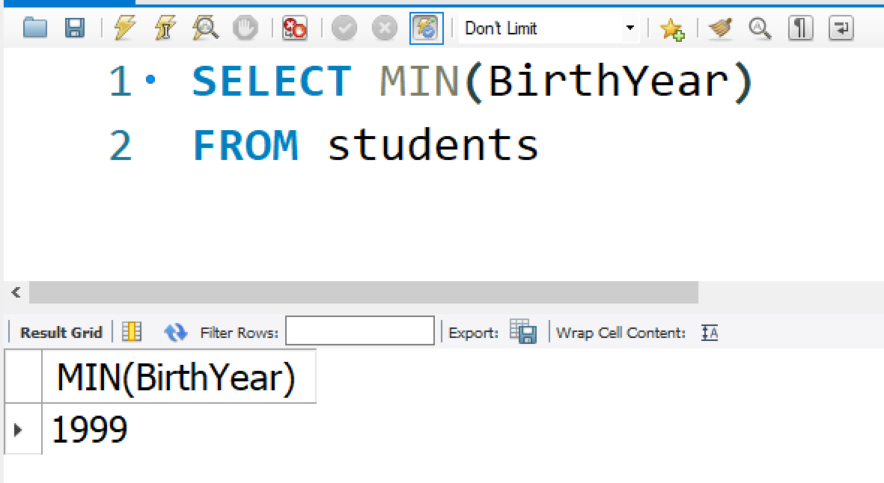
Aggregation Examples
Examples
/* show minimum birthyear of students */
SELECT MIN(BirthYear)
FROM students
Notes:
SELECT * from students where birthyear= (select MIN(BirthYear) from students);

Slide 27
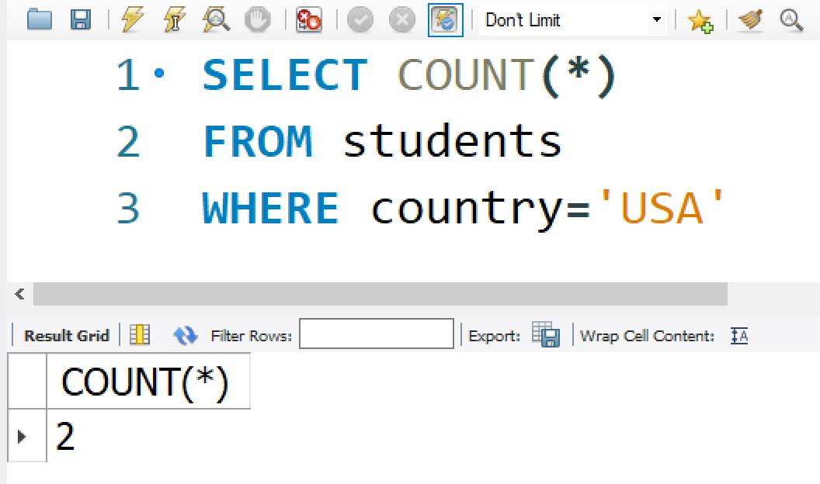
Aggregation Examples
Examples
/* count number of students from USA*/
SELECT COUNT(*)
FROM students
WHERE country=‘USA’

Slide 28
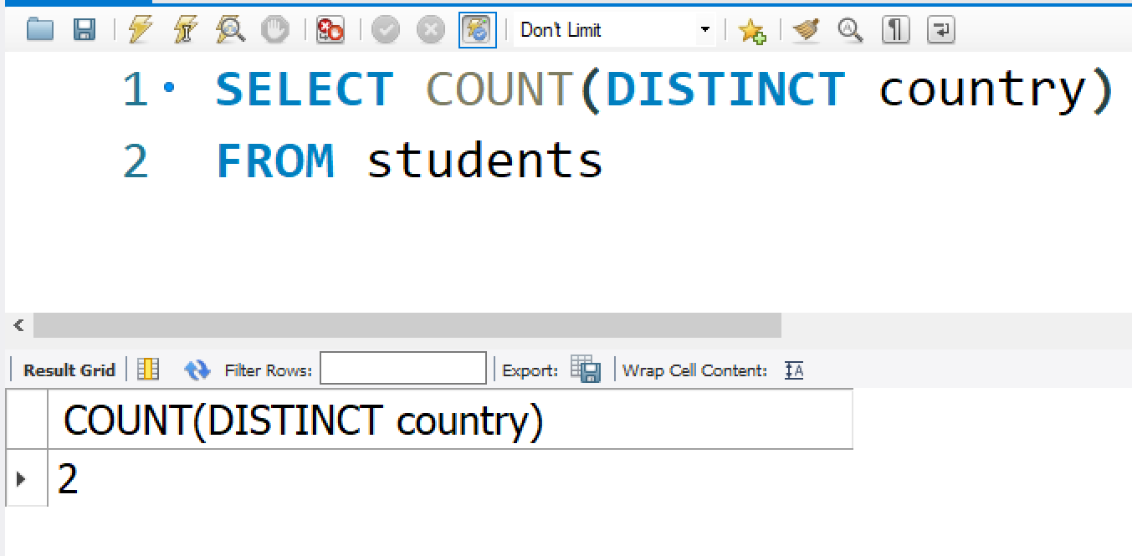
Aggregation Examples
Examples
/* count the number of countries that the students are from */
SELECT COUNT(DISTINCT country)
FROM students

Slide 29
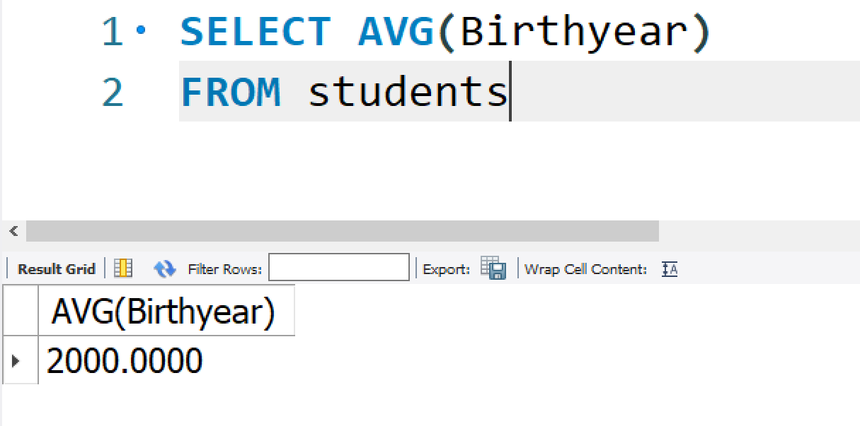
Aggregations Examples (2)
Examples
/* find average student total score */
SELECT AVG(Birthyear)
FROM students

Slide 30
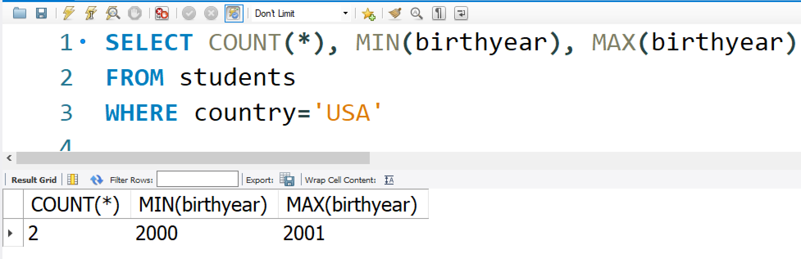
Aggregations Examples (2)
Examples /* find total number, minimum-maximum birthyear of USA students*/
SELECT COUNT(*), MIN(birthyear), MAX(birthyear) FROM students WHERE country=‘USA’

Slide 31
Aggregation Syntax
SUM and AVG only take columns that are numbers as arguments
COUNT, MIN, MAX accept any data type
Aggregations can only be used after ‘SELECT’
Aggregation can not be used in WHERE clause, e.g. ‘WHERE birthyear > min(birthyear)’ is WRONG
When aggregations are used, normal column names can not be used in ‘SELECT’
For example, the following query is WRONG
SELECT firstname, avg (birthyear)
FROM students

Slide 32
SELECT Syntax
SELECT expressions
FROM tables
[WHERE conditions]
[GROUP BY expressions]
[HAVING conditions]
[ORDER BY expression [ ASC | DESC ]]
[LIMIT number_rows ]

Slide 33
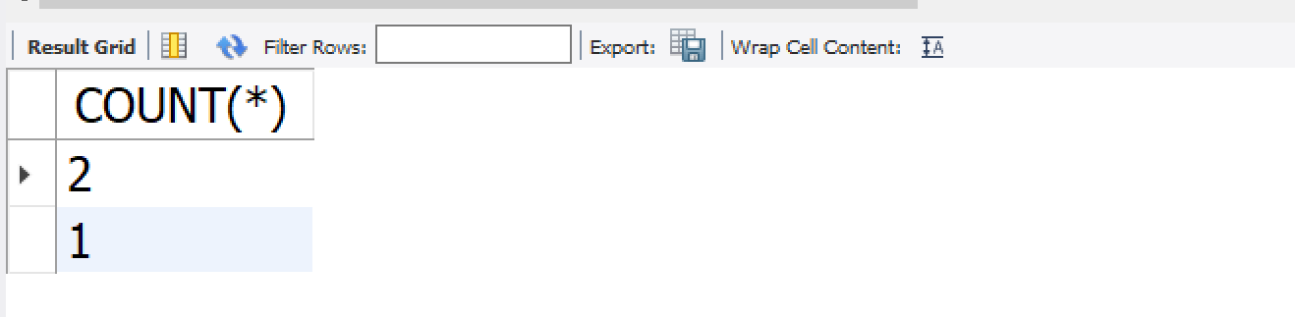
GROUP BY
GROUP BY allows aggregation to be done in groups instead of all rows
Example
/* Count the number of students from each country*/ SELECT COUNT(*) FROM students GROUP BY country
Output of GROUP BY has number of rows equal to number of existing groups
Without GROUP BY, output of aggregation always has one row

Slide 34
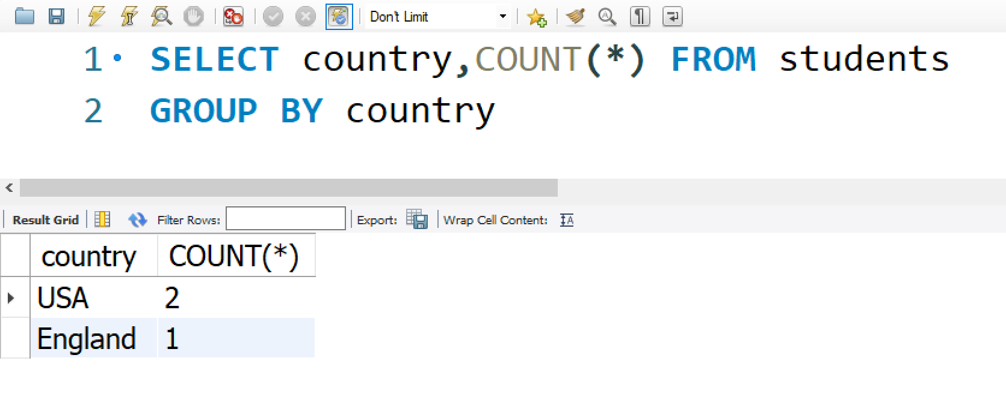
GROUP BY (2)
If there is an attribute name in ‘SELECT’ , it must be the same attribute name as used in in ‘GROUP BY’ clause
/* find the cities that student are from and number of students from each city */
SELECT country, COUNT(*)
FROM students
GROUP BY country

Slide 35
SELECT Syntax
SELECT expressions
FROM tables
[WHERE conditions]
[GROUP BY expressions]
[HAVING conditions]
[ORDER BY expression [ ASC | DESC ]]
[LIMIT number_rows ]

Slide 36
HAVING
Aggregations can not be used in WHERE condition
HAVING allows aggregations to be used as conditions
HAVING is used with GROUP BY to eliminate groups that do not meet the condition

Slide 37
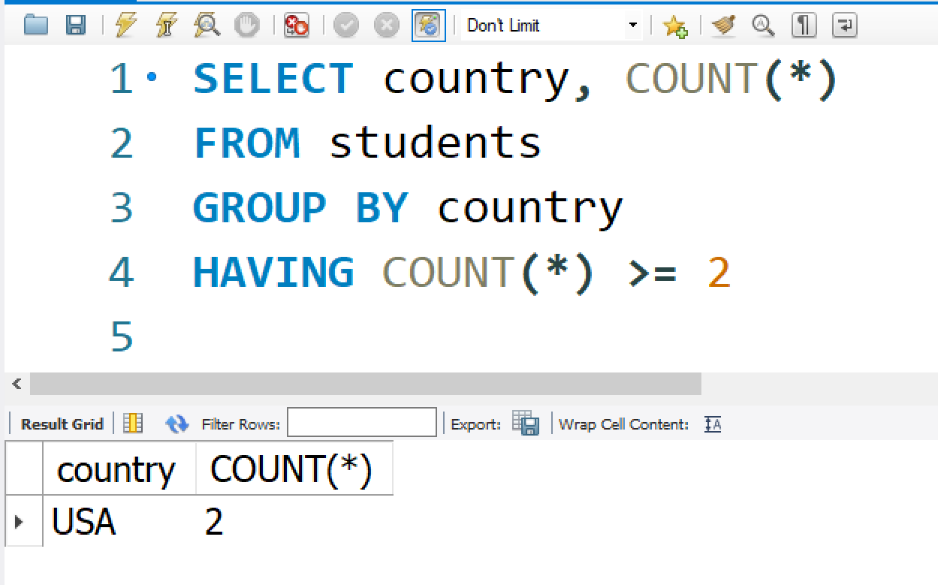
HAVING (2)
Example
/* list the country if at least 2 students are from and show the number of students from each country */
SELECT country, COUNT(*)
FROM students
GROUP BY country
HAVING COUNT(*) >= 2

Slide 38
References
SQL Tutorial : https://www.sqltutorial.org/

Slide 39

Thank you.

Slide 40
Attribute Reference
For non-duplicated column name, there is no need to reference table name before attribute name
For duplicated column names, the table name must be referenced before attribute name, e.g.,
/* list student names who are in the course ‘DMM101’*/
SELECT firstname, lastname, name /* no need for s.firstname */
FROM students s, courses c
WHERE s.course_id = c.course_id
AND s.course_id = ‘DMM101’ /* s.course_id or c.course_id is required*/

Slide 41
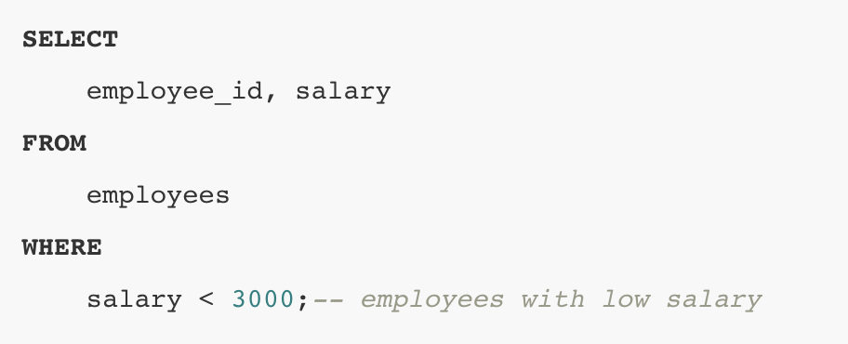
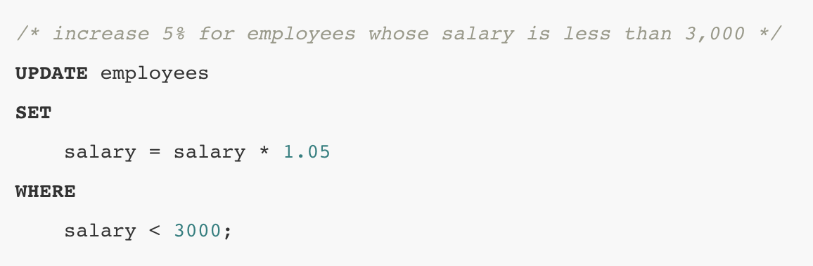
SQL Syntax
Keyword: SQL has many keywords that have special meanings such as SELECT, INSERT, UPDATE, DELETE, and DROP. These keywords are the reserved words.
Identifiers: Identifiers refer to specific objects in the database such as tables, columns, indexes, etc. SQL is case-insensitive with respect to keywords and identifiers.
Select * From employees;
SELECT * FROM EMPLOYEES;
Comments: When parsing SQL statements with comments, the database engine ignores the characters in the comments.
Notes:
SELECT employee_id, first_name, last_name
FROM employees
WHERE employee_id = 100
SELECT *
FROM employees
WHERE employee_id = 100

