Slide 1


This Photo by Unknown Author is licensed under CC BY
LAB Submission system: google
classroom

Slide 2




AT82.02
Data Modeling and Management
Lab6: MongoDB- Document Model

Slide 3
Outline
1. Connect to a MongoDB Cloud database
2. CRUD Operations of MongoDB
Create (Insert), Update, Delete Documents
Read data
Simple query
Query nested field
Aggregate function
Join/Link documents

Slide 4
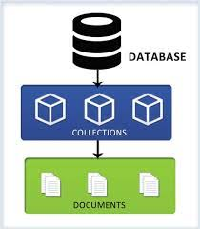
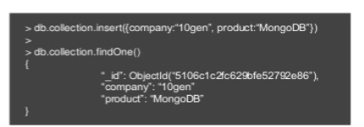

MongoDB Lab Architecture
DDM2020 MongoDB Cloud
MongoDB Shell
2 Databases
Shop101
RDBProject
Shop101
Customer
Username
st_dmm/st_dmm
onlne/online
offline/offline
mongo "mongodb+srv://dmmcluster.f1uoi. gcp.mongodb.net/<dbname>“ --username <username> --password <password>
i.e., mongo "mongodb+srv://dmmcluster.f1uoi.gcp.mongodb.net/shop101" --username st_dmm --password st_dmm
Notes:
D:
Cd D:\_Phd_Candidate\AITTA-DMM\mongodb-win32-x86_64-windows-4.4.1\bin
mongo "mongodb+srv://dmmcluster.f1uoi.gcp.mongodb.net/shop101" --username st_dmm --password st_dmm

Slide 5
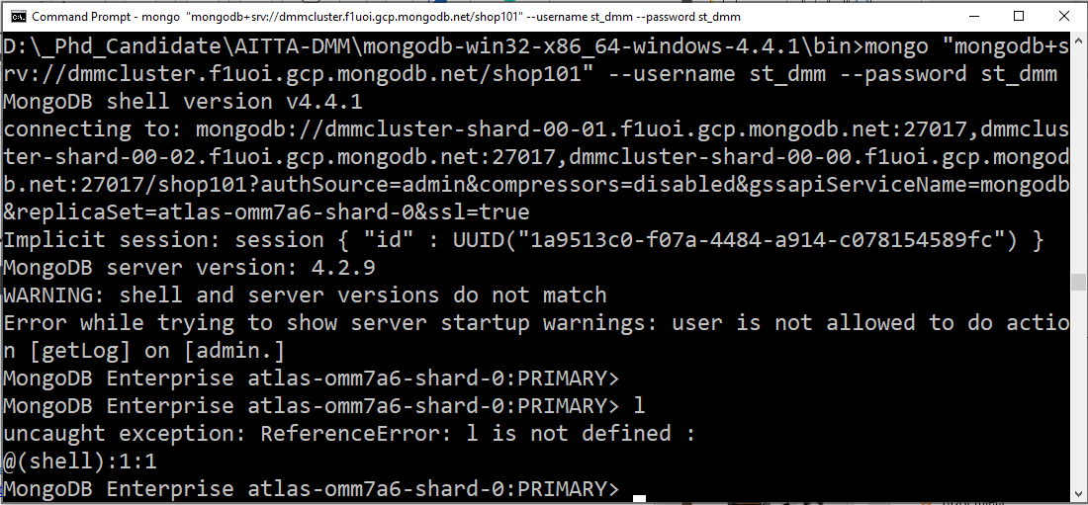
1.Connect to shop101 database
Notes:
D:
Cd D:\_Phd_Candidate\AITTA-DMM\mongodb-win32-x86_64-windows-4.4.1\bin
mongo "mongodb+srv://dmmcluster.f1uoi.gcp.mongodb.net/shop101" --username st_dmm --password st_dmm

Slide 6
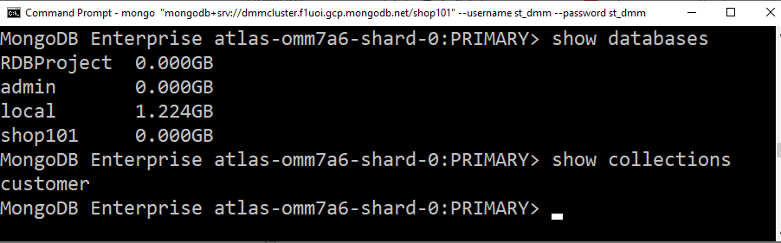
Common command in mongoDB shell more command : https://docs.mongodb.com/manual/reference/mongo-shell/
Show databases
Listing all the databases in mongoDB
Show collections
Listing all the tables in the current database

Slide 7
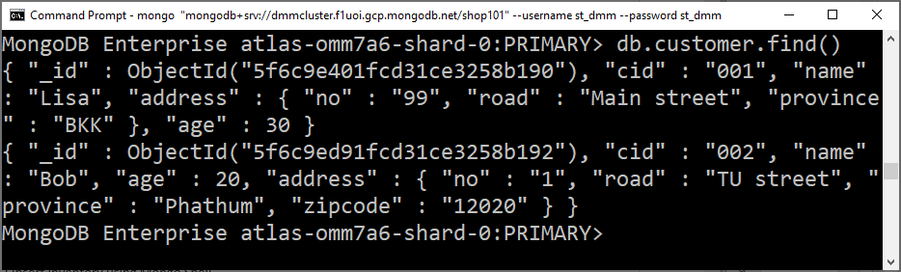
Common command in mongoDB shell more command : https://docs.mongodb.com/manual/reference/mongo-shell/
db.collection.find() : Find all documents in the collection.

Slide 8
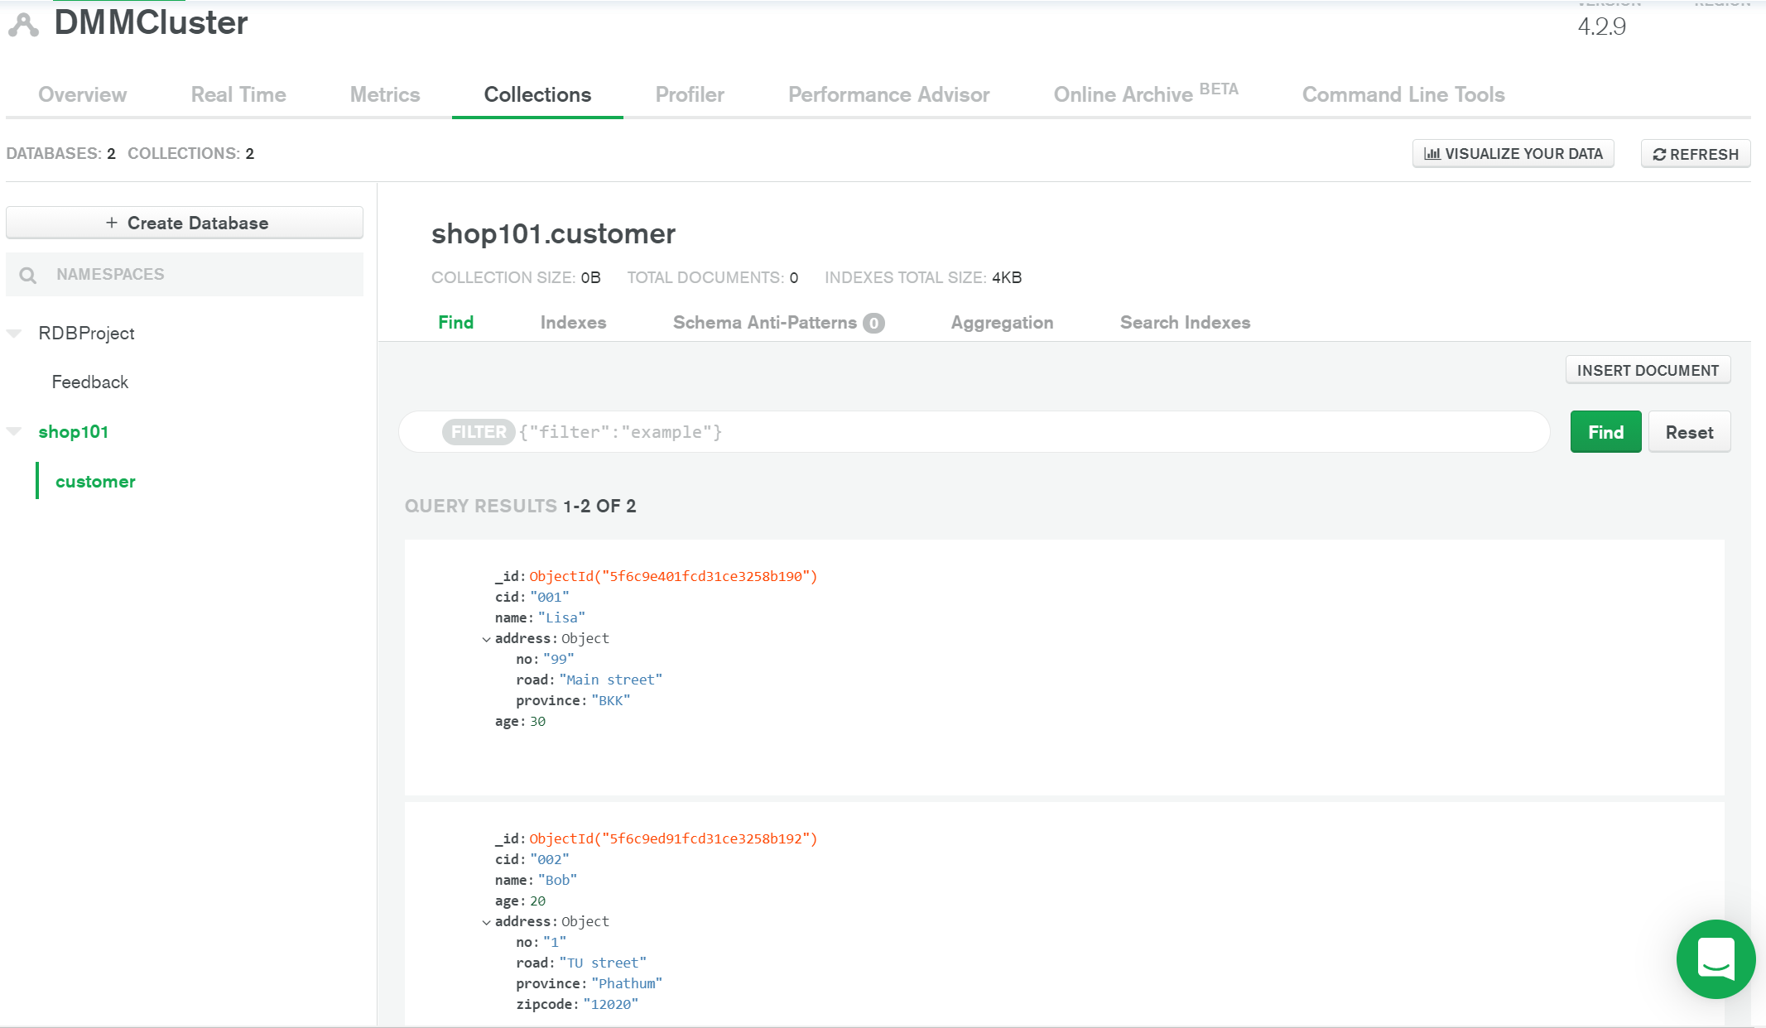
Shop101 Database in MongoDB Cloud Atlas

Slide 9
2. INSERT Operations of MongoDB

Slide 10
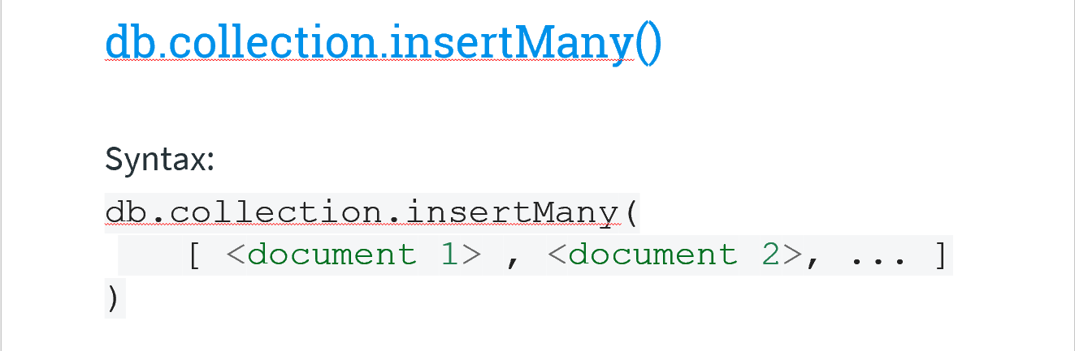


Insert Documents
Document Model Architecture
DDM2020 MongoDB Server
Shop101 Database
Insert information about inventory
Customer
canvas
pen
mat
mousepad
- Lisa - Bob

Slide 11
Insert inventory documents
db.inventory.insertOne(
{ item: "canvas", qty: 100, price: 500, tags: ["cotton"], size: { h: 28, w: 35.5, uom: "cm" } })
db.inventory.insertMany([
{ item: "pen", qty: 25, price: 200, tags: ["red"], size: { h: 14, w: 1, uom: "cm" } },
{ item: "mat", qty: 85, price: 99, tags: ["gray"], size: { h: 27.9, w: 35.5, uom: "cm" } },
{ item: "mousepad", qty: 25, price: 29, tags: ["gel", "blue"], size: { h: 19, w: 22.85, uom: "in" } }
])

Slide 12
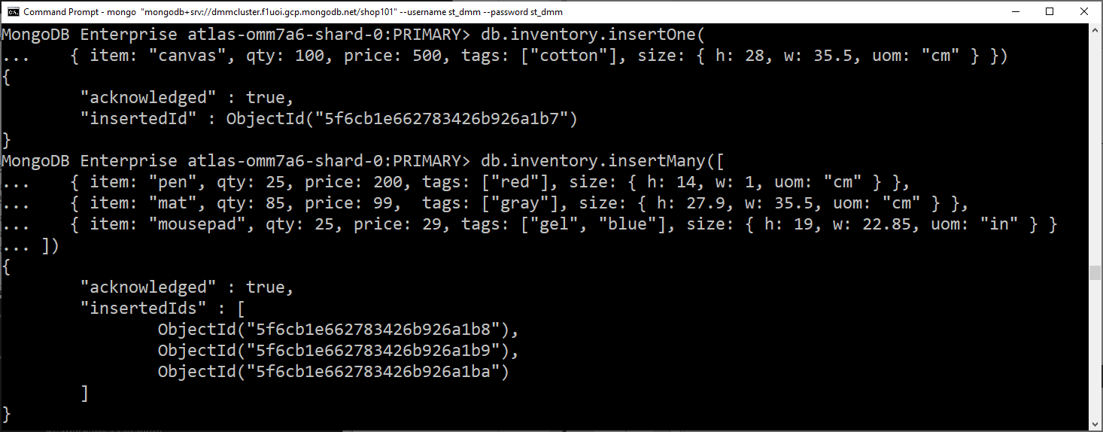

Slide 13
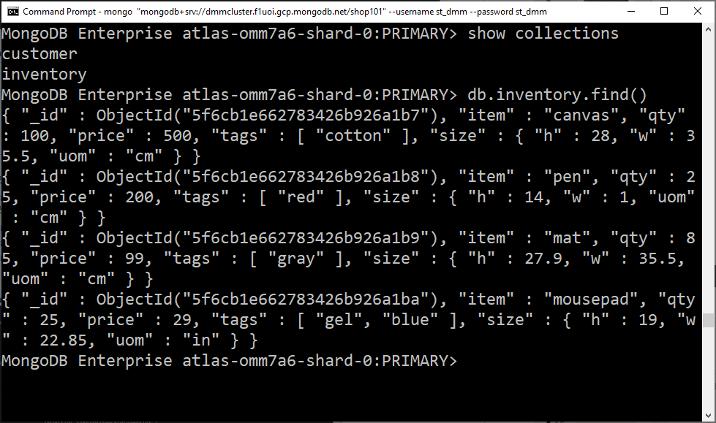
Verify the inventory insertion
DDM2020 MongoDB Cloud
Shop101 Database
Customer
Inventory
- Lisa - Bob
canvas
pen
mat
mousepad

Slide 14
Insert Sales information
Shop101 Database
Insert transaction about sales
Lisa bought 1 canvas and 1 pen …
Bob bought 1 mousepad …
Bob bought 1 mat …
Customer
Inventory
- Lisa - Bob
canvas
pen
mat
mousepad

Slide 15
Insert sales
db.sales.insertOne(
{ item: [{pid: "canvas", qty: 1, price: 500},{pid: "pen", qty: 1, price: 200}], customer:"Lisa" , total:700 , couponused:true })
db.sales.insertOne(
{ item: [{pid: "mousepad", qty: 1, price: 29}], customer:"Bob" , total:29, couponused:true })
db.sales.insertOne(
{ item: [{pid: "mat", qty: 1, price: 99}], customer:"Bob" , total:99, couponused:false })

Slide 16
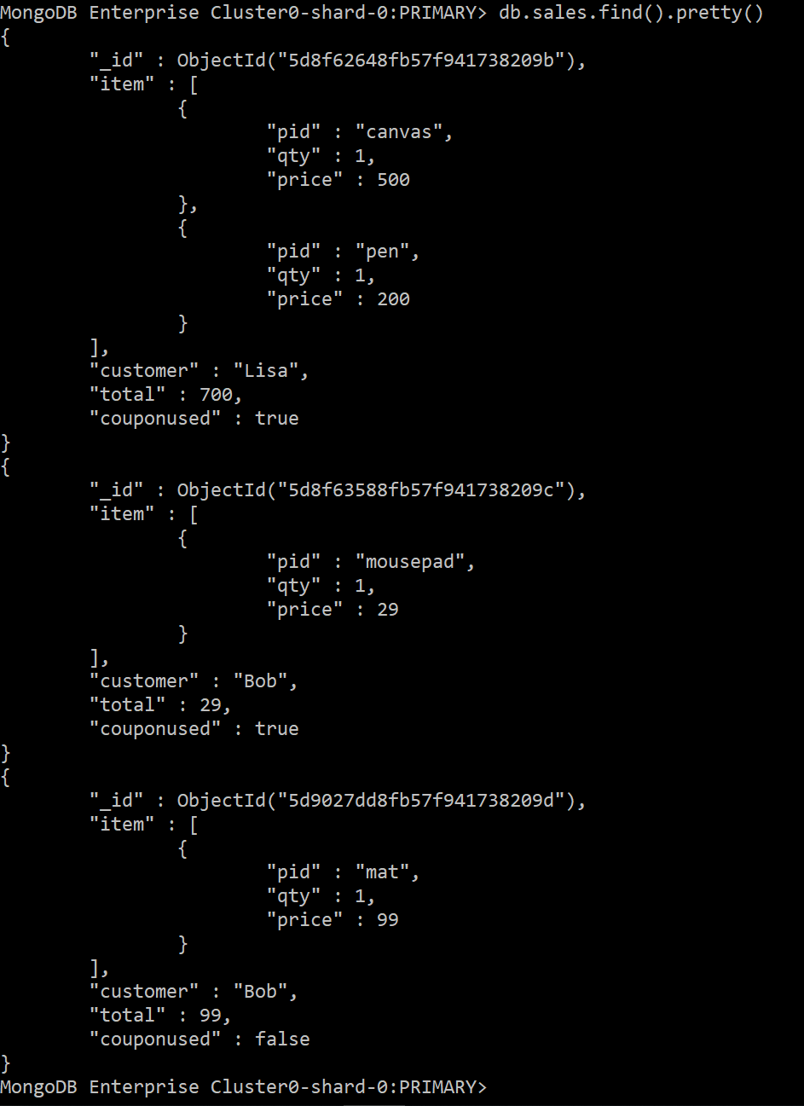
Verify the sales insertion
DDM2020 MongoDB Cloud
Shop101 Database
Customer
Inventory
Sales
- Lisa - Bob
canvas
pen
mat
mousepad
- Lisa’s - Bob’s

Slide 17
3. UPDATE Operations of MongoDB

Slide 18
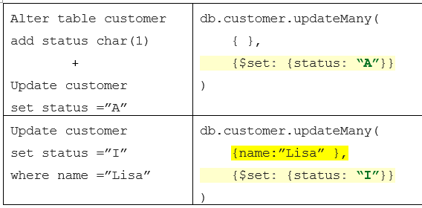
Update customer add status field
Relational Database SQL
MongoDB Command
- Lisa - Bob
- Lisa status=“I” - Bob status=“A”
Notes:
db.customer.updateMany({ },{$set: {status: "A"}})
db.customer.updateMany({name:"Lisa" }, {$set: {status: "I"}})

Slide 19
4. Basic QUERY in MongoDB
FIND()

Slide 20
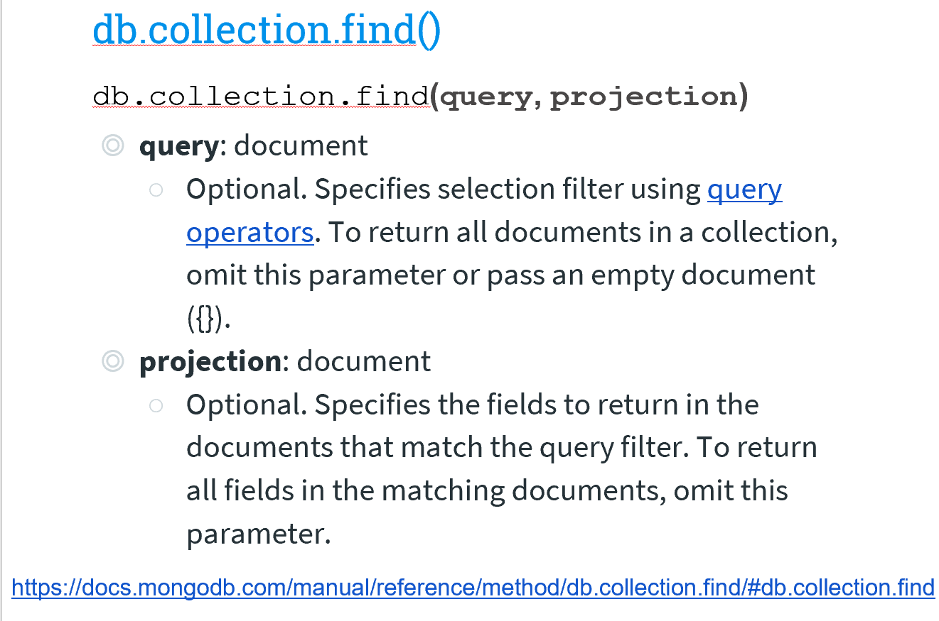
Query Documents
Note: pretty() - displays the results in a formatted way.

Slide 21
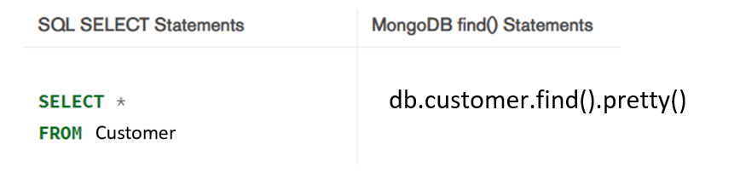
Basic Select

Slide 22
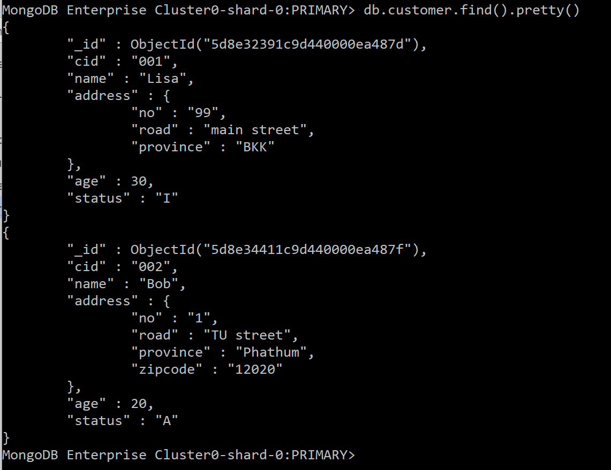

Slide 23
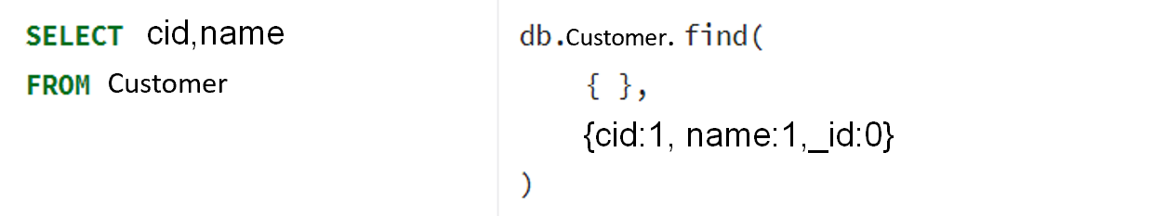
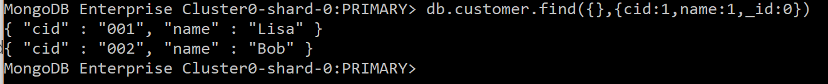
Projection (return some fields)
Show
Not Show
Notes:
db.customer.find({},{cid:1,name:1,_id:0}).pretty()

Slide 24

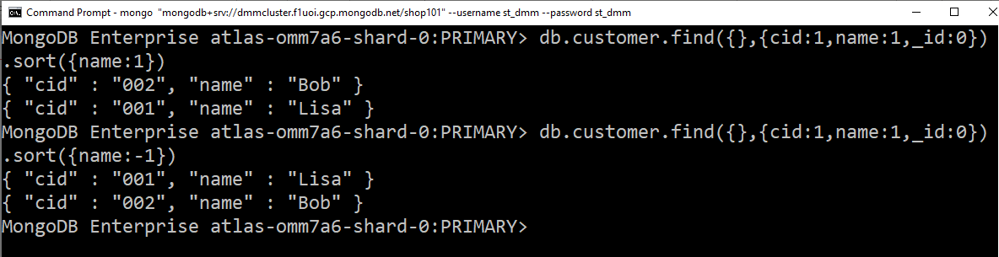
Order by
1 = ASC
-1 = DESC

Slide 25
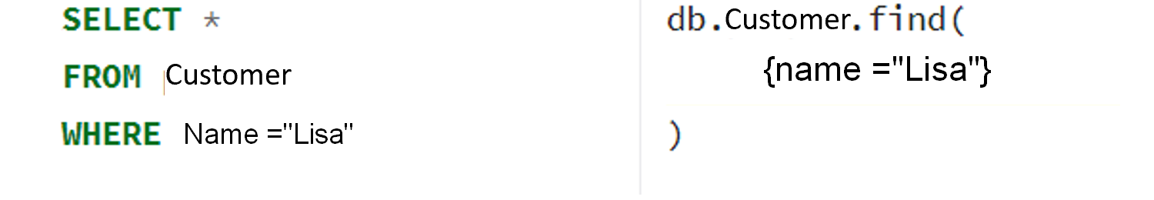
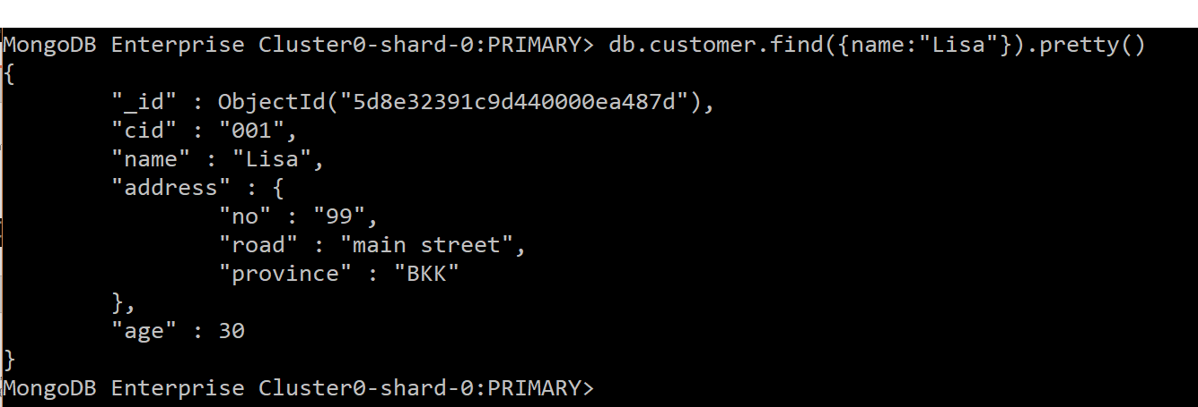
WHERE condition
{name : “Lisa”}
Notes:
db.customer.find({name:"Lisa"}).pretty()

Slide 26
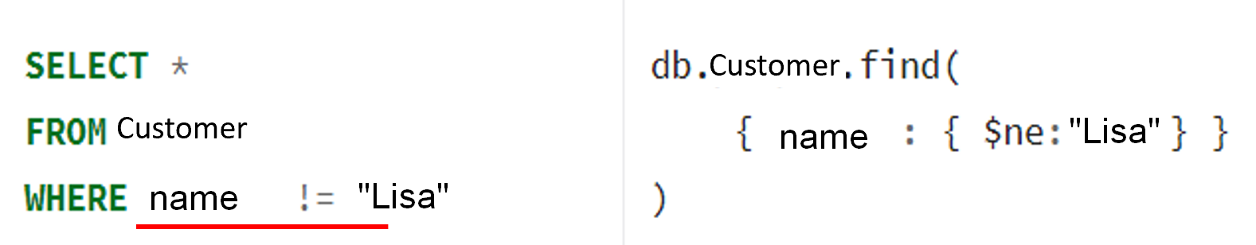
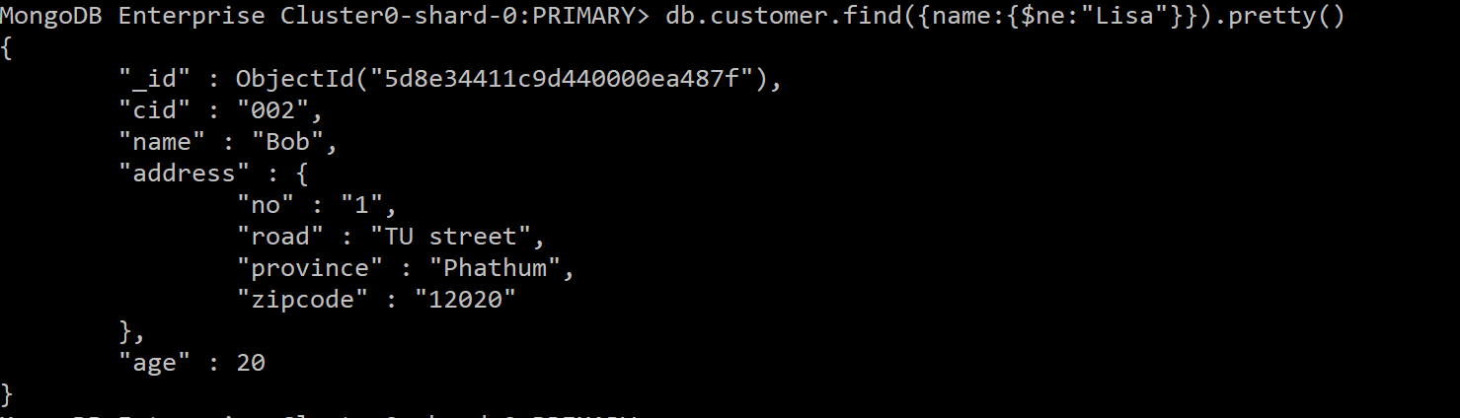

Slide 27
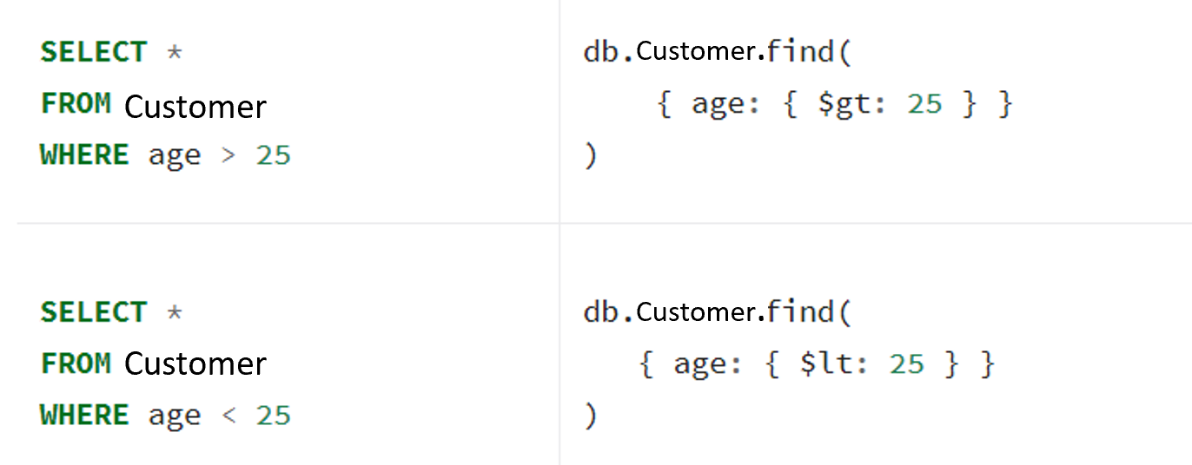

Slide 28
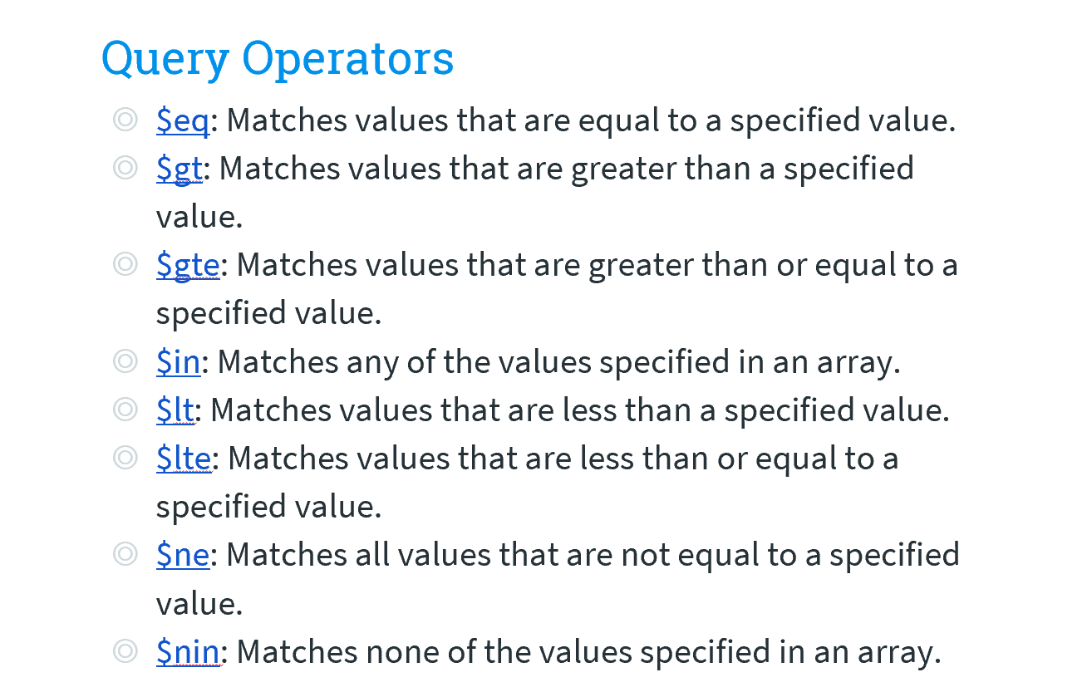

Slide 29
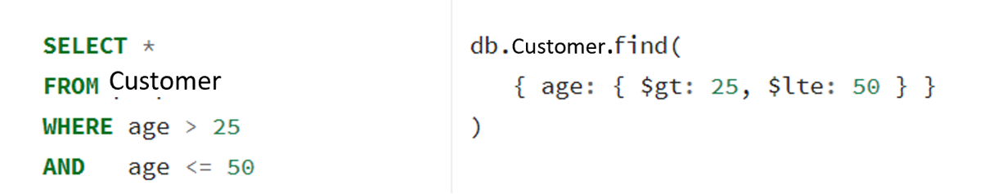
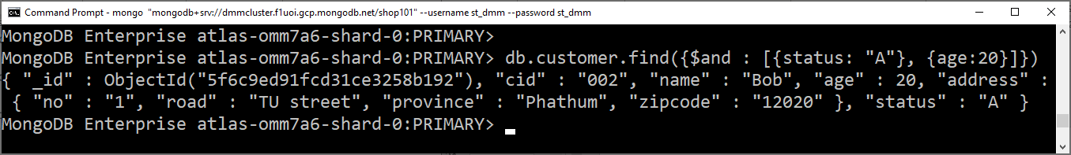
AND
Example : db.customer.find({$and : [{status: "A"}, {age:20}]})

Slide 30
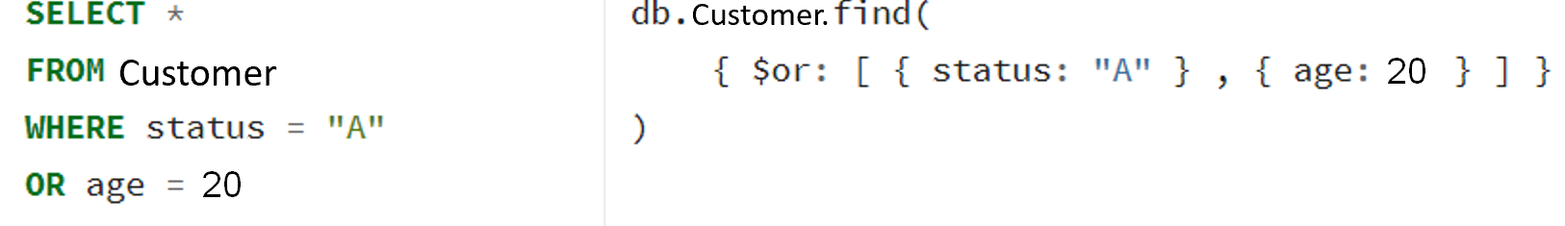
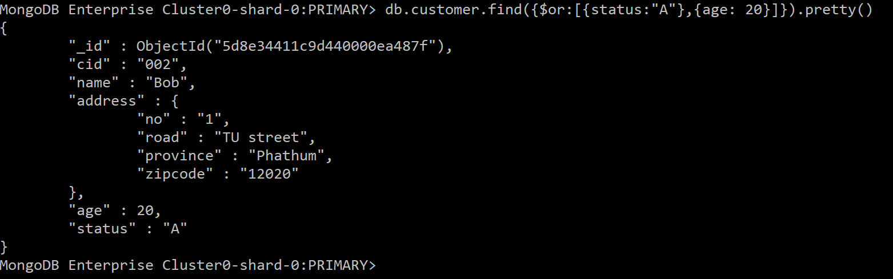
OR
Notes:
db.customer.find({$or : [{status: "A"}, {age:20}]})

Slide 31
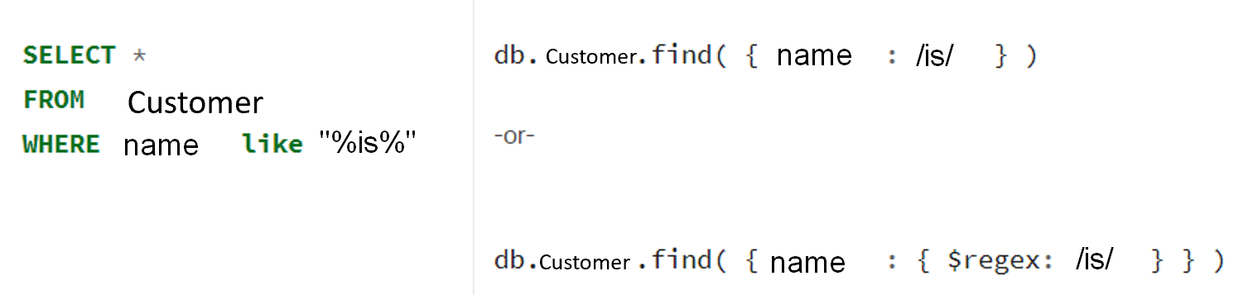
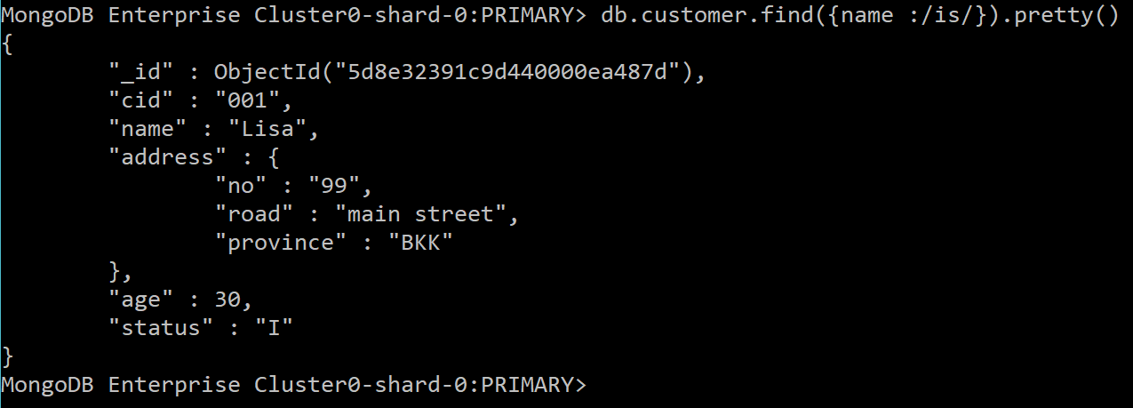
LIKE
Notes:
db.customer.find({name: /is/}).pretty()

Slide 32
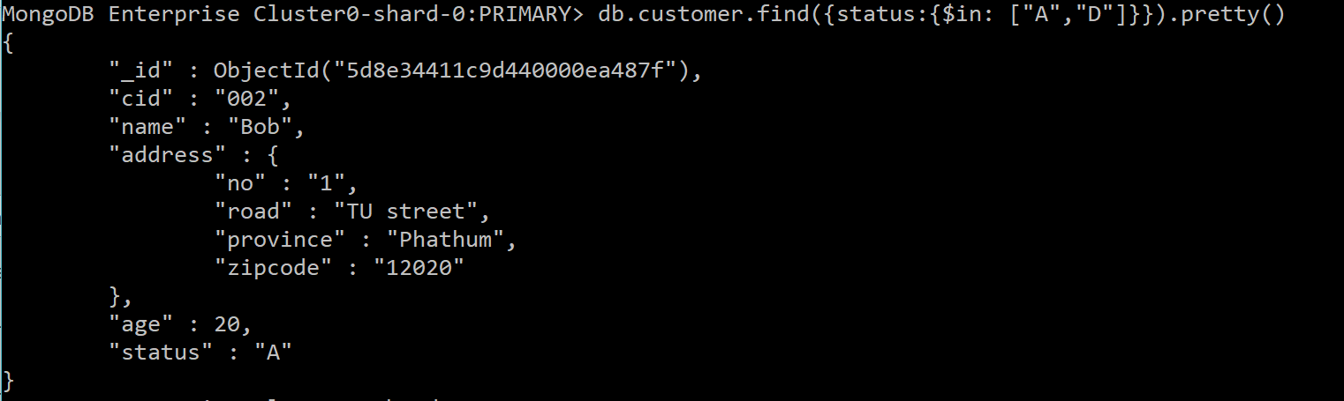
IN
Notes:
db.customer.find({status: {$in: ["A", "D"]}}).pretty()

Slide 33
5. QUERY on Complex fields
Nested Fields or array fields

Slide 34
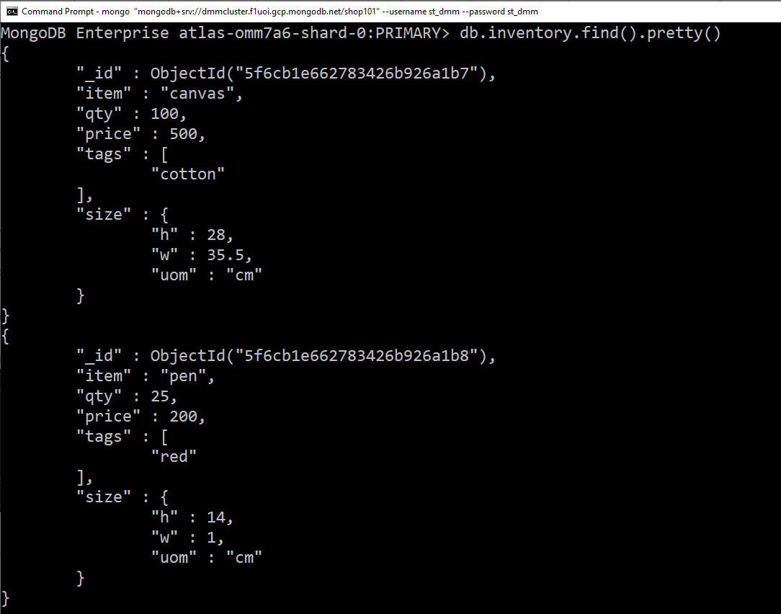
Complex Fields
Nested Field
Ex. Size
Array Field
Ex. Tags

Slide 35
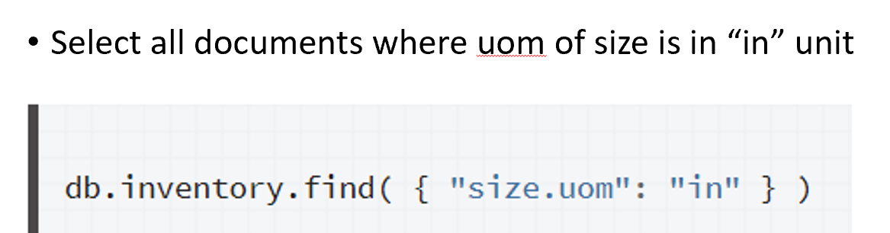
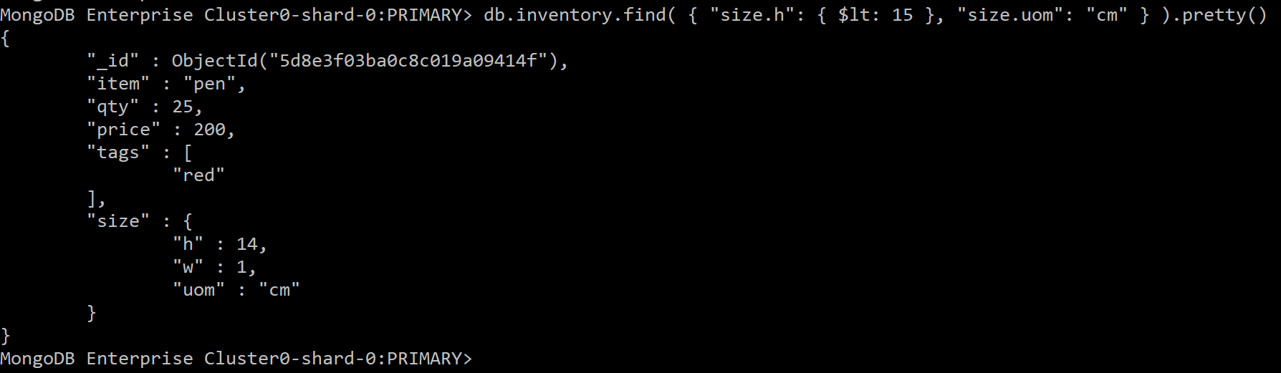
Query Nested Field
Uses dot notation to access fields in an embedded document:
selects items where their height less than 15 CM and the UOM is in cm.
Notes:
db.inventory.find({"size.uom" : "in"}).pretty()

Slide 36
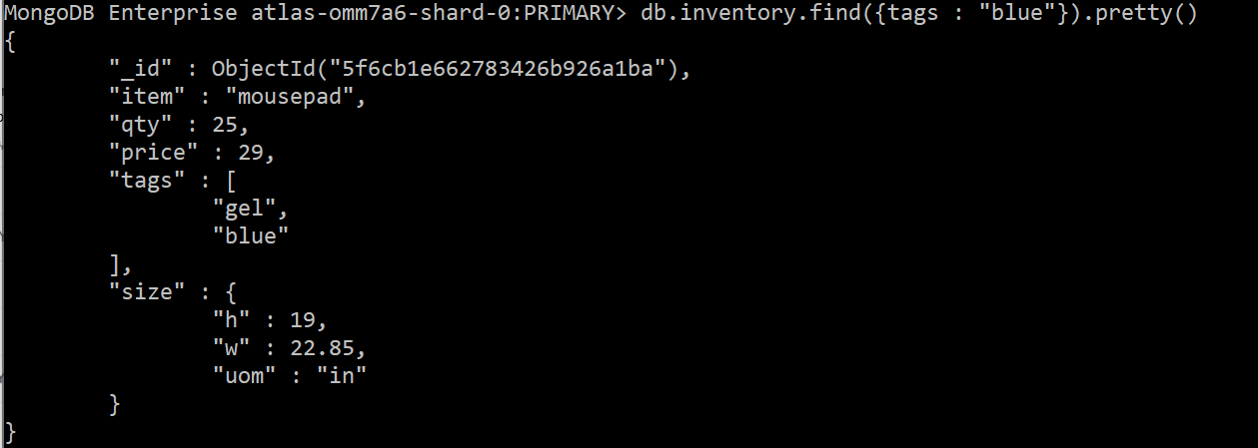
Query Array Field
selects items where their tags has “blue”.
db.inventory.find({tags : "blue"}).pretty()

Slide 37
6. Aggregate Operations
Aggregation operations group values from multiple documents together and can perform a variety of operations on the grouped data to return a single result.

Slide 38
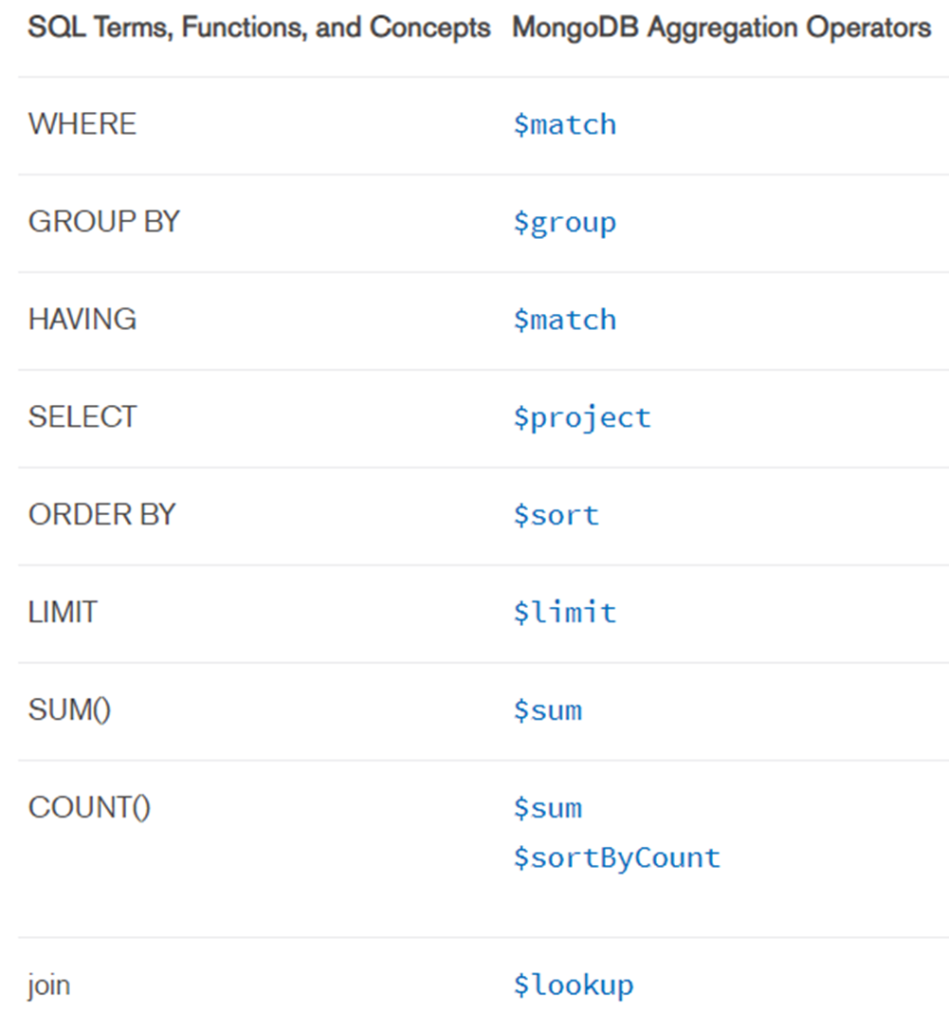

Slide 39
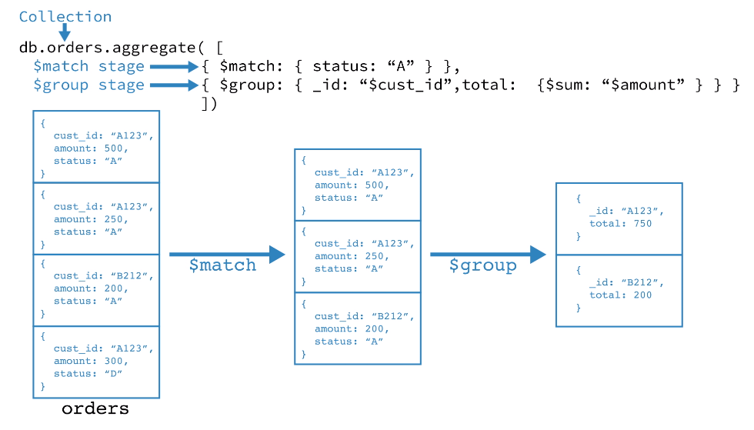
EX. SQL -> Select sum(amount) from orders where status = “A” group by cust_id Mongo -> ???

Slide 40
Sales documents

Slide 41
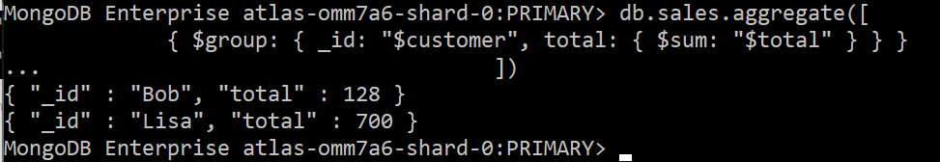
SUM
db.sales.aggregate([ { $group: { _id: "$customer", total: { $sum: "$total" } } }
])
Notes:
db.sales.aggregate([ { $match: { couponused:true } }, { $group: { _id: "$customer", total: { $sum: "$total" } } } ])

Slide 42
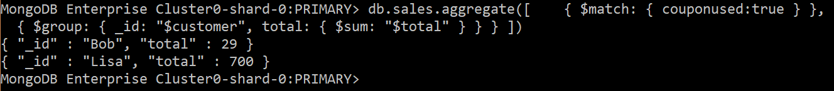
db.sales.aggregate([ { $match: { couponused:true } }, { $group: { _id: "$customer", total: { $sum: "$total" } } }
])

Slide 43
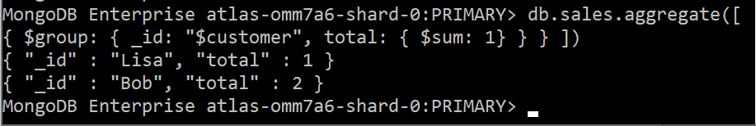
COUNT
db.sales.aggregate([ { $group: { _id: "$customer", total: { $sum: 1} } }
])
Notes:
db.sales.aggregate([ { $group: { _id: "$customer", total: { $sum: 1} } } ])

Slide 44
Note:
FIND() also has COUNT() function

Slide 45
Average, Min, Max
db.sales.aggregate([ { $group: { _id: "$customer", average: { $avg: "$total" } } } ])
db.sales.aggregate([ { $group: { _id: "$customer", minimum: { $min: "$total" } } } ])
db.sales.aggregate([ { $group: { _id: "$customer", maximum: { $max: "$total" } } } ])

Slide 46
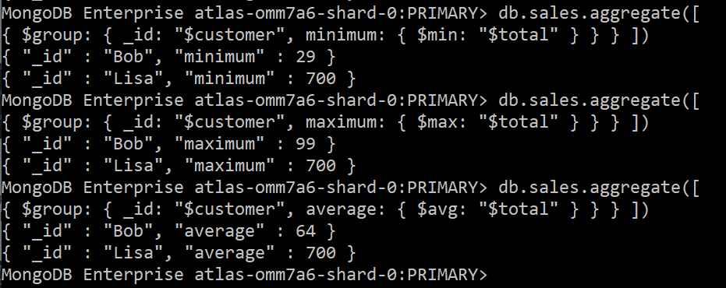
Result
Notes:
db.sales.aggregate([ { $group: { _id: "$customer", average: { $avg: "$total" } } } ])
db.sales.aggregate([ { $group: { _id: "$customer", minimum: { $min: "$total" } } } ])
db.sales.aggregate([ { $group: { _id: "$customer", maximum: { $max: "$total" } } } ])

Slide 47
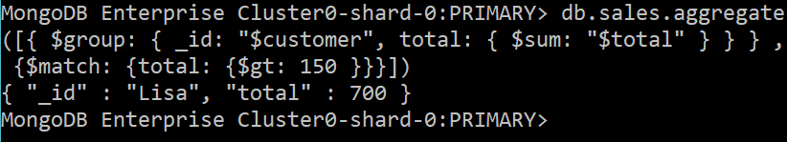
HAVING
db.sales.aggregate([{ $group: { _id: "$customer", total: { $sum: "$total" } } } , {$match: {total: {$gt: 150 }}} ])

Slide 48
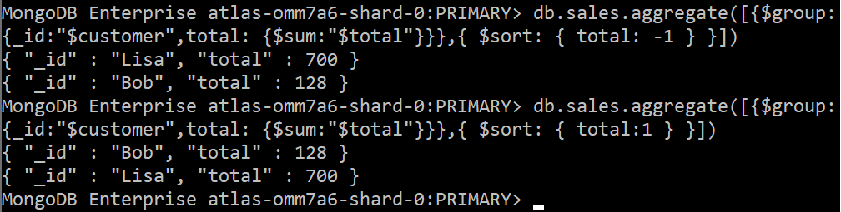
Sort and Limit in Aggregate
db.sales.aggregate([ {$group:{_id:"$customer",total: {$sum:"$total"}}}, { $sort: { total: -1 } } ])
Notes:
db.sales.aggregate([{$group:{_id:"$customer",total: {$sum:"$total"}}},{ $sort: { total: -1 } }])

Slide 49
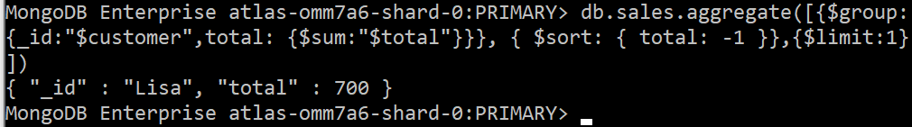
db.sales.aggregate([ {$group:{_id:"$customer",total: {$sum:"$total"}}}, { $sort: { total: -1 }}, {$limit:1} ])
Notes:
db.sales.aggregate([ {$group:{_id:"$customer",total: {$sum:"$total"}}}, { $sort: { total: -1 }}, {$limit:1} ])

Slide 50
7. JOIN Operations

Slide 51
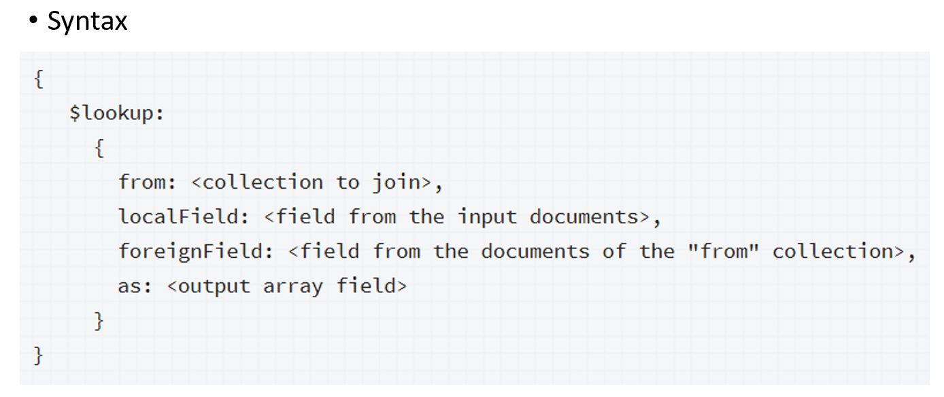
JOIN

Slide 52
Join Customer vs. Sale
db.sales.aggregate([
{
$lookup:
{
from: "customer",
localField: "customer",
foreignField: "name",
as: "cust_info"
}
}
]).pretty()
Notes:
db.sales.aggregate([
{
$lookup:
{
from: "customer",
localField: "customer",
foreignField: "name",
as: "cust_info"
}
}
]).pretty()

Slide 53
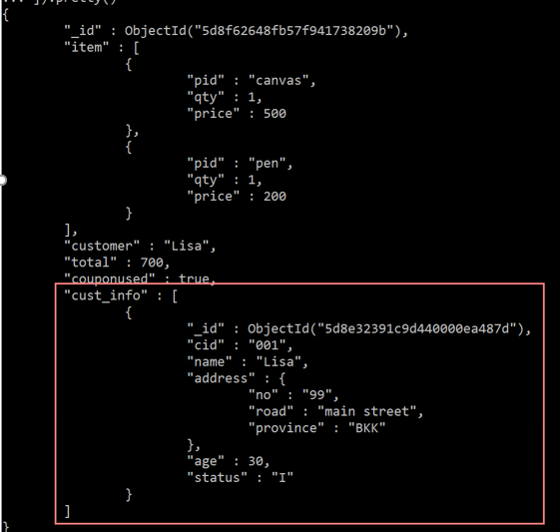

Slide 54
Lab 6 Assignment
Submission system: google classroom

Slide 55
Mongo Shell download
Windows https://downloads.mongodb.org/windows/mongodb-shell-windows-x86_64-4.4.1.zip
MACOS
brew install mongodb/brew/mongodb-community-shell
Ubuntu 16.04,18.04,20.04
https://downloads.mongodb.org/linux/mongodb-shell-linux-x86_64-ubuntu1604-4.4.1.tgz https://downloads.mongodb.org/linux/mongodb-shell-linux-x86_64-ubuntu1804-4.4.1.tgz https://downloads.mongodb.org/linux/mongodb-shell-linux-x86_64-ubuntu2004-4.4.1.tgz

Slide 56
1. Connect to RDBProject
2 Databases
Shop101
RDBProject
RDBProject
Feedback
Username
st_dmm/st_dmm
onlne/online
offline/offline
DDM2020 MongoDB Cloud
MongoDB Shell
mongo "mongodb+srv://dmmcluster.f1uoi. gcp.mongodb.net/<dbname>“ --username <username> --password <password>
i.e., mongo "mongodb+srv://dmmcluster.f1uoi.gcp.mongodb.net/RDBProject" --username st_dmm --password st_dmm
Notes:
D:
Cd D:\_Phd_Candidate\AITTA-DMM\mongodb-win32-x86_64-windows-4.4.1\bin
mongo "mongodb+srv://dmmcluster.f1uoi.gcp.mongodb.net/shop101" --username st_dmm --password st_dmm

Slide 57
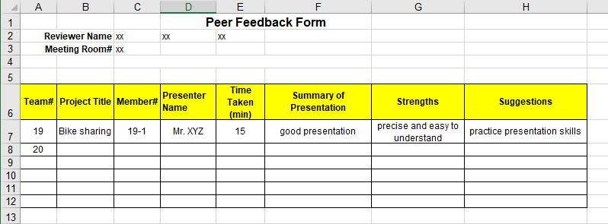
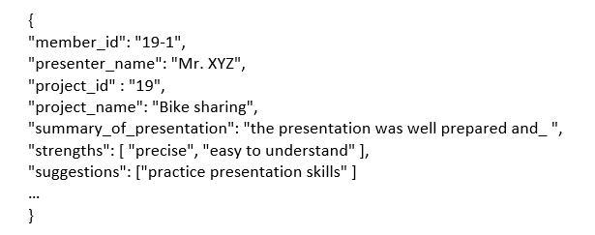
2. Peer Review -> JSON Documents

Slide 58
3. Insert into feedback table in RDBProject MongoDB
4. Write MongoDB command to retrieve Task1-3 information
5. Submit the commands and the capture images in DMM GOOGLE CLASSROOM

Slide 59
Deadline TUE SEP 29 11:59 AM
LAB 5: REDIS SUBMIT on DSAI
LAB 6: MONGODB SUBMIT on GOOGLE CLASSROOM LAB 7-10 SUBMIT on GOOGLE CLASSROOM

Slide 60
References
https://docs.mongodb.com/manual/
https://docs.mongodb.com/manual/reference/sql-comparison/#examples
https://docs.mongodb.com/manual/reference/operator/aggregation/lookup/index.html#lookup-single-equality

Slide 61
Good Luck for the Midterm Exams
See you next wednesday

Slide 62

Thank you.

