Slide 1

Generative AI & Large Language Models (LLMs)
USE CASES, PROJECT LIFECYCLE, AND
MODEL PRE-TRAINING

Slide 2
Generative AI & Large Language Model
Use Cases & Model Lifecycle

Slide 3
Generative AI & Large Language Models

Slide 4
Generative AI
ChatBot
Who designed the street layout of Washington DC?
T
The street layout of
Washington D.C. was designed by Pierre Charles L'Enfant, a French-born American architect and civil engineer.

Slide 5
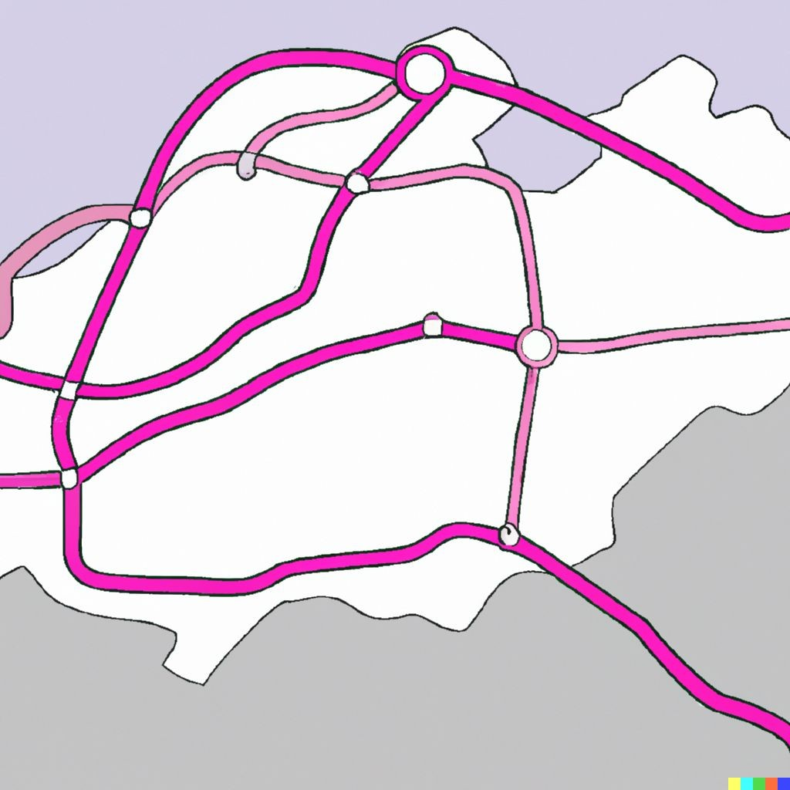
Generative AI
pAIntBox
What do you want to create?
An | imaginary | subway | map
in | a coastal | city.
Image dimensions:
by
(Max 2048)
Generate

Slide 6

Generative AI
CodeAId
1 | def binary_search(arr, x, l, r):_ if r >= l: mid = l + (r - l) // 2 if arr[mid] == x: return mid elif arr[mid] > x: return binary_search(arr, x, l, mid - 1) else: return binary_search(arr, x, mid + 1, r) else: _{return -1} < 1/2 > Accept | Tab
2
3
4
5
6
7
8
9
AI Con | nected Run security scan
11

Slide 7
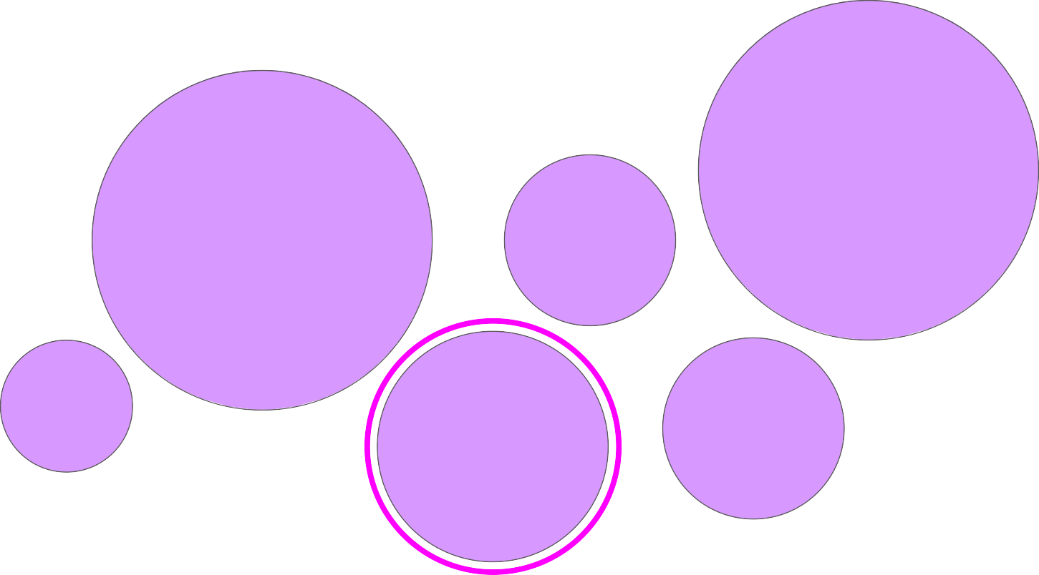
Large Language Models
Gemini
GPT
LLaMa
BERT
Mixtral
Claude

Slide 8



Prompts and completions
Prompt
Model
Completion
Where is Ganymede located in the solar system?
Where is Ganymede located in the solar system?
LLM
Ganymede is a moon of Jupiter and is located in the solar system within Jupiter’s orbit.
Context window
typically a few 1000 words.

Slide 9

Prompts and completions

Slide 10
Use cases & tasks

Slide 11
LLM use cases & tasks
Essay Writing
Summarization
Translation
Information retrieval
Invoke APIs and actions
Action call
External Applications

Slide 12
The signiﬁcance of scale: language understanding
BERT* 110M
BLOOM 176B
*Bert-base

Slide 13
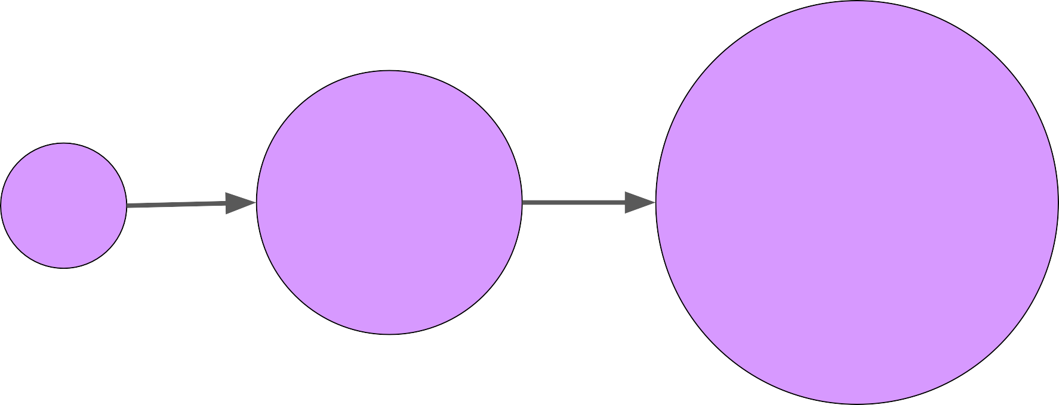

Model size vs. time
Growth powered by:
Introduction of transformer
Access to massive datasets
More powerful compute resources
BERT-L 340M
GPT-2 1.5B
GPT-3 175B
PaLM 540B
2018
2022
2023

Slide 14
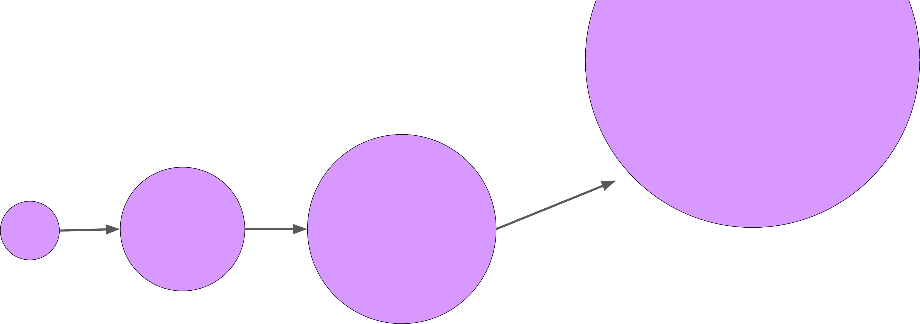
Model size vs. time
increase?
Trillion(s)
BERT-L 340M
GPT-2 1.5B
GPT-3 175B
PaLM 540B
2018
2022
2023

Slide 15
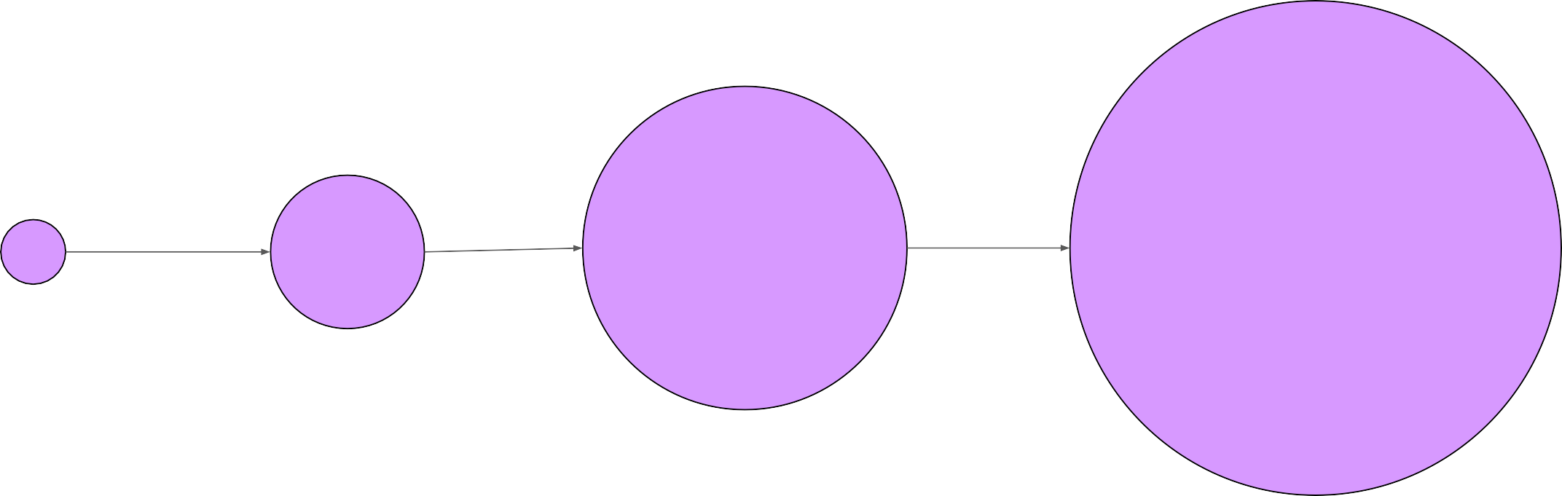


Model size vs. time
increase?
Trillion(s)
BERT-L 340M
GPT-2 1.5B
GPT-3 175B
PaLM 540B
decrease?
LLaMa 65B
BloombergGPT 50B
2018
2022
2023

Slide 16
How LLMs work - Transformers architecture

Slide 17

Understanding language can be challenging
I took my money to the bank.
River bank?

Slide 18
Understanding language can be challenging
The teacher’s book?
The teacher taught the student with the book.
The student’s book?

Slide 19
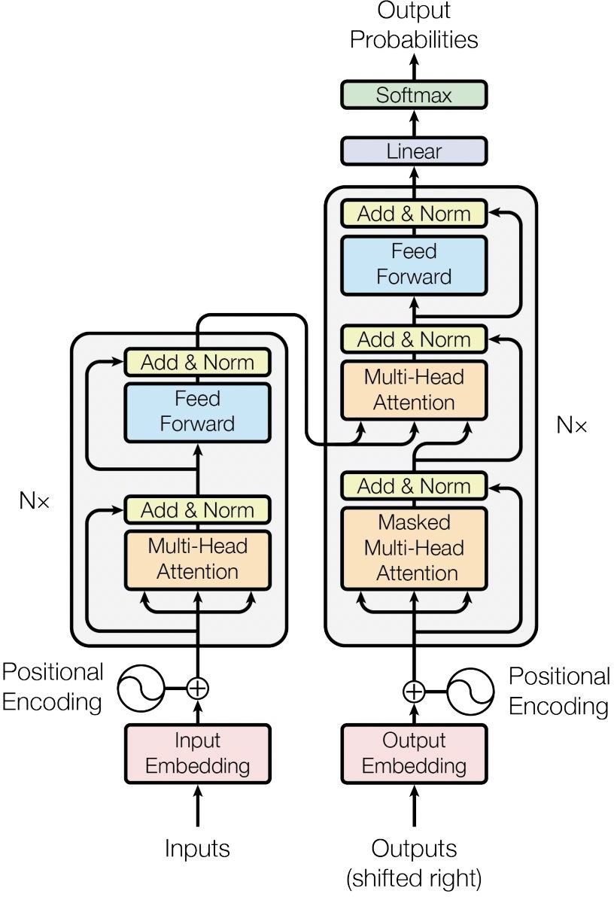

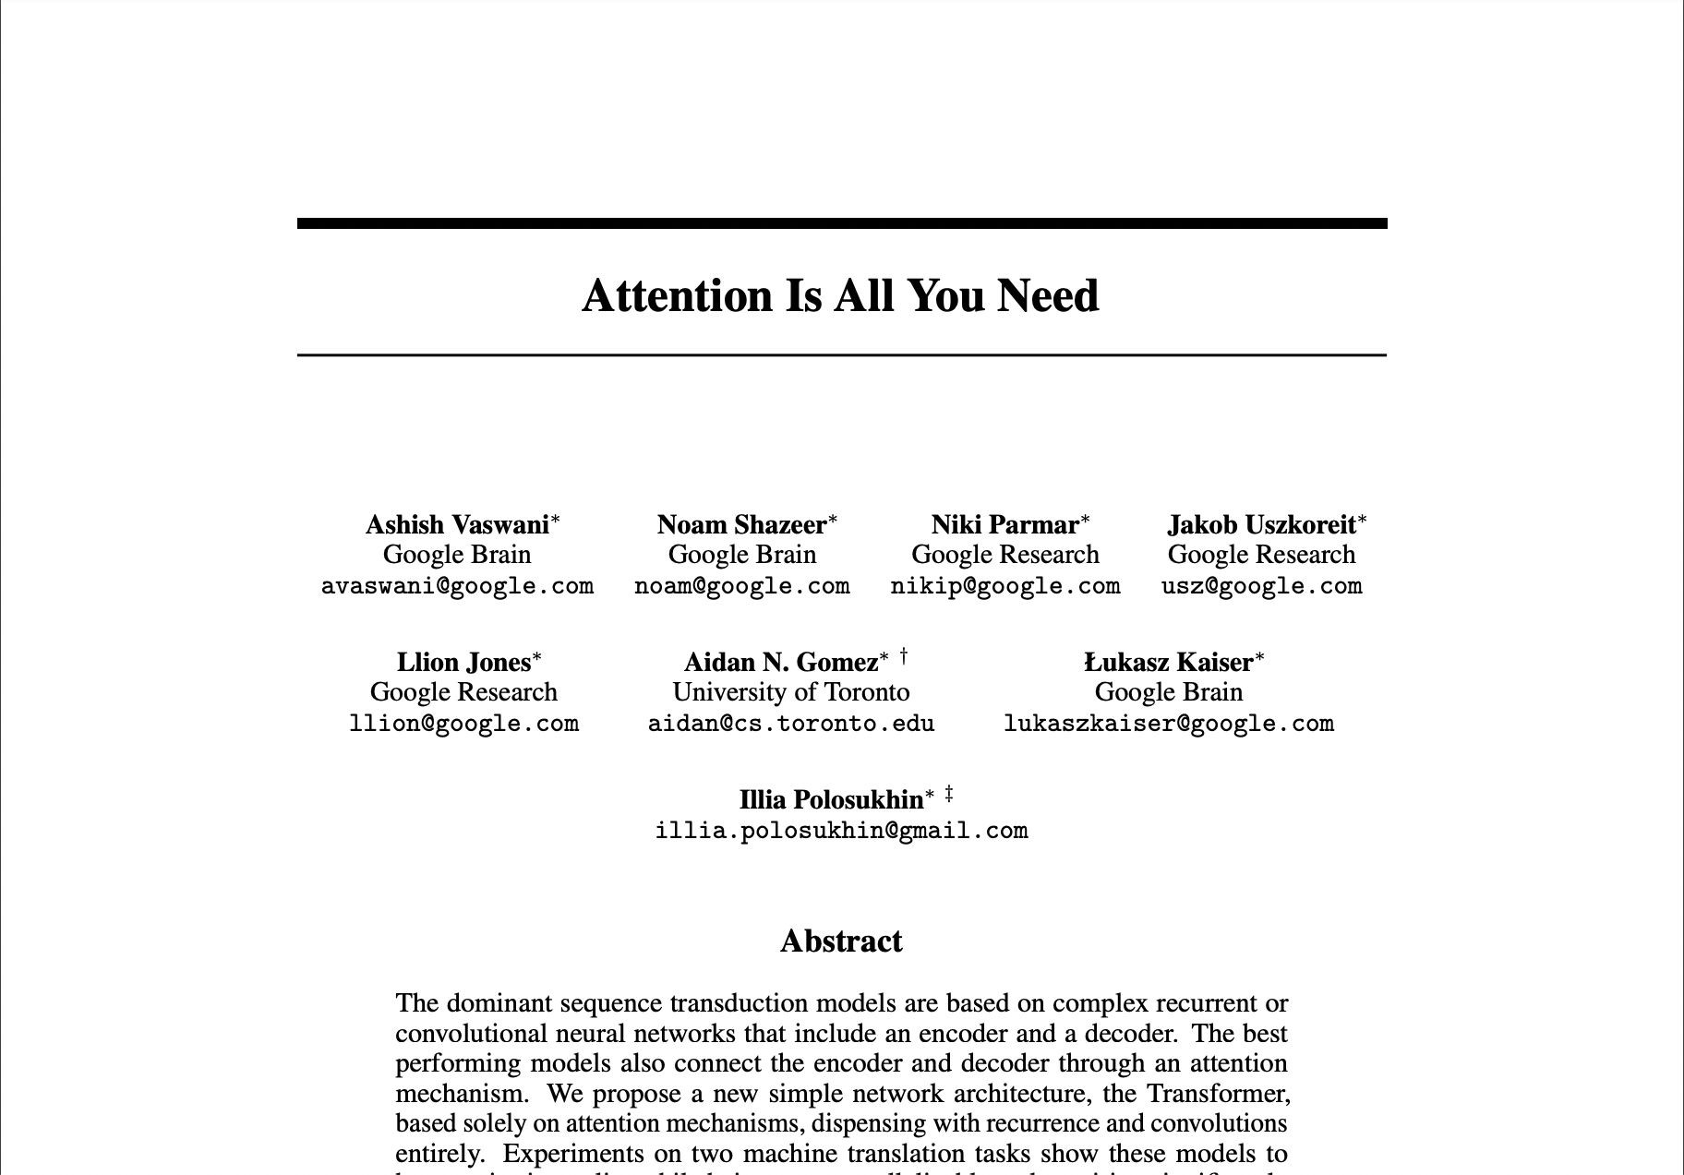
Transformers

Slide 20
Self-attention
The teacher taught
the student
with
a book
.
The teacher taught the student with
a book
.

Slide 21
Transformers
Output
Softmax output
Decoder
Encoder
Embedding
Embedding
Inputs

Slide 22


Transformers
Output
Softmax output
Decoder
Encoder
Embedding
Embedding
Inputs

Slide 23

Transformers
Decoder
Encoder
Embedding
Embedding
Inputs
Tokenizer
342 | 879 | 432 | 342
Token IDs
Input:
the teacher
taught the

Slide 24
Transformers
Decoder
Encoder
Embedding
Embedding
Inputs
Tokenizer
156 | 790 | 321 | 890 | 156
Token IDs
Input:
the teach er taught the

Slide 25


Transformers
Output
Softmax output
Decoder
Encoder
Embedding
Embedding
Embedding
Embedding
Inputs

Slide 26
Transformers
Output
Translation:
sequence-to-sequence task
Softmax output
J'aime l'apprentissage automatique
Decoder
Encoder
Embedding
Embedding
Inputs

Slide 27
Transformers
Output
Translation:
sequence-to-sequence task
Softmax output
J'aime l'apprentissage automatique
Decoder
Encoder
J’a
ime
l'a
pprentissage
automatique
2345
3425
3853
Embedding
Embedding
Inputs

Slide 28
Transformers
Output
Translation:
sequence-to-sequence task
Softmax output
J'aime l'apprentissage automatique
Decoder
Encoder
J’a
ime
l'a
pprentissage
automatique
2345
3425
3853
Embedding
Embedding
Inputs

Slide 29
Transformers
Output
Translation:
sequence-to-sequence task
Softmax output
J'aime l'apprentissage automatique
Decoder
Encoder
J’a
ime
l'a
pprentissage
automatique
2345
3425
3853
Embedding
Embedding
Inputs

Slide 30
Transformers
Output
Translation:
sequence-to-sequence task
Softmax output
J'aime l'apprentissage automatique
Decoder
Encoder
J’a
ime
l'a
pprentissage
automatique
2345
3425
3853
Embedding
Embedding
Inputs

Slide 31
Transformers
Output
297
Translation:
sequence-to-sequence task
Softmax output
J'aime l'apprentissage automatique
Decoder
Encoder
J’a
ime
l'a
pprentissage
automatique
2345
3425
3853
Embedding
Embedding
Inputs

Slide 32
Transformers
Output
297
450
901
389
Translation:
sequence-to-sequence task
Softmax output
J'aime l'apprentissage automatique
Decoder
Encoder
J’a
ime
l'a
pprentissage
automatique
2345
3425
3853
Embedding
Embedding
Inputs

Slide 33

Transformers
Output
297
450
901
389
Translation:
sequence-to-sequence task
Softmax output
I
love
machine
learning
J'aime l'apprentissage automatique
Decoder
I love machine learning
Encoder
J’a
ime
l'a
pprentissage
automatique
2345
3425
3853
Embedding
Embedding
Inputs

Slide 34
Prompting and prompt engineering

Slide 35
Prompting and prompt engineering
Prompt
Model
Completion
Where is Ganymede located in the solar system?
Where is Ganymede located in the solar system?
Ganymede is a moon of Jupiter and is located in the solar system within Jupiter’s orbit.
LLM
Context window: typically a few thousand words

Slide 36
In-context learning (ICL) - zero shot inference
Prompt
Model
Completion
Classify this review: I loved this movie!
Sentiment:
Classify this review: I loved this movie!
Sentiment: Positive
LLM
Zero-shot inference

Slide 37
In-context learning (ICL) - zero shot inference
Prompt
Model
Completion
Classify this review: I loved this movie!
Sentiment:
Classify this review: I loved this movie!
Sentiment: Reived a very nice book review
LLM

Slide 38
In-context learning (ICL) - one shot inference
Prompt
Model
Completion
Classify this review: I loved this movie!
Sentiment: Positive
Classify this review: I loved this movie!
Sentiment: Positive
Classify this review: I don’t like this chair.
Sentiment: Negative
LLM
Classify this review: I don’t like this chair.
Sentiment:
One-shot inference

Slide 39
In-context learning (ICL) - few shot inference
Prompt
Model
Completion
Classify this review: I loved this DVD!
Sentiment: Positive
Classify this review: I loved this DVD!
Sentiment: Positive
Classify this review: I don’t like this chair.
Sentiment: Positive
Classify this review: This is not great.
Sentiment: Negative
LLM
Classify this review: I don’t like this chair.
Sentiment: Negative
Classify this review: This is not great.
Sentiment:

Slide 40




Summary of in-context learning (ICL)
Prompt / Zero Shot
Prompt / One Shot
Prompt / Few Shot
>5 or 6 examples
Classify this review: I loved this movie!
Sentiment:
Classify this review: I loved this movie!
Sentiment: Positive
Classify this review: I don’t like this chair.
Sentiment:
Classify this review: I loved this movie!
Sentiment: Positive
Classify this review: I don’t like this chair.
Sentiment: Negative
Classify this review: Who would use this product?
Sentiment:
Context Window
(few thousand words)

Slide 41
The signiﬁcance of scale: task ability
BERT* 110M
BLOOM 176B
*Bert-base

Slide 42
Generative conﬁguration parameters for inference

Slide 43
Generative conﬁguration - inference parameters
Max new tokens
Enter your prompt here…
200
Sample top K
Sample top P
Temperature
25
1
Inference conﬁguration parameters
0.8
Submit

Slide 44
Generative conﬁguration - max new tokens
Max new tokens
Enter your prompt here…
200
Max new tokens
Sample top K
25
Sample top P
1
Temperature
0.8
Submit

Slide 45

Generative conﬁg - max new tokens
max_new_tokens = 100
max_new_tokens = 150
Softmax
output
max_new_tokens = 200

Slide 46
Generative conﬁg - max new tokens
max_new_tokens = 100
max_new_tokens = 150
Softmax
output
max_new_tokens = 200
Stop token

Slide 47


Generative conﬁg - greedy vs. random sampling
Token probability
0.20
cake
greedy: The word/token with the highest probability is selected.
0.10
donut
Softmax
output
0.02
banana
0.01
apple
…
…
prob
word
0.20
cake
random(-weighted) sampling: select a token using a random-weighted strategy across the probabilities of all tokens.
0.10
donut
Softmax
output
0.02
banana
Here, there is a 20% chance that ‘cake’ will be selected, but ‘banana’ was actually selected.
0.01
apple
…
…

Slide 48
Generative conﬁguration - top-k and top-p
Enter your prompt here…
Max new tokens
200
Top-k and top-p sampling
Sample top K
Sample top P
25
1
Temperature
0.8
Submit

Slide 49
Generative conﬁg - top-k sampling
prob
word
0.20
cake
top-k: select an output from the top-k results after applying random-weighted strategy using the probabilities
0.10
donut
Softmax
output
0.02
banana
k=3
0.01
apple
…
…

Slide 50
Generative conﬁg - top-p sampling
prob
word
0.20
cake
top-p: select an output using the random-weighted strategy with the top-ranked consecutive results by probability and with a cumulative probability <= p.
p = 0.30
0.10
donut
Softmax
output
banana
0.02
0.01
apple
…
…

Slide 51
Generative conﬁguration - temperature
Enter your prompt here…
Max new tokens
200
Sample top K
25
Sample top P
1
Temperature
0.8
Temperature
Submit

Slide 52



Generative conﬁg - temperature
Temperature setting
Cooler temperature (e.g <1)
prob word
Higher temperature (>1)
prob word
0.001 | apple
0.002 | banana
0.400 | cake
0.012 | donut
… | …
0.040 | apple
0.080 | banana
0.150 | cake
0.120 | donut
… | …
Softmax
output
Strongly peaked probability distribution
Broader, ﬂatter probability distribution

Slide 53
Generative AI project lifecycle

Slide 54
Generative AI project lifecycle
Scope
Select
Adapt and align model
Application integration
Deﬁne the use case
Choose an existing model or pretrain your own
Prompt engineering
Evaluate
Optimize and deploy model for inference
Augment model and build LLM- powered applications
Fine-tuning
Align with human feedback

Slide 55
Generative AI project lifecycle
Scope
Select
Adapt and align model
Application integration
Deﬁne the use case
Choose an existing model or pretrain your own
Prompt engineering
Evaluate
Optimize and deploy model for inference
Augment model and build LLM- powered applications
Fine-tuning
Align with human feedback

Slide 56
Generative AI project lifecycle
Scope
Select
Adapt and align model
Application integration
Deﬁne the use case
Choose an existing model or pretrain your own
Prompt engineering
Evaluate
Optimize and deploy model for inference
Augment model and build LLM- powered applications
Fine-tuning
Align with human feedback

Slide 57
Generative AI project lifecycle
Scope
Select
Adapt and align model
Application integration
Deﬁne the use case
Choose an existing model or pretrain your own
Prompt engineering
Evaluate
Optimize and deploy model for inference
Augment model and build LLM- powered applications
Fine-tuning
Align with human feedback

Slide 58
Generative AI project lifecycle
Scope
Select
Adapt and align model
Application integration
Deﬁne the use case
Choose an existing model or pretrain your own
Prompt engineering | Evaluate
Fine-tuning
Align with human feedback
Optimize and deploy model for inference
Augment model and build LLM- powered applications

Slide 59
Generative AI project lifecycle
Scope
Select
Adapt and align model
Application integration
Deﬁne the use case
Choose an existing model or pretrain your own
Prompt engineering
Evaluate
Optimize and deploy model for inference
Augment model and build LLM- powered applications
Fine-tuning
Align with human feedback

Slide 60
Generative AI project lifecycle
Scope
Select
Adapt and align model
Application integration
Deﬁne the use case
Choose an existing model or pretrain your own
Prompt engineering
Evaluate
Optimize and deploy model for inference
Augment model and build LLM- powered applications
Fine-tuning
Align with human feedback

Slide 61
Considerations for choosing a model
Train your own model
Custom
LLM
Foundation model
Pretrained
LLM

Slide 62
Considerations for choosing a model
Foundation model
Pretrained
LLM
Train your own model
Custom
LLM

Slide 63
Approximate GPU RAM needed to store 1B parameters
1 parameter = 4 bytes (32-bit ﬂoat) 1B parameters = 4 x 10⁹ bytes = 4GB
4GB @ 32-bit full precision
Sources: https://huggingface.co/docs/transformers/v4.20.1/en/perf_train_gpu_one#anatomy-of-models-memory, https://github.com/facebookresearch/bitsandbytes

Slide 64
Additional GPU RAM needed to train 1B parameters
 | Bytes per parameter
Model Parameters (Weights) | 4 bytes per parameter
Adam optimizer (2 states) +8 bytes per parameter
Gradients +4 bytes per parameter
~20 extra bytes per parameter
Activations and +8 bytes per parameter (high-end estimate)
temp memory (variable size)
^{TOTAL} =4 bytes per parameter
+20 extra bytes per parameter
Sources: https://huggingface.co/docs/transformers/v4.20.1/en/perf_train_gpu_one#anatomy-of-models-memory, https://github.com/facebookresearch/bitsandbytes

Slide 65
Approximate GPU RAM needed to train 1B-params
Memory needed to store model Memory needed to train model
80GB @ 32-bit full precision
4GB @ 32-bit full precision

Slide 66
Quantization: Summary
 | Bits | Exponent | Fraction | Memory needed to store one value
FP32 | 32 | 8 | 23 | 4 bytes
FP16 | 16 | 5 | 10 | 2 bytes
BFLOAT16 | 16 | 8 | 7 | 2 bytes
INT8 | 8 | –/– | 7 | 1 byte
FLAN T5
Reduce required memory to store and train models
Projects original 32-bit ﬂoating point numbers into lower precision spaces
Quantization-aware training (QAT) learns the quantization scaling factors during training
BFLOAT16 is a popular choice

Slide 67
Approximate GPU RAM needed to store 1B parameters
Full- precision model
16-bit quantized model
8-bit quantized model
4GB @ 32-bit full precision
2GB @ 16-bit half precision
1GB @ 8-bit precision
Sources: https://huggingface.co/docs/transformers/v4.20.1/en/perf_train_gpu_one#anatomy-of-models-memory, https://github.com/facebookresearch/bitsandbytes

Slide 68
Approximate GPU RAM needed to train 1B-params
80GB @ 32-bit full precision
40GB @ 16-bit half precision
20GB @ 8-bit precision
80GB is the maximum memory for the Nvidia A100 GPU, so to keep the model on a single GPU, you need to use 16-bit or 8-bit quantization.
Sources: https://huggingface.co/docs/transformers/v4.20.1/en/perf_train_gpu_one#anatomy-of-models-memory, https://github.com/facebookresearch/bitsandbytes

Slide 69
GPU RAM needed to train larger models
1B param model
175B param model
500B param model
40,000 GB @ 32-bit
full precision
14,000 GB @ 32-bit
full precision

Slide 70
GPU RAM needed to train larger models
As model sizes get larger, you will
need to split your model across multiple GPUs for training
500B param model
40,000 GB @ 32-bit
full precision
14,000 GB @ 32-bit
full precision
175B param model
1B param model

