Slide 1

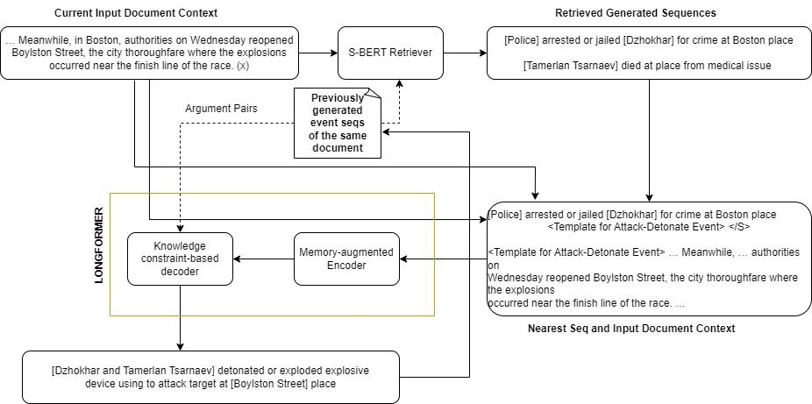
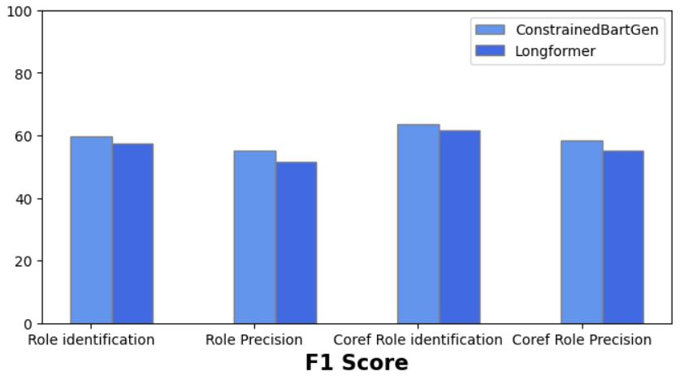
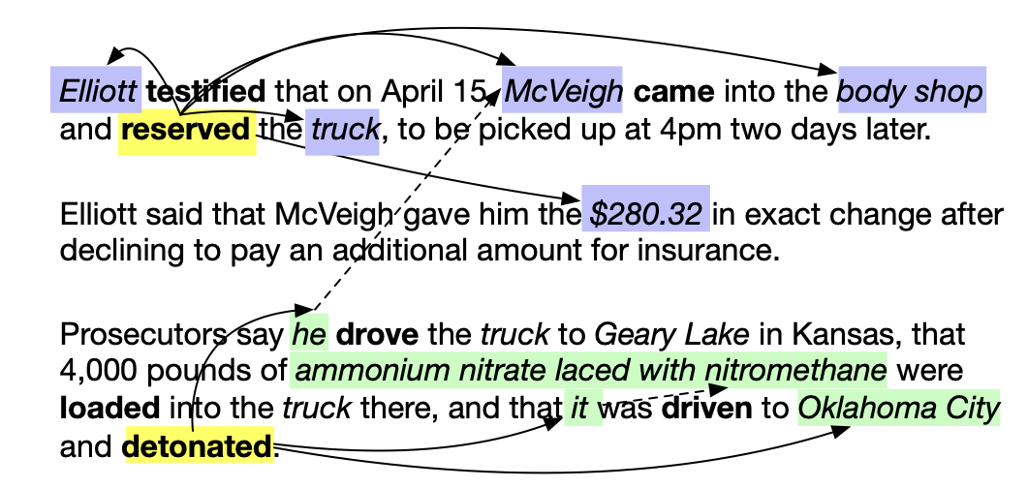
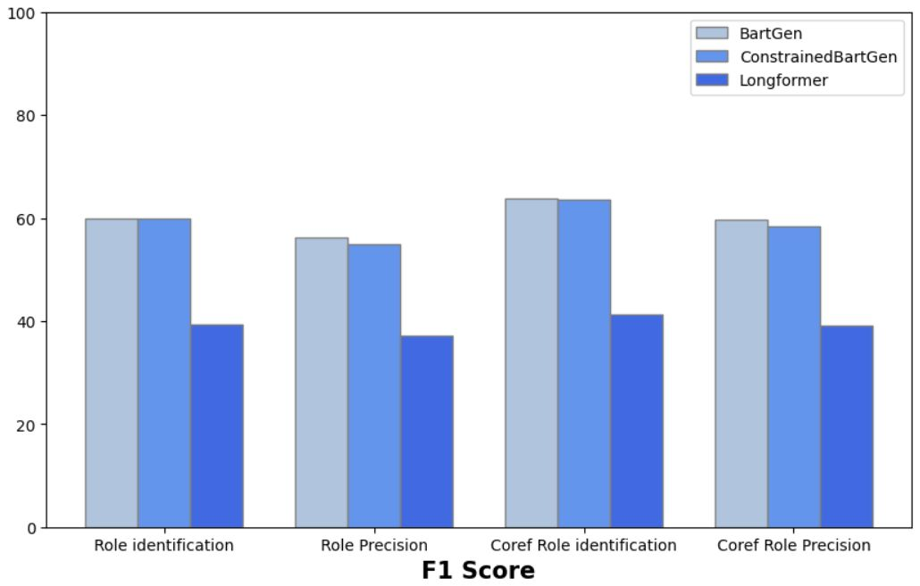
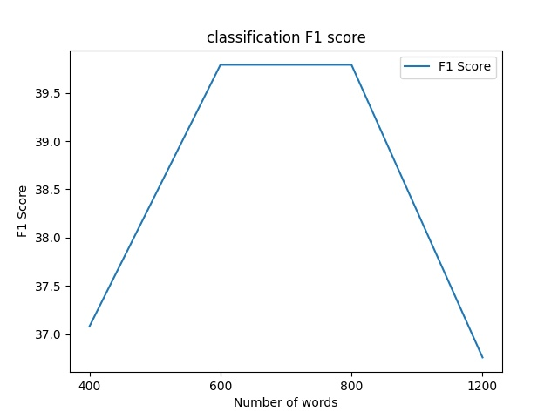
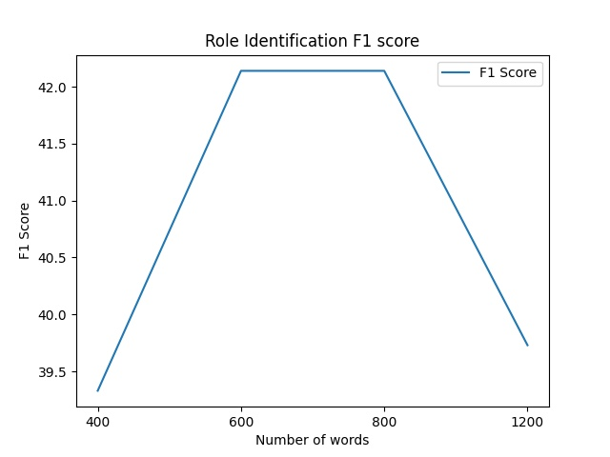
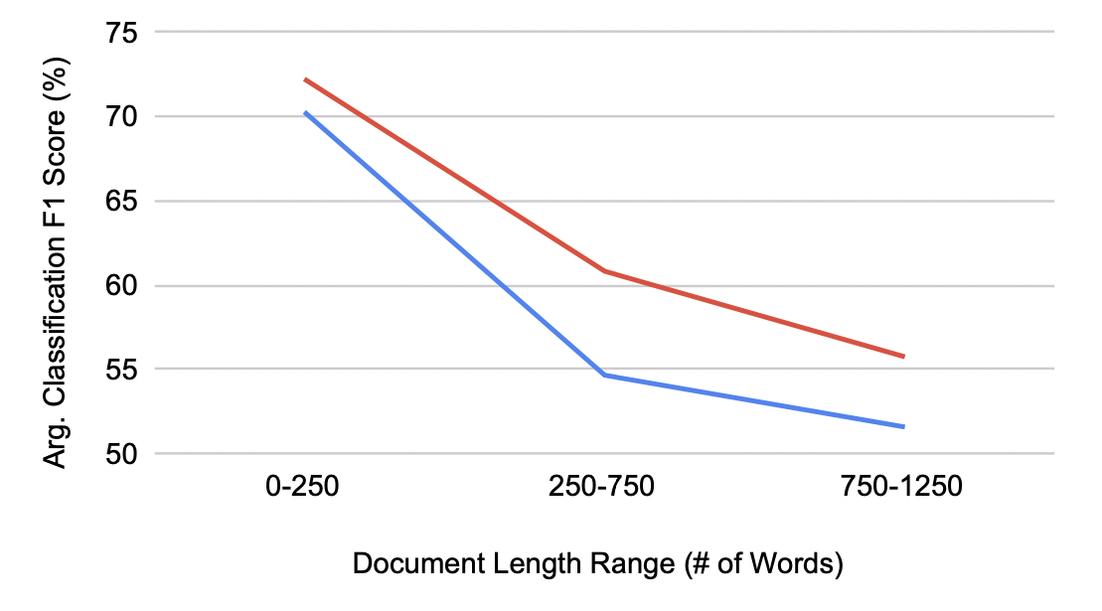
Document level argument extraction using conditional generation using Dynamic Global Memory and Longformer
Rajeev Kashetti, Jagadish Ramidi, Vamshi krishna Peddi, Sai Srujan Dandyala
{rkashett, jramidi, vpeddi, sdandyala}@gmu.edu
Highlights
Approach:
Task:Extracting Informative Arguments of Events from document
As per our initial error analysis made on subset of the data where informative arguments and gold standard triggers are substantially far apart the model cannot identify most of the arguments.
So, we proposed Longformer Encoder decoder model to take whole document as the input so that model can identify arguments that are far apart from triggers.
We used Wiki-Events dataset because it is the only dataset which focused on annotations for informative arguments which is highly useful for informative argument extraction.
We consider an argument span to be correctly identified if its offsets match any of the gold/reference informative arguments of the current event (i.e., argument identification); and it is correctly classified if its semantic role also matches (i.e. argument classification)
We also report performance under a more lenient metric “Coref F1”: the extracted argument span gets full credit if it is coreferential with the gold-standard arguments
Tasks
Our Work
dfffsshhyu
This graphs shows our model vs the authors model for checkpoint2.
The graph compares Memory-basedTraining w/ knowledge constrained decoding
As we can see the model we have developed is performing on a nearly same level as the author’s model.
We implemented the authores paper and performed error analysis. Then we implemented LongFormer encoder decoder model on top of it as our approach to tackle the problem.
Analysis
This graphs shows memory based training vs memory based training with knowledge constrained decoding and our longformer encoder decoder model.
As we can see our model gives lower accuracy than the author model. This shows that our model needs better fine tuning.
Performance of other two models are similar.
Tun
Ken
Ind-n
Ind
Da
Evaluations:
With increase in the number of words in the document the logformer is performer is performing well to a certain extent, post that we observe drop in performance.
In role identification we don’t see a significant drop but for the classification task we observed a significant drop in the score.
Ind-n
Ind
Bd
Mar
Ken
Ind-n
Ind
Ken
These are the performance drops of the author’s model(Red) vs the papers baseline model(Blue).
Here we can observe that our model doesn’t see similar performance drop compared to the author’s model and its baseline.
Future Work
Analyze the reason for drop in
f-1 score using longformer encoder decoder model.
Fine-tune longformer encoder decoder model for better results.
We want to try some ideas like ensemble the Longformer encoder decoder model, adding global_attention as mentioned in documentation to fine-tune model.

