Slide 1
About Dinosaurs and Mammals
About Dinosaurs and Mammals
The largest dinosaurs that walked the earth were approximately an order of magnitude (a factor of ten) more massive than the largest land mammals. It has been hypothesized that this may have been due to factors such as, but not limited to, the different levels of oxygen in the atmosphere, the difference in the effort required for giving birth to live young versus laying eggs, differences in metabolic rates, differences in the availability of food sources, or differences in ambient temperature. Develop a model to account for the differences in mass between the largest dinosaurs and the largest land mammals, and evaluate the effectiveness of this model using biological/paleontological data.

Slide 2
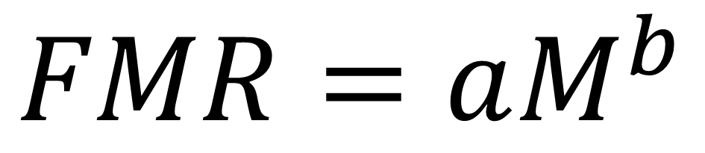

Model
Model

Slide 3
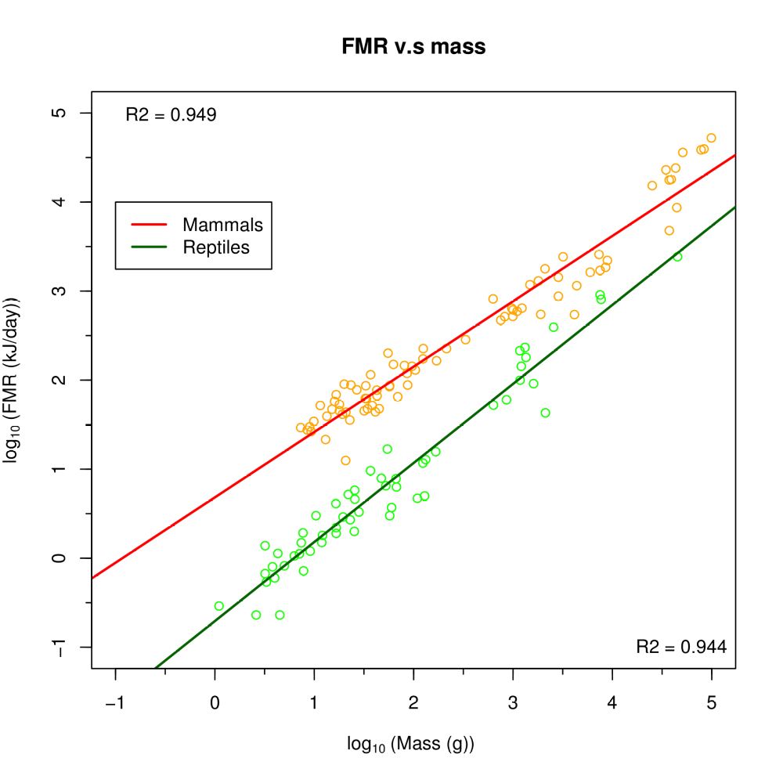

Slide 4
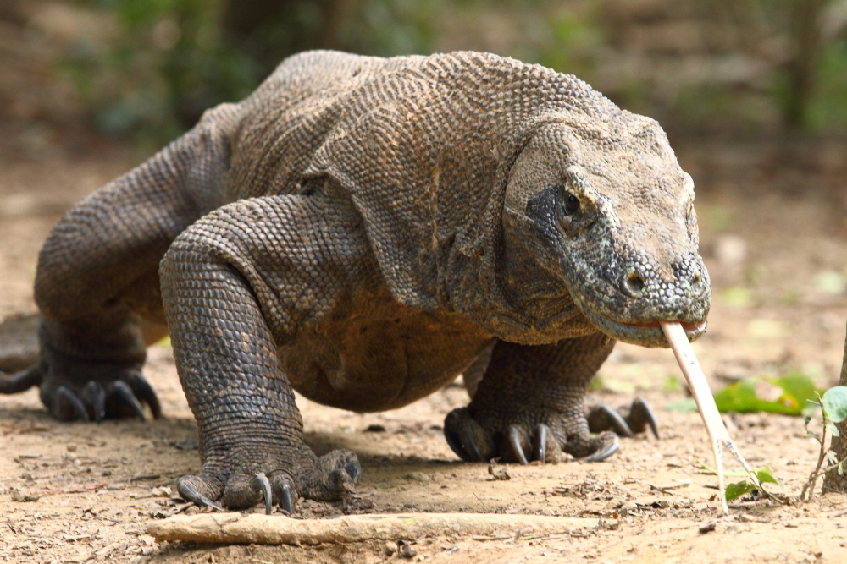

Slide 5
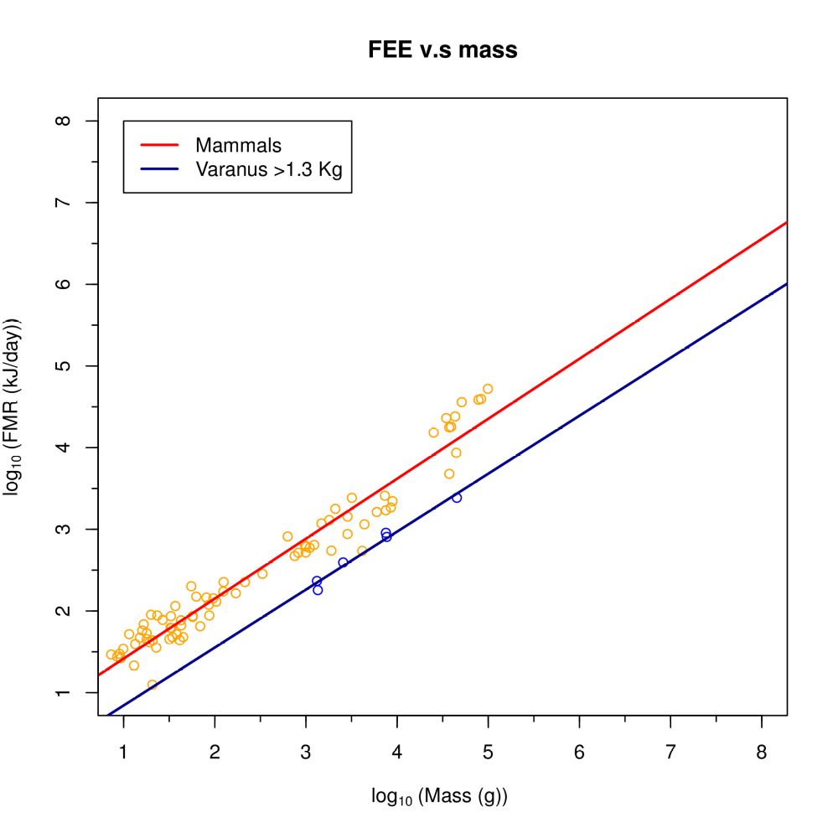




Slide 6
Conclusions
Conclusions
La llei al·lomètrica pel FMR ho peta
Els dinosaures tenien una taxa metabòlica que propera a la dels varànids, en particular inferior a la dels mamífers, fet que permet explicar les diferències de massa
No refusem que els dinosaures fossin ectotèrmics (sang freda, no tenen gast energètic d'autoregulació de temperatura)

