Slide 1
Software Engineering
At least what I think it is…

Slide 2
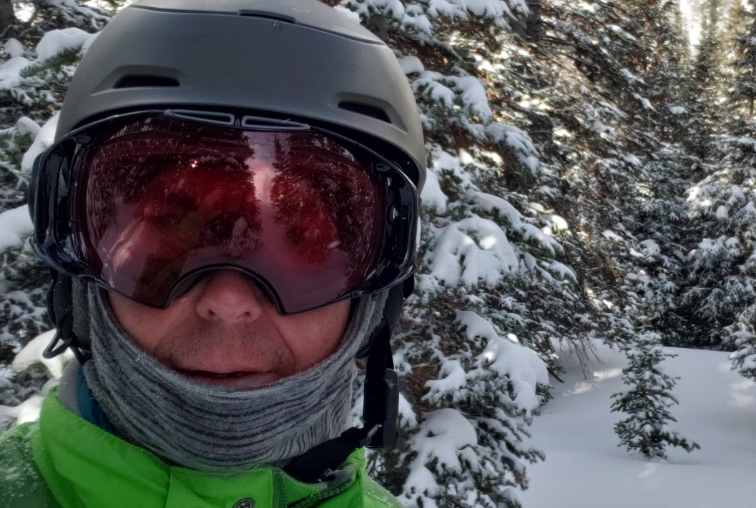
Background
Computer Science – Rose Hulman 95
A couple of worthless jobs out of college
Terre Firma 1996 – Director, Development
Aprimo 1998 – VP, Engineering
ZirMed 2011 – VP, Engineering
3DSIM 2014 – Chief Technology Officer
Bolstra 2018 – Chief Technology Officer
Winter 2019/2020 – Ski Bum

Slide 3
Computer Science Software Engineering
Computer Science
The art of problem solving with computers and computer-based tools
Software Engineering
The process of applying the discipline of CS across a bigger problem and larger team
Notes:
Large scale
Coordinated services
Dependencies

Slide 4
Roles of a Software Engineering
Individual Contributor
Team Lead
Manager
Director
Executive
Notes:
IC – Tech ladder
TL – no HR duties, planning and execution
Manager – hiring, firing, etc…
Director – manager of managers
Executive – Top tech person, reports to CEO

Slide 5
Roles you will interact with
Team Lead / Manager
Product Manager / Business Analyst
Support
Customers
Management and Executive Peers
Notes:
TL / Manager – they should be your ally, “boss” is a negative term. Make them look good and in tern, they should give credit to you
PM / BA – know the customer, product, help define features, UI, business details
Support – they might escalate stuff to you that comes from customers
Customers – more common as you move up in the org, help solve a problem, debrief an issue, discovery
Kodak
Mgmt and Executive Peers
Aprimo Sales
Zirmed VP customer support

Slide 6
Tools and Skills to get on your own
Source Code Control (Git / Git flow)
Open Source Basics
Dev Ops
Continuous Learning
Public Speaking
Goal and Objective setting (OKR)
Notes:
Draw common git flow
Open Source Basics
GPL
LGPL
MIT
Dev Ops – 3DSIM example
Continuous Learning – follow blogs, Plurasight
Public Speaking – terrified first 15 years in my career
Objectives and Key Results

Slide 7
Good Habits that have treated me well
Always work for a software company
Have clear objectives
Weekly planning cadence
Treat people as partners
Don’t focus on climbing the ladder
Take ownership of your deliveries
Suggest improvements, not just complaints
Comment your code!
If you move on, leave your employer in a good spot
Be willing to work hard when need, But… have a balance
Find mentors
Notes:
Caveat – that is my philosophy
Objectives - Top down OKRs
Planning – Sunday/Monday morning
Partners – Zirmed story
Ladder – I never wanted to be a manager…
Move On - Transferring knowledge, right hand person
Mentors – didn’t really have one

Slide 8
Startup 101
Options
Founder vs. Employee
Fundraising and Dilution
High risk, high reward – 90% failure rate
Notes:
What are options
Option pool
Founder at 3DSIM vs everywhere else
Aprimo story 90 down to 10…

Slide 9
Last Statement on Process
In industry, don’t forget you are delivering a product, not a process

