Slide 1

happyHomeMortgage Company
Founders:
Dawn Salisbury
Alissa Vokes
ChrissySuckow
Since 2020

Slide 2
Founders: Dawn Salisbury Alissa Vokes Chrissy Suckow
happyHomeMortgage
Company

Slide 3
Machine Learning
What is Machine Learning?

Slide 4
Factors for Mortgage Qualification
Gender
Martial status
Number of Dependents
College Graduation
Employment status
Monthly income
Loan amount
Length of loan
Credit Score

Slide 5
Factors for Mortgage Qualification
Gender
Martial status
Number of Dependents
College Graduation
Employment status
Monthly income
Loan amount
Length of loan
Credit Score

Slide 6
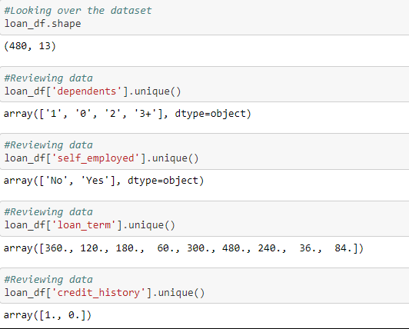
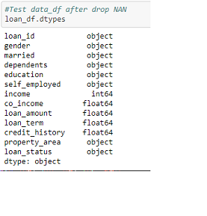
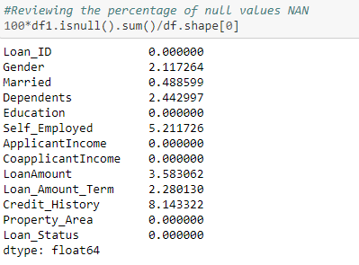
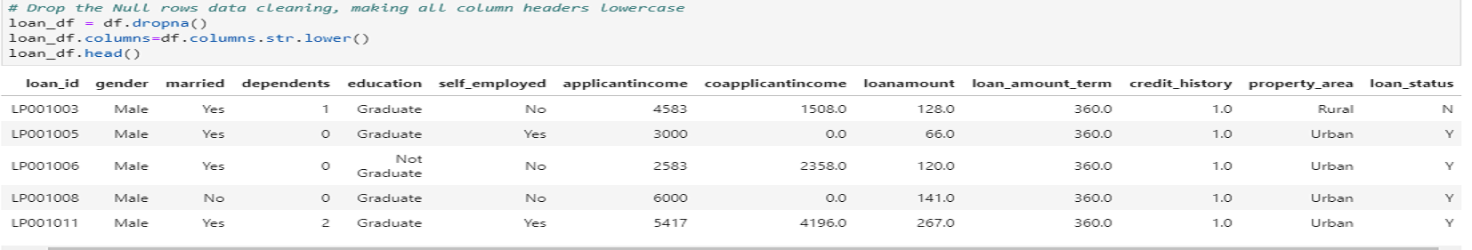
Process
Review and clean data using Jupyter Lab
Remove all NAN and null values

Slide 7
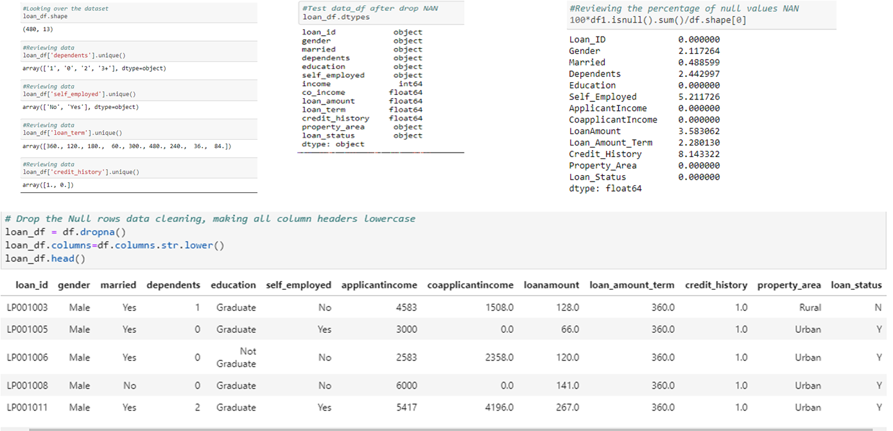
Process
Review and clean data using Jupyter Lab
Remove all NAN and null values

Slide 8
Process

Slide 9
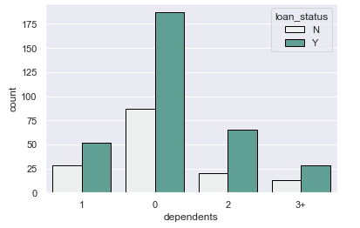
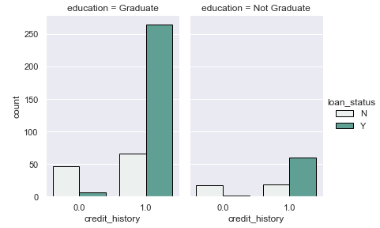
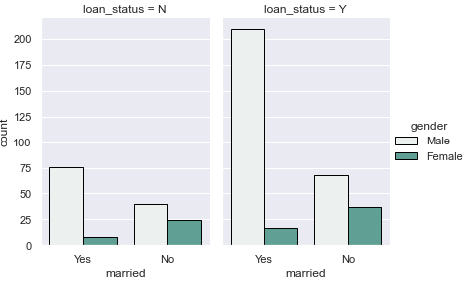
Process
Select features to be used in model
Plot data

Slide 10
Process
Select features to be used in model
Plot data

Slide 11
Process
Set machine learning code
Set deep learning code
Create Simulation

Slide 12
Process
Set machine learning code
Set deep learning code
Create Simulation

Slide 13
Technologies Used
Python Pandas
Matplotlib/Numpy/Seaborne
HTML/CSS/BOOTSTRAP
JavaScript/D3.js
Machine Learning using SKlearn
JupyterLab
VSCode

Slide 14
Technologies Used
Python Pandas
Matplotlib/Numpy/Seaborne
HTML/CSS/BOOTSTRAP
JavaScript/D3.js
Machine Learning using SKlearn
JupyterLab
VSCode

Slide 15
happyHomeMortgage
See if you qualify today!!
http://myprojectrepo.com/MachineLearningProject/

Slide 16
happyHomeMortgage See if you qualify today!!
http://myprojectrepo.com/MachineLearningProject/

