Slide 1
Founders: Dawn Salisbury Alissa Vokes Chrissy Suckow
happyHomeMortgage
Company

Slide 2
What is Machine Learning?
Machine learning is a question-and-answer system that is built through training a model.
Step 1: Collect data and pick features.
Step 2: Prepare the data.
Split data into sets for training and evaluation.
Step 3: Choose a model
Types: Classification, Clustering, Regression, Deep Learning…

Slide 3
What is Machine Learning?
Step 3: Choose a model
Types: Classification, Clustering, Regression, Deep Learning…
Step 4: Train the data.
Initialize random data and predict outputs for those values.
Adjust outcomes based on actual values.
Repeat cycle to update weights and biases.
Use evaluation data with the model.
Step 5: Prediction.
The model is used to predict and answer the question.

Slide 4
Factors for Mortgage Qualification
Gender
Marital status
Number of Dependents
College Graduation
Employment status
Monthly income
Loan amount
Length of loan
Credit Score

Slide 5
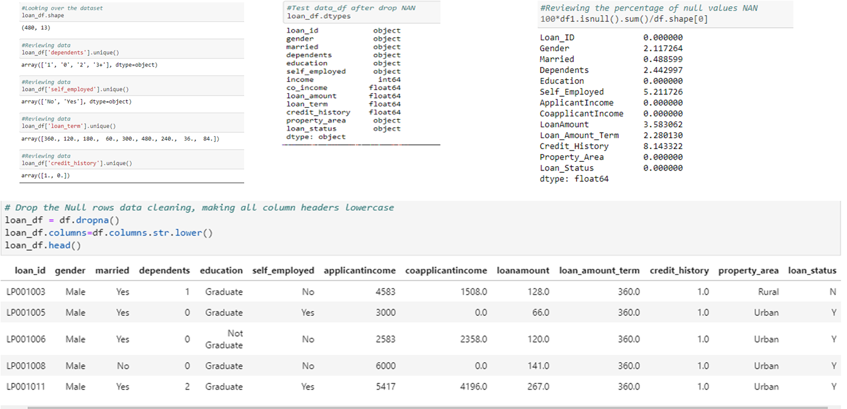
Process
Find the best data for our model
Review and clean data using Jupyter Lab
Remove all NAN and null values

Slide 6
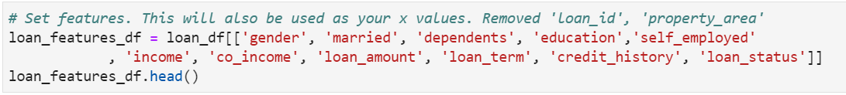
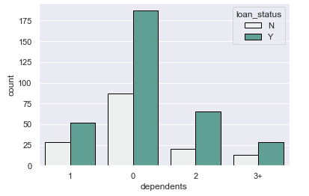
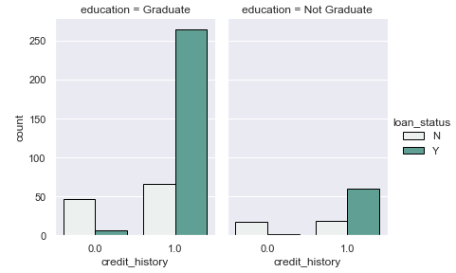
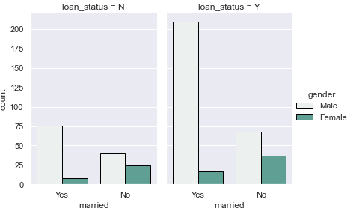
Process
Select features to be used in model
Plot data

Slide 7
Process
Choose the right machine learning algorithm
Train test and split your data
Preprocessing
Train and test your model
Hyperparameter Tuning
Save your model

Slide 8
Technologies Used
Python Pandas
Matplotlib/Numpy/Seaborne
HTML/CSS/BOOTSTRAP
JavaScript/D3.js
Machine Learning using SKlearn
JupyterLab
VSCode

Slide 9
happyHomeMortgage See if you qualify today!!
http://myprojectrepo.com/MachineLearningProject/

