Slide 1
Analysis of Profitable Arcade Locations within Philadelphia

Slide 2
Arcades and gaming venues in Philadelphia are an untapped market
Gaming and e-sports are on the rise, but arcades and gaming related venues are few and far between in Philadelphia
By looking at the distribution of arcades around Philadelphia, we can find where opening a new arcade would be getting competition, and where it would most likely be appreciated
This research would greatly help anyone looking to build arcades or other similar gaming related businesses within Philadelphia and would provide them important information to keep in mind all throughout the decision-making process

Slide 3
Data acquisition and cleaning
Data was gathered using the Foursquare API location data
Data was gathered on arcades within Philadelphia, which had less than 10 marked venues
Dropped a bank coin counter and a church with “arcade” in their names
Gathered a second set of data on all game related venues in Philadelphia
Dropped exhibit, sculpture garden, art gallery, hunting establishments, unrelated restaurants, dupes, and a barber

Slide 4



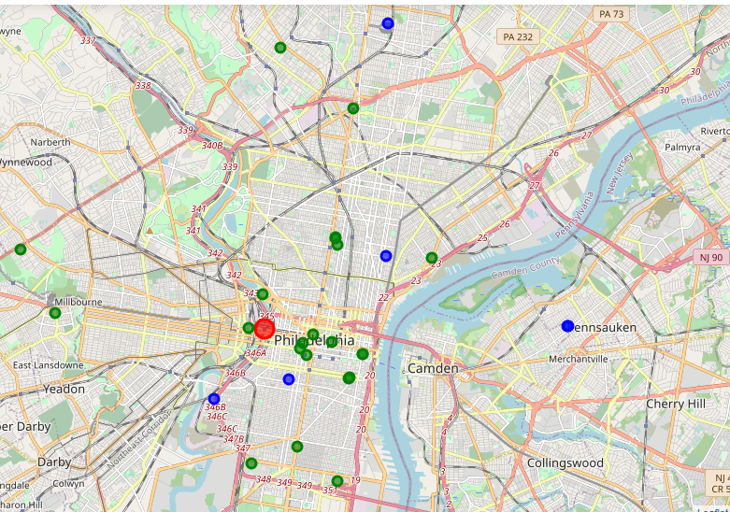
Mapping of results
z
Red dot indicates 30th Street Station, which was selected as a center point of Philadelphia
Green points indicate established game related venues
Blue points indicate established arcade venues

Slide 5
Discussion
There appears to be a trend, albeit insignificant, between gaming related venues and arcade locations
40% (2) of the arcades do not show a tendency of being close to a gaming related venue, although one of these is located nearby a school, which could indicate a market for younger people to go to an arcade
There are two main locations I would suggest for a new arcade
West Philadelphia, as there are no arcades in sight, but there are 2 gaming related locations nearby. This implies an interest in gaming related venues and could prove profitable for a new arcade location.
South Philadelphia, where 3 gaming related locations form an almost perfect triangle. There is clear interest in gaming related venues for three of them to be near one another, and thus I believe opening an arcade in this general location would prove to be successful.

Slide 6
Conclusions and Future Developments
Some hindrances prevented this project from being as good as it could have been
The findings are only as strong as the records within Foursquare’s API database
The findings are limited by the venues’ naming and category structure within Foursquare’s database
These hindrances could only be accounted for by knowing every one of those outlier cases, which is why I believe this analysis is a good first step towards solving the problem initially brought forth

