Slide 1



MI Cables Thermal Studies and Hollow Feeders Conceptual Design Progress report
D. Samsonov, S. Masyukevich, N. Babinov,
A. Dmitriev, E. Mukhin, A. Razdobarin,
St.-Petersburg
11th May 2018

Slide 2
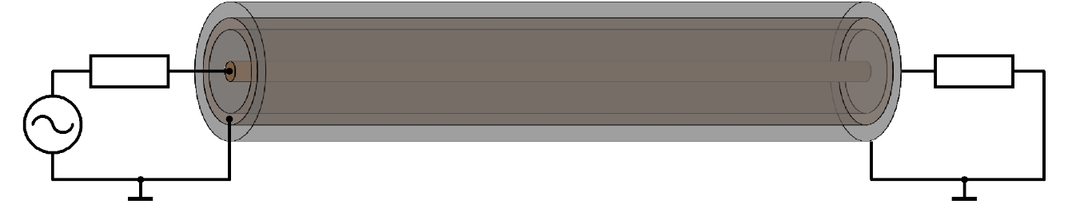
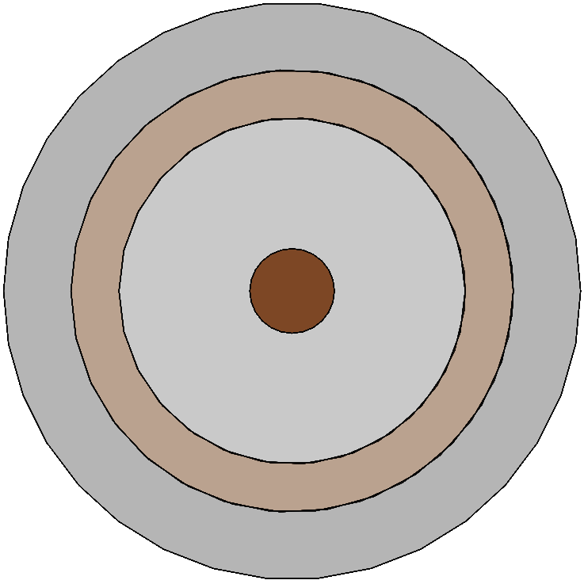



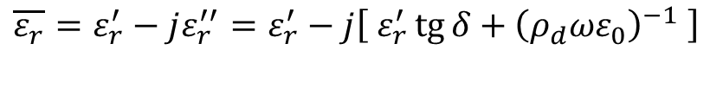








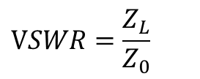
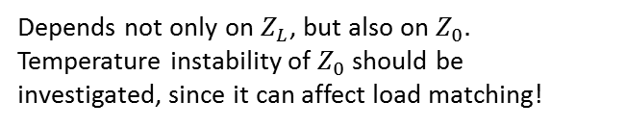
MI Cable RF+Thermal Model
Goal: study MI Cable longitudinal heating distribution depending on loss growth with temperature and load reflection.
$$Z_{S}$$
$$Z_{L}$$
$$U_{RF}$$
MI Cable: $Z_{0},α\left(f,T\right)$
$$x$$
$$\overline{ε_{r}}$$
$$r_{s}$$
Complex relative dielectric permittivity:
$$r_{d}$$
$$r_{o}$$
$$\overline{ε_{r}}=ε_{r}^{′}−jε_{r}^{′′}=ε_{r}^{′}−j\left[ ε_{r}^{′}\operatorname{tg}{δ}+{\left(ρ_{d}ωε_{0}\right)}^{−1} \right]$$
$$r_{i}$$
Polarization loss
Conductivity loss
Load Voltage Standing Wave Ratio:
$$VSWR=\frac{Z_{L}}{Z_{0}}$$
Depends not only on $Z_{L}$, but also on $Z_{0}.$
Temperature instability of $Z_{0}$ should be investigated, since it can affect load matching!
$$ρ_{c}$$
Material and dimensional parameters
Model parameters can be extracted either from measurements or from datasheets.

Slide 3
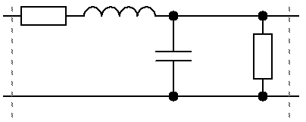
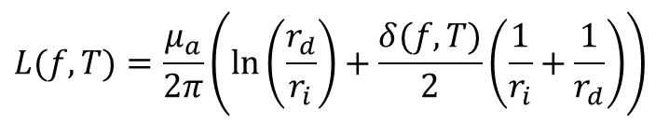
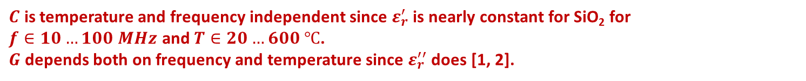



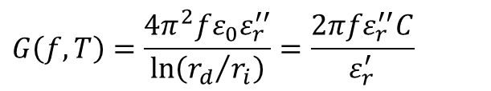


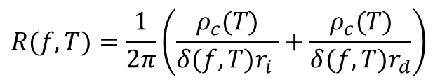
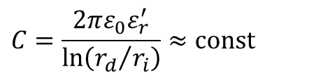
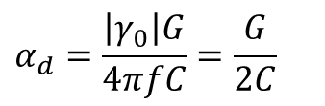
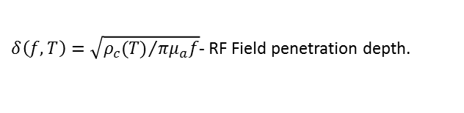

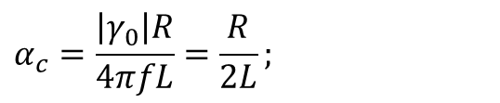

Line Loss
Temperature and Frequency Dependence
$$R∆x$$
$$L∆x$$
Line loss components through primary parameters:
$$α_{c}=\frac{\left|γ_{0}\right|R}{4πfL}=\frac{R}{2L};$$
$$α_{d}=\frac{\left|γ_{0}\right|G}{4πfC}=\frac{G}{2C}$$
$$C∆x$$
$$G∆x$$
$γ_{0}=j2πf\sqrt{μ_{a}ε_{a}}$ - Transmission coefficient for TEM wave in lossless medium.
$$∆x$$
Series resistance ($δ≪r_{o}−r_{d}$):
Series inductance ($δ≪r_{o}−r_{d}$):
$$R(f,T)=\frac{1}{2π}\left(\frac{ρ_{c}(T)}{δ(f,T)r_{i} }+\frac{ρ_{c}(T)}{δ(f,T)r_{d}}\right)$$
$$L(f,T)=\frac{μ_{a}}{2π}\left(\ln\left(\frac{r_{d}}{r_{i}}\right)+\frac{δ(f,T)}{2}\left(\frac{1}{r_{i}}+\frac{1}{r_{d}}\right)\right)$$
$δ\left(f,T\right)=\sqrt{{ρ_{c}(T)}/{πμ_{a}f}}$- RF Field penetration depth.
$R$ and $L$ depend both on temperature and frequency.
Parallel capacitance:
Parallel conductance:
$$C=\frac{2πε_{0}ε_{r}^{′}}{\ln\left({r_{d}}/{r_{i}}\right)}≈\text{const}$$
$$G\left(f,T\right)=\frac{4π^{2}fε_{0}ε_{r}^{′′}}{\ln\left({r_{d}}/{r_{i}}\right)}=\frac{2πfε_{r}^{′′}C}{ε_{r}^{′}}$$
$C$ is temperature and frequency independent since $ε_{r}^{′}$ is nearly constant for SiO₂ for
$f∈10…100 MHz$ and $T∈20…600 ℃$.
$G$ depends both on frequency and temperature since $ε_{r}^{′′}$ does [1, 2].
[1] Zhang, T., Wu, M. Q., Zhang, S. R., He, M., Li, E., Wang, J. M., ... & Li, Z. P. (2012). Temperature dependence of microwave dielectric performance of silica. Journal of Shanghai Jiaotong University (Science), 17(6), 748-754.
[2] Hotta, M., Hayashi, M., Nishikata, A., & Nagata, K. (2009). Complex permittivity and permeability of SiO₂ and Fe₃O₄ powders in microwave frequency range between 0.2 and 13.5 GHz. ISIJ international, 49(9), 1443-1448.

Slide 4

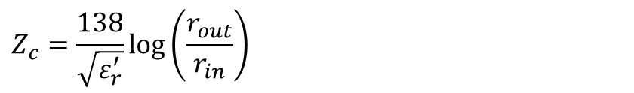
Sample calculation: 3 mm Thermocoax @ 50 MHz
Extracting parameters from datasheet data
Inputs: Total loss @ 20°C, Temperature loss dependence,
Inputs:
Total cable attenuation*
Conductors and dielectric resistivity
*Cable attenuation measured at 20 °C;
Attenuation temperature coefficient taken from [1]
$$α\left(f,T\right)=α_{0}(f)+3⋅{10}^{−4}\left(T−20\right)=α_{c}+a_{d}$$
$$Z_{c}=\frac{138}{\sqrt{ε_{r}^{′}}}\log\left(\frac{r_{out}}{r_{in}}\right)$$
$$ρ_{c}\left(T\right)=1.72⋅{10}^{−8}\left[1+3.8⋅{10}^{−3}\left(T−20\right)\right]$$
$$α_{d}=α−α_{c}$$

Slide 5
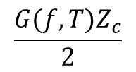
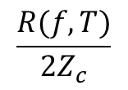
$$\frac{G(f,T)Z_{c}}{2}$$
Thermal dependence
$$\frac{R(f,T)}{2Z_{c}}$$

Slide 6
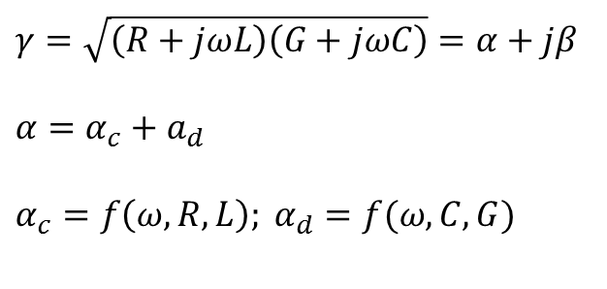
Cable RF Parameters
Lossy transmission line model
Transmission constant:
$$γ=\sqrt{\left(R+jωL\right)\left(G+jωC\right)}=α+jβ$$
$$α=α_{c}+a_{d}$$
$$α_{c}=f\left(ω,R,L\right); α_{d}=f(ω,C,G)$$

Slide 7
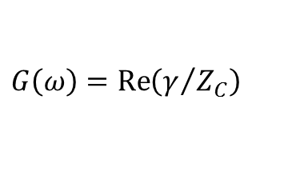
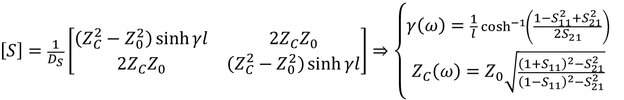
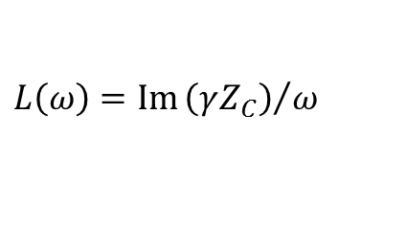



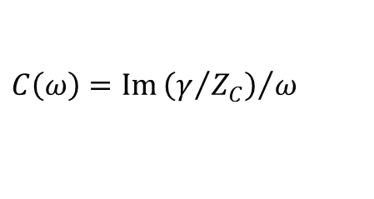
Cable RF Parameters Extraction
$$\left[\begin{matrix}b_{1} \\ b_{2}\end{matrix}\right]=\left[S\right]\left[\begin{matrix}a_{1} \\ a_{2}\end{matrix}\right]$$
$$\left[S\right]=\left[\begin{matrix}S_{11} & S_{12} \\ S_{21} & S_{22}\end{matrix}\right]$$
Transmission line of length l
$$\left[S\right]=\frac{1}{D_{S}}\left[\begin{matrix}\left(Z_{C}^{2}−Z_{0}^{2}\right)\sinh{γl} & 2{Z_{C}Z}_{0} \\ 2{Z_{C}Z}_{0} & \left(Z_{C}^{2}−Z_{0}^{2}\right)\sinh{γl}\end{matrix}\right]⇒\left\{\begin{aligned}γ\left(ω\right)=\frac{1}{l}\cosh^{−1}\left(\frac{1−S_{11}^{2}+S_{21}^{2}}{2S_{21}}\right) \\ Z_{C}\left(ω\right)=Z_{0}\sqrt{\frac{{\left(1+S_{11}\right)}^{2}−S_{21}^{2}}{{\left(1−S_{11}\right)}^{2}−S_{21}^{2}}} \end{aligned}\right.$$
$$D_{S}=2{Z_{C}Z}_{0}\cosh{γl}+\left(Z_{C}^{2}+Z_{0}^{2}\right)\sinh{γl}$$
$$R\left(ω\right)=\operatorname{Re}\left(γZ_{C}\right)$$
$$L\left(ω\right)=\operatorname{Im}{{\left(γZ_{C}\right)}/ω}$$
$$G\left(ω\right)=\operatorname{Re}\left(γ/{Z_{C}}\right)$$
$$C\left(ω\right)=\operatorname{Im}{{\left(γ/{Z_{C}}\right)}/ω}$$
Papazyan, R., Pettersson, P., Edin, H., Eriksson, R., & Gafvert, U. (2004). Extraction of high frequency power cable characteristics from S-parameter measurements. IEEE Transactions on Dielectrics and electrical insulation, 11(3), 461-470.

Slide 8
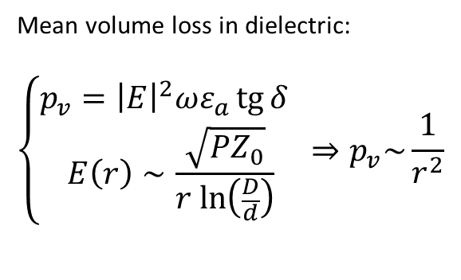
Loss distribution
Mean volume loss in dielectric:
$$\left\{\begin{aligned}p_{v}={\left|E\right|}^{2}ωε_{a}\operatorname{tg}{δ} \\ E\left(r\right)∼\frac{\sqrt{PZ_{0}}}{r ln\left(\frac{D}{d}\right)}\end{aligned}⇒p_{v}\sim \frac{1}{r^{2}}\right.$$
 | 0.296” MGT, TMW | 0.275” MGT, TMW | 6mm TCX
Din, mm | 2.44 | 2.21 | 0.9
Ddiel, mm | 6.78 | 6.25 | 3.77
Dout, mm | 6.98 | 6.45 | ?
Dsheath, mm | 7.52 | 6.99 | 6
n, % (ε_{r}, a. u.) | 80 (1.56) |  | 60 (2.79)
_{Qheat}
_{Radiation}

Slide 9
 |  | Operating Temperature Range
Times Microwave | Cable | 1000
 | Standard Connectors | 200
 | High Temp Connectors | 600
Thermocoax | Type-N | 70
 | High Temp | 500
 | Cable | 1000

Slide 10
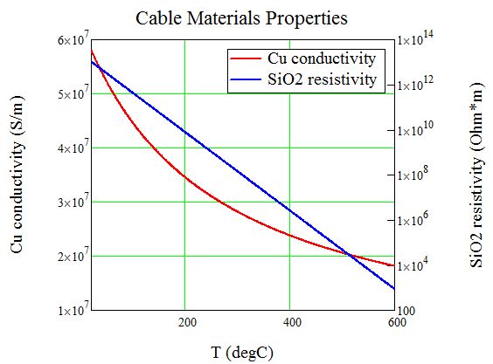
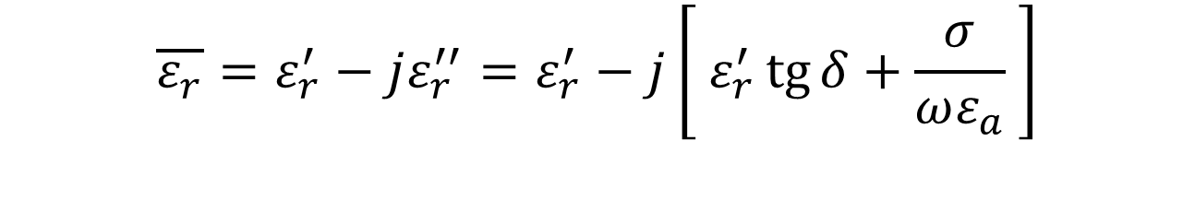
Material model
$$\overline{ε_{r}}=ε_{r}^{′}−jε_{r}^{′′}=ε_{r}^{′}−j\left[ ε_{r}^{′}\operatorname{tg}{δ}+\frac{σ}{ωε_{a}} \right]$$
Polarization
Conductivity
$$α\left(f,T\right)=α_{0}(f)+3⋅{10}^{−4}\left(T−20\right)$$
$$ρ_{cond}\left(T\right)=1.72⋅{10}^{−8}\left[1+3.8⋅{10}^{−3}\left(T−20\right)\right]$$

Slide 11
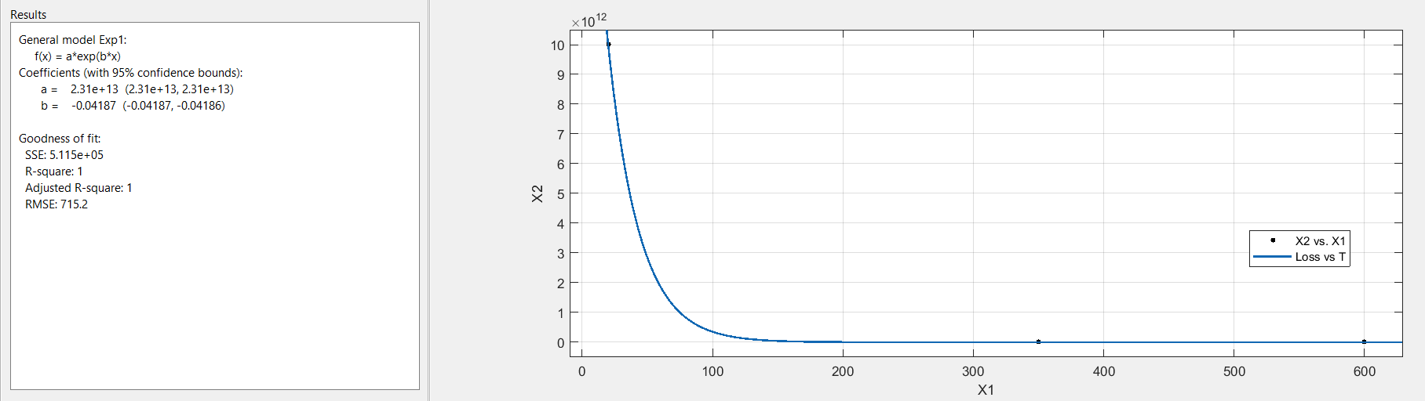

Slide 12

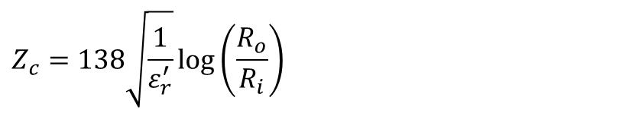
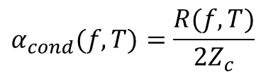
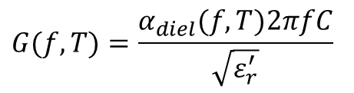
$$G(f,T)=\frac{α_{diel}(f,T)2πfC}{\sqrt{ε_{r}^{′}}}$$
$$α_{cond}(f,T)=\frac{R(f,T)}{2Z_{c}}$$
$$α_{diel}=\frac{}{}$$
$$Z_{c}=138\sqrt{\frac{1}{ε_{r}^{′}}}\log\left(\frac{R_{o}}{R_{i}}\right)$$

