Slide 1



MI Cables Thermal Studies and Hollow Feeders Conceptual Design Progress report
D. Samsonov, S. Masyukevich, N. Babinov,
A. Dmitriev, E. Mukhin, A. Razdobarin,
St.-Petersburg
28th March 2018

Slide 2
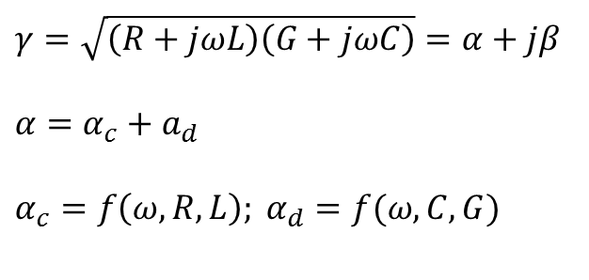
Cable RF Parameters
Lossy transmission line model
Transmission constant:
$$γ=\sqrt{\left(R+jωL\right)\left(G+jωC\right)}=α+jβ$$
$$α=α_{c}+a_{d}$$
$$α_{c}=f\left(ω,R,L\right); α_{d}=f(ω,C,G)$$

Slide 3
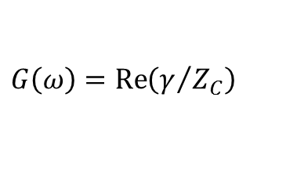
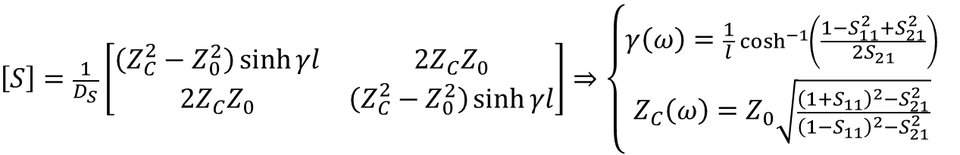
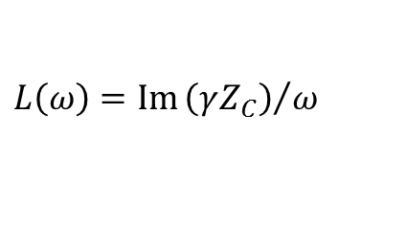



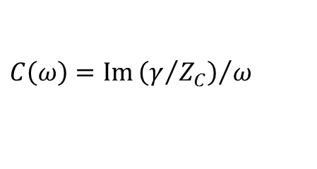
Cable RF Parameters Extraction
$$\left[\begin{matrix}b_{1} \\ b_{2}\end{matrix}\right]=\left[S\right]\left[\begin{matrix}a_{1} \\ a_{2}\end{matrix}\right]$$
$$\left[S\right]=\left[\begin{matrix}S_{11} & S_{12} \\ S_{21} & S_{22}\end{matrix}\right]$$
Transmission line of length l
$$\left[S\right]=\frac{1}{D_{S}}\left[\begin{matrix}\left(Z_{C}^{2}−Z_{0}^{2}\right)\sinh{γl} & 2{Z_{C}Z}_{0} \\ 2{Z_{C}Z}_{0} & \left(Z_{C}^{2}−Z_{0}^{2}\right)\sinh{γl}\end{matrix}\right]⇒\left\{\begin{aligned}γ\left(ω\right)=\frac{1}{l}\cosh^{−1}\left(\frac{1−S_{11}^{2}+S_{21}^{2}}{2S_{21}}\right) \\ Z_{C}\left(ω\right)=Z_{0}\sqrt{\frac{{\left(1+S_{11}\right)}^{2}−S_{21}^{2}}{{\left(1−S_{11}\right)}^{2}−S_{21}^{2}}} \end{aligned}\right.$$
$$D_{S}=2{Z_{C}Z}_{0}\cosh{γl}+\left(Z_{C}^{2}+Z_{0}^{2}\right)\sinh{γl}$$
$$R\left(ω\right)=\operatorname{Re}\left(γZ_{C}\right)$$
$$L\left(ω\right)=\operatorname{Im}{{\left(γZ_{C}\right)}/ω}$$
$$G\left(ω\right)=\operatorname{Re}\left(γ/{Z_{C}}\right)$$
$$C\left(ω\right)=\operatorname{Im}{{\left(γ/{Z_{C}}\right)}/ω}$$
Papazyan, R., Pettersson, P., Edin, H., Eriksson, R., & Gafvert, U. (2004). Extraction of high frequency power cable characteristics from S-parameter measurements. IEEE Transactions on Dielectrics and electrical insulation, 11(3), 461-470.

Slide 4
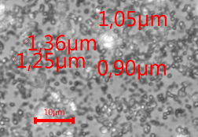
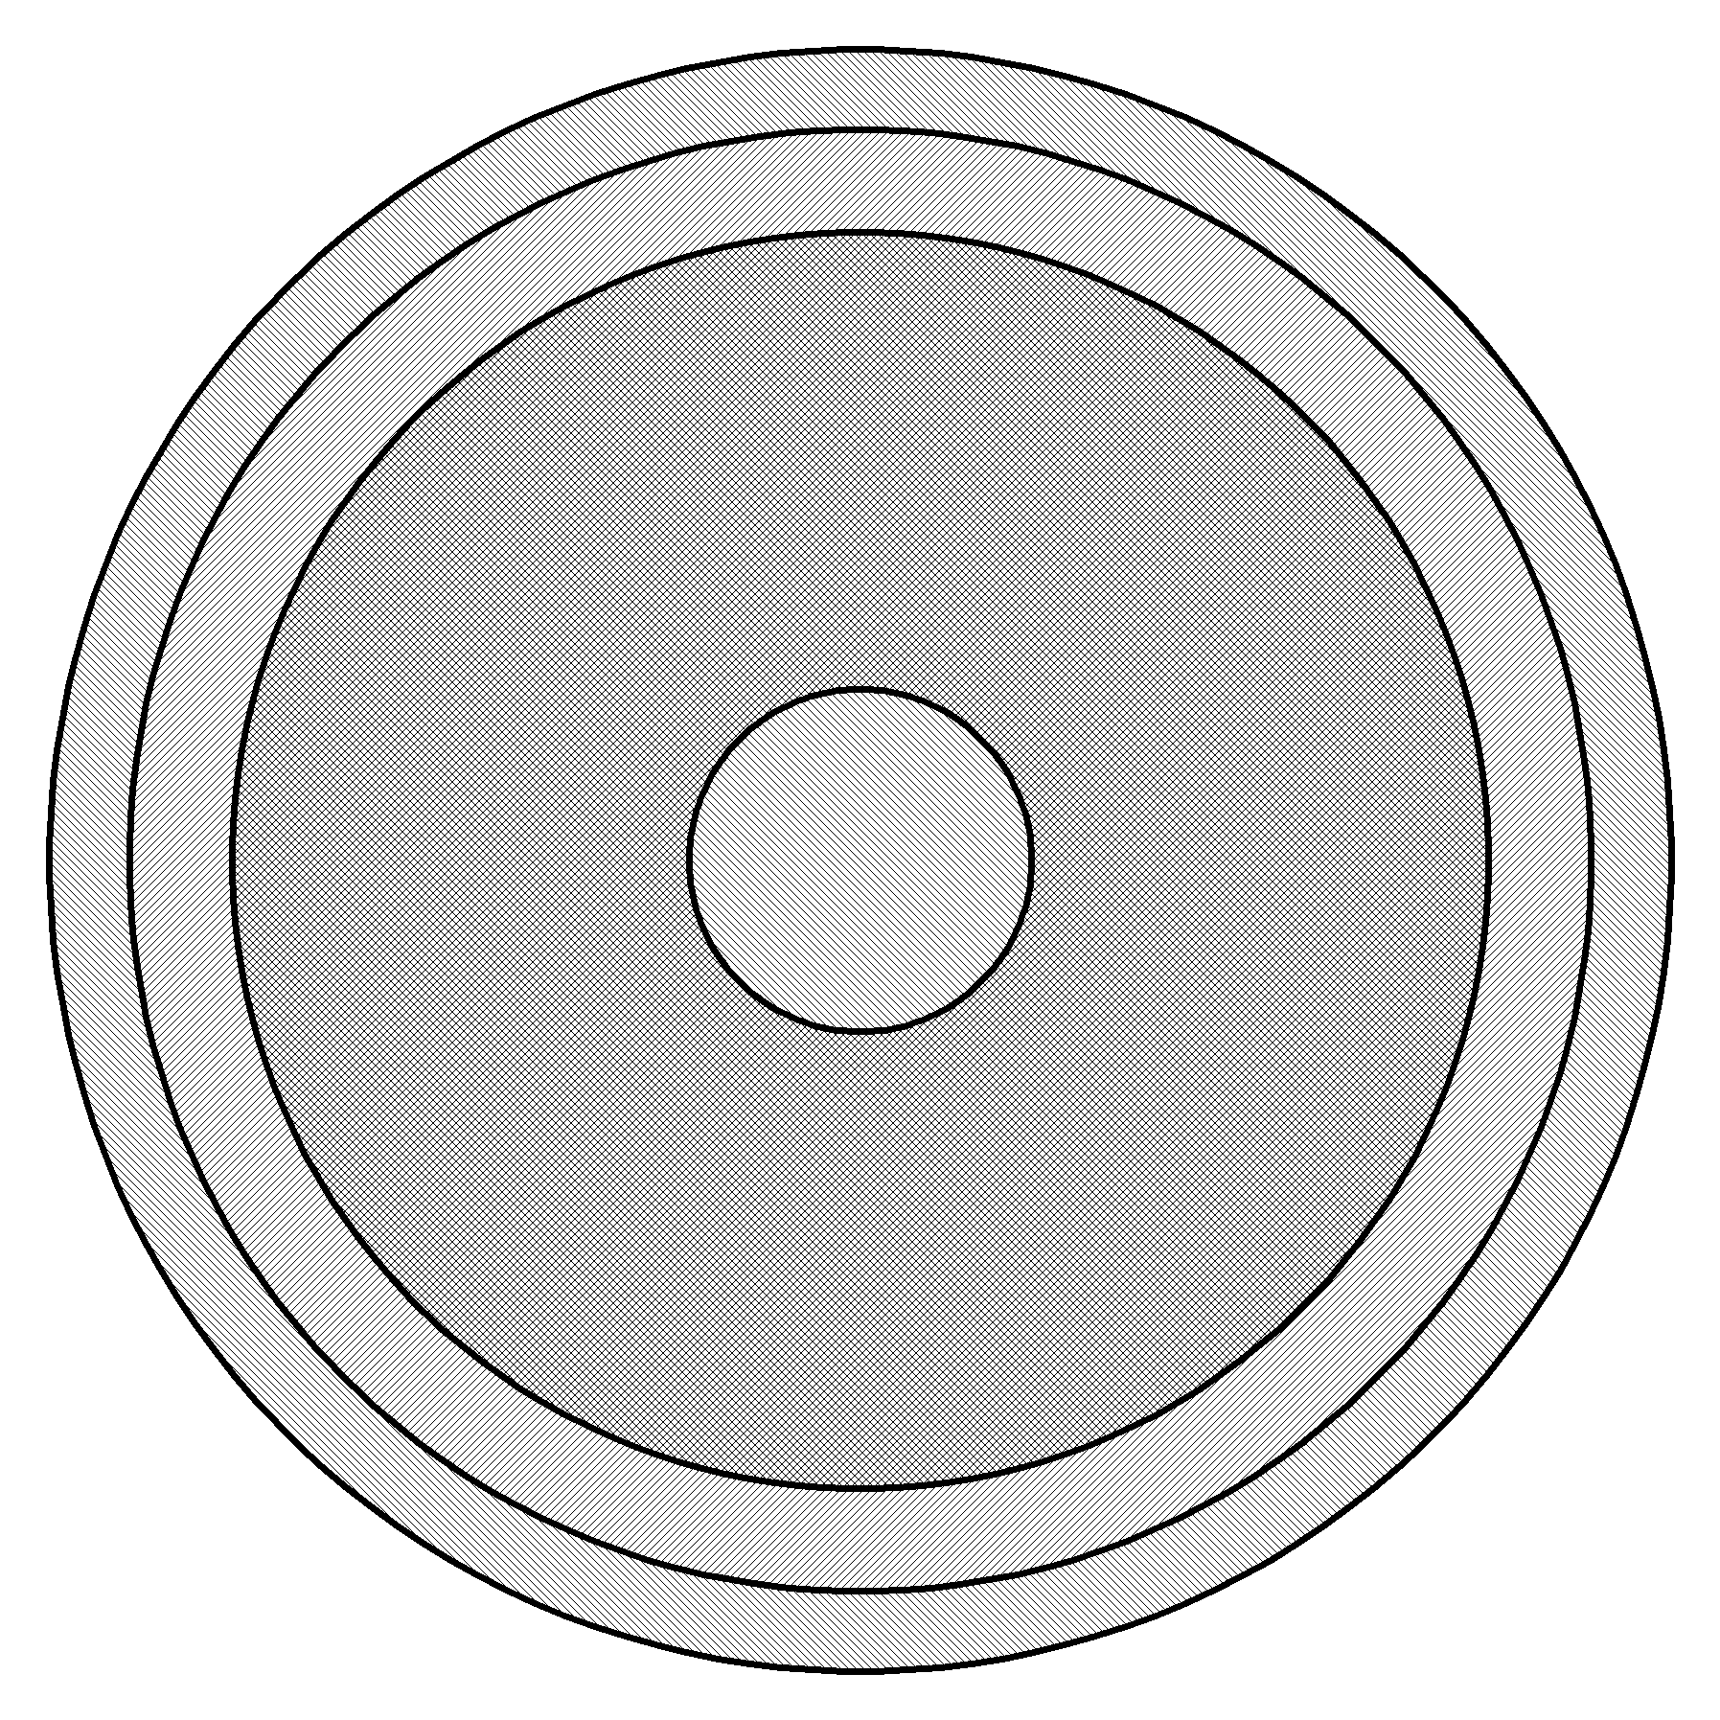
MI Cable structure
Inner conductor (Cu)
Mineral filling (SiO₂)
Outer conductor (Cu)
SiO₂ filling optical microscopy
(3 mm Thermocoax cable)
Outer sheath (SS304, Inconel)
Material Properties Handbook (32SAC7)
SiO2 powder thermal data can be hardly revealed from the literature.
Considered further to be 0.15…1.5 W/(mk)

Slide 5
Sample Heating Numerical Calculation
Dimensional parameters
Inner conductor heating, Tinner=1358K, isolated, radiation ON
Diameter | Value, mm
Outer sheath | 6
Outer conductor | 5
Mineral dielectric | 4.5
Inner conductor | 1
ε | λ SiO₂ | P₁₀₈₅, W/m | T_{outer}, K | t_{steady}, s
0.1 | 0.15 | 161 | 1106 | 1300
1 | 0.15 | 373 | 773 | 500
0.1 | 1.5 | 315 | 1310 | 1000
1 | 1.5 | 1590 | 1105 | 200
500 °C
70 °C, 250 °C
Connectors become the most emerging problem!

Slide 6
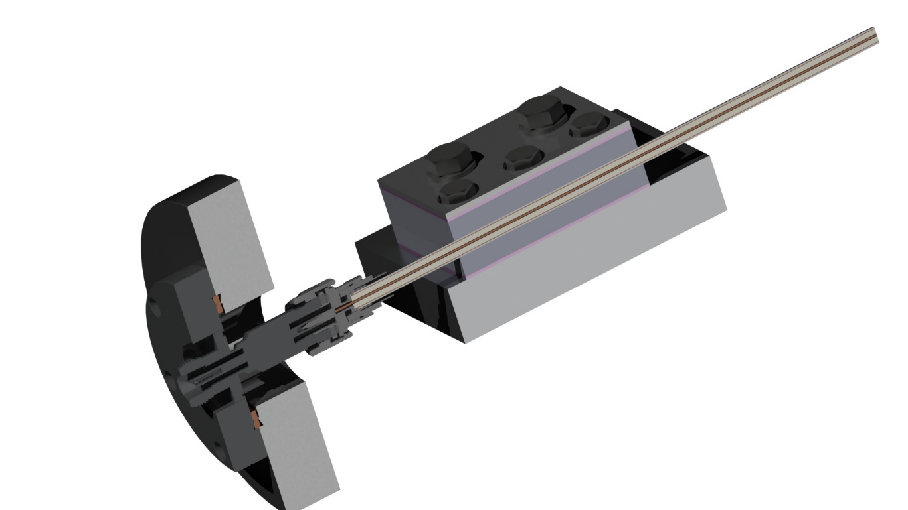
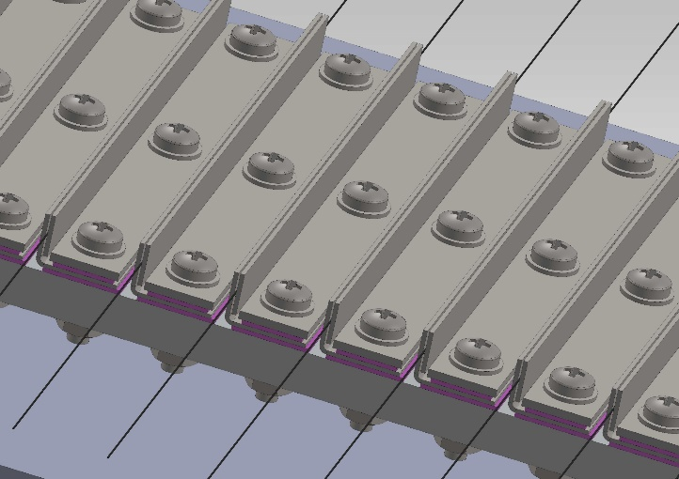
Thermal grounding
T=T1=const
Thermocouples thermal grounding

Slide 7

Outer sheath heating
Relevant for low-signal S-parameters measurements
P=370 W/m, e=0.1, k=0.15 → Tinner = 1365K minimal power cable can withstand
≈10cm of temperature-controlled tail is enough to ground the temperature of inner conductor near connector to 333K (60 °C) having it 1365K in the constant temp area – depends on k
Constant temp area lies between ≈0.2m (ε=1) and ≈0.3m(ε=0.1), and does not depend on k.
Having 8m cable length, the total unknown temp zone length of ≈2*0.4 m is ~10%

Slide 8
Inner conductor heating
Relevant for loading with high RF power
Outer sheath temperature
Inner conductor temperature

Slide 9
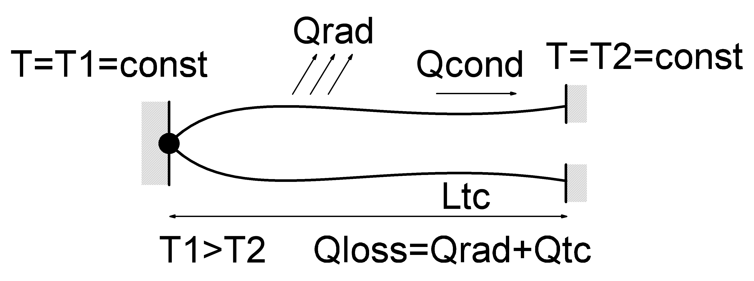
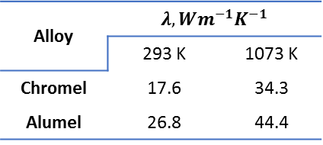
Power loss on thermocouples
Thermocouples Type: K (Chromel-Alumel)
Diameter: 0.2 mm
Alloy | $$λ, Wm^{−1}K^{−1}$$
 | 293 K | 1073 K
Chromel | 17.6 | 34.3
Alumel | 26.8 | 44.4
Worst-case assessment ($λ=40 Wm^{−1}K^{−1}$, $T_{high}=1300 K$)
Temperature along thermocouple tails
Total loss vs T_{high}
Thermocouple length L_{tc} should be ≥ 0.3 m to achieve the lowest power loss
Total power loss per TC ≈ 0.5 W. Main loss is due to radiation (Q_{rad}≈10Q_{tc})

Slide 10

Hollow Feeders Work Schedule 2018
Task | Apr 2018 |  | May 2018 |  | Jun 2018 |  | Jul 2018 |  | Aug 2018 |  | Sep 2018 |  | Oct 2018 |  | Nov 2018
1. Comparative analysis of feeder basic element (FBE) options without taking into account risk of breakdown. Preparing inputs for breakdown risk assessment and thermal calculations | █ | █ | █ | █
2. FBE breakdown risk assessment and thermal calculations |  |  |  | █ | █
3. Correction of FBE analysis using the results of breakdown risk assessment and thermal calculations. Final conclusions on FBE options applicability. FBE conceptual design proposals |  |  |  |  |  | █ | █
4. CC RF discharge plasma load impedance measuring technique development | █ | █ | █
5. Fixtures for plasma load impedance measurements development and fabrication. Performing measurements |  |  | █ | █ | █
6. Revealing requirements for in-vessel and ex-vessel matching units taking into account CC RF plasma load impedance measurement results. Optimizing FBE performance for application in matching unit design |  |  |  |  |  | █ | █
7. FBE Conceptual design, including turning and joint junction features |  |  |  |  |  | █ | █ | █ | █ | █ | █ | █
8. FBE-based matching unit conceptual design. Developing list of mock-ups for fabrication at further development stages |  |  |  |  |  | █ | █ | █ | █ | █ | █ | █
9. R&D Final Report |  |  |  |  |  |  |  |  | █ | █ | █ | █ | █ | █ | █
In partnership with
http://hfpower.ru

