Slide 1

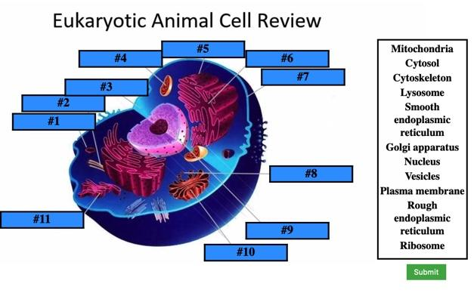
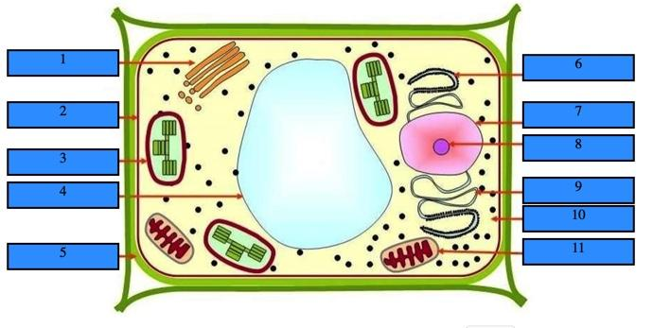
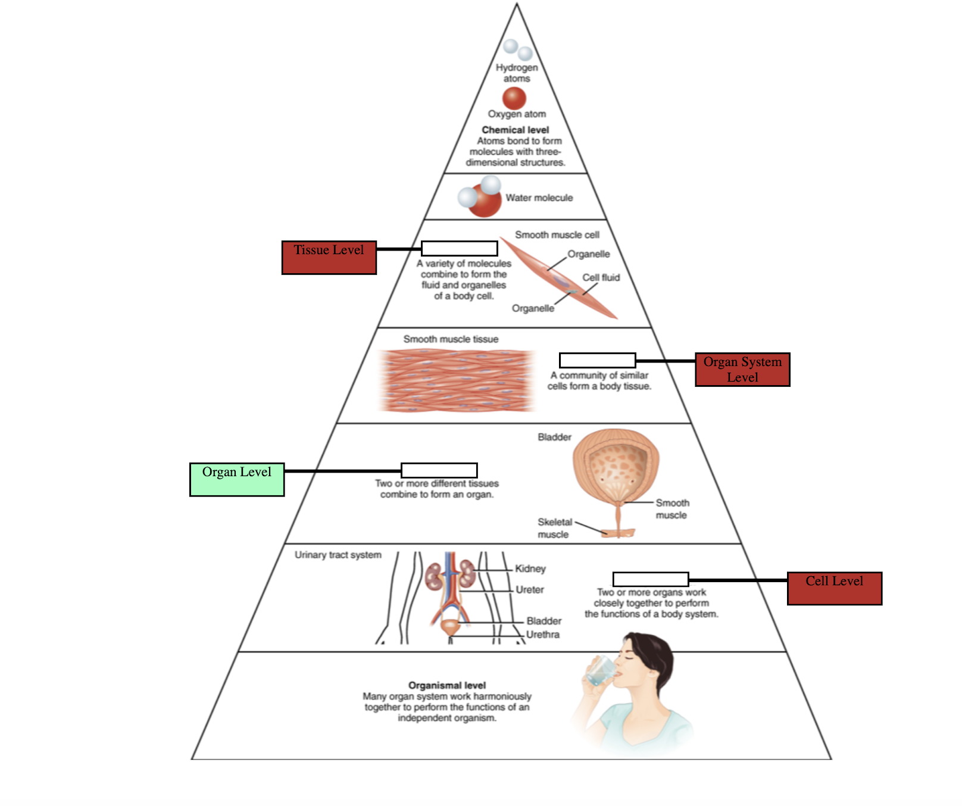
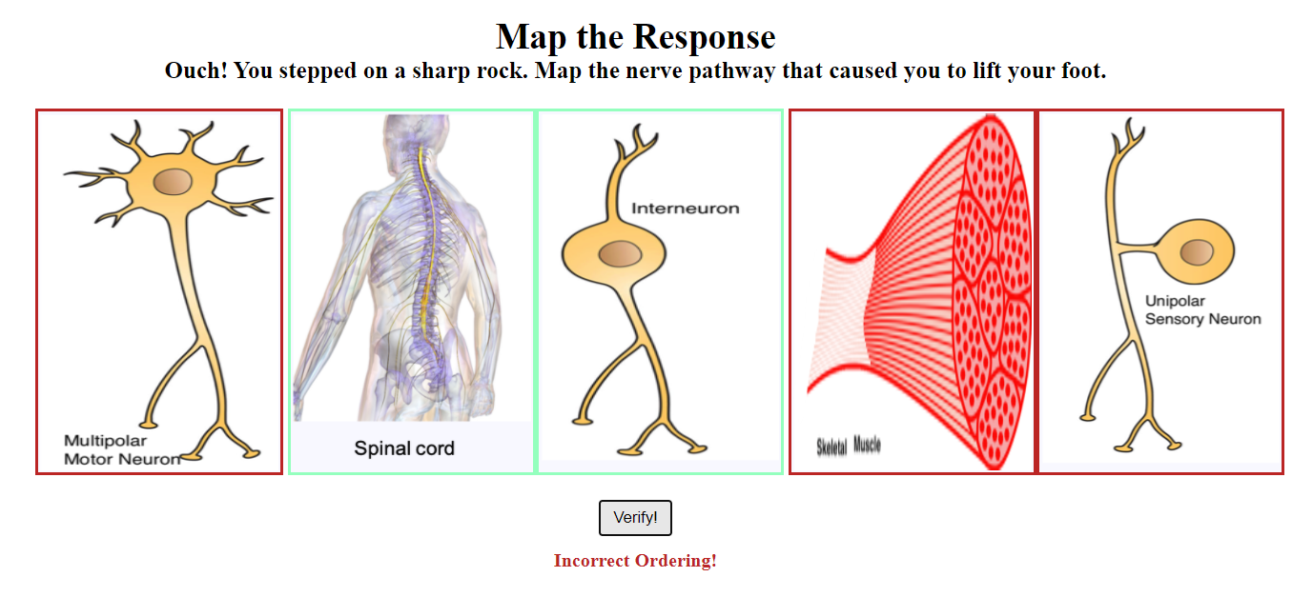
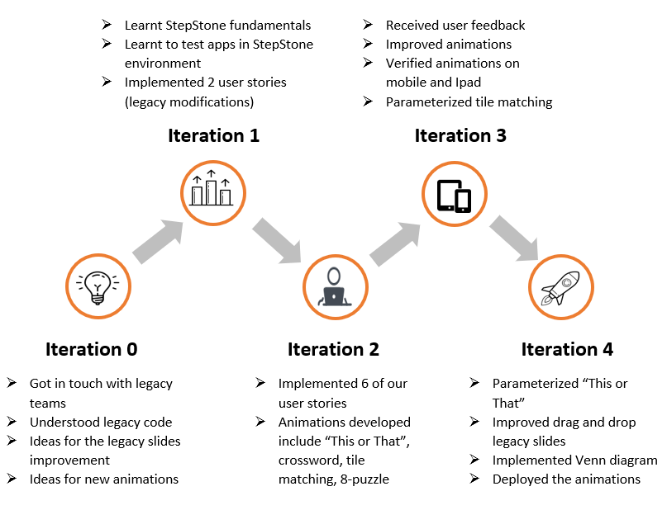
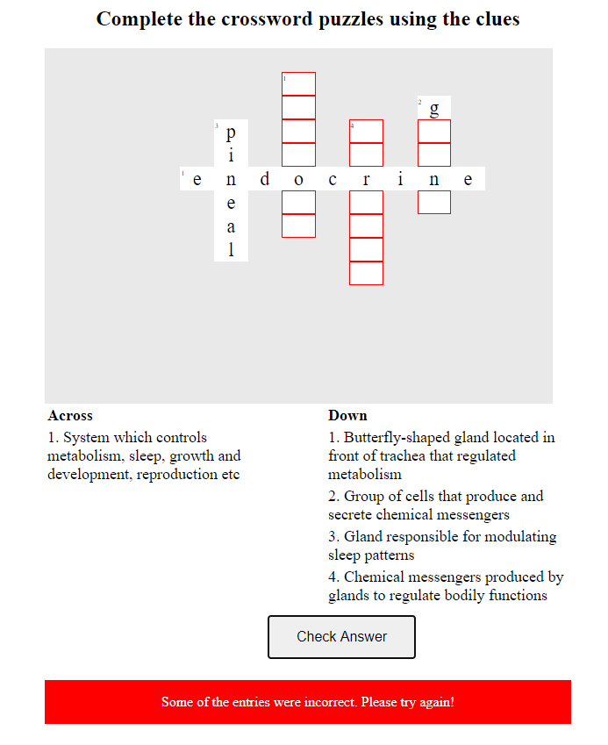
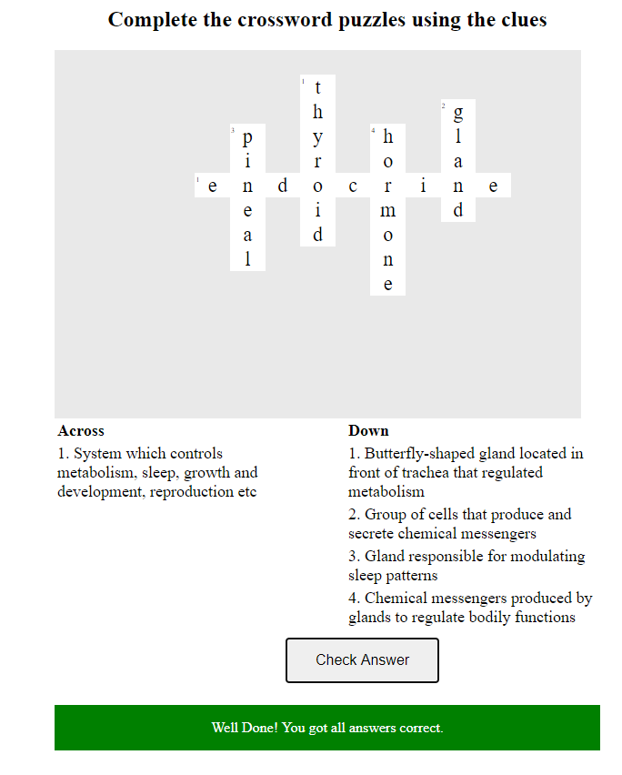
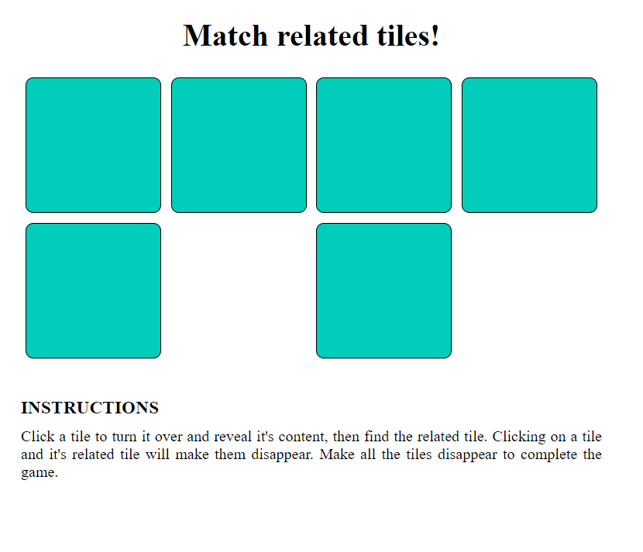
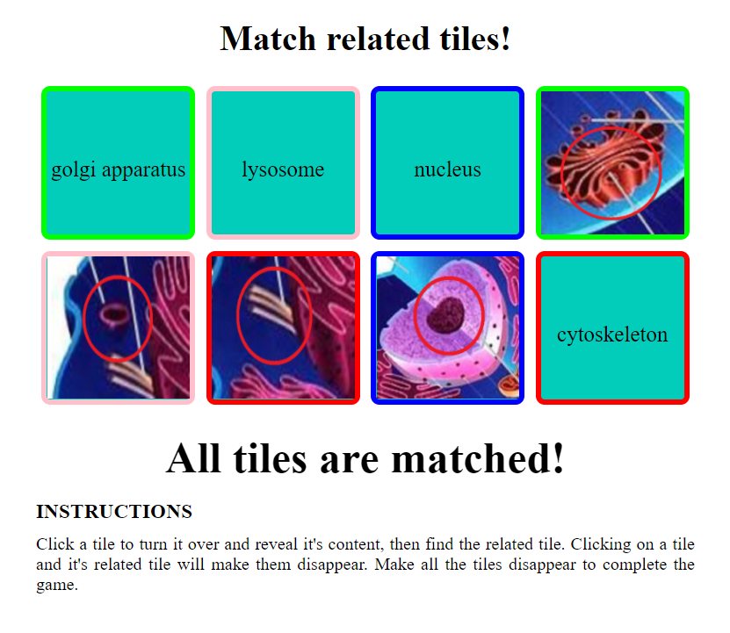
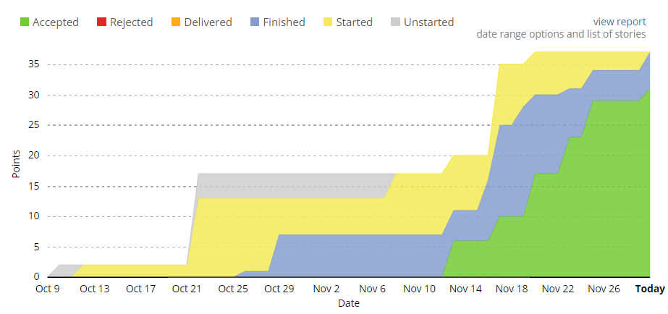
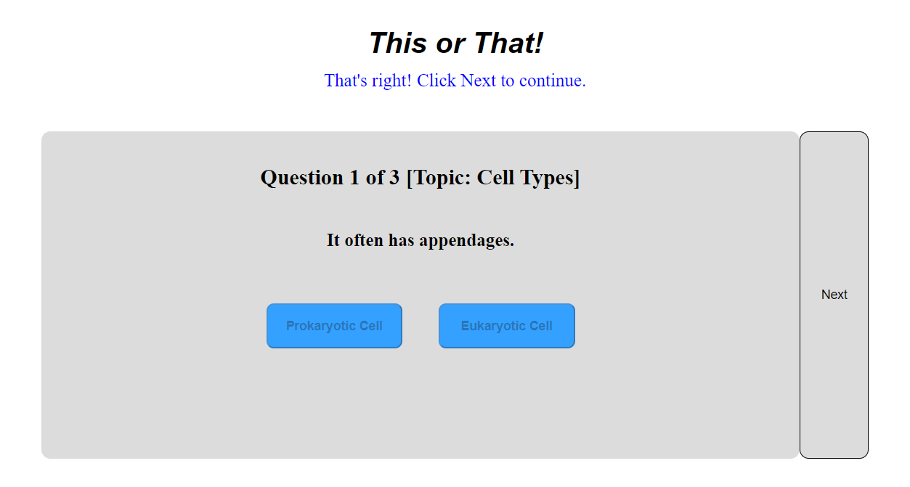
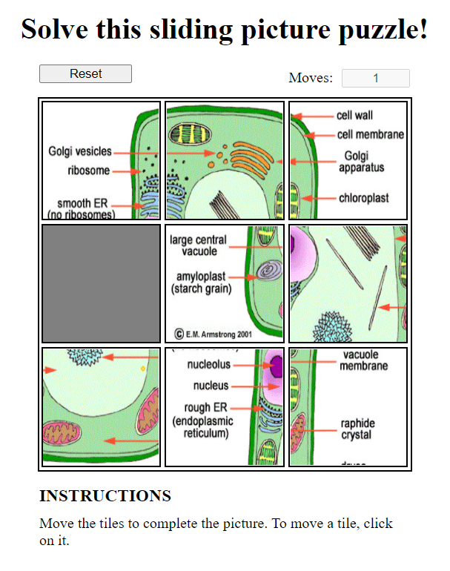
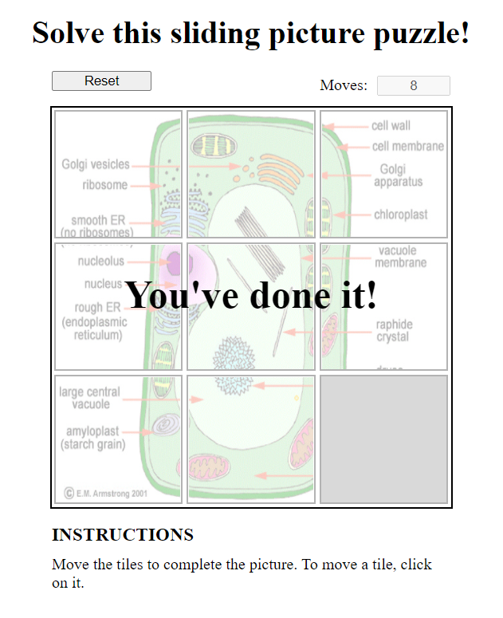
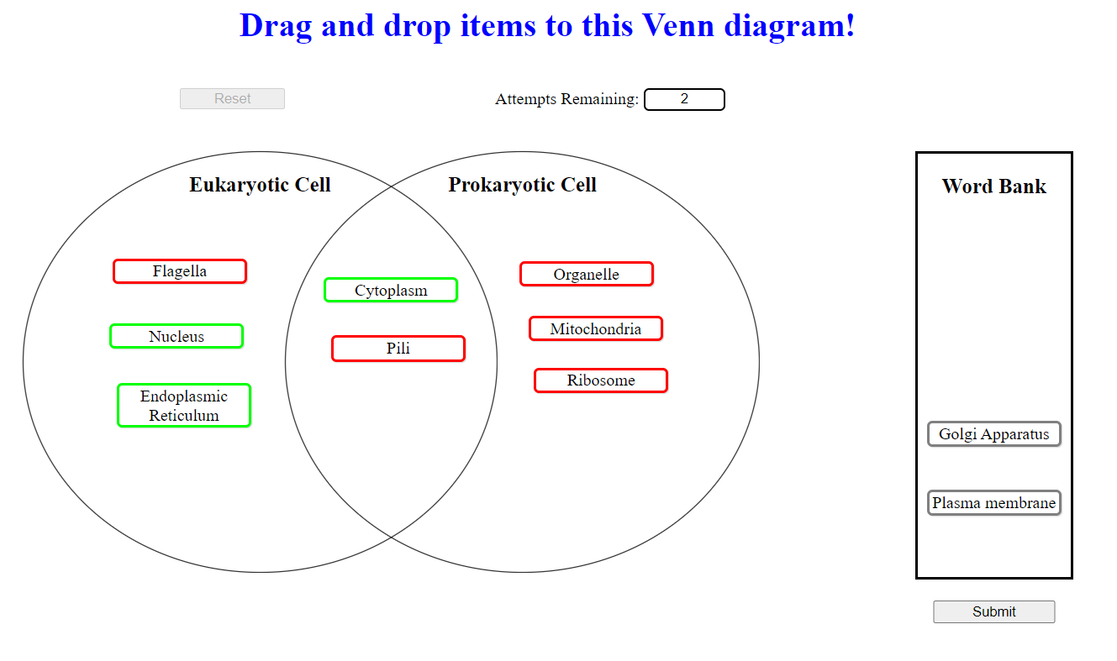
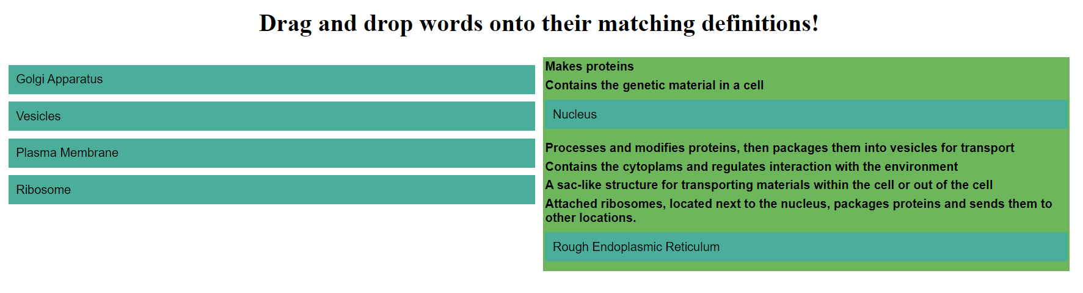
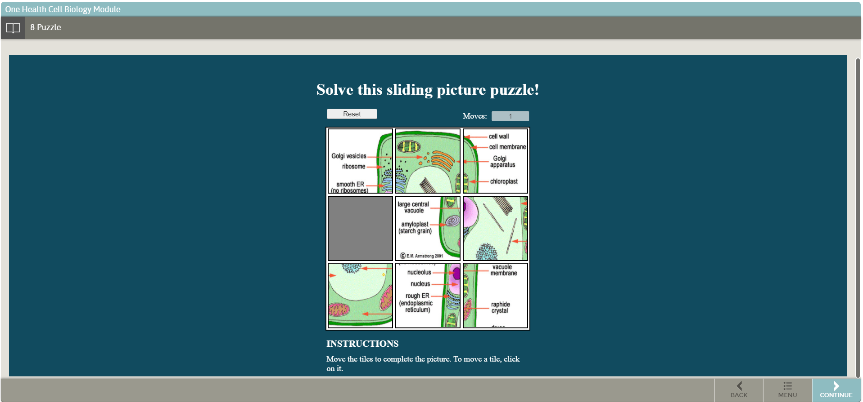
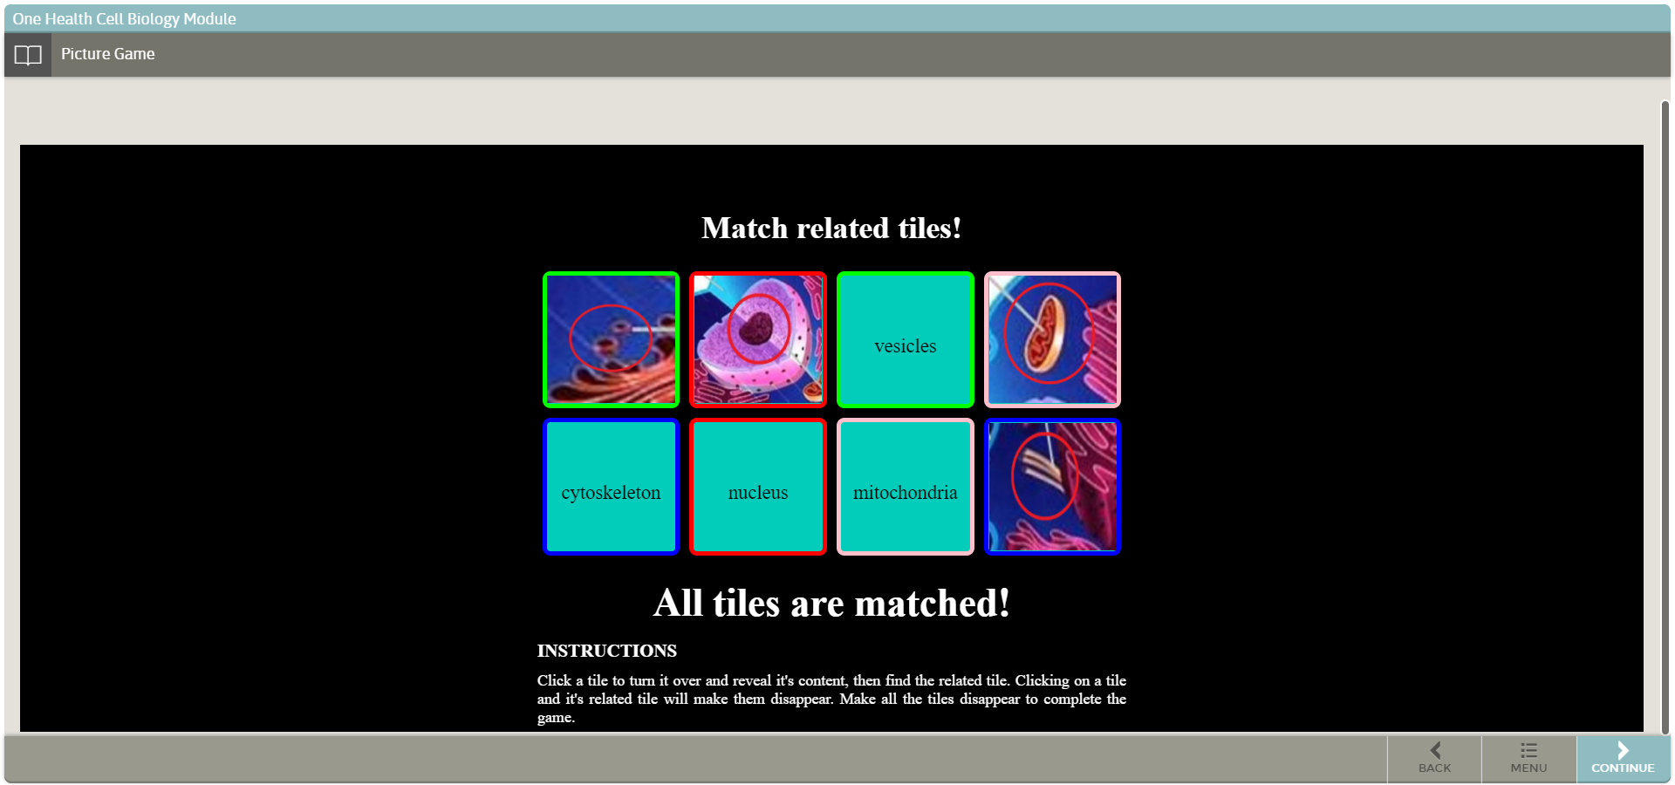
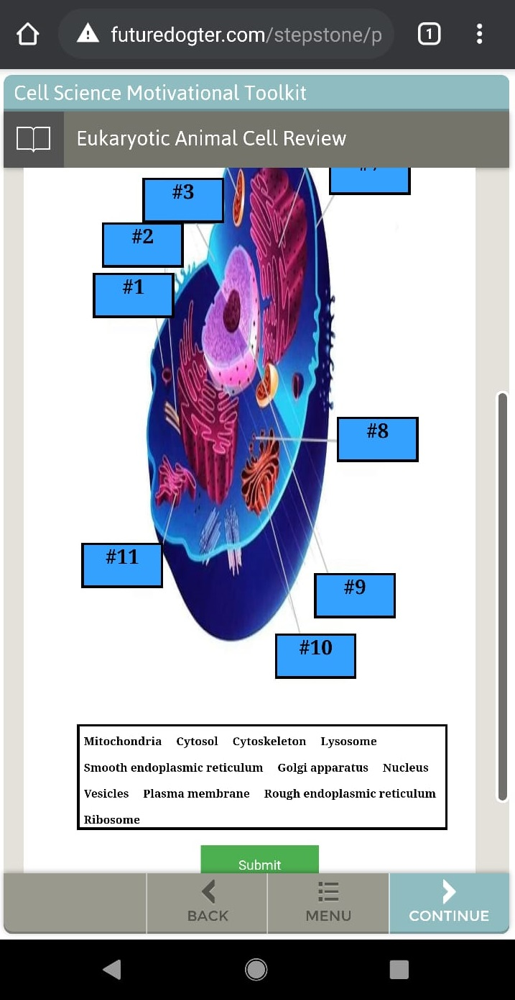
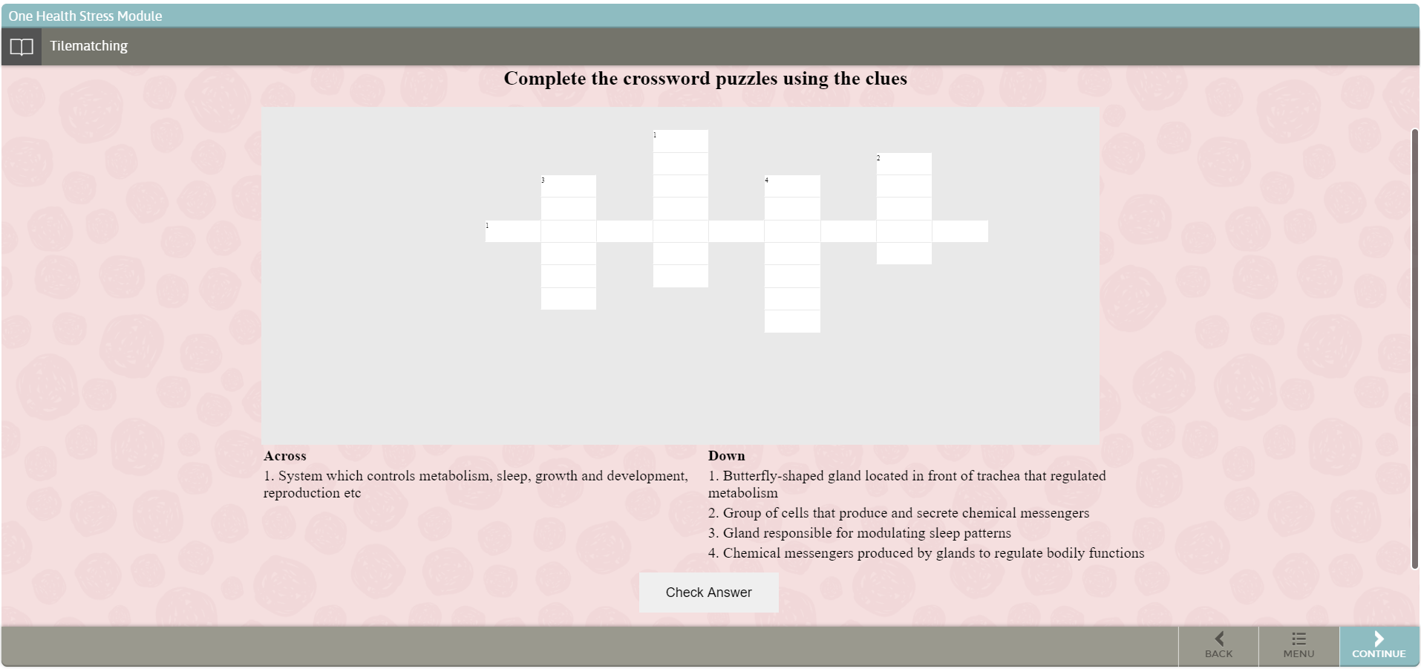
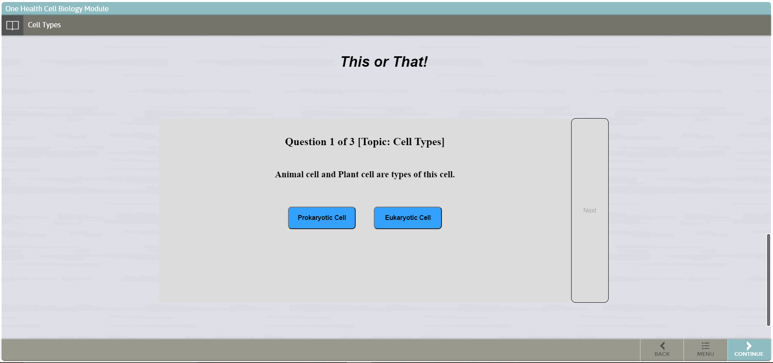
Animation in Cell Biology Learning Content
Branden Klar, Devi Sandeep Endluri, Esha Dutta, Himani Deshpande, Sanjeev Kumar Singh, Vipul Tiwari
Department of Computer Science and Engineering, Texas A&M University
Introduction
Legacy modifications
Target customer: VetMed (Torri Whitaker / Hank Walker)
Goal: Aid middle school aged children to interactively learn biological concepts
Requirement: Create JS/Jquery applications to be dispersed throughout a “module” built on an existing platform called “Stepstone” .
We have resized the label boxes of legacy drag and drop slides, while also making the colors color-blindness accessible.
We fixed resizing issues with the “map the response” animation
We modified it to include “submit” to show correct, incorrect responses.
Agile Workflow
New animations
“Crossword puzzle” provides a set of clues, that are used to fill a rectangular grid with words. The “Check Answer” button is used to verify solutions after completion.
In the “Tile matching” game, on clicking a tile, it's content is revealed. Clicking on a tile and it's related tile will make both of them disappear. The goal is to match and remove all tiles.
This shows our velocity graph. Animations are deployed to StepStone environment in Iteration 4, therefore most of the points are accepted only starting Iteration 4
For “This or That”, the screen displays a statement that can refer to one of the two options given as buttons. User has to select which of the two options the statement refers to.
In the “8-puzzle”, clicking on a tile adjacent to empty tile moves it. The goal is to arrange the pieces in such a way that it forms a complete picture.
Lessons and Challenges
Learning JavaScript/Jquery: Some of the team members didn’t know building a JS/Jquery application. The team was able to learn and deploy the animations.
Touch issues: Drag and drop slides didn’t work on mobile devices. This is fixed by including jQuery UI Touch Punch, a library to add touch support to jQuery UI
Mobile compatibility: Most of the animations were working properly on browser, but we found layout issues when tried on mobile. To make the animations compatible with mobile devices, viewport meta tag, media queries and used relative widths for all the css elements.
Stepstone compatibility: Since we didn’t have the iframe resizer code in the production server, even though we have tested in an environment which simulates StepStone, we have faced issues with the height of the mini-app when deployed. Setting the height of the html or the main container to use a specific value fixes most of these issues.
“Venn diagram” quiz is to drag and drop words from word bank into their respective areas, and drop the common characteristics in common region.
The quiz is to drag and drop words to their corresponding definitions. If the pairing is correct, the word appends under the definition, and the word returns back to the first column if the pairing is incorrect.
StepStone deployment
Goals Achieved / Impact
We were able to achieve the project goal i.e., to create interactive animations to learn biological concepts
We have parameterized our animations so that these can be used at multiple places with minimum modifications and effort.
We have verified the changes on multiple browsers, mobile devices and Ipad.
We have deployed our final animations to StepStone.
Acknowledgements
We would like to thank Dr. Hank Walker for his help and inputs throughout the project, and Daniel Shuta (StepStone developer) for his support in deploying our animations.
We have successfully deployed 8-puzzle, This or That, crossword, tile matching, map the response slide and drag and drop legacy slides to the StepStone production environment.

