Slide 1
AdviseMe (Team J.A.A.R.D.)
Jason Anthraper
Ross McGarity
David Sandler
Alex Stolzberg
Alex Wishlinski
Notes:
All-Introduction

Slide 2
Have you ever….
Had trouble finding information for classes?
Questioned whether you should take two classes together?
Been confused by a course description on the Registrar’s website?
Notes:
Alex W.

Slide 3
Motivation/Intent
Registration is currently a very stressful process
Sometimes difficult to find the information you need
AdviseMe will make registration easier for students
One-stop source for relevant course information
Peer feedback on courses/proposed schedules
Insights on course difficulty/workload
Suggestions of “compatible” courses
How hard is it to take these two courses together?
Is it beneficial to take a certain class before another?
Notes:
Alex W.

Slide 4
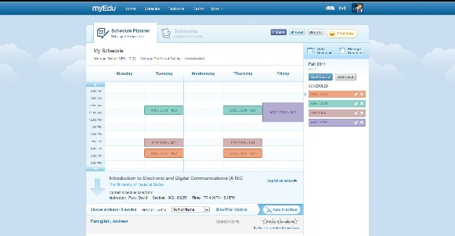
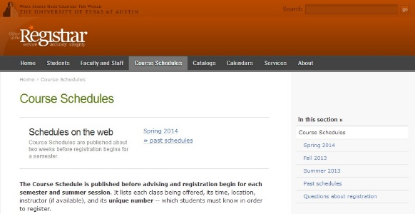
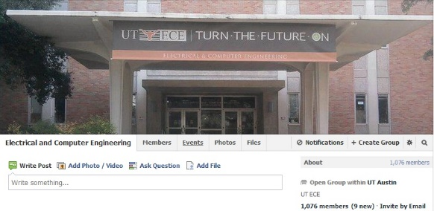
Current Approaches
MyEdu
UT Course Schedule (UT Registrar Website)
Facebook groups
“Senior” Advice
Recommendations from friends
Notes:
David

Slide 5
How is AdviseMe Different?
AdviseMe integrates functionality of current services.
By UT students for UT students
Easy to obtain the information you want all in one place
Ability to share schedules and receive peer feedback
Difficulty
Course placement/recommended timing
Professor recommendations
Notes:
David

Slide 6
Use Case Diagram
Notes:
Jason- briefly explain diagram/main use-cases

Slide 7
Tools/API’s
Google AppEngine Datastore
Objectify
Facebook User Integration
Message reputable users
Connect with students with similar schedules
XMPP Chat Capabilities
Live chat forum
Quick responses on course questions
Notes:
Ross

Slide 8
Potential Pitfalls/Feasibility
Setting a reasonable scope for the project
All functionality must be achievable
5 Undergraduate ECE Students
1 semester time frame
Feature prioritization
What are the essential features?
Other supplementary features (i.e. nice to have)
Dealing with potential new ideas
Learning to use external API’s
Facebook user services
Notes:
Alex S.

Slide 9
Questions?

Slide 10
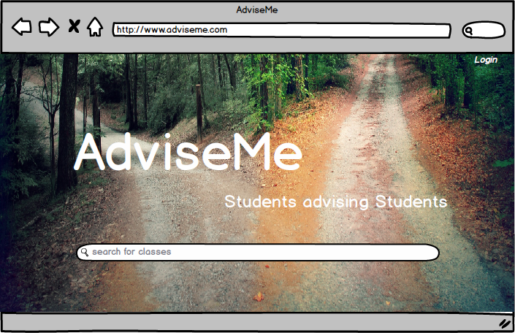

Slide 11
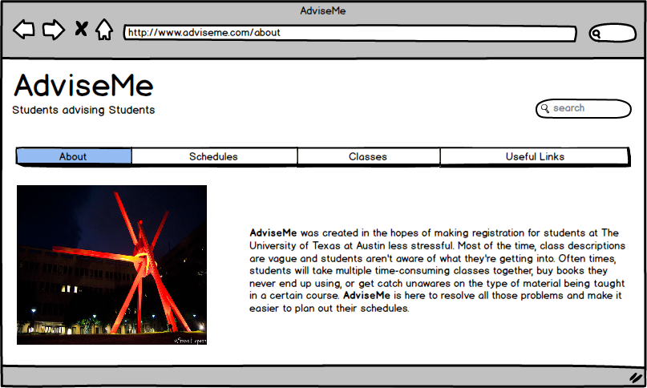

Slide 12
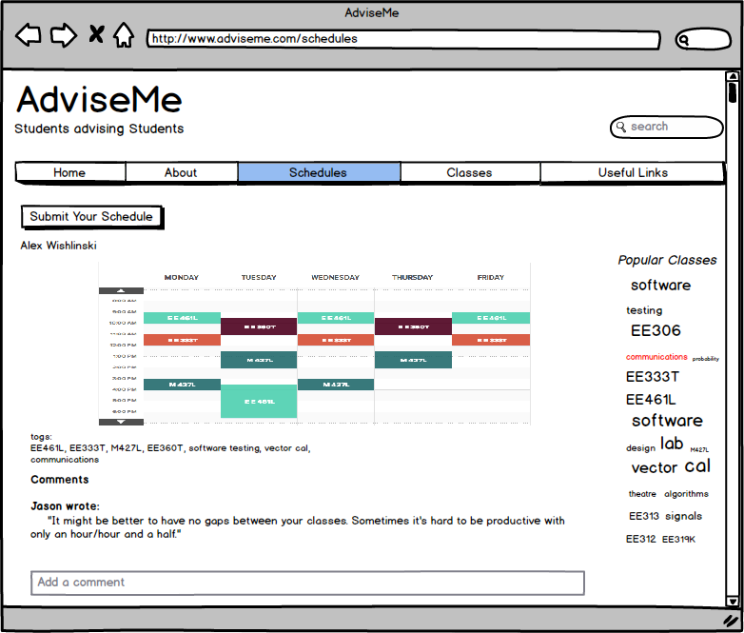

Slide 13
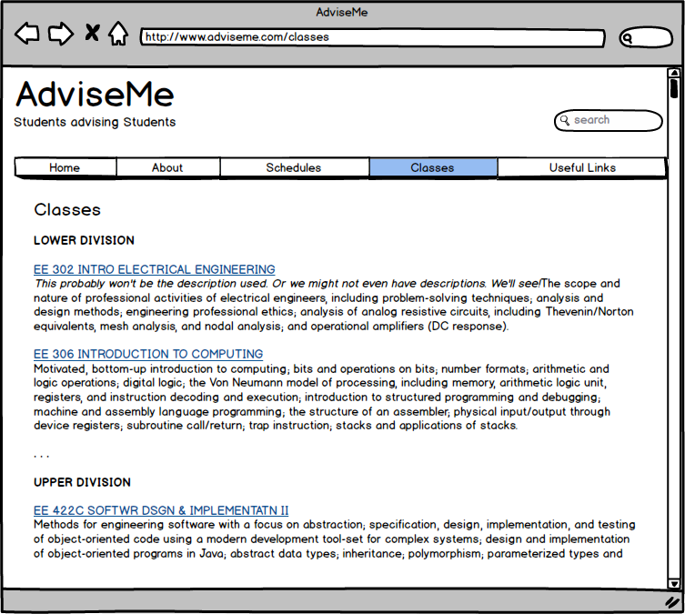

Slide 14
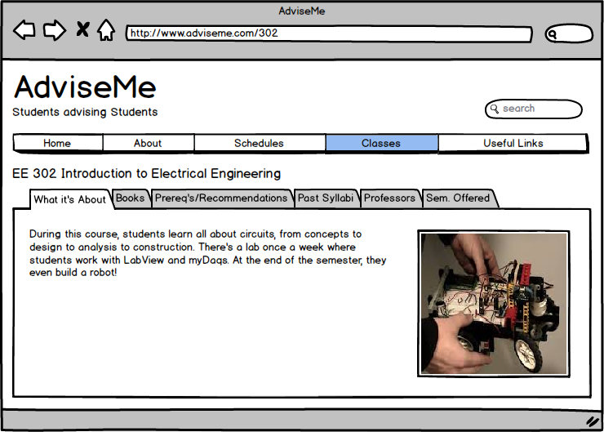

Slide 15
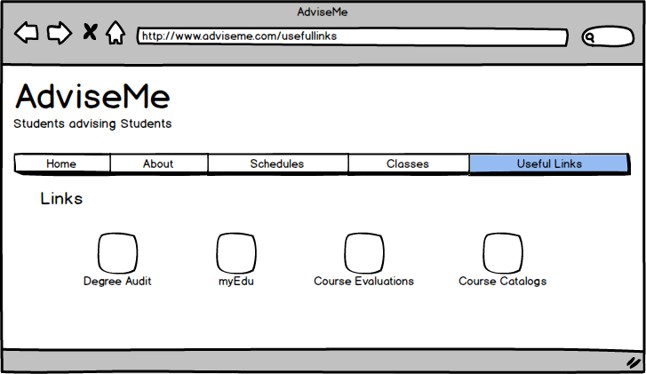

Slide 16
Questions?

