Slide 1
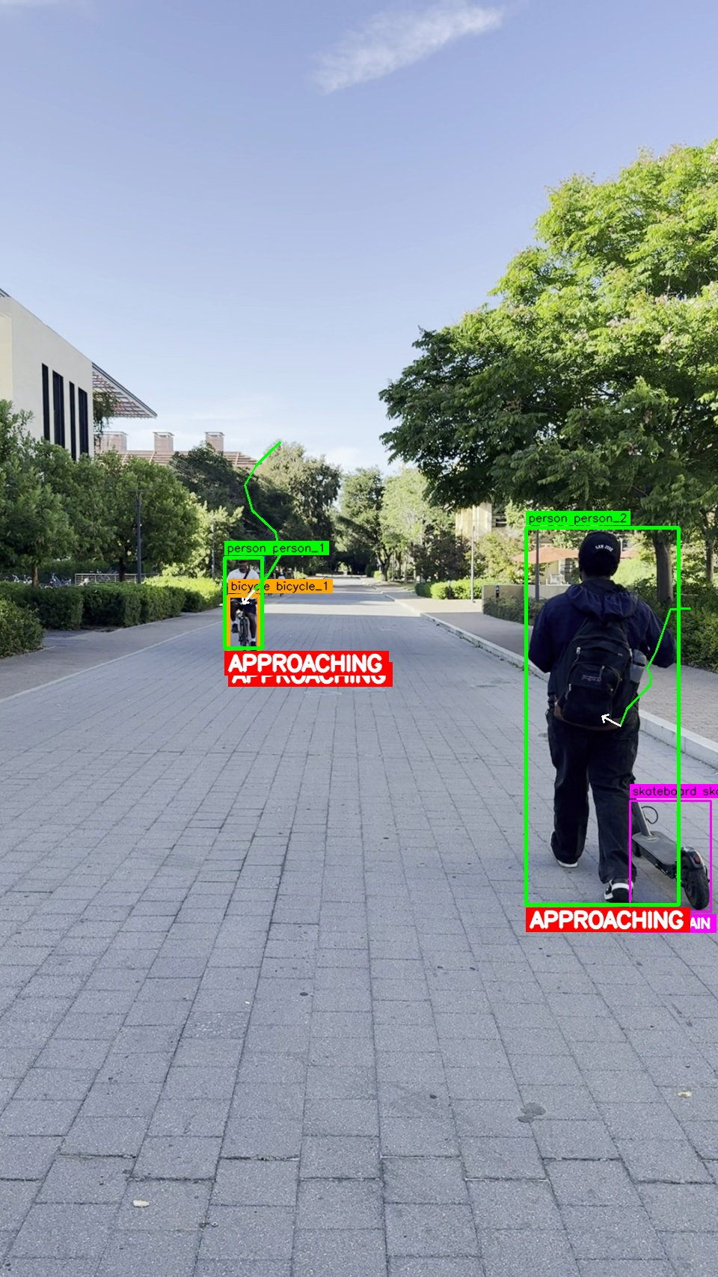
SpatialLens Assist
Motion-Aware Hazard Detection for Campus Navigation
from Low-FPS Egocentric Video
Diego Sanchez · Stanford CS131
Notes:
Hi, I'm Diego. SpatialLens Assist turns a cheap phone video of a campus walkway into spoken hazard alerts for blind and low-vision pedestrians — telling them not just WHAT is nearby, but whether it's COMING AT THEM. (15s)

Slide 2
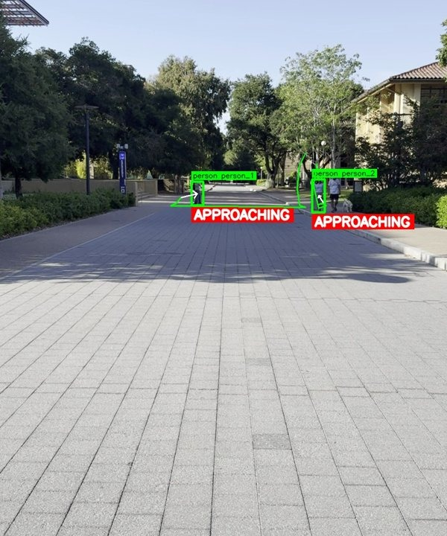
Detection tells you what, not what it’s doing
• A parked bicycle and one bearing down on you are both just “bicycle, 0.86”.
• A sighted person reads intent from context — a blind / low-vision
– pedestrian can’t. The safety signal is motion, not the label.
• Our task: per-track motion classification from a ~10 s clip @ 2 fps
– approaching · crossing_LTR · crossing_RTL
– moving_away · static · uncertain
Hazard overlay on a campus walkway clip
Notes:
Here's the problem. A parked bike and a bike speeding toward you are detected identically — bicycle, point eight-six. A sighted person fills in the intent; the user we care about can't. So the safety-critical signal isn't the label, it's the motion. We frame it as per-track classification: given a ten-second clip at just two frames a second, decide whether each object is approaching, crossing left or right, moving away, static — or explicitly uncertain. (40s)

Slide 3
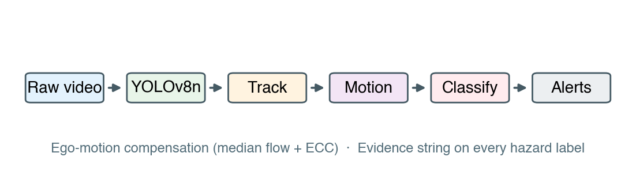
A transparent, CPU-only pipeline
2 fps frames → YOLOv8n → tracker + appearance re-ID → ego-motion-compensated motion features → rule cascade → alert + evidence string
• Explainable — every prediction carries a natural-language evidence string.
• Calibrated abstention — “uncertain” is first-class; short tracks don’t bluff.
• CPU-only — the full pipeline runs in ~4 min on a GPU-less Mac.
• Key trick: ego-motion compensation cancels camera pan, so static objects stay static.
Notes:
The pipeline has six stages. Off-the-shelf YOLOv8n detects; a lightweight IoU-plus-centroid tracker links objects, with an appearance re-ID pass to stitch fragments. Then motion features — and the key trick is ego-motion compensation: we subtract the camera's own panning so a parked bench doesn't look like it's charging at you. Finally an interpretable rule cascade — no black box — emits the label plus a plain-English evidence string. Three principles: everything is explainable, it abstains rather than guesses, and it runs on CPU in about four minutes. (45s)

Slide 4
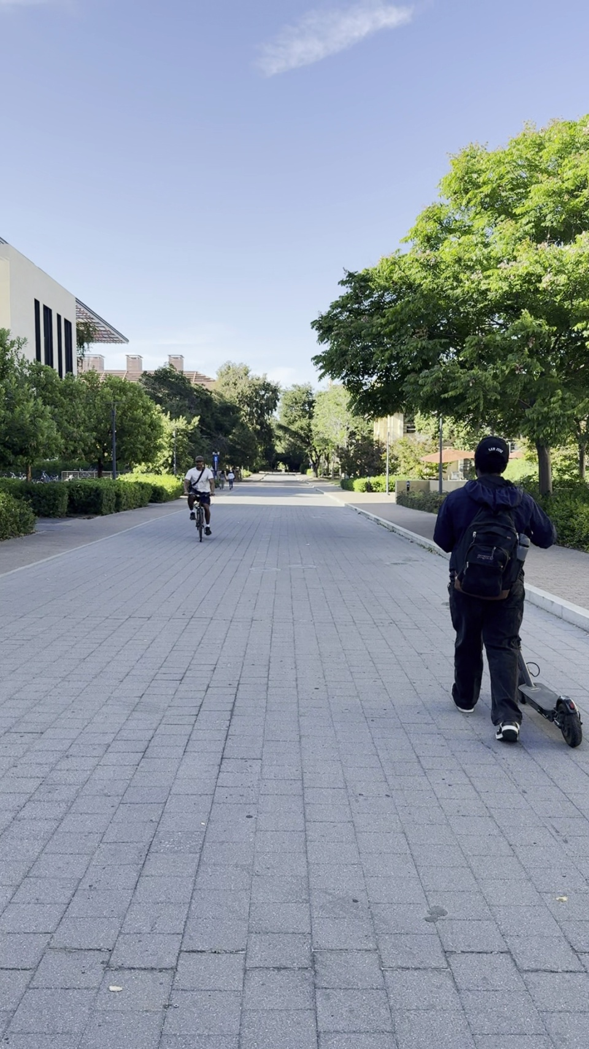
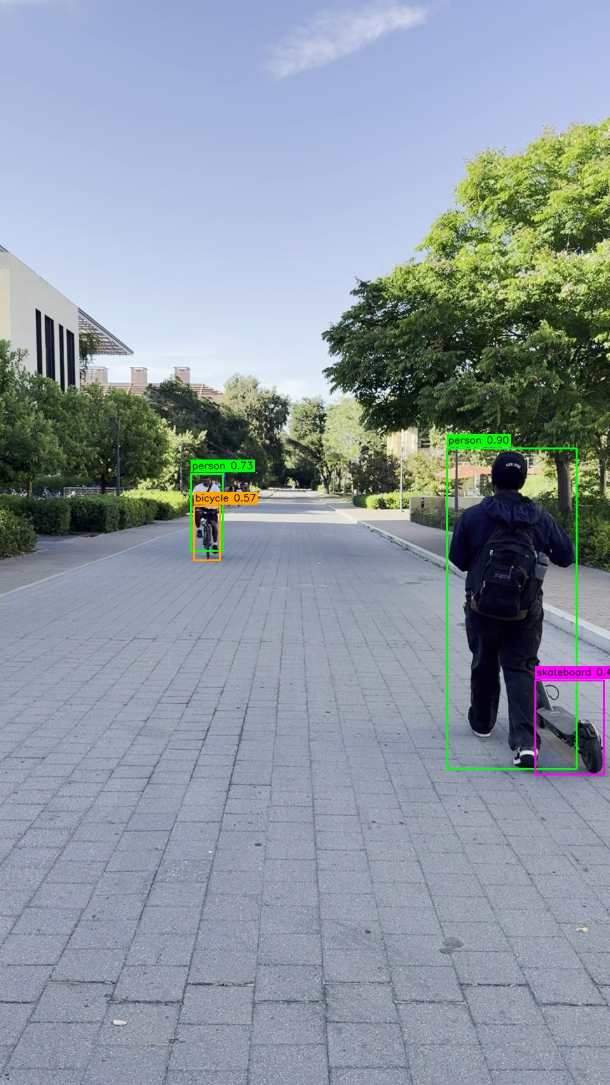
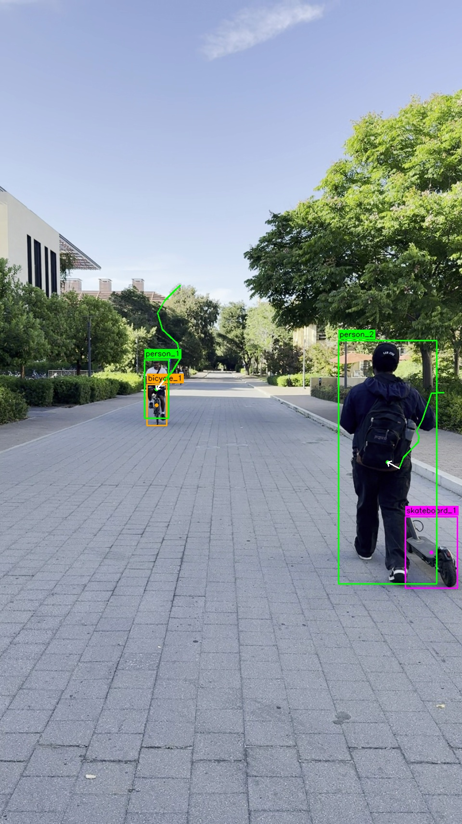
From pixels to a spoken alert
1 · Raw frame (2 fps)
2 · YOLOv8n detections
3 · Tracking + re-ID
4 · Hazard overlay
🔊 “Bicycle approaching directly ahead.” [high]
evidence string: the cyclist’s bounding box grew ~22×; centroid moved toward image center
Notes:
Here's a real run, left to right. Raw frame. YOLO's detections. The tracker links the cyclist across frames — that's the yellow trail. And the motion stage fires: the bounding box grew almost twenty-two-fold and the centroid moved toward the center, so the system says, out loud, 'bicycle approaching directly ahead,' high confidence — and it shows you exactly why it said that. (45s)

Slide 5
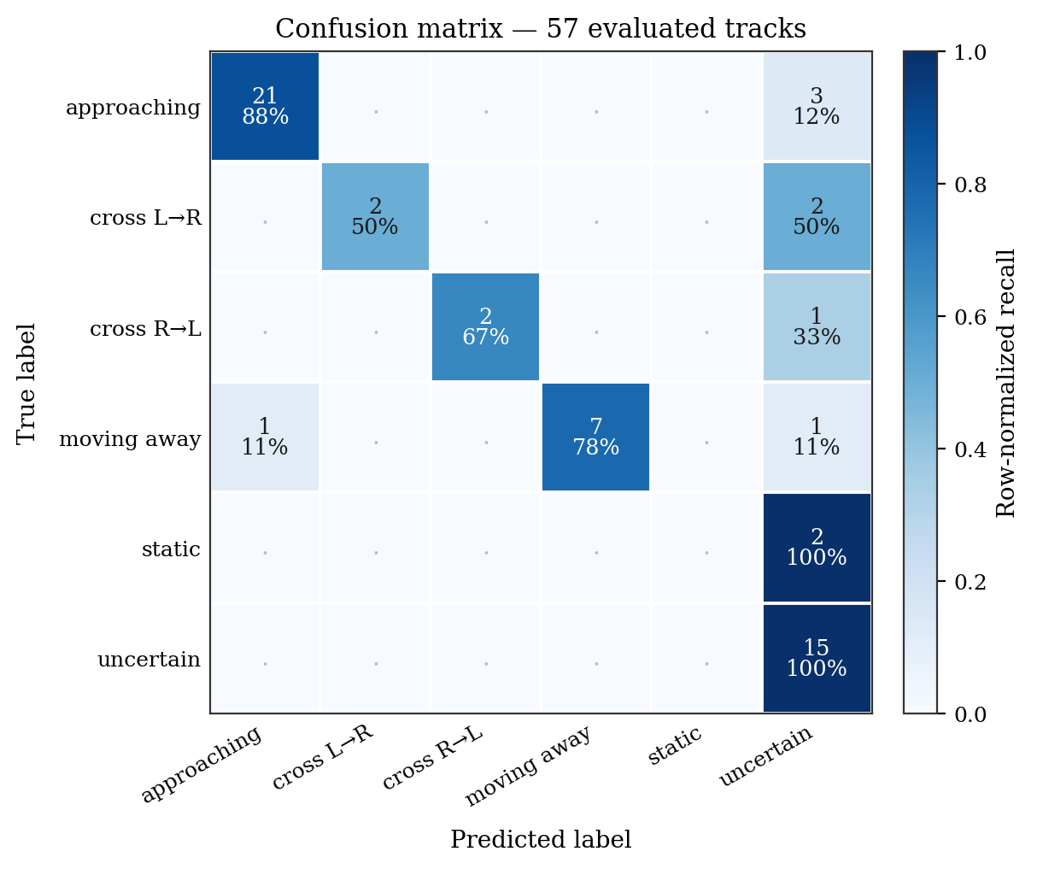
Accurate where it counts
Overall accuracy: 82.5%
Decidable (≥3-frame tracks): 93.3%
approaching P / R: 0.95 / 0.88
11 videos · 61 hand-labelled tracks
Confusion matrix (57 evaluated tracks)
Zero approaching ↔ moving_away confusion
Notes:
On 11 controlled walkway videos and 61 hand-labeled tracks: 82.5% overall, and 93.3% on tracks long enough to decide — three frames or more. The safety-critical approaching class hits 0.95 precision, 0.88 recall. And the number I care most about: zero confusion between approaching and moving-away. When unsure it abstains into uncertain — it never told a user something was leaving when it was actually coming at them. For an alert system, that's the right asymmetry. (40s)

Slide 6
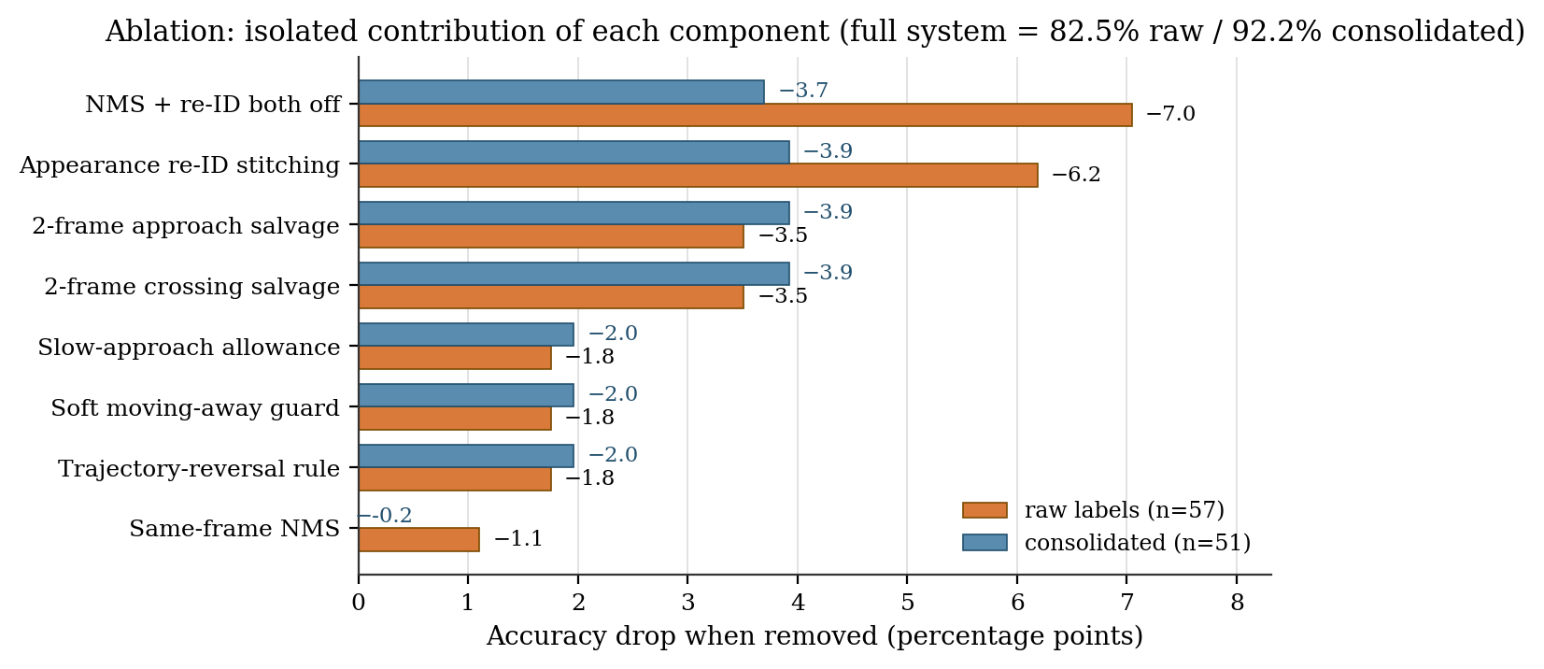
Continuity beats classifier complexity
• Biggest gains = keeping tracks intact, not fancier rules:
– appearance re-ID: +6.2 pts (largest single gain)
– two short-track salvage rules: +3.5 pts each
• Negative result: ByteTrack → 32.8% on 2 fps offline footage —
– its online motion-continuity assumption breaks under sparse sampling.
• Abstention = the “fragmentation tax made auditable”:
– 23 of 24 abstentions are short tracks, not classifier confusion.
Accuracy drop when each component is removed
Notes:
The ablations taught me the real lesson. The biggest accuracy gains didn't come from smarter rules — they came from keeping tracks from fragmenting. Appearance re-ID alone is worth six points. And a useful negative result: ByteTrack, a state-of-the-art online tracker, drops to 33% here, because at two frames a second its motion-continuity assumption just doesn't hold. The system's uncertainty is almost entirely short broken tracks — so the abstentions are an honest, auditable tax, not confusion. (40s)

Slide 7
Takeaways & what’s next
• Simple, interpretable motion cues recover useful hazard labels from cheap
• low-fps video — and continuity matters more than classifier sophistication.
• Next:
– monocular depth (MiDaS) · learned re-ID embedding
– denser sampling (5–10 fps) · user study with blind / low-vision walkers
Thank you!
Notes:
So: cheap, low-frame-rate video plus interpretable motion cues is enough to give useful, explainable hazard alerts. Next steps are adding depth, a learned re-ID embedding, and a study with actual blind and low-vision walkers. Thank you. (15s)

