Slide 1
PHARMACEUTICAL INDUSTRY
PRESCRIBING WITH ACCURACY

Slide 2
WORKFLOW
01.
PROBLEM STATEMENT
02.
DATA ANALYSIS
03.
MODELING ALGORITHMS
04.
FINAL PRODUCT

Slide 3
PROBLEM STATEMENT
Dataset contains types of drugs used for treating high blood pressure, cholesterol, and Sodium to Potassium Ratio Levels for 200 patients.
Goal is to automate the prediction of the right drug based on patient’s portfolio.

Slide 4
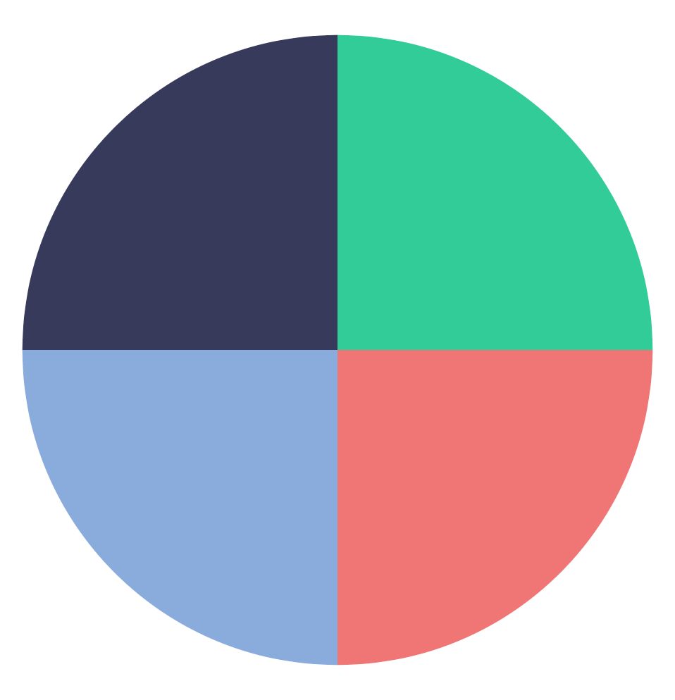
MAIN OBJECTIVES
Conduct EDA based on categories in dataset
Compare various Machine Learning models and pick the most accurate model prediction system for drugs
Generate insights from data via Machine Learning and produce recommendations
Analyse latest trends in the pharmaceutical industries

Slide 5
01. EXPLORATORY DATA ANALYSIS

Slide 6
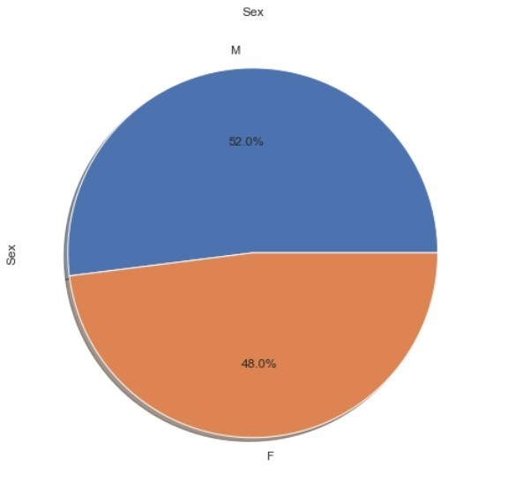
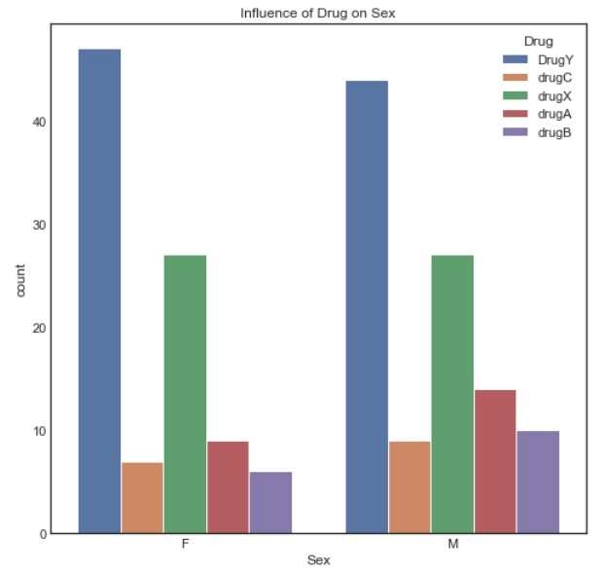
Relationship: Drugs vs Gender
Consumption of Drug Y is common among both genders
Proportion of males vs females
There are more males than females
Influence of Drugs on gender
Female gender is major consumption of Drug Y

Slide 7
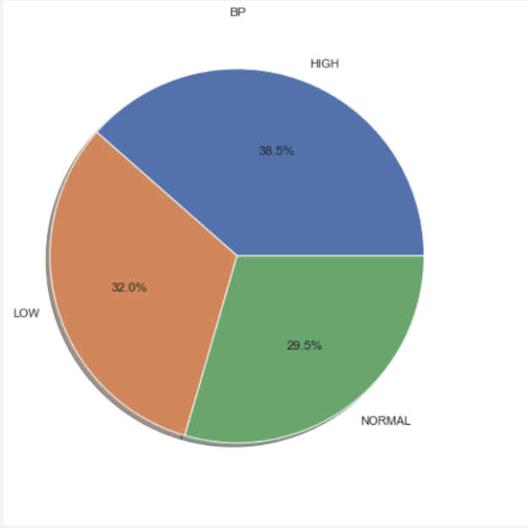
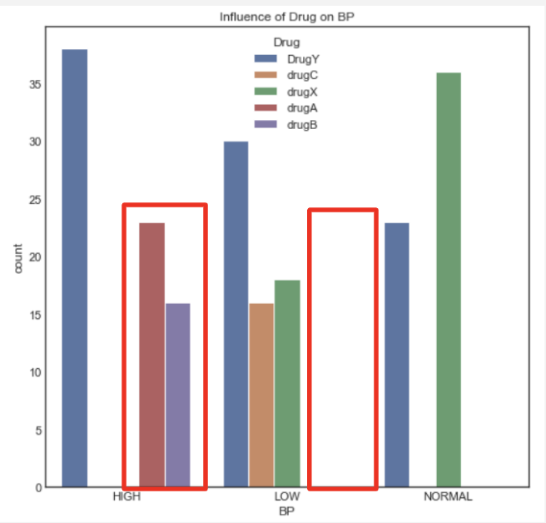
Relationship: Drugs vs Blood Pressure
38.5% of patients have high blood pressure
Degrees of Blood Pressure
“Drug C” and “Drug X” are not used when blood pressure is high
Influence of Drug on Blood Pressure
“Drug A” and “Drug B” are consumed by patients have high blood pressure levels

Slide 8
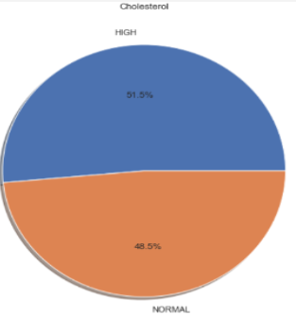
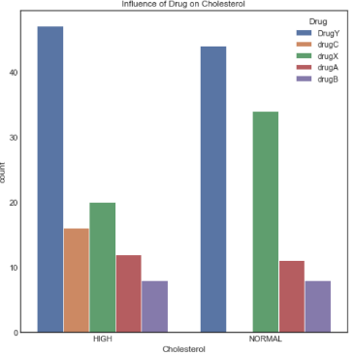
Relationship: Drugs vs Cholesterol
Pie Chart (Cholesterol vs Gender)
51.5% of patients have high cholesterol levels
“Drug C” is consumed by patients who have high cholesterol levels
Influence of Drug on Cholesterol
“Drug A” and “Drug B” are consumed by patients have high blood pressure levels

Slide 9
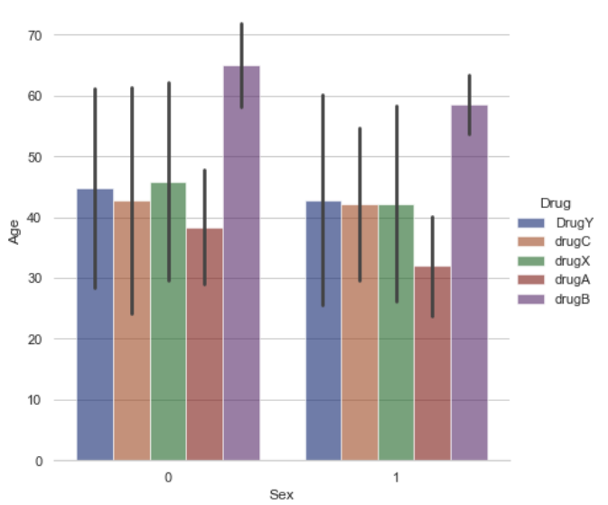
Relationship: Age & Drug vs Gender
“Drug B” is suited for consumption by aging people and patients with high blood pressure
Blood Pressure increases with age
Dosage of “Drug B” should be given accordance with age (direct proportional)
Bar Plot
(Age & Drug vs Gender)

Slide 10
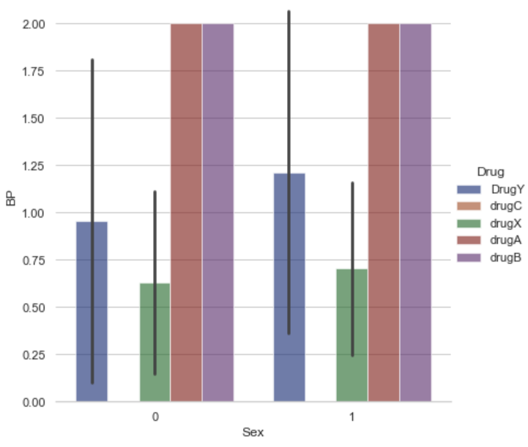
Relationship: Blood Pressure & Drug vs Gender
“Drug A” and “Drug B” is suited for consumption by aging people and patients with high blood pressure
Blood Pressure increases with age
Dosage of “Drug B” should be given accordance with age (directly proportional)
Bar Plot
(Blood Pressure vs Drug vs Gender)

Slide 11
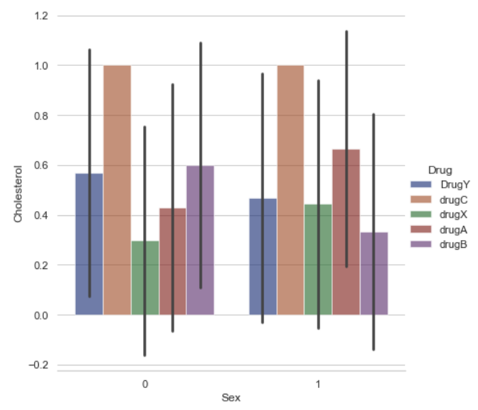
Relationship: Cholesterol & Drug vs Gender
“Drug C” is mainly consumed by patients with High Cholesterol Levels
“Drug A”, “Drug B” and “Drug X” have no effect on Cholesterol Levels
Bar Plot
(Cholesterol & Drug vs Gender)

Slide 12
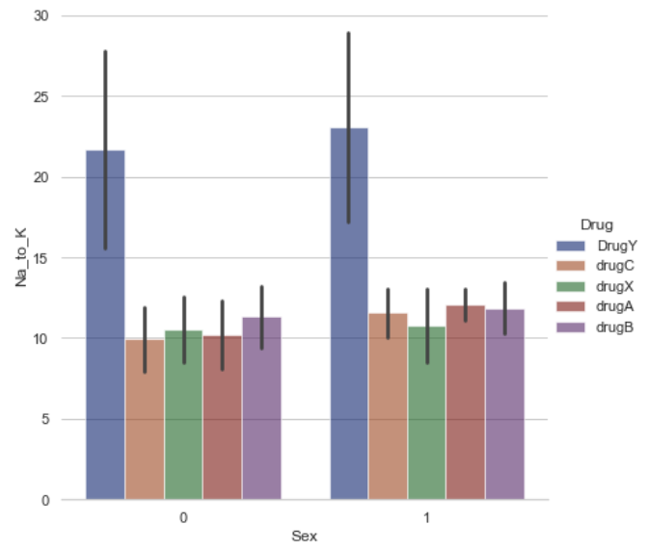
Relationship: Na_to_K & Drug vs Gender
“Drug Y” is mainly consumed by patients with high Sodium to Potassium ratio
The consumption level of “Drug Y” is independent of the gender
Bar Plot
(Na_to_K & Drug vs Gender)

Slide 13
Effectiveness of Drugs
 | Drug A | Drug B | Drug C | Drug X | Drug Y
High Cholesterol | No | No | Yes | No | No
High Blood Pressure | Yes | Yes (Aged People) | No | No | No
Sodium to Potassium Ratio | No | Yes | No | No | Yes

Slide 14
02.
MACHINE LEARNING ALGORITHMS

Slide 15
Machine Learning Algorithms
ML Classifier
KNN (K Nearest Neighbours)
Naive Bayes Method
Logistic Regression Method
Decision Tree Algorithm
Accuracy: 67.5%
Accuracy: 87.5%
Accuracy: 96.0%
Accuracy: 100.0%
Cannot be used for predictions of drugs
Can be used for prediction but need to explore more on other models
Can be used for prediction but need to explore more on other models
Unfit for use in production due to overfitting

Slide 16
Machine Learning Algorithms
ML Classifier
Random Forest Algorithm
Gradient Boosting Algorithm
Final Classifier: Logistic Regression
Accuracy: 100.0%
Accuracy: 95.0%
Accuracy: 96.0%
Unfit for use in production due to overfitting
Can be used for prediction but it underperforms compared to logistic regression
Reasons:
Easy to interpret compare to other models.
Avoids overfitting compared to tree based algorithms while giving decent performance.

Slide 17
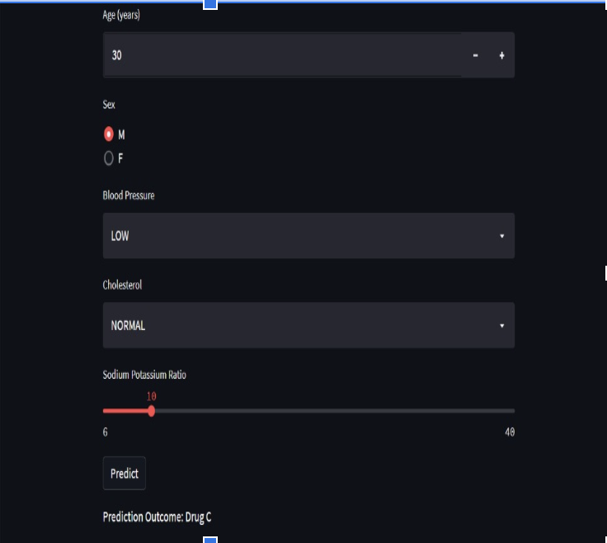
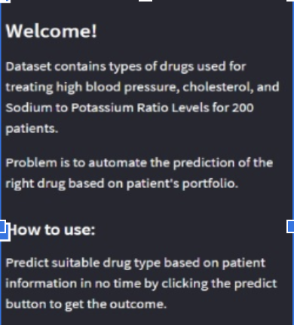
Suitable Drug Predictor
Key in patient informations
Web Interface to predict drugs

Slide 18
THANKS!!
Do you have any questions?
https://drugtypeprediction.herokuapp.com/

