Slide 1




GLOBAL CERT NUS ENTERPRISE
RESUME SCREENING

Slide 2
LIST OF CONTENTS
01
INTRODUCTION
03
DATA SET
05
MODEL TRAINING & TESTING
02
PROBLEM STATEMENT
04
EXPLORATORY DATA ANALYSIS
06
CONCLUSION
Page 02 of 12

Slide 3

INTRODUCTION
Automated hiring encompasses the integration of artificial intelligence (AI) and machine learning (ML) to streamline resume review, outreach, vetting, following, hiring, and onboarding candidates.
Automated processes can quickly sift through an avalanche of resumes and applications, putting forth the right candidates.
Page 03 of 12

Slide 4

PROBLEM STATEMENT
Hiring the right talent is a challenge for all businesses. This challenge is magnified by the high volume of applicants if the business is labour-intensive, growing, and facing high attrition rates.
Typically, large companies do not have enough time to open each CV, so they use machine learning algorithms for the Resume Screening task.
Page 04 of 12

Slide 5
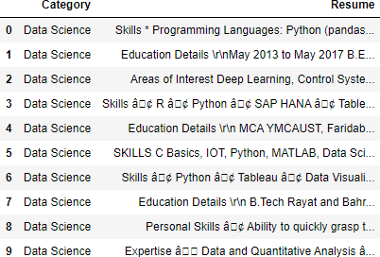
DATA SET
To solve this problem, we've used a kaggle dataset which has two columns:
Job Category
Resume
Page 05 of 12

Slide 6
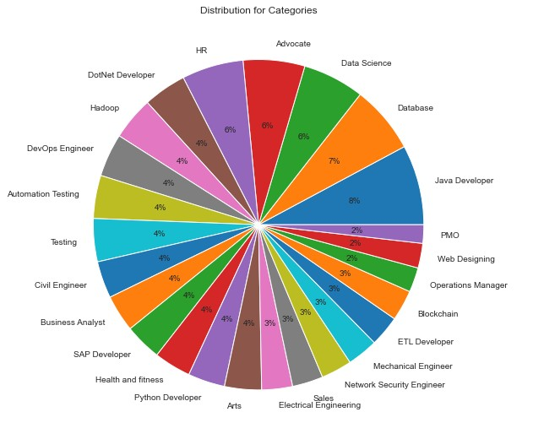
EXPLORATORY DATA ANALYSIS
This dataset contains resumes for multiple job categories which can be seen in the pie chart along with its' distribution.
We can observe that 8% of the resumes are for Java Developers which is followed by Database and Data Science resumes respectively.
Page 06 of 12

Slide 7
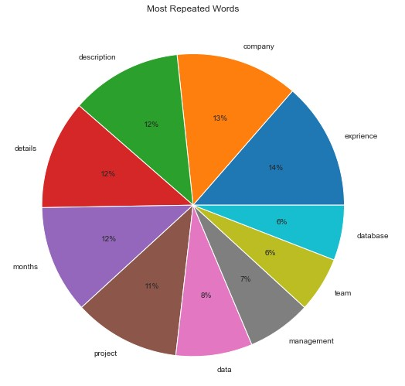
EXPLORATORY DATA ANALYSIS
Using Natural Language Processing (NLP), we were able to clean the resumes and find the most repeated words in them.
We can observe that words like experience, company, months, projects are the most repeated words in the resumes which also makes sense.
Page 07 of 12

Slide 8
Text Preprocessing
NATURAL LANGUAGE PROCESSING
Before training our model; we used Text Preprocessing, Lemmatization,Label Encoder, word2vec, and TF-IDF functions to transform our data from text into numerical form.
Cleaning the text data and preparing
it for the model. eg: removing stopwords and symbols
Lemmatization
Based on the context, it converts the word to its meaningful base form.
Label Encoder
Transformed the category column into numerical form.
Word Embedding
Transforms textual data to numerical data (In form of matrices).
TF-IDF Vectorizer
Used TF-IDF Vectorizer to extract top features from the resume data.
Page 8 of 12

Slide 9




MODEL TRAINING / TESTING
We used multiclassification OvR with KNeighbors Classifier & Random Forest Classifier to train our model for filtering out resumes of different job categories. While testing our model, we got testing accuracy of 75%.
Split Dataset
Training
Testing
Results
Page 09 of 12

Slide 10
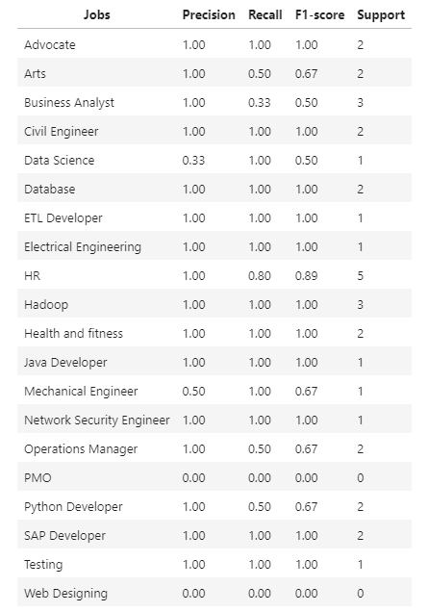
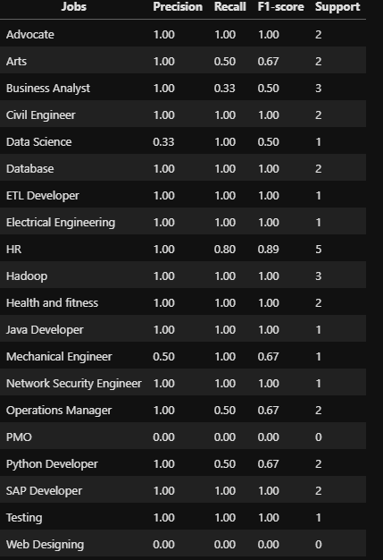
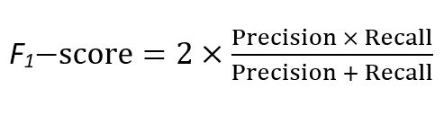
CLASSIFICATION REPORT
A Classification report is used to measure the quality of predictions from a classification algorithm.
F1-score of our classifier is measured to be 82% which is calculated using the harmonic mean of precision and recall.

Slide 11

CONCLUSION
Our Model helps screening resumes based on experience, qualifications, and skills of candidates mentioned in them to determine the job position most suitable for the candidate.
Screening resumes helps hiring managers and recruiters hire the right candidates for different job positions available and saves a lot of time.

Slide 12
THANKS
FOR WATCHING

