Slide 1


MICROSOFT
HACKATHON INNOVATION CHALLENGE
NOVEMBER 2025
CÓDIGO FACILITO

Slide 2
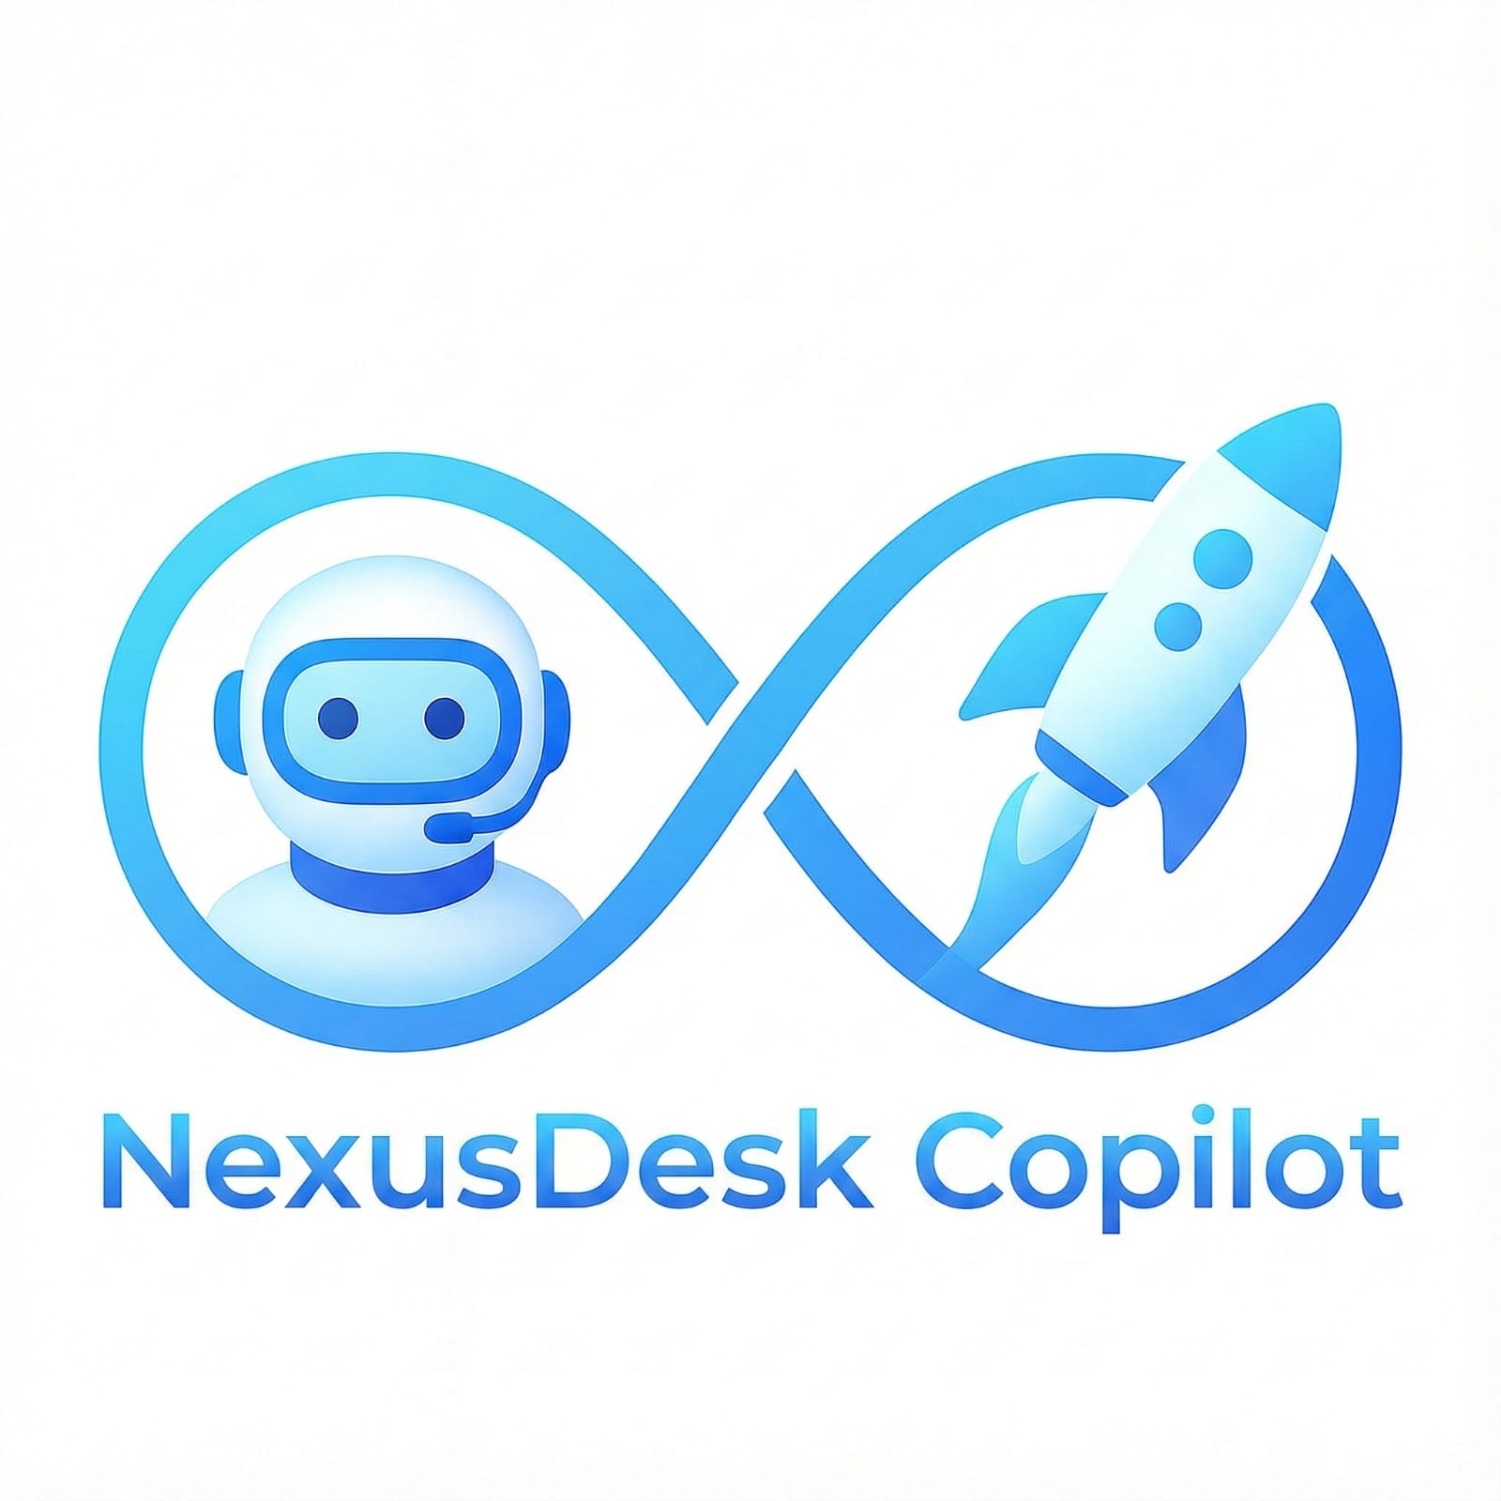
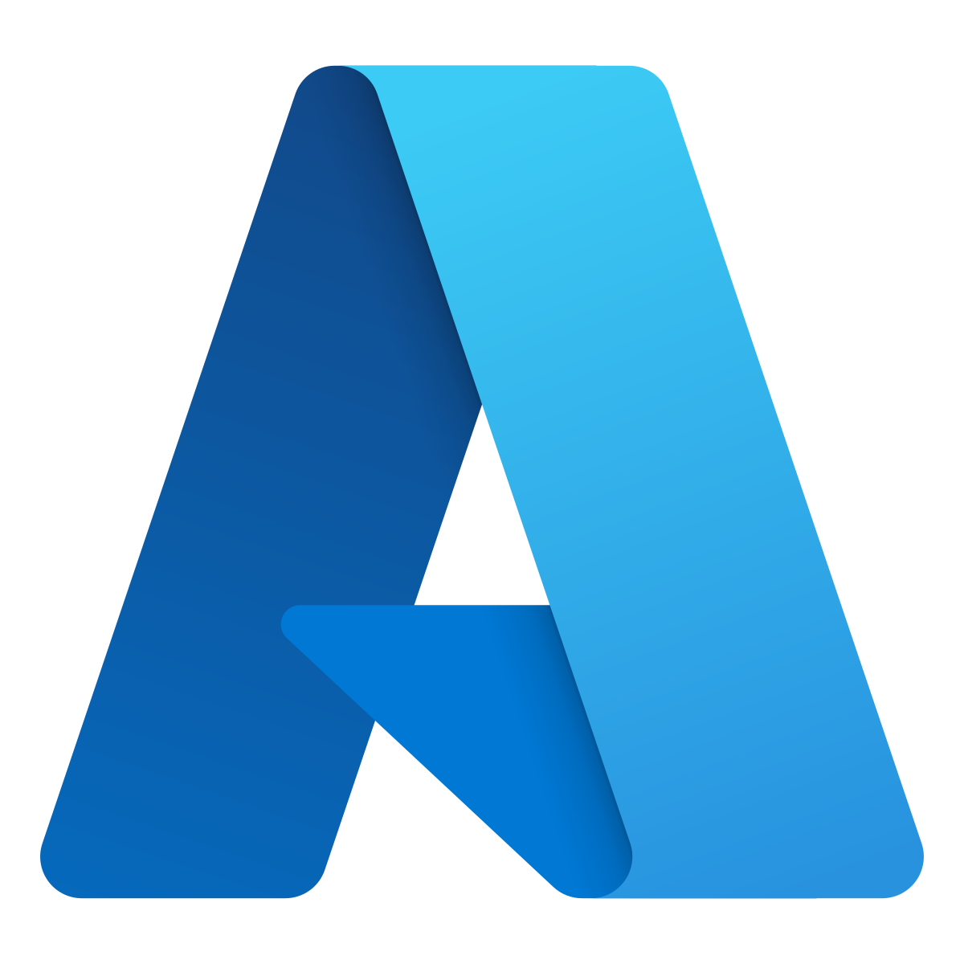


NexusDesk Copilot: Auto-Resolve Service Desk with AI Agents + Azure DevOps
Powered by Microsoft Azure
EXECUTIVE CHALLENGE:
Auto-resolve Service Desk

Slide 3
Project Description
NexusDesk Copilot is a Service Desk auto-resolution solution powered by Artificial Intelligence and a system of cooperative agents built on MCP (Model Context Protocol). The solution transforms Azure DevOps into an intelligent operations hub, where the agents can classify requests, create and manage tickets, execute automated pipelines, retrieve documentation, and resolve incidents without human intervention.
The solution incorporates an orchestrator with internal policies that evaluates the company’s organizational chart, employee roles, the criticality of the requested action, and authorized vs. required permissions in order to decide whether the request can be resolved automatically or must be safely escalated.

Slide 4


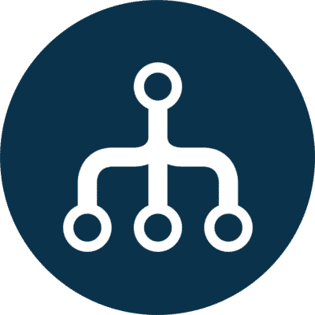

Integrate AI + DevOps within a secure, transparent, and governed workflow. All actions are executed through Azure DevOps Pipelines, ensuring traceability, auditing, versioning, and complete technical evidence.
Reduce repetitive Service Desk tickets by 70% through intelligent auto-resolution. Automate access requests, common issues, basic configurations, and frequent inquiries without requiring IT staff intervention.
Ensure intelligent escalation based on risk, role, and internal policies. The orchestrator validates whether the user has the appropriate profile to perform the action. If not, the request is escalated to a human with a clear explanation.
Key Objectives

Slide 5

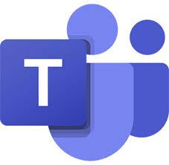
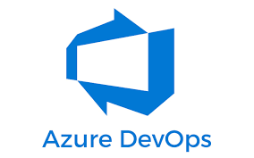
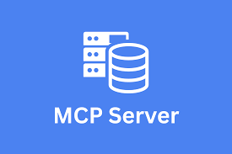
Features
Multichannel AI platform (Teams, Web, API, Bots) with the ability to handle requests across multiple channels using natural language. Users can request support from Teams, Web, APIs, or chatbots, while MCP agents understand and automatically process each request.
Advanced integration with Azure DevOps (repos, pipelines, work items) that enables real operational actions such as creating tickets, running pipelines, managing repositories, and generating evidence, ensuring traceability, auditing, and secure end-to-end automation.
Orchestrator with corporate policies + MCP agent, which applies formal organizational policies to determine whether an action can be resolved automatically or should be escalated, ensuring security, compliance, and governance.

Slide 6
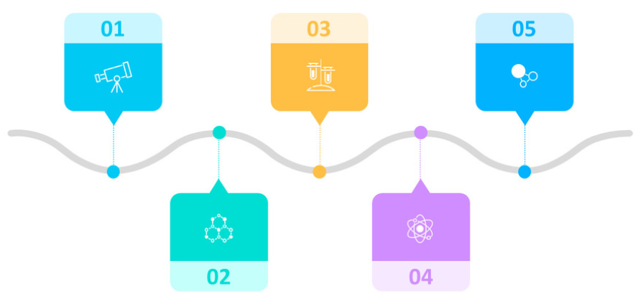



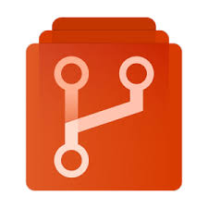
1. The user signs in and the system retrieves their permissions and role, automatically validating their position in the organizational chart and available access levels.
3. The orchestrator applies corporate policies, evaluating whether the user is authorized to perform the action or if the request requires approval or escalation.
5. The system responds to the user with the outcome, explaining what was done, why it was authorized (or why it was escalated), and documenting everything in the Work Item.
2. The user submits the request through Teams, Web, or Chatbot, and the AI agent interprets it in natural language to identify the intent and the required action.
4. If the action is permitted, the agent executes the process through Azure DevOps: creating tickets, running pipelines, or managing repositories, while recording all evidence.

Slide 7
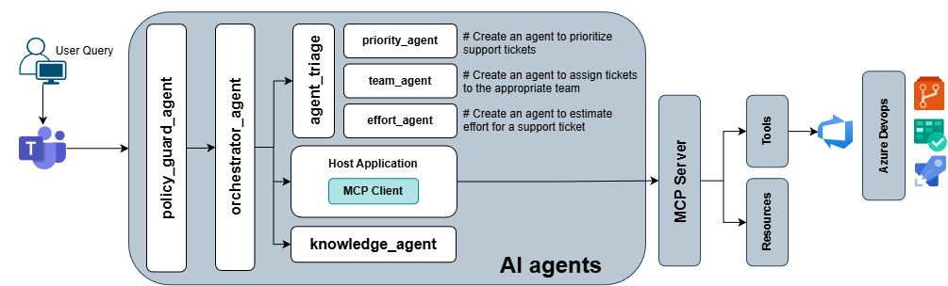
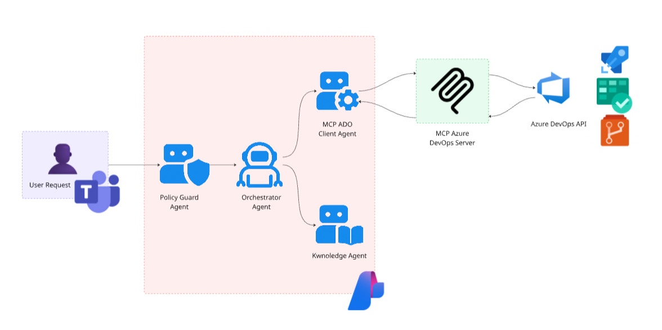
Architecture & Process Flow

Slide 8
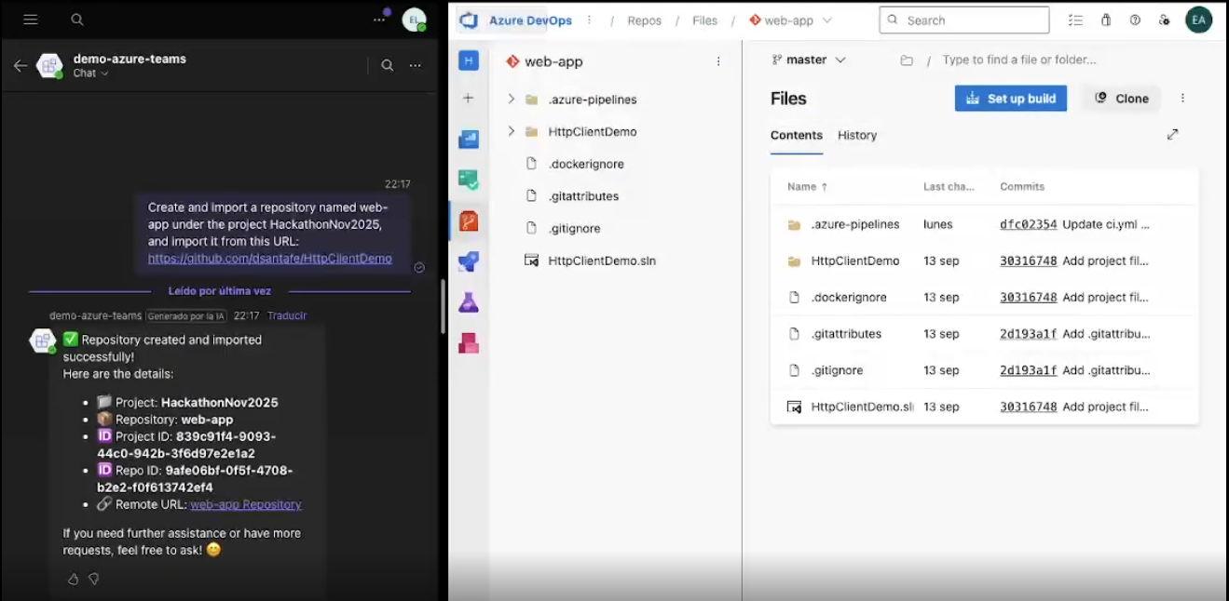
Scenario: Create and import a repository in Azure DevOps
Input: Create and import a repository named web-app under the project HackathonNov2025, and import it from this URL:https://github.com/dsantafe/HttpClientDemo

Slide 9
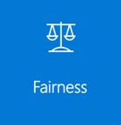


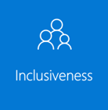
NexusDesk Copilot – Responsable AI
Fairness: Ensure fairness by basing all decisions on corporate policies, defined roles, and permissions, eliminating subjective or human bias. Requests are processed consistently and uniformly for all employees, ensuring that access to resources or the execution of actions is granted solely according to formal and verifiable criteria.
Privacy and Data Security: Maintain privacy by using only the information necessary to validate the employee’s permissions and role, without storing personal data outside authorized channels. All communication with Azure DevOps uses encrypted credentials, and access is restricted and auditable, ensuring compliance with internal policies and data protection standards.
Reliability and Security: Ensure that all actions are executed exclusively through controlled and audited Azure DevOps pipelines, preventing direct or unexpected access. Each operation includes pre-execution validations, secure execution, full traceability, and technical evidence, guaranteeing operational safety and reducing risks.
Inclusion: Design the system so that any employee, regardless of technical background, can interact in natural language through multiple channels such as Teams, Web, or Chatbots. Responses are clear, accessible, and easy to understand so that any user can follow the process and its outcome without technical knowledge.

Slide 10
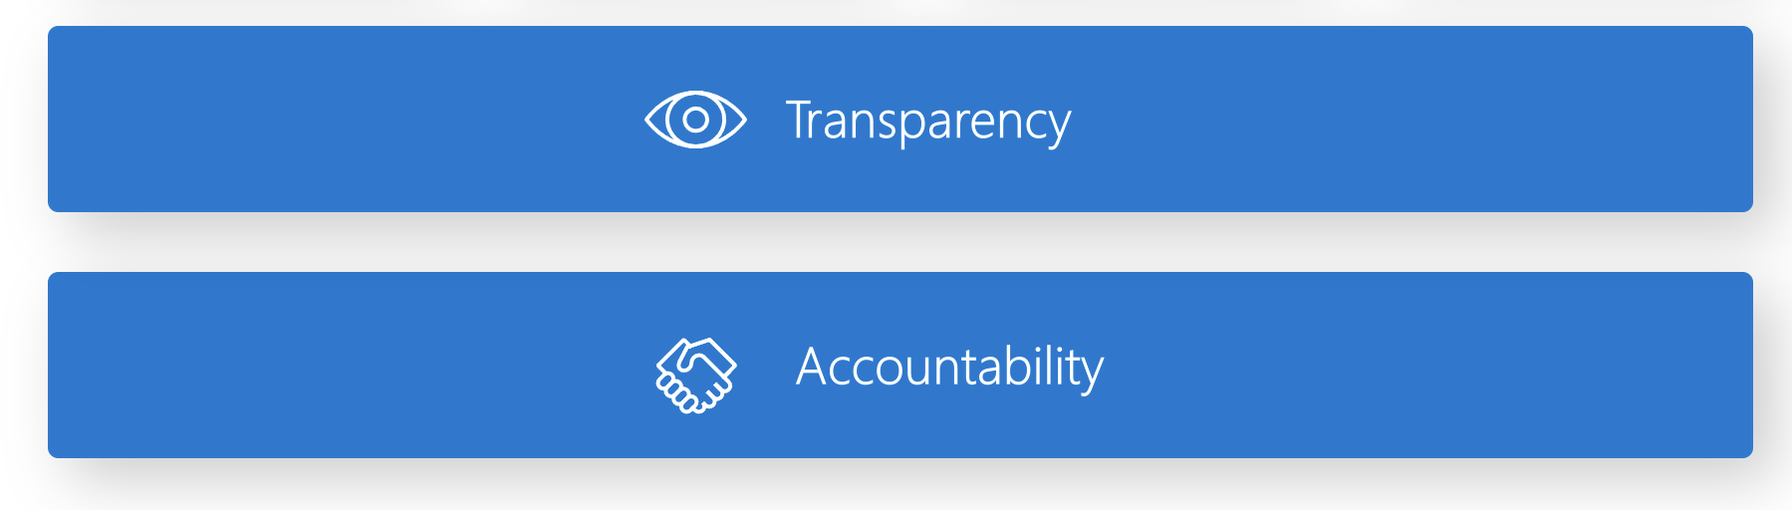
NexusDesk Copilot – Responsable AI
Transparency: Ensure users understand every action by clearly explaining what was done, why it was authorized, and the evidence supporting the execution. If a request cannot be completed, the system explicitly states the reason, helping the user understand the process and the rules applied.
Accountability: Ensure accountability through an orchestrator that consistently applies corporate policies and documents every decision in a Work Item. All AI actions are recorded with evidence and traceability, and any high-risk or out-of-policy request is automatically escalated to a human, maintaining proper oversight and control.

Slide 11






Hackers
Advisors
Daniela Vallejo
ML Engineer
Carla Mamani
MSFT MVP y Especialista de Azure en Código Facilito
Liseth Ramos
ML Engineer
Emilio Martínez López
ML Engineer
David Santafe
.NET developer

