Slide 1


Slide 2


Argumentation

Slide 3
ENG1002 English for Academic Purposes 1
Argument Essays
Lecture 17

Slide 4
Agenda
Introducing argument essay
Choosing a topic for an argument essay
Writing the thesis statement
Organizing an argument essay
Analyzing a sample argument essay

Slide 5
1. Questions to think about
What is the purpose of an argument essay?
Is it necessary to mention the weaknesses of your argument/position?
Is it necessary to use outside sources in your essay?

Slide 6

i. The purpose of an argument essay
to argue for or against something
to persuade readers to agree with your position
to give valid reasons for your position

Slide 7
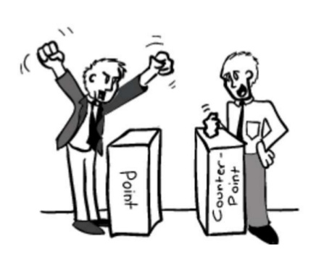
Argument Essay
Your task in writing an argument essay is to convince the reader that your position is correct by explaining your reasons for taking the position.

Slide 8
ii. Is it necessary to mention the weaknesses of your argument/position?
Yes.
Presenting the opposing viewpoint shows confidence in your argument and shows that you are aware of the limitations or potential weaknesses in your own argument.
Fairness and objectivity

Slide 9
How to present an opposing viewpoint?
a counterargument – an opposing viewpoint (negative)
a refutation – a response to the counterargument (double negatives).
Reinforcement of the writer’s position

Slide 10
Useful words and expressions
Counterargument
“Some people may say/believe that...”,
“Some experts argue that”…
“An alternative viewpoint suggests that…”
Refutation
However, nevertheless, yet, but…

Slide 11
iii. Is it necessary to use outside sources in your essay?
Yes.
Citing credible sources can greatly strengthen an argument by providing evidence.

Slide 12
How to write an argument essay?

Slide 13
Use the writing process
Choose a topic
Brainstorm
Outline
Write the first draft
Get feedback from a peer
Reread, rethink, rewrite
Proofread the final draft

Slide 14
What makes a good topic for an argument essay?

Slide 15
Argument essay topics
Task 1. Analyze the following titles of argument essays. Think about the essentials of a good topic/title of an argument essay.
We should abolish zoos and set the animals free in the wild.
Death sentences should be activated in every country of the world.
Female employees should have longer paternity leave with pay.
Schools should require students to wear uniforms.
English debate should be a compulsory course in all schools.
It is appropriate for scientists to use animals for medical research.

Slide 16
Argument essay topics
The topic is debatable; it has two (or more) viewpoints.
The topic generates more than just a subjective opinion. You can provide reliable evidence for the argument.
Frequent use of modal verbs
(e.g., should/must/might/ought to).

Slide 17

Argument essay topics
Blue is the most beautiful color in the world.
It is healthy for humans to eat blue food.

Slide 18
Task 2. Identify topics for argument essays (GW5, p.146)
1. The first time someone flew in a plane
2. The choice of a specific candidate to vote for in an election
3. How and why birds migrate south for the winter
4. Steps in negotiating an international contract
5. The necessity of higher taxes on gasoline
6. Why schools should offer after-school programs for at-risk students
7. Reasons that you deserve a pay raise
8. How to play chess well
Notes:
Answer: 2, 5, 6, 7

Slide 19
When selecting a topic, you should consider…
Is it a topic relevant to your own life?
How much do you know about this topic?
Do you have an opinion on the topic? Why do you feel this way?
Can the topic generate more than just a personal opinion? (“Chocolate is the best flavor")
Does this topic allow multiple potential viewpoints?

Slide 20
Sample topics for argument essays
Is technology limiting creativity?
Are contemporary people too much reliant on technology?
Is censorship of Internet necessary?
Does technology make people feel alone?
Death sentence should be activated in every country of the world
Alcohol usage should be controlled.
When can citizens start drinking and smoking (specific age)?

Slide 21
Thesis statements of argument essays

Slide 22
Which one is the best?
Cigarette smoking in public places is not a very good idea.
Cigarette smoking in public places should be banned.
Cigarette smoking in public places should be banned because of several important reasons.
Cigarette smoking in public places should be banned because of the health dangers it presents to not only smokers but also to people around them.

Slide 23
Which one is the best?
Cigarette smoking in public places is not a very good idea.
Cigarette smoking in public places should be banned.
Cigarette smoking in public places should be banned because of several important reasons.
Cigarette smoking in public places should be banned because of the health dangers it presents to not only smokers but also to people around them.

Slide 24
Thesis statements of argument essays
Clearly state you position on the topic.
(it is essential that, should, ought to, need to, have to, must)
Briefly present the reasons for your position.
(because of…, for the following reasons…)

Slide 25

Thesis statements of argument essays
Task 3. Brainstorm and write a thesis statement for this topic: CUHK(SZ) students should/should not take GE courses (5 mins)

Slide 26
Compare these thesis statements
It’s a good idea for CUHK(SZ) students to take GE courses.
CUHK(SZ) students should be required to take GE courses.
CUHK(SZ) students should be required to take GE courses because of several important reasons.
CUHK(SZ) students should be required to take GE courses because taking the courses helps them grow into more responsible global citizens and provides opportunities to communicate with and learn from peers from other disciplines.

Slide 27
Outlining your argument essay
How can we make sure that our essay is well-structured?

Slide 28
Organizing an argument essay
1. An introductory paragraph
2. Two body paragraphs
3. A third body paragraph
4. A conclusion
introduces the topic and thesis statement
support the thesis statement
counterargument and a refutation
summarizes the main points of the argument and restates the thesis

Slide 29
An outline of this argument essay
?
Topic: requiring CUHK(SZ) students to take GE courses
Introduction (Thesis statement)
CUHK(SZ) students should be required to to take GE courses because taking the courses helps them grow into more responsible global citizens and provides opportunities to communicate with and learn from peers from other disciplines.
Body paragraph 1 (positive 1)
Students develop their global perspective after taking the course.
Body paragraph 2 (positive 2)
Students can expand their social circle and learn from one another.
Conclusion

Slide 30
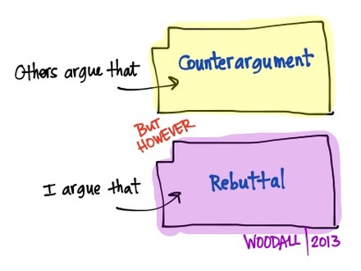
Do not forget to enrich your body paragraphs by presenting possible argument(s) from the other side!

Slide 31
Task 4. Enrich your body paragraphs by presenting multiple positions
Write a counterargument and a refutation for this thesis statement (5 mins):
CUHK(SZ) students should be required to take GE courses because taking the courses helps them grow into more responsible global citizens and provides opportunities to communicate with and learn from peers from other disciplines.

Slide 32
Body paragraph 3 (presenting multiple positions)
Counterargument: Some people argue that GE courses are almost irrelevant to students’ majors and waste students’ time.
Refutation/rebuttal: However, by developing students’ critical thinking skills, GE courses help sharpen students’ perspectives in conceptualizing their own disciplinary knowledge.

Slide 33
A complete outline of an argument essay
Topic: requiring CUHK(SZ) students to take GE courses
Introduction (Thesis statement: Pro)
Body paragraph 1 (positive 1)
Students grow into more responsible global citizens after taking the course.
Body paragraph 2 (positive 2)
Students can meet expand their social circle and learn from one another.
Body paragraph 3 (presenting multiple positions)
Some people argue that GE courses are almost irrelevant to students’ majors and waste students’ time. (negative 1).
However, by developing students’ critical thinking skills, GE courses help sharpen students’ perspectives in conceptualizing their own disciplinary knowledge. (negative 1 is wrong).
Conclusion

Slide 34
A sample argument essay

Slide 35
Task 5 Studying an example argument essay
Read the Essay Why Studying Abroad Is the Best Classroom and discuss the following questions (5 mins)
What is the purpose of the essay?
What is the thesis statement in the essay?
What arguments does the writer give to support his or her viewpoint?
Can you identify the counterarguments in this essay? What are the refutations?
Does the last sentence in the conclusion offer a suggestion, an opinion, or a prediction?

Slide 36
Assignment 2: Argument Essay
Your essay is due on either May 8th/May 9th, before your class time.
Your essay should be 900 to 1200 words (not counting the references).
Use at least four high-quality English-language sources.
Use at least one direct quotation and three paraphrases of sources in your text.
Remember, I want to see your work, not ChatGPT’s.

Slide 37

Questions?

