Slide 1
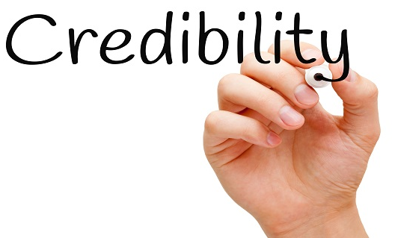
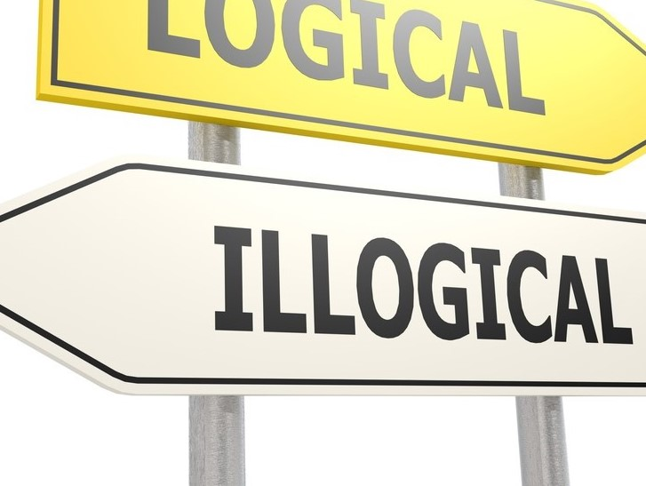
Q1. What is the easiest way to lose your credibility?
Q2. What is the best strategy you can use to make your arguments more prone to being attacked?

Slide 2
Making absolute overgeneralized, and unsupported claims!

Slide 3
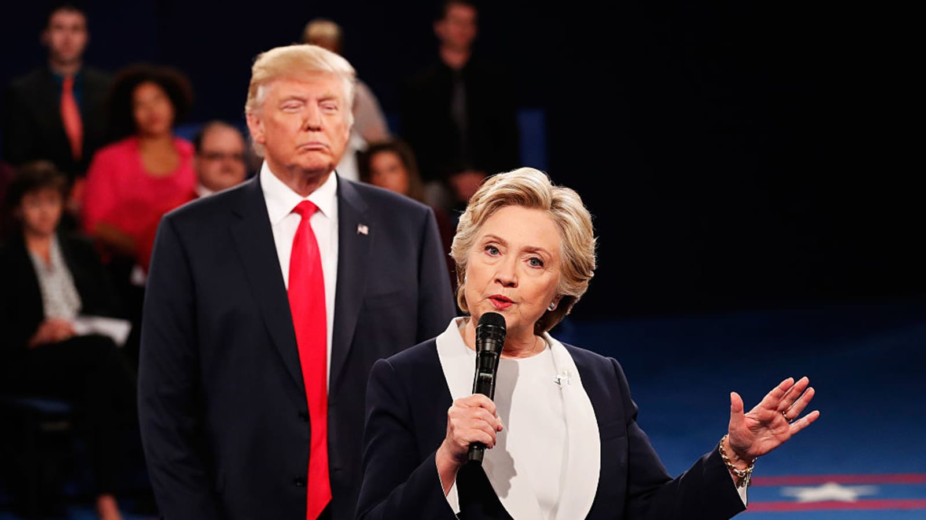
The 2016 presidential election in the US

Slide 4
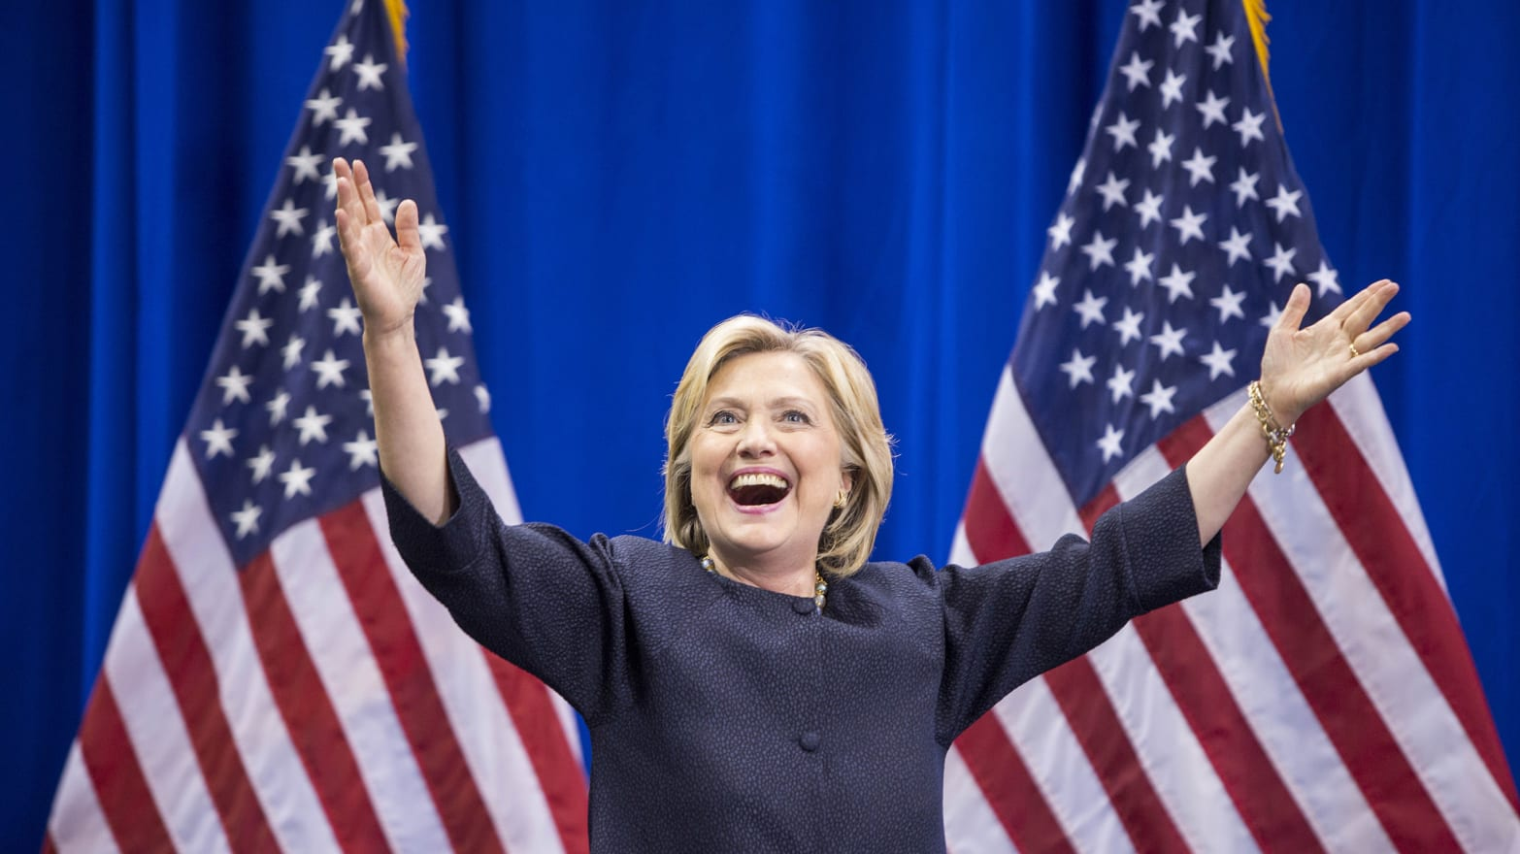
Bold predictions by media outlets and political commentators in 2016
Hillary Clinton Is a Virtual Certainty to Be Our Next President
It's Impossible for Donald Trump to Win
Trump Can’t Win

Slide 5
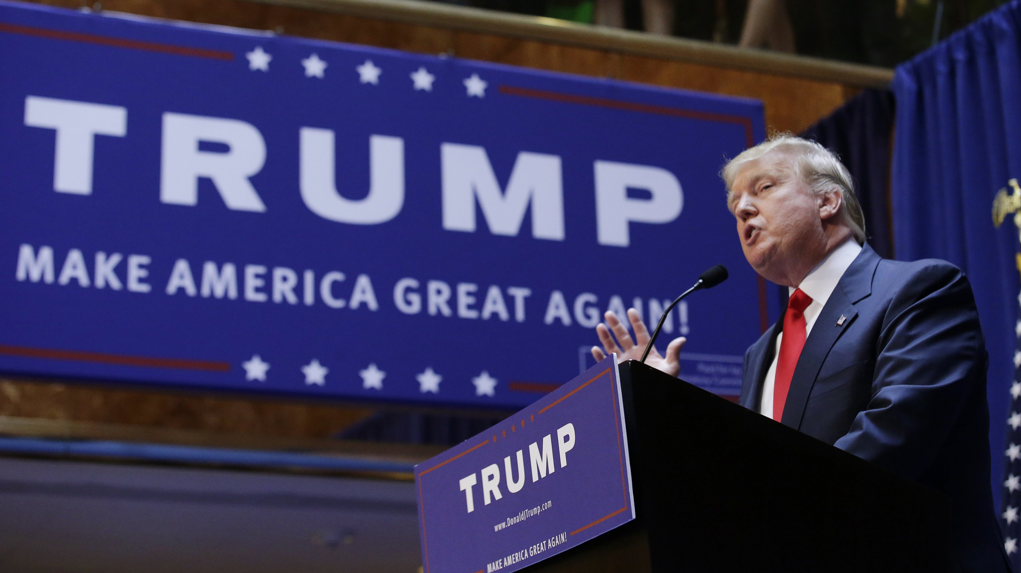

Slide 6
What if?
Hillary Clinton Is a Virtual Certainty to Be Our Next President
It's Impossible for Donald Trump to Win
Trump Can’t Win
According to the current poll results, Hillary Clinton is likely to be our next president.
The survey indicates it’s almost impossible for Donald Trump to win.
The survey suggests Trump can’t seem to win.

Slide 7
Hedging Language
Module III EAP Characteristics
Honest and Cautious

Slide 8
Agenda
What is “hedging”?
Why hedge?
How to hedge?

Slide 9
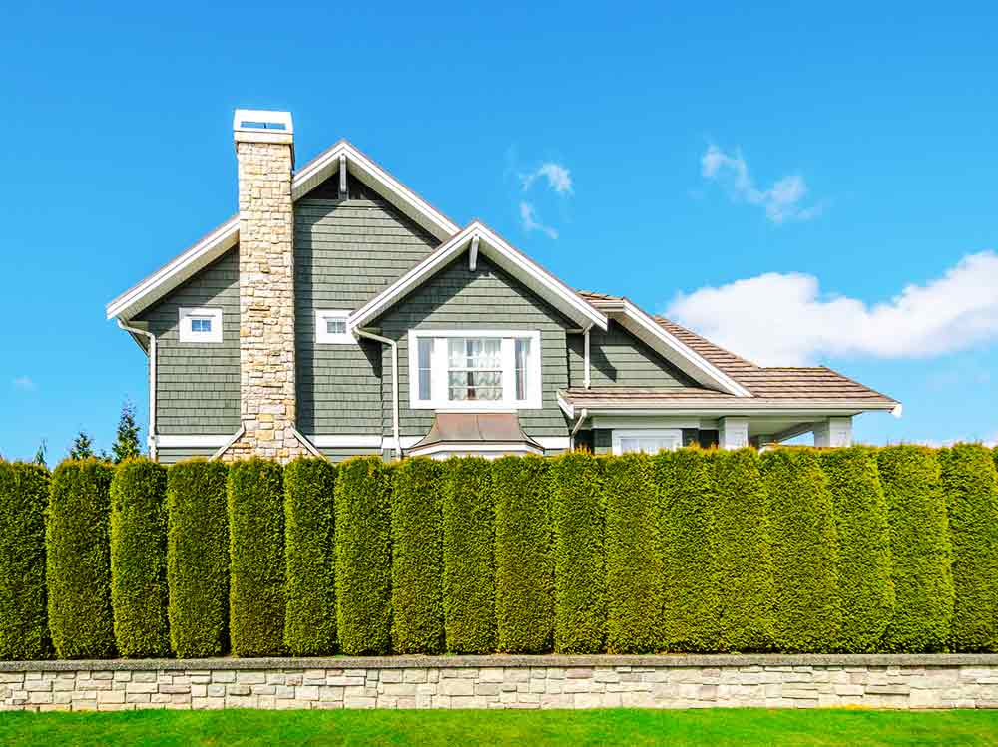
What is hedging?
Originally, a hedge — a form of protection from outsiders.
Today, hedge — protecting yourself against some risk (criticism).
Hedging language refers to the cautious language writers use to express certainty or uncertainty.
.

Slide 10
What is hedging & Why hedge?
Hedging entails anticipating possible opposition from your readers by not saying things too assertively or directly.
It protects the writer against being proved wrong while recognizing alternative ideas on the subject.
(Hyland, 1996, as cited in Wallwork, 2016, p. 134)

Slide 11
When we may use it
not 100% sure of the claims that are being made in their subject area.
perhaps the ideas are good, but the evidence is not strong.

Slide 12
Compare the following statements
S1: There is no doubt that this policy is a failure.
S2: There are concerns and criticisms regarding the effectiveness of this policy.
S1: This study definitively demonstrates...
S2: This study provides compelling evidence indicating...
S1: Everyone agrees that...
S2: There is a general consensus that...
S1: This method is superior to all others
S2: This method has demonstrated advantages compared to alternative approaches.

Slide 13
S1: *Although many authors have investigated how PhD students write papers, this is the first attempt to systematically analyze all the written output (papers, reports, grant proposals, CVs etc.) of such students.
S2: Although many authors have investigated how PhD students write papers, we believe / as far as we know / to the best of our knowledge this is the first attempt to systematically analyze all the written output (papers, reports, grant proposals, CVs etc.) of such students.

Slide 14
S1: *Our results demonstrate that students from humanistic fields produce longer written texts than students from the pure sciences and this is due to the fact that humanists are more verbose than pure scientists.
S2: Our results seem to demonstrate that students from humanistic fields produce more written work than students from the pure sciences and this may be due to the fact that humanists are generally more verbose than pure scientists.

Slide 15
Linguistic devices for hedging
Toning down verbs:
Replacing verbs that indicate 100% certainty, for example, prove, demonstrate, is (and other forms of the verb to be) with may be.
This factor may be/could be/might be responsible for …
This problem tends/seems/appears to be the result of…
Toning down adjectives and adverbs:
somewhat, relatively, mainly, generally…
probably, likely, possible/possibly…

Slide 16
Some linguistic devices for hedging
Toning down phrases:
Adding a few words/phrases before making your claim
to a certain extent,
more or less,
on the whole,
the majority of,
certain types of,

Slide 17
Hedging devices for avoiding expressing absolute certainty
may could might is likely to will probably will almost certainly
Severe weather |  | become more common in the future.
 | the situation will improve in the long term.
It is likely It is possible It is almost certain There is a possibility There is a small chance There is a strong possibility
(that)
Notes:
Source: Academic phrase bank: https://www.phrasebank.manchester.ac.uk/using-cautious-language/

Slide 18
Hedging devices when explaining the cause and effects
may be could be might be are almost certainly
These frequent storms | are | due to climate change.
 | the more extreme weather | is a result of climate change.
It may be It is likely It could be It is possible It is probable It is almost certain
Notes:
Source: Academic phrase bank: https://www.phrasebank.manchester.ac.uk/using-cautious-language/

Slide 19
Hedging devices for avoiding over-generalization
Ozone levels |  | exceed WHO levels in many cities.
often generally frequently sometimes occasionally
most almost all some types of many types of the majority of certain types of
Ozone is toxic to |  | living organisms.
Notes:
Source: Academic phrase bank: https://www.phrasebank.manchester.ac.uk/using-cautious-language/

Slide 20
Give it a try: Please add hedging device for the following sentences
An explanation is that these frequent storms are a result of climate change.
A likely explanation A probable explanation A possible explanation
…may be/could be/ might be a result

Slide 21
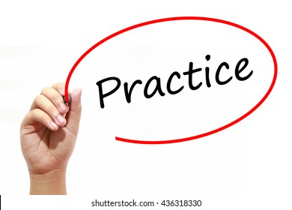
Task 1. Revise the following statements to make them softer.
This factor is responsible for the increase in ...
These results demonstrate the importance of ...
These findings are conclusive proof that x = y.
This problem manifests itself in …
This means that x = y.

Slide 22
Task 1. Adding toning down verbs
Versions leave no room for doubt
1. This factor is responsible for the increase in...
2. These results demonstrate the importance of...
3. These findings are conclusive proof that x = y.
4. This problem manifests itself in ...
5. This means that x = y.
Toned down versions
This factor may be / is probably responsible for the increase in ...
These results would seem to show / indicate / suggest the importance of...
These findings provide some evidence / appear to prove that x = y.
This problem tends / seems / appears to manifest itself in ...
It seems that x = y.

Slide 23
Task 2. Identify the problems with the following statements.
1. It may thus, given these particular circumstances, be assumed that there is a certain possibility that yellow may be preferable to red for alerting danger.
2. It is clear that in these particular circumstances, yellow may be preferable to red.

Slide 24
Don’t over-hedge
Over-hedged versions
1. It may thus, given these particular circumstances, be assumed that there is a certain possibility that yellow may be preferable to red for alerting danger.
2. It is clear that in these particular circumstances, yellow may be preferable to red.
Revised versions
Given these particular circumstances, yellow may be preferable to red for alerting danger.
It is clear that yellow is preferable to red.
In these particular circumstances, yellow may be preferable to red.

Slide 25
Task 3. Rewrite the sentences using hedging language

Slide 26
Task 3. Rewrite the sentences using hedging language
1. Despite a number of minor problems, the scheme was very successful.
If there were problems, was it completely successful?
__________________________________________________________
2. Coral reefs are seriously affected by rises in sea temperature.
I don't think the research has 100% proven this link yet.
________________________________________________________________
Answer: Despite a number of minor problems, overall/on the whole, the scheme was very successful.
Answer: Coral reefs seem/appear to be seriously affected by rises in sea temperature

Slide 27
3. Solar power offers a solution to producing clean, cheap energy in developing countries.
Is it certain to work in all contexts? Isn't it quite expensive to set up?
________________________________________________________________
4. The study shows that bilingual children have better memory skills than children who only speak one language.
This is only one study – can we say that it clearly proves the link? Is it true for all children?
__________________________________________________________________
Answer: Solar power offers a potential/possible solution to producing clean, relatively cheap energy in developing countries.
Answer: The study indicates/suggests that bilingual children may/typically have better memory skills than children who only speak one language

Slide 28
Summary
Show an open mind to alternative interpretations.
Save your face by writing in an impersonal fashion.
Consider using toning down verbs, adjectives, and adverbs to modify your level of certainty.
Don’t over-hedge.

Slide 29
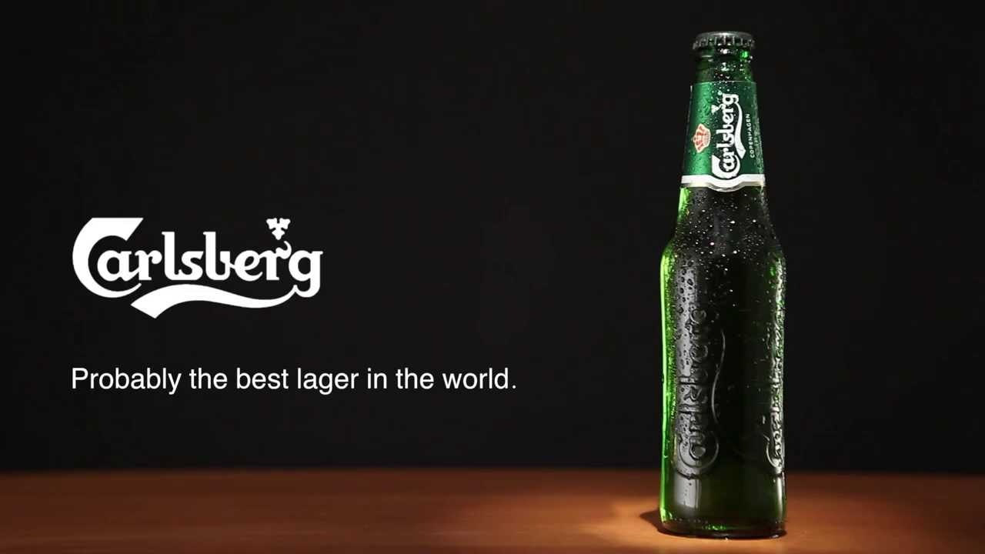

Slide 30
References
Wallwork, A. (2016). English for Writing Research Papers (2nd Edition). Springer.
Academic phrase bank: https://www.phrasebank.manchester.ac.uk/using-cautious-language/

