Slide 1
Getting Involved in Group Discussions & Unpacking Discussion Topics
Group Discussion Practice
April 15/16, 2024

Slide 2
Today’s Agenda
FAQs
Group debate practice
Learn to unpack group discussion topics

Slide 3
FAQs
Is it a good idea to interrupt people during the free debate?
What is the main duty of Speaker 2?
How will our debate performance be evaluated?
When do I need to define the key terms?
How should I analyze the topic and generate meaningful points?

Slide 4
Is it a good idea to interrupt people during the free debate?
Interruptions are particularly important where a student…
(a) has spoken for too long
(b) is off topic
(c) has completely misunderstood a point raised by your team
Use appropriate language and manner
Can I say/add something? May I interrupt for a moment? Is it okay if I jump in for a second?
Excuse me/ Sorry to interrupt, but…
I am sorry, I have a question about…

Slide 5
2. What is the main duty of Speaker 2?
1. Counter the first speaker's perspective
2. Elaborate on one or two points with more details and examples
3. Introduce a fresh perspective: present a new point that the first speaker did not address or may have overlooked.
Do not just repeat what the first speaker said.

Slide 6
Independent thought
Claim
Evidence
Relevance

Slide 7
3. How will our debate performance be evaluated?
Each student will be given an individual grade
Content | Delivery& Language
On topic Presents ideas clearly with support Demonstrates subject knowledge Persuasiveness Interacts with others (+/-) Uses time effectively | Fluency Body language (e.g. eye contact, gestures, posture), Pronunciation (clarity), use of intonation and stress, effective use of pauses, volume, speed of speech Accuracy, appropriateness, variety and complexity of vocabulary & grammar Effective use of discussion language (for example interrupting, agreeing, disagreeing, etc.)

Slide 8
4. When do I need to define the key terms?
Ask yourself: will my speech be confusing/ambiguous if I don’t define this term? Could the opposition misinterpret what I mean without a definition?
“We should ban plastic straws”
“We should ban smoking in public buildings”
“Marijuana should be legalized”

Slide 9
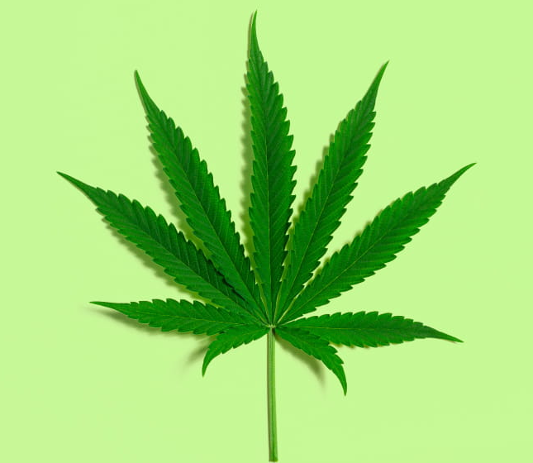
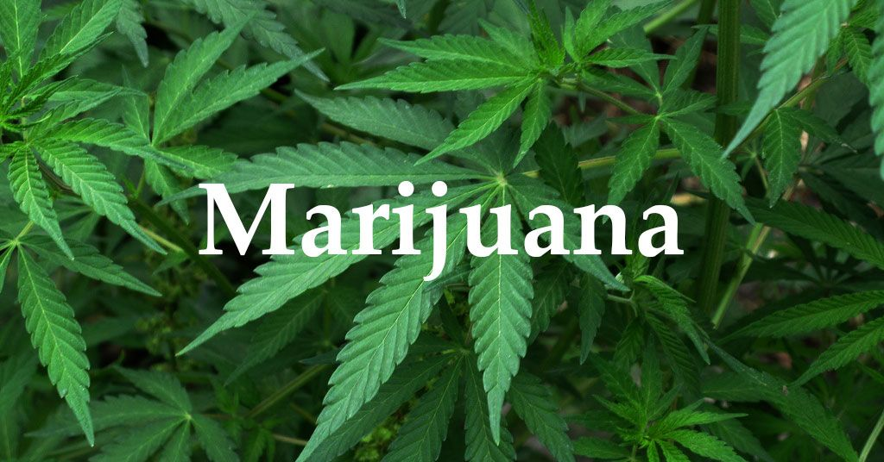
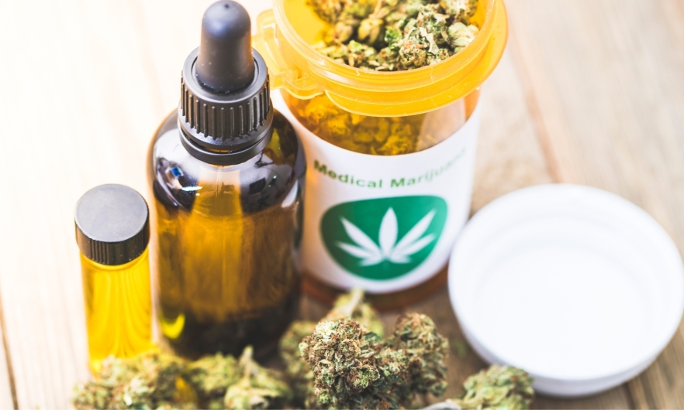
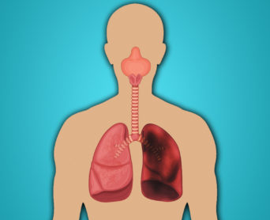

Slide 10
Define key terms
Define key terms: Legalization
No penalties if regulations are complied with
May be criminal penalties if regulations aren’t followed
Drug possession and use are legal
Regulations control production, distribution and supply
Regulated or permitted under certain conditions
Source: https://adf.org.au/talking-about-drugs/law/decriminalisation/

Slide 11
4. When do I need to define the key terms?
Ask yourself: will my speech be confusing/ambiguous if I don’t define this term? Could the opposition misinterpret what I mean without a definition?
“We should ban plastic straws”
“We should ban smoking in public buildings”
“Marijuana should be legalized”
Terms open to interpretation: justice, freedom, equality, sustainability, democracy…
Defining key terms helps narrow down the scope of the debate and ensures that arguments are focused on a specific interpretation.

Slide 12
5. How should I analyze the topic and generate meaningful points ?
Break down the topic into subtopics by analyzing different perspectives:
Consider cause and effect relationships
Consider different stakeholders and their perspectives
Identify the fundamental moral and ethical principles of autonomy, beneficence (doing good), do-no-harm, and respect for persons
Consider equity, fairness, and justice: Examine whether the proposed policies distribute benefits and burdens fairly among individuals or groups
Consider practicality in application: Examine the possible challenges in implementing these proposals or policies.

Slide 13
Practice Debate

Slide 14
Preparation
Take your assigned position.
Use 15 minutes to research this topic.
Jot down your main points.

Slide 15
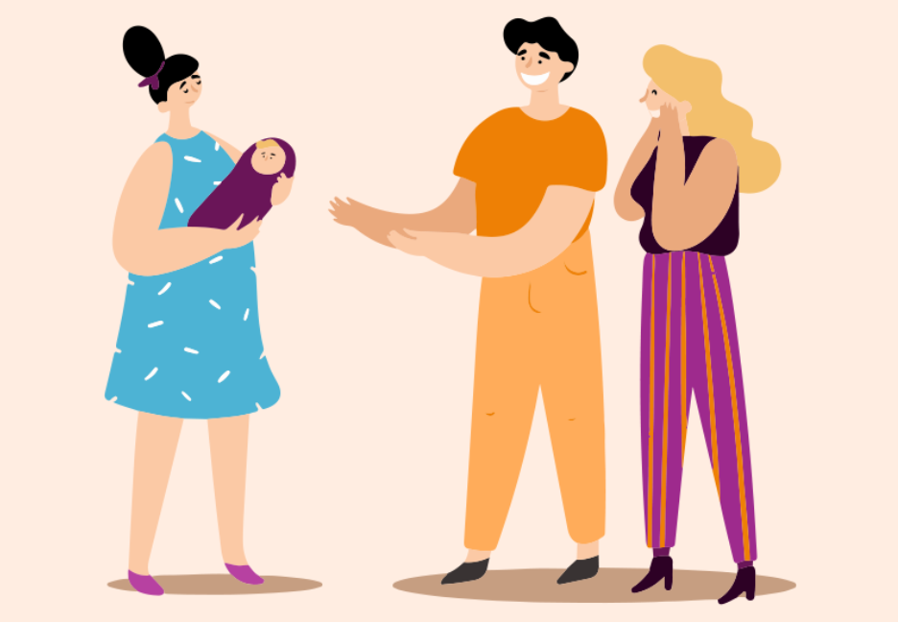

Surrogacy should be legalized in China

Slide 16
Topic Analysis Guidelines
Define key terms:
Break down the topic into subtopics by analyzing different perspectives:

Slide 17
Break down the topic into subtopics by analyzing different perspectives:
Consider cause and effect relationships
Consider different stakeholders and their perspectives
Identify the fundamental moral and ethical principles of autonomy, beneficence (doing good), do-no-harm, and respect for persons
Consider equity, fairness, and justice: Examine whether the proposed policies distribute benefits and burdens fairly among individuals or groups
Consider practicality in application: Examine the possible challenges in implementing these proposals or policies.

Slide 18
Tentative group presentation schedule
Date | Group
April 1/2 | Group 1
April 3/4 | Group 2
April 8/9 | Group 3
April 10/11 | Group 4
April 15/16 | Group 1,2,3,4
April 17/18 | Group 1,2,3,4
April 22/23 | Group 1&2 (Graded)
April 24/25 | Group 3&4 (Graded)

Slide 19


