Slide 1
ENG1002 English for Academic Purposes 1
Lecture 2
Review of the Writing Process and Essay Structure
January 10/11, 2024

Slide 2
Agenda
Reviewing the essay
Different essay types
The structure of an essay
Essential components of an essay
Reviewing the writing process
How to write an outline

Slide 3
What is an essay?
An essay is a piece of writing from a personal point of view that methodically examines and evaluates a topic or issue.
An essay is designed to describe an experience, present an idea, propose an argument, express the views of the writer, and persuade readers of a position or perspective through informed arguments.

Slide 4

What are the most common types of essays?
Notes:
4

Slide 5

Task 1. Please name the essay type based on the descriptions.
Notes:
5

Slide 6
Narrative Essays
1. These essays tell a story or recount personal experiences, often in chronological order, with the goal of engaging the reader.

Slide 7
Descriptive Essays
2. These essays aim to create a vivid picture or sensory experience of a person, place, object, or event. They use detailed language and sensory imagery to bring the subject to life.

Slide 8
Expository Essays
3. These essays present information, explain a concept, or provide an analysis of a topic. They are focused on presenting facts, evidence, and logical explanations.

Slide 9
Persuasive Essays
4. These essays aim to persuade or convince the reader to adopt a particular viewpoint or take a specific action. They present arguments, evidence, and reasoning to support the writer's position.

Slide 10
Argumentative Essays
5. Similar to persuasive essays, these essays require the writer to take a stance on a specific topic and provide evidence and logical reasoning to support their position. However, these essays also acknowledge and address counterarguments.

Slide 11
Comparison Essays
6. These essays analyze the similarities and differences between two or more subjects, highlighting both their shared characteristics and their distinctive features.

Slide 12
Cause and Effect Essays
7. These essays examine the causes and consequences of a particular event, situation, or phenomenon. They explore the relationships between actions, events, or conditions and their outcomes.

Slide 13
Responsive Essays
8. These essays share the writers’ thoughts, opinions, and reflections on the content of the materials they are responding to. The essay may explore the writer's emotional response, critical evaluation, or interpretation of the text.

Slide 14
What are the most common types of essays?
Narrative Essays
Expository Essay
Descriptive Essay
Persuasive Essay
Argumentative Essay
Comparison Essays
Cause and Effect Essays
Responsive Essays
Notes:
14

Slide 15
Essay type | Skills required | Example topics
Argumentative
Expository
Narrative
Descriptive
Cause-and-Effect
Forming an opinion via research
Building an evidence-based argument
Research
Should the use of cell phones be allowed in schools?
Should animal testing be banned?
Knowledge of a topic
Communicating information clearly
Newspaper articles, how-to manuals
The advancement in communication over the last 20 years
Storytelling, descriptive writing, creativity
A memorable childhood experience.
A personal accomplishment and its impact on your life
Creative language use
Sensory language, attention to detail, vivid imagery
Describe an object that has sentimental value for you.
Ability to use using evidence and logical reasoning to support the connections between the causes and effects.
The causes and effects of cyberbullying
Effects of stress on college students’ academic performance

Slide 16
Essay Structure
How is an essay organized?

Slide 17
How is an essay organized?
Three basic parts:
an introduction, a body, and a conclusion
Task 2. Please work in groups to place the "essay-related elements" in the appropriate positions

Slide 18
hook
call-to-action (CTA)
topic sentence
thesis statement
introduction of the topic
supporting details/evidence
transitions
summary
in-text citation
Introduction
Conclusion
Body
Notes:
A "call to action" (CTA) is a phrase or statement that urges or prompts the audience or readers to take a specific action after consuming certain content.

Slide 19
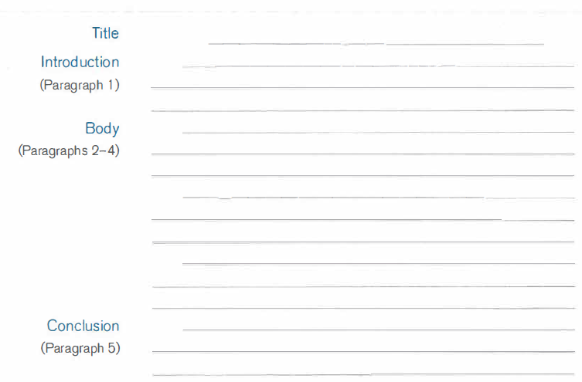
The Five-Paragraph Essay

Slide 20
The Introduction Paragraph
starts with a hook that grabs the reader's attention
mentions the topic of the essay and gives background information to connect the reader to the topic
includes a thesis statement that gives the main point of the essay and explains the writer's idea or position about the topic

Slide 21

The Hook
The hook is a device used to catch the reader's attention.
It is often the opening sentence of an essay.
Type of hook:
Definition
Quote from a famous person
Question
A statement that shocks and surprises people
Dilemma/conflict
Comparison (simile or metaphor)

Slide 22
Examples of the Hook
The dictionary defines gossip as “casual conversation," but gossip is in reality a much more negative interaction.
As entrepreneur Richard Branson said, "There is no planet B. We have to take care of the one we have."
Have you ever thought about where your salad comes from?
Each year thousands of teenagers die in driving accidents.
Some college graduates must decide between an interesting, low­ paying job and a more mundane job that pays well.
Life is like a roller coaster

Slide 23
Thesis Statement
tells a reader what the essay is about and why it was written
states the writer's opinion and/or position on the subject
mentions the reasons behind the writer’s position briefly
Look at a thesis statement for an essay on the use of cell phones in schools:
Cell phones should be banned in schools because they distract students, allow cheating in schools, and they can pose potential risks to student safety, such as cyberbullying and the unauthorized sharing of sensitive information
Which type of essay is it?

Slide 24
Thesis Statements for Different Types of Essay
Thesis for a personal essay
Halloween might seem a casual and fun holiday for some, but for me it was offensive and uncomfortable when I felt forced to celebrate it in school.
Thesis for an expository essay
If you think Halloween is just a “kids’ night,” you might be surprised to know that this holiday has ancient religious origins.
Thesis for an argumentative essay
Halloween should not be celebrated in public schools because of some religious and cultural reasons.

Slide 25

Which thesis statement is the best?
Cigarette smoking in public places is not a very good idea.
Cigarette smoking in public places should be banned.
Cigarette smoking in public places should be banned because of several important reasons.
Cigarette smoking in public places should be banned because of the health dangers it presents to not only smokers but also to people around them.

Slide 26
Body Paragraphs
The body of the essay includes two or more body paragraphs that explain and support the thesis statement.
Each body paragraph should include a topic sentence that connects clearly to the thesis statement.
After the topic sentence, you can provide examples, cite work, provide necessary definitions, describe, analyze, and organize your ideas to support your topic sentence.

Slide 27
Conclusion
summarizes the writer's main point
uses key vocabulary from the introduction paragraph to restate the thesis statement
may offer a call-to-action, provide a suggestion, give an opinion, make a prediction, or ask a question

Slide 28
The Writing Process

Slide 29


The Writing Process
Thoughts
Papers

Slide 30
FIVE Essential Steps
Prewrite
1
2
3
4
5
Planning Stage
Outline
Draft
Writing Stage
Revision
Improving Stage
Proofread

Slide 31
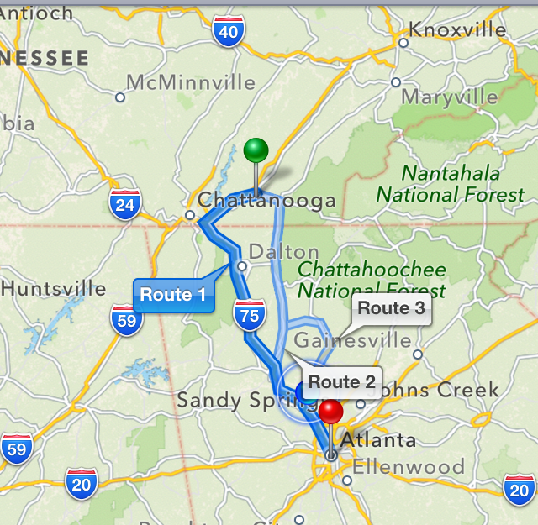
Why do we need to outline our essay?
Helps you organize your ideas in a logical manner
Shows the relationships among ideas in your writing
Defines boundaries between different ideas

Slide 32
How can we write an outline?
Identify your topic and thesis statement
Brainstorm: list all the ideas that you can think of about the chosen topic
Decide what points you would like to discuss in your paper
Put your points in logical, numerical order so that each point connects back to your main point
Write possible transitions between paragraphs (optional)

Slide 33
Task 3 Outlining a topic
Write an outline for the topic ‘Effects of Technology on Our Lives’ with the help of:
An outline template

Slide 34
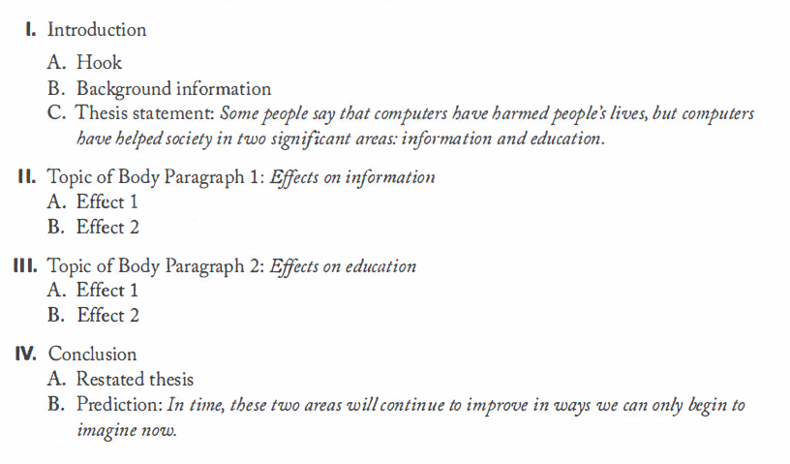
Title: Some Positive Effects of Computers on Society (GW5, p. 32)

Slide 35
Possible thesis statement
Topic: ‘Effects of Technology on Our Lives’
The pervasive influence of technology has brought about significant changes in our lives, fostering better social connections and convenience in the workplace and providing more entertainment options. However, it is crucial to recognize the adverse effects of technology, including increased screen time and the erosion of privacy in the digital age.

Slide 36
Possible topic sentences
Topic Sentence 1: The integration of technology in our daily lives has redefined our relationships, transforming the way we exchange information and ideas and leading to increased connectivity.
Topic Sentence 2: The influence of technology on work environments has led to increased flexibility in the workplace, so people need to continuously adapt to the evolving digital tools and platforms.
Topic Sentence 3: Technology has reshaped leisure activities, providing new avenues for entertainment, such as streaming services and virtual reality experiences.
Topic sentence 4: However, it is crucial to recognize that technology also carries some negative effects, such as excessive screen time and the invasion of privacy

Slide 37
References
Folse, K. S., & Pugh, T. (2019). Great writing 5: From great essays to research (5th ed.). Cengage Learning.
Writing types: https://www.scribbr.com/academic-essay/essay-types/

Slide 38

Homework
Read the article ‘Against E-Voting’ and complete the following questions.

Slide 39
Questions about ‘E-voting’
1. What is the purpose of this essay? Begin with “The purpose of”
2. How many body paragraphs?
3a. How many citations are used in this essay?
3b.What is the list of sources at the end of the essay called?
3c. How does the number of citations in the text compare with the number of sources listed at the end of the essay?
4. What is the strongest supporting point in the essay?

Slide 40

Any questions?

