Slide 1
ENG1002 English for Academic Purposes 1
Lecture 3
Review of Public Speaking
January 15/16, 2024

Slide 2

Agenda
Reflect on your own public speaking experience
Review public speaking strategy via a TED talk
Presentations in ENG1002
How to prepare for a good presentation?
Presentation expressions (signposts)

Slide 3
Warm-up
Task 1. Work in pairs and share your answers to these questions.
1. Which areas have you improved the most in ENG1001?
2. Which areas do you need to work more on?
3. What are the most useful strategies that you have been using to boost your presentation?
Four key areas in public speaking:
Body Control
Voice / Language
Content
Visual Aids

Slide 4

Task 2. Watch the TED talk and identify the public speaking strategies he used
Notes:
https://www.youtube.com/watch?v=8S0FDjFBj8o

Slide 5
Key Vocabulary
flounder /ˈflaʊndər/: to struggle to know what to say or do or how to continue with sth.
phony /ˈfoʊni/: a person who is not honest or sincere.
gibberish /ˈdʒɪbərɪʃ/: words that have no meaning or are impossible to understand.
gesticulate /dʒeˈstɪkjuleɪt/: move your hands and arms about in order to attract attention or make sb. understand what you are saying.

Slide 6
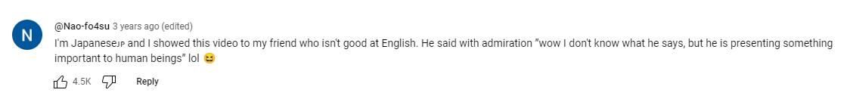

@Nao-fo4su 3 years ago (edited)
I'm Japanese, and I showed this video to my friend who isn't good at English. He said with admiration ”wow I don't know what he says, but he is presenting something important to human beings.
@chloeren1224 2 years ago (edited)
our teacher made us watch this with the sound off and it looks like he's really giving an amazing speech

Slide 7
Presentations in ENG1002

Slide 8
Individual presentations in this semester
Practice presentations: Jan 22/23-Mar 6/7
Graded presentations: Mar 18/19-Mar 25/26
Presentation schedule: Download it from BB
Length: 5 mins + 1min (Q&A)
Dress code: “business formal” for your graded presentations.
Requirement: PPT slides (accurate, attractive, and easy-to-read)
Percent of your grade: 25%

Slide 9
What you need to do in your presentation
Summary
Response

Slide 10
Summary
A summary is a brief list of the main points of something you have read, seen, or heard.
A summary does NOT have to follow the exact sequence of events.
Use your own words, except for quotations
A summary DOES NOT include your interpretation of or opinion about the work summarized. Just the facts.

Slide 11
Response
1. Share what you think about the issue and relate it to your own experiences or other things you have read
e.g., Did you have a similar experience? Did you read something similar?
2. Provide a critique or evaluation of the article you’ve read
e.g., Do you agree or disagree with the writer/speaker? Are the arguments of the author convincing?
3. Share your inspiration from this material
e.g., Did the work increase your understanding of a particular issue?
Did it change your perspective in any way?
4. Raise (and discuss) a question related to the materials
e.g., Why would someone choose this course of action instead of a different course of action? What might happen if...?
5. Talk about an idea that surprised you – or disappointed you

Slide 12

Don’t forget to make a connection between your response and the talk or the article.
For example:
The talk highlights …, and I couldn’t agree more.
The article discusses the impact of…, and it really resonated with me.
The article provides insights into …, and I have personally experienced its positive effects.
The talk sheds light on the importance of …, and it struck a chord with me.

Slide 13
Grading Criteria

Slide 14
Grading Rubric
Body Control | Appropriate appearance. Confident. Emotional control. Relaxed. Facial expression. Gestures with hands. Eye contact. Moves purposefully or sits or stands with poise. Speaks from notes – does not memorize or read the presentation.
Voice/ Language use | Good volume. Modulates voice. Good speaking speed. Pauses, emphasizes, punctuates. Clear, correct pronunciation. Minimizes accent. Correct spoken grammar. Avoids filler words and sounds, slang, profanity, stuttering, staccato repeaters. Appropriate vocabulary and tone. Uses transitions and signposts.
Content | Good introduction. Generates interest. Main points clear. Application clear. Strong evidence/ examples. Logical structure. Maintains focus. Well-paced. Engages the audience. Asks questions. Strong conclusion. Well-timed.
Visual Aids | Support the main theme. Easy to read. Easily understood. Grammatically correct. Appropriate. Attractive. Interesting. Effective. Uncluttered. Equipment and software function correctly and demonstrate advance preparation.

Slide 15

1. Body Control
Appropriate appearance
Confident and relaxed
Emotional control
Facial expression
Gestures with hands
Eye contact
Moves purposefully or stands with poise
Does not read the presentation

Slide 16

2. Voice / Language
Good volume
Good speaking speed
Pauses, emphasizes, punctuates
Modulates voice
Expression of emotions
Clear, correct pronunciation
Correct spoken grammar
Appropriate vocabulary and tone
Avoids filler words and sounds, slang, profanity, and stuttering
Fluency
Uses transitions and signposts

Slide 17
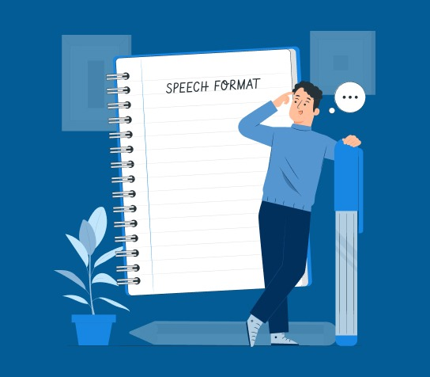
3. Content
Good introduction
Generates interest
Main points clear
Strong supporting evidence/examples
Logical progression of ideas
Maintains focus
Engages the audience
Strong conclusion
Well-timed
Respond properly to questions

Slide 18

4. Visual Aids
Support the main theme
Easy to read
Easily understood
Grammatically correct
Appropriate
Attractive
Effective
Uncluttered
Equipment and software function correctly and demonstrate advanced preparation.

Slide 19
How to prepare for a good presentation?

Slide 20
Five Steps to an Effective Presentation
1. Read the source materials carefully
2. Decide which type of response you will give
3. Organize your presentation in an outline
4. Prepare your presentation slides
5. Rehearse your presentation

Slide 21
3. Organize your presentation
Introduction
Introduce the source material, the topic and the context
Body
Present your response
Conclusion
Summarize your response, ask questions, CTA, a prediction…

Slide 22
4. Prepare your presentation slides
Language use
Remove any jargon and try to use plain English instead. If necessary, explain the terms when you first use them.
Sentence structure
Use short sentences and keep the structure simple.
The flow
Make your presentation into a cohesive unit. Links should be clearly stated between ideas and/or slides.
Check, and double-check, for spelling and grammar.

Slide 23

5. Rehearse your presentation
1. Start with presentation notes.
2. Practice under 'mild stress.'
3. Ask for specific feedback.
4. Record it.
5. Practice until it's effortless.

Slide 24
Presentation Signposts

Slide 25

Presentation signposts
Use of speech signposts can
indicate the organization and flow of your speech or writing
establish logical connections between ideas
facilitate smooth transitions between different parts of your discourse
encourage active engagement from your audience, for example, the use of phrases like "What do you think?" or "Let's consider the following"

Slide 26

Task 3. Put the presentation expressions in the box in the correct category below

Slide 27

Any questions?

