Slide 1
ENG1002 English for Academic Purposes 1
Lecture 5&6
Cause and Effect Essays
January 22/23-24/25, 2024

Slide 2

Agenda
Introduce two types of cause-effect essays
Review the common structures of cause-effect essays
Analyze a sample cause-effect essay
Practice writing thesis statements for cause-effect essays

Slide 3
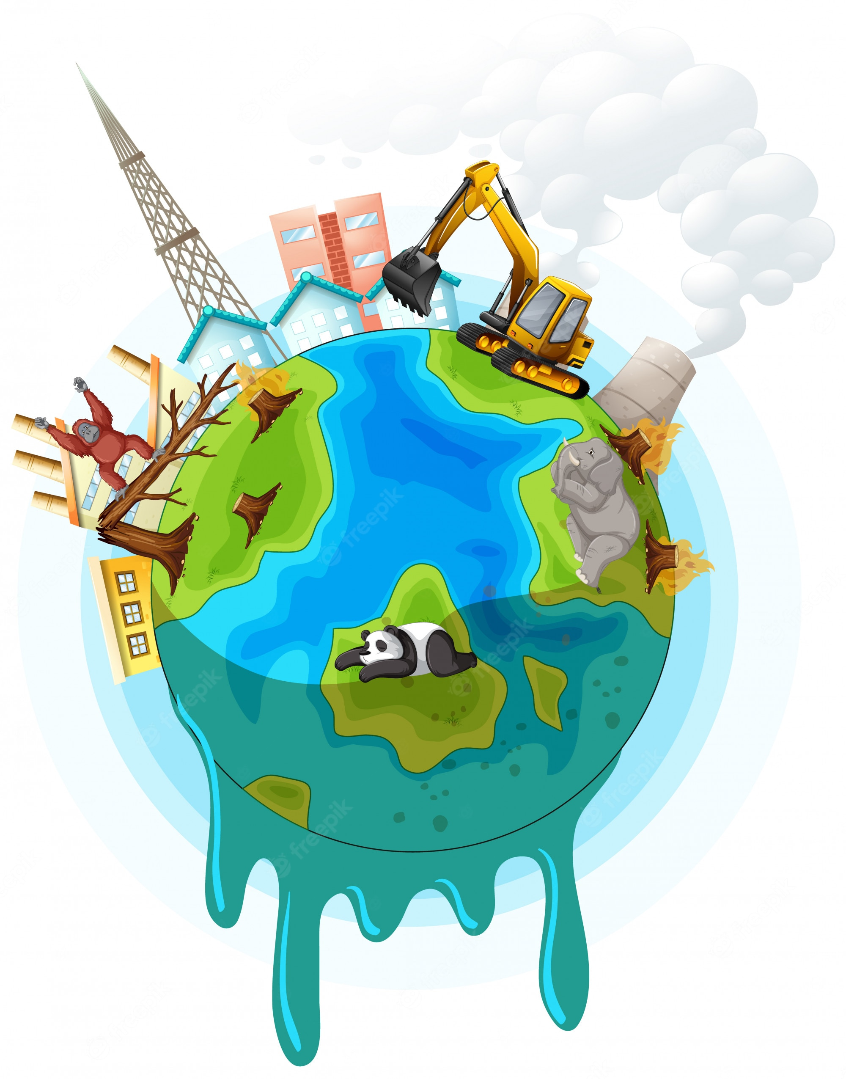
What is a cause-effect essay?
Q1. What is the purpose of a cause-effect essay?
A cause-effect essay tells how one event (a cause) leads to another event (an effect)
Q2. What should be the focus of a cause-effect essay?
The effects of A on B (focus-on-effects method)
The causes of A (focus-on-causes method)

Slide 4
Two methods for writing a cause-effect essay
Focus-on-effects
how one cause creates multiple effects
Focus-on-causes
how one effect can be the result of multiple causes

Slide 5
A focus-on-effects essay
How A affects B
A = global warming
B = the habitat of polar bears
Number of effects = 3
INTRODUCTION | Paragraph 1 | Hook Connecting information Thesis statement
BODY | Paragraph 2 | Effect 1: dangerous swimming conditions
 | Paragraph 3 | Effect 2: scarcity of food
 | Paragraph 4 | Effect 3: reduced population
CONCLUSION | Paragraph 5 | Restated thesis Suggestion, opinion, prediction

Slide 6
A focus-on-causes essay
The causes of A
A = global warming
Number of causes= 3
INTRODUCTION | Paragraph 1 | Hook Connecting information Thesis statement
BODY | Paragraph 2 | Cause 1: human activities
 | Paragraph 3 | Cause 2: increased industrial activities
 | Paragraph 4 | Cause 3: deforestation
CONCLUSION | Paragraph 5 | Restated thesis Suggestion, opinion, prediction

Slide 7

What is the first step when we write an essay?
Find a good topic!

Slide 8
Task 1 Identifying topics for cause-effect essays
1. the reasons that Earth's weather has changed so much in the last century
2. Bangkok versus Singapore as a vacation destination
3. a trip to visit my grandparents
4. the increasing use of computers in schools
5. explaining dietary guidelines for children
6. how to AI tools to write a good essay
7. falling birthrates in China
8. why some college students are so stressed
Extracted from GW5 (Folse & Pugh, 2019, p. 76)

Slide 9
Example topics for cause-effect essays
Focus-on-Causes Essays
The causes of the high divorce rate in some countries
The causes of stress among college students
The reasons new teachers quit
How humans cause climate change
Why only a small percentage of people read newspapers today
Focus-on-Effects Essays
The effects of high salaries for athletes
The influences of social media on business
The impact of technology on communication skills
How sleep deprivation affects overall health and well-being
What happens when a large percentage of adults cannot read well

Slide 10
Choose a good topic for your cause-effect essay
What makes a good topic for a cause-effect essay?
1. Ice cream sales vs. sunglasses sales
2. Coffee consumption vs. intelligence
3. Education level vs. income
Is there only one main effect or cause, or are there several effects or causes?
Do the two events really have a cause-effect relationship?

Slide 11
What is the second step when writing an essay?
Brainstorm for your topic!

Slide 12
Task 2 Brainstorming for two methods
Causes of stress among college students | Effects of stress on college students

Slide 13
What is the next step when writing an essay?
Outlining your essay!

Slide 14
Task 3 Studying an example cause-effect essay
3.1 Read the essay How Weather Has Changed World History and discuss the following questions.
What is the purpose of the essay?
What is the thesis statement in the essay?
How is this essay organized? Focus-on-effects or focus-on-causes?
Complete the diagram with the causes and effects in this essay.

Slide 15
4. Complete the diagram
CAUSES | EFFECTS
a.__________________________________________ | a.__________________________________________
b.__________________________________________ | b.__________________________________________
c.__________________________________________ | c.__________________________________________
Monsoons in Japan
Kublai Khan failed to conquer Japan.
Fog in Long Island
The British failed to defeat the American troops.
The cold winters of Russia
France failed to conquer Russia.

Slide 16
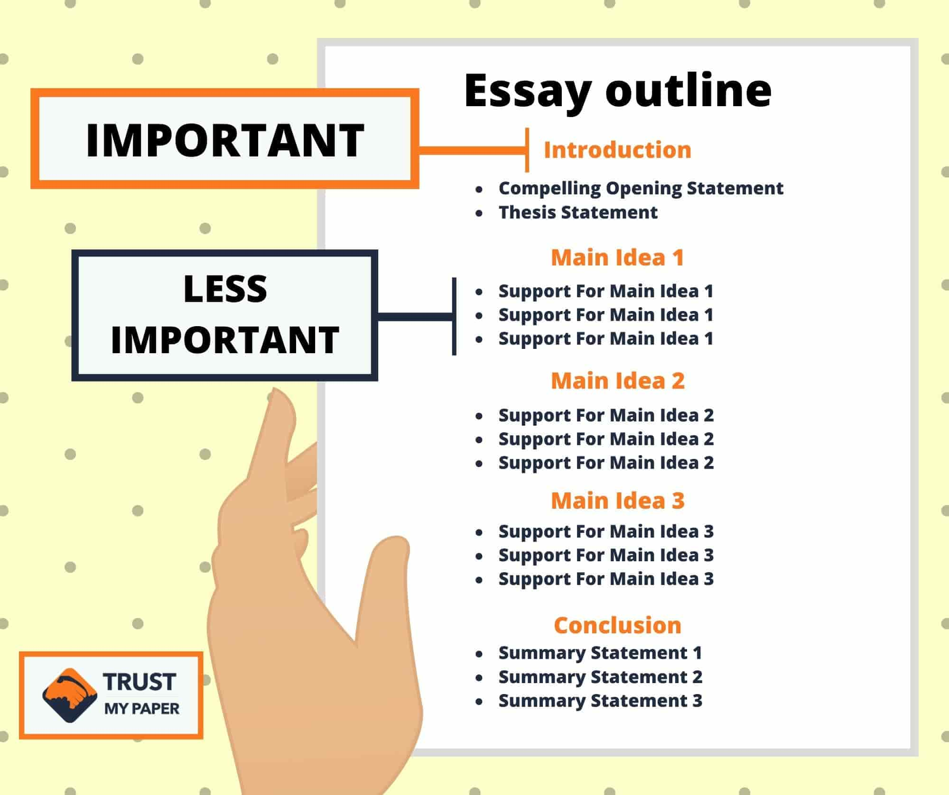
3.2 Completing the outline

Slide 17
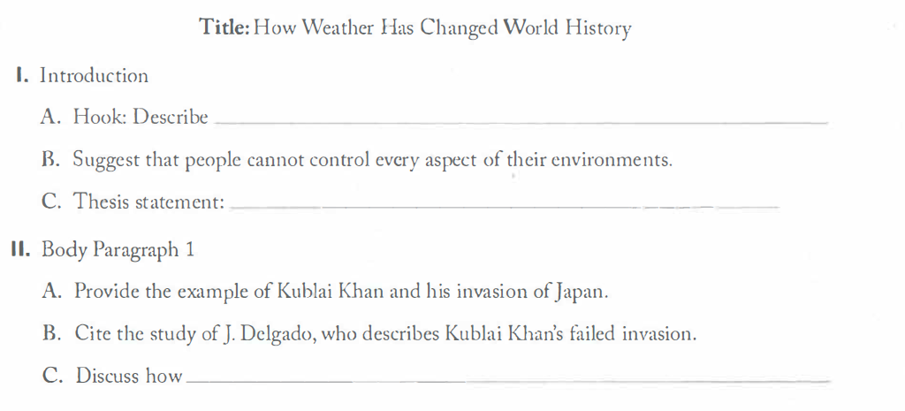
3.2 Completing the outline
Complete the outline using information from this essay (GW5, pp.81-82)

Slide 18
3.2 Completing the outline
Title: How Weather Has Changed World History
I. Introduction
A. Hook: Describe ______________________________
B. Suggest that people cannot control every aspect of their environments.
C. Thesis statement:_______________________________________
3) how people think they control their fate.
5) The weather has changed world history in important ways.

Slide 19
3.2 Completing the outline
II. Body Paragraph 1
A. Provide the example of Kublai Khan and his invasion of Japan.
B. Cite the study of J. Delgado, who describes Kublai Khan's failed invasion.
C. Discuss how _________________________________________
6) Japan’s cultural identity would have changed if Khan had succeeded in his invasion.

Slide 20
3.2 Completing the outline
III. Body Paragraph 2
A. Provide the example of _________________________________
B. Cite the study of W. Seymour, who documents the circumstances of the battle.
C. Discuss _______________________________________________
1) the American Revolution against Great Britain.
7) how the United States might have remained a member of the British Commonwealth, if not for a heavy fog.

Slide 21
3.2 Completing the outline
IV. Body Paragraph 3
A. Provide the example of Napoleon Bonaparte’s invasion of Russia.
B. Cite the study of______________________________________
C. Discuss the consequences of Napoleon’s defeat in relation to Russia’s rise as a world power.
4) H. Belloc, who documents the effect of the Russian winter.

Slide 22
3.2 Completing the outline
V. Conclusion
A. Summarize the three examples from the body paragraphs.
B. Suggest that, although weather forecasters can predict the weather with more accuracy than in the past,__________________________
2) The course of history cannot be fully isolated from the effects of weather.

Slide 23

What is the most essential step in outlining your essay?
Draft your thesis statement!

Slide 24
Thesis Statements for Cause-Effect Essays
A strong thesis statement for a cause-effect essay serves as a clear roadmap, effectively guiding the content and structure of the entire essay.
Briefly state the cause(s) and the effect(s) being explored
Show the focus of the essay
Is it a must to offer your own stance and attitudes?
No

Slide 25

Thesis Statements for Cause-Effect Essays
1. Walking for 20 to 30 minutes per day has several positive effects on both mental and physical health.
2. Many customers prefer to shop online for three important reasons: convenience, low price, and more choices.
3. Watching too much TV has a great impact on children's family life, interpersonal skills, and academic performance.
4. The increase in obesity in our country is due to food commercials, cheap fast food, and video games.

Slide 26
Thesis Statements for Cause-Effect Essays
2. Many customers prefer to shop online for three important reasons: convenience, low price, and more choices
4. The increase in obesity in our country is due to food commercials, cheap fast food, and video games.
1. Walking for 20 to 30 minutes per day has several positive effects on both mental and physical health.
3. This essay will discuss the impacts of watching too much TV on children's family life, interpersonal skills, and school life.

Slide 27
Thesis Statements for Cause-Effect Essays
Focus-on-Causes
2. Many customers prefer to shop online for three important reasons: convenience, low price, and more choices
4. The increase in obesity in our country is due to food commercials, cheap fast food, and video games.
Focus-on-Effects
1. Walking for 20 to 30 minutes per day has several positive effects on both mental and physical health.
3. This essay will discuss the impacts of watching too much TV on children's family life, interpersonal skills, and school life.

Slide 28

Task 4 Writing thesis statements for cause-effect essays
Causes of stress among college students
Effects of stress on college students
Brainstorm with your partner for more ideas!

Slide 29
Task 4 Writing thesis statements for cause-effect essays
1. Causes of stress among college students
2. Effects of stress on college students

Slide 30
Task 4 Writing thesis statements for cause-effect essays
1. Causes of stress among college students
The increasing academic demands, financial pressures, and social challenges faced by college students are significant contributors of stress among college students.
2. Effects of stress on college students
The detrimental effects of stress on college students can manifest in various ways, including academic performance decline, mental health issues, and some physical problems.

Slide 31
Assignment 1: Cause and Effect Essay
Your essay is due on Mar 13/14, before your class time.
Your essay will be at least three full pages, around 900 words (not counting the reference page). Keep it within four pages.
You should use at least three good-quality sources to support your ideas.
Please consult Purdue OWL APA Formatting and Style Guide (APA7) for information on in-text citations and the Reference section.
Send me your topic and outline if you want some feedback before your writing (at least 5 days before the due date)
Notes:
https://owl.purdue.edu/owl/research_and_citation/apa_style/apa_formatting_and_style_guide/index.html

Slide 32

Sample cause and effect essay topics for college students
How does online schooling affect the academic performance of students?
What is the effect on educational outcomes for extended school days?
How is the rate of dropouts influenced by standardized tests?
How is student motivation affected by the general grading system?
How is the effectiveness of learning influenced by the adoption of technology?
How are the academic outcomes of students affected by sports and other extracurricular activities?
What are the positive and negative outcomes of school uniforms?
How is a student's future success affected by taking a "gap year"?
What does learning fine arts do to affect students' learning in schools?

Slide 33

Sample Essays
Read the sample essay 1 and discuss the following questions:
What is the main purpose or thesis statement of the essay?
What are the main causes/effects discussed in the essay?
What evidence or examples does the author provide to support their claims?
What is the overall tone or stance of the author towards the topic?
Are there any specific transition words or phrases used to indicate cause-and-effect relationships?

Slide 34

Questions?

Slide 35
Reference
Folse, K. S., & Pugh, T. (2019). Great writing 5: From great essays to research (5th ed.). Cengage Learning.

