Slide 1
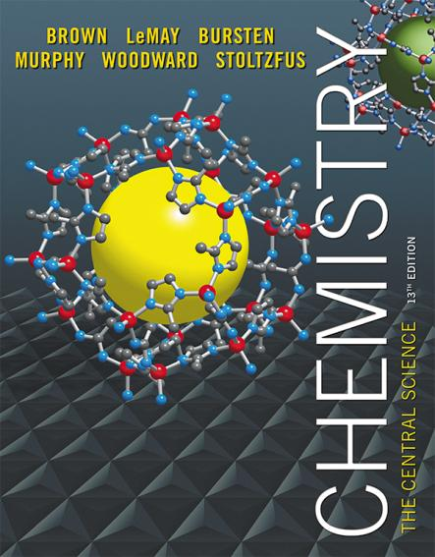
Lecture Presentation
Chapter 19 Chemical Thermodynamics
© 2015 Pearson Education, Inc.

Slide 2
First Law of Thermodynamics
You will recall from Chapter 5 that energy cannot be created or destroyed.
Therefore, the total energy of the universe is a constant.
Energy can, however, be converted from one form to another or transferred from a system to the surroundings or vice versa.

Slide 3
Enthalpy/Entropy
Enthalpy is the heat absorbed by a system during a constant-pressure process.
Entropy is a measure of the randomness in a system.
Both play a role in determining whether a process is spontaneous.

Slide 4
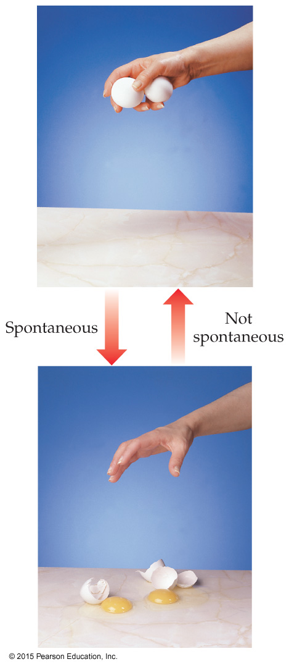
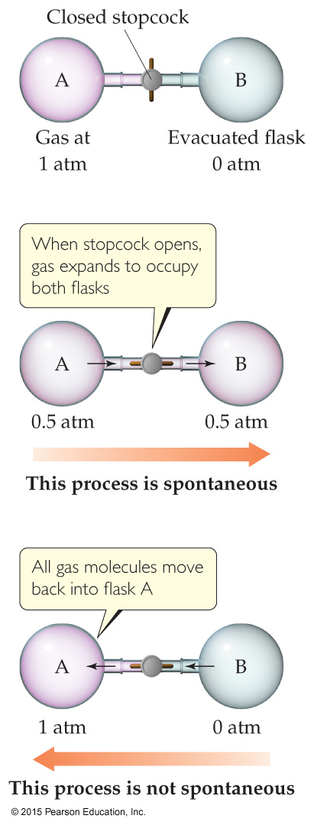
Spontaneous Processes
Spontaneous processes proceed without any outside assistance.
The gas in vessel A will spontaneously effuse into vessel B, but it will not spontaneously return to vessel A.
Processes that are spontaneous in one direction are nonspontaneous in the reverse direction.

Slide 5
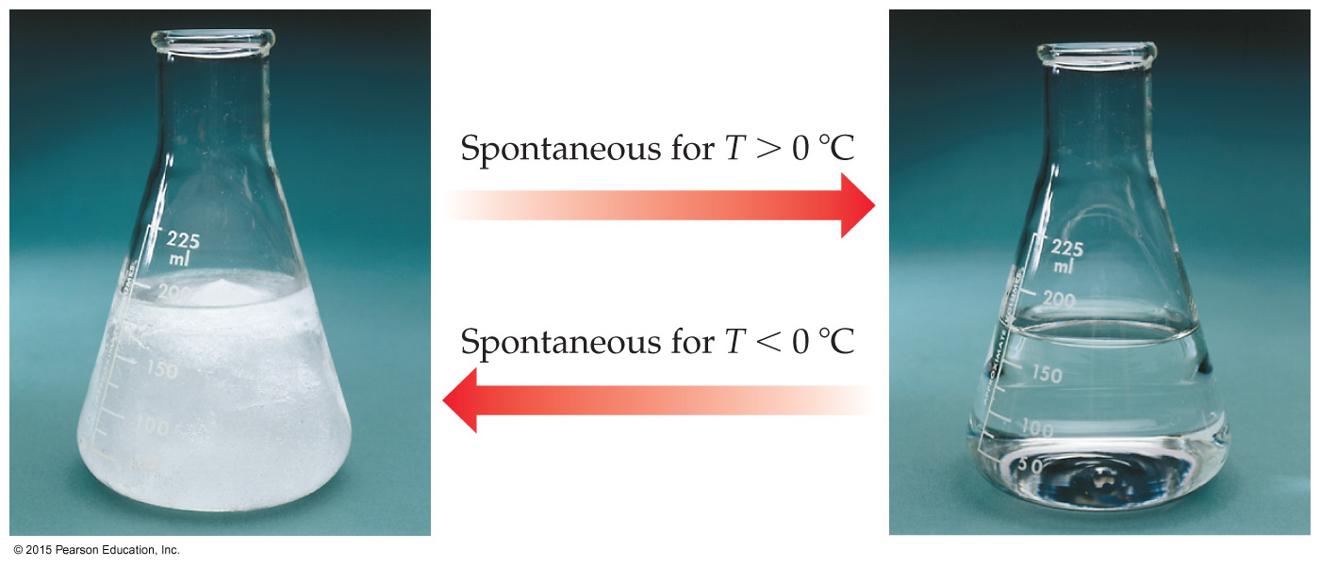
Experimental Factors Affect Spontaneous Processes
Temperature and pressure can affect spontaneity.
An example of how temperature affects spontaneity is ice melting or freezing.

Slide 6
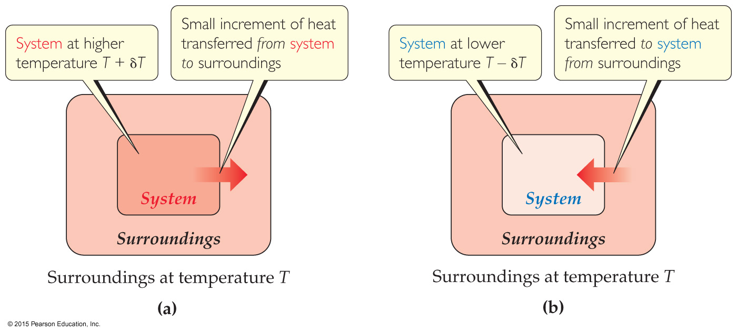
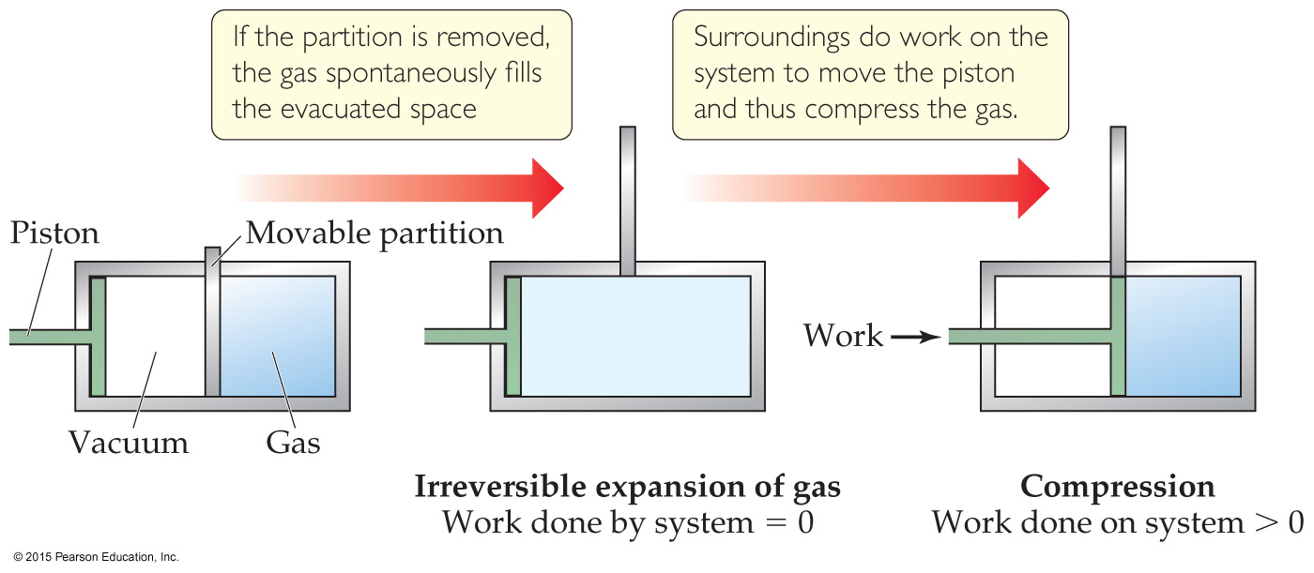
Reversible and Irreversible Processes
Reversible process: The system changes so that the system and surroundings can be returned to the original state by exactly reversing the process. This maximizes work done by a system on the surroundings.
Irreversible processes cannot be undone by exactly reversing the change to the system or cannot have the process exactly followed in reverse. Also, any spontaneous process is irreversible!

Slide 7


Entropy
Entropy can be thought of as a measure of the randomness of a system.
It is a state function:
It can be found by heat transfer from surroundings at a given temperature:

Slide 8
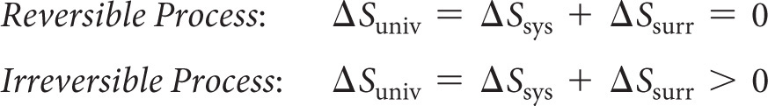
Second Law of Thermodynamics
The entropy of the universe increases in any spontaneous processes.
This results in the following relationships:

Slide 9
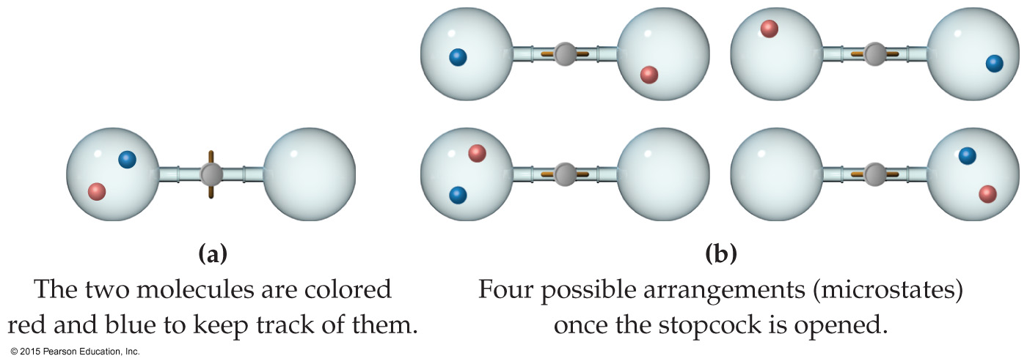
Entropy on the Molecular Scale
Boltzmann described entropy on the molecular level.
Gas molecule expansion: Two molecules are in the apparatus above; both start in one side. What is the likelihood they both will end up there? (1/2)²
If one mole is used? (1/2)^{6.02×1023}! (No chance!)
Gases spontaneously expand to fill the volume given.
Most probable arrangement of molecules: approximately equal molecules in each side

Slide 10
Statistical Thermodynamics
Thermodynamics looks at bulk properties of substances (the big picture).
We have seen what happens on the molecular scale.
How do they relate?
We use statistics (probability) to relate them. The field is called statistical thermodynamics.
Microstate: A single possible arrangement of position and kinetic energy of molecules

Slide 11
Boltzmann’s Use of Microstates
Because there are so many possible microstates, we can’t look at every picture.
W represents the number of microstates.
Entropy is a measure of how many microstates are associated with a particular macroscopic state.
The connection between the number of microstates and the entropy of the system is:

Slide 12

Entropy Change
Since entropy is a state function, the final value minus the initial value will give the overall change.
In this case, an increase in the number of microstates results in a positive entropy change (more disorder).

Slide 13
Effect of Volume and Temperature Change on the System
If we increase volume, there are more positions possible for the molecules. This results in more microstates, so increased entropy.
If we increase temperature, the average kinetic energy increases. This results in a greater distribution of molecular speeds. Therefore, there are more possible kinetic energy values, resulting in more microstates, increasing entropy.

Slide 14
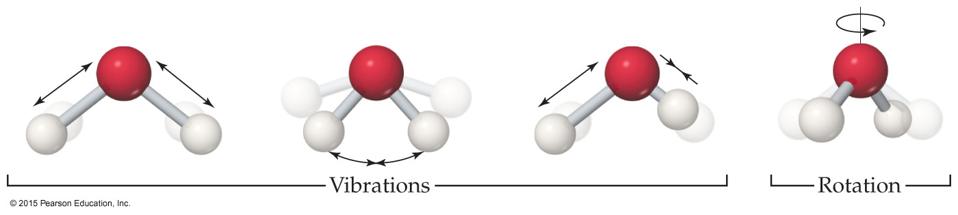
Molecular Motions
Molecules exhibit several types of motion.
Translational: Movement of the entire molecule from one place to another
Vibrational: Periodic motion of atoms within a molecule
Rotational: Rotation of the molecule about an axis
Note: More atoms means more microstates (more possible molecular motions).
Notes:
€

Slide 15
Entropy on the Molecular Scale
The number of microstates and, therefore, the entropy tend to increase with increases in
temperature.
volume.
the number of independently moving molecules.

Slide 16
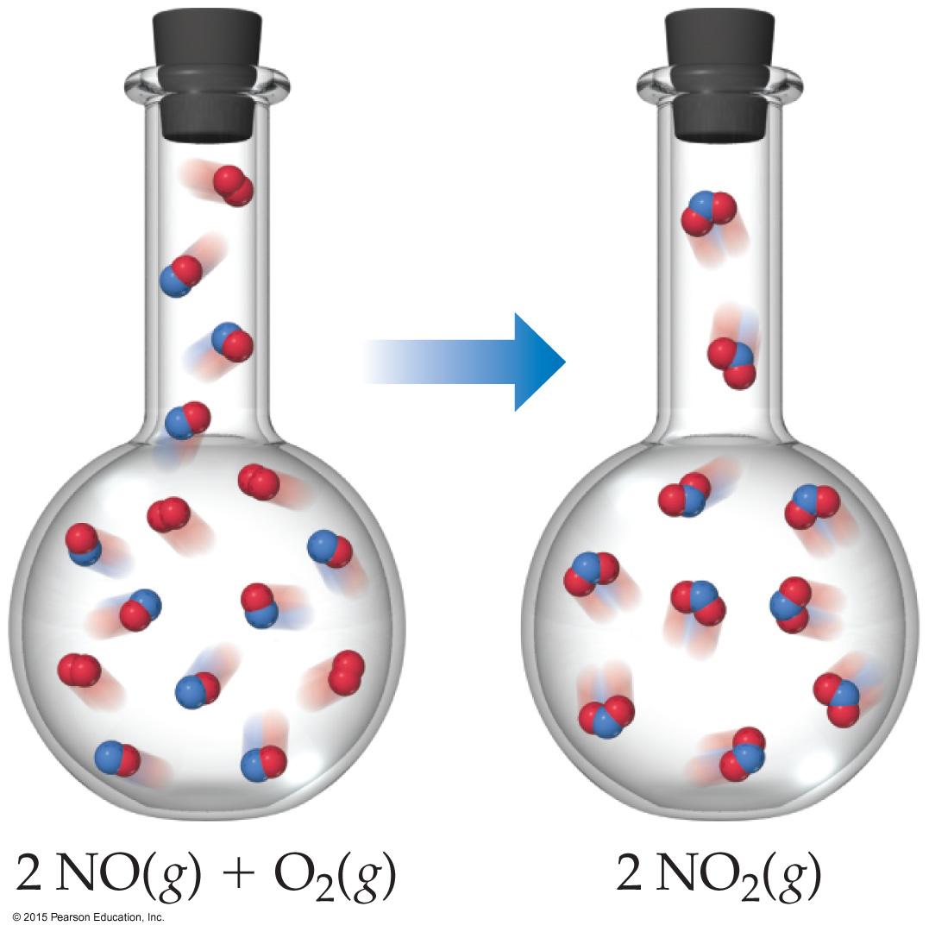
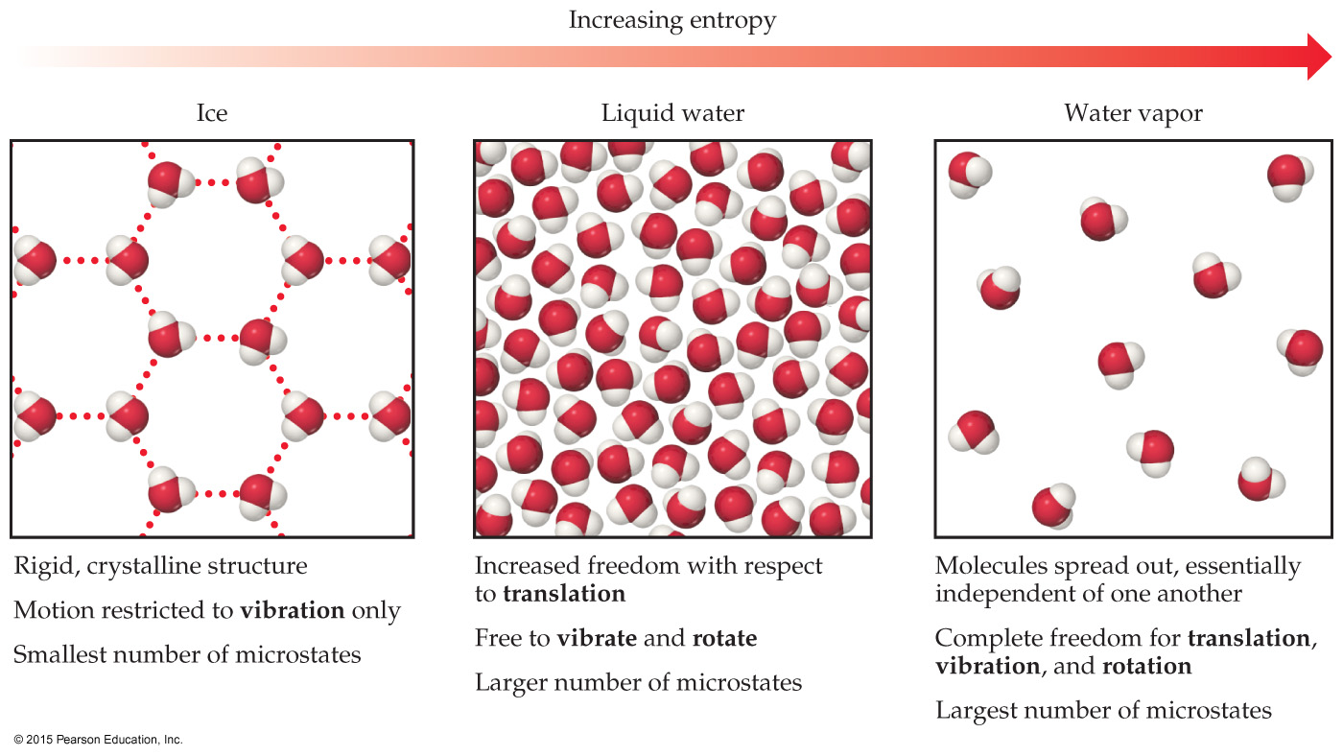
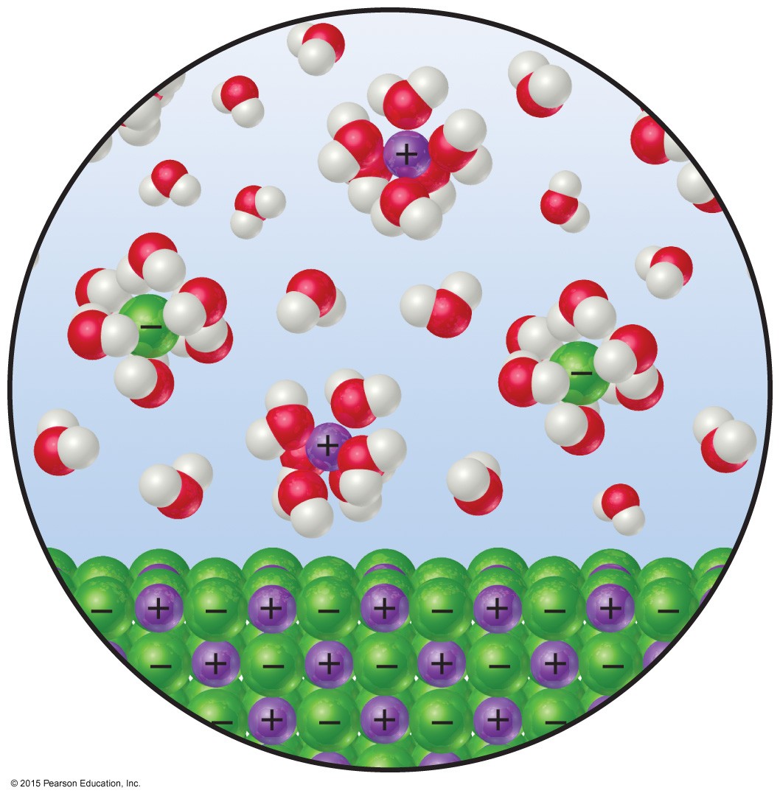
Entropy and Physical States
Entropy increases with the freedom of motion of molecules.
S(g) > S(l) > S(s)
Entropy of a system increases for processes where
gases form from either solids or liquids.
liquids or solutions form from solids.
the number of gas molecules increases during a chemical reaction.

Slide 17
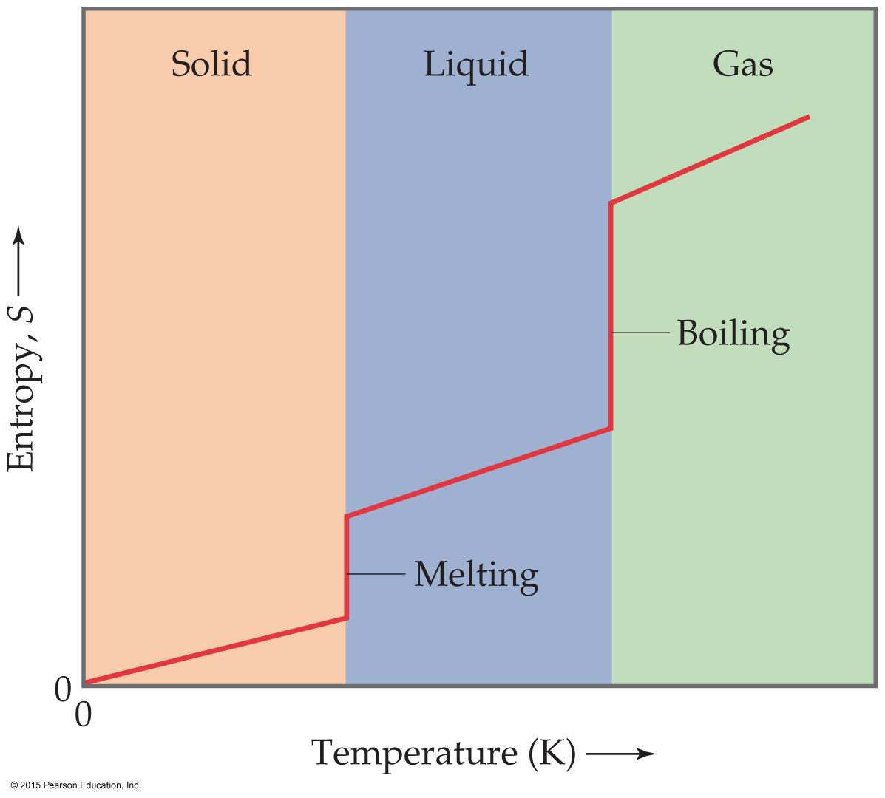
Third Law of Thermodynamics
The entropy of a pure crystalline substance at absolute zero is 0.
Consider all atoms or molecules in the perfect lattice at 0 K; there will only be one microstate.
S = k ln W = k ln 1 = 0

Slide 18
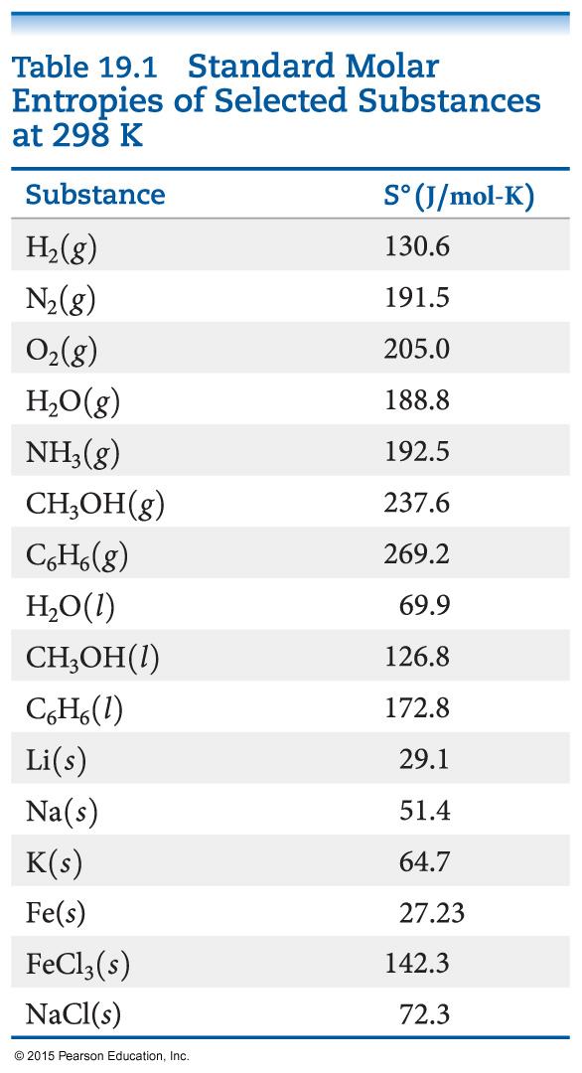
Standard Entropies
The reference for entropy is 0 K, so the values for elements are not 0 J/mol K at 298 K.
Standard molar enthalpy for gases are generally greater than liquids and solids. (Be careful of size!)
Standard entropies increase with molar mass.
Standard entropies increase with number of atoms in a formula.

Slide 19
Entropy Changes
Entropy changes for a reaction can be calculated in a manner analogous to that by which ΔH is calculated:
ΔS° = ΣnΔS°(products) – ΣmΔS°(reactants)
where n and m are the coefficients in the balanced chemical equation.

Slide 20


Entropy Changes in Surroundings
Heat that flows into or out of the system changes the entropy of the surroundings.
For an isothermal process
At constant pressure, q_{sys} is simply ΔH° for the system.

Slide 21
Entropy Change in the Universe
The universe is composed of the system and the surroundings.
Therefore,
ΔS_{universe} = ΔS_{system} + ΔS_{surroundings}
For spontaneous processes
ΔS_{universe} > 0

Slide 22
Total Entropy and Spontaneity
ΔS_{universe} = ΔS_{system} + ΔS_{surroundings}
Substitute for the entropy of the surroundings:
ΔS_{universe} = ΔS_{system} – ΔH_{system}/T
Multiply by −T:
−TΔS_{universe} = −TΔS_{system} + ΔH_{system}
Rearrange:
−TΔS_{universe} = ΔH_{system} − TΔS_{system}
Call −TΔS_{universe} the Gibbs Free Energy (ΔG):
ΔG = ΔH − T ΔS

Slide 23
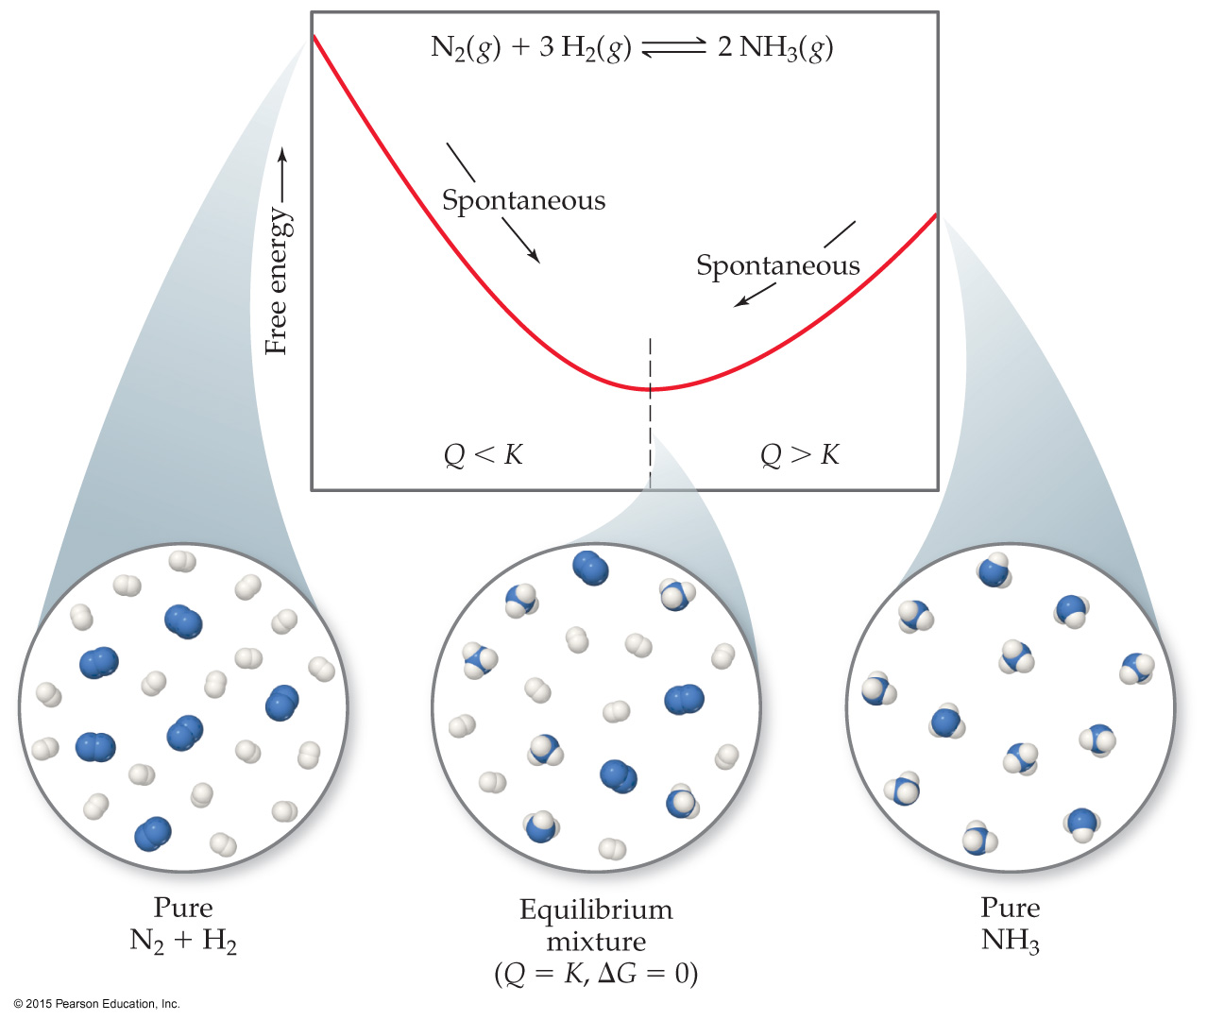
Gibbs Free Energy
If ΔG is negative, the forward reaction is spontaneous.
If ΔG is 0, the system is at equilibrium.
If ΔG is positive, the reaction is spontaneous in the reverse direction.

Slide 24
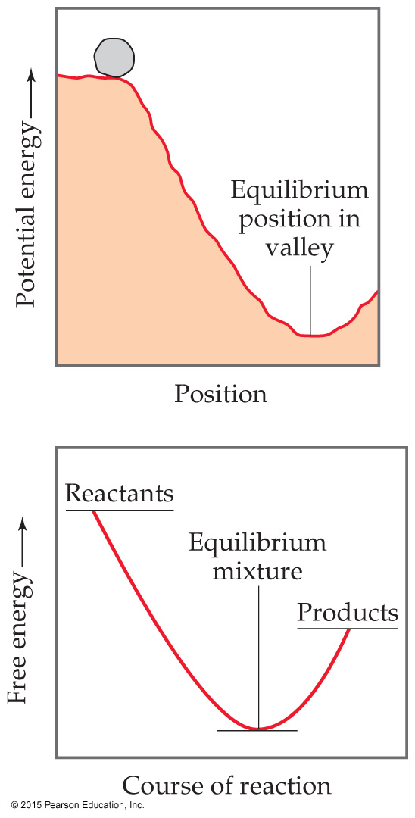
Standard Free Energy Changes
Analogous to standard enthalpies of formation are standard free energies of formation, ΔG_{f}°:
where n and m are the stoichiometric coefficients.

Slide 25
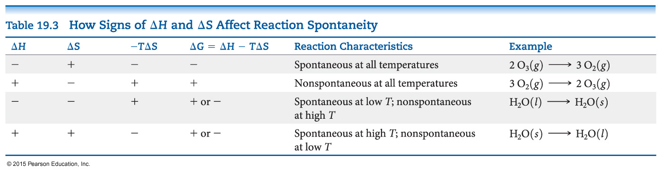
Free Energy Changes
How does ΔG change with temperature?
ΔG = ΔH – TΔS
Since reactions are spontaneous if ΔG < 0, the sign of enthalpy and entropy and the magnitude of the temperature matters to spontaneity.

Slide 26
Free Energy and Equilibrium
Under any conditions, standard or nonstandard, the free energy change can be found this way:
ΔG = ΔG° + RT ln Q
(Under standard conditions, concentrations are 1 M, so Q = 1 and ln Q = 0; the last term drops out.)

Slide 27
Free Energy and Equilibrium
At equilibrium, Q = K, and ΔG = 0.
The equation becomes
0 = ΔG° + RT ln K
Rearranging, this becomes
ΔG° = −RT ln K
or
K = e
−ΔG°/RT

