Slide 1
Module I Research Steps Lecture 9
Posing Questions
Initial steps to writing a well-researched essay II

Slide 2
Today’s agenda
Initial steps to essay writing
Identifying an essay topic/a phenomenon
Narrowing down the topic to a focused question
Researching the selected topic

Slide 3
Task 1 Topic evaluation
Please read the topics on your worksheet and identify the potential issues in these topics.
All the topics in one group have a shared issue.

Slide 4
Today’s agenda
Initial steps to essay writing
Identifying an essay topic/a phenomenon
Narrowing down the topic to a focused question
Researching the selected topic

Slide 5



Where do you start your (re)search?
Search engines?
Random webpages
Encyclopedia?
Wikipedia
Baidu Encyclopedia
These lower-quality sources effectively help you LOOK LAZY!

Slide 6
How and where to find high-quality sources?
Make your selected topic researchable
Try Google Scholar (scholar.google.com) for access to academic research and evaluate the quality of the sources
Try online databases available in your school library for more high-quality sources

Slide 7
Make your topic researchable
Maybe you have a topic, but you find it difficult to find relevant high-quality sources for it.
Look carefully at the way you have framed the topic. Make sure the key words are (re)searchable.
For example: Why are Chinese women less willing to give birth/have a baby?

Slide 8
Make your topic researchable
Demonstration: Why are Chinese women less willing to give birth/have a baby?
1. Extract key words for a Google search: Chinese women, willingness, give birth/have a baby
2. Browse relevant articles/reports in major newspapers/magazines/websites to find more formal/academic expressions for the topic: low/declining fertility rate, low birth rates…
3. Try Google Scholar with the revised topic: declining fertility rate in China
Notes:
https://scholar.google.com/

Slide 9
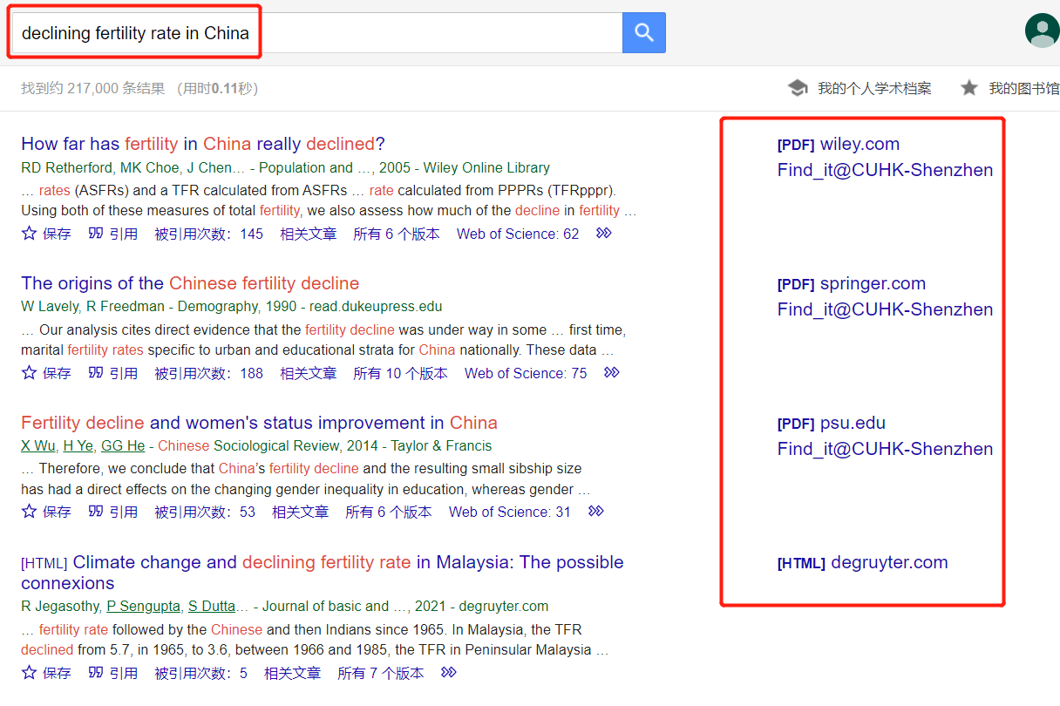

Slide 10
Is the source reliable?
Is it peer-reviewed?
For a source to be peer-reviewed, experts assess the merits of the paper before it is published, which ensures its quality.
Is the publisher reputable?
University and academic presses publish high-quality material that has been peer-reviewed.

Slide 11






Is the publisher reputable?
Some renowned university and academic presses

Slide 12









Slide 13







If you are using a website, make sure it is reputable.
Government, international organization or educational sites—ones that have URLs ending in .gov or .edu—are usually reputable.

Slide 14
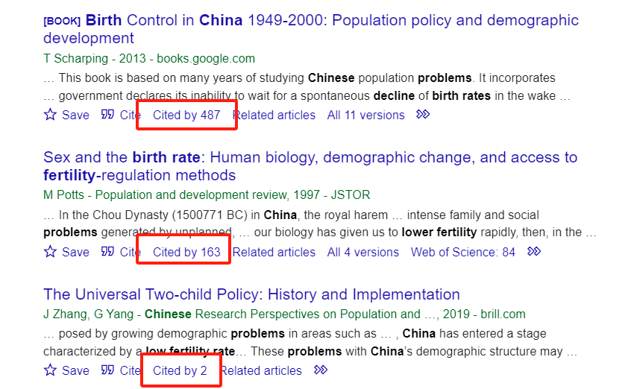
Is the source reliable?
Is it peer-reviewed?
Is the publisher reputable?
Is it cited by other researchers?

Slide 15


How to have a basic understanding of your topic?
Encyclopedias are highly recommended as a starting point for your research on a particular topic
Encyclopedia Britannica (Latin for "British Encyclopædia")– a more trustable encyclopedia
Notes:
https://www.britannica.com/

Slide 16
How to enter into a research conversation?
Try Google Scholar (scholar.google.com) for access to academic research.
Add words such as debate, disagreements, proponents, or opponents to your search terms
debates on the decreasing birth rate in China.
Another approach is to try using a journalist’s questions — Who? When? Where? What? Why? — to refine an online search: Why is birth rate decreasing in China?

Slide 17

How to find reputable sources?
Try online databases available in your school library for peer-reviewed scientific journal articles:
Scopus, EBSCO, Academic Search Premier, Web of Science, JSTOR, ScienceDirect…
Use “” for exact phrases
Use Boolean Operators (e.g., AND, OR, NOT, AND NOT)
For example: "low fertility rate" OR "low birth rate" AND Chinese OR China
Sort by “Relevance”
Notes:
NOTE: Don’t rule out an article just because it’s long. Read the abstract or the introductory paragraphs and the conclusion to see if the source is worth further investigation.

Slide 18
The hierarchy of sources (four tiers)
First-tier sources
Journal articles (esp. those published in reputable journals)
Books (esp. those from academic and university presses)
Government, international organization or educational sites, e.g., UN, WHO, WTO, ICRC, National Bureau of Statistics of China, Data.Gov.HK, U.S. Bureau of Economic Analysis (BEA), Bureau of Justice Statistics, etc.

Slide 19
Second-tier sources
Major newspapers (The New York Times, The Wall Street Journal, The Washington Post, China Daily, etc.) and magazines (Time, National Geographic, Health, Vogue, The New Yorker, Vanity Fair, etc.)
Interviews (esp. interviews published on reputable media)
PhD dissertations and MA theses

Slide 20
Third-tier sources
Online articles by authors of uncertain qualifications
Blog posts
Audio podcasts
Video podcasts
TED talks
…

Slide 21
Fourth-tier sources (banned in this course!)
Encyclopedia (Encyclopedia Britannica may be used very occasionally)
Dictionary entries (an effective way to be lazy)
Movies & songs (an effective way to be lazy)
Quotes by famous people (an effective way to be lazy)

Slide 22
How to manage your information
Maintain a working bibliography
Keep track of source materials (e.g. save function on Google Scholar)
Avoid unintentional plagiarism as you take notes

Slide 23
1. Maintain a working bibliography
Keep a record of any sources you read or view. This record, called a working bibliography, will help you compile the list of sources that will appear at the end of your paper.
Bibliography vs. References
A reference list is a detailed list of references that are cited in your work.
A bibliography is a detailed list of references cited in your work, plus the background readings or other material that you may have read, but not actually cited

Slide 24
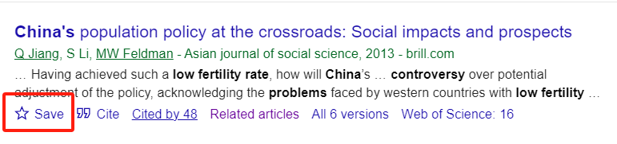
2. Keep track of source materials
The best way to keep track of source materials is to save a copy of each potential source as you conduct your research.
Use ‘save’ function in Google Scholar
You can highlight key passages, perhaps even color-coding them to reflect topics in your outline.
You can note down key ideas or your thoughts you while reading.
There are three kinds of note-taking:
summarizing
paraphrasing
direct quotation

Slide 25
3. Avoid unintentional plagiarism as you take notes
Be especially careful when using copy-and-paste functions in electronic files.
Be sure to keep track of the source materials and the exact page for all three types of notes; you will need the page numbers later if you use the information in your paper.
Finally, don’t forget to compare your use of a source in your paper with the actual source, not just with your notes.

Slide 26

Task 2
Take 8 minutes to research your selected topic using different methods and find at least three high-quality sources that are pertinent to your topic.
Note: You may refine your topic while researching it.

Slide 27
References
Hacker, D., & Sommers, N. (2013). The Bedford Handbook (9th ed.). Bedford/St.
Martin’s.
Hacker, D., & Sommers, N. (2017). The Bedford Handbook (10th ed.). Bedford/St.
Martin’s.

