Slide 1

Is it a must to use external sources (e.g., academic articles, books, statistics, and expert opinions) in our essay?

Slide 2
What sources can do for us?
Providing background information or context
Explaining terms or concepts
Providing evidence to support your position
Lending authority to your argument
Avoiding errors and inaccuracies in your argument
(Hacker & Sommers, 2013, p. 752)

Slide 3
Citing sources in APA Style
Module II Research steps I
Lecture 10

Slide 4
Contents
Citing your sources in the text and avoiding plagiarism
Integrating source material effectively
Documenting sources (APA reference list)

Slide 5
Why it is important to cite your sources properly
To avoid plagiarism
To tell readers where your information comes from
To give credit to the writers from whom you have borrowed words and ideas
To add to the credibility of your essay

Slide 6
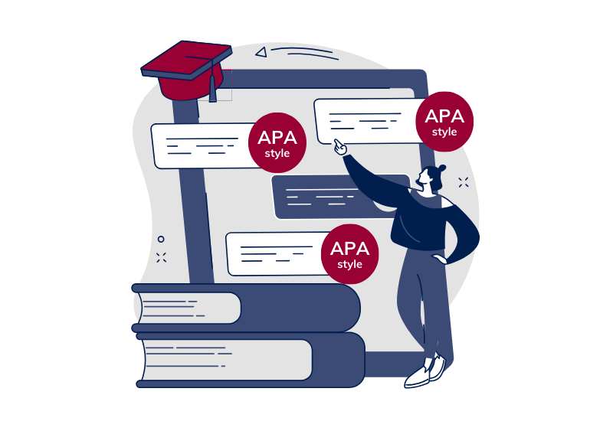

Different citation styles

Slide 7
Citation style in this course
APA style (APA: American Psychological Association)
Specifically, APA 7th edition is required.
Good online APA guides
Purdue OWL:
https://owl.purdue.edu/owl/research_and_citation/apa_style/apa_formatting_and_style_guide/general_format.html
APA website:
https://apastyle.apa.org/style-grammar-guidelines/references

Slide 8
Two essential parts of APA citation
In-Text Citation
End-of-Text Citation (References)
Brief notation of the source you're referencing in the body of your paper
Bell (2010) reported that students engaged in this kind of learning performed better on both project-based assessments and standardized tests (pp. 39–40).
More detailed list of your sources at the end of your work
Notes:
Source: https://guides.lib.uiowa.edu/citationhelp

Slide 9
In-Text Citation
APA 7

Slide 10
Four ways of using information in your in-text citation
Direct quotation
Paraphrasing
Summarizing
Synthesizing
What is the difference?
Which is a shorter version of the main points of a text, in your own words?
Which uses the exact words as someone else?
Which uses different words in the same amount of space?
Which one uses paraphrasing to combine ideas from more than one source?

Slide 11
Two most common ways of using information:
Direct quotation:
Paraphrasing:
same words in quotation marks “”
same idea but different words
APA parenthetical citation
APA narrative citation

Slide 12
Two types of APA in-text citation
APA parenthetical citation
E.g., A recent study of student plagiarism found that “plagiarism is often a matter of confusion rather than deception” (Horváth & Kovács, 2020, p. 4).
APA narrative citation
E.g., Horváth and Kovács (2020) argue that “plagiarism is often a matter of confusion rather than deception” (p. 4).

Slide 13
In-Text Citation: Direct Quotation
Direct Quotation: Using exactly the same words from another work.
What is important in learning a foreign language? According to Wilkins (1972), “While without grammar very little can be conveyed, without vocabulary nothing can be conveyed” (p. 111).
What is important in learning a foreign language? Wilkins (1972) claimed that “While without grammar very little can be conveyed, without vocabulary nothing can be conveyed” (p. 111).
Note: APA style allows either past or present tense for discussing the literature, so long as you are consistent.

Slide 14
In-Text Citation: Paraphrasing
Paraphrasing: Using your own words to restate an idea from another work.
What is important in learning a foreign language? According to Wilkins (1972), communication depends much more on vocabulary than on grammar (p. 111).
Note: including the page number is optional for paraphrasing but can be beneficial

Slide 15
Basic in-text citation styles
Author type | Parenthetical citation | Narrative citation
One author | (Rode, 2012) | Rode (2012) indicates…
Two authors | (Mayer & Rilke, 2019) | Mayer and Rilke (2019) suggest…
Three or more authors | (Smith et al., 2000) | As Smith et al. (2000) point out…
Group author with abbreviation (first citation) | (National Institute of Mental Health [NIMH], 2020) | Research by National Institute of Mental Health (NIMH, 2020) supports…
Group author with abbreviation (subsequent citations) | (NIMH, 2020) | NIMH (2020)
Notes:
Source: https://www.bibguru.com/c/apa-citation-generator/

Slide 16
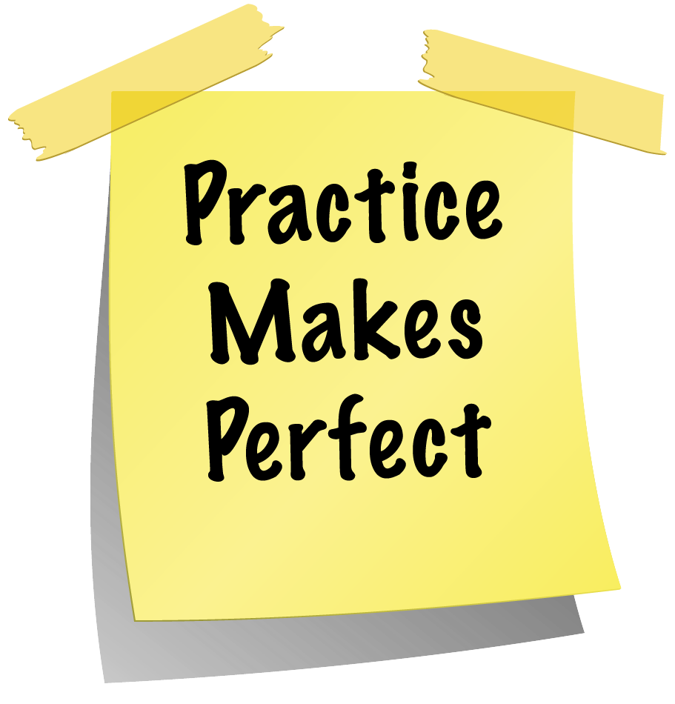
Task 1 Find and correct the errors in the following in-text citations

Slide 17
Part 1
(Sharin and Sotir 2016)
(Yeo, Poke, & McDonald 1998)
(Charman 2007)
(Smith 2009 p 7)
(Brown nd)
(White, 2005, p. 36-37)
(Turnbull cited in Shera 2003)
(Minogue 1968, Lopez 1971)
(Dickinson, 2009 & 2012)
(Copyright Act 1968)
Use APA Style Guide on BB as a reference

Slide 18
Part 1
(Sharin & Sotir, 2016)
(Yeo et al., 1998)
(Charman, 2007)
(Smith, 2009, p. 7)
(Brown, n.d.)
(White, 2005, pp. 36-37)
(Turnbull, 1998, as cited in Shera, 2003, p.#)
(Minogue, 1968; Lopez, 1971)
(Dickinson, 2009, 2012)
(Copyright Act, 1968)
Use APA Style Guide on BB as a reference

Slide 19
Part 2
According to Jones (1998), “students often had difficulty using APA style”.
According to Jones (1998), “students often had difficulty using APA style, especially when it was their first time (p.199).”
Jones found that “students often had difficulty using APA style” (1998, p. 199); what implications does this have for teachers?
She stated, “ Students often had difficulty using APA style,” (Jones, 1998, p. 199) but she did not offer an explanation as to why.

Slide 20
Part 2
According to Jones (1998), “students often had difficulty using APA style”.
According to Jones (1998), “students often had difficulty using APA style, especially when it was their first time (p.199).”
Jones found that “students often had difficulty using APA style” (1998, p. 199); what implications does this have for teachers?
She stated, “ Students often had difficulty using APA style,” (Jones, 1998, p. 199) but she did not offer an explanation as to why.

Slide 21
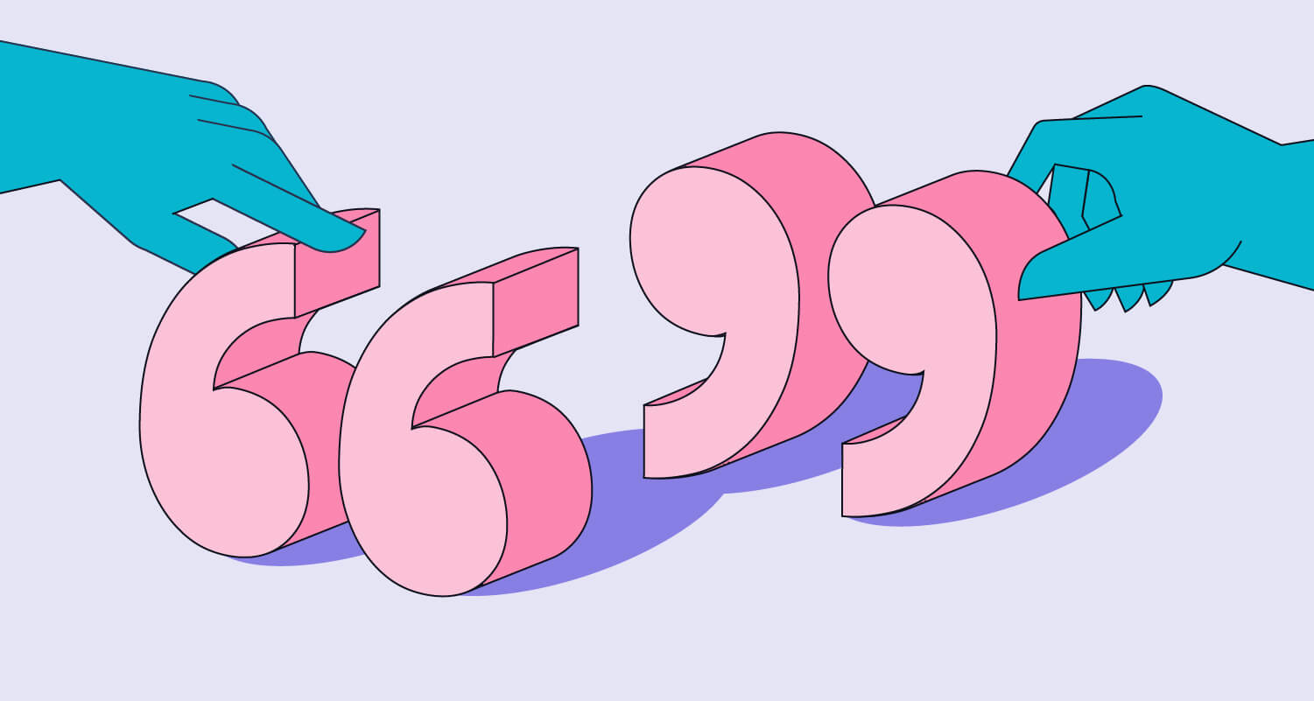
How to avoid plagiarism?

Slide 22
Understand what plagiarism is
Three different acts are considered plagiarism:
failing to cite quotations and borrowed ideas
failing to enclose borrowed language in quotation marks
failing to put summaries and paraphrases in your own words

Slide 23
How to avoid plagiarism?
1. Use quotation marks around borrowed language.
Original source
Student-centered learning, or student-centeredness, is a model which puts the student in the center of the learning process. —Çubukçu, Z. (2012, p. 50). “Teachers’ Evaluation of Student-Centered Learning Environments.”
Citation 1: According to Çubukçu (2012), student-centered learning … is a model which puts the student in the center of the learning process (p. 50).
plagiarism
Citation 2: According to Çubukçu (2012), “student-centered learning … is a model which puts the student in the center of the learning process” (p. 50).
Notes:
Citation 1 is plagiarism
Citation 2 is borrowed language in quotation marks

Slide 24
How to avoid plagiarism?
2. Put summaries and paraphrases in your own words.
A summary condenses information.
A paraphrase conveys the information using roughly the same number of words as in the original source.

Slide 25
Task 2 Please take a look at the following two paraphrases and tell me whether they are plagiarized.
Original Source:
Student-centered teaching focuses on the student. Decision-making, organization and content are determined for most by taking individual students’ needs and interests into consideration. Student-centered teaching provides opportunities to develop students’ skills of transferring knowledge to other situations, triggering retention, and adapting a high motivation for learning.
Source: Z. Çubukçu, “Teachers’ Evaluation of Student-Centered Learning Environments” (2012), p. 52

Slide 26
Paraphrase 1
According to Çubukçu (2012), this new model of teaching centers on the student. The organization and material of the course are chosen by considering the students’ needs and interests. Student-centered teaching gives a chance for students to develop useful skills of transferring knowledge to new situations, triggering retention, and keeping high motivation for learning (p. 52).
Paraphrase 2
Çubukçu’s (2012) research has documented the numerous benefits of student-centered teaching in putting the student at the center of teaching and learning. When students are given the option of deciding what they learn and how they learn, they are motivated to apply their learning to new settings and to retain the content of their learning (p. 52).

Slide 27
Task 2
Suggested paraphrase: Paraphrase 2
Çubukçu’s (2012) research has documented the numerous benefits of student-centered teaching in putting the student at the center of teaching and learning. When students are given the option of deciding what they learn and how they learn, they are motivated to apply their learning to new settings and to retain the content of their learning (p. 52).

Slide 28
Task 2 Can you paraphrase this paragraph using your own words?

Slide 29

How to integrate external sources into your writing

Slide 30
Integrating sources
Summarize the paraphrase effectively
Provide a context for the quotation and use signal phrases to introduce sources
Explain how the external source supports your argument or contributes to the discussion

Slide 31
Avoid “dropped quote”
What is a dropped quote?
A dropped quote is a quote from someone else that is placed in your writing, but it stands alone and is not introduced and not integrated into a sentence of your own.
It has no context, so it is difficult to understand.
It interrupts the flow of your writing, as the reader must jump abruptly from your words to someone else’s and back again.

Slide 32
Task 3. Please look at the following two paragraphs and tell me which one is better. What is the problem of the other one?
Paragraph 1
A number of journalists have been critical of genetic engineering. “The problem is, no one really knows the long-term effects of such complex genetic manipulation—and the potential dangers to humans and the environment are substantial” (Turner, 2022, p. 21).
Paragraph 2
A number of journalists have been critical of genetic engineering. Turner (2022) calls attention to the unpredictable nature of genetic engineering in her recent publication. She states, “The problem is, no one really knows the long-term effects of such complex genetic manipulation—and the potential dangers to humans and the environment are substantial” (p. 21).

Slide 33
Task 3 Please look at the following two paragraphs and tell me which one is better. What is the problem of the other one?
Paragraph 1
A number of journalists have been critical of genetic engineering. “The problem is, no one really knows the long-term effects of such complex genetic manipulation—and the potential dangers to humans and the environment are substantial” (Turner, 2022, p. 21).
Paragraph 2
A number of journalists have been critical of genetic engineering. Turner (2022) calls attention to the unpredictable nature of genetic engineering in her recent publication. She states, “The problem is, no one really knows the long-term effects of such complex genetic manipulation—and the potential dangers to humans and the environment are substantial” (p. 21).
Dropped quote
Integrated quote

Slide 34
Bibliography
Hacker, D., & Sommers, N. (2013). The Bedford Handbook (9th ed.). Bedford/St. Martin’s.
Purdue OWL. (n.d.). General Format. https://owl.purdue.edu/owl/research_and_citation/apa_style/apa_formatting_and_style_guide/general_format.html
American Psychological Association. (2022). APA Style common reference examples guide. https://apastyle.apa.org/instructional-aids/reference-examples.pdf

Slide 35
Resources
Citation Help Guide A comprehensive guide to citing sources. A great place to start!
Purdue OWL The Online Writing Lab (OWL) at Purdue University houses writing resources and instructional material, and we provide these as a free service of the Writing Lab at Purdue. Students, members of the community, and users worldwide will find information to assist with many writing projects. Teachers and trainers may use this material for in-class and out-of-class instruction.
Zotero [zoh-TAIR-oh] is a free, easy-to-use tool to help you collect, organize, cite, and share your research sources. It lives right where you do your work—in the web browser itself.
Notes:
Credit to: https://guides.lib.uiowa.edu/c.php?g=385221&p=2612009

