Slide 1

ENG1002 English for Academic Purposes 1
Writing Workshop
April 29/30, 2024

Slide 2

Agenda
Common writing issues: Cause/Effect Essay
Common organization issues
Common logic issues
Common language issues
Common formatting issues in citations

Slide 3
Common organization issues
Lack of a clear thesis statement (with main points listed)
Lack of a topic sentence in each paragraph
Body paragraphs do not correspond to the thesis statement
Lack of paragraph unity and coherence within paragraphs

Slide 4
Task 1 Thesis statement
Please look at the following thesis statements and discuss the following questions:
Which ones are good thesis statements?
Any suggestions to improve the underdeveloped ones?

Slide 5
Task 1 Thesis statement
In the following article, I will explore the impact of divorce on children from three aspects.
Nowadays, China has stepped into the aging of its population. There are several main reasons for population aging.
Mental health problems can cause many negative effects.

Slide 6
Task 1 Thesis statement
The rise of self-media has brought an influx of content to the news industry and increased the interactivity of information, contributing to its prosperity. However, it has also led to a more complex and confusing speech environment.
The popularity of short videos can be attributed to several factors, including personalized content, a fast-paced and stressful lifestyle, and advanced technological support.
This essay will discuss the manifold effects of AI on students’ studies, encompassing alleviating the heavy workload of educators, facilitating personalized learning for students, impacting the quality of assignments, and potentially diminishing students' ability for independent thinking.

Slide 7
Task 2 Paragraph organization
Please read the following two paragraphs on the causes of the rise in popularity of mindfulness (meditation) and discuss the following questions:
Is there a topic sentence in each paragraph?
Do all the sentences support the topic sentence？
Are all the sentences clearly related to each other?

Slide 8
Topic: Causes of the rise in popularity of mindfulness (meditation)
Regular meditation can relieve your pain. You are able to reach inner peace through meditation, so you will feel your pain vanish unconsciously. In addition, the impact of mindfulness on pain relief is considerable. In Zedian and Vago’s findings, they claim that “Mindfulness meditation is a technique that has been found to significantly reduce pain in experimental and clinical settings.” Many people also use mindfulness to improve their sleeping quality. Sleeping quantity and quality is a problem that troubles people of all ages, especially seniors. According to Camino and his colleagues (Camino et al., 2022), mindfulness-based therapy effectively treats older people’s insomnia.
A person with daily meditation habits will likely form many positive changes in self-awareness. In recent years, there has been a significant advancement in meditation research related to concentration improvement. In other words, if you have your mindful set, you gain the opportunity to lengthen your attention span and know yourself better. Even a brief mindful training can promote students’ attention. Krumholz et al. (2003) found that a four-week basis of mindfulness for graduate students can promote their concentration significantly.

Slide 9
Topic: Causes of the rise in popularity of mindfulness (meditation)
Regular meditation can relieve your pain. You are able to reach inner peace through meditation, so you will feel your pain vanish unconsciously. In Zedian and Vago’s findings, they claim that “Mindfulness meditation is a technique that has been found to significantly reduce pain in experimental and clinical settings.” Many people also use mindfulness to improve their sleeping quality. Sleeping quantity and quality is a problem that troubles people of all ages, especially seniors. According to Camino and his colleagues (Camino et al., 2022), mindfulness-based therapy effectively treats older people’s insomnia.

Slide 10
Topic: Causes of the rise in popularity of mindfulness (meditation)
A person with daily meditation habits will likely form many positive changes in self-awareness. In recent years, there has been a significant advancement in meditation research related to concentration improvement. In other words, if you have your mindful set, you gain the opportunity to lengthen your attention span and know yourself better. Even a brief mindful training can promote students’ attention. Krumholz et al. (2003) found that a four-week basis of mindfulness for graduate students can promote their concentration significantly.

Slide 11
Unity and Coherence
Unity
In order for a paragraph to maintain a sense of unity, the paragraph must focus solely on a single idea, point, or argument that is being discussed.
Coherence
After presenting your main idea in your topic sentence, each sentence following must build upon each other in an organized manner.
Coherent writing is easy to read and has logical links between the various points made.

Slide 12
Task 3 Logic issues
Please go through the following sentences and identify the logic issues in those sentences.
Ad populum
False cause
Hasty generalization/Stereotype
Circular arguments
Slippery slope

Slide 13
Task 3 Logic issues
Chinese people are not willing to spend much time on football or even sports.
One main reason for the public’s mistaken impression of feminism is the common misconception of it.
Through this research, it can be seen that in 2014, the number of people who did not believe in the safety of online payment was greater than the number of people who believed in its safety, but online payment still became popular after a few years, which shows that online payment is indeed safe.
Eating more vegetables can decrease the consumption of land and water resources, and reduce greenhouse gas emissions, therefore if everyone was a vegetarian we would solve the climate crisis.

Slide 14
Task 3 Logic issues
Chinese people regard humans and nature as a harmonious whole, but Americans think about nature with a mastery-over-nature worldview.
People will evaluate all options before making choices. However, some people over-analyze each option. They waste much time and energy on making decisions, so they are more likely to regret their decision.
Different skin colors generally have different kinds of personalities. East Asians are more calm than other races. Europeans are more open and aggressive. Africans are more direct and passionate. Those basic differences often result in some conflict between the races.

Slide 15

Common language issues
Fragment
Run-on
Word choice
Word use
Word form
(e.g., noun vs. verb, -ing vs. -ed, -ic vs -ical)
Preposition
Articles
Absolute
Wordiness

Slide 16
Task 4 Language issues
1. Look at the sentences on your worksheet and identify the issue(s) in each sentence.
2. Provide suggestions on how to make them better.

Slide 17
Run-on sentences
ChatGPT has a vast database and powerful language processing capabilities, it can understand students’ queries and provide them with a wide range of learning resources.
Social media will immediately dominate the market in these areas because they have numerous users, meanwhile, these functions will appeal to new users and consolidate their place.
Additionally, some testing websites would even give out what other famous people share the same type of MBTI with you, for example, if one’s result is INTJ, you will be told that you share the same personality with Isaac Newton.
Nothing can stop us from moving forward, eventually we will live the life we want.
These two don’t share any connection on the surface, however, this cause-and-effect relationship is common in real life.

Slide 18
Fragments
As more and more people are skipping breakfast nowadays.
Because self-respect is significant for others too.
Whereas in 2015, the shift in trend shows that the percentage of pro-internet censorship respondents dwindled to 42.70% (Wang & Mark, 2015).
In conclusion, these three reasons why multiple commercial advertisements have negative effects such as time consumption, fake information and consumerism on the society.

Slide 19
Word choice/use issues
A research has shown that children of divorced parents are more likely to drop out of school and have lower levels of educational attainment than children from intact families (Lee & Bean, 2010).
On one hand, adolescents are more likely to play video games than people of other ages (Király et al., 2022). On the other hand, adolescents can get addicted to online games more easily.
Some people believe that technology is isolating us from one another. Take social media as an example, we can connect with people from all over the world on social media.

Slide 20
Absolutes
To sum up, growing popularity of camping is a result of COVID-19.
They could even place an order at 1 a.m. on a freezing winter night while lying in their warm and cozy bed. In other words, all factors that may hinder consumers from spending money have disappeared.
Every college student has experienced anxiety as a result of worrying about their GPA.
Censorship always damages the public discourse.
All food, even if it's fast food, naturally allows us to enjoy ourselves.

Slide 21
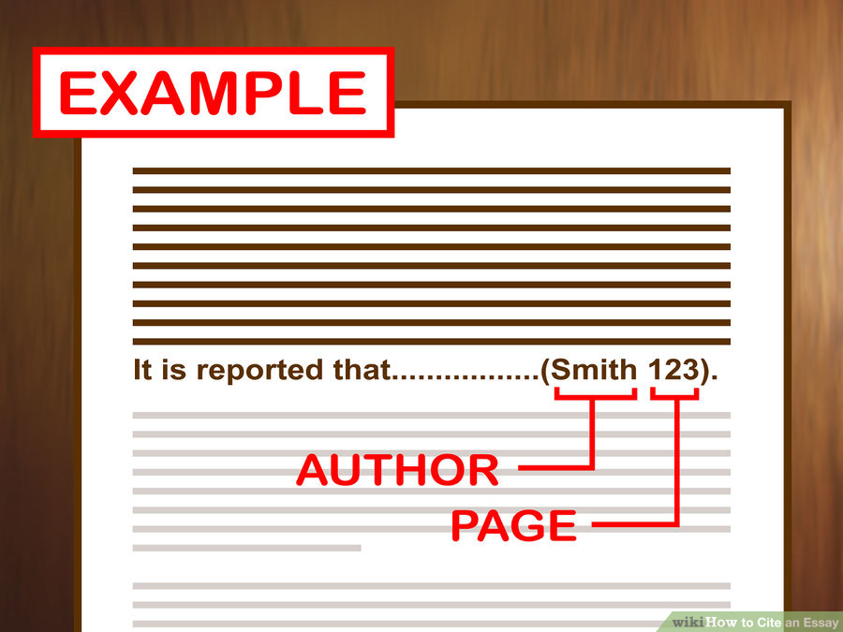
Task 5 Citation issues: In-text citations
Please go through the following three in-text citations and identify the formatting issues.

Slide 22
Task 5 Citation issues: In-text citations
In a study conducted by Zhang, Li, and Deng(2020) of 1274 college students in Beijing, “91.8% of the students had experience in takeout food consumption. However, as a new way of dining, takeout food is different from traditional food”.
As claimed by Gillespie, algorithms delimit the boundaries of knowledge and cognition (2014).

Slide 23
Task 5 Citation issues: In-text citations
3. “According to a Chinese Academy of Social Sciences report, released in September last year, 93.67 percent of elderly netizens view using the internet as an integral part of daily life, with 17.25 percent of them admitting they had been victims of online frauds involving the sale of healthcare and financial products (Yang, F. and Zheng, J., 2022, p. 67-68).”

Slide 24

Task 6 Citation issues: Reference list
Please go through the reference list on your worksheet and identify the formatting issues.

Slide 25
The miscellaneous
Use of long quotes (more than 40 words)
Use of abbreviation
Use of a single space AFTER each of your punctuation mark
Use of consistent point-of-view (POV)

Slide 26
Inconsistent point-of-view (POV)
One of the most common reasons people attempt mindfulness is that they find it fruitful in anxiety reduction and pain relief. Proper and regular mindfulness can improve your emotional health.
In conclusion, social media has exerted a profound influence on our lives. It enables people to interact with others at great distances and thus has become a favorite means of entertainment for people around the world.
Compared to the traditional methods, the characteristics of low cost and accessibility allow everyone to have the opportunity to voice their opinions and your posts can be read by everyone.

Slide 27
Inconsistent point-of-view (POV)
One of the most common reasons people attempt mindfulness is that they find it fruitful in anxiety reduction and pain relief. Proper and regular mindfulness can improve your emotional health.
In conclusion, social media has exerted a profound influence on our lives. It enables people to interact with others at great distances and thus has become a favorite means of entertainment for people around the world.
Compared to the traditional methods, the characteristics of low cost and accessibility allow everyone to have the opportunity to voice their opinions and your posts can be read by everyone.

Slide 28
Argument Essay
Your essay is due on either Wednesday, May 8th (L25&26)
or Thursday, May 9th (L27&28), before your class time.
Your essay should be 900 to 1200 words (not including the reference page).
use at least four high-quality English-language sources
Use at least one direct quotation and three paraphrases of sources in your text.
Remember, I want to see your work, not ChatGPT’s.

Slide 29


