Slide 1
ENG1002 English for Academic Purposes 1 (EAP 1)
Lecture 1
Introduction
January 8/9, 2024

Slide 2


Introduction
Instructor: Dr. Wang Qian (Bobbie)
Contact info.: wangqian@cuhk.edu.cn
WeChat: bobbie-wang
Office: TB527
Office hours: Tue/Thu 9:30-11:30 am
Some facts about me:
I enjoy good food, reading, traveling, spending time with students
I love kids and dogs and appreciate all beautiful things.

Slide 3
Agenda
Introduction of the course syllabus and schedule
Syllabus quiz
Goal setting and action planning
Join in the Class WeChat group

Slide 4
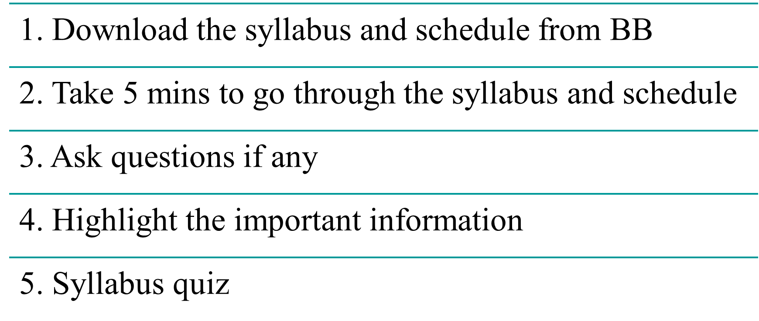
Introduction of the course syllabus and schedule

Slide 5
Syllabus Quiz
Part 1 True/ False
F
1. Attendance is worth 10 percent of your final grade.
2. Attendance will be taken at the end of each class session.
3. Anyone not present on time will not be allowed to enter the classroom.
4. All assignments are due at the end of class.
5. Late work is not accepted.
6. Students don’t need to print their assignments and submit the physical copy.
F
F
F
F
T

Slide 6
Syllabus Quiz
Part 2 Short answers
1. How many presentations do you need to do this semester?
2. Where are the assignment due dates located?
3. Where can you find the formatting requirements?
4. How can you submit your written assignments?
5. How will the instructor give you the participation scores?
6. How many articles/videos should you read/watch per week?
7. Where can you find the reading and listening materials?
8. What happens if a student plagiarizes or uses AI tools to write?

Slide 7
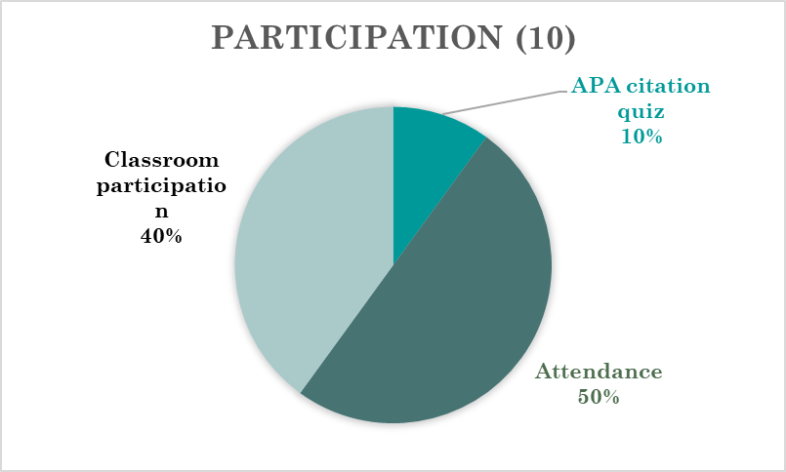
How the participation score is calculated
Attendance (full) = 5 (absence without reasonable explanation -1, late arrival*3 -1)
Classroom participation = 4 (students' contributions to class discussions and activities)
APA citation and reference quiz = 1

Slide 8
Goal setting and action planning: SMART framework
A goal without a plan is just a wish. - Antoine de Saint-Exupéry
Do you set goals for yourself, either in your personal life or during your time in college?
How do you go about setting your goals? Do you have a specific process or technique such as writing your goals down?
What is an English language learning goal you would like to achieve?

Slide 9

Goal setting and action planning

Slide 10
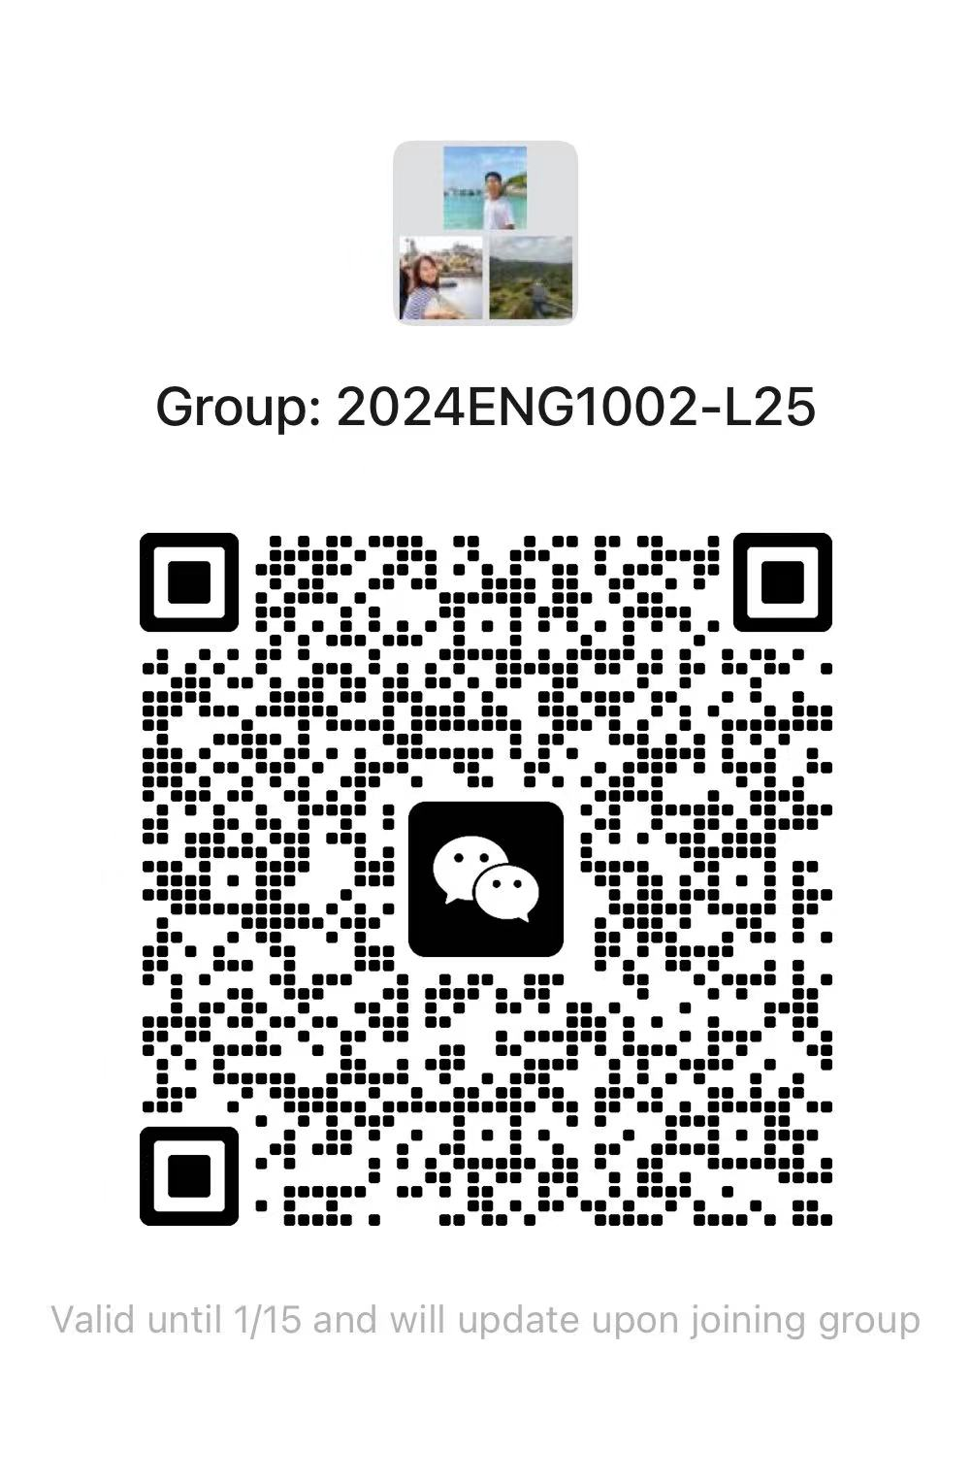
Class WeChat group-L25

Slide 11
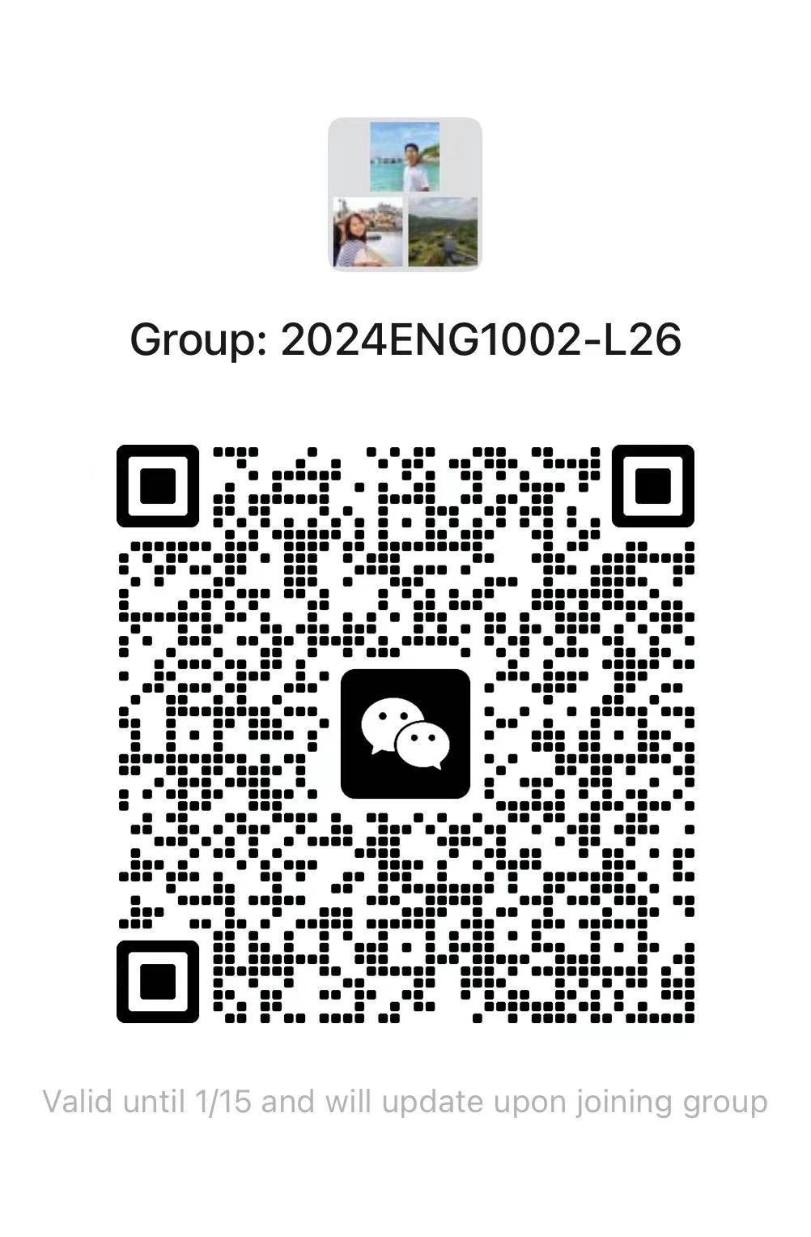
Class WeChat group-L26

Slide 12
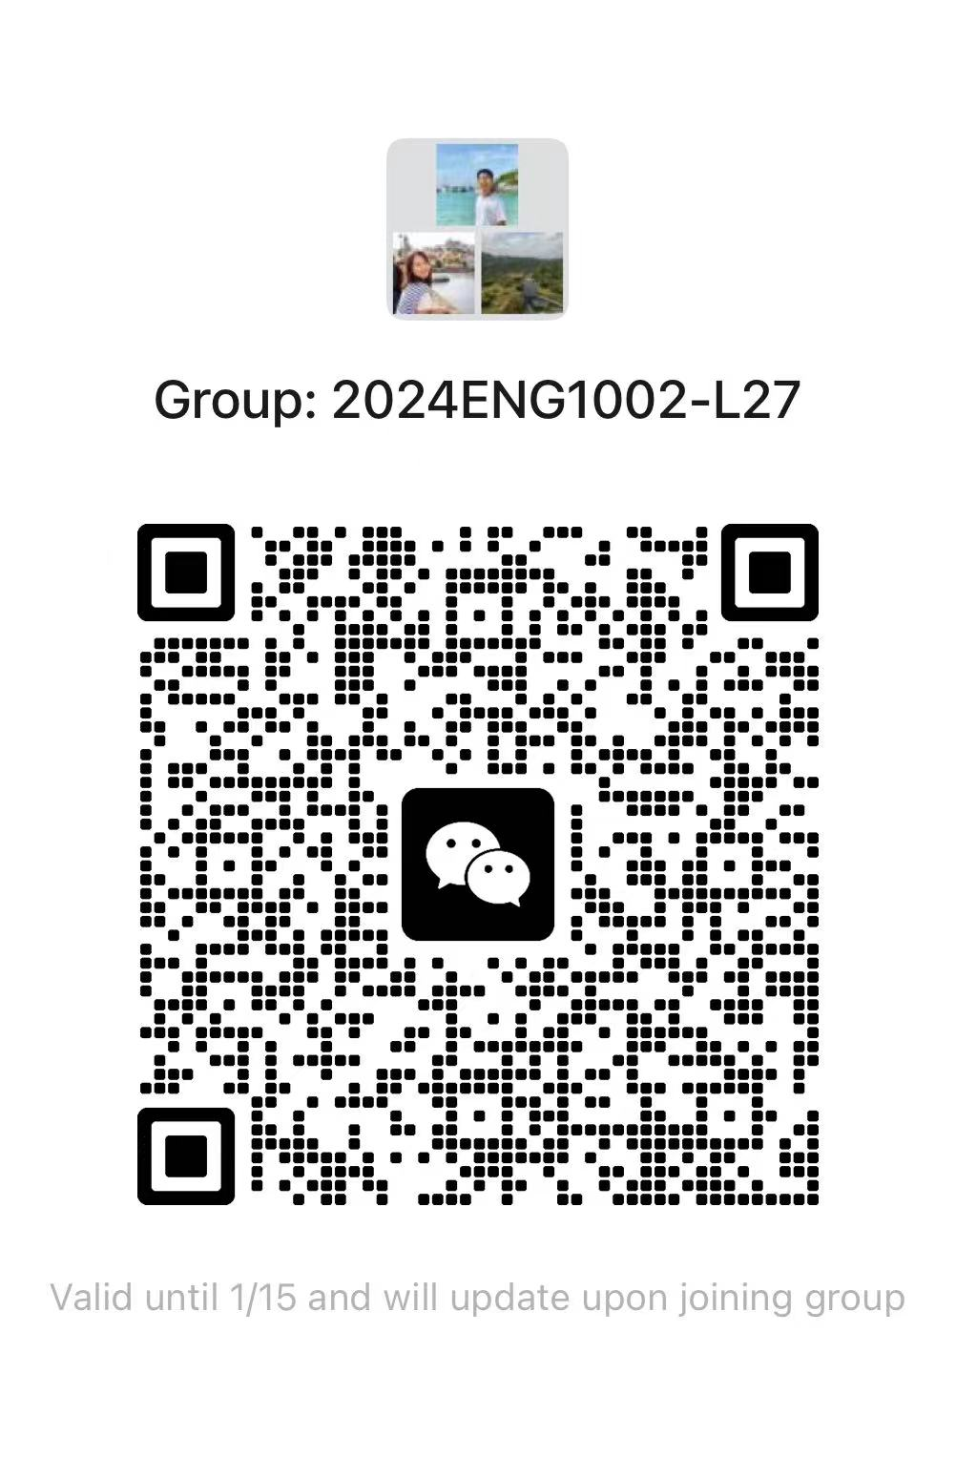
Class WeChat group-L27

Slide 13
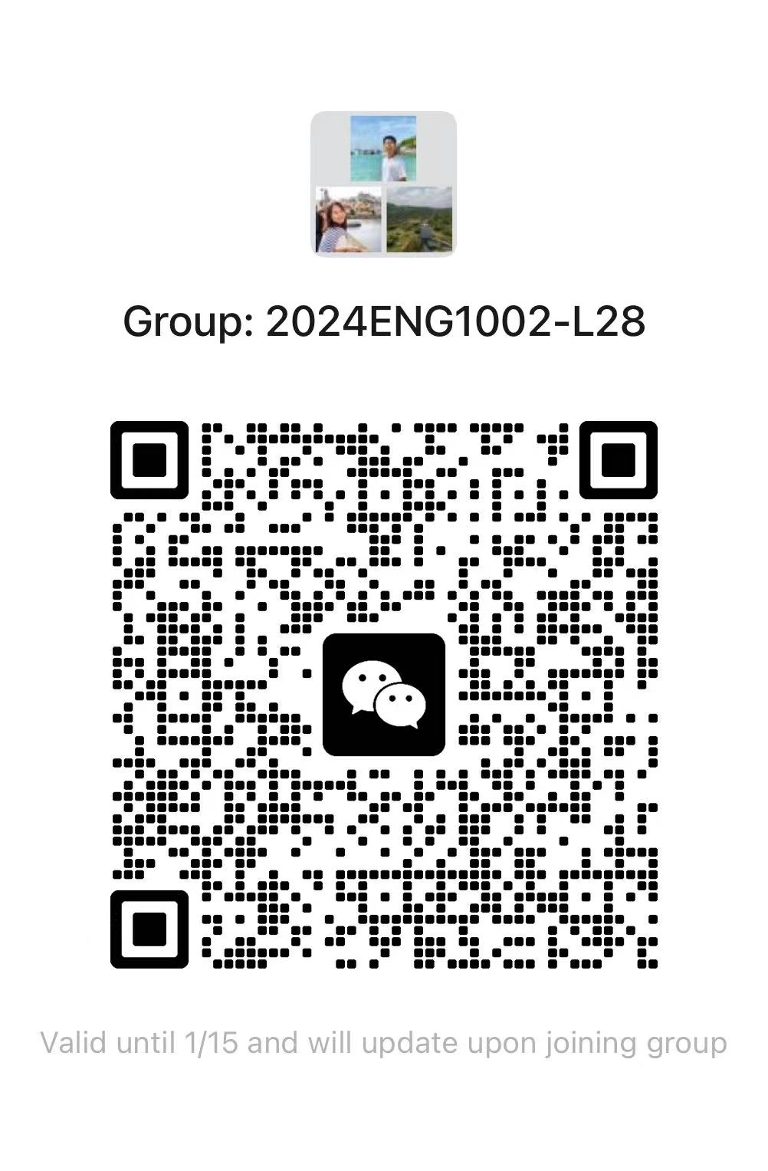
Class WeChat group-L28

Slide 14

Any questions?

