Slide 1
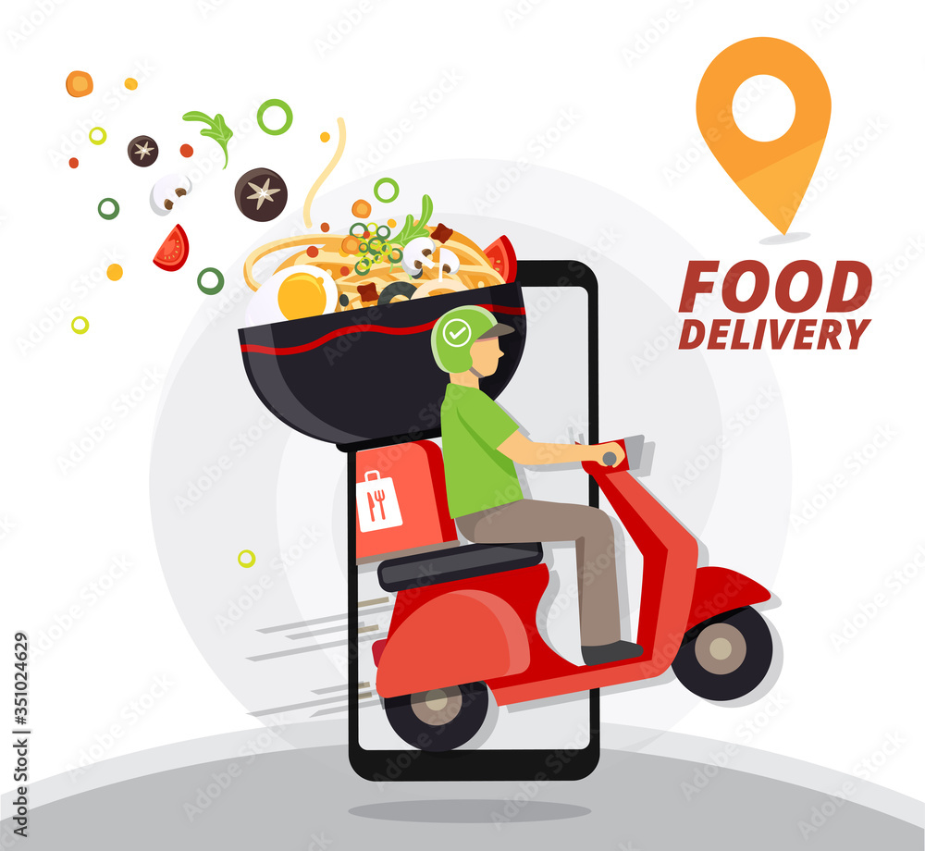
Meal Delivery
Optimization Model
DS 852
Presented By:
Durga Naga Padmasree Sappa

Slide 2
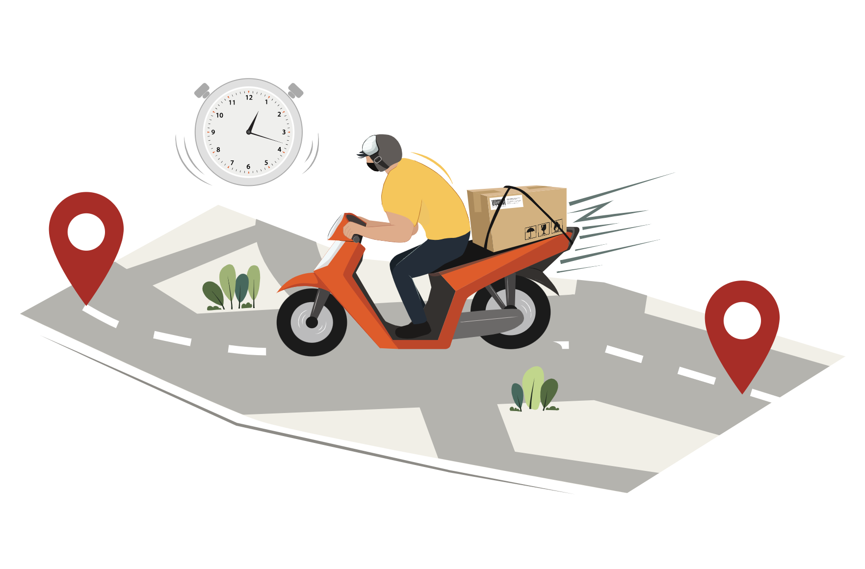
Introduction
Delivery speed is critical to customer satisfaction.
Operational challenges: traffic, weather, courier availability.
We built the Meal Delivery Optimization Model (MDOM).
Project Objective:
Uses Excel Solver for intelligent courier-order assignments by minimizing total delivery time
Notes:
Meal delivery services are under constant pressure to be fast, accurate, and consistent. Customers expect their meals to arrive hot and on time, and any delays can lead to complaints or lost business. On the operations side, companies face challenges like managing traffic, weather, and different courier speeds — all while trying to keep costs down and workloads fair. Our solution is the Meal Delivery Optimization Model, or MDOM. It uses Excel Solver to make smart, data-driven courier assignments. Rather than relying on guesswork or random matching, the model considers real-world factors to assign the best courier to each order, improving speed and overall service reliability.

Slide 3




Problem Context
Random assignments lead to:
  Delays
  High costs
  Unfair workloads
Real-world example: motorcycle vs scooter in traffic.
MDOM chooses the best courier using speed, traffic, speed, weather and distance.
Notes:
One of the main problems in meal delivery is how couriers are assigned to orders. Without a proper system, it’s easy to end up with inefficient matches. For example, if you assign a slower scooter to a distant customer while a faster motorcycle is available, delivery times increase. That hurts customer satisfaction and adds cost. Random or manual assignments often result in unfair workloads too, with some couriers overburdened while others sit idle. MDOM fixes this by evaluating courier characteristics like speed, traffic, weather, and distance for every order — choosing the most efficient pairing to reduce delays and balance the work more effectively.

Slide 4
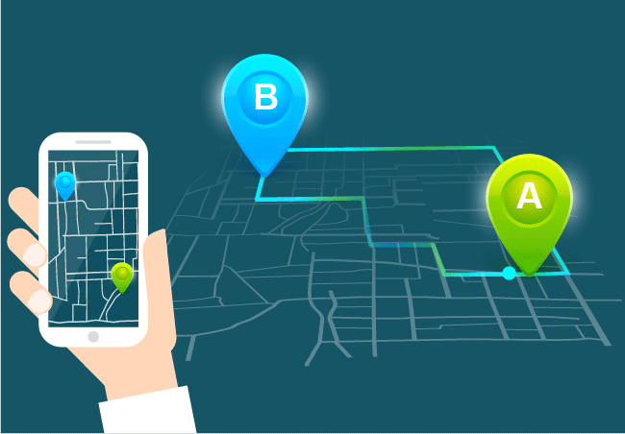
Scope and Objectives
Minimize total delivery time.
Assign each order once.
Balance workloads across couriers.
Account for traffic, weather, and courier speed.
Notes:
We focused on four main goals for this model. First, we wanted to minimize total delivery time across all orders by selecting the best courier-order combinations. Second, the model ensures that every order is assigned exactly once — no overlaps or missing deliveries. Third, it balances workloads, so that no one courier is overwhelmed while others have nothing to do. Finally, we wanted the model to be grounded in real-world operating conditions — that means accounting for traffic congestion, vehicle types, and even weather disruptions. These objectives make the model not just theoretically sound, but actually useful in day-to-day operations.

Slide 5


Inputs &
Data Preparation
Inputs: order details, locations, courier info, traffic, weather, timing.
Cleaning steps:
  Remove missing/duplicate/outlier data.
  Validate courier age and rating.
  Standardize text fields for formulas.
Result: High-quality dataset for reliable optimization.
Notes:
The effectiveness of MDOM depends on having good, clean data. We started with a dataset from real delivery operations — including details like order locations, restaurant coordinates, courier ratings, vehicle types, and even traffic and weather conditions. Then, we cleaned the data carefully. We removed incomplete records, dropped duplicates, filtered out unrealistic entries like 200-minute deliveries, and standardized text fields. We also kept only couriers aged 18–65 with ratings above 3.9. The result was a clean, reliable dataset that Solver could work with. This ensured the model wouldn’t crash or produce strange results — just smart, efficient courier assignments.

Slide 6

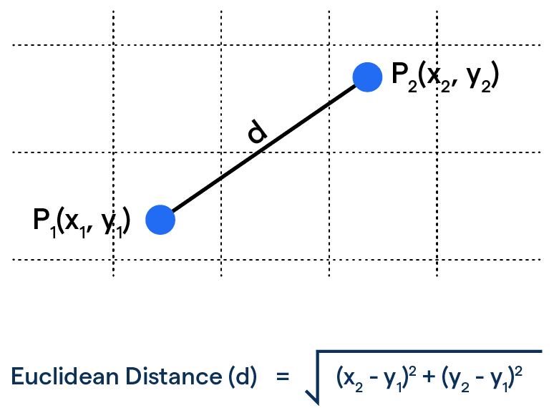
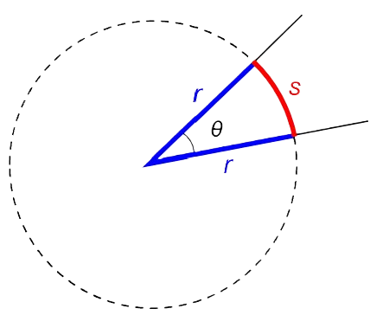
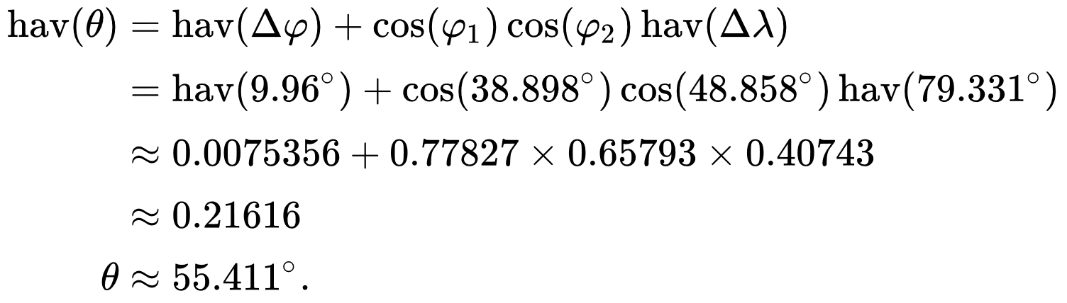
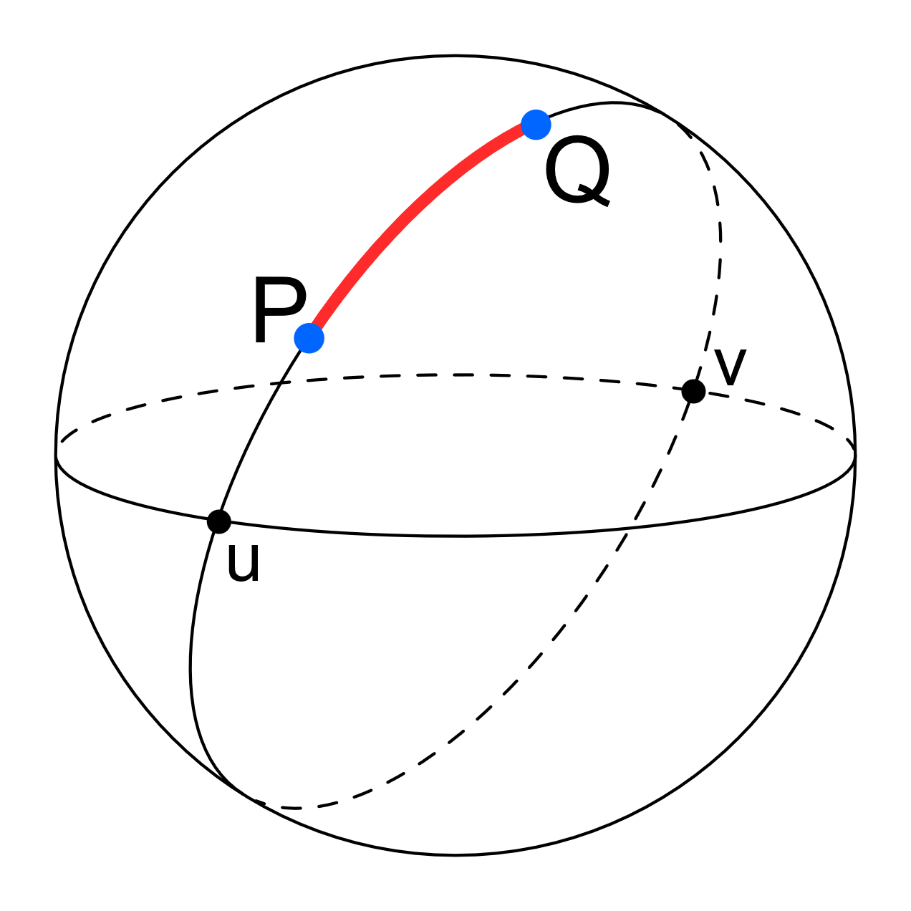
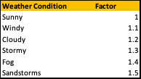



Feature Engineering for Inputs
1
Delivery Distance
Haversine Formula (The Great-circle Distance)
A
ϕ1​ (phi 1) Latitude of the first point
λ1 (lambda 1) Longitude of the first point
ϕ2 (phi 2) Latitude of the second point
λ2 (lambda 2) Longitude of the second point
B
D = (θ × π/180 ) × Earth's Radius
where Earth's Radius = 6,371.2 km
π approximately 3.14159
2
Estimated Delivery Time
Delivery Time
=
Weather Factor
Delivery Distance
Preparation Time
Delivery Time
Traffic Factor
Average Adjusted Velocity

Slide 7
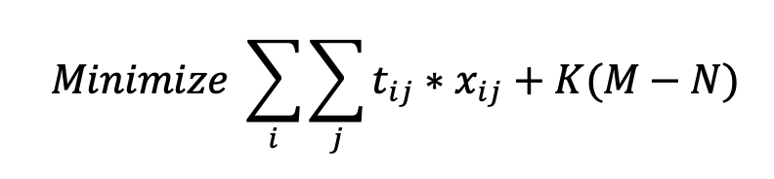
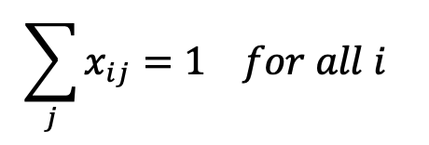
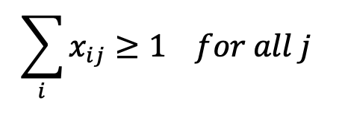
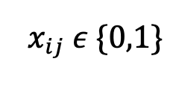
Model Mathematical Formulation and Logic
Objective Function
Delivery Time
Penalty Time
Where
t_{ij} = estimated delivery time for order i by courier j
Decision Variables
Constraints
Penalty Factor
X_{ij} = 1 if courier j is assigned to deliver order i; 0 otherwise
Order Assignment
K = Penalty Time Factor
2. Order Load
M = maximum number of deliveries per courier
N = minimum number of deliveries per courier
3.

Slide 8
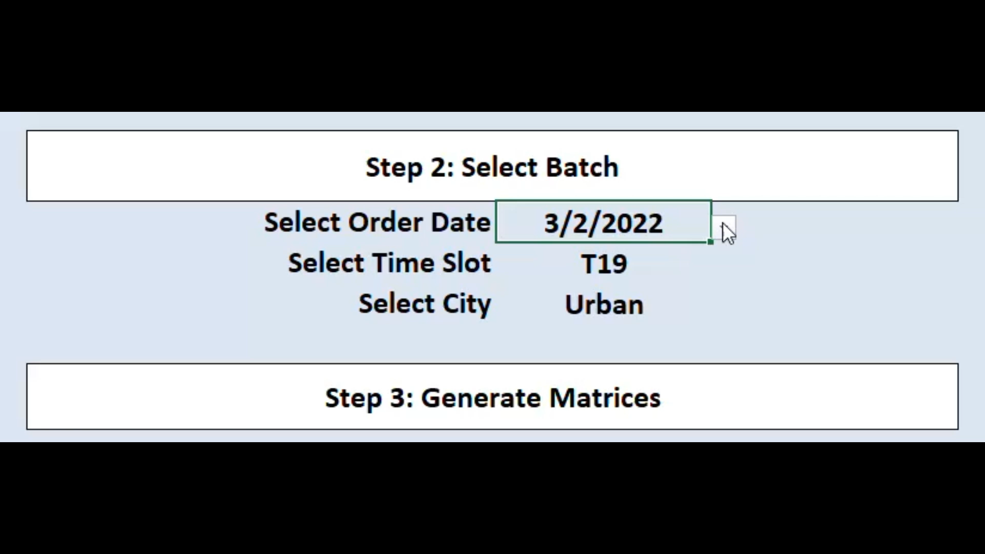
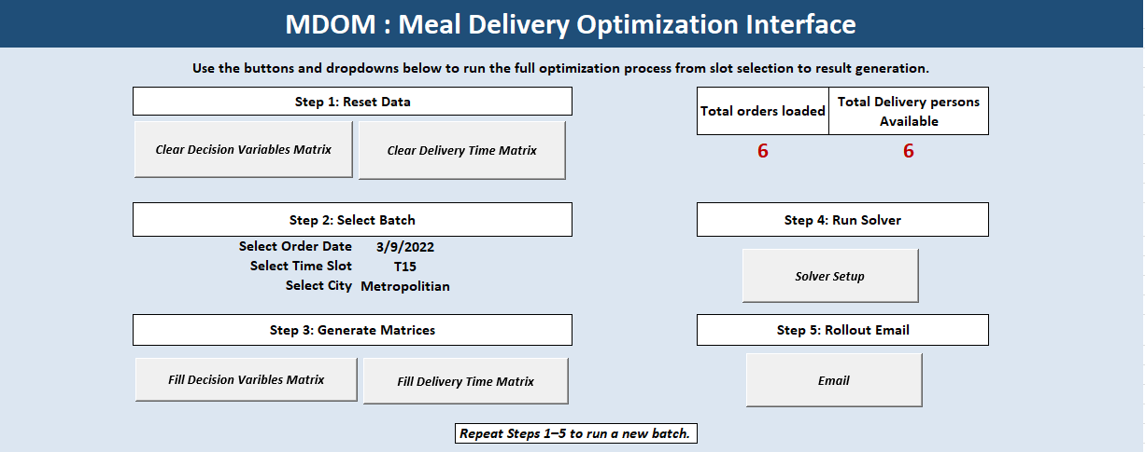
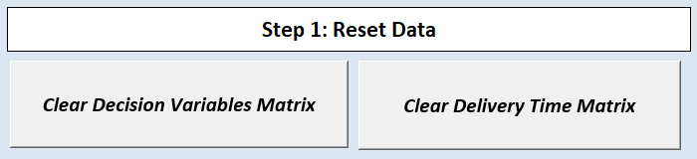

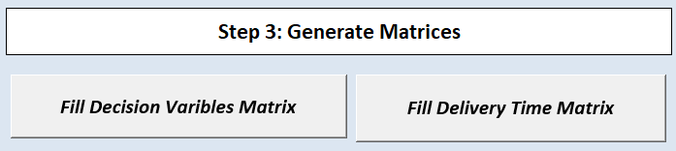
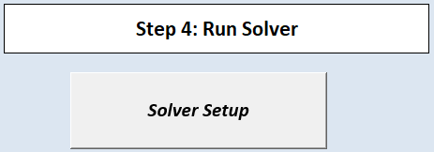
Automation and Macros Setup
Why Automation?

Slide 9
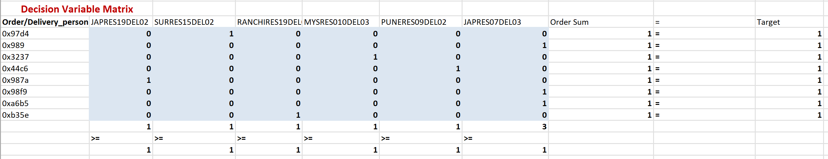
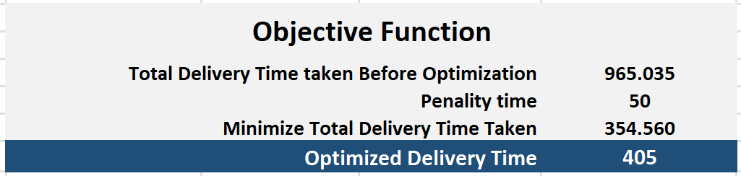
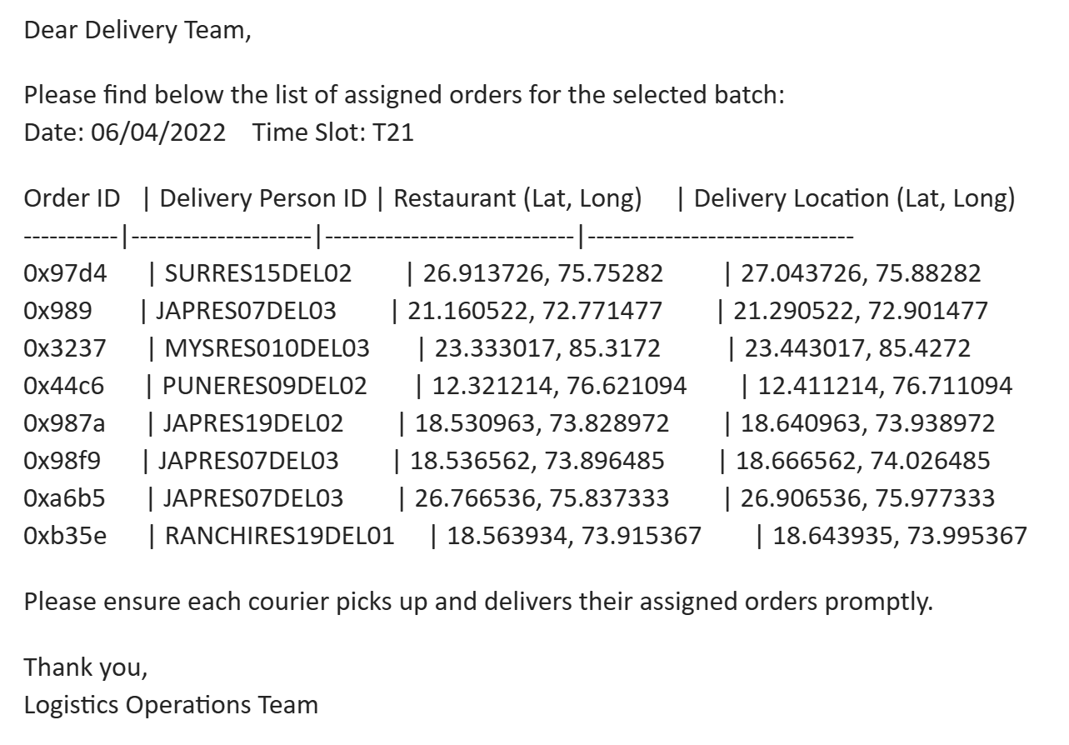
Demonstration and Output
Step 1
Select time slot using dropdown
Step 2
Run “Fill Matrices” macro
Step 3
Execute Solver optimization
Step 4
View optimized order-courier map & delivery times
Result
Minimized delivery time across all orders and output emailed instantly

Slide 10

Conclusion & Recommendations
Key Achievements
Built scalable courier-assignment model using Excel Solver + Macros
Real-time batching with traffic, weather, and courier speed factors
Business Impact
Reduced delivery time
Balanced courier workload
Scalable, reusable tool
Limitations
Excel Solver's 250-variable cap
Static speed assumptions
Future Scope
Migrate to Python/OpenSolver for scale
Add time windows, route planning, and live tracking

Slide 11
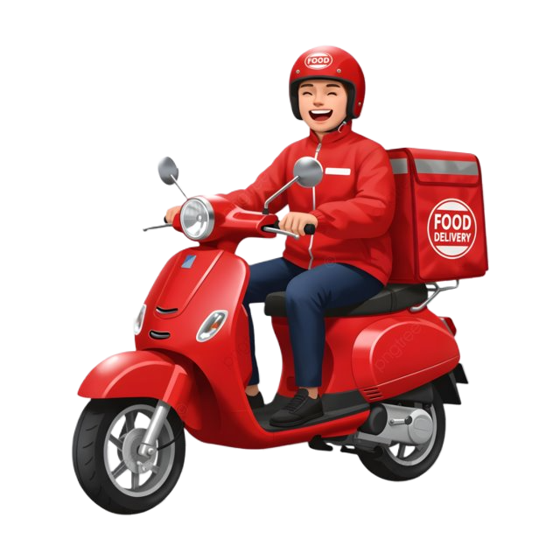
THANK YOU
ANY QUESTIONS?

