Slide 1
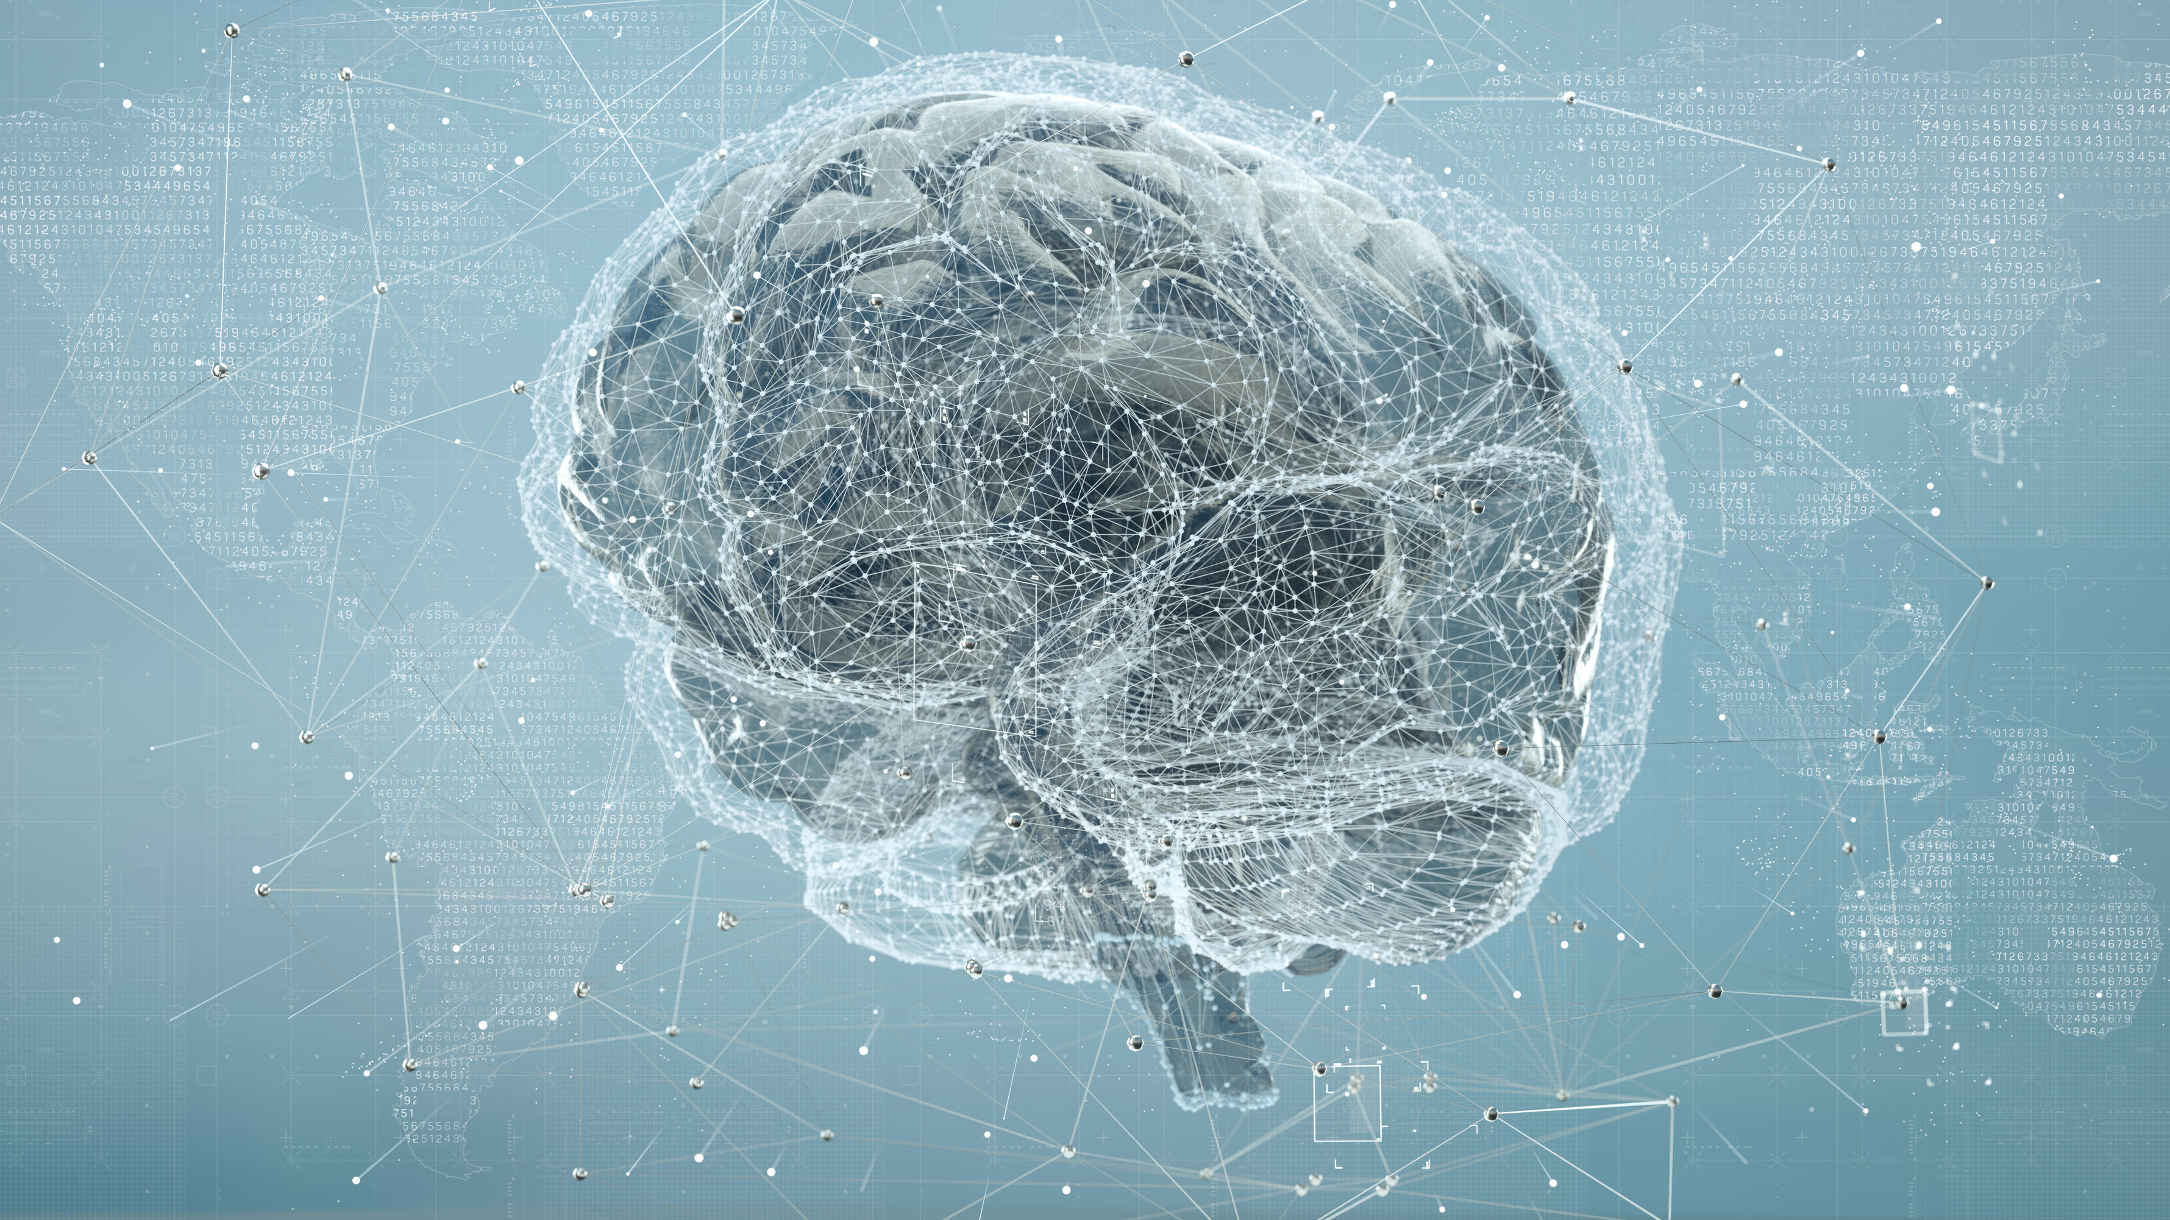
Beyond the Black Box: A Story of Trust, Transparency, and Technology in Alzheimer’s Detection Team Guardians of the Galaxy Under the guidance of Dr. Tim Smith
Kathryn Burkhart
Prince Praveen
Debjani Sarma

Slide 2

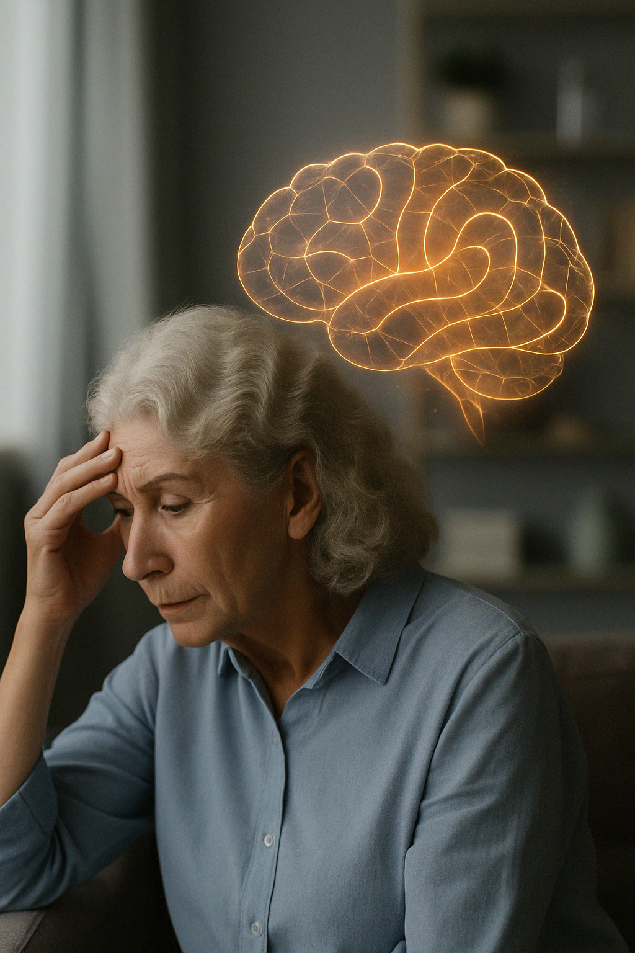
Reclaiming Time: How AI Could Transform Alzheimer's Detection and Understanding
In the US, a new Alzheimer diagnosis occurs every 65 seconds. This marks the urgency of our mission.
Alzheimer’s is a brain disease that slowly destroys memory and thinking skills, making it harder for a person to do everyday tasks. Over time, it can even affect their ability to recognize loved ones or care for themselves.
“What if an AI could help doctors spot the signs of Alzheimer’s—and explain why it sees them?”
Alzheimer's is a cruel thief, stealing more than just memories. It erodes identities and dismantles relationships. Families grapple with profound loss. Over 55 million face this disease globally.

Slide 3

The Challenge: Urgency Meets Skepticism
AI holds promise for early Alzheimer’s detection
Models can achieve high accuracy
But most function as black boxes, lacking explainability
Clinicians demand clarity—not just predictions
78% say they won’t trust AI without understandable reasoning
Past failures (Watson, Streams, Mount Sinai) show accuracy alone isn’t enough
The real challenge: building trust, not just performance
It must become a trusted assistant—one that supports doctors, explains its reasoning, and enhances clinical judgment rather than replacing it.
Must explain why it flagged a scan—not just what it predicted
Explainable AI (XAI) is no silver bullet
But it’s the first step toward AI as a trusted clinical assistant
A partner that enhances, not overrides, clinical judgment

Slide 4
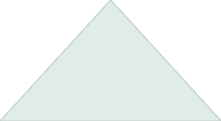

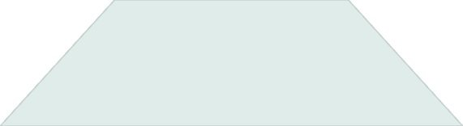

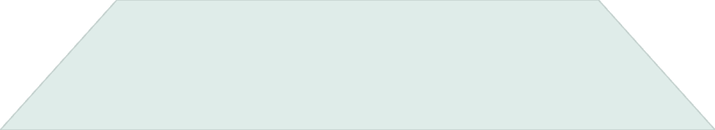

A Rich but Untamed Dataset: OASIS-3
OASIS-3 stands as one of the most clinically detailed public resources for Alzheimer's research. It contains over 2,000 MRI sessions from more than 1,000 subjects with various diagnoses.
Longitudinal
Tracks patients over time with multiple scans per subject.
Diverse
Includes broader population than earlier datasets.
Realistic
Mirrors actual clinical complexity, not simplified research data.
The challenge: raw scans aren't directly linked to diagnoses. We developed a careful curation pipeline to extract a clean, single-scan-per-subject dataset.

Slide 5





From Raw Scans to Model-Ready Volumes
T1-Weighted MRI Selection
We focused exclusively on T1-weighted structural brain scans from OASIS-3 dataset.
Standardized Resizing
All volumes were uniformly resized to 128×128×128 dimensions for consistent processing.
Z-Score Normalization
Normalized intensity values ensure scanner-independent analysis across patients.
Data Augmentation
Applied random flips, Gaussian noise, and brightness adjustments during training.
Tensor Conversion
Transformed volumes into tensor format ready for 3D CNN input.
These augmentations mimic real-world variability between scans and patients, helping our model develop more robust feature
recognition.

Slide 6
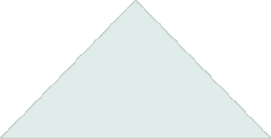

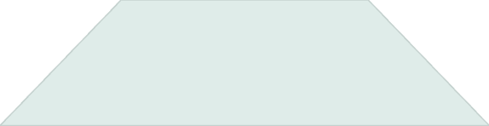

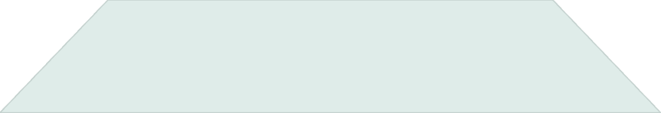

Class Imbalance and Stratified Sampling
After careful curation, our dataset revealed a significant class imbalance across diagnostic categories.
Risk
Models overfit to majority class, missing critical AD cases
Strategy
Stratified 80/20 train-test splits preserve class proportions
Solution
Class-weighted loss function penalizes minority misclassifications
829
232
81
Healthy Controls
MCI Cases
AD Patients
Dominant class in dataset
Mild Cognitive Impairment
Critical diagnostic minority

Slide 7
How Our Approach Compares to Existing Research
Aspect | Jain et al. (2021) (Category 1) | Kumar & Nelson (2024) (Category 1) | Gallay et al. (2020) (Category 2) | Ntampakis et al. (2024) (Category 3) | Our Project
Model Type | Traditional ML (SVM, AdaBoost) | 2D CNN | Deep CNN with FullGrad | 3D CNN Ensemble (Dem3D) | 3D CNN (ResNet-34/50)
MRI Modality | OASIS-3 (2D slices) | OASIS-1 (2D slices) | OASIS-3 (3D T1) | 3D MRI (slice selection) | OASIS-3 (Full 3D Volumes)
Explainability | ❌ None | ❌ None | ✅ FullGrad (no atlas mapping) | ✅ Grad-CAM (attention maps only) | ✅ 3D Grad-CAM + Atlas Mapping
Focus Metric | Accuracy (96.7%) | Accuracy (98.8%) | Accuracy, voxel importance | Confidence + heatmap focus | Recall, F1, Region-wise Activation
Anatomical Mapping | ❌ None | ❌ None | ❌ None | ❌ None | ✅ Harvard-Oxford Atlas Overlay
Class Handling | Binary (Demented vs. Healthy) | 4-Class (Mild, Moderate, Severe, Non-AD) | Binary classification | Binary classification | 3-Class (Healthy, MCI, AD)
Class Imbalance Handling | ❌ Not addressed | ✅ Augmentation only | ❌ Not mentioned | ✅ Confidence-based ensemble | ✅ Weighted Loss + Augmentation
Model Reproducibility | ❌ No logging or artifacts | ❌ No MLOps | ❌ Not reproducible | ❌ Closed setup | ✅ Full W&B Logging + Model Artifacts

Slide 8
From Foundations to Fine Tuning
Why not train from scratch?
OASIS-3 is large and complex
But training full 3D CNNs from scratch is computationally expensive and slow
So, we used transfer learning to build efficiently on prior knowledge
What is transfer learning in our case?
Started with pretrained 3D ResNet models
These models already “understand” 3D structure from prior medical scans
We customized the final FC layer and unlocked last layers
(e.g., Layer3, Layer4, fc)
This allowed us to adapt the model to our Alzheimer’s classification task (Healthy, MCI, AD)
Why MONAI ResNet?
MONAI provides 3D ResNets trained on MRI, PET, CT scans
Works directly with our input shape: (1, 128, 128, 128)
Ideal backbone for clinically relevant transfer learning
Hyperparameter Optimization: No One-Size-Fits-All
We ran extensive tuning experiments across multiple dimensions:
Learning rate, dropout, weight decay
Optimizers: Adam, AdamW, SGD
Activation functions: ReLU vs LeakyReLU
Weight initialization: Kaiming, Xavier
Sweeps were tracked via Weights & Biases (W&B) for full reproducibility
Helped us identify the best-performing configurations

Slide 9
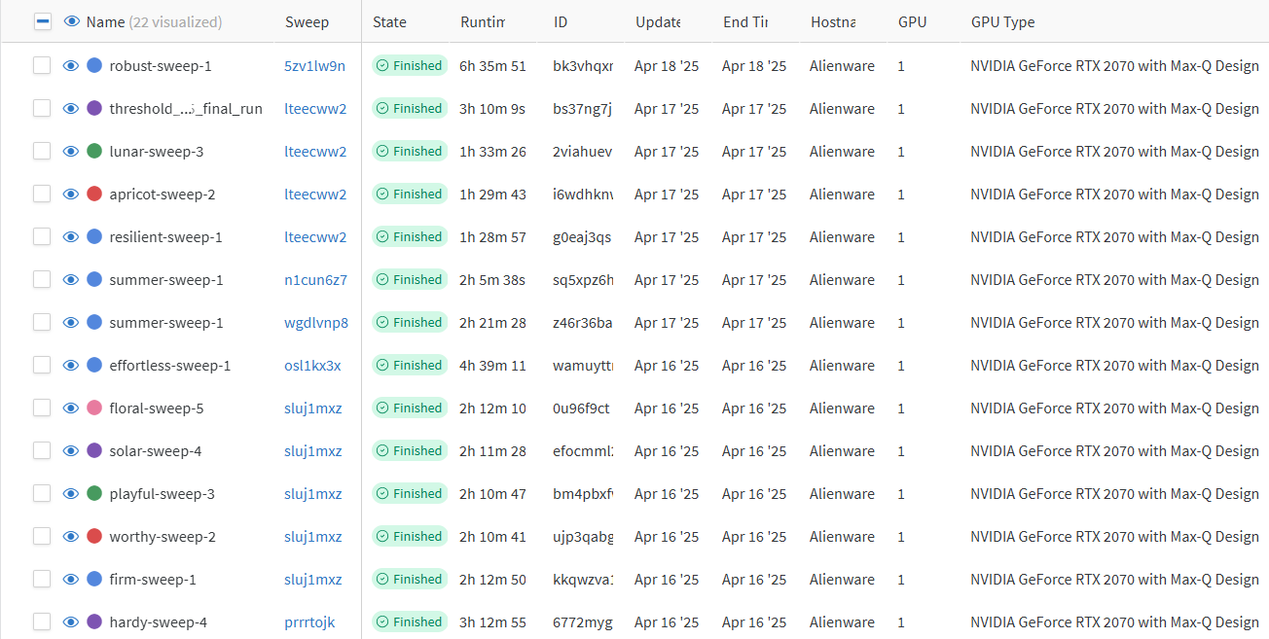
A look at our WEIGHTS & BIASES workspace: The Model Runtimes

Slide 10
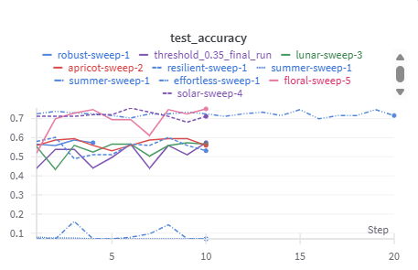
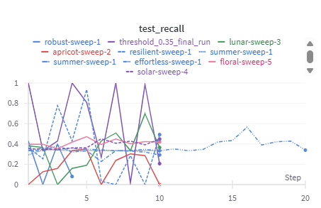
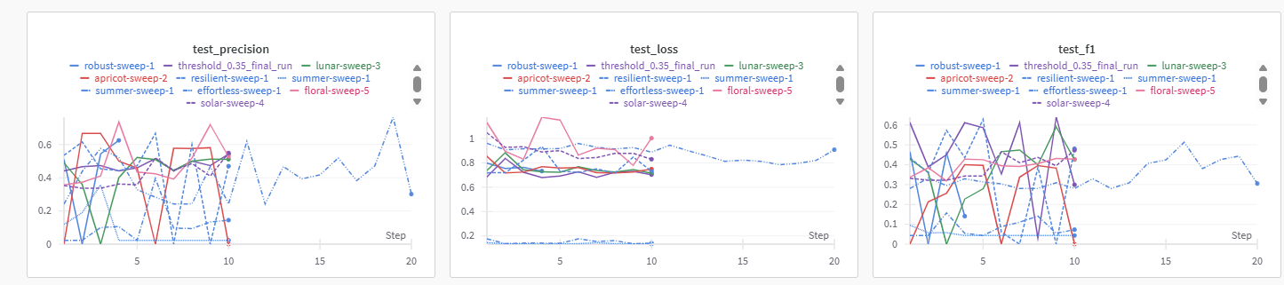
Weights & Biases Model Metrics

Slide 11
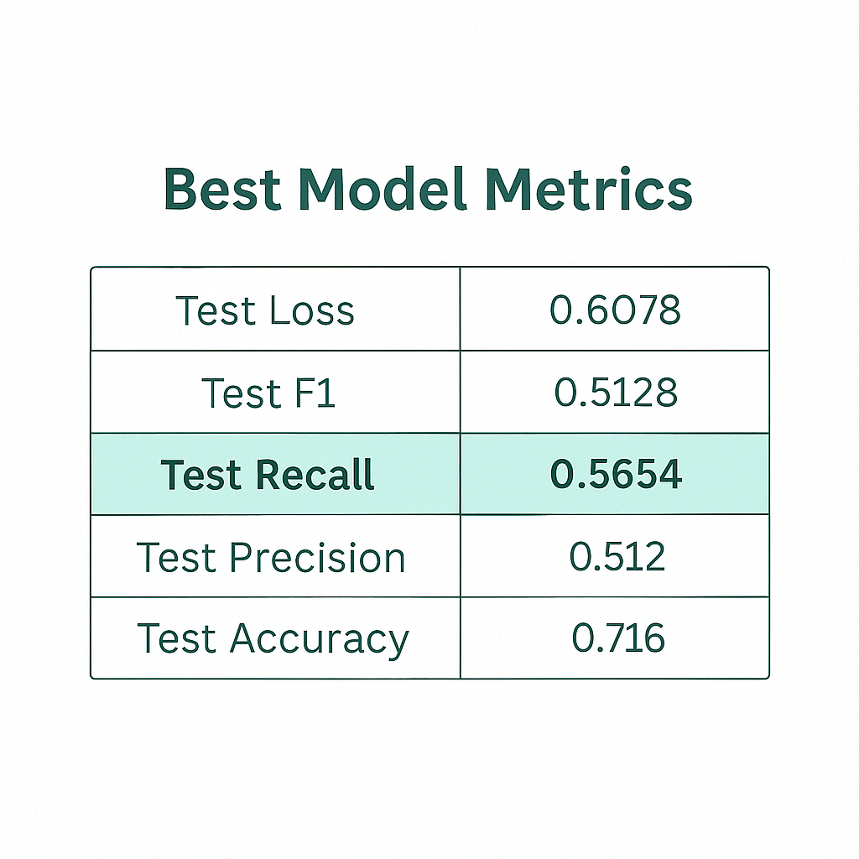
Top Performing Model Config
Parameter | Details
Model | MONAI 3D CNN ResNet - 50
Layers | Layer 3, Layer 4, FC
Dropout | 0.1
Learning Rate | 0.00005
Weight Decay | 0.001
Batch Size | 2
Activation | LeakyRelu
Weight_Init | Kaiming_Normal
Low Recall -> High False Negatives!
False Negative: A dangerous oversight—early Alzheimer’s labeled as Healthy, risking delayed intervention.

Slide 12
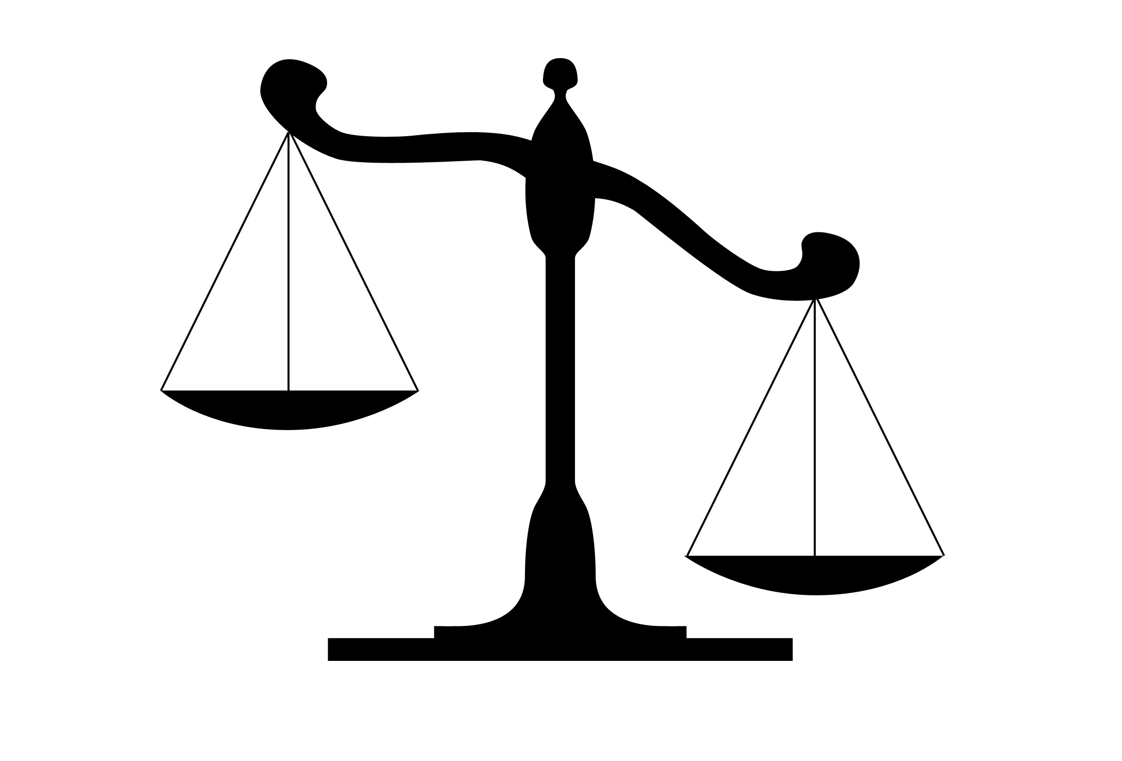
Rethinking Class Labels
Can Balance Improve Recall?
Class imbalance poses a significant challenge for our 3-class Alzheimer's detection model. The minority AD cases often get overlooked despite their critical importance.
Binary Reframing
Improved Balance
Enhanced Learning
Merged MCI+AD into single "Demented" class
Achieved cleaner
1:1.6 class ratio
Better feature extraction for cognitive impairment
This strategic rebalancing aims to boost recall for early dementia detection and reduce potentially dangerous false negatives in clinical applications.

Slide 13
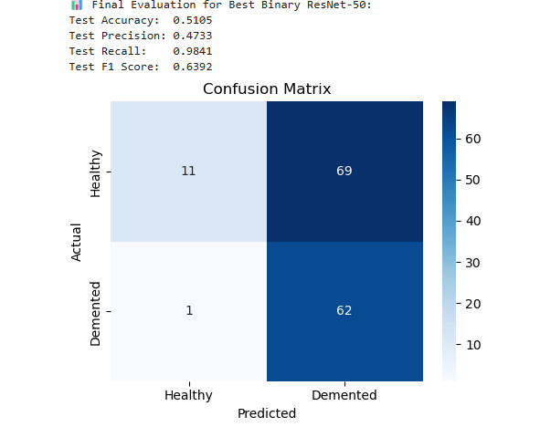
Binary Model Performance Metrics
Why Recall Matters in Alzheimer’s Screening
High recall (98.4%) ensures most dementia cases are correctly flagged
Only 1 false negative — missing a case is riskier than a false alarm
Lower accuracy (51%) is acceptable when prioritizing early detection
The model can flag high-risk cases for urgent review by clinicians
These flagged cases can be accompanied by an explanation of what the model saw — setting the stage for explainable AI (XAI)

Slide 14
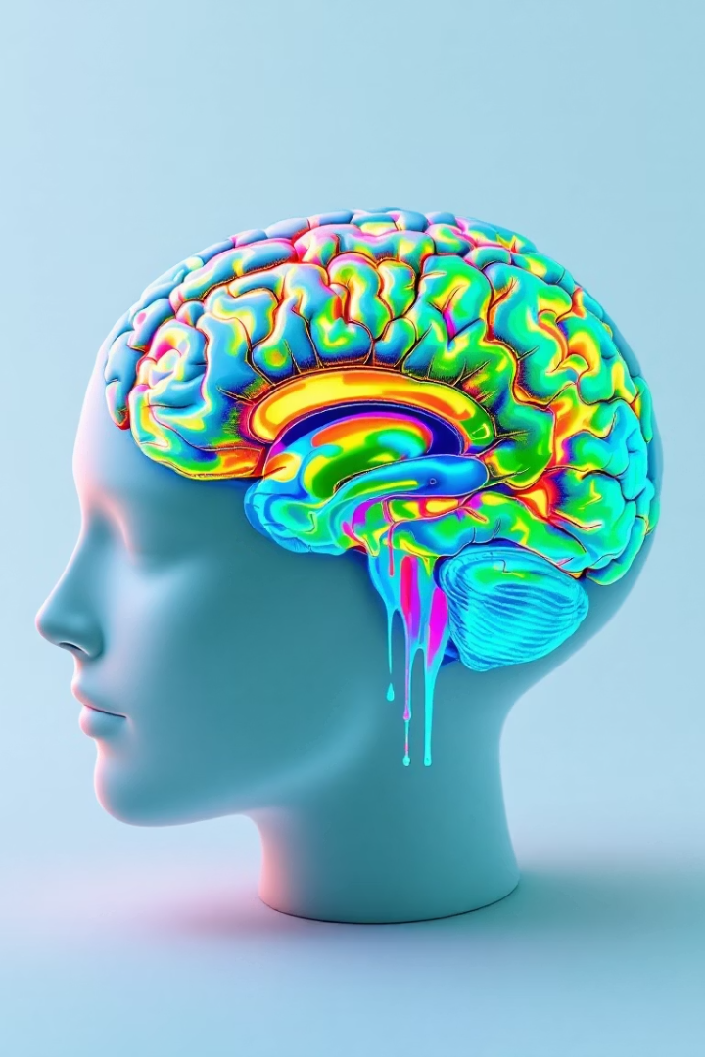
From Predictions to Explanations: 3D Grad-CAM + Brain Atlas Integration
Most XAI methods (SHAP, LIME, 2D Grad-CAM) are designed for flat, non-volumetric data
But brain MRIs are 3D structures — slicing them into 2D loses critical spatial context
We implemented true volumetric 3D Grad-CAM, preserving anatomical continuity across planes
This fills the gap: now, clinicians see where in the full brain volume the model focused
Standard saliency maps show “something lit up” — but don’t explain what region it was
Our solution: map Grad-CAM activations to the Harvard-Oxford Atlas
The Harvard-Oxford Cortical Atlas is a probabilistic brain atlas that divides the cerebral cortex into named regions based on anatomy.
This bridges AI attention with named, clinically recognized brain regions
Clinicians don’t just see a hot spot — they see why the model predicted AD, and where

Slide 15
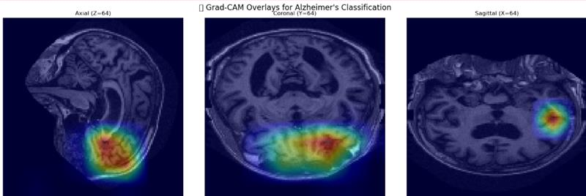
What the Doctors see
Key Observations
The most intense activations are clustered around the medial temporal lobe and hippocampal region, especially in the coronal and sagittal views.
These areas are clinically significant for Alzheimer’s disease and related dementias, as the hippocampus is one of the earliest regions to show atrophy in neurodegenerative processes.

Slide 16
Inside the Model’s Mind: Grad-CAM in Action
This animated overlay was created by us directly from our model’s Grad-CAM output and original MRI scans
Each frame shows an axial slice of the brain with heatmap activations overlaid on the corresponding MRI section
It helps visualize how our model's attention moves through the brain volume, providing clinical insight into region-wise predictions

Slide 17
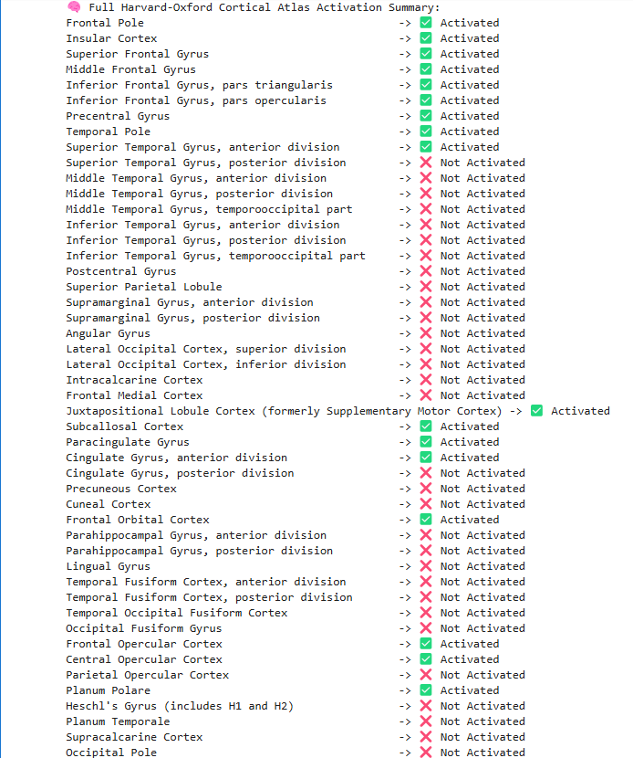
Full Harvard-Oxford Cortical Atlas Activation
What the Model Focused On
Highlighted Regions:
Frontal areas (frontal pole, orbital cortex): linked to planning and decision-making — often impacted early in dementia.
Insula and opercular zones: help integrate sensory and emotional info.
Anterior cingulate: plays a role in attention and motivation.
What It Missed:
Temporal lobe structures like the parahippocampal gryus and fusiform areas - key for memory.
Posterior regions (e.g., precuneous, occipital) tied to visual-spatial awareness.
Summary: The model focused more on cognitive control areas than on classic memory regions.

Slide 18
Conclusion: From Prediction to Partnership: Building Trustworthy AI in Healthcare
Our 3D CNN models, built on ResNet architectures, can identify high-risk dementia cases with strong recall
With 3D Grad-CAM and anatomical mapping, these models don’t just predict - they explain why
This positions AI as a clinical assistant, not a replacement - supporting doctors with insight, not just output
We are continuing to scale model performance using deeper architectures like ResNet-50 and beyond
The next step: collaborate with clinicians, present our heatmaps and region-based explanations, and gather real-world feedback on usability and trust
This is not just model development - it’s a step toward clinically grounded, explainable, and human-centered AI

