Slide 1
Traffic Sign Recognition and Audio Output Integration

Slide 2
Introduction
Project Overview
Traffic sign recognition (TSR) is a critical technology in the development of advanced driver-assistance systems (ADAS) and autonomous vehicles. It aims to automatically identify and interpret traffic signs on the road, enhancing safety and improving driving experience. This project focuses on implementing a robust TSR system using computer vision techniques.
Alert drivers: Warn drivers about upcoming stop signs, speed limits, and other important regulations.
Augment reality: Integrate traffic sign information with navigation displays for enhanced awareness.
Improve autonomous vehicle navigation: Enable self-driving cars to interpret traffic signs and navigate roads safely.

Slide 3
Project Overview
This project aims to develop a system for automatic traffic sign recognition (TSR) using computer vision techniques. The goal is to create a system that can:
Detect various traffic signs in real-world images and videos.
Classify the detected signs into different categories (e.g., stop, yield, speed limit).
Achieve high accuracy under diverse lighting and weather conditions.
Operate efficiently for real-time applications.

Slide 4
Objective
This project aims to develop a system for automatic traffic sign recognition (TSR) using computer vision techniques. The goal is to create a system that can:
Detect various traffic signs in real-world images and videos.
Classify the detected signs into different categories (e.g., stop, yield, speed limit).
Achieve high accuracy under diverse lighting and weather conditions.
Run efficiently for real-time applications.

Slide 5
Literature Survey
Traffic Sign Recognition with Multi-Scale Convolutional Networks by Pierre Sermanet and Yann LeCun (2011): https://ieeexplore.ieee.org/document/6033589
Robust Traffic Sign Detection and Classification Using Color, Edge, and Elliptic Ring Features by Ren Wu, Yudong Yuan, and Changxing Shao (2021): https://www.mdpi.com/1424-8220/21/5/1845
Traffic Sign Detection and Recognition Using Deep Learning by Yuxin Luo, Qingtian Zhu, and Jianye Hao (2019): https://www.hindawi.com/journals/mpe/2019/6783756/
Traffic Sign Detection and Recognition Using a Vision-Based Deep Learning System by Daesik Jang, Young-Gyu Kim, and Dong-Il Cho (2021): https://www.mdpi.com/2076-3417/11/13/6109
Traffic Sign Detection and Recognition Using a Convolutional Neural Network" by Yicheng Zhang, Jing Fu, and Zhicheng Zhao (2021): https://www.sciencedirect.com/science/article/pii/S2352492821000623

Slide 6

Block Diagram
Input
Image Preprocessing
Feature Extraction
Classification
Postprocessing
Output
Text-to-Speech Integration

Slide 7
Preprocessing
The Preprocessing steps which we included in our project are :
Jittered and Brightness Increased Image
Normalizing Image
Standardized Image
Resized Image

Slide 8




300x300 pixels
300x200 pixels

Slide 9
Feature Extraction
Convolutional Neural Networks (CNNs)
Briefly explain CNNs as a type of deep learning architecture commonly used for image recognition tasks.
Feature Extraction Process
load_img and img_to_array functions are used to convert the image to a NumPy array suitable for model input.
np.expand_dims(img, axis=0): necessary to add a batch dimension for compatibility with the CNN.
model_shortpredict Function: it takes the image (inputs) and a list of convolution layer indices (conv_ind) as input.
sub-model (short_model) that extracts feature outputs from the specified convolution layers (outputs) within the original model (model).
Feature Visualization : This helps in visualization of the extracted features (using plt.imshow), explain how it iterates through the feature maps for each layer and displays them using a subplot layout.

Slide 10
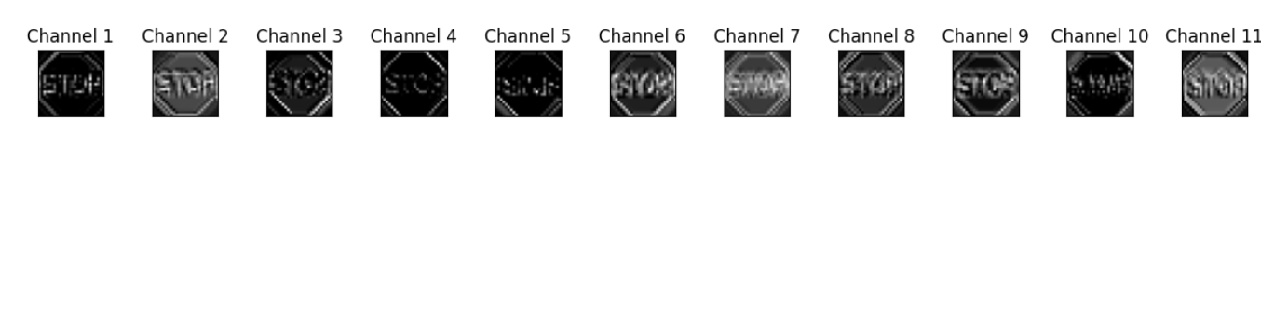
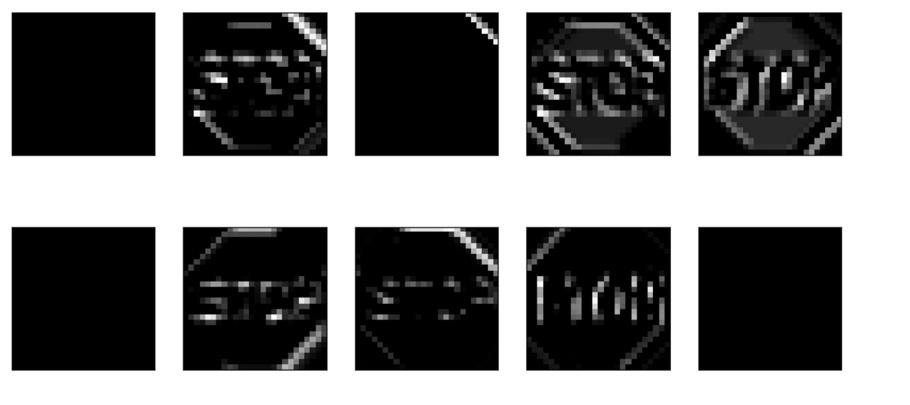

Slide 11
Classification
Convolutional Neural Network (CNN)
The model takes the extracted features and predicts the traffic sign category based on the class number provided as input.
Fully-Connected Layers:
After the convolutional layers extract features, the network typically uses fully-connected layers to process the extracted features and learn higher-level relationships between them.
Activation Functions:
Fully-connected layers often employ activation functions like ReLU (Rectified Linear Unit) or softmax to introduce non-linearity and map the outputs to a desired range

Slide 12
Postprocessing
Post-Processing in Traffic Sign Recognition:
While the core classification might identify the most likely traffic sign category, post-processing techniques can further refine the results and improve system robustness.

Slide 13
Output
The output generated by your code depends on the specific implementation details of the model_shortpredict function and any additional code you have for processing the results.
Textual Output : To print the predicted traffic sign category or class label.

Slide 14
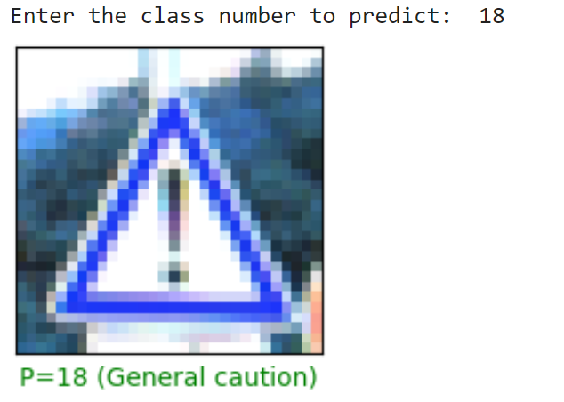
Input given is class number, it predicts the images in that class number and return the predicted image

Slide 15
Text-to-Speech Integration
Text-to-Speech Integration: Traffic sign recognition systems can benefit from integrating text-to-speech (TTS) functionality. This would allow the system to not only visually display the predicted traffic sign category but also announce it audibly.
To achieve TTS integration, we need to incorporate a TTS library like pyttsx3 or a similar tool.
The TTS library would then be used to synthesize the text into spoken audio, which could be played through the computer's speakers or integrated with an in-car audio system.

