Slide 1

Estimating the Parameter for the Exponential Distribution
Daniel Briggs, Hillary Miller, David Sasson, Colby Wilkinson

Slide 2
Introduction
Estimators:
Maximum Likelihood: Inverse of the Mean
Inverse of the median
Exponential-Gamma Estimator with Jeffrey’s Prior
Confidence Intervals:
Delta method, using the MLE
Exact distribution (Chi-squared distribution)
Credible interval (interval with highest posterior density (HPD))

Slide 3
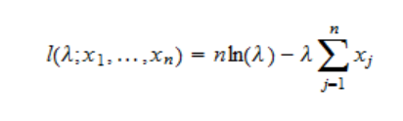

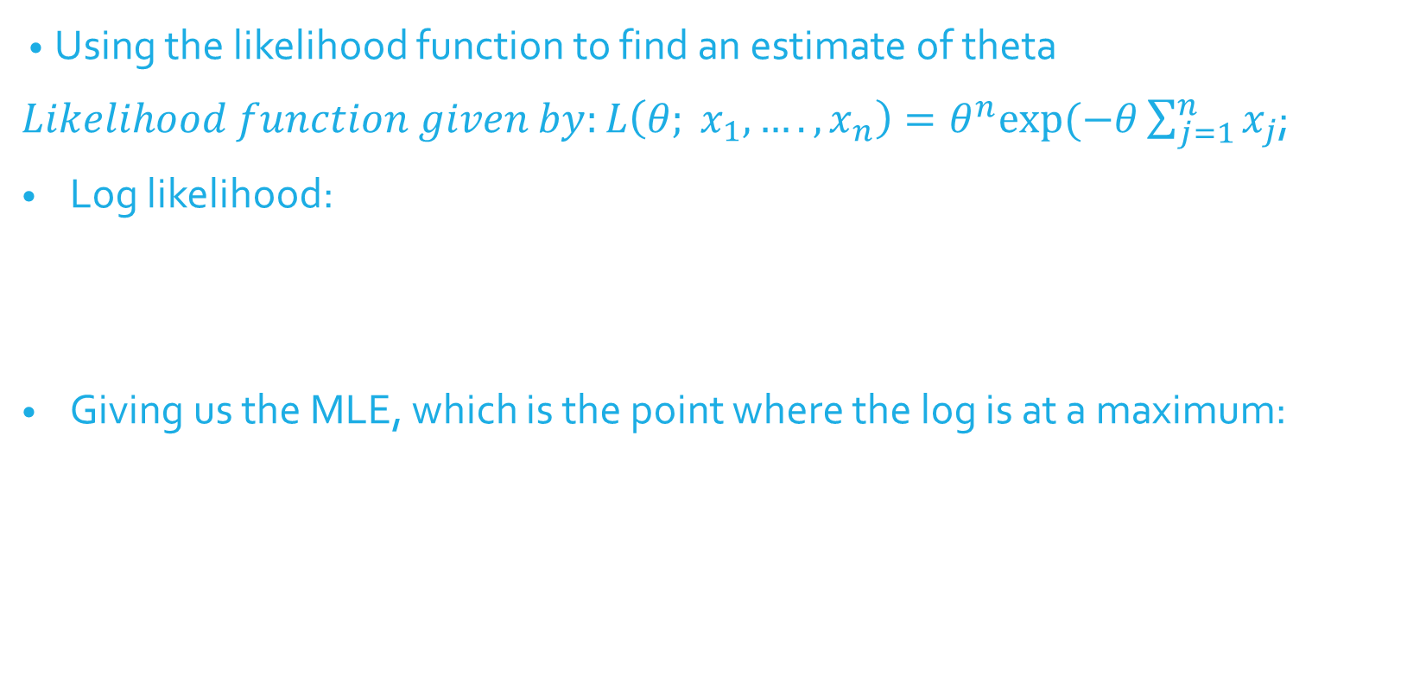
Maximum Likelihood Estimator
Using the likelihood function to find an estimate of theta
$Likelihood function given by:L\left(θ; x_{1},….,x_{n}\right)=θ^{n}exp⁡(−θ\sum_{j=1}^{n}{x_{j}}$;
Log likelihood:
Giving us the MLE, which is the point where the log is at a maximum:

Slide 4
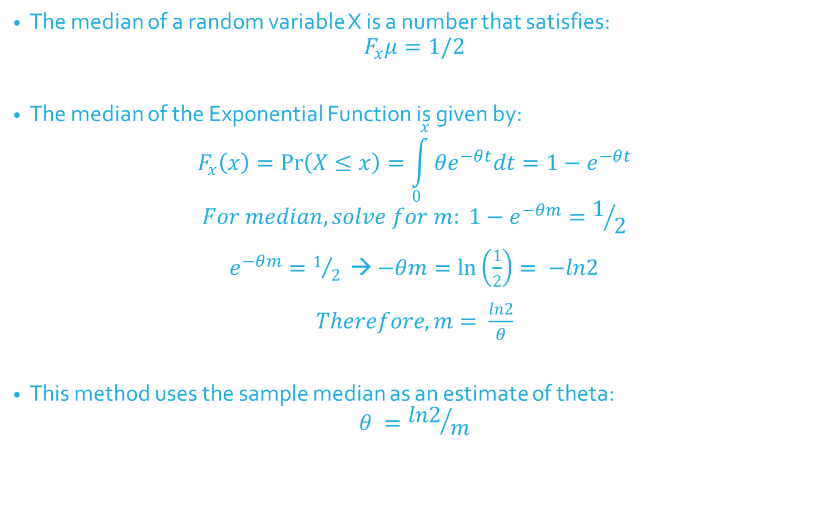
Inverse of the Median
The median of a random variable X is a number that satisfies:
$$F_{x}μ=1/2$$
The median of the Exponential Function is given by:
$$F_{x}\left(x\right)=\operatorname{Pr}\left(X≤x\right)=\int_{0}^{x}{θe^{−θt}dt=1−e^{−θt}}$$
$$For median, solve for m: {1−e}^{−θm}=1/2$$
$e^{−θm}=1/2$ → $−θm=\ln\left(\frac{1}{2}\right)= −ln2$
$Therefore, m= \frac{ln2}{θ}$
This method uses the sample median as an estimate of theta:
$$θ ={ln2}/m$$

Slide 5
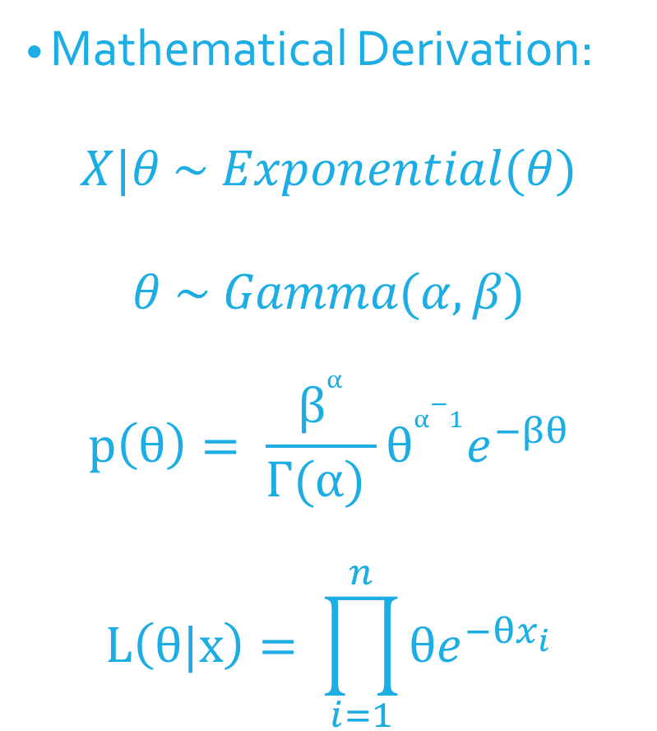
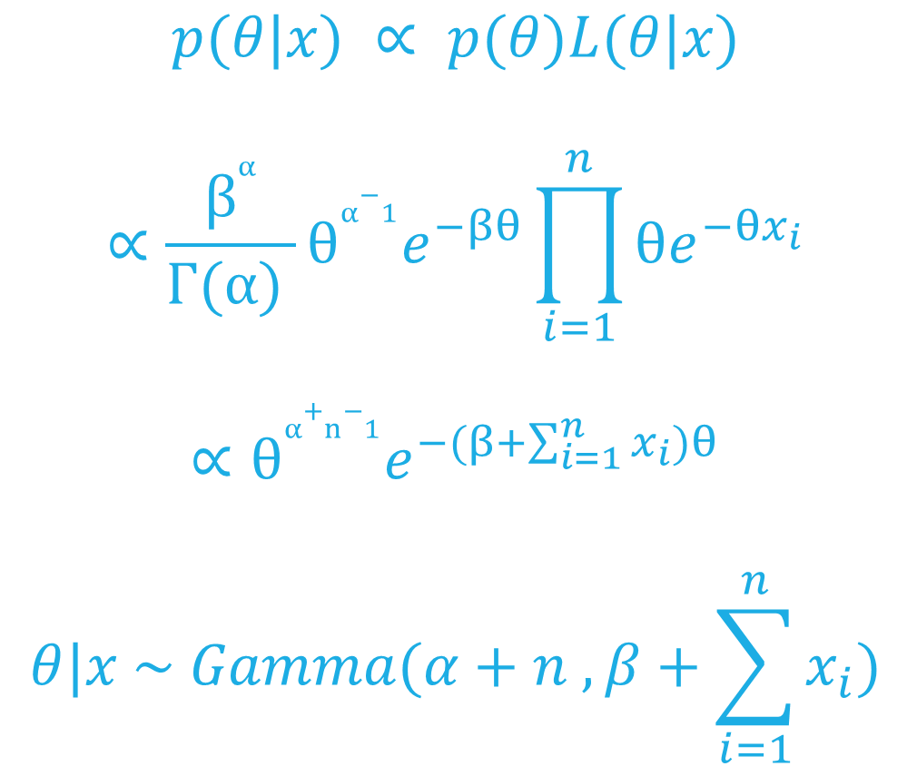
Jeffrey’s Prior Bayesian Estimate
Mathematical Derivation:
$$X|θ \sim Exponential(θ)$$
$$θ \sim Gamma(α, β)$$
$$p\left(θ\right)= \frac{β^{α}}{Γ(α) }θ^{α−1}e^{−βθ}$$
$$L\left(θ|x\right)= \prod_{i=1}^{n}{{θe}^{−θx_{i}}}$$
$$p(θ|x) ∝ p(θ)L(θ|x)$$
$$∝\frac{β^{α}}{Γ(α) }θ^{α−1}e^{−βθ}\prod_{i=1}^{n}{{θe}^{−θx_{i}}}$$
$$∝θ^{α+n−1}e^{−(β+\sum_{i=1}^{n}{x_{i}})θ}$$
$$θ|x \sim Gamma(α+n , β+\sum_{i=1}^{n}{x_{i}})$$

Slide 6
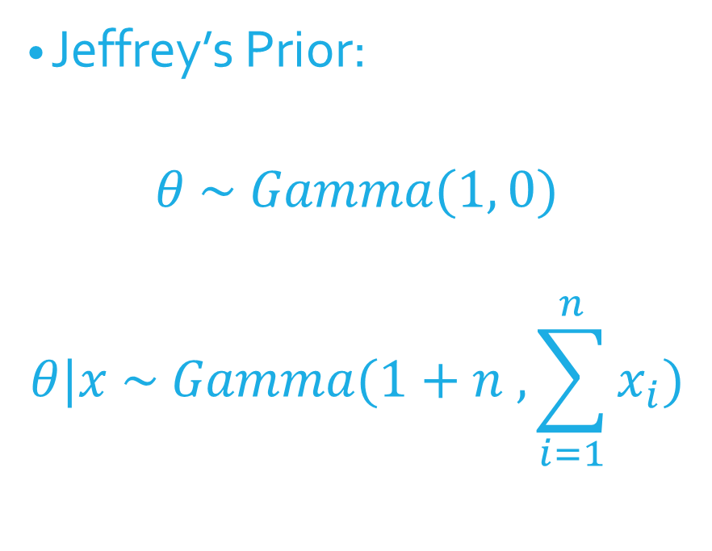
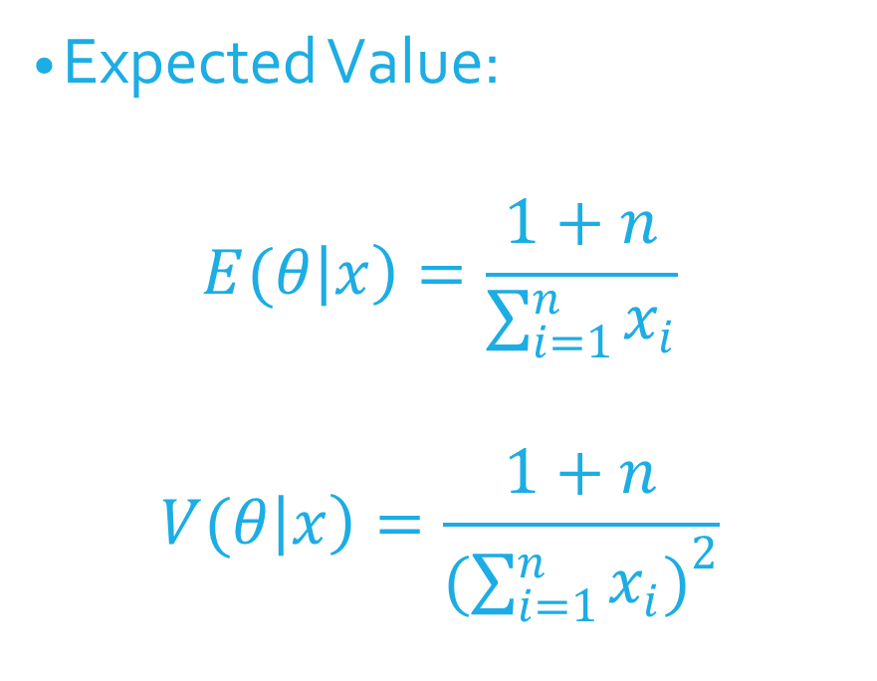
Jeffrey’s Prior Bayesian Estimate (continued)
Jeffrey’s Prior:
$$θ \sim Gamma(1, 0)$$
$$θ|x \sim Gamma(1+n , \sum_{i=1}^{n}{x_{i})}$$
Expected Value:
$$E(θ\left|x\right)=\frac{1+n}{\sum_{i=1}^{n}{x_{i}}}$$
$$V(θ\left|x\right)=\frac{1+n}{{(\sum_{i=1}^{n}{x_{i})}}^{2}}$$

Slide 7
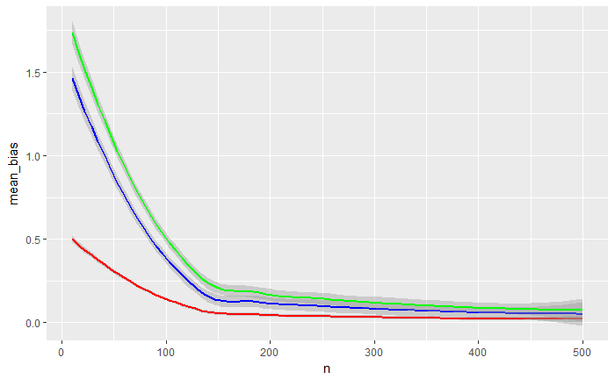
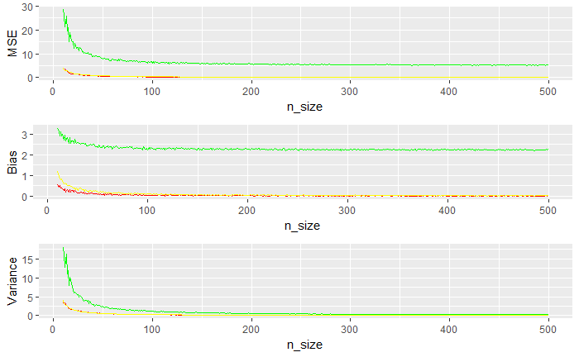
Estimates MSE, bias, variance as as N increases (graphs for each estimator; with θ=5)

Slide 8
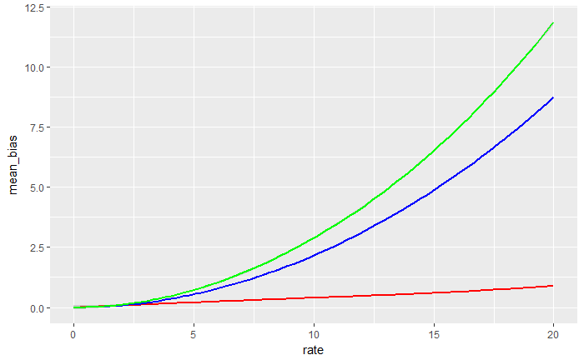
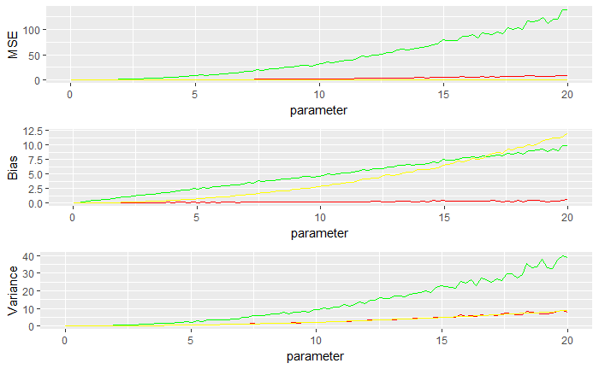
Estimates MSE, bias, variance as θ changes
(one for each estimator; θ = .1,…20, n=25)

Slide 9
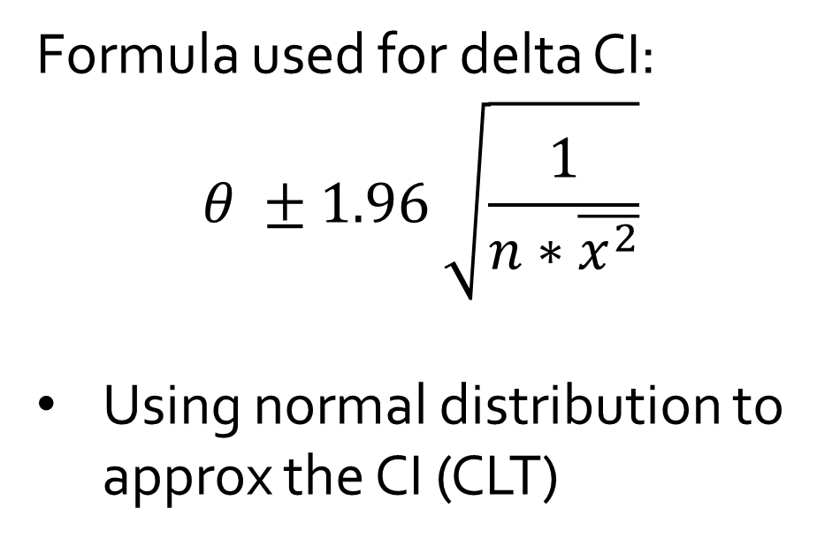
Delta method, using the MLE
Formula used for delta CI:
$$θ ±1.96 \sqrt{\frac{1}{n∗\overline{x^{2}}}}$$
Using normal distribution to approx the CI (CLT)

Slide 10
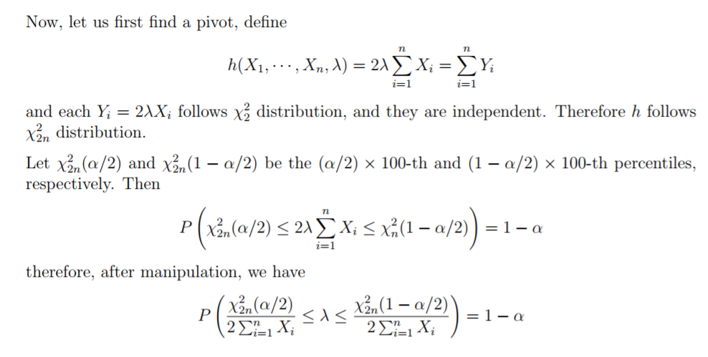
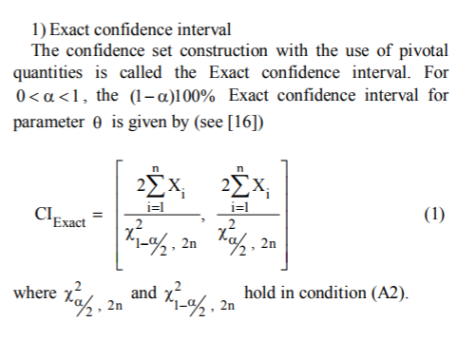
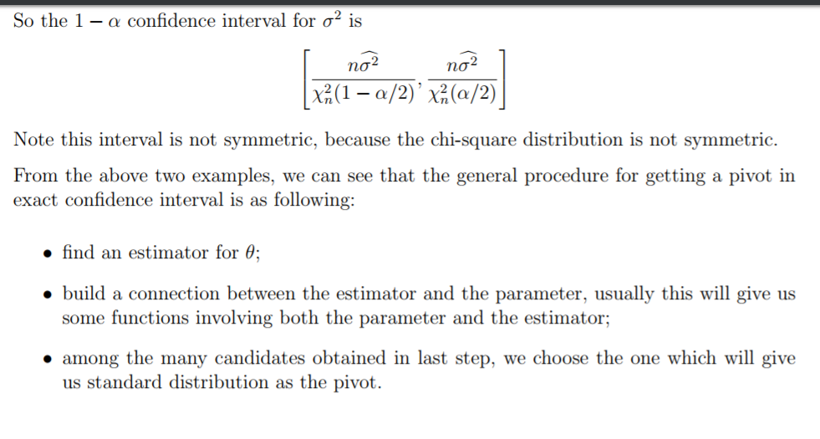
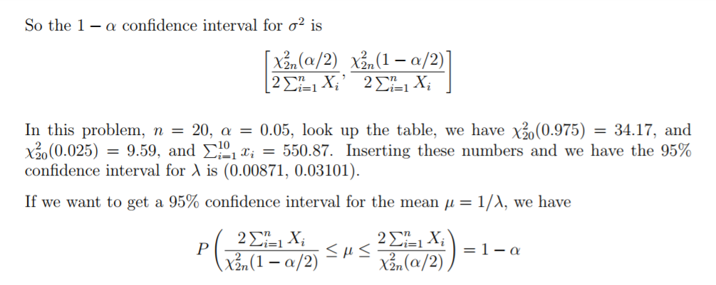
Exact distribution (Chi-squared dist.)
I think this could be a good page for the hand-waving?? If this math is correct, I’ll type it up and format;but likely skip a step or two

Slide 11
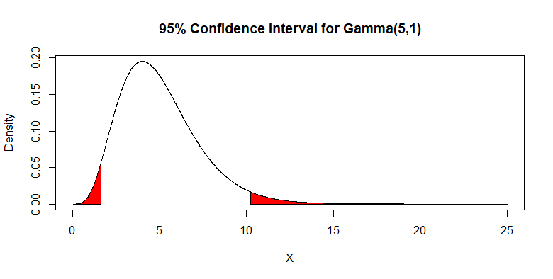
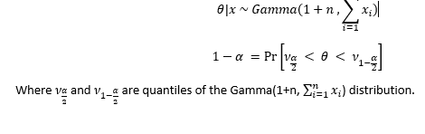
Credible interval (using highest posterior density (HPD))

Slide 12
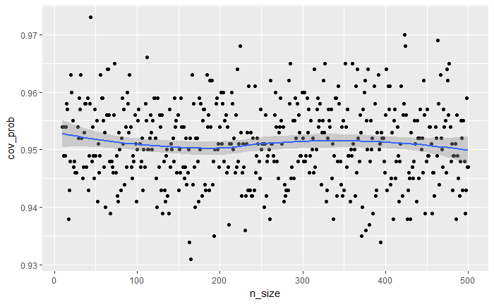
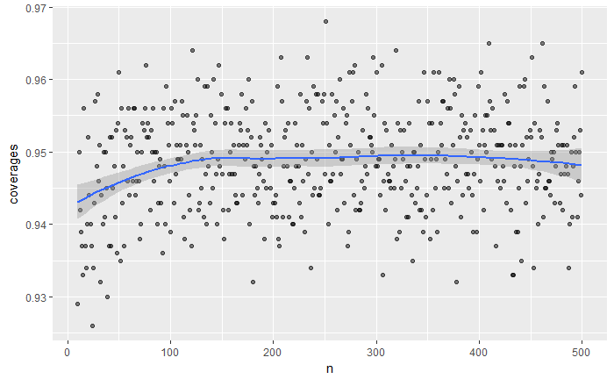
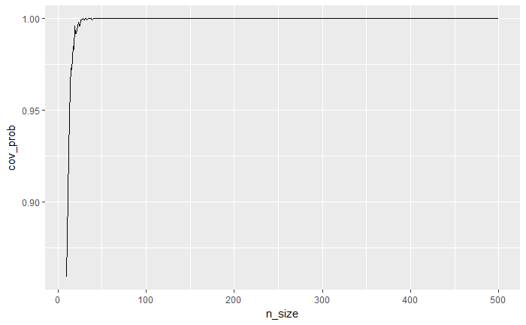
Coverage as n increases, θ = 5
Delta
Bayesian
Exact

Slide 13
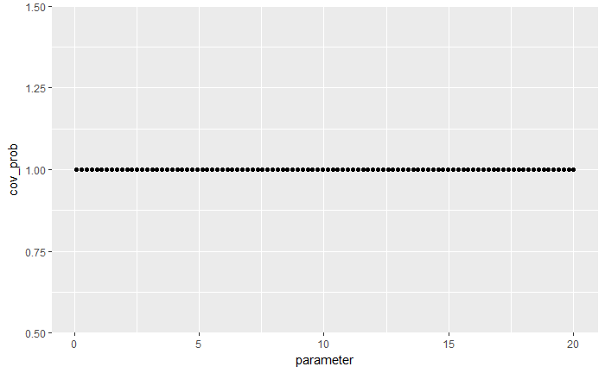
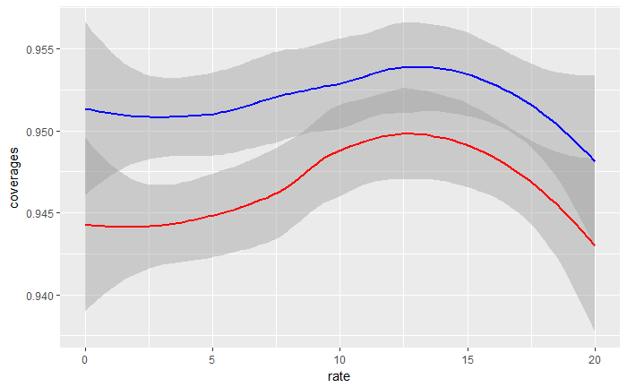
Coverage with changing θ, n=100

Slide 14
Conclusions
brief summary of your findings and recommendations
(eg. this estimator is biased, but asym. unbiased … , this has better cov prob)

