Slide 1

Estimating the Parameter for the Exponential Distribution
Daniel Briggs, Hillary Miller, David Sasson, Colby Wilkinson

Slide 2
Introduction
Estimators:
Maximum Likelihood: Inverse of the Mean
Inverse of the Median
Exponential-Gamma Estimator with Jeffrey’s Prior
Confidence Intervals:
Delta method, using the MLE
Exact distribution (Chi-squared distribution)
Credible interval (interval with highest posterior density (HPD))
Approach:
R programming
Comparison criteria:
We created 1000 simulations in R to determine the MSE, variance and bias for each estimator. We assessed estimator performance over different parameter and n-size values.
We created 1000 simulations in R to determine the coverage probabilities for different confidence intervals. We assessed coverage performance over different parameter and n-size values.

Slide 3
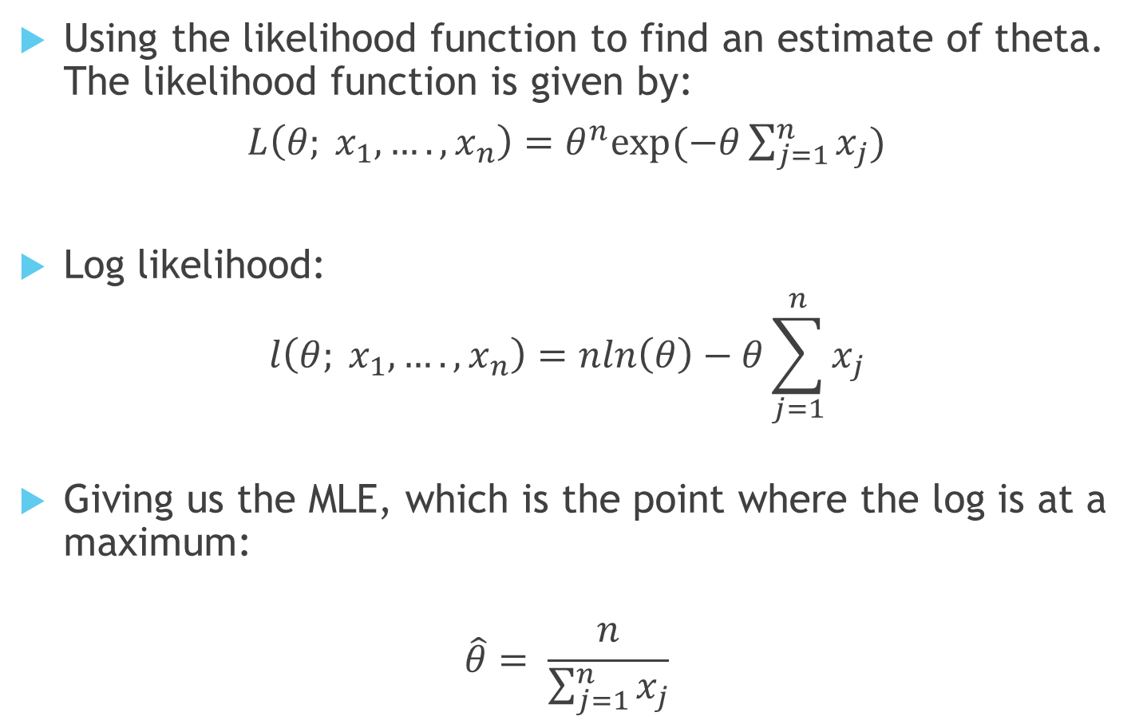
Maximum Likelihood Estimator
Using the likelihood function to find an estimate of theta. The likelihood function is given by:
$L\left(θ; x_{1},….,x_{n}\right)=θ^{n}exp⁡(−θ\sum_{j=1}^{n}{x_{j}})$
Log likelihood:
$$l\left(θ; x_{1},….,x_{n}\right)=nln\left(θ\right)−θ\sum_{j=1}^{n}{x_{j}}$$
Giving us the MLE, which is the point where the log is at a maximum:
$$\hat{θ}= \frac{n}{\sum_{j=1}^{n}{x_{j}}}$$

Slide 4
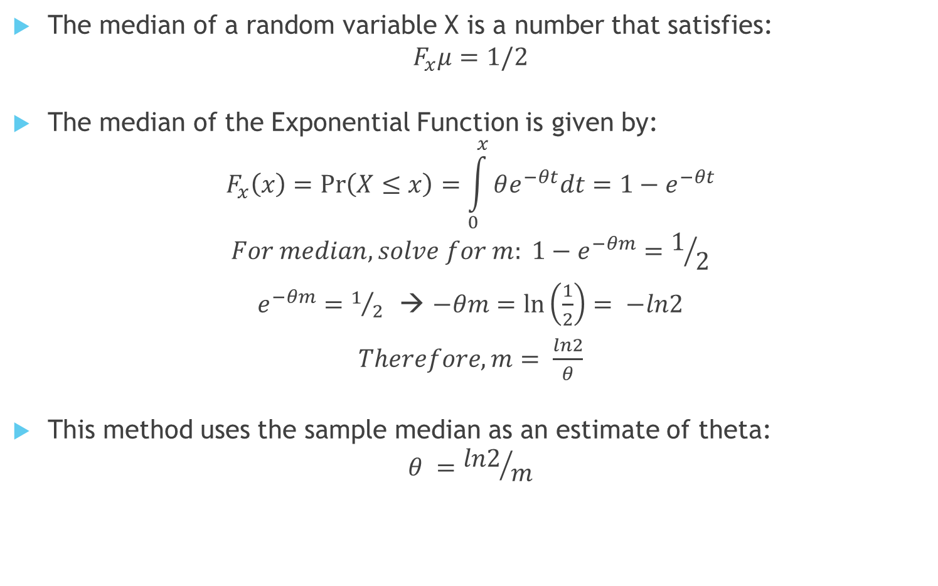
Inverse of the Median
The median of a random variable X is a number that satisfies:
$$F_{x}μ=1/2$$
The median of the Exponential Function is given by:
$$F_{x}\left(x\right)=\operatorname{Pr}\left(X≤x\right)=\int_{0}^{x}{θe^{−θt}dt=1−e^{−θt}}$$
$$For median, solve for m: {1−e}^{−θm}=1/2$$
$e^{−θm}=1/2$ → $−θm=\ln\left(\frac{1}{2}\right)= −ln2$
$Therefore, m= \frac{ln2}{θ}$
This method uses the sample median as an estimate of theta:
$$θ ={ln2}/m$$

Slide 5
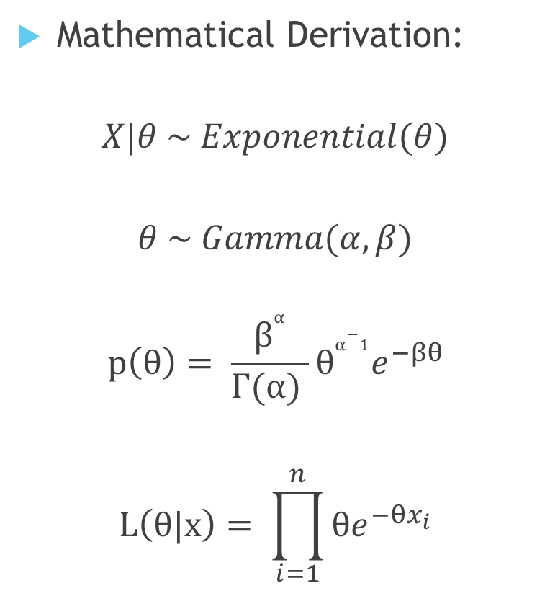
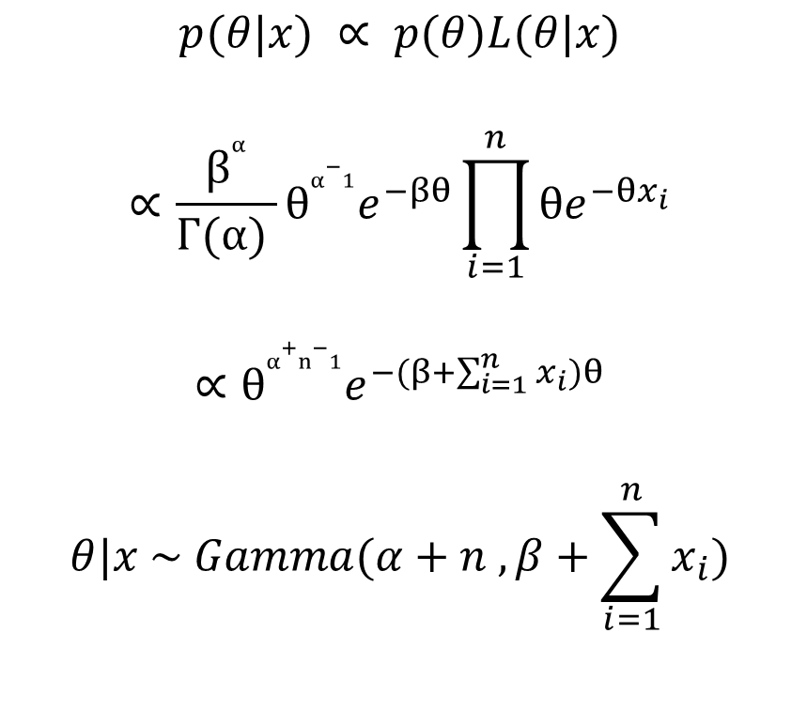
Jeffrey’s Prior Bayesian Estimate
Mathematical Derivation:
$$X|θ \sim Exponential(θ)$$
$$θ \sim Gamma(α, β)$$
$$p\left(θ\right)= \frac{β^{α}}{Γ(α) }θ^{α−1}e^{−βθ}$$
$$L\left(θ|x\right)= \prod_{i=1}^{n}{{θe}^{−θx_{i}}}$$
$$p(θ|x) ∝ p(θ)L(θ|x)$$
$$∝\frac{β^{α}}{Γ(α) }θ^{α−1}e^{−βθ}\prod_{i=1}^{n}{{θe}^{−θx_{i}}}$$
$$∝θ^{α+n−1}e^{−(β+\sum_{i=1}^{n}{x_{i}})θ}$$
$$θ|x \sim Gamma(α+n , β+\sum_{i=1}^{n}{x_{i}})$$

Slide 6
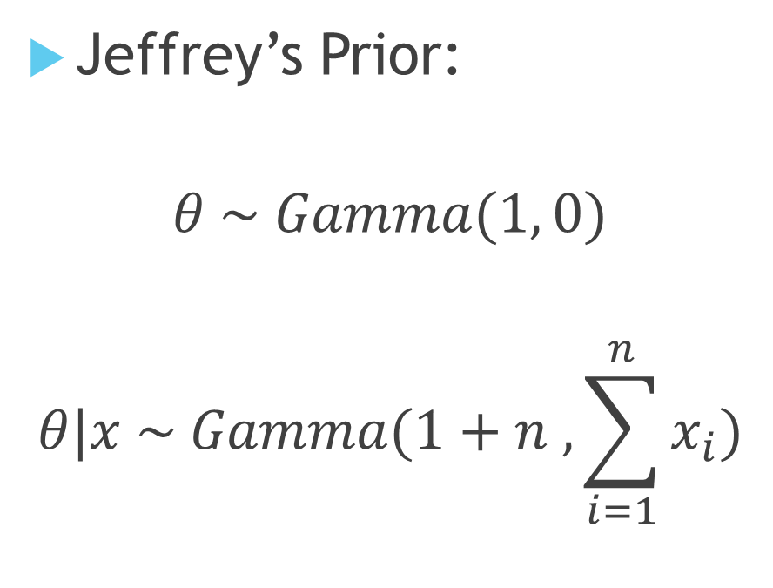
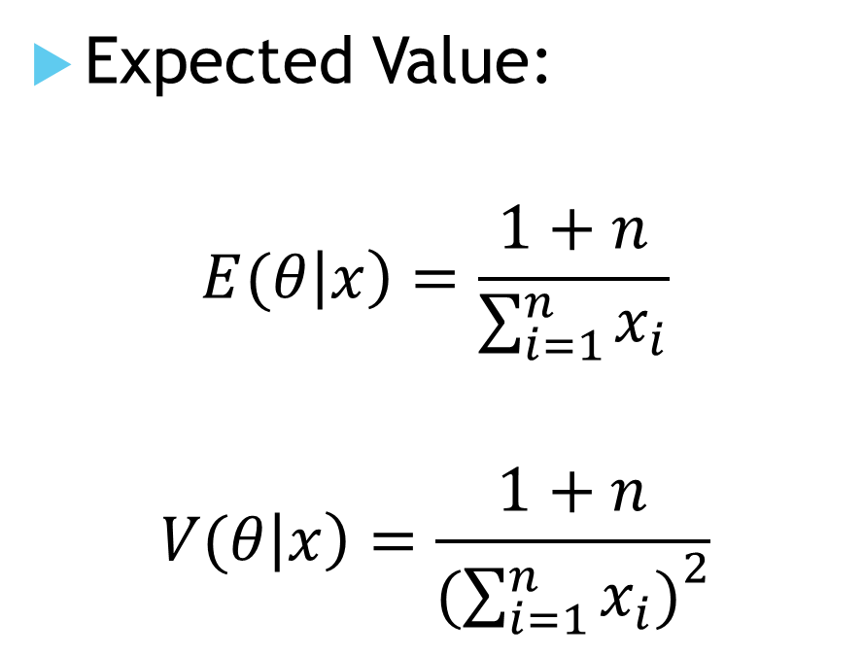
Jeffrey’s Prior Bayesian Estimate (continued)
Jeffrey’s Prior:
$$θ \sim Gamma(1, 0)$$
$$θ|x \sim Gamma(1+n , \sum_{i=1}^{n}{x_{i})}$$
Expected Value:
$$E(θ\left|x\right)=\frac{1+n}{\sum_{i=1}^{n}{x_{i}}}$$
$$V(θ\left|x\right)=\frac{1+n}{{(\sum_{i=1}^{n}{x_{i})}}^{2}}$$

Slide 7
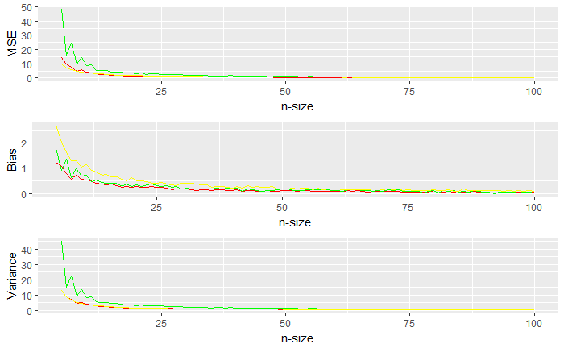
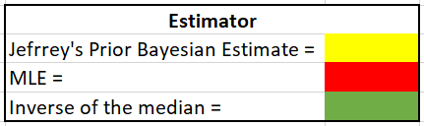
Estimates MSE, bias, variance as N increases
θ=5 for all
graphs

Slide 8
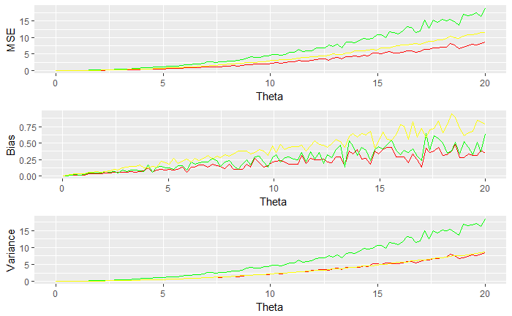
Estimates MSE, bias, variance as θ changes
N=50 for all
graphs

Slide 9
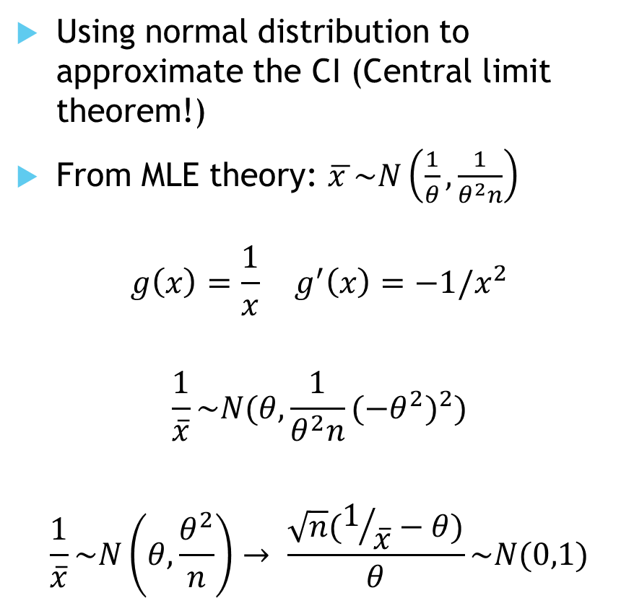
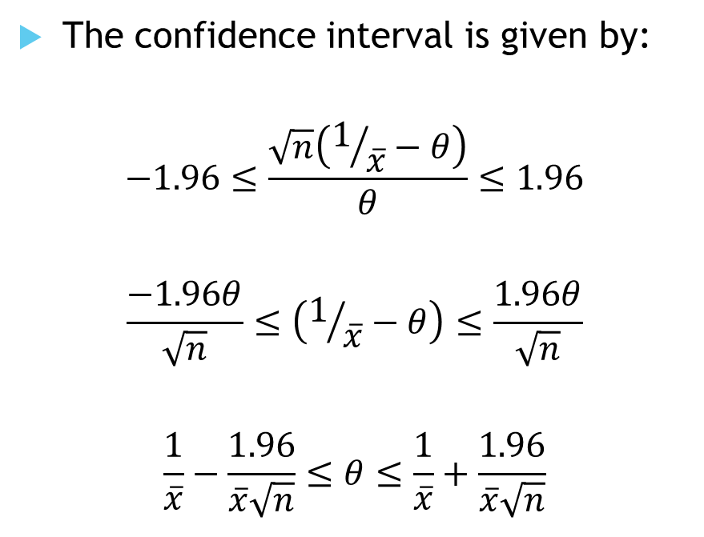
Delta method, using the MLE
Using normal distribution to approximate the CI (Central limit theorem!)
From MLE theory: $\overline{x }\sim N\left(\frac{1}{θ}, \frac{1}{θ^{2}n}\right)$
$$g\left(x\right)=\frac{1}{x} g^{′}\left(x\right)=−1/x^{2}$$
$$\frac{1}{\overline{x}}\sim N(θ, \frac{1}{θ^{2}n}(−θ^{2})^{2})$$
$$\frac{1}{\overline{x}}\sim N\left(θ, \frac{θ^{2}}{n}\right)→ \frac{\sqrt{n}(1/{\overline{x}}−θ)}{θ}\sim N(0,1)$$
The confidence interval is given by:
$$−1.96≤\frac{\sqrt{n}\left(1/{\overline{x}}−θ\right)}{θ}≤1.96$$
$$\frac{−1.96θ}{\sqrt{n}}≤\left(1/{\overline{x}}−θ\right)≤\frac{1.96θ}{\sqrt{n}}$$
$$\frac{1}{\overline{x}}−\frac{1.96}{\overline{x}\sqrt{n}}≤θ≤\frac{1}{\overline{x}}+\frac{1.96}{\overline{x}\sqrt{n}}$$

Slide 10

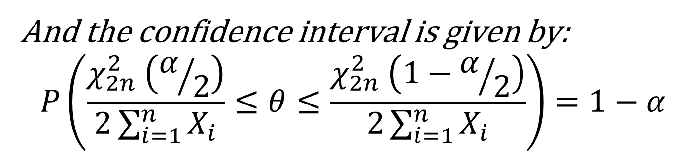

Exact distribution (Chi-squared dist.)
Use the chi-squared distribution to find a pivot, which in turn is used for the confidence interval
The general procedure:
Find an estimator for $θ$;
Build a connection between the estimator and the parameter (usually functions involving both)
Among those obtained, choose the one that gives the standard distribution as the pivot
Interval will not be symmetric, because the chi-square distribution is not symmetric
To find the pivot, define:
$$h\left(X_{1},…,X_{n},θ\right)=2θ\sum_{i=1}^{n}{X_{i}}=\sum_{i=1}^{n}{Y_{i}}$$
And each $Y_{i}=2θX_{i} follows χ_{2}^{2} and they are independent.$
Then…
And the confidence interval is given by:
$$P\left(\frac{χ_{2n}^{2} \left(α/2\right)}{2\sum_{i=1}^{n}{X_{i}}}≤θ≤\frac{χ_{2n}^{2} \left(1−α/2\right)}{2\sum_{i=1}^{n}{X_{i}}}\right)=1−α$$
CALCULUS MAGIC

Slide 11
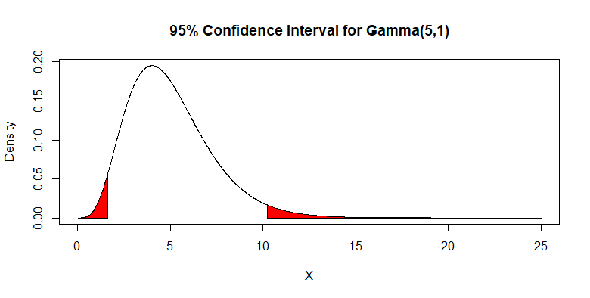
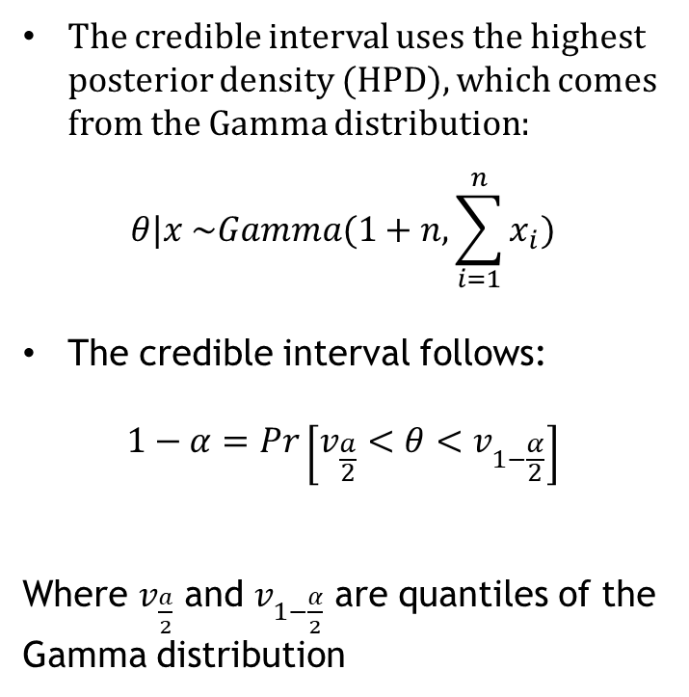
Credible interval
The credible interval uses the highest posterior density (HPD), which comes from the Gamma distribution:
$$θ|x \sim Gamma(1+n, \sum_{i=1}^{n}{x_{i}})$$
The credible interval follows:
$$1−α=Pr\left[v_{\frac{a}{2}}<θ<v_{1−\frac{α}{2}}\right]$$
Where $v_{\frac{a}{2}}$ and $v_{1−\frac{α}{2}}$ are quantiles of the Gamma distribution
Using the credible interval, there is a 95% chance the true value falls in the interval range, without repeated sampling.

Slide 12
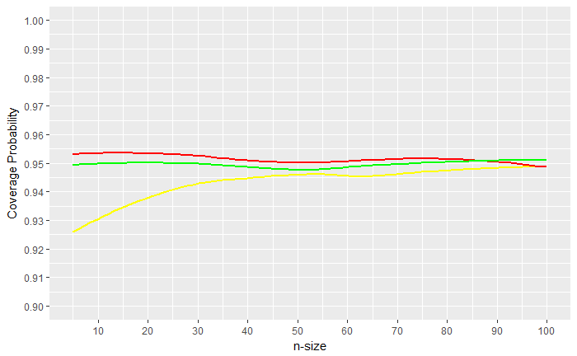
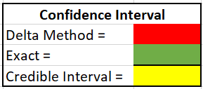
Confidence Interval Coverage as n increases
θ=5

Slide 13
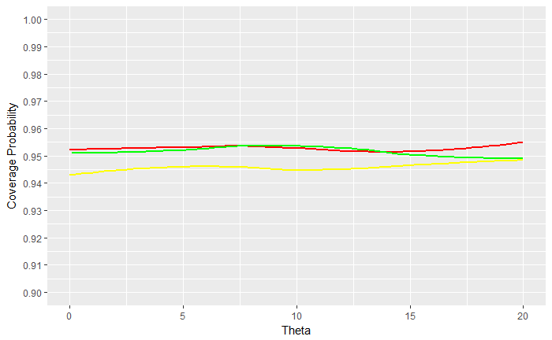
Confidence Interval Coverage with changing θ
N=50

Slide 14
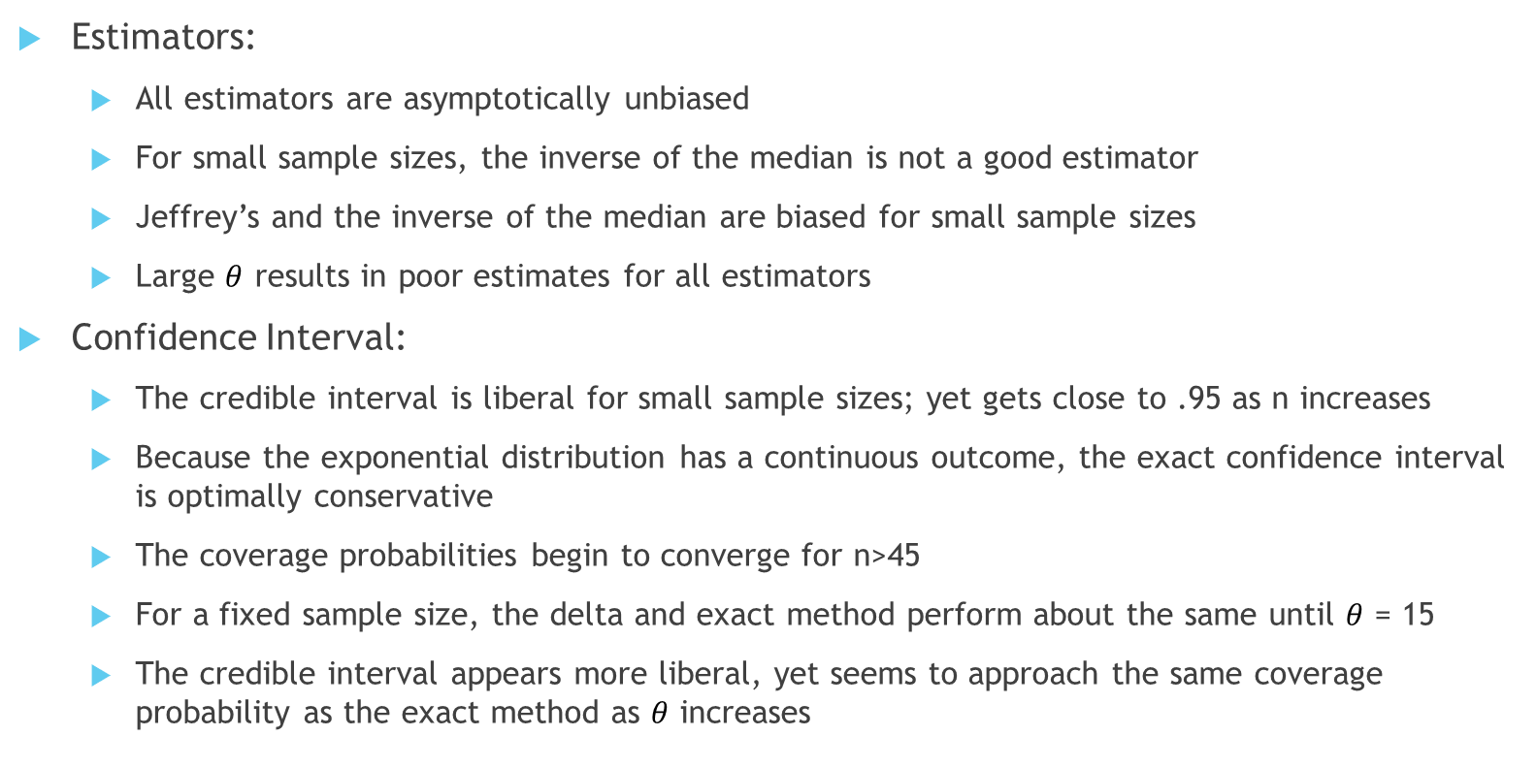
Conclusions
Estimators:
All estimators are asymptotically unbiased
For small sample sizes, the inverse of the median is not a good estimator
Jeffrey’s and the inverse of the median are biased for small sample sizes
Large $θ$ results in poor estimates for all estimators
Confidence Interval:
The credible interval is liberal for small sample sizes; yet gets close to .95 as n increases
Because the exponential distribution has a continuous outcome, the exact confidence interval is optimally conservative
The coverage probabilities begin to converge for n>45
For a fixed sample size, the delta and exact method perform about the same until $θ$ = 15
The credible interval appears more liberal, yet seems to approach the same coverage probability as the exact method as $θ$ increases

