Slide 1
Predicting Walmart Weekly Sales
By Danny Satterthwaite and Drew Jepsen

Slide 2

Problem Description and Goal
Develop and evaluate machine learning models that incorporate internal and external factors to predict department sales, supporting Walmart in strategic decision-making and resource management
Notes:
Walmart needs a robust forecasting model to predict weekly sales for each department across its stores.
Accurate forecasts would enable Walmart to optimize inventory, manage promotions, and better allocate resources, especially during holiday seasons when sales fluctuations are most significant.
We will developed many permutations of our models predicting sales over different time frames.
(30 seconds)

Slide 3

Our Approach and Models
1: Use polynomial regression, random forest, SVM, and an ANN to predict weekly sales across various feature sets
2: Use a polynomial regression, a random forest, and an SVM to predict CPI using all other features
3: Use a polynomial logistic regression, a random forest, and an SVM to predict whether a given week is a holiday week using the other features
Notes:
Presenting Notes
In this presentation we focus primarily on the results from the full feature set
The key here is that across our goal of predicting weekly sales we used 4 different feature sets. A complete feature set as well as different subsets that include both less features as well as some sets that include just social data (non walmart dta but provided) like cpi gas prices
We ended up with over 15 models so for this presentation we will focus just on the complete feature set when discussing predicting weekley sales
Consolidated notes
For predicting weekly sales, looked at various subsets of features and then compared
Focus on full feature set
Our focus was really on task 1

Slide 4
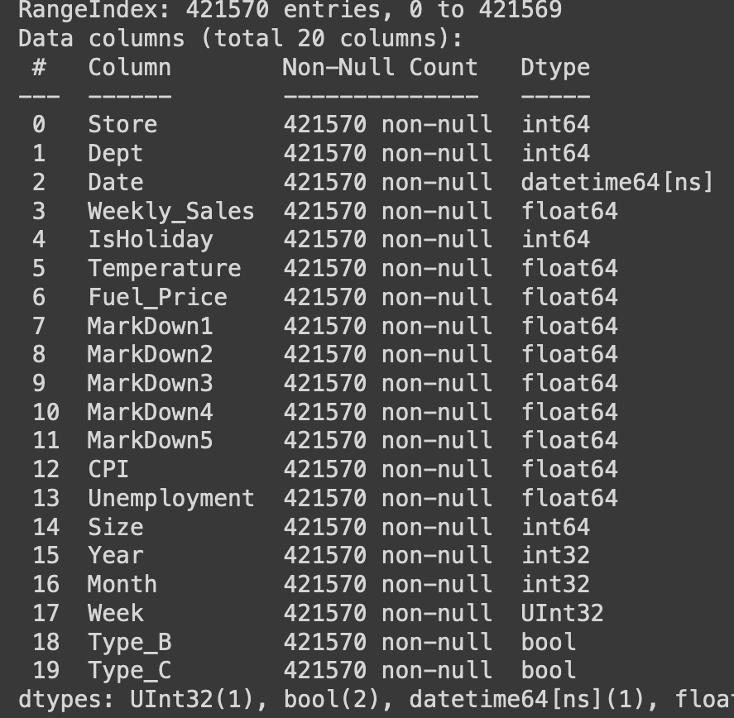
About the Data
Historical sales data from 45 Walmart locations around the country with over 400k records
Sales are tagged by their location, week, and department as well as several other factors
The data is comprised of both the core sales data (store, date, department, weekly sales), data that could affect sales discounts (whether the week is a holiday week and promotional markdowns), as well as variables that correspond to the consumer (region temperature, fuel price, consumer price index, unemployment rate, holidays)
Notes:
The data is labeled and we merged and combined allt he data
Perhaps this is where we discuss the different datasets and allude to using feature importance in the randon forest (discussed in write up)
Mention for SVM had to reduce 50k rows due to runtime
(Drew)

Slide 5
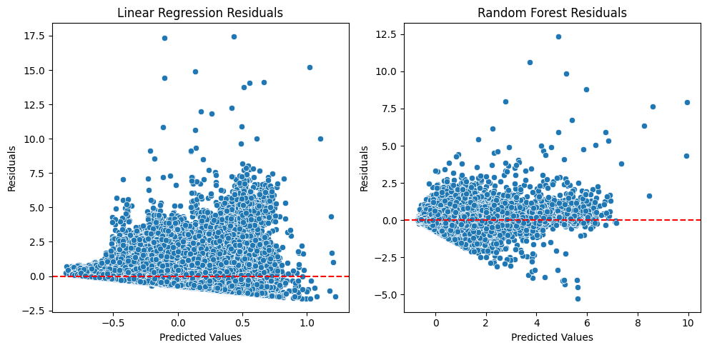
Exploring Other Work
MAE 0.6412
WMAE: 0.6533
MAE: 0.1751
WMAE: 0.1958
Notes:
K means stuff
Pca stuff
Quick mention to sentiment analyisis

Slide 6
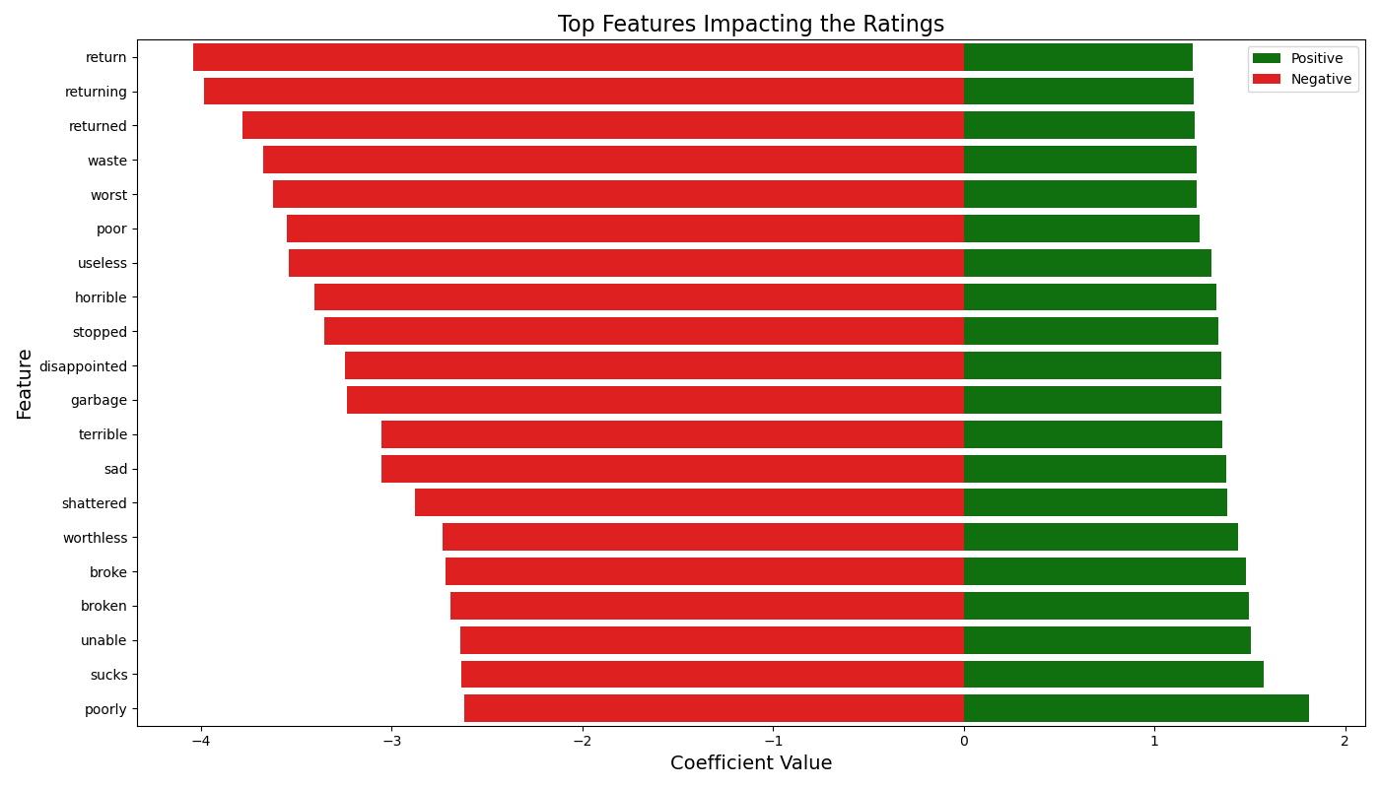
Sentiment Analysis
Ridge Regressor predicting product ratings based on tokenized review data MAE 0.7663

Slide 7
Hyperparameters
3-fold cross validation (after train-test split) using random search of 15 combinations of the following hyperparameters:
Predicting weekly sales and CPI
Poly Reg: L1 ratio (0.001 to 1), alpha (1 to 100,000), degree (1 to 3)
SVM: RBF kernel with C = 1/alpha (-100 to 100), gamma (-1,000 to 1,000)
RF: Number of estimators (10 to 200), max depth (5, 15, 30)
Predicting holiday week
Poly Log Reg: L1 ratio (0.001 to 1), alpha (-1,000 to 1), degree (1 to 3)
SVM: Polynomial kernel with C (-100 to 100), degree (1 to 3)
RF: Number of estimators (10 to 200), max depth (5, 15, 30)
Notes:
Goal was really to just cast as wide of a net possible
Was already taking so long to run so only looked at 15 combos but in a perfect world, obviously we would have done more
As we didnt know which type of regulziarikn to use, we figured a little bit of both couldnt help so we used elastic net regulariztion
(45 seconds)
Consolidated notes
80-20 test train split then 3- fold cross val to find optimal hyperparams
Used random search and considered 15 combinations
We identified the core hyperparams we dciussed in class and considered a wide space of possibilities for values.
For example, we used elastic net regularization and explored both the amount of regularization and l1 ratio to balance minimizing weight size feature selection. Aslo explored the hardness and impact of points by considering a range of c and gamma values. And for the random forest we explored both how big the ensemble is (number of estimators) and the depth to try to minimize overfititn

Slide 8
Scoring
Regression models optimized on MSE however we discuss using MAE
Classification models optimized on precision due to class imbalance
Only 7% of entries correspond to a holiday week
We used precision instead of recall as Walmart would prefer to avoid mistakenly classifying a regular week as a holiday week, which could lead to unnecessary discounts and revenue loss
Context (all based on “y test”)
Weekly Sales
Mean: $15,989.4
Range: $426,230.25
CPI
Mean: 171.23
Range: 101.16
Notes:
Consolidated notes
For our regression tasks we optimized our models around MSE as it is the industry default. However as our key focus was on interpretatblity to an audience of walmart employees who are maby less technical we focus our interpretation on mean absolute error as its essential the average magnitude of the errors (just how far off were we) and easier to interpret in the context of the mean and range.
With that being said, weekley sales has a mean of 16k and a range of 425k
Cpi has a mean of 171 and range of 100
For the classification task to predict whether a week is a holiday week, we noticed a clear class imbalance with there are on,y 7% of weeks which are holiday weeks.
Given this, we could either pick precision or recall but we chose precision as in the context of the walmart overloaders, theyd rather call a week not a holiday, because if they do, there would be pressure add more discounting which hurts profits
We also report many other metrics in the final results
Need to incorporate the subset for svm. Mention it took over 10 hours to run
The big thing here is that we chose to use mean absolute error for the interpreting our results. It’s essential the average magnitude of the errors (just how far off were we) so in the context of the mean and range it’s far easier to inteprret
All metrics are with reference to th test set
Walmart would rather minimize running sales (to the extent they still sell things) we prefer to say a holiday week is in fact not a holiday week, and thus we focus our analysis through the lens of precision.
Walmart would rather say a holiday week is not a holiday week, (so they would’t feel the need to lower pricing or run sales and sell things for a discount when they don’t need them),
MAE is a lot easier to talk to your non tecncial boss than RMSE
( 45 seconds)

Slide 9
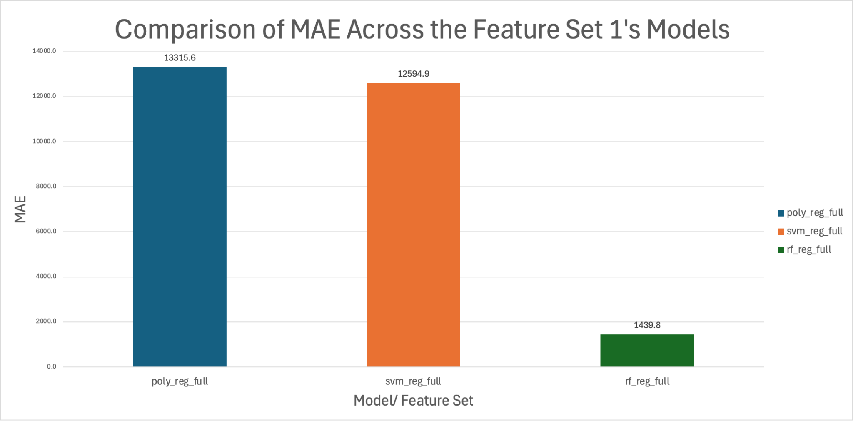
Results: Predicting Weekly Sales
Poly Reg:
Optimal model: Degree=3, L1 ratio = 0.112, alpha=1
Results: MAE=$13,315.6 → 3.1% of range and 83% of mean
RF:
Optimal model: Trees=180, max depth = 30
Results: MAE=$1,440→ 0.34% of range and 9% of mean
SVM:
Optimal model: Gamma=0.1, C=35.94
Results: MAE=$12,594.9 →2.9% of range and 79% of mean
Notes:
Consolidated notes
First looking at our results for predicting weekly sales
Our polynomial regrssion regression model had an mae of about 13 which is 3% of the rang and 80% of the mean which is not great. It used hyperparams that were in the middle of the road but the largest degree
The random forest used the most predictors and grew the deepest and ended up 10 times better than the other models with an mae of 1400 which is about 0.3% of the range and 9% of the mean so when we are off, its not by much
The svm again resulted in hyperparams there were fairly middle of the road but had perfomranc closer to the regression with a mae again near 13k correspond to 3% fo the range and 80 % of the mean. Again not great
Really the takeaway is that with our mixture of categorical and numeric features, randomforests ability to quickly split and narrow down a pathway is key and this is clear here. So we explored feature importance
Again mention in our write up we have all other metrics
And all test set
This is really interesting and we note two main things
The polynomial regression and svm are not good. The fact that the average error is about the size mean is bad. Imagine if the average pearson 5’10 and we had a model and the average amount we were off by means we could say a person is 18 inches tall or 9 and a half feet tall
However, our random forest is nearly 10 times better so using that analogy you can see how much the error shrinks and now we are getting good results in context

Slide 10
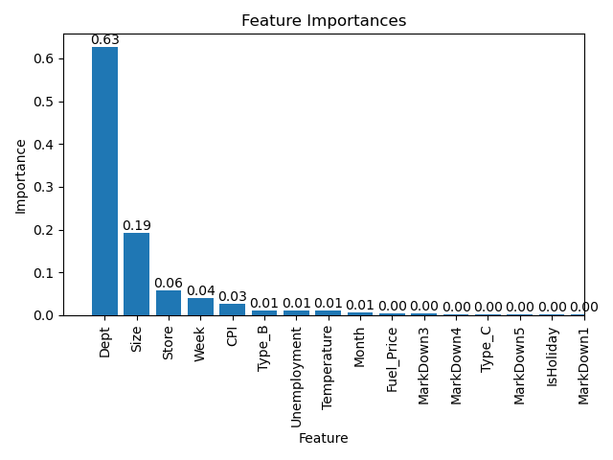
Weekly Sales Feature Importance
From the random forest we also extracted feature importance
Department and size of the store alone account for over 80% of the impurity reduction (importance)
Across all feature sets this holds true
Notes:
Consolidated notes
Continuing this, we looked at feature importance for the aforementioned random model and generated feature importance.
We see that department is the most important by a factor of 3 and that the two most important features, department and size, combined lead 80% importance which really means 80% of a reduction in impurity

Slide 11
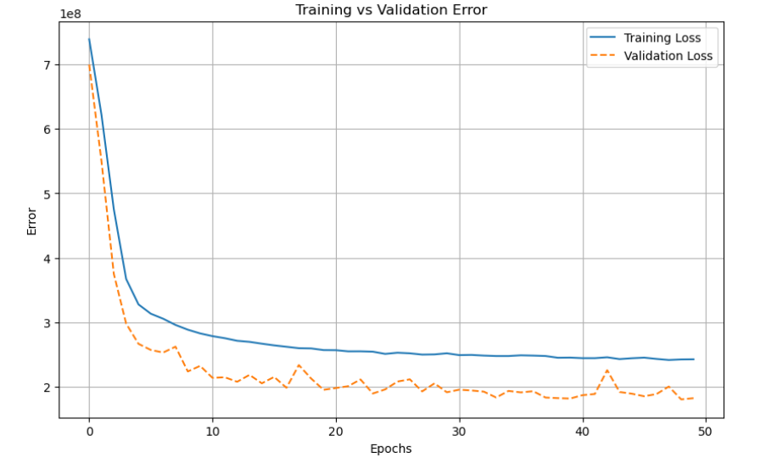
Results: Predicting Weekly Sales Using An ANN
Approach:
Fully connected
Leaky ReLu
Batch size = 64
Experimented with various depths (between 3 and 20 layers) and various numbers of neurons per layer with the best model using:
4 hidden layers of size 300, 200, 100, 50
Used batch normalization, dropout (between 10% and 40% depending on layer) and early stopping
Results:
MAE= $8,212.8 → 1.9% of range and 51.3% of mean
ANN results were better than those of polynomial regression and SVM, but they did not perform as well as the random forest model
Notes:
We also used an ANN to predict weekly sales
Include all the regularization, batch norm etc
Discuss the trials and tribulations to get here
What data we used (the full dataset)
In looking at the graph we see train vs validation scores. We see that training loss is higher than validation loss but this is likely due to the dropout we used. When we look at the final train test MAE (and othe metrics) the test error is more than the training error so all is right
The error falls considerable and plateaus.
Narrow gap and with all of the regularization things (ex dropout) we don’t suspect overfitting or underfitting

Slide 12
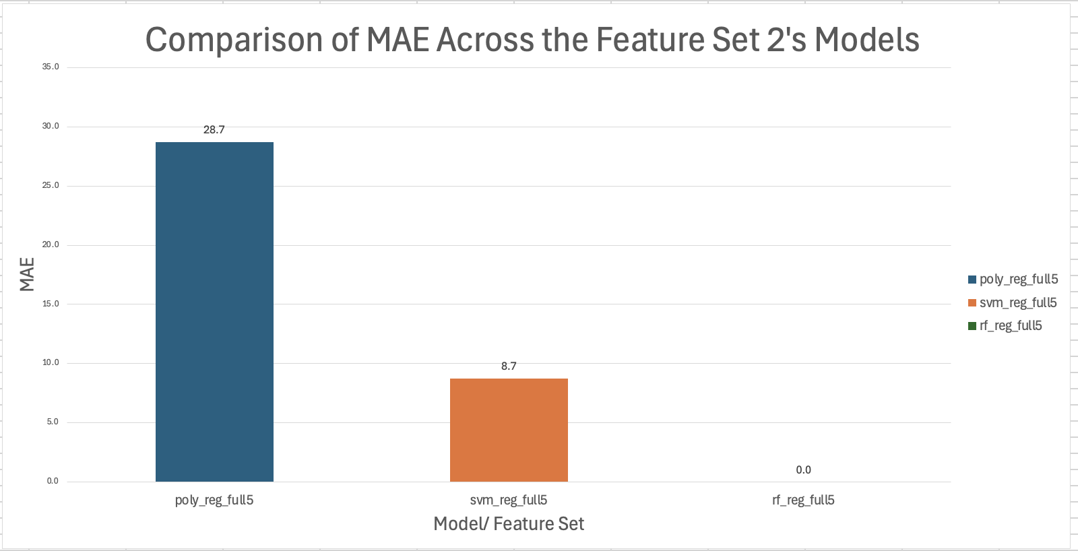
Results: Predicting CPI
Poly Reg:
Optimal model: Degree=3, L1 ratio = 0.112, alpha=1
Results: MAE=28.7→ 28% of range and 16.7% of mean
RF:
Optimal model: Trees=80, max depth = 30
Results: MAE=0 → 0% of range and 0% of mean
SVM:
Optimal model: Gamma=0.1, C=35.94
Results: MAE=8.7 → 8.6% of range and 5.1% of mean
Feature Importance:
Store: 40% of importance. Size: 34% of importance. Unemployment 22% of importance.
Notes:
The big thing here is that the random forest had, across all metrics for both training and test, an error of 0
The fact that the training set also results in an error of zero is interesting as it hints at overfitting not being a problem. So, while surprising, our random forest gives us a perfect performance. Note that these results are rounded, technically there is a non-zero error out to tenth (or more) digit for the random forest.
This makes sense as CPI is tracked locally in the data, thus the model can learn, given the location (store), what the CPI is. Size is likely correlated with location and demand and is thus helpful in narrowing down CPI. Unemployment is interesting as well as high CPI is often associated with inflation which can be associated with high unemployment.

Slide 13
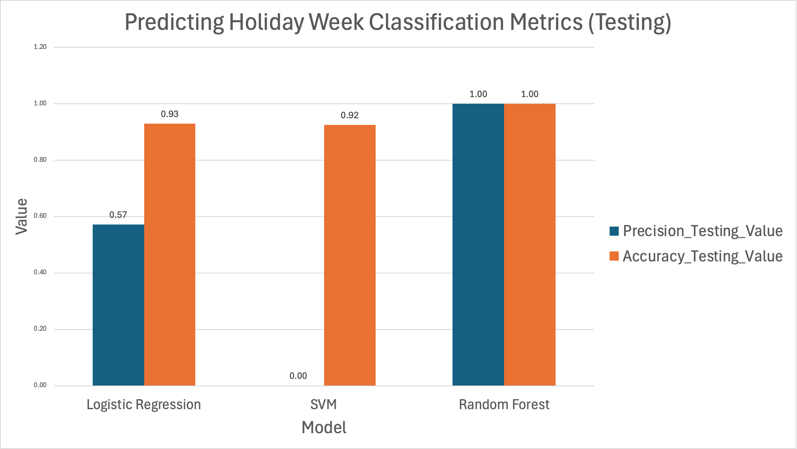
Results: Classifying a Week as a Holiday Week
Poly Log Reg:
Optimal model: Degree=3, L1 ratio = 0.22, C=1.29
Results: Precision = 0.57, Acc=0.93
RF:
Optimal model: Trees=60, max depth = 30
Results: Precision = 1, Acc=1
SVM:
Optimal model: Degree=3, C=0.028
Results: Precision = 0, Acc=0.92
Feature Importance:
Fuel price, CPI, and temperature are the most important features accounting for 86% of the importance
Notes:
Consolidated notes
Lastly, we wanted to briefly talk about our classification task of predicting holiday weeks
Across the board, like we’ve already seen, hyperparams were middle of the space except for the random forest which grew big and deep. You’ll see those details in the slides.
In regard to performance as we’ve already talked about, precision is really what matters to use as due to the class imbalance of 7% 93% of the time we could say a week is not a holiday week and be right. This is exactly what the svm and logistic regression appear to be doing
In regard to precision, the logistic reg had a precision of about 0.6, the svm 0, and the RF 1. So every time the rf says a week is a holiday week, it is, to the othe extreme, for the svm, none of the weeks it says are holiday weeks are actually holiday weeks which is again problematic.
This all floolws a similar trend of the random forests being great while the other models not so much
We also examined feature importance and found tha fuel price, cpi and temp were the most important and accounted for 86% of the omporatna
Interestingly, the random forest had perfect accuracy on both the testing and training sets. On the other hand, the logistic regression and SVM struggle with the proportion of true holiday weeks (precision) with the SVM interestingly having a precision of 0. This makes sense as only 7% of of weeks are holiday weeks, (1-0.7)% =93% of the time we are correct we see a week is a holiday week and thus we would expect accuracy to be right around 93%. This is exactly what we see for the logistic regression and SVM models
Additionally, both the SVM and logistic regression have a recall of 0 meaning they can’t predict any of the holiday weeks (this is of course problematic).
On the completely other hand, across all measures the random forest model is perfect. This is again quite surprising but the fact that the testing scores were also perfect makes us less concerned.
This is all to say, that in our context of not selling items for less than we need to, the random forest model is clearly the best option.
Once against he random frest grew as deep as we allowed
For feature importance, Fuel price → 0.35, CPI→0.26, Temp→ 0.25
Notes to self omitted some other pieces as didnt want to muddy water. Explain more in paper

Slide 14
Final Thoughts and Next Steps
For our data and our problems, random forest performed significantly better than other models
Analyze the results on a store-by-store basis to uncover location-specific trends
Explore RNN and LSTM models
Notes:
Random forests are great
As we have seen through this entire project, random forests are incredibly powerful and work well with our mixture of categorical data (easy and clear splits) and geographical spread, narrowing down the answer very quickly and accurately.
Also, this is for 47 stores, but we think it would be interesting and perhaps even more useful to explore predicting the sales for just a single store. We suspect some of the national varation that could be dragging our results down would go away and if anything these results would be more usable for a local manager or CEO

