Slide 1
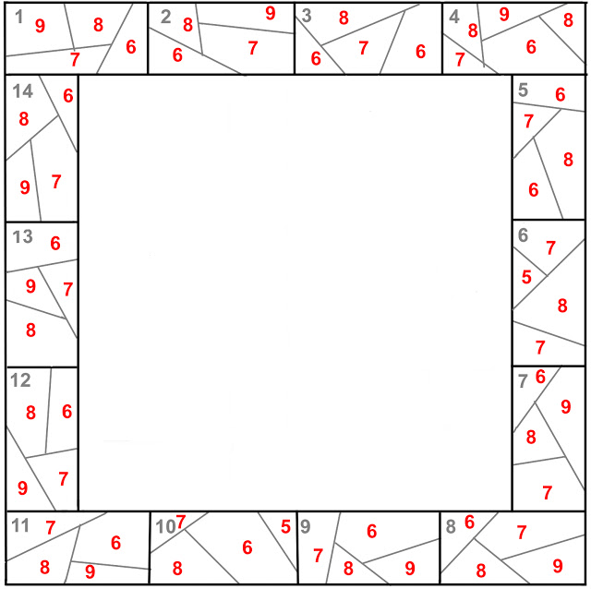
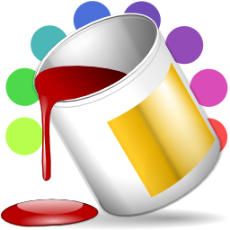
Color by Number
Developed by: Darrenn Saulis
Hosted by: Saulis Inc.
In partnership with : JEDI & CCNB

Slide 2
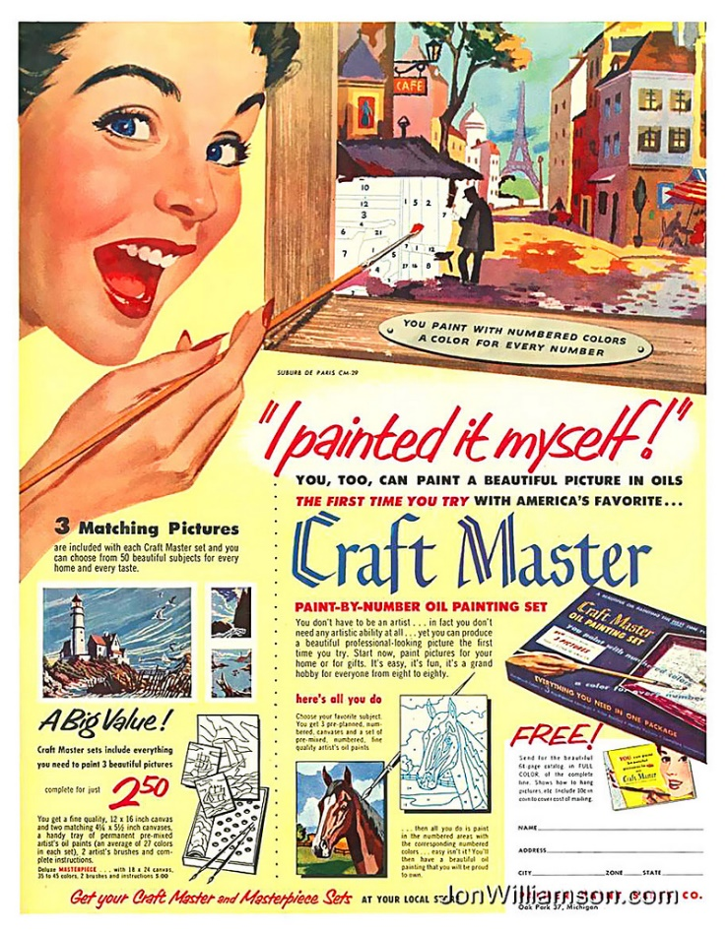
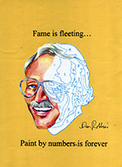
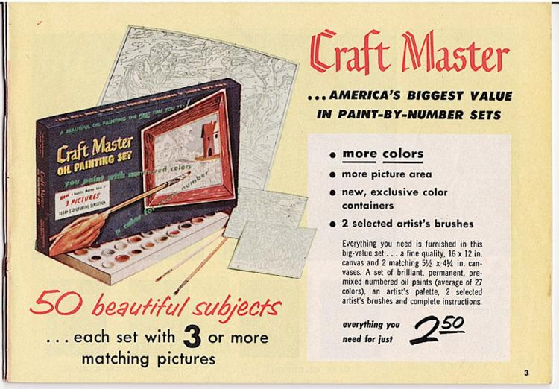
History Lesson
Began in the 1950’s
Dan Robbins
ABSTRACT NO.1
Craft Master
Notes:
- Max S Klein owner of the Palmer paint company
- creating washable paint for kids
Was the first prototype, and was impressed by the work but it wasn’t “pretty enough”
(Craft Master)With many attempt Dan create 6 new kits. From 1954 Palmer sold 12 million kits.

Slide 3
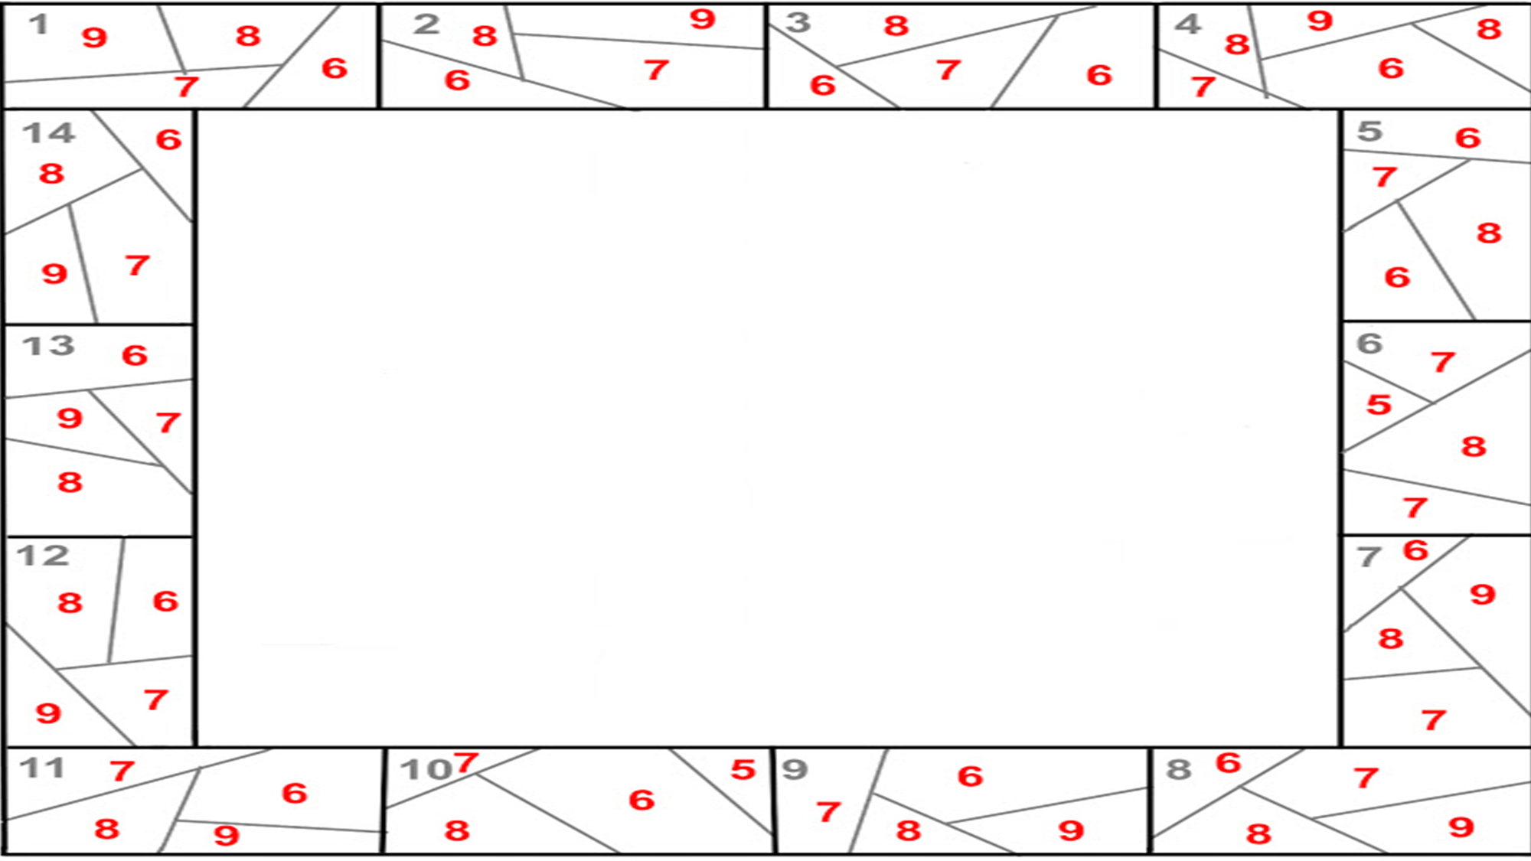
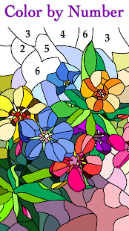


21st Century
Ages 2-100
Basic Color by Number
Target Market
Features
Purpose
Therapeutic benefits
Stages
Notes:
Simple color by number but virtual form
Target market- Anyone from 2-100, artistic people and just bored.
Attach to user by using limited ads and better pictures
Entertain people.
Connect with social media, print artwork from a wireless printer, create your own color by number, or submit own.
Studies have shown its calming.
Broken down into 3 stages

Slide 4
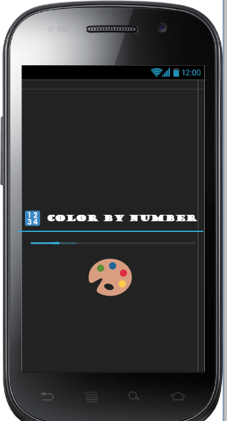
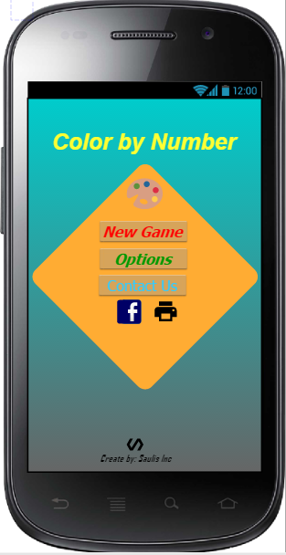
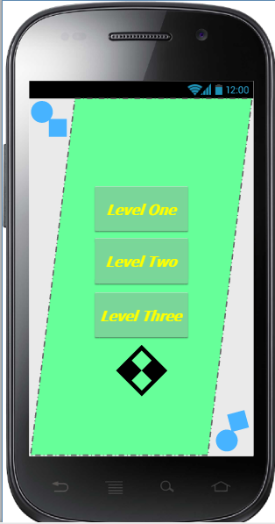
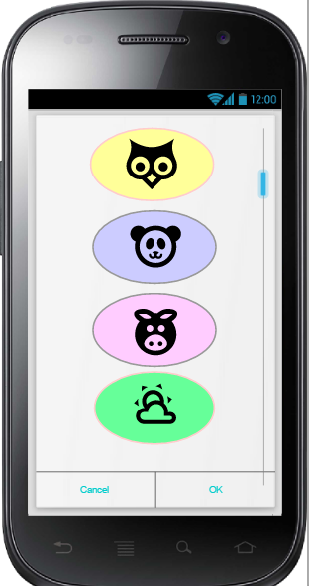
Run Down

Slide 5
References
https://www.paintbynumbermuseum.com/dan_robbins_intro
https://www.google.ca/search?biw=1366&bih=657&tbm=isch&sa=1&ei=i5fxW4KhJ-eIggfjhJW4Ag&q=color+icons&oq=color+icons&gs_l=img.3..0l10.19919.23642..23761...2.0..0.377.3634.2-6j6......1....1..gws-wiz-img.....0..35i39j0i67j0i5i30j0i8i30.-21ocWrZrAM#imgrc=mGivgUwplS7v7M:
http://americanhistory.si.edu/paint/rembrandt.html
https://www.paintbynumbermuseum.com/dan_robbins_intro

