Slide 1

Credit card fraud detection
By:
Olu Olayeye
Daniel Saulsberry
Seth Boswell
Malli Montano

Slide 2
overview
The Annual Data Book compiled by the Federal Trade Commission reports that Credit card fraud accounted for 393,207 of the nearly 1.4 million reports of identity theft in 2020.
This makes credit card fraud the second most common type of identity theft reported, behind only government documents and benefits fraud for that year.
Some surveys suggest that a typical organization loses 5% of their yearly revenues to fraud. These numbers can only increase since the number of non-cash transactions increases, providing more opportunities for credit card fraud.

Slide 3
OVERVIEW
For retailers and banks to not lose money, procedures must be put in place to detect fraud prior to it occurring.
Credit card companies must identify fraudulent credit card transactions so that customers are not charged for items that they did not purchase.
To combat this problem, financial institution traditionally uses rule-based approaches to identify fraudulent transactions.
These algorithms use strict rules to determine when a transaction is fraudulent.

Slide 4
Challenges of a strict ruled-based algorithm include:
Any new scenario that could lead to fraud needs to be manually coded into the algorithm.
Increases in customers and size of data leads to a corresponding increase in the human effort, time and cost required to track new scenarios and update the algorithm.
Since the algorithm cannot go beyond defined rules, it cannot dynamically recognize new scenarios that could result in fraudulent transaction.

Slide 5
How do we overcome these limitations?
Organizations are beginning to utilize machine learning and data science to build fraud detection systems.
Given the size of available data, computational resources, and powerful machine learning algorithm available today, data science and machine learning processes will be able to find patterns in data and detect fraud easily.

Slide 6
goal
The goal of this Credit Card Fraud Detection project is to classify a transaction as valid or fraudulent in a large dataset.
Since we are dealing with discrete values, this is a binary classification problem, and we would employ the use of a supervised machine learning algorithm.

Slide 7
Dataset used:
Transactions made by credit cards in September 2013 by European cardholders.
Transactions that occurred in two days, where we have 492 frauds out of 284,807 transactions.

Slide 8
Control flow
1. Understanding the problem
2. Importing required libraries and understanding their use
3. Importing data and learning its structure
4. Performing basic EDA
5. Scaling different variables
6. Outlier treatment
7. Building basic Classification model with Random Forest
8. Nearmiss technique for under sampling data
9. SMOTE for oversampling data

Slide 9
Control flow (CONTINUED)
10. cross validation in the context of under sampling and oversampling
11. Pipelining with sklearn/imblearn
12. Applying Linear model: Logistic Regression
13. Applying Ensemble technique: Random Forest
14. Applying Non-Linear Algorithms: Support Vector Machine, Decision Tree, and k-Nearest Neighbor
15. Making predictions on test set and computing validation metrics
16. ROC curve and Learning curve
17. Comparison of results and Model Selection
18. Visualization with seaborn and matplotlib

Slide 10
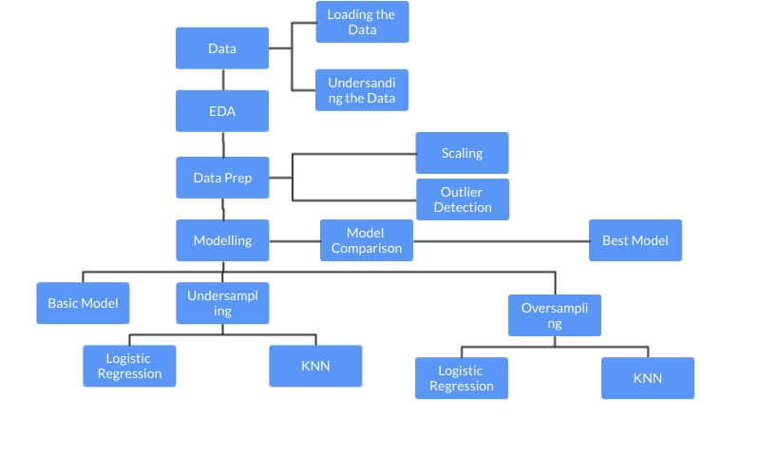
Solution workflow

Slide 11

technology

Slide 12
Logistic regression
Logistic regression is a classification algorithm used to find the probability of event success and event failure.
It is used when the dependent variable is binary (0/1, True/False, Yes/No) in nature.
It supports categorizing data into discrete classes by studying the relationship from a given set of labelled data.
It learns a linear relationship from the given dataset and then introduces a non-linearity in the form of the Sigmoid function.

Slide 13
Why logistic regression?
Logistic regression is easier to implement, interpret, and very efficient to train.
It makes no assumptions about distributions of classes in feature space.
It not only provides a measure of how appropriate a predictor (coefficient size) is, but also its direction of association (positive or negative).
Good accuracy for many simple data sets and it performs well when the dataset is linearly separable.

Slide 14
RANDOM FOREST
Random forest is a technique used in modeling predictions and behavior analysis and is built on decision trees..
It contains many decision trees representing a distinct instance of the classification of data input into the random forest.
The random forest technique considers the instances individually, taking the one with most votes as the selected prediction.
It works well with both categorical and continuous values and automates missing values.

Slide 15
Why random forest?
It reduces overfitting in decision trees and helps to improve the accuracy.
It is flexible to both classification and regression problems.
It works well with both categorical and continuous values.
It automates missing values present in the data.
Normalizing of data is not required as it uses a rule-based approach.

Slide 16
SVM
While SVMs do a good job recognizing speech, face, and images, they also do a good job at pattern recognition in categorical datasets.
SVM can be used for the data that is not regularly distributed and have unknown distribution.
New examples are then mapped into that same space and predicted to belong to a category based on which side of the gap they fall.
SVM maps training examples to points in space to maximize the width of the gap between the two categories

Slide 17
Why svm?
SVM works relatively well when there is a clear margin of separation between classes.
SVM is effective in high dimensional spaces.
SVM can be used for other types of machine learning problems, such as regression, outlier detection, and clustering.
SVM is very helpful method if we don’t have much idea about the data. It can be used for the data such as image, text, audio etc. It can be used for the data that is not regularly distributed and have unknown distribution

Slide 18
K-Means Clustering
Is a centroid-based algorithm, or a distance-based algorithm, where we calculate the distances to assign a point to a cluster.
It aims to partition n observations into k clusters in which each observation belongs to the cluster with the nearest mean, serving as a prototype of the cluster.
The "cluster center" is the arithmetic mean of all the points belonging to the cluster, and each point is closer to its own cluster center than to other cluster centers.
The k-means algorithm searches for a pre-determined number of clusters within an unlabeled multidimensional dataset

Slide 19
Why k-means clustering?
It is easy to implement k-means and identify unknown groups of data from complex data sets. The results are presented in an easy and simple manner.
K-means algorithm can easily adjust to the changes. If there are any problems, adjusting the cluster segment will allow changes to easily occur on the algorithm.
K-means is suitable for many datasets, and it’s computed much faster than the smaller dataset. It can also produce higher clusters.
The results are easy to interpret. It generates cluster descriptions in a form minimized to ease understanding of the data.
Compared to using other clustering methods, a k-means clustering technique is fast and efficient in terms of its computational cost

Slide 20
Database approach
Load raw dataset into AWS S3 bucket/PgAdmin.
Connect to AWS S3 bucket/PgAdmin and read data into Pandas.
Load the raw data into a PgAdmin Database Instance located in AWS.
Perform preprocessing steps and store cleaned data in a new table in AWS S3 bucket/PgAdmin.
Store some intermediate results (which can be used later for visualization) in AWS S3 bucket/PgAdmin.
The connection and S3 bucket details are in the Segment_One Jupyter Notebook.
A notebook that contains the code of the above steps is part of this repository.

Slide 21
Data cleaning and analysis
This project will utilize Jupyter notebook and the panda's library to perform data cleaning and analysis.

Slide 22
Description of communication protocols
Communication for this project was through the Slack Group Chat.
Every team member will work in their individual branches.
A designated team member will validate the pull request and merge the request to the main branch.
Team members will create pull requests which will be collectively approved in the slack channel.

Slide 23

results

Slide 24
Database erd
Database ERD shows all tables used to store intermediate exploratory data analysis results, and modelling results.

Slide 25
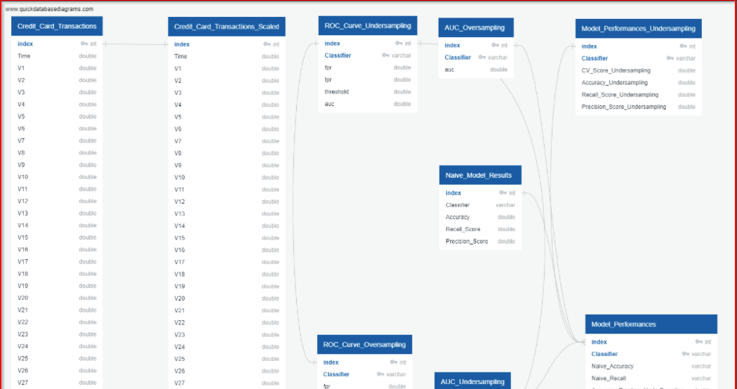

Slide 26

Exploratory data analysis

Slide 27
Univariate analysis
Univariate plots show that the dataset is highly imbalanced.
The pie chart shows an imbalance in the data, with only 0.17% of the total cases being fraudulent.
The univariate distribution plot of the time and amount feature show we have a dataset with some large outlier values for amount.
The time feature is distributed across two days.
Bivariate plots show that the valid transaction class has a normal distribution shape across most of the features.
Conversely, the fraud class show long-tailed distribution across many of the features.

Slide 28
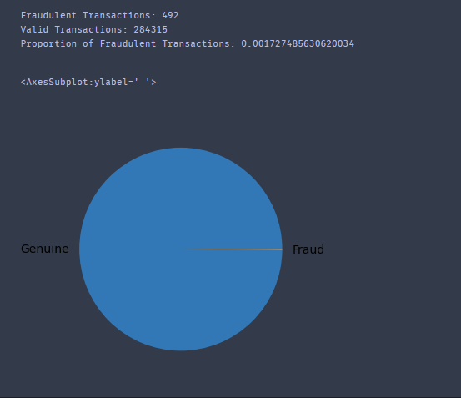
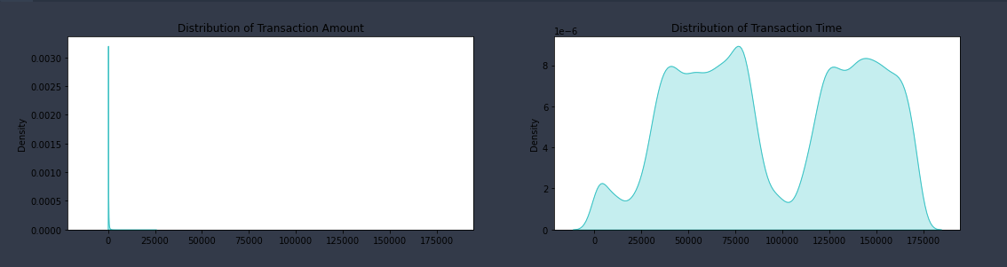
Univariate analysis

Slide 29
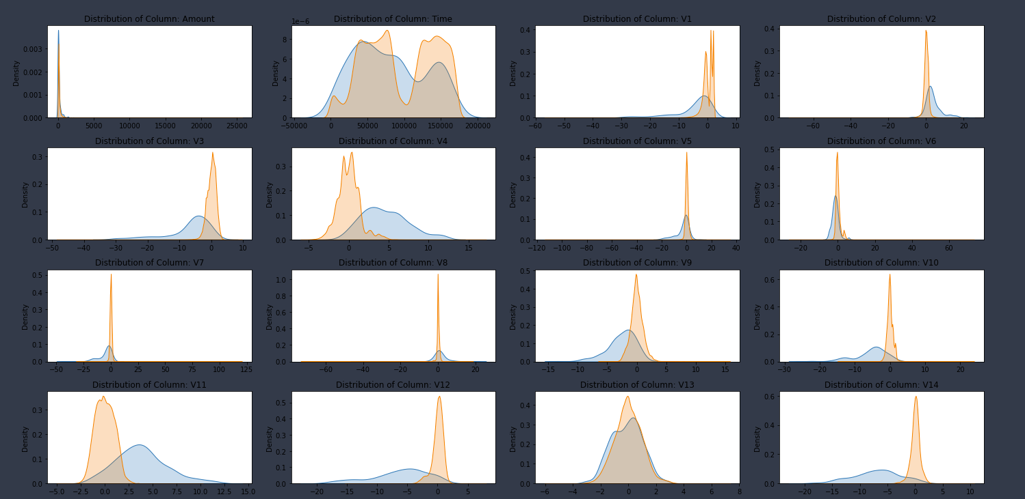
Bivariate analysis

Slide 30

Naïve model results
While the naive logistic classifier accuracy is 100%, our classifier did not do an excellent job at predicting fraudulent transactions.
While the naive random forest classifier accuracy is 100%, and precision is 95%, our random forest classifier only achieved a 77% recall.
With precision and recall of 0.84 and 0.62, we would need a better understanding of the dataset to determine the best way to improve the recall metric.
We would need a better understanding of the dataset to determine the best way to improve the recall metric.

Slide 31
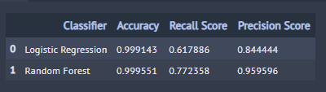
Naïve model results

Slide 32
The roc-auc curve
ROC is a probability curve that plots True Positives and False Positives at different classification thresholds.
AUC - ROC curve is a performance measurement for a classifier at various classification thresholds.
Lowering the classification threshold classifies more items as positive, thus increasing both False Positives and True Positives.
Increasing the classification threshold classifies more items as negative, thus increasing both False Negatives and True Negatives.
The AUC lets us find the optimal classification threshold that minimizes False Positives and False Negatives.
For our credit card classification problem, we would want a classification threshold that increases True Positives.
AUC measures the entire two-dimensional area underneath the entire ROC curve from (0,0) to (1,1).
AUC tells how much the model is capable of distinguishing between classes.
Higher the AUC, the better the model is at predicting 0 classes as 0 and 1 classes as 1.

Slide 33
The learning curve
The learning curve is the plot of the training/cross-validation error versus the sample size.
Learning curves show the relationship between training set size and the recall metric on the training and validation sets.
The learning curve detects whether the model has the high bias or high variance.
If the model suffers from high bias problem, as the sample size increases, training error will increase and the cross-validation error will decrease.
Training error and cross-validation error will end up close to each other but still at a high error rate.
If the model suffers from high variance, as the sample size increases, the training error will keep increasing and cross-validation error will keep decreasing.
Training error and cross-validation error will end up at a low training and cross-validation error rate.

Slide 34
Undersampling model results
By Undersampling the majority class in our dataset, all classifiers achieved recall scores greater than 85% except for the Support vector classifier.
The ROC Curve show that the Support Vector Classifier has the largest AUC at 0.979, while the decision tree classifier has the smallest AUC at 0.700.
All undersampling curves show a fairly ideal learning curve.
As the training size increases, training error and validation error generally reduces and end up at a low rate.

Slide 35
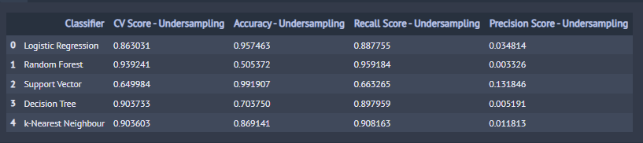
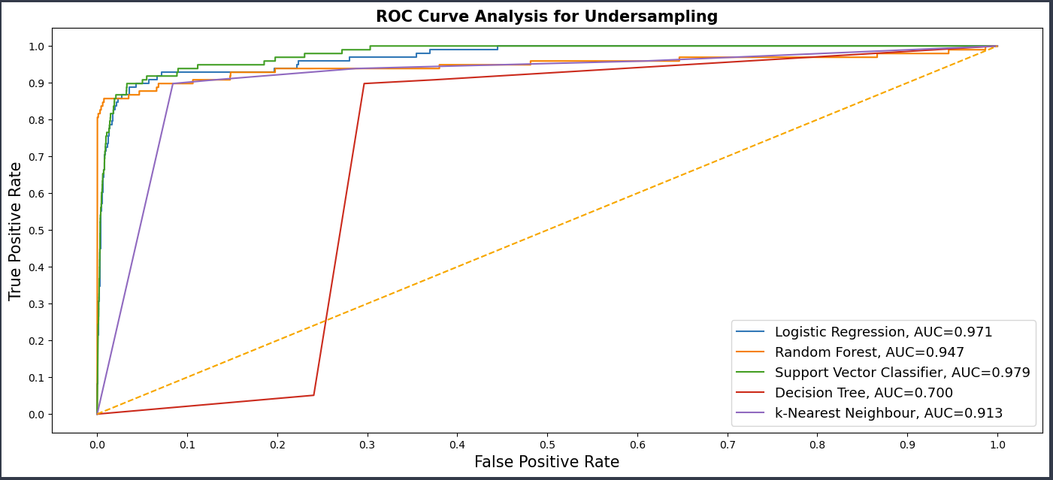
Undersampling results

Slide 36
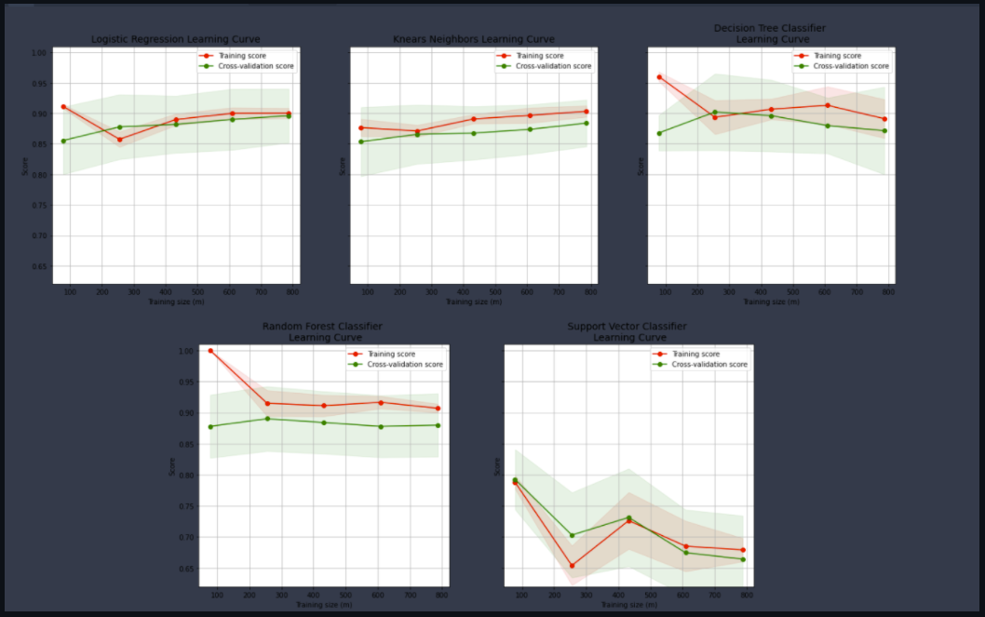
UNDERSAMPLING RESULTS

Slide 37
Oversampling model results
By Oversampling the dataset, we achieved recall scores greater than 85% for all classifiers.
The Random Forest classifier had the best accuracy of 99%.
The ROC Curve show that the random forest classifier has the largest AUC at 0.987 while the decision tree classifier has the smallest AUC at 0.692.
All oversampling learning curves show a good fit.
As the training size increases, training error and validation error generally reduces and end up at a low error rate.

Slide 38
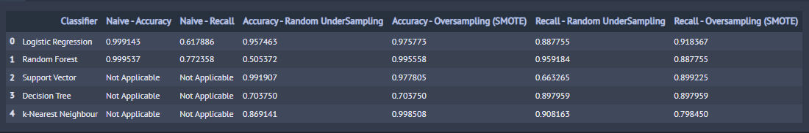
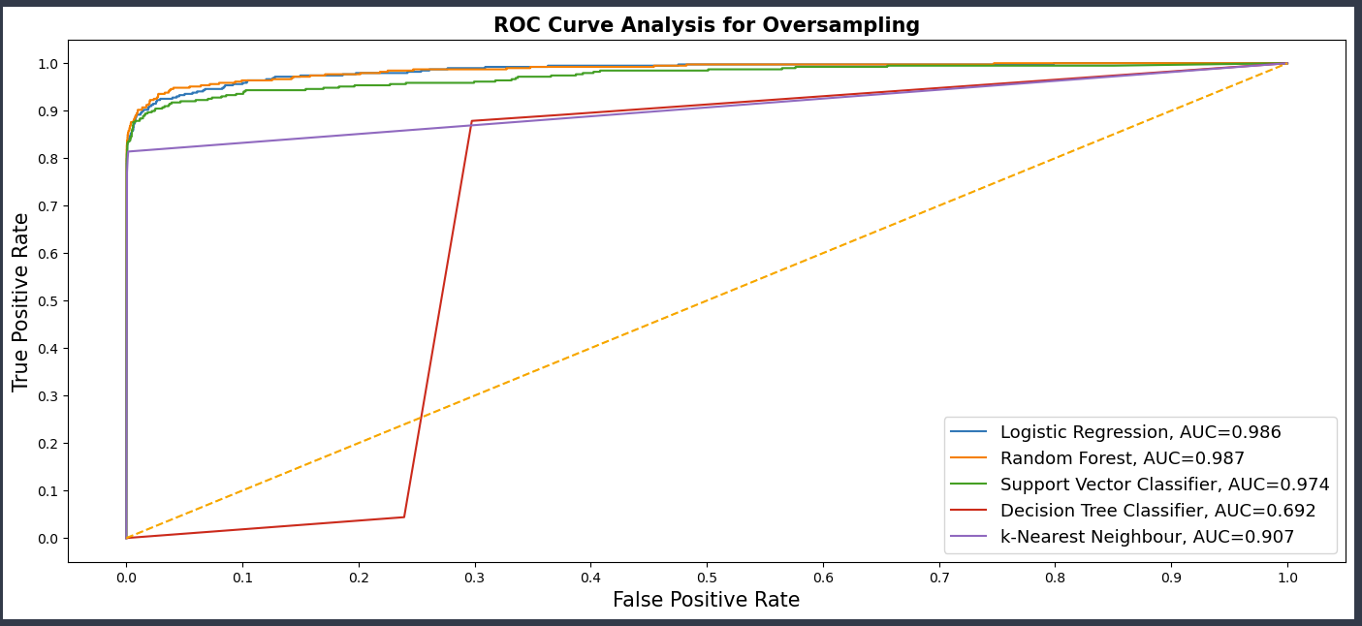
Comparing model results

Slide 39
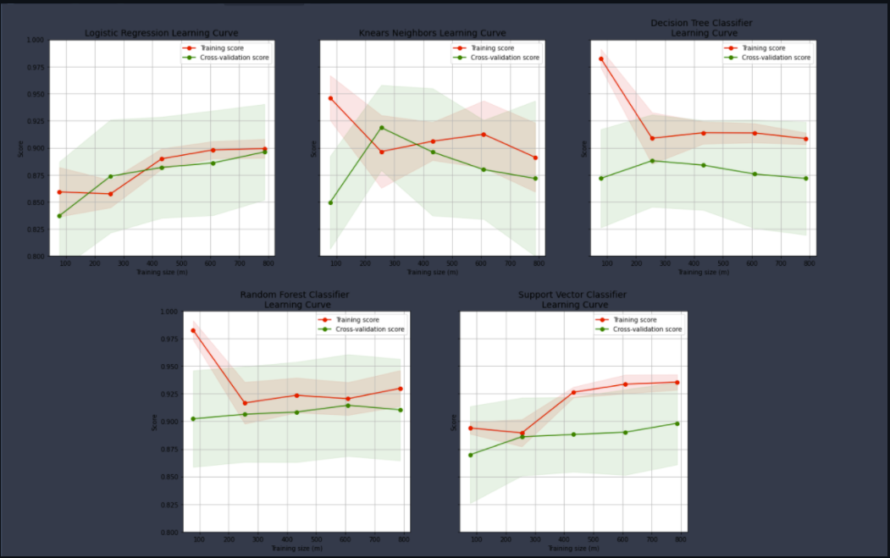
OVERSAMPLING LEARNNG CURVE

Slide 40
summary

Slide 41
The dataset
The dataset used for this project has 284807 rows of credit card transactions.
Exploratory data analysis reveal as expected that we have a highly imbalanced dataset.
Only 0.17% of all transaction are fraudulent.
While a large portion of the features have been anonymized with PCA, univariate and bivariate distribution plots show that the genuine transaction class has an approximately normal distribution across all features, and the fraud class was had a left skewed distribution for many of the features.

Slide 42
Naïve models
While naive logistic regression and random forest had an accuracy of 100% and a precisions of 84% and 96% respectively, both classifiers only managed recall scores of 62% and 77% respectively.
This means that, the classifiers would miss fraud transaction almost 25% of the time.
This type of metric would cost an organization alot of money.

Slide 43
Performance metric
Classifying transactions as fraud or genuine is an anomaly detection problem where only a small fraction are the anomalies, measuring model performance with the accuracy metric will not be ideal.
To capture fraud transactions, we would require a classifier that has a high recall metric.
Recall is the ratio of of True Positives to the total of True Positives and False Positives

Slide 44
Oversampling, undersampling, roc, and learning curve
To improve the recall score of the naive models, we employ oversampling and undersampling.
With these methods, we achieved recall scores greater than 90%, and 85% for the undersampling and oversampling methods, respectively.
While recall for random forest was highest at 95.9%, the classifier had a lower AUC value (91.5) than the logistic regression classifier with AUC of 92.1.
Analysis of the learning curve show that the logistic regression had a generally good fit.

Slide 45

Best model
To choose the best model, we may consider the following factors:

Slide 46
Characteristics of the dataset
Since we are dealing with an imbalanced dataset, our first intuition is applying techniques such as undersampling and oversampling.
The Random Forest Classifier works well with resampling.
The Random Forest classifier lets us bootstrap samples, so we take a resample of our training data set.
And then we rebuild classification or regression trees on each of those bootstrap samples.

Slide 47
Evaluation metric: recall score
Since imbalanced datasets will generally have high accuracy scores, we need a different metric to evaluate model performance.
The choice of model may depend on the recall metric which measures the ratio of of True Positives to the total of True Positives and False Positives

Slide 48
Auc-roc curve
The learning curve helps us evaluate whether our model is overfitting, underfitting, or has a good fit.
The learning curve can be used in addition to the recall metric, and the AUC-ROC curve to select the best model for this classification problem.

Slide 49
Challenges and recommendations
One challenge with this project was computation resources required to run the RandomizedGridSearchCV and the model Cross-Validation scores.
One way to to mitigate this challenge in the future may be to use the HalvingGridSearchCV which may in some cases may be 30% faster than the RandomizedGridSearchCV.
We may also explore using an online environment that has unlimited computation resources that can handle the resource requirements for memory and CPU intensive models and processes.
Since feature extraction had been done on the dataset, visualizing potentially interesting relationships was not possible with this dataset.

Slide 50
Takeaways
When dealing with an imbalanced dataset, model accuracy is almost always high.
High model accuracy in an imbalanced dataset does not always translate to a good model
Depending on the problem at hand precision or recall may be a better metric to measure model performance.
Undersampling and Oversampling are two methods that can be used to potentially increase model performance when we have an imbalanced dataset.
While recall is a good way to measure our model performance, it is important that we determine our optimum threshold from the AUC-ROC curve
While we can implement a model with good accuracy and recall score, we want to validate that our model has a good learning experience.
We can determine model overfit, underfit or good fit with the ROC curve.

Slide 51

Thank You

