Slide 1

Can we predict Eurovision’s winners through twitter feed?

Slide 2
Data Preprocessing & Cleaning
Challenges:
Twitter parsers offer recent data only
Twitter API does not allow a lot of data requests
Data Retrieval:
Only tweets in English
Tweets between 05-08-2018 to 05-12-2018

Slide 3
Data Preprocessing & Cleaning
Preprocessing:
Tweets in English only
Exclude URLs from tweets
Stop words (‘Eurovision’, ‘twitter’)
Exclude punctuation

Slide 4
Workflow
Collect Tweets
Tokenize, Stem
TFI-DF
Topic Modeling

Slide 5
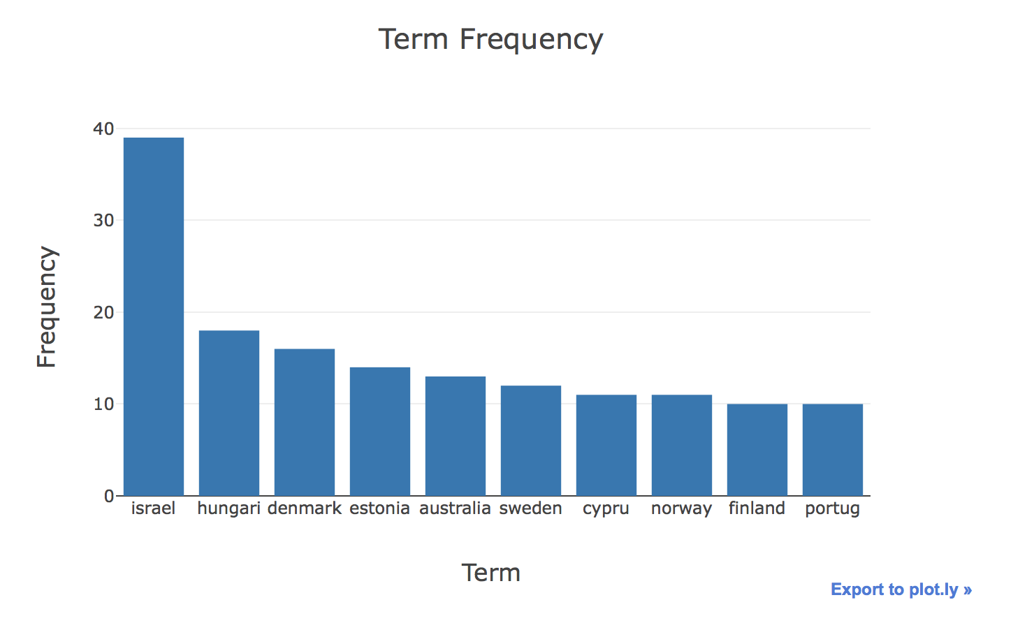
Frequently tweeted countries

Slide 6
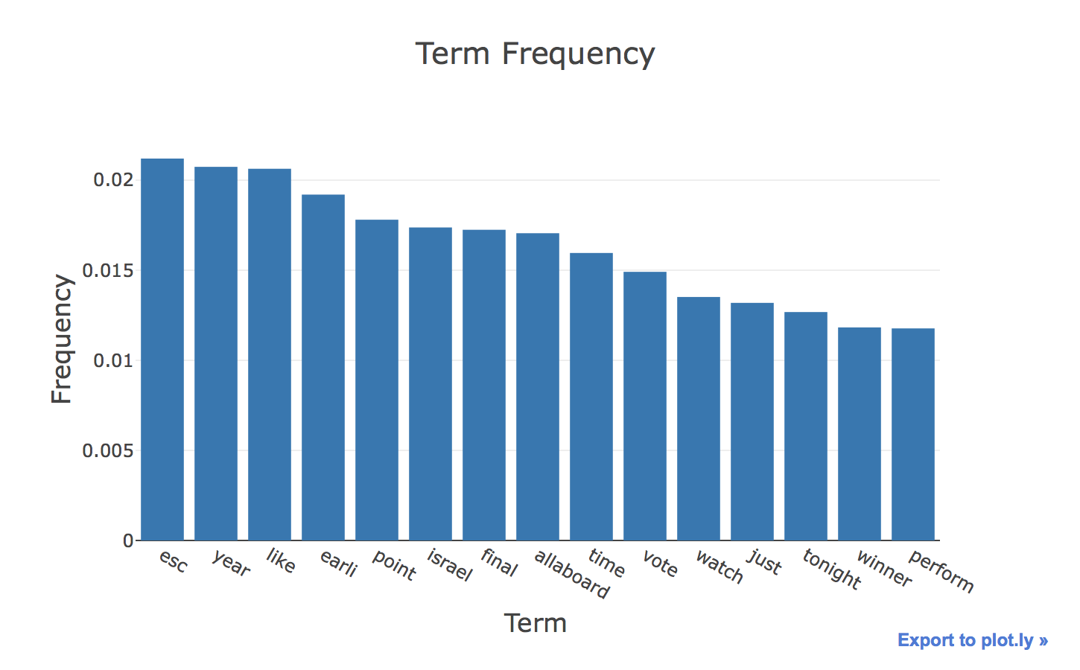
TFI-DF
term | weight
esc | 0.0212
year | 0.0207
like | 0.0206
earli | 0.0192
point | 0.0173
israel | 0.0174
final | 0.0172

Slide 7
Topic modeling - lda
Common Topic
odd esc rank final
like earli song join
year israel love point
good earli like know
song year esc time
song esc s lisbon
point card time live
song earli year s
final semi cest song
‘I am 1000 % Team Israel! #Eurovision’
‘Toy is the best Eurovision winner off the 2000 's #Eurovision’
Why Israel why?! #eurovision

Slide 8
Topic modeling - lda
‘18 Palestinians killed by Israel so far Rabbi this is the true face of Israel more than 1000 injured Rabbi #Eurovision’
‘As Israel kills dozens and injures close to 2000 peaceful protesters in Gaza, "celebratory"concert taking place in Tel Aviv tonight. #Eurovision pic.twitter.com/e1uAuAY7YP’
‘Israel has killed 57 Palestinians since March 30th alone and shot over 2000 with live ammunition. #Eurovision votes for Israel would be stained with the blood of Palestinians & OK for more murders by the Apartheid state . #BDS #BoycottIsrael #Eurovision2018 #FinalEurovision pic.twitter.com/0RuyHsaG5J’
Common Topic
israel palestinian kill vote
israel esc entri year
israel time year watch

