Slide 1
Hands-on 3: Yield Modeling
Rhonda Morgan (JPL) & Dmitry Savransky (Cornell University)

Slide 2
Science Yield Modeling
Yield modeling seeks to answer the questions:
How much “science” will a mission concept produce?
How do engineering design decision impact science return?
How can we optimize mission operations to maximize science?
In this hands-on session, we will learn about the basics of yield modeling for exoplanet direct imaging space missions
Topics covered include:

Slide 3
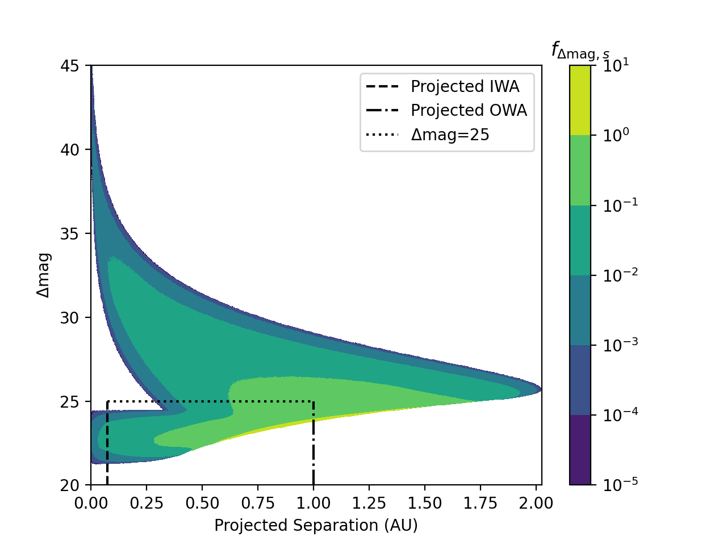
How to Compute Completeness and Yield
Completeness is the probability of detecting an exoplanet with a given instrument
Survey yield can be computed by summing completeness values

Slide 4
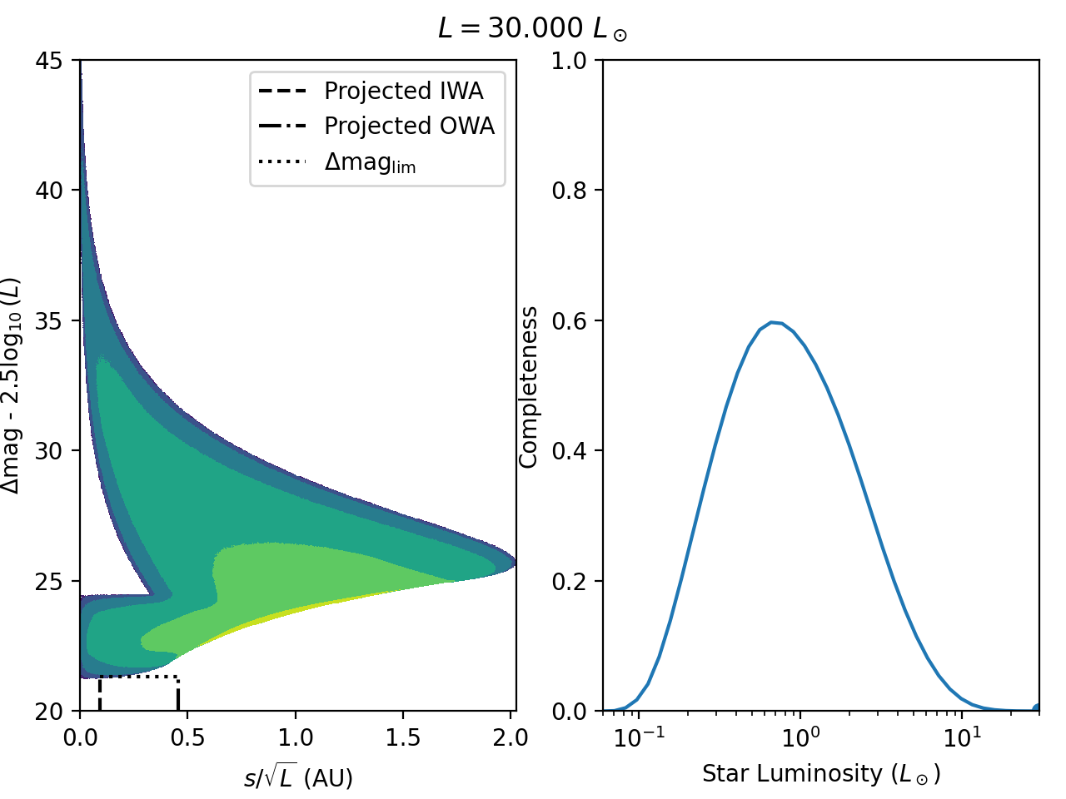
How astrophysical assumptions impact yield

Slide 5
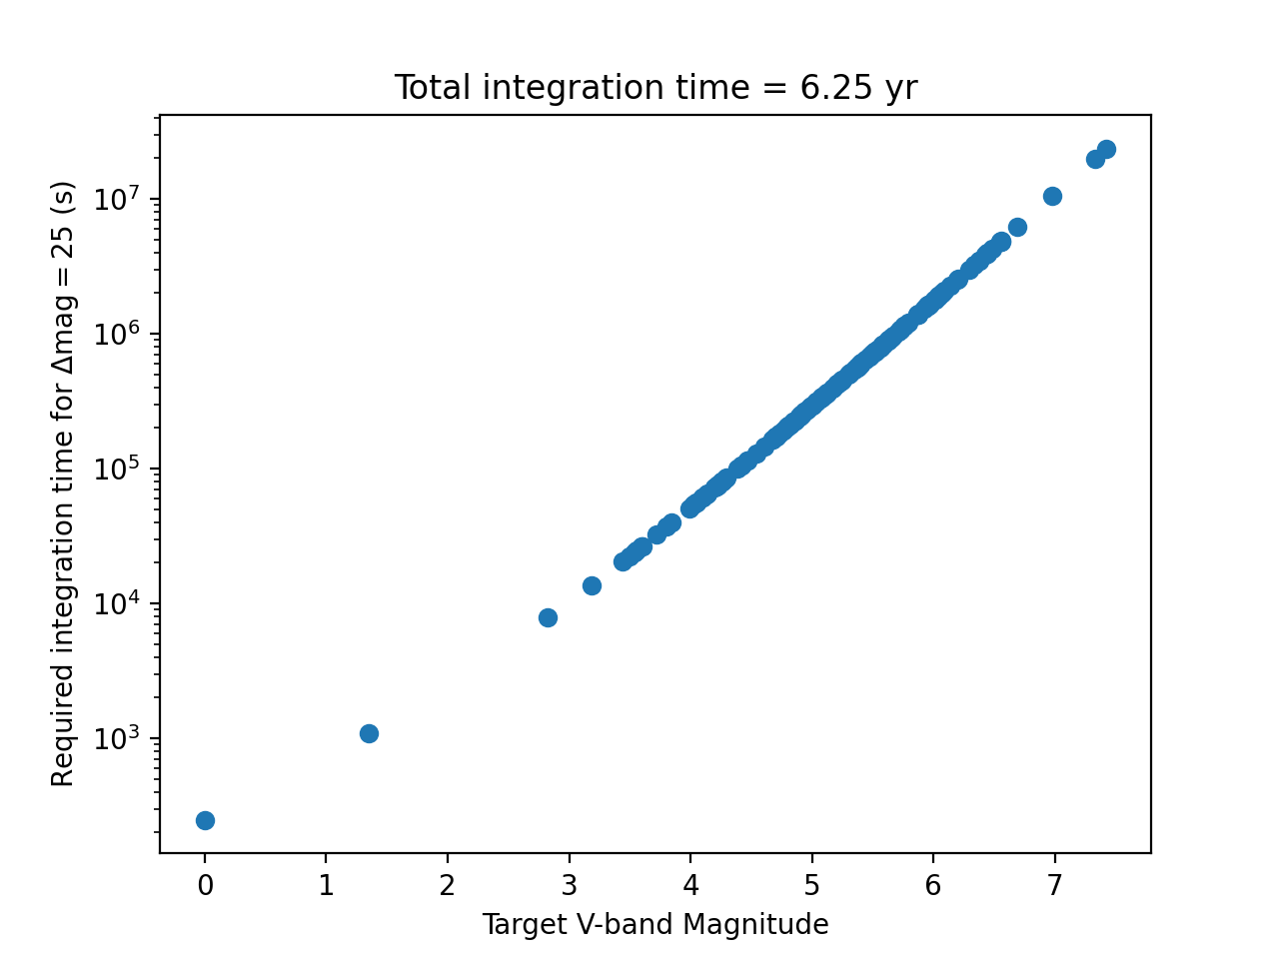
How to Compute Integration Times

Slide 6
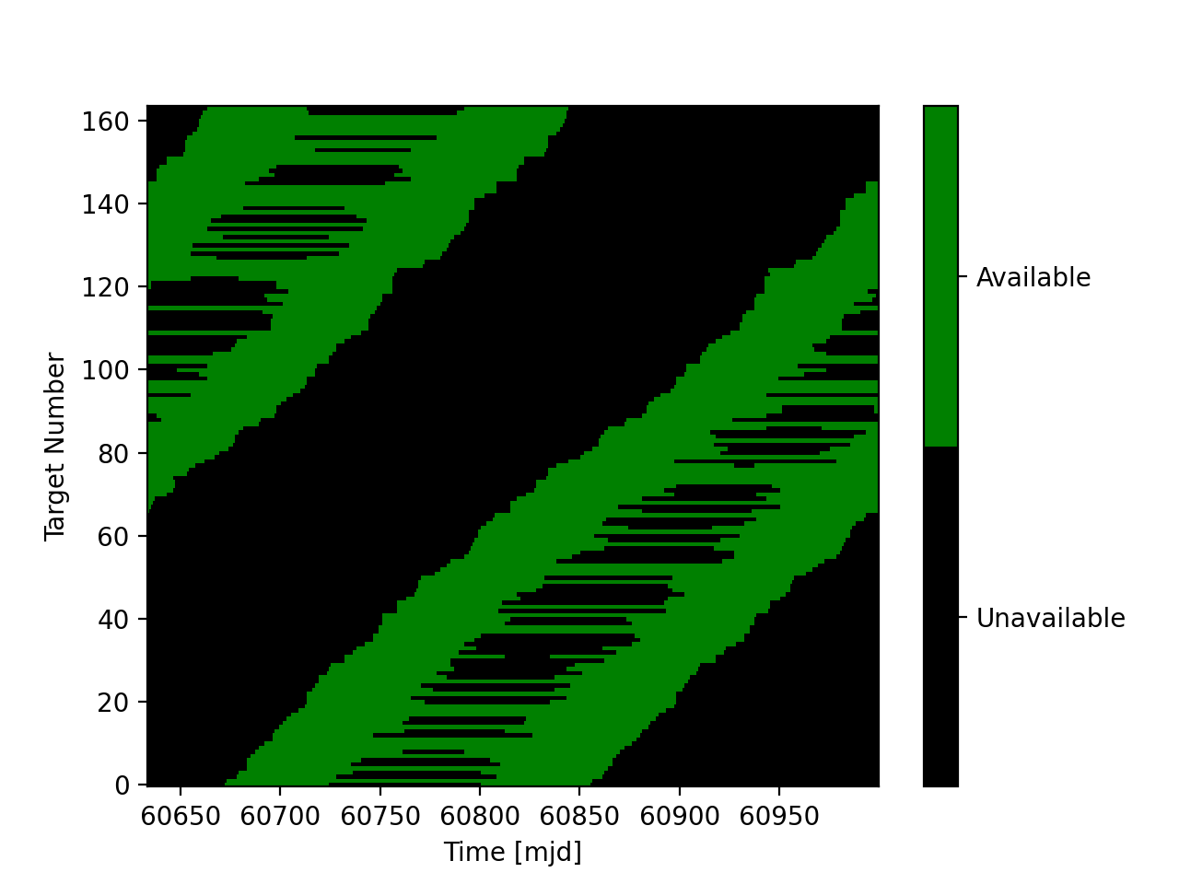
How to Account for Mission Constraints
Not all stars are always observable
This has a significant impact on observation scheduling

Slide 7
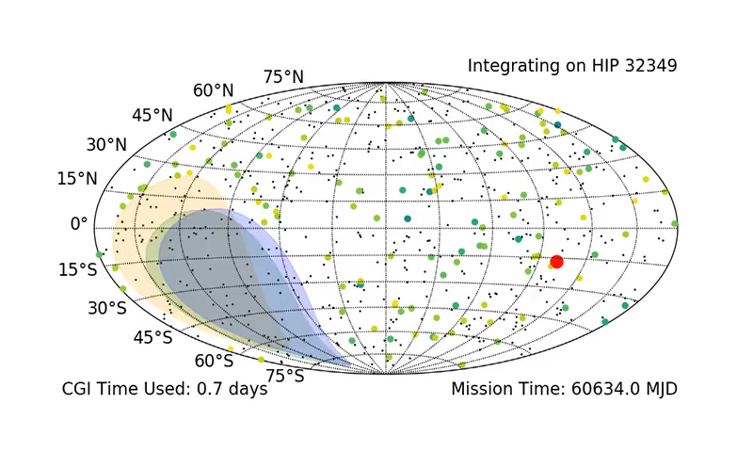
Putting it All Together
In the group projects, you’ll have a chance to try to plan and optimize a realistic exoplanet observing campaign

