Slide 1
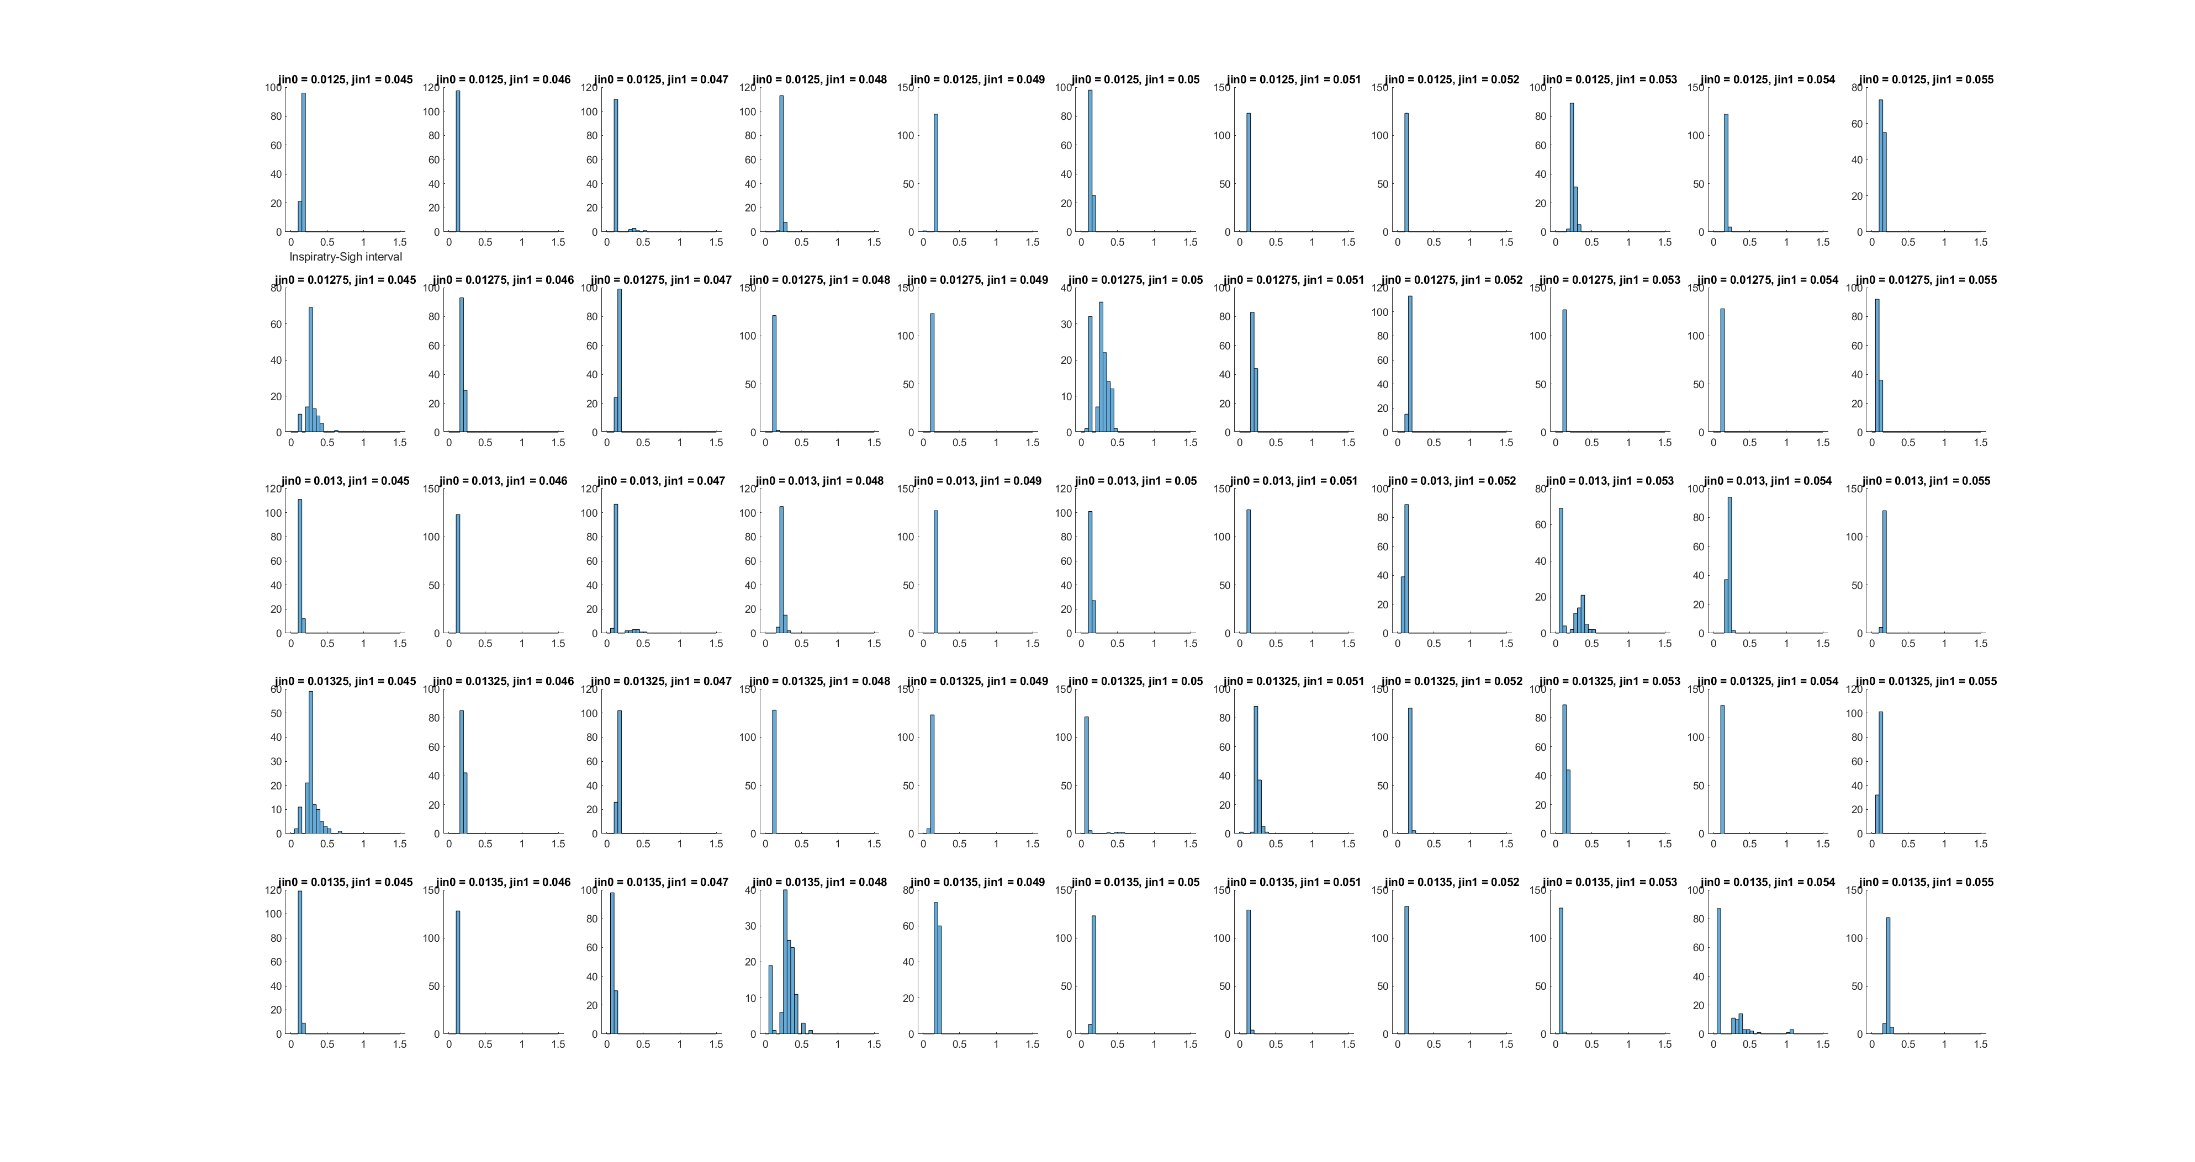
Small changes in parameters give vastly different distribution results. This is the result of phase locking probably. 200413_111550
dJ1 = 0.001
dJ0 = 0.00025

Slide 2
Small changes in parameters give vastly different distribution results. This is the result of phase locking probably. 200413_111550
dJ1 = 0.001
dJ0 = 0.00025

Slide 3
Looks like we are going to need noise in the simulation to get the desired distribution. I will run a giant p study and pick one or more regions to zoom in on and add noise to.

Slide 4
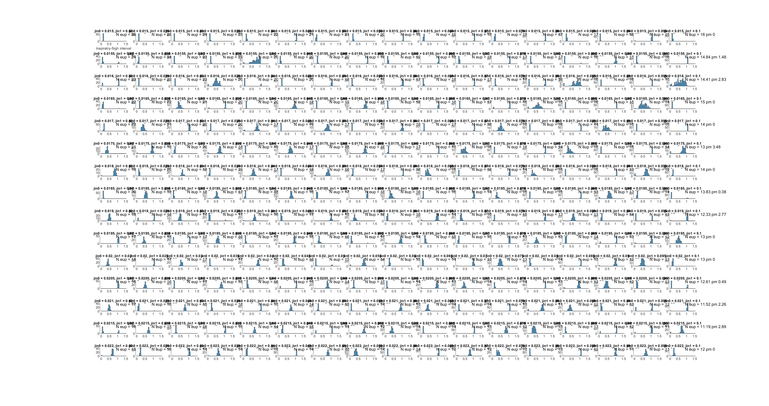
Sweep_200415_024527

Slide 5
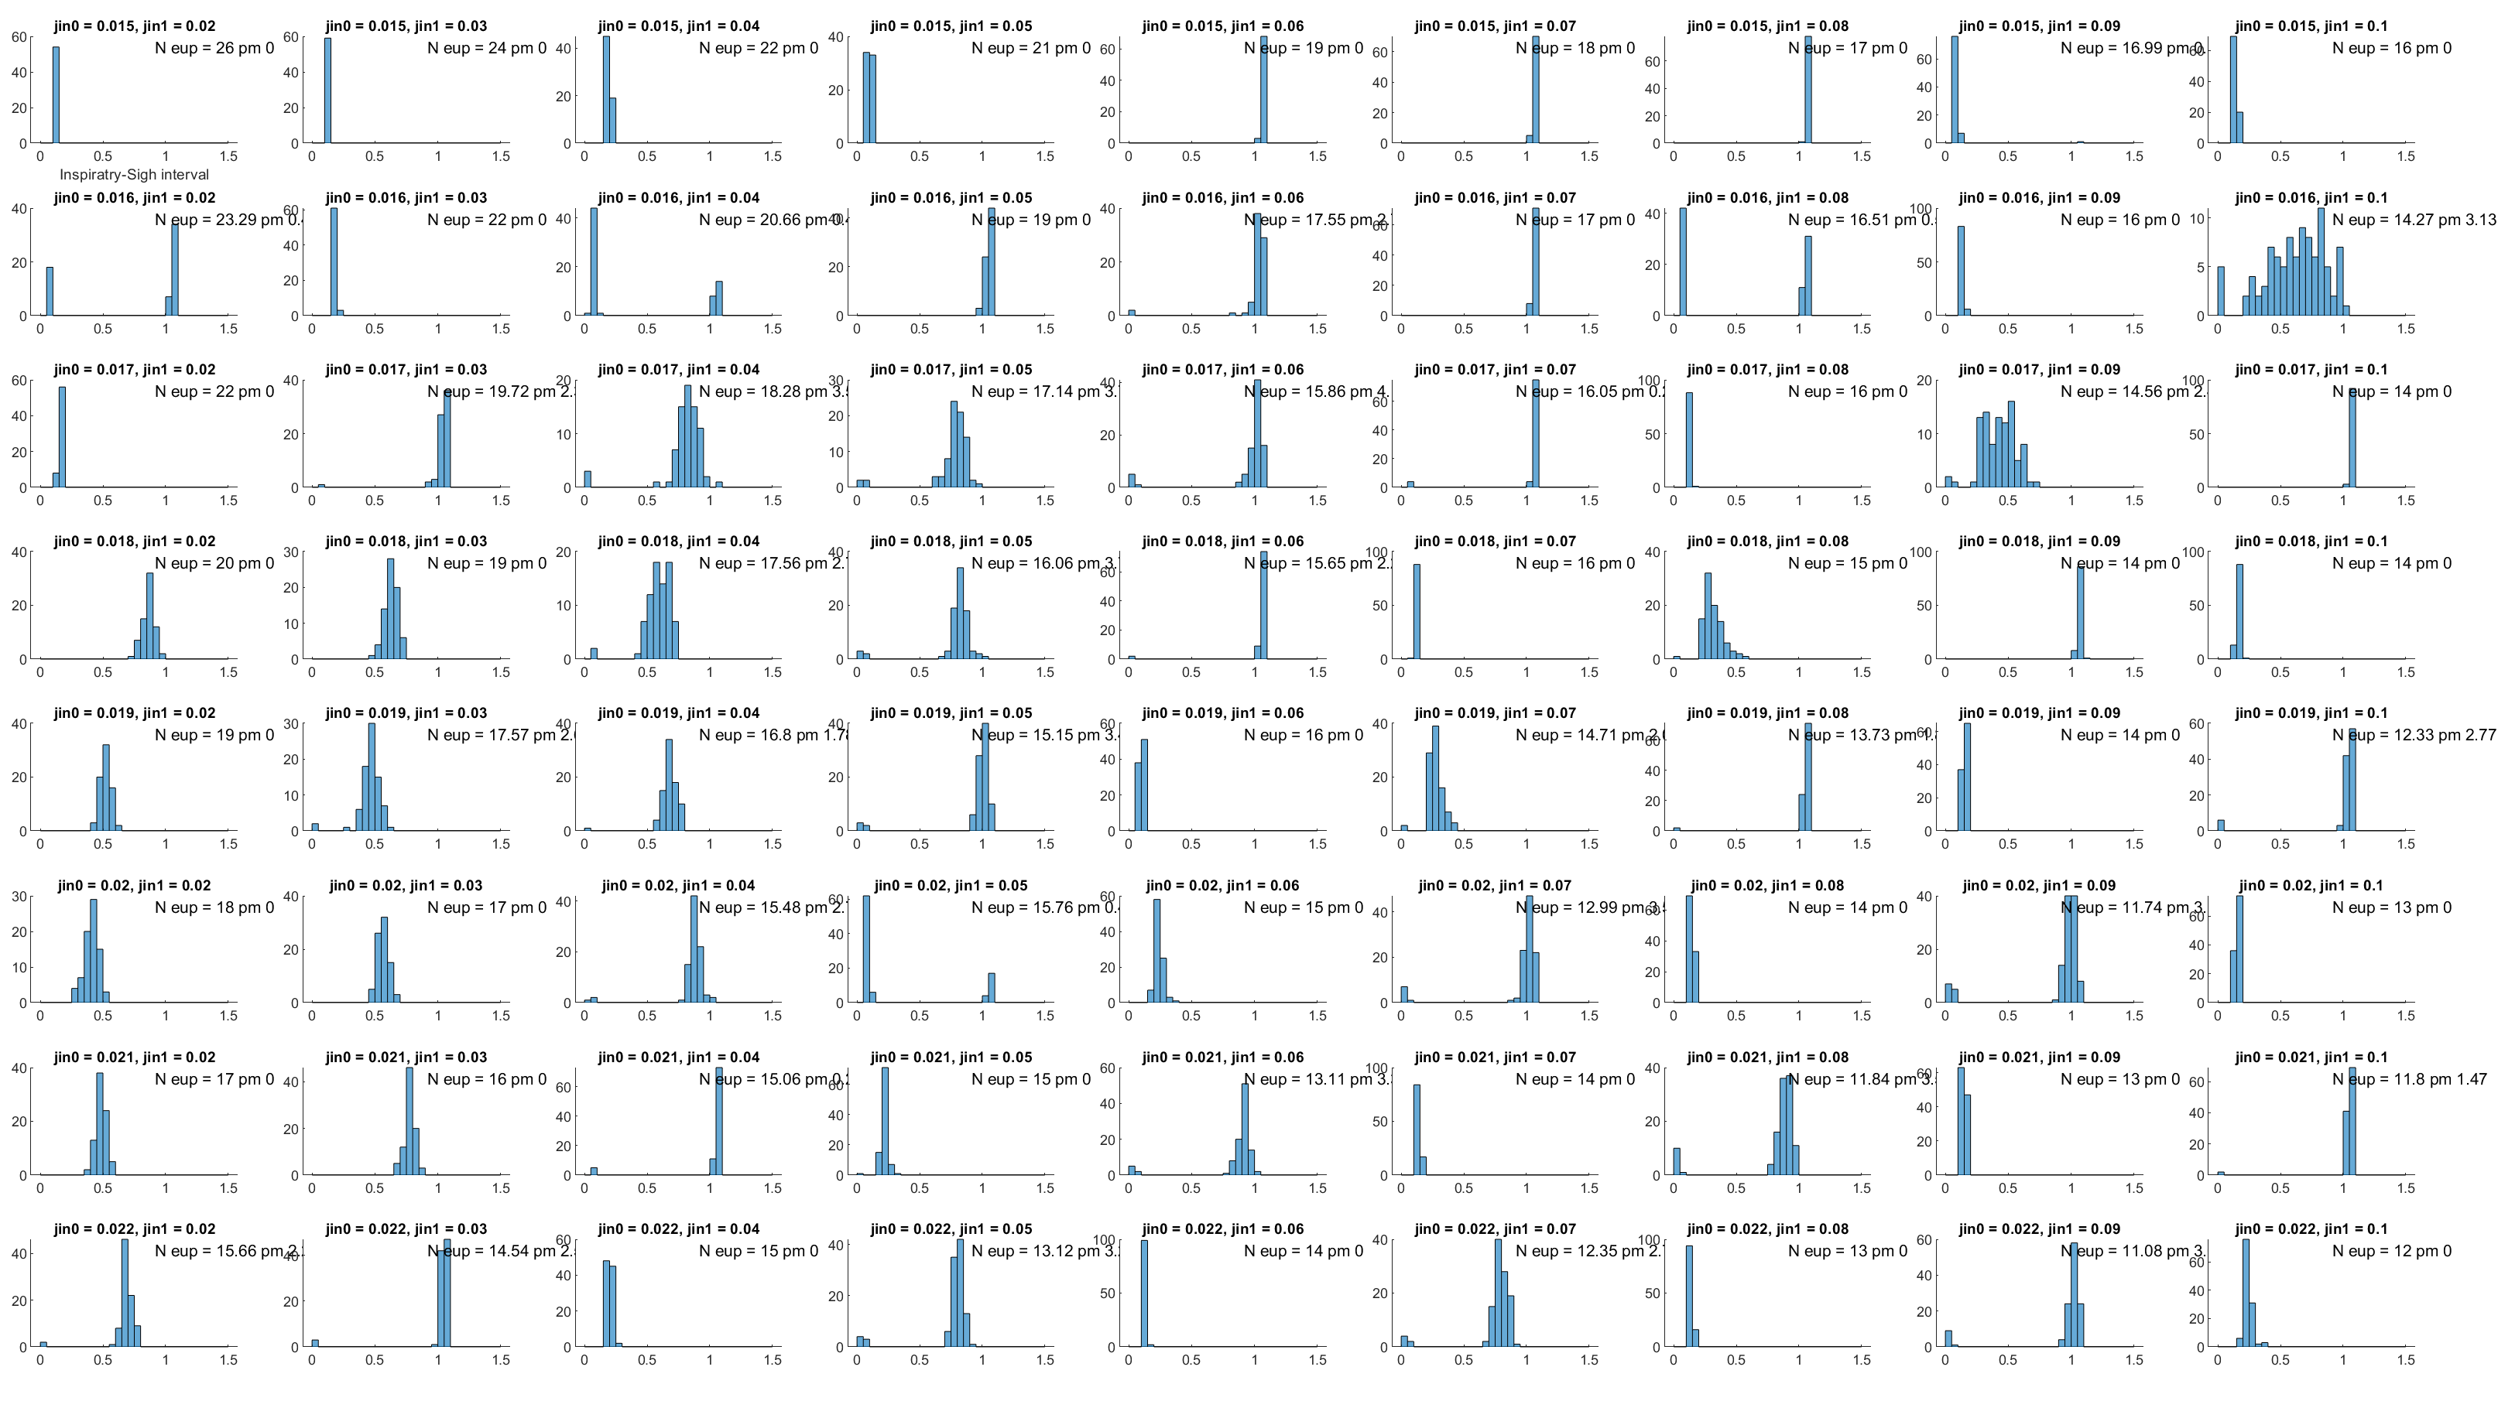
Sweep_200415_025702. Cyan = small variance, but in spot we want. Magenta = large variance, but not in spot we want. 1x NOISE

Slide 6
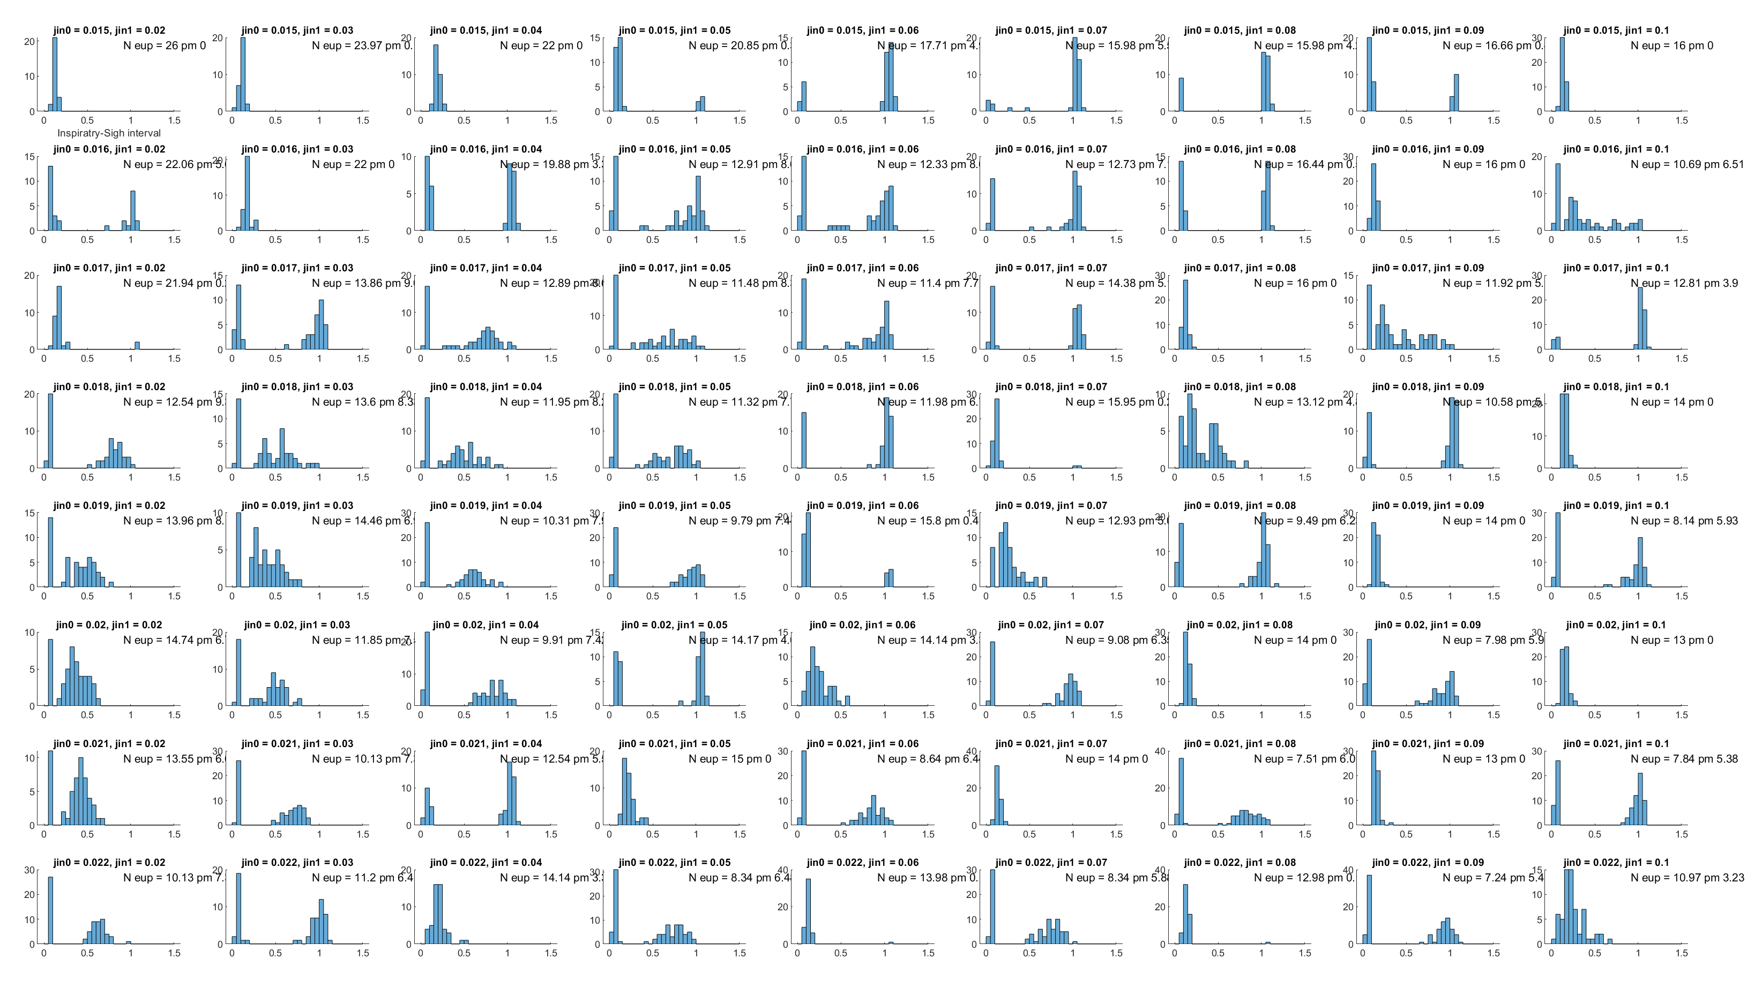
Sweep_200415_0423. Cyan was small variance. Magenta = was large variance. 3x NOISE

Slide 7
Sweep_200415_0423. Cyan was small variance. Magenta = was large variance. 3x NOISE
Take away: at 3x noise, I’m getting patterns that look promising.
Going to think about if the shape of the sigh is causing the dip at ~0.1…

