Slide 1
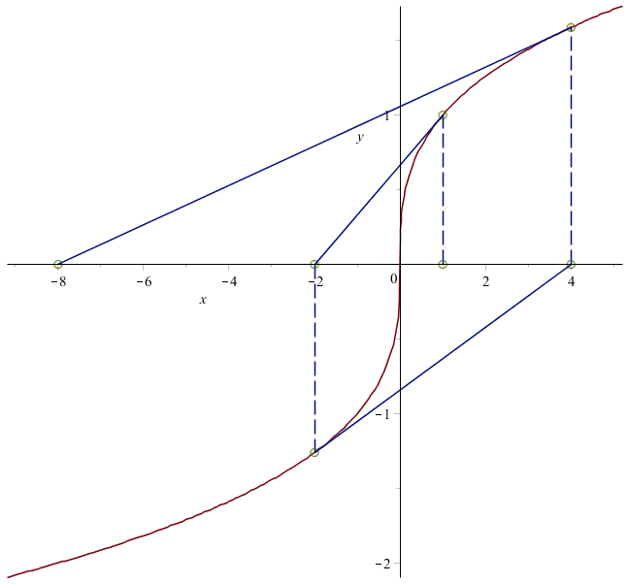
x₀
x₂
x₃
x₁
Desired Solution
y = x^{1/3}

Slide 2
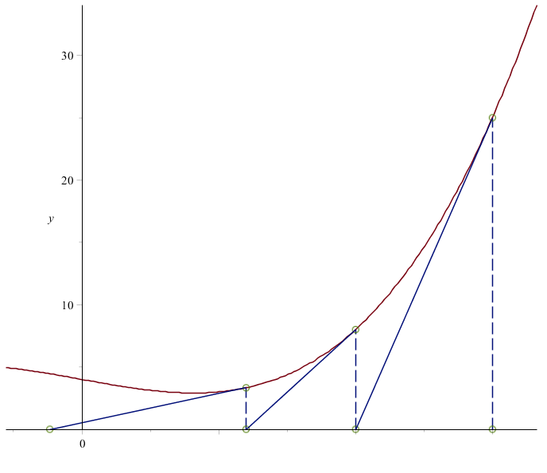
f(x)=x³-2x+4
T₁
T₂
T₃
X₃
X₂
X₁
X₀=3

